Slide 1
Online Expense Tracker System — ExBot
Project by Gondaliya Abhay S. (En. No. 24CS0020G02894) — Guide: Prof. Vipul Baldha
Kamani Science & Pratapray Arts College, Saurashtra University, Rajkot — BCA (BCA) 2026-2027

Slide 2
Executive Summary
The Online Expense Tracker System, ExBot, addresses the common challenge of managing personal and business finances efficiently. In an increasingly complex financial landscape, individuals and small businesses often struggle with manual expense tracking methods, leading to inaccuracies, missed deductions, and a lack of real-time insight into spending habits. This project aims to develop a robust, intuitive, and secure web-based solution that simplifies the process of logging, categorizing, and analyzing expenditures.
ExBot is designed to empower users with greater financial control and informed decision-making. By providing a centralized platform for all financial transactions, the system eliminates the tediousness of paper-based records and disparate spreadsheets. It offers features such as automatic categorization suggestions, customizable reporting, and visual dashboards, transforming raw financial data into actionable intelligence. The system's core objective is to enhance financial literacy and promote healthier spending patterns by making expense management accessible and insightful for everyone.
Problem Identified
ExBot Solution
Key Benefits
Manual expense tracking leads to inefficiencies, errors, and poor financial visibility.
A secure, intuitive web platform for streamlined expense logging and categorization.
Enables real-time insights, informed financial decisions, and improved financial health.

Slide 3
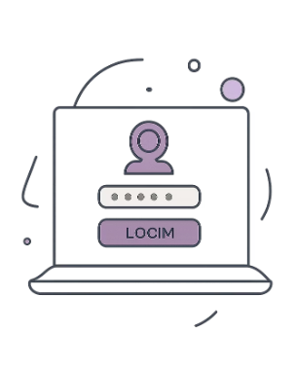
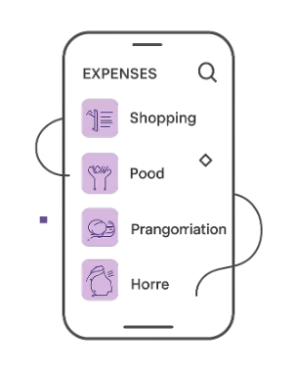
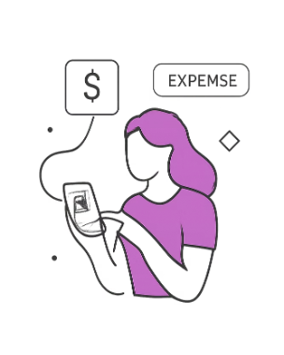
Executive Summary
ExBot is a web application designed to modernize personal finance management for students and everyday users. It replaces notebooks and spreadsheets with a secure, mobile-friendly system that logs income and expenses, auto-calculates totals and balances, groups transactions into categories, and produces clear reports. An optional AI-driven chatbot simplifies entry by interpreting natural-language statements like "Today I spent 300rs on food" and creating the corresponding expense record.
Secure Access
Intuitive Dashboard
AI Chatbot
Protected user authentication with role-based actions for privacy and data integrity.
Natural-language expense entry that speeds up logging and reduces friction.
Snapshot of balance, recent transactions, and category breakdowns for quick insight.

Slide 4







Problem Definition & SDLC
Problem: Manual expense tracking (notebooks/Excel) is time-consuming, error-prone, insecure, and not optimized for mobile daily use. Users struggle to maintain accurate records or generate insights quickly.
Requirement Analysis
System Design
Implementation
Design data models, UI flows, and API endpoints to support real-time logging and reporting.
Frontend (HTML/CSS/JS) + Backend (Flask) + MongoDB for schema-flexible transaction storage.
Gather user needs: ease of entry, categorization, reporting, security, and mobile access.
Testing
Deployment & Maintenance
Unit, integration, and user acceptance testing to ensure reliability and security.
Deploy to a cloud host or college server; provide updates, backups, and user support.

Slide 5
Project Objectives
Usability
Automation
Provide an easy-to-use interface for quick daily logging and review of finances.
Automate totals, balances and category summaries to reduce manual calculation and errors.
AI Assistance
Reports & Export
Allow conversational expense entry and smart suggestions using an AI agent.
Generate downloadable reports (PDF, Excel) and visual charts for analysis and budgeting.

Slide 6



Requirement Specification — Features & Navigation
This section summarizes functional requirements, navigation structure, and premium offerings. The system supports both manual and AI-assisted logging, secure user management, category controls, search & filter, and data export. Monetization is subscription-based with premium features including AI agent, budget and bill reminders, and advanced exports.
Navigation
Core Features
Premium (Subscription)
Home
Login / Signup
Dashboard
Add Income / Expense
Reports / Categories / Profile / Logout
Secure login & registration
Add, edit, delete transactions
Search, filter & category management
Auto totals, balance & export
AI agent & expense chatbot
Budget & bill reminders
PDF & Excel reports

Slide 7

Technology Stack & Requirements
Software Stack
System Requirements
Frontend: HTML, CSS, JavaScript
Backend: Python (Flask)
Database: MongoDB
Tools: VS Code, Git, GitHub
Software: Windows 10/11, Python 3.x, Flask, MongoDB, Web Browser
Hardware: Dual-core CPU, 4GB RAM, 500MB storage, Internet connection
Theme accent color is used here for emphasis. Ensure Python and MongoDB versions match campus guidelines before deployment.

Slide 8


Income & Expense Categories
Income Categories
Expense Categories
Salary, Business, Freelancing, Investment, Gift, Other
Food, Transport, Shopping, Bills, Health care, Education, Entertainment, Travel, Rent, Other

Slide 9
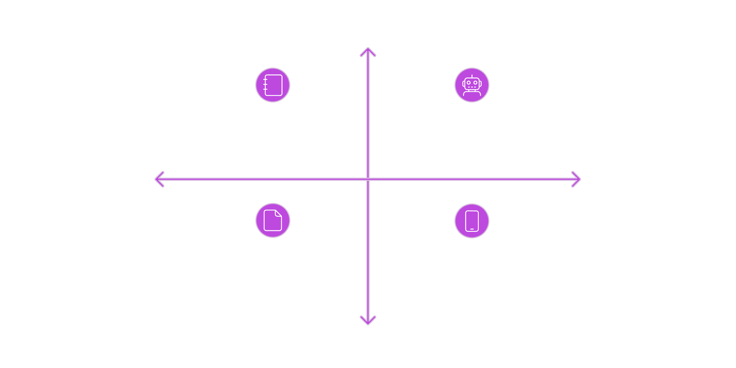
Comparison: Existing System vs ExBot
Reliable Data
Manual Notebooks & Excel — Slow, Error-Prone
ExBot — Automated, Centralized, Secure
Usability
Efficiency
Paper Trails — Inconsistent, Insecure
Mobile AI Logging — Fast, Accurate, Portable
Risk & Security
The diagram contrasts the traditional manual approach with ExBot's streamlined solution. ExBot reduces human error, automates calculations, supports mobile entry and AI-driven logging, and centralizes data for reporting—making daily finance management practical for students and busy users alike.

Slide 10
Sample Data Log — Requirement Gathering
Type
Amount (₹)
Category
Date
Income
+10,000
Salary
01/06/2026
Expense
-1,000
Grocery
01/06/2026
Expense
-2,000
Shopping
05/06/2026
Expense
-1,500
Rent
05/06/2026
Expense
-1,500
Loan
05/06/2026
Income
+1,000
Stocks
15/06/2026
Expense
-2,500
Saving
20/06/2026
Expense
-500
Vegetable
21/06/2026
Expense
-1,000
Petrol
22/06/2026
Expense
-1,000
Repair
23/06/2026
Use this sample data for testing dashboards, balance calculations, category filtering, and report exports during demonstrations.

Slide 11
Conclusion & Demo Plan
Demo flow for evaluation: 1) Show secure signup/login, 2) Add income and expense manually, 3) Demonstrate AI chatbot entry ("I spent 300rs on food"), 4) Filter transactions by category and date, 5) Display totals, balance and category charts, 6) Export a PDF/Excel report, 7) Explain monetization & maintenance. The system emphasizes usability, automation, and portability to suit students and faculty needs.
Next Steps
Submission
Finalize UI polish and responsive behaviour
Complete AI intent mapping for common phrases
Conduct user testing with classmates
Prepare demo video and README for submission
Package code on GitHub with documentation, deployment guide, and sample data for faculty review.

