Slide 1


BlackHole

Slide 2

BlackHole
Something Different Then Normal
Hi There , Guest Your Playlist
Search
Home
Library
Abhaya Nigam (201910101110151)
Janhvi Mishra (201910101110128)

Slide 3
Content
“Music gives a soul to the universe, wings to the mind,
flight to the imagination, and life to everything.”
Introduction
Key Features of BlackHole Music App
How it Works
Conclusion
For more info: GitHub | Gmail
You can visit our projects: https://github.com/abhayanigam/flutter_projects_and_practice/tree/master/Projects/BlackHole

Slide 4
01
Introduction
Our Music Playlists
Search
Home
Library
Blackhole is a music app created with the Purpose of high resolution music streaming experience on your phone with no advertising or paid subscriptions. You can even download songs on your device

Slide 5
Key Features of BlackHole Music App
01
02
03
04
Music from Multiple Platforms
Free Listening and Downloads
Users can access an extensive library of songs from Spotify, Jio Saavn, and YouTube Music all in one place.
Enjoy a wide range of music genres and discover new tracks easily.
The BlackHole Music App offers free access to songs, allowing users to listen to their favorite tracks without any restrictions.
Users can also download songs to their device for offline listening, eliminating the need for a constant internet connection.
3:15min
3:15min
YouTube Content
User-Friendly Interface
In addition to music streaming services, the app also provides access to YouTube content.
Users can listen to and download audio form of YouTube videos, including music videos, interviews, podcasts, and more.
The app is designed with a clean and intuitive interface, making it easy for users to navigate and find their preferred songs or content.
Smooth browsing and search functionalities ensure a seamless user experience.
02
3:15min
3:15min

Slide 6
03
How it Works ?
Our Music Playlists
Search
Home
1. Search and Discover:
Users can search for specific songs, albums, artists, or genres within the app.
The app will display relevant results from Spotify, Jio Saavn, and YouTube Music.
2. Listen and Download:
Once users find their desired song, they can listen to it directly within the app.
Users also have the option to download the song for offline playback.
3. YouTube Content Access:
Users can explore and access YouTube content by searching for specific videos or browsing through various categories.
The app extracts the audio from the YouTube videos, allowing users to enjoy the content as a song.
4. Playlists and Favorites:
Users can create personalized playlists and add their favorite songs from different music streaming platforms.
The app also provides recommendations based on user preferences and listening history.
Library

Slide 7
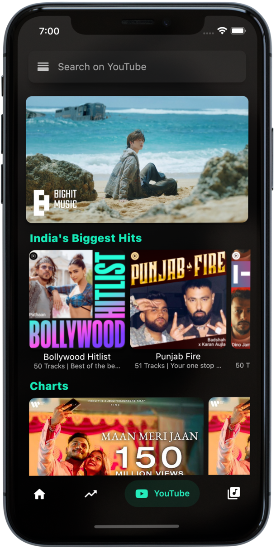
Conclusion
04
The BlackHole Music App revolutionizes the way users enjoy and access their favorite songs and YouTube content.
With its seamless integration of Spotify, Jio Saavn, YouTube Music, and YouTube, the app offers a comprehensive music experience.
Users can listen and download songs from multiple platforms, ensuring a diverse music collection at their fingertips.

Slide 8

Thank You!
Our Music Playlists
Search
Home
Library
Do you have any questions?
“Music, once admitted to the soul, becomes a sort of spirit,
and never dies.”
Download The App Now

