Slide 1

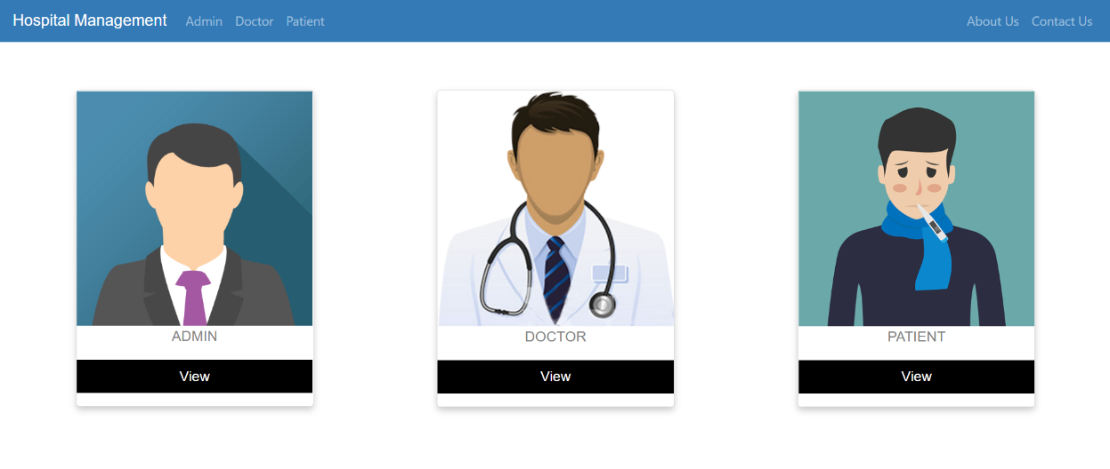
Hospital Management System

Slide 2
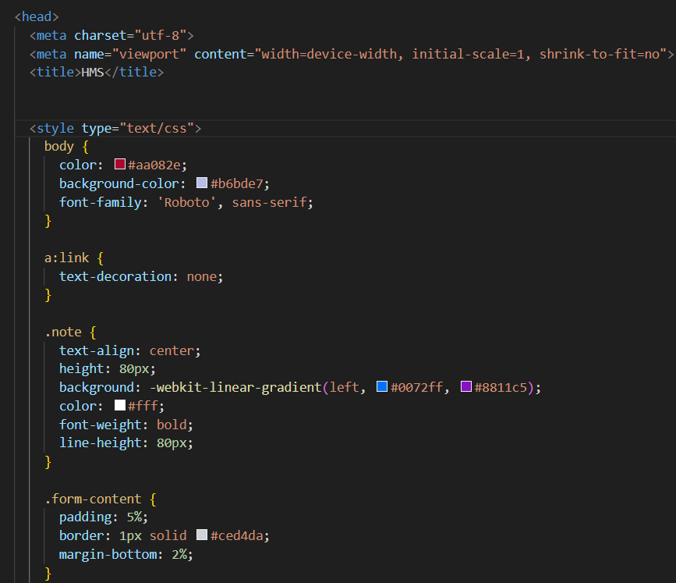
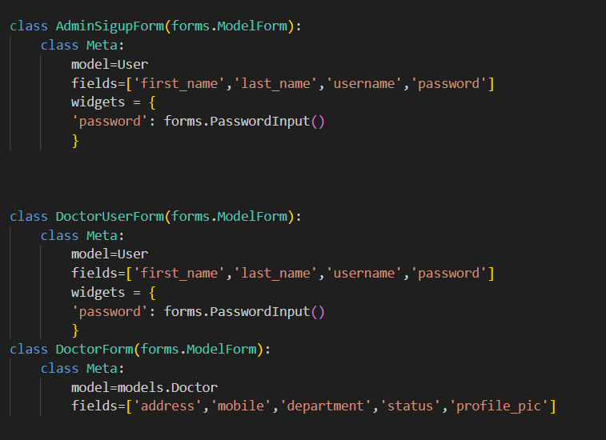
Introduction
This management system aims to streamline hospital operations, improve patient care, and enhance overall efficiency.
This presentation provides an overview of a comprehensive Hospital Management System built using Django, a powerful Python web framework. HTML, the standard markup language was used for web pages.

Slide 3
Overview of Django and HTML
Django
HTML
Synergy
Django is a high-level Python web framework that simplifies the process of building robust, scalable, and secure web applications. It offers a vast array of features, like powerful admin interface, and built-in authentication system.
HTML (Hypertext Markup Language) is the standard markup language used to create and structure web pages. It provides the foundation for building the user interface and organizing the content of the Hospital Management System.
By combining Django's powerful server-side capabilities with the flexibility of HTML for client side rendering, the Hospital Management System can deliver a seamless and responsive user experience.

Slide 4
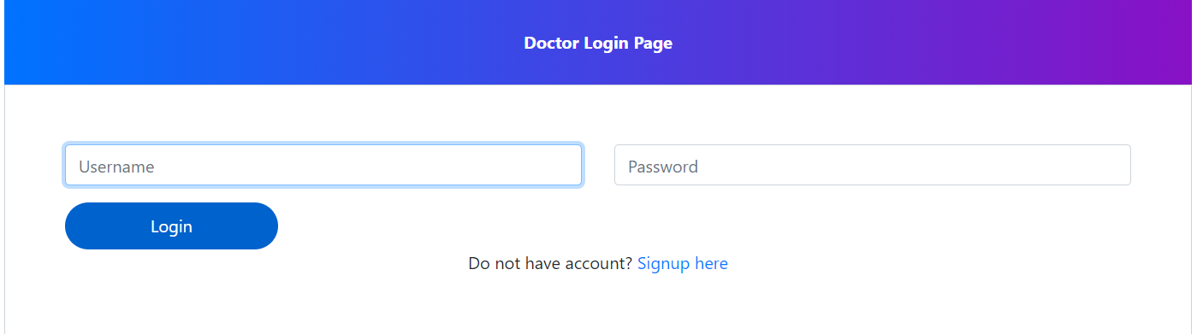
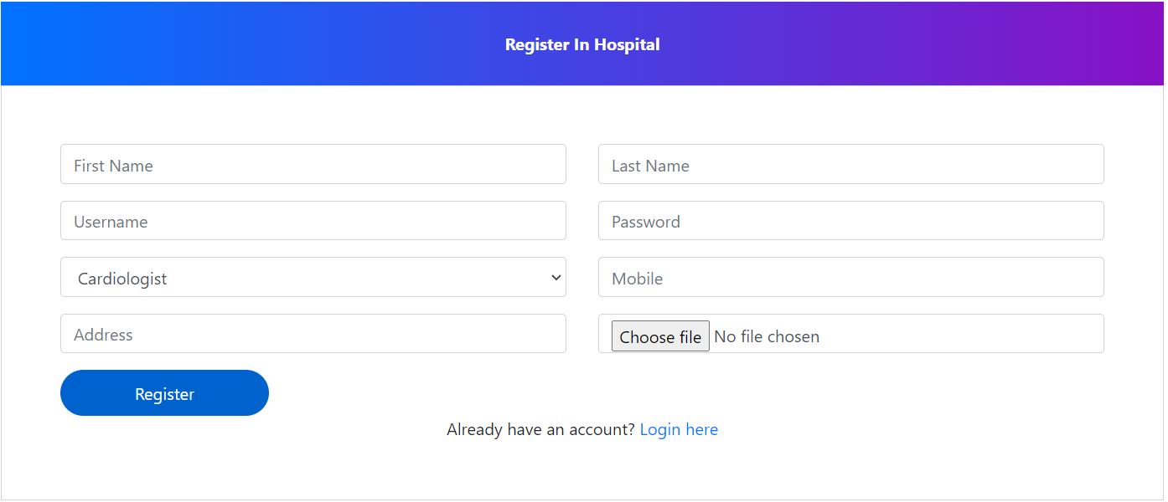
User Authentication and Authorization
1
Secure Login
Implementing a robust user authentication system to ensure
only authorized personnel can access the hospital management system.
2
Role-based Access
Granting different levels of access and permissions based on the user's role, such admin, doctor, or patients even.
3
Password Management
Securely storing and managing user passwords, including features like sign-up and login.

Slide 5
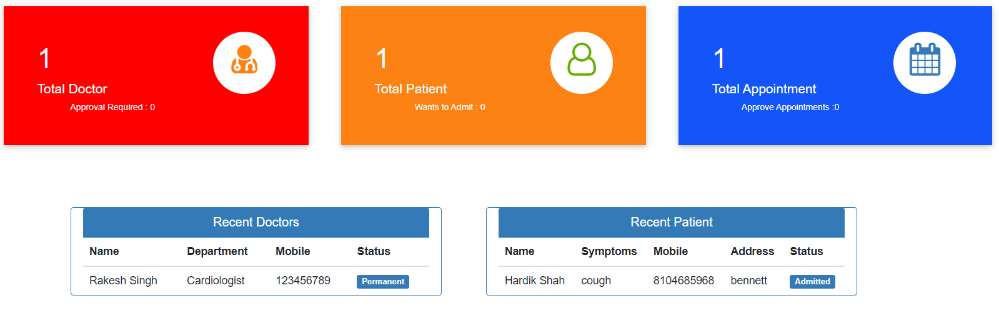
Database Design for Hospital Records
1
Patient Information
Storing comprehensive patient details, including personal information, medical symptoms, and contact details.
2
Appointment and Schedules
Tracking patient appointments, procedures, and the availability of medical staff and resources.

Slide 6
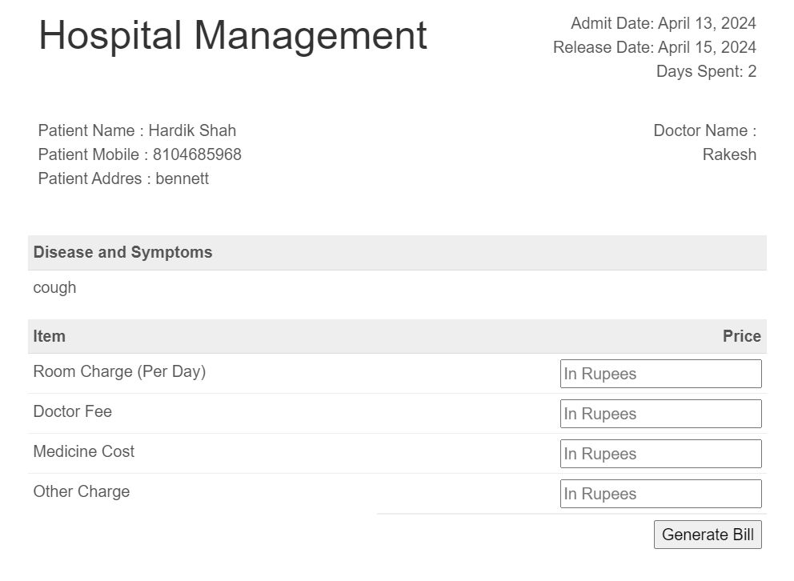
Patient Management Module
1
Patient Records
Comprehensive storage and management of patient history.
2
Billing and Insurance
Seamless integration of patient billing information and insurance claims to streamline the financial aspects of healthcare.
3
Appointment Booking
Allowing patients to conveniently schedule
and manage their appointments with doctors and healthcare providers.

Slide 7
Thank You
E22CSEU1574 | Abhayansh Deo Kumar
E22CSEU1515 | Aditya Singh Bisht

