Slide 1

HOSPITAL MANAGEMENT System Demo UNTIGNITORS

Slide 2
Agenda
Project Description
Members and code contribution
Core Requirements
Implementation Details
Testing
Feedback from peer reviews
Code inspection
Demo

Slide 3
Project Description
We aim to create Hospital Management System that contains several modules that includes appointment module, treatment module, administration module and the registration module.
The proposed application will be used by the four types of users (i.e., Admin, Doctors, Patients, Hospital staff).
Admin user which is the root user has the access to perform different kind of operations that includes managing master data of doctors, patients, and other medical workers.
Admin can also perform actions like addition of doctors along with their specializations , managing branches which are newly constructed or existing branches and update the details about the room availability and medicine availability details.

Slide 4
Project Description
Another user like the doctor has the access to view the list of patients, manage appointments, and provide a second opinion on surgeries/operations.
In the Doctor dashboard, the doctor can see a list of patients under him as well as the treatment provided to that specific patient.
They provide the treatment to the patients and suggest medicines to their disease

Slide 5
Project Description
The patient can see the pending therapies that he has started.
Patients can schedule appointments with different specialists. They can also add/update their personal health information.
Patients use the HMS to find and contact doctors by entering their office hours and location into the system and scheduling an appointment.
staff plays an important role in the HMS because they are the first person in the hospital to take basic information about a patient who arrives as an emergency case and enter it into the system database.

Slide 6
Phase 1 Deliverable
Members Contribution
Members | Contribution
DHEERAJ REDDY AGUTHU | Backend Developer, Database DBA , Group Coordinator, Documentation
ABHAY ARORA | Front End Developer , SCRUM Master , PMS (GitHub/Trello Board Management), Requirement Facilitator, Architect, Planning, Testing, Deployment, DBA, Documentation
RAVI TEJA BALAJI | UI Developer, Database , Testing, Documentation
PRAVEEN NAKKA | FE Developer, Database, Testing, Documentation
CHARISHMA NAGA SAI SARADA BALUSU | Backend Developer, Documentation, Testing
GEETHA KRISHNA DODDA | FE Developer, Database , Documentation
SRIKANTH GOPI | UI/FE Developer, Database, Documentation
MEGHANA JUNNUTULA | Backend Developer, UI Developer, Testing, DBA
Implementation plan forMembers
Contribution
DHEERAJ REDDY AGUTHU
Backend Developer, Database DBA , Group Coordinator, Documentation
ABHAY ARORA
Front End Developer , SCRUM Master ,
PMS (GitHub/Trello Board Management), Requirement Facilitator, Architect, Planning, Testing, Deployment, DBA, Documentation
RAVI TEJA BALAJI
UI Developer, Database , Testing, Documentation
PRAVEEN NAKKA
FE Developer, Database, Testing, Documentation
CHARISHMA NAGA SAI SARADA BALUSU
Backend Developer, Documentation, Testing
GEETHA KRISHNA DODDA
FE Developer, Database , Documentation
SRIKANTH GOPI
UI/FE Developer, Database, Documentation
MEGHANA JUNNUTULA
Backend Developer, UI Developer, Testing, DBA
Hospital Management System (HMS) Phase 2 includes developing user interfaces for
Admin Dashboard
Doctor Dashboard

Slide 7
Phase 1 Deliverable
Code Contribution
Members | Contribution
DHEERAJ REDDY AGUTHU | Database Creation , Front End Development of Staff Module, Testing , Documentation
ABHAY ARORA | Front End Development and API Implementation (Doctor Module, Patient Module) , Deployment, Testing , Documentation, DBA
RAVI TEJA BALAJI | Database Creation , Front End Development of Staff Module, Testing, Documentation
PRAVEEN NAKKA | FE Developer (Admin and Patient Module), Testing
CHARISHMA NAGA SAI SARADA BALUSU | Database , Documentation, Testing
GEETHA KRISHNA DODDA | Database, Testing , Documentation
SRIKANTH GOPI | Front End Development of Staff Module, Testing , Documentation
MEGHANA JUNNUTULA | API Implementation (Admin Module, Staff and Doctor Module) , Testing , Documentation ,DBA
Implementation plan forMembers
Contribution
DHEERAJ REDDY AGUTHU
Backend Developer, Database DBA , Group Coordinator, Documentation
ABHAY ARORA
Front End Developer , SCRUM Master ,
PMS (GitHub/Trello Board Management), Requirement Facilitator, Architect, Planning, Testing, Deployment, DBA, Documentation
RAVI TEJA BALAJI
UI Developer, Database , Testing, Documentation
PRAVEEN NAKKA
FE Developer, Database, Testing, Documentation
CHARISHMA NAGA SAI SARADA BALUSU
Backend Developer, Documentation, Testing
GEETHA KRISHNA DODDA
FE Developer, Database , Documentation
SRIKANTH GOPI
UI/FE Developer, Database, Documentation
MEGHANA JUNNUTULA
Backend Developer, UI Developer, Testing, DBA
Hospital Management System (HMS) Phase 2 includes developing user interfaces for
Admin Dashboard
Doctor Dashboard

Slide 8
Core Requirements
Authentication and Authorization
User Registration
The user of type Doctor, Patient, Staff, and Admin can register to Hospital Management System.
User Login:
Only those users who are registered and active can log in to this system.
Role-Based Authorization:
The system will show the relevant section of the screen to the specific type of user on basis of the role permissions matrix.

Slide 9
Core Requirements
Patient Module
Registered patients can schedule new appointments with a specific doctor on basis of the doctor’s availability.
Staff Module
Staff members of the hospital can modify the details of patients, who visited for consultation or treatment.
Doctor Module
Registered doctors can add the details of prescribed medicines against specific patient appointments.
Admin Module
Admin is the primary user of this system.

Slide 10
Implementation Details
Front End : HTML, CSS, TypeScript, Angular
Database : MySQL
Webserver : WebAPI
Deployment: IIS and Microsoft Azure

Slide 11
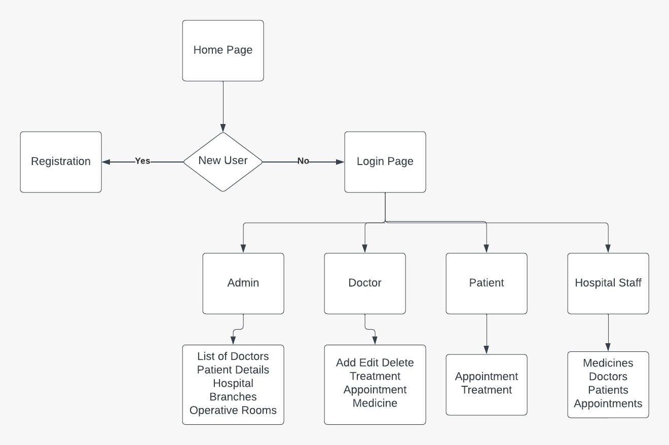
Overall Structure

Slide 12
Admin Dashboard
Admin Module
Admin is the primary user of this system.
Admin has complete access and privileges to perform any actions.
The system provides various rights to the admin to modify hospital branches, doctors, and patient details in the system.
Admin can maintain inventory of items required in managing the whole hospital system like room types, specializations, treatment, and medications.

Slide 13
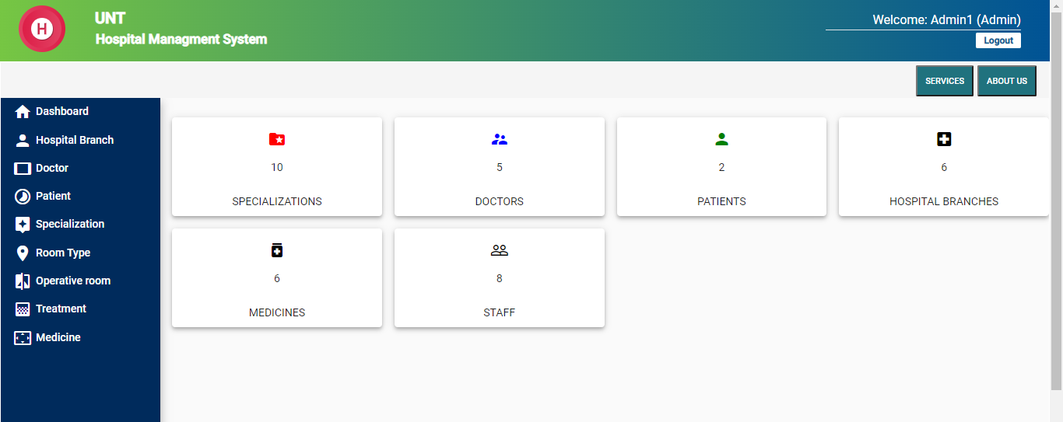
Admin Dashboard

Slide 14
Doctor Dashboard
Doctor Module
Registered doctors can add the details of prescribed medicines against specific patient appointments
Doctors can request specific medicines which are required for some common types of treatments
The system also provides the feature to doctors to view and modify patient appointments.

Slide 15
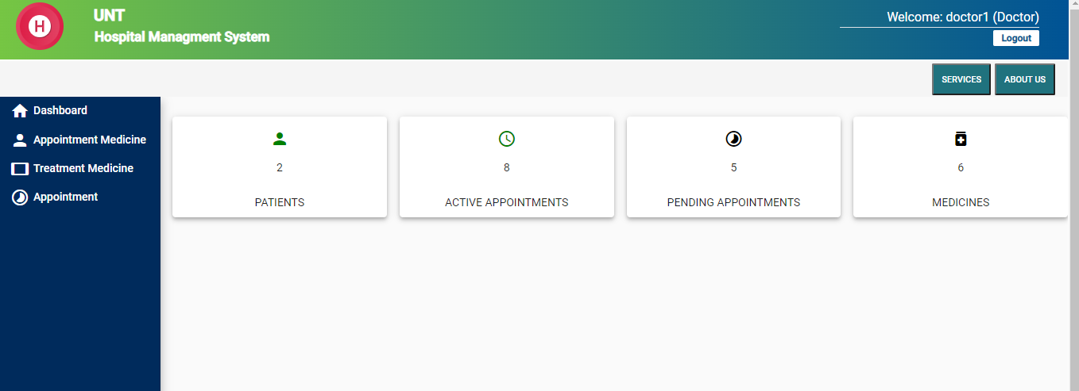
Doctor Dashboard

Slide 16
Patient Dashboard
Patient Module
Registered patients can schedule new appointments with a specific doctor on basis of the doctor’s availability.
The system also provides the feature to reschedule or cancel existing appointments.
Patients can view the details of doctors working in a specific department.
The system showcases medications linked with specific patient appointments and generic against the disease treatment.

Slide 17
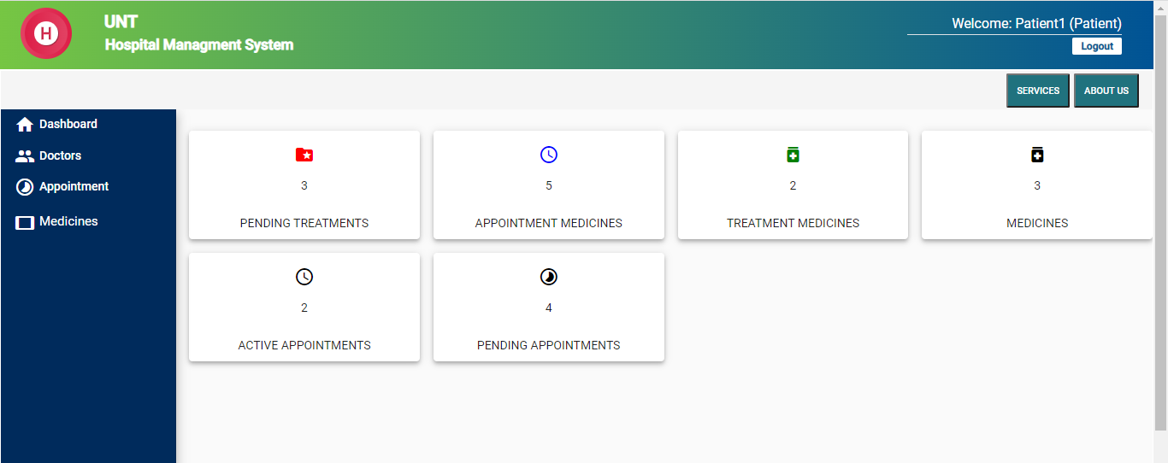
Patient Dashboard

Slide 18
Staff Dashboard
Staff Module
Staff members of the hospital can modify the details of patients, who visited for consultation or treatment.
Staff can view the details of doctors working in a specialized department.
The system also provides the feature to staff members to view all the patient appointments.
Staff can provide the details of different medicines available in the hospital pharmacy.

Slide 19
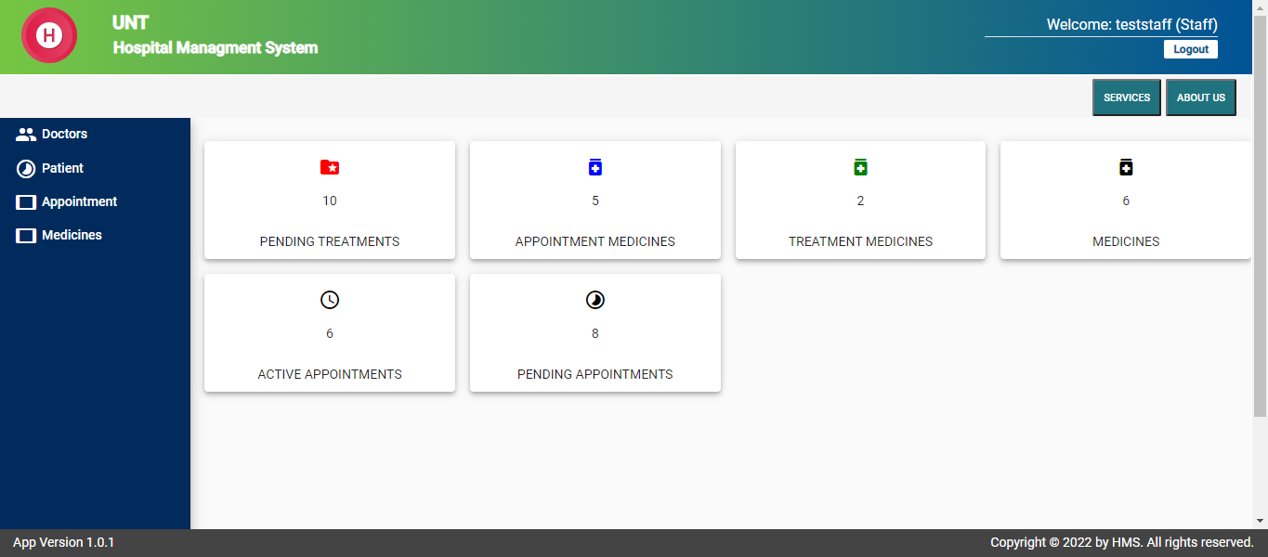
Staff Dashboard

Slide 20
Unit Testing
Individual module is tested in every development and testing phase.
Bugs were fixed after every iteration of testing performed by the tester.
For each screen, 10-15 test cases were recorded by each developer.
Testing of features like login, registration, appointment, treatment were tested during various phases of development
For End-to-End testing, we used the angular jasmine testing framework.

Slide 21
Functionality Testing
Functional Testing
The entire web application is tested in many aspects during system testing
Overall performance of different modules was tested during system testing (like page response time, user load)
Are validations working on all form fields or not.
System is showing appropriate error/notification messages or not.
Whether UI is easy to navigate or not.

Slide 22
Feedback from peer reviews
We received a few suggestions from the peer review sessions, one of which was to implement a hospital staff login to collect patient data in the event of an emergency, and another was to add a nurse login, which was rejected because hospital staff includes nurses as well.
Tooltip text can be added to some buttons/icons.
The use of colors and font size can be improved.
Icons inside the navbar should be like the action they perform.

Slide 23
Code inspection
To add the comments for the source code about the functionalities
The length of the overall code inspection document can be reduced (as per the submission guidelines)
Comments should be added in angular (ts code) as it’s not present in some places
SQL code snippets can be avoided in inspection documents.
Accepted:
Accepted to include the comments in the source code and to reduce the overall document length
Rejected:
To remove the SQL code snippets from the document. Rejected this point, as the Database schema and DB Setup were already included in the phase 1 development plan

Slide 24
Limitations
1- Screen Resolution (System does not support Tablet/Ipad screen sizes)
2 –The system will not provide any offline access feature.
3- Minimum Hardware and Software interfaces required to run the application.

Slide 25
Summary of Deliverables
Phase 1: Log in, Homepage, Service, and about page
Phase 2: Admin Dashboard, Doctor dashboard
Phase 3: Patient Dashboard, Hospital Staff dashboard
Link: https://hms-unt2022.azurewebsites.net/

Slide 26
THANK YOU Any Questions?

