Slide 1


QDM Image Super Resolution BTP
Biweekly Meeting
Friday, 23 October 2026
Combined-data ConvLISTA experiment
GPU training and reconstruction results
By Abhay Chandra
1
Notes:
Biweekly meeting, Friday 23 October 2026. Abhay Chandra. Final 200-epoch combined-data ConvLISTA results, transferred from the professor server. Source: runs/combined_full_200/status.json.

Slide 2
Work completed so far
Learned one blur operator jointly from Bx, By and Bz.
Compared ISTA, FISTA and ConvLISTA on the original coil fields.
Checked stopping criteria and the limits of direct crop pairing.
Implemented ALISTA for a separate synthetic sparse-recovery test.
Next step: expand the dataset and train one shared ConvLISTA model.
2
Notes:
Recap of work preceding the combined-data experiment, based on the supplied biweekly and LISTA/ALISTA thesis decks and ALISTA.md. The magnetic work fitted a joint Bx/By/Bz Fourier blur operator, compared ISTA/FISTA and ConvLISTA for the original single geometry and height pair, investigated solver stopping and crop-boundary effects, and implemented a separate synthetic sparse-recovery ALISTA benchmark. Synthetic ALISTA results do not establish magnetic-field performance. This update then expands the ConvLISTA dataset and runs the comparison on remote GPU compute.
Sources
/Users/abhay/Desktop/bsp/learning_ker/presentations/LISTA_ALISTA_Thesis_Presentation.pptx; /Users/abhay/Desktop/bsp/learning_ker/presentations/biweekly_update/QDM_BTP_Biweekly_07_Oct_2026_Crop_Hypothesis_Final.pptx
/Users/abhay/Desktop/bsp/learning_ker/ALISTA.md

Slide 3
HPC transfer and GPU setup
Transferred the code and both datasets to remote compute.
Moved execution from the Prajna queue to the professor’s server.
RTX A6000, 48 GB GPU memory. CUDA checks passed.
200 epochs complete. Best checkpoint: epoch 200.
3
Notes:
The code and both datasets first moved to Prajna. Queue limits delayed access, so the experiment ran on the professor server RTX A6000, 48 GB. Python 3.11.17, PyTorch 2.6.0+cu124, CUDA runtime 12.4. Training completed 200 epochs; best epoch 200. Sources: user-supplied transfer/queue logs; runs/combined_full_200/setup.json and status.json.

Slide 4
Combined data: 17 height pairs, 51 component pairs
Geometry | CSV planes | Reference | Height pairs | Component pairs
L1_C1 | 11 | 0.5 µm | 10 | 30
IC_4um | 7 | 0.5 µm | 6 | 18
IC_2um | 2 | 1.0 µm | 1 | 3
Total | 20 | Within geometry | 17 | 51
Pair each higher plane with its geometry’s lowest plane.
17 pairs × (Bx, By, Bz). Full 1400 × 1400 fields, with no crops.
4
Notes:
The raw inventory contains 20 CSV planes: 11 L1_C1, 7 IC_4um and 2 IC_2um. Anchor pairing uses each geometry’s lowest available plane as reference. L1_C1 inputs z=1 through 10 µm use reference 0.5 µm. IC_4um inputs z=3,4,5,6,7,10 µm use reference 0.5 µm. IC_2um input 2 µm uses reference 1 µm. Every pair provides matched Bx, By and Bz examples. The loader validates units, finite values, complete grids and coordinate alignment, then caches float32 µT fields with checksums. These are full 1400x1400 maps, not crops. Examples share references and are correlated.
Sources
/Users/abhay/Desktop/bsp/learning_ker/hpc/combined_dataset_inventory.json
/Users/abhay/Desktop/bsp/learning_ker/scripts/combined_data.py
User-supplied server outputs in this conversation, 23 October 2026: runs/combined_pilot/status.json, summary.csv, comparison.csv and combined-pilot.log. These numerical outputs were pasted by the user; the remote artifacts were not downloaded.

Slide 5
One shared ConvLISTA across the combined data
16 layers, two shared 9 × 9 filters and one scalar: 163 parameters.
Fit and freeze one Fourier operator for each of the 17 height pairs.
Normalize every input and reference by one global training scale q.
Process one full component at a time, with gradient weight 1/51.
After all 51 examples, take one Adam update and save a checkpoint.
5
Notes:
The method extends the previous single-pair ConvLISTA without changing its 163-parameter count. Pair-specific Fourier kernels H are jointly fitted to Bx/By/Bz and then frozen. A=Crop(real(IFFT(H*FFT(Pad(x))))) with 32-pixel padding; its adjoint uses conjugate H. In normalized coordinates the update is soft at threshold s_p theta of x-s_p A_p*(A_p x-b)+C_b b+C_x x. The pair step is 0.99/max|H_p|². There are two tied bias-free 9x9 convolutional filters and one nonnegative shared scalar. Zero filters and theta=lambda/q initialize the model at ISTA for every pair. q is the maximum absolute value across all training inputs and references, preserving relative amplitudes. Predictions return to µT by multiplication by q. One full component per batch contributes normalized MSE weight 1/51. Gradients accumulate across all components before one Adam update. The model uses activation checkpointing and a blurred-field warm start.
Sources
/Users/abhay/Desktop/bsp/learning_ker/scripts/combined_lista.py
/Users/abhay/Desktop/bsp/learning_ker/scripts/compare_combined.py
/Users/abhay/Desktop/bsp/learning_ker/scripts/torch_inverse.py and scripts/deblur.py
/Users/abhay/Desktop/bsp/learning_ker/README_COMBINED_EXPERIMENT.md (methodology and reported pilot results; introductory pre-run wording is stale)

Slide 6
Training and comparison protocol
Setting | Protocol
Training budget | 2-epoch pilot, then 200 epochs
Adam / regularization | Learning rate 10⁻⁴, λ = 10⁻⁴ µT
Checkpoint selection | Minimum training MSE, including epoch 0
Classical comparisons | ISTA / FISTA at 16 updates and to tolerance
Stopping rule | Relative PG ≤ 0.001, cap 100,000 updates
Inference timing | Warm-up, then median of 3 synchronized repeats
Same training fields for evaluation. No independent validation or test split.
6
Notes:
Defaults match the actual pilot and full-run launch: 16 layers, Adam learning rate 1e-4, gradient norm clip 1, physical lambda 1e-4 µT, 32-pixel pad, blurred initialization, batch size one and activation checkpointing. The pilot trains for 2 epochs and the new full run for 200 from the original initialization. Best post-update training MSE including epoch 0 selects the checkpoint. All pairs also enter joint reference-assisted operator fitting, so this is same-sample reconstruction, not held-out generalization. Classical methods use the same pair operator, scale, precision and GPU. Relative PG is RMS proximal-gradient mapping divided by its initial value. Stop at <=0.001 or the 100000-update cap. Timing uses one warm-up and three synchronized repeats, and the summary sums per-batch medians. Learned model loss is sharp-field MSE; ISTA/FISTA minimize the L1 reconstruction objective.
Sources
/Users/abhay/Desktop/bsp/learning_ker/scripts/compare_combined.py
/Users/abhay/Desktop/bsp/learning_ker/README_COMBINED_EXPERIMENT.md (methodology and reported pilot results; introductory pre-run wording is stale)

Slide 7
Training through 200 epochs
MSE: 0.005757 to 0.004803. Reduction: 16.6%. Best epoch: 200.
Training and evaluation: 57.4 min. No independent validation set.
7
Notes:
Sources: /Users/abhay/Desktop/bsp/learning_ker/runs/combined_full_200/training.json; status.json. All 201 recorded points (epochs 0 through 200), values rounded to 12 significant digits for the editable Excel chart. No smoothing or interpolation beyond straight lines. Minimum normalized training MSE at epoch 200. No held-out validation. Training_seconds includes post-update evaluation; 3441.37 seconds is about 57.4 minutes, not total workflow walltime.

Slide 8
Final results across 51 component pairs
Method | NRMSE (%) | RMSE (µT) | Time sum (s)
ConvLISTA 16 | 3.790 | 13.824 | 2.253
ISTA 16 | 4.192 | 15.284 | 2.052
FISTA 16 | 3.844 | 14.006 | 2.133
ISTA to tolerance* | 2.737 | 9.877 | 5,384.015
FISTA to tolerance | 2.960 | 10.644 | 124.458
ConvLISTA: 3.918% after 2 epochs, 3.790% after 200 epochs.
* Two ISTA components reached the cap. Time sum uses batch medians.
8
Notes:
Sources: /Users/abhay/Desktop/bsp/learning_ker/runs/combined_full_200/summary.csv; comparison.csv; status.json; setup.json. Mean per-component range NRMSE and RMSE across all 51 training examples. Time sum is the sum of median batch inference durations, one component per batch, excluding setup/I/O. Classical values/timings are verified reuses from the pilot. Adaptive ISTA includes two capped IC_2um components. LISTA best epoch 200, 16 layers. Pilot mean LISTA NRMSE was 3.9175267933922653% from user-supplied pilot summary.

Slide 9
Earlier model versus shared model: same pair
L1_C1, input 3 µm, reference 0.5 µm. Both models: 200 epochs.
Component | Earlier specialist | Shared ConvLISTA
Bx | 1.988% | 2.160%
By | 1.751% | 1.892%
Bz | 2.861% | 2.920%
Mean range NRMSE | 2.200% | 2.324%
The specialist retains lower error on all three components of this pair.
Original inventory: 30 pairs. Archived training: 3. Shared training: 51.
Training scope and normalization differ. This is not a data-only ablation.
9
Notes:
Sources: /Users/abhay/Desktop/bsp/learning_ker/runs/combined_full_200/comparison.csv, L1_C1_z03.0_to_z00.5 rows method lista; /Users/abhay/Desktop/bsp/learning_ker/notebooks/runs_results/metrics-2.json. Both networks use 16 layers, 9x9 filters and 200 training epochs. Earlier model trains on three components of this one pair; shared model trains on all 51 examples. The normalization pool and threshold parameterization also differ, so this is not a controlled data-only ablation. Original L1_C1 inventory has 30 possible component pairs; no archived all-30 training run was found. No cross-hardware latency comparison.

Slide 10
Results by geometry
Mean range NRMSE (%), evaluated on each geometry’s training fields.
Geometry | Examples | ConvLISTA 16 | FISTA 16 | FISTA tolerance
L1_C1 | 30 | 3.167 | 3.162 | 2.323
IC_4um | 18 | 5.026 | 5.134 | 3.904
IC_2um | 3 | 2.600 | 2.923 | 3.666
The shared model’s L1_C1 subset contains all 30 original component pairs.
ConvLISTA improves on FISTA-16 for IC_4um and IC_2um.
L1_C1 errors are nearly equal. No independent geometry test.
10
Notes:
Sources: /Users/abhay/Desktop/bsp/learning_ker/runs/combined_full_200/comparison.csv. Arithmetic mean of range NRMSE percentages within each geometry, with counts 30,18,3. No geometry is held out; all enter training and joint operator fitting. Values are not equivalent to a geometry-specific separately trained model.

Slide 11
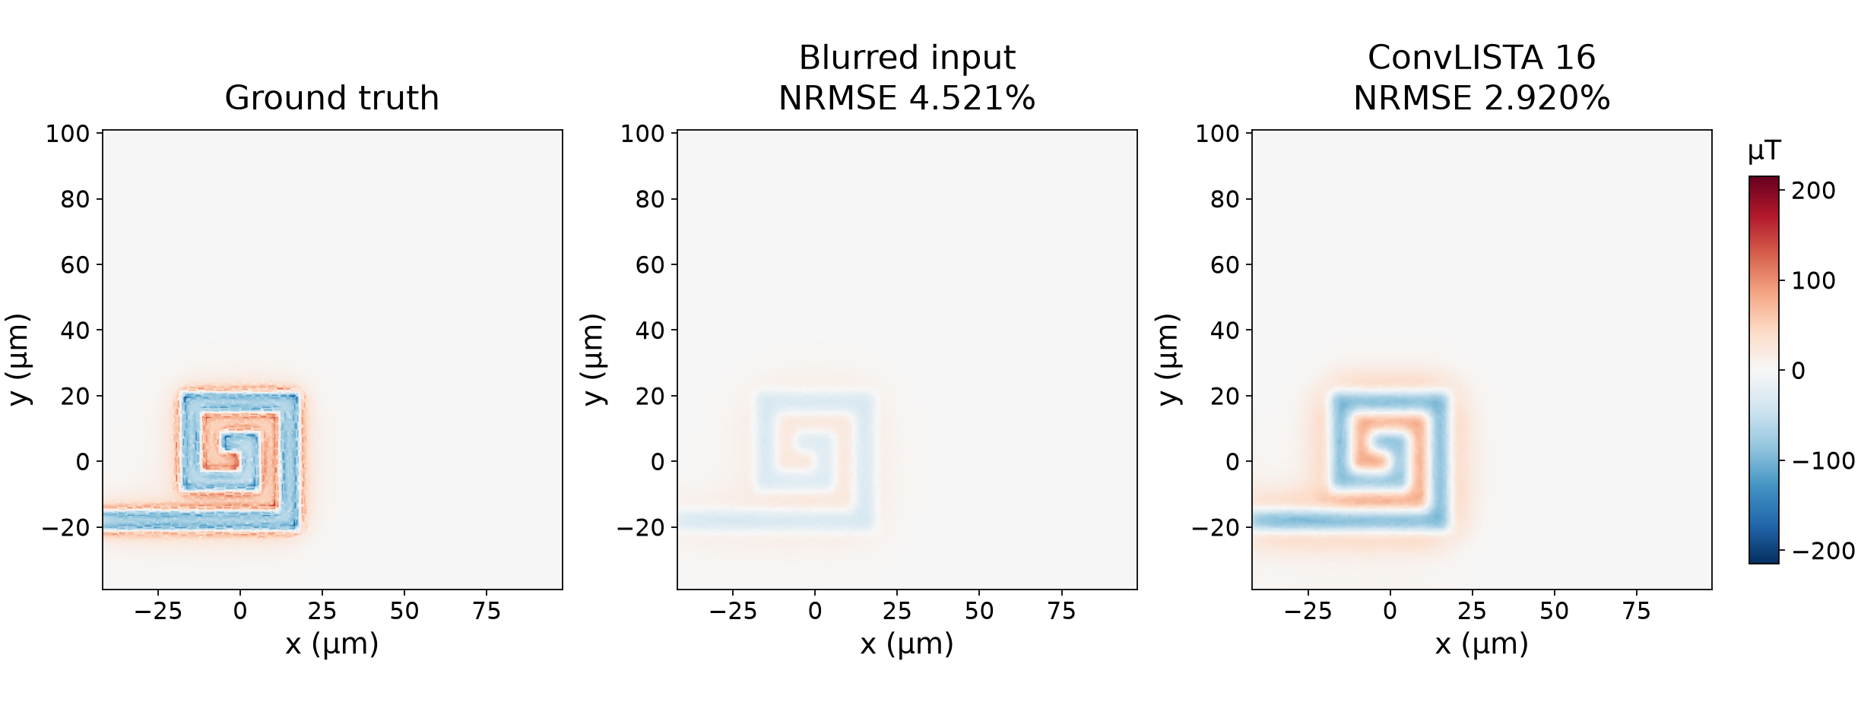
L1_C1 reconstruction: Bz
Input 3 µm, reference 0.5 µm. Shared model, epoch 200.
Full fields, common scale in µT. NRMSE uses the reference range.
11
Notes:
Sources: /Users/abhay/Desktop/bsp/learning_ker/runs/combined_full_200/comparison/L1_C1_z03.0_to_z00.5.npz; comparison.csv; setup.json. Bz. All 1400x1400 pixels included in the displayed full-field maps and NRMSE calculations. Common symmetric color scale for every map in this figure, limits +/-215.14413452148438 uT. No per-image amplitude rescaling. Ground truth means COMSOL reference plane. Best epoch 200; training fields. Example selection: L1_C1 z3 matches the earlier model; IC_4um z3 matches that input/reference height; IC_2um has one pair. Numeric scores independently recomputed from saved arrays, matching comparison.csv.

Slide 12
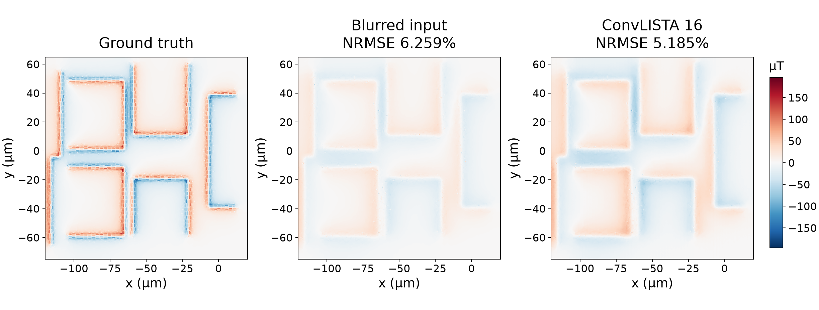
IC_4um reconstruction: Bz
Input 3 µm, reference 0.5 µm. Shared model, epoch 200.
Full fields, common scale in µT. Evaluation on training data.
12
Notes:
Sources: /Users/abhay/Desktop/bsp/learning_ker/runs/combined_full_200/comparison/IC_4um_z03.0_to_z00.5.npz; comparison.csv; setup.json. Bz. All 1400x1400 pixels included in the displayed full-field maps and NRMSE calculations. Common symmetric color scale for every map in this figure, limits +/-196.11358642578125 uT. No per-image amplitude rescaling. Ground truth means COMSOL reference plane. Best epoch 200; training fields. Example selection: L1_C1 z3 matches the earlier model; IC_4um z3 matches that input/reference height; IC_2um has one pair. Numeric scores independently recomputed from saved arrays, matching comparison.csv.

Slide 13
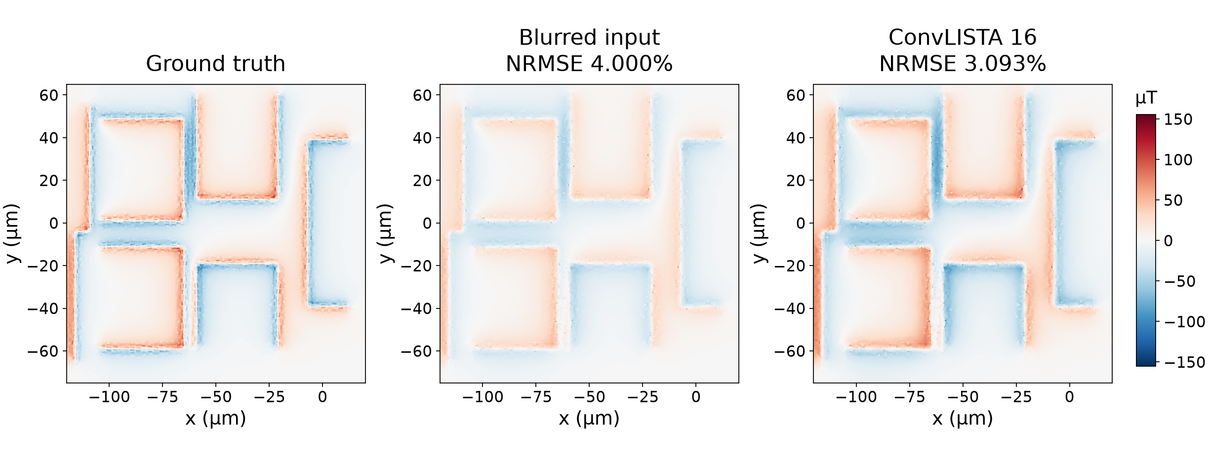
IC_2um reconstruction: Bz
Input 2 µm, reference 1 µm. Shared model, epoch 200.
Full fields, common scale in µT. Evaluation on training data.
13
Notes:
Sources: /Users/abhay/Desktop/bsp/learning_ker/runs/combined_full_200/comparison/IC_2um_z02.0_to_z01.0.npz; comparison.csv; setup.json. Bz. All 1400x1400 pixels included in the displayed full-field maps and NRMSE calculations. Common symmetric color scale for every map in this figure, limits +/-155.492431640625 uT. No per-image amplitude rescaling. Ground truth means COMSOL reference plane. Best epoch 200; training fields. Example selection: L1_C1 z3 matches the earlier model; IC_4um z3 matches that input/reference height; IC_2um has one pair. Numeric scores independently recomputed from saved arrays, matching comparison.csv.

Slide 14
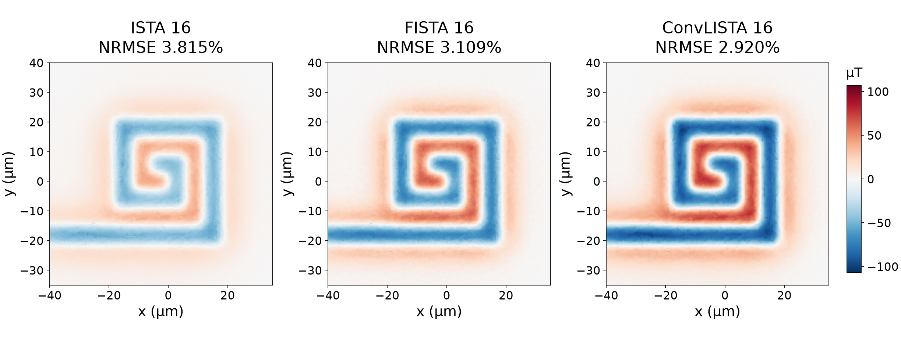
L1_C1 detail: equal-depth reconstructions
Bz, input 3 µm, reference 0.5 µm. Each method uses 16 updates.
Same displayed ROI: x = −40 to 35 µm, y = −35 to 40 µm. NRMSE uses full fields.
14
Notes:
Sources: /Users/abhay/Desktop/bsp/learning_ker/runs/combined_full_200/comparison/L1_C1_z03.0_to_z00.5.npz; comparison.csv; setup.json. Bz. Display ROI [-40,35,-35,40] um; all NRMSE values use the entire field. Common symmetric color scale for every map in this figure, limits +/-107.16419982910156 uT. No per-image amplitude rescaling. Ground truth means COMSOL reference plane. Best epoch 200; training fields. Example selection: L1_C1 z3 matches the earlier model; IC_4um z3 matches that input/reference height; IC_2um has one pair. Numeric scores independently recomputed from saved arrays, matching comparison.csv.

Slide 15
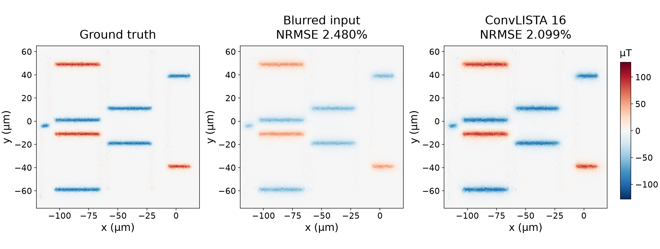
IC_2um reconstruction: Bx
Input 2 µm, reference 1 µm. Shared model, epoch 200.
This component’s adaptive ISTA baseline reached 100,000 updates without convergence.
15
Notes:
Sources: /Users/abhay/Desktop/bsp/learning_ker/runs/combined_full_200/comparison/IC_2um_z02.0_to_z01.0.npz; comparison.csv; setup.json. Bx. All 1400x1400 pixels included in the displayed full-field maps and NRMSE calculations. Common symmetric color scale for every map in this figure, limits +/-127.70335388183594 uT. No per-image amplitude rescaling. Ground truth means COMSOL reference plane. Best epoch 200; training fields. Example selection: L1_C1 z3 matches the earlier model; IC_4um z3 matches that input/reference height; IC_2um has one pair. Numeric scores independently recomputed from saved arrays, matching comparison.csv.

Slide 16
Results and remaining limitations
One shared model completed 200 epochs on 51 component pairs.
ConvLISTA slightly lowers mean error versus FISTA-16. Inference is 5.7% slower.
FISTA to tolerance retains lower overall error, at greater compute cost.
Two IC_2um ISTA components reached the cap. All adaptive FISTA solves converged.
Next experiment: held-out geometries and validated synthetic augmentation.
Current results measure reconstruction of training fields.
16
Notes:
Sources: /Users/abhay/Desktop/bsp/learning_ker/runs/combined_full_200/summary.csv; status.json; training.json; comparison.csv. Final 200-epoch results. ConvLISTA mean 3.789666099656446%, FISTA16 3.8442948979197764%, adaptive FISTA 2.9598749845343475%. LISTA inference 2.25337191025028 s sum of batch medians versus FISTA16 2.1327676869696006 s, hence no latency win at equal depth. Two adaptive ISTA components capped, IC_2um Bx and By. All evaluation is same-sample. Future experiments are proposals, not completed work.

