Slide 1
PROJECT ON TWITTER DATA SENTIMENT ANALYSIS

Slide 2
INTRODUCTION:
Sentiment Analysis is a technique used in text mining. It may, therefore, be described as a text mining technique for analyzing the underlying sentiment of a text message, i.e., a tweet. Twitter sentiment or opinion expressed through it may be positive, negative or neutral. However, no algorithm can give you 100% accuracy or prediction on sentiment analysis.
As a part of Natural Language Processing, algorithms like SVM, Naive Bayes is used in predicting the polarity of the sentence. sentiment analysis of Twitter data may also depend upon sentence level and document level.

Slide 3
Why Is There A Need For Sentiment Analysis?
Sentiment analysis is useful for every kind of business. Here are some of its proposed benefits:
Empowers businesses to monitor brand and product sentiment
Helps analyze content to pivot business strategy and drive political analysis
Allows companies to assess audience actions
Provides real-time insights extracted from customer feedback
Helps businesses deep-dive into their customer's needs as well as pain-points

Slide 4
Importance Of Performing Sentiment Analysis On The Twitter Platform
Business Strategizing: Twitter sentiment analysis plays a central role in developing a rock-solid business strategy as it can help assess your customers’ feelings towards your product/brand.
Politic Sentiment: Unknown to many, a Twitter dataset is also used to monitor political sentiment and orientations towards competing candidates in addition to analyzing election results.
Public Actions And Opinions: One of the most widespread applications of Twitter sentiment analysis is to gauge brand reputation, determine the sentiment of the Twitterverse, and analyze customer feedback by way of surveys, polls, etc.

Slide 5
Step 1: To gather the twitter data Step 2: Clean the data Step 3: To find out the sentiments Step 4:To do analysis
Steps to access the twitter
data using python program

Slide 6
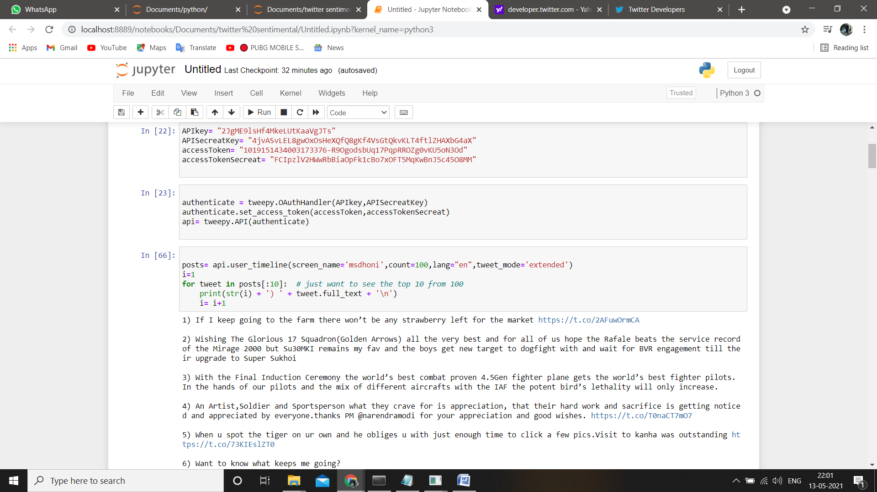
STEP 1

Slide 7
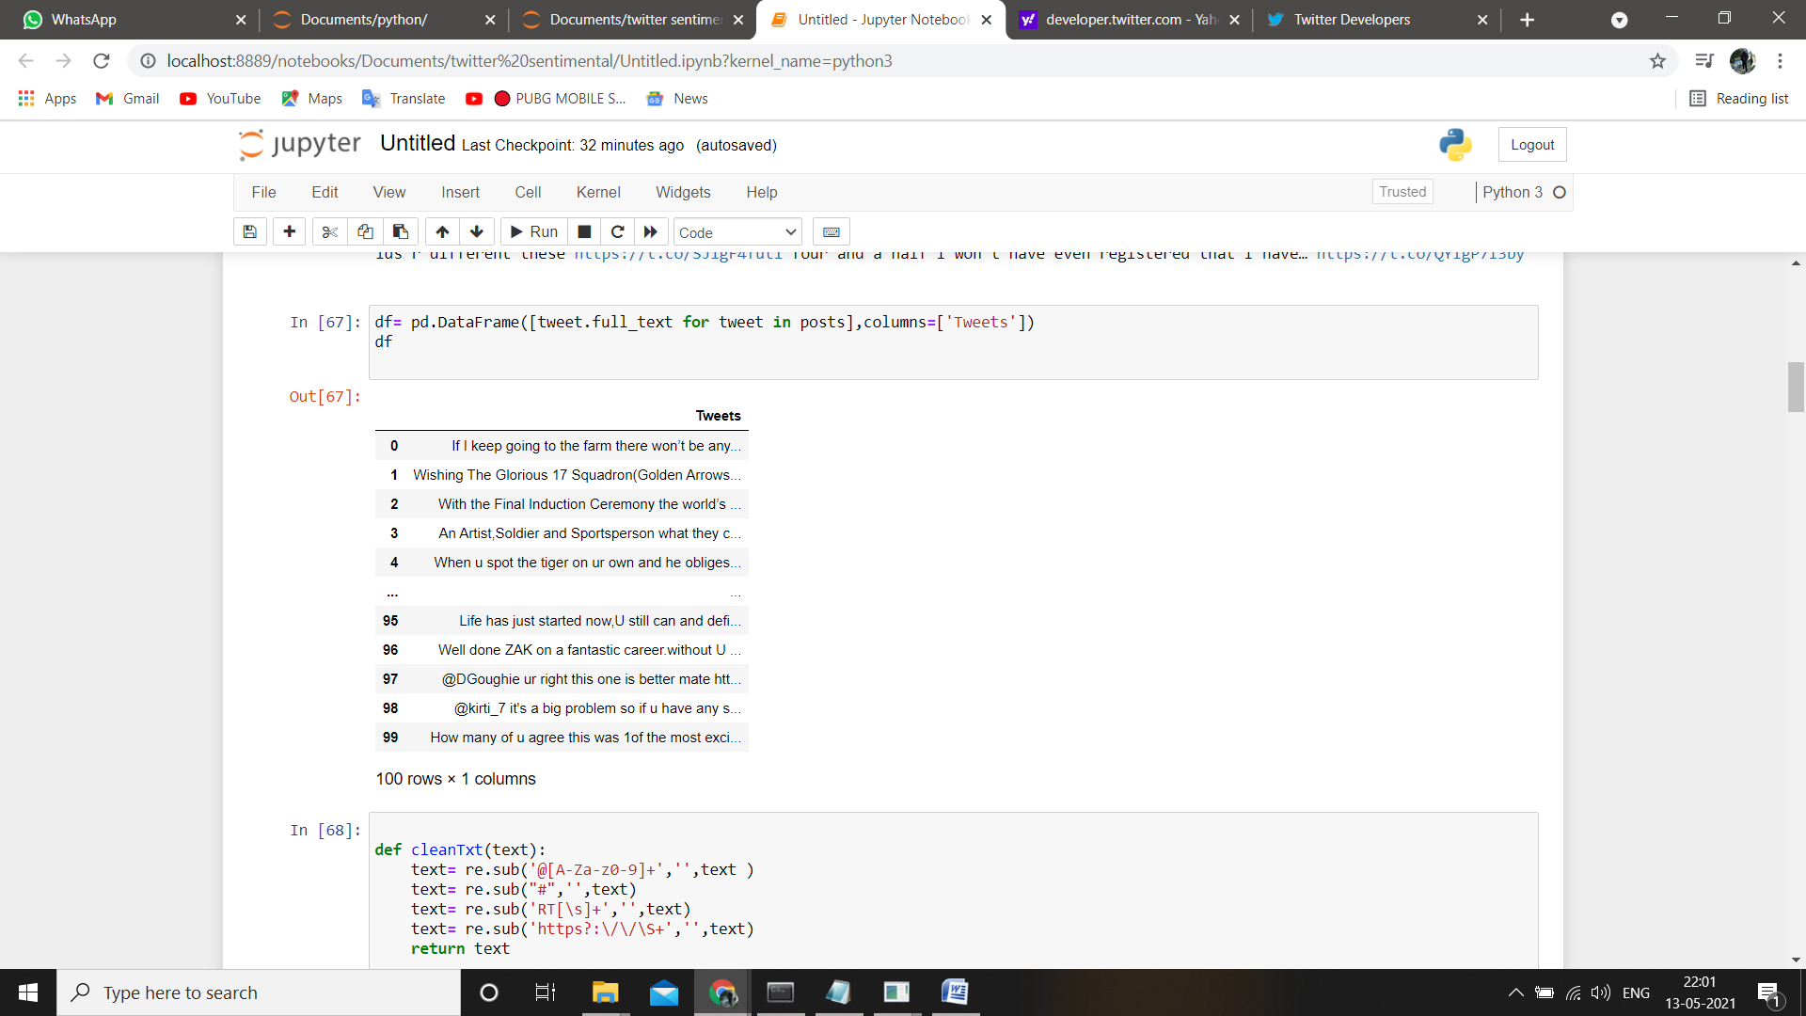

Slide 8
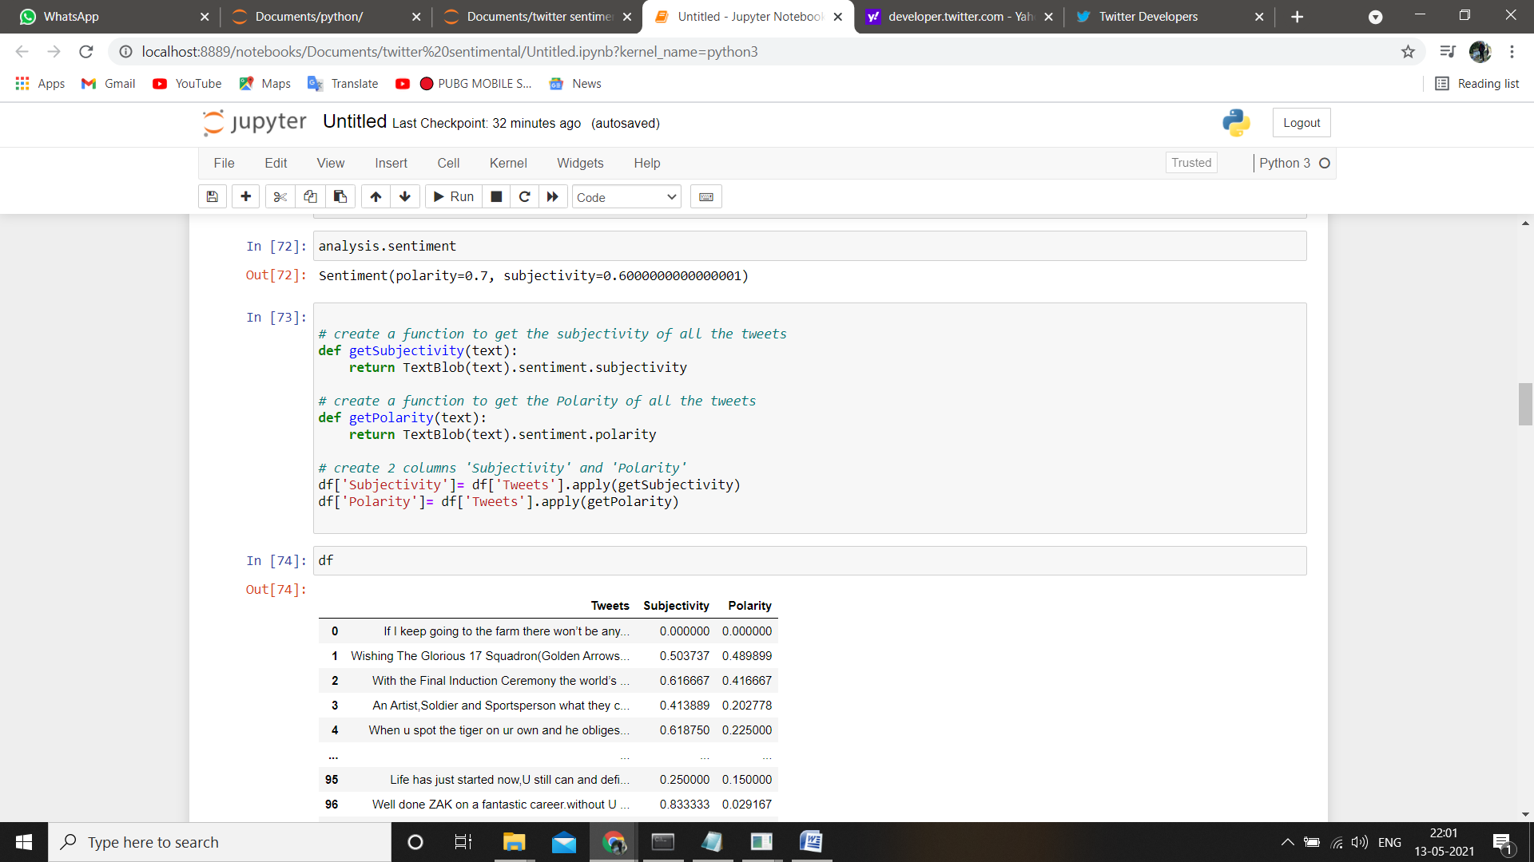
STEP 2

Slide 9
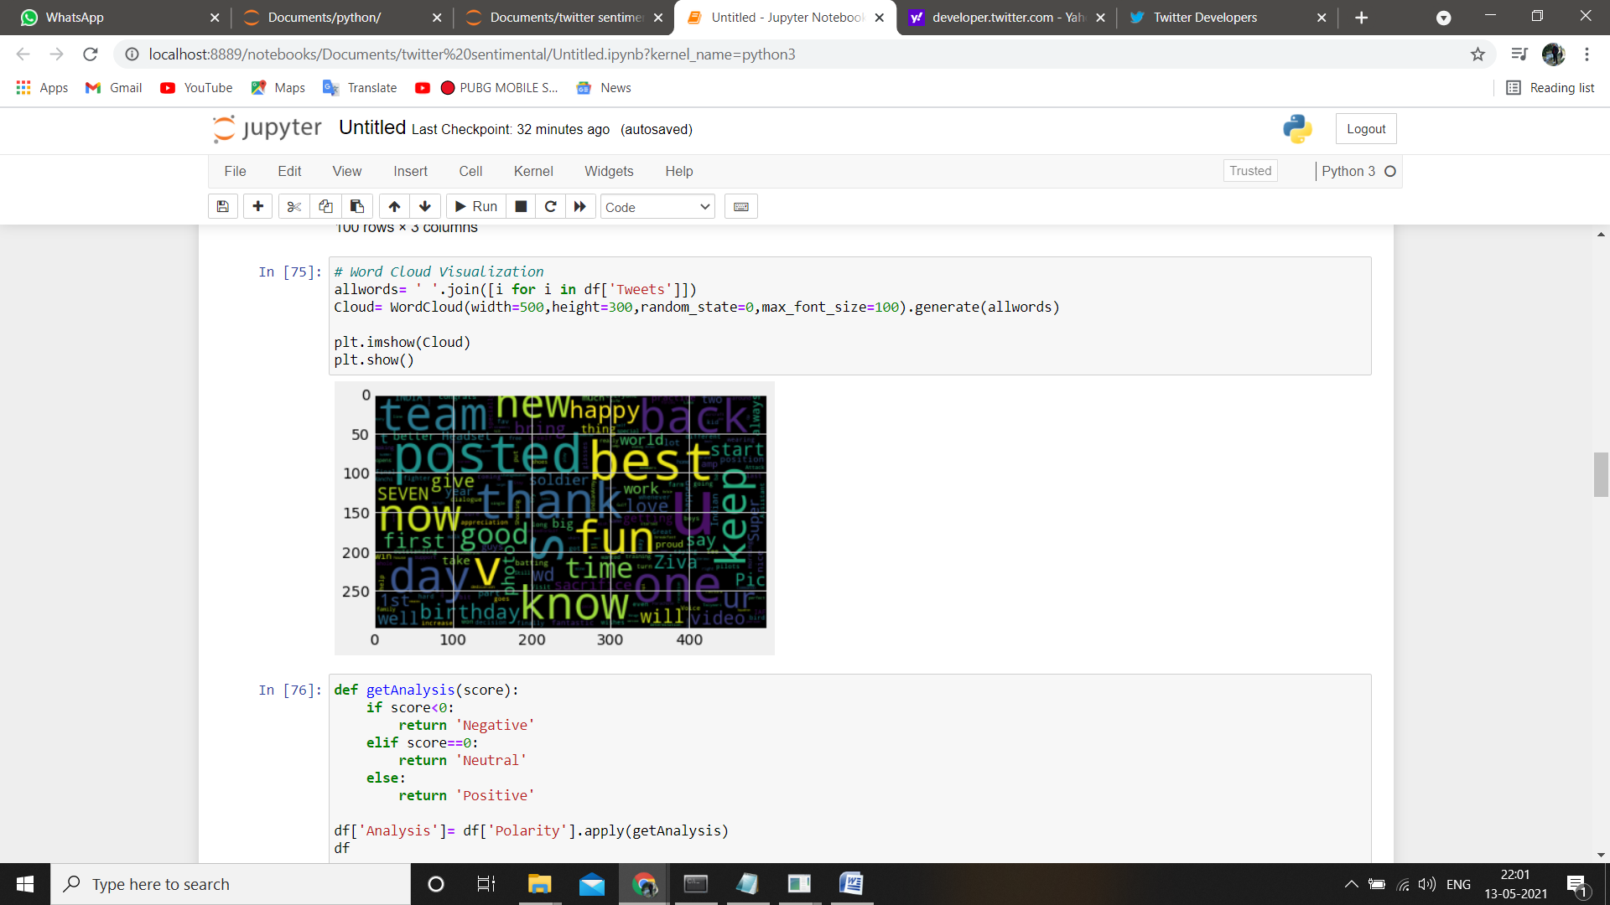

Slide 10
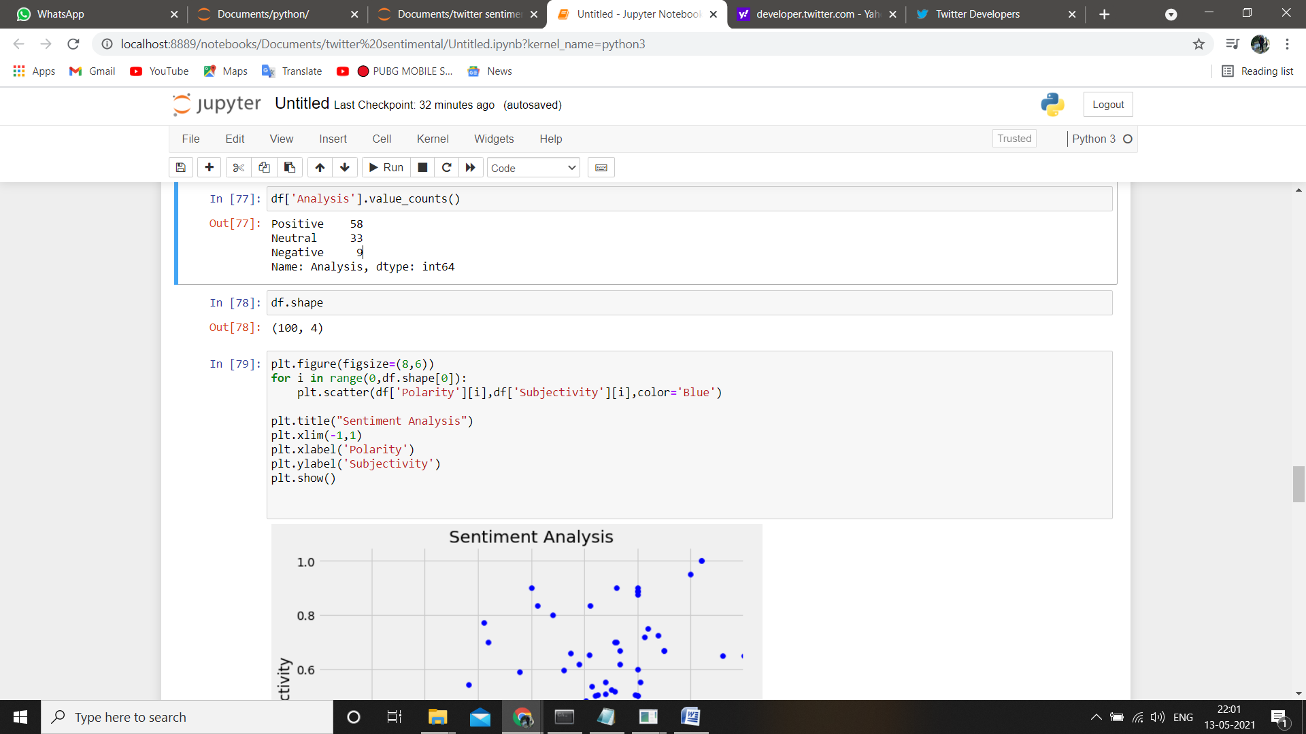
STEP 3

Slide 11
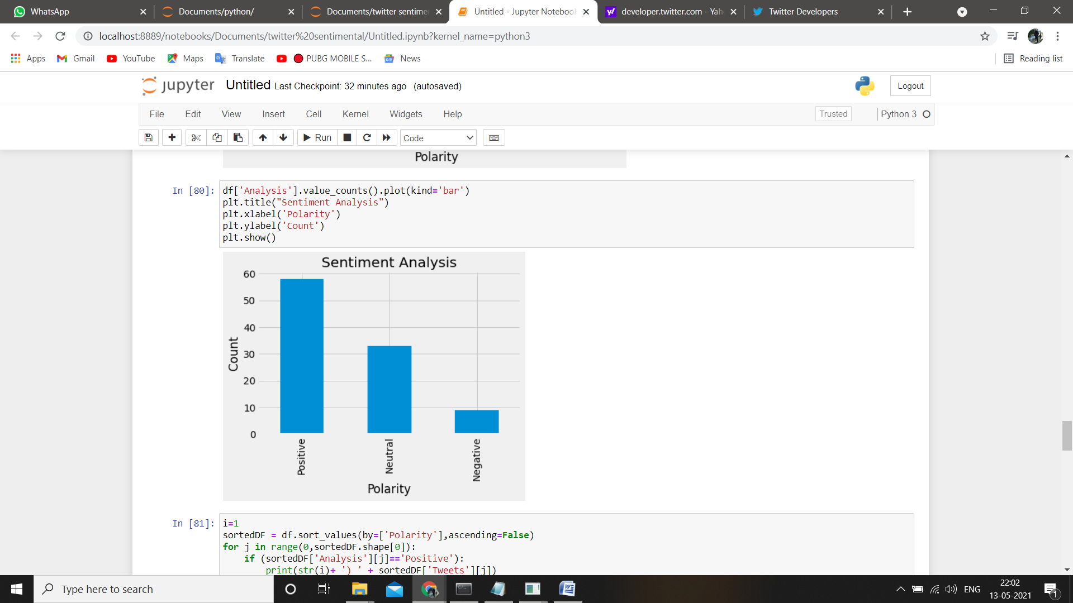

Slide 12
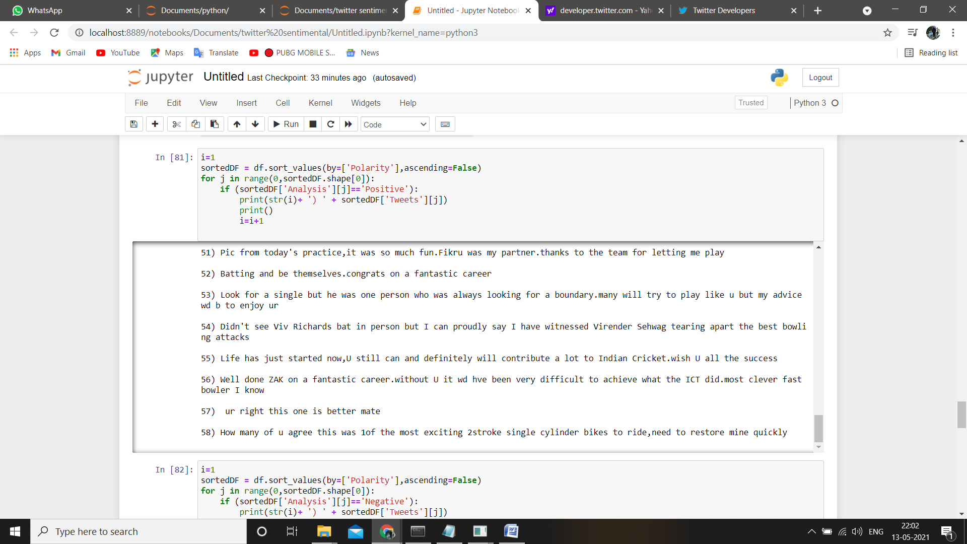

Slide 13
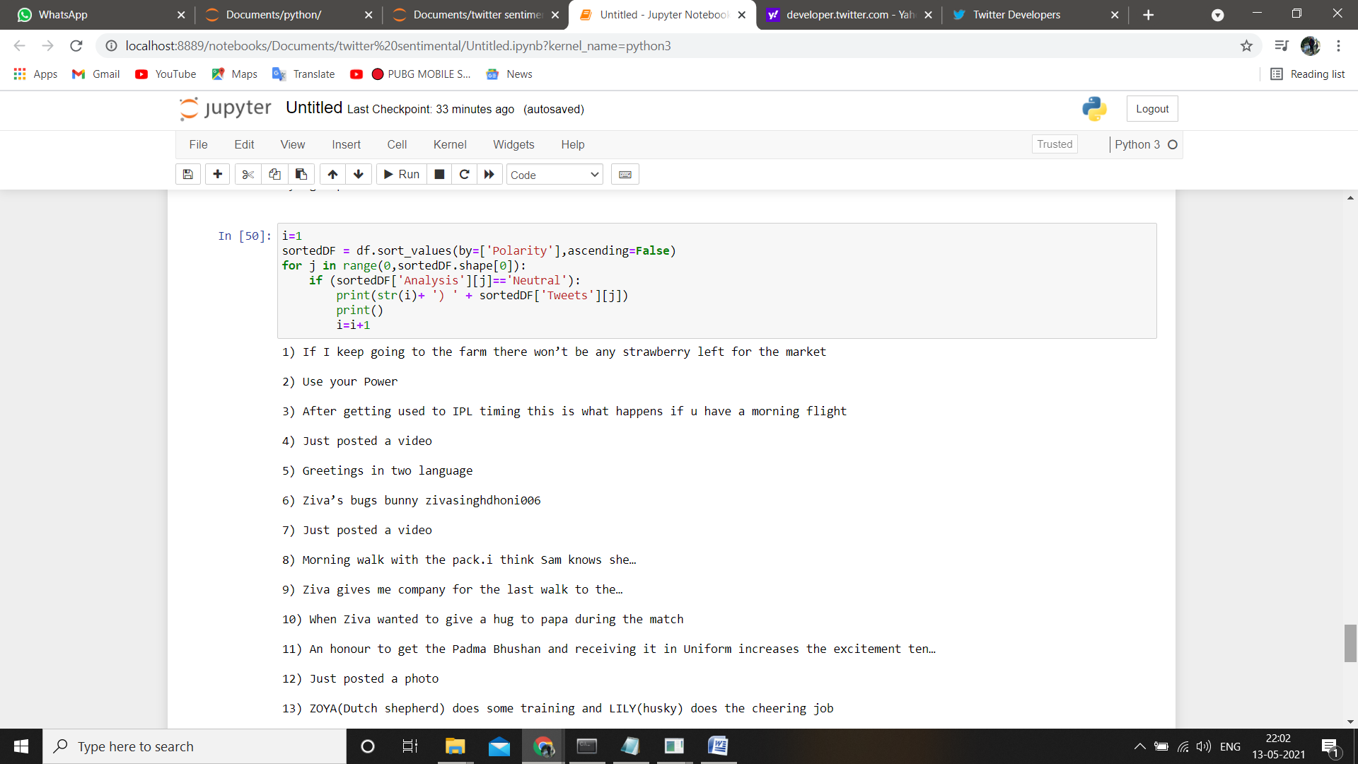
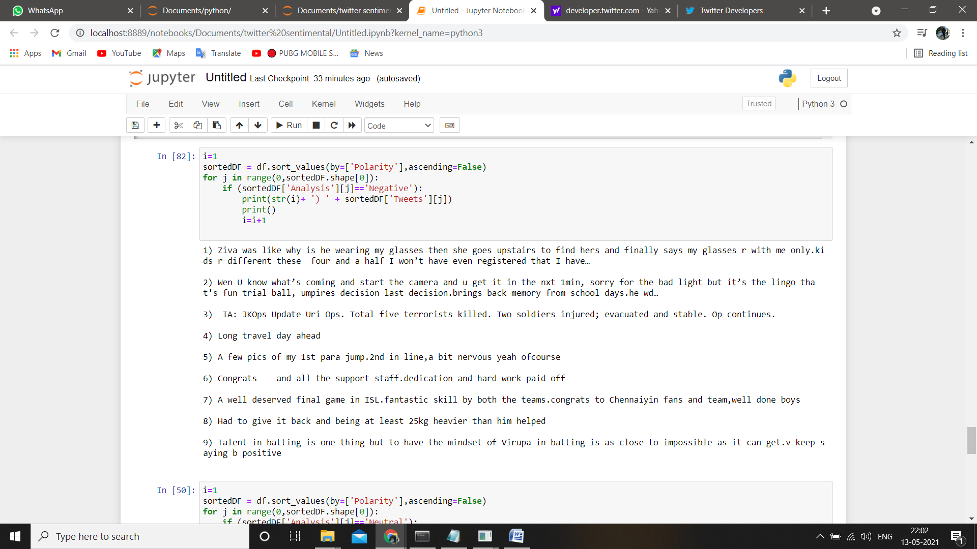
STEP 4

Slide 14
In this Project we aim to serve a processed twitter tweet database to frontend third party visualization applications. Text analysis focused on processing the tweets to extract information from the raw data of tweet, which can benefit the application in projecting more information to the user, in terms of usability and exploring text-engineered data. In delivering a quality solution we conducted early tests on the application proto-type, which is very useful to learn from mistakes and resolved the issues.
CONCLUSION

Slide 15
THANK YOU

