Slide 1
Finance and risk analysis Capstone project
Abhay Desai

Slide 2
Problem Statement – investor risk profiling and portfolio recommendation
There are 2 investors, mr. patrick jyenger and mr. peter jyenger, who are looking to invest their capital in stocks to meet their financial objectives.
mr. patrick jyenger wants to maintain decent standard of living post his retirement, and has always been a conservative investor during his life. He wants to invest usd 500,000 in equities and expects doubling his capital with less risk in 5 year’s time.
Mr. peter jyenger is consistent with his attitude towards risk and prefers high-return investments. He wants to invest USD 1,000,000 and expects high returns to meet his future goals.
our task is to provide consultation to two different investors, Mr Patrick Jyenger and Mr Peter Jyenger based on their requirements and financial objectives.

Slide 3
STEPS to be taken
Data exploration and creation of interactive visualization dashboards
Stock analysis and portfolio management to meet financial goals
Compare alpha, beta and sharpe ratio of stocks and come up with portfolio recommendation balancing return and risk
Prepare an executive report summarizing all the findings, insights, visuals and recommendations

Slide 4
Alpha, beta and sharpe ratio of stocks
Alpha shows how well or bad a stock has performed in comparison to a benchmark index. A high alpha is always good.
Beta indicates how volatile a stock's price has been in comparison to the market as a whole. Beta is a concept that measures the expected move in a stock relative to movements in the overall market. A beta greater than 1.0 suggests that the stock is more volatile than the broader market, and a beta less than 1.0 indicates a stock with lower volatility.
Sharpe ratio tells investors whether an investment's returns are due to smart investment decisions or are the result of excess risk. Usually, any Sharpe ratio greater than 1.0 is considered acceptable to good by investors. A ratio higher than 2.0 is rated as very good. A ratio of 3.0 or higher is considered excellent. A ratio under 1.0 is considered sub-optimal.
Anything more than zero is a good alpha; higher the alpha ratio in stocks on a consistent basis, higher is the potential of long term returns. Generally, beta of around 1 or less is recommended. If your stock beta is less than 1, make sure that stock alpha is high enough so that you can meet your financial goals. If you are stock beta is more than 1, then make sure that you are comfortable with the risk, as per your risk capacity.

Slide 5
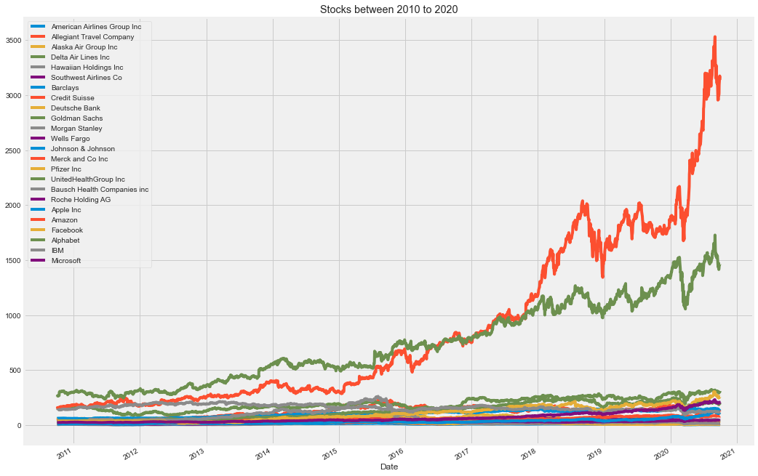
all stocks

Slide 6
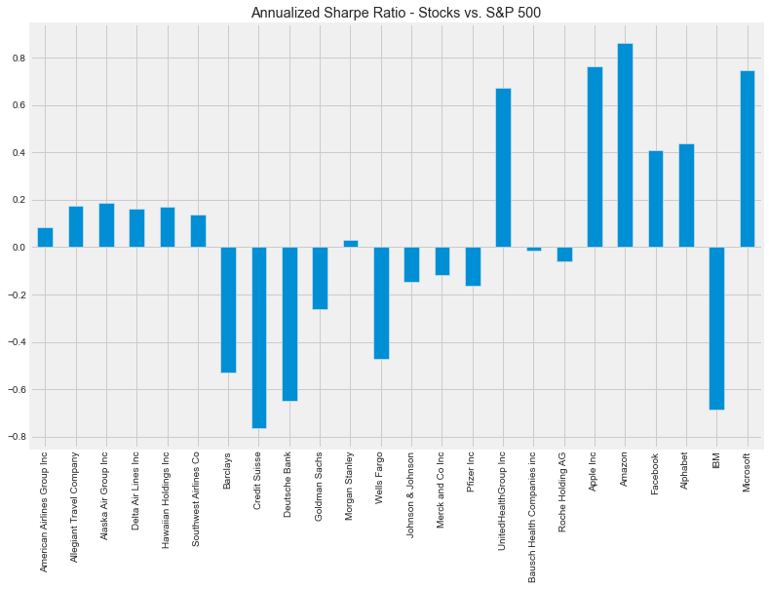
all stocks

Slide 7
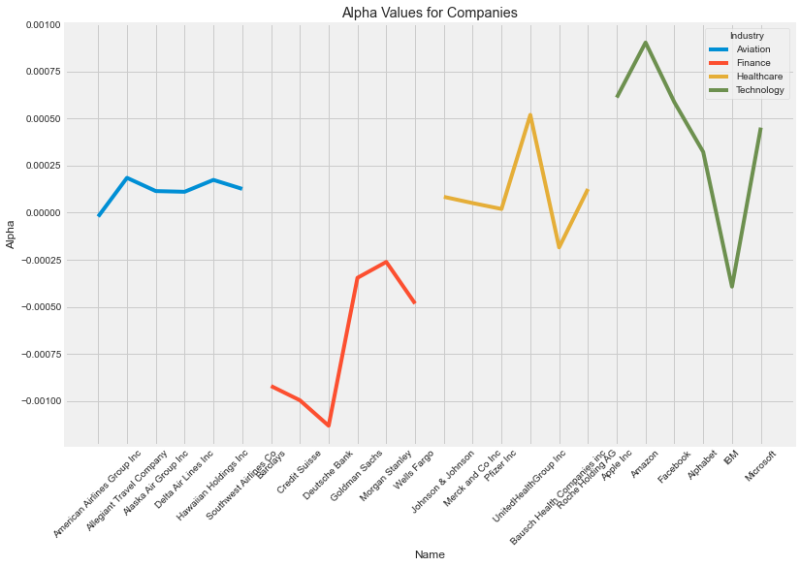
Alpha for all stocks

Slide 8
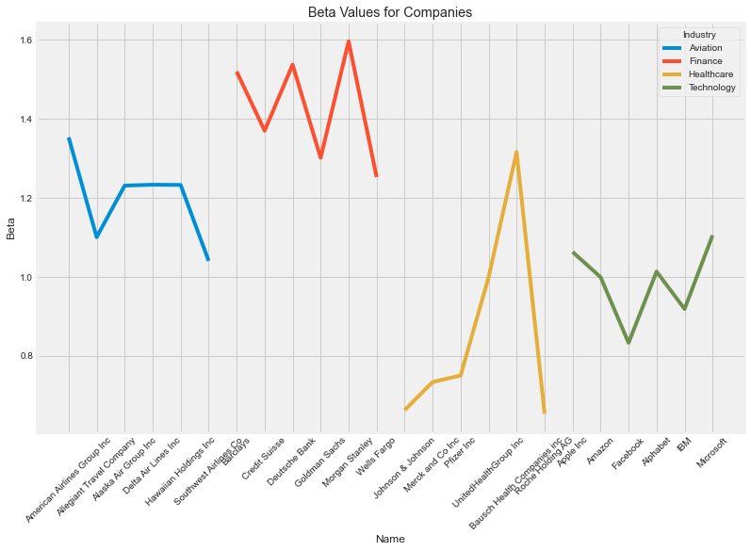
Beta for all stocks

Slide 9
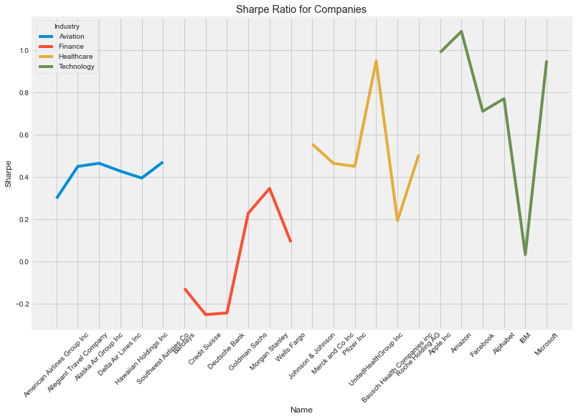
Sharpe ratio for all stocks

Slide 10
recommendation
Mr Patrick Jyenger (Conservative Investor: Less Risk and Volatility with Average Return)
portfolio stocks could be 'Johnson & Johnson‘ and 'Microsoft‘.
Weight of stocks could be …
This means combination of 'Johnson & Johnson‘ and 'Microsoft‘ can give returns in range of 350% to 670%.
Weight | Portfolio Risk | Portfolio Cumulative Return
[0.5, 0.5] | 0.185124 | 4.924906606837572
[0.25, 0.75] | 0.215651 | 6.6923528788065205
[0.75, 0.25] | 0.169281 | 3.5058432779306417

Slide 11
recommendation
Mr Peter Jyenger (Agressive Investor: High Risk and Volatility with High Return)
portfolio stocks could be 'Apple Inc', 'Amazon', 'Microsoft‘ and 'United HealthGroup Inc'.
Weight of stocks could be …
This means combination of 'Apple Inc', 'Amazon', 'Microsoft‘ and 'United HealthGroup Inc'. can give returns in range of 1300% to 1700%.
Weight | Portfolio Risk | Portfolio Cumulative Return
[0.25, 0.25, 0.25, 0.25] | 0.213989 | 13.729154684165696
[0.5, 0.5, 0.0, 0.0] | 0.253001 | 17.4186602401503
[0.0, 0.33, 0.33, 0.33] | 0.217899 | 13.229097086876253
[0.4, 0.2, 0.2, 0.2] | 0.217951 | 13.614986484085057

Slide 12


