Slide 1
TABLEAU IPL VISUALIZATION Case Study
Abhay Desai

Slide 2
Problem Statement – Tableau dashboard of IPL statistics
The Indian Premier League, or IPL, is a T20 cricket league, which was founded in 2008 and is held every year.
Over the years, IPL has become one of the most-watched and most attended live sporting events all over the world.
a nationally recognized news agency wants to build a Tableau dashboard of IPL statistics over the years since its inception in order to create an infographic for a newsletter.

Slide 3
STEPS to be taken
Establish data source connection with input files (csv files)
Verifying table fields and join them on relevant fields to get data from multiple tables
Prepare infographics showing …
Player statistics
match statistics
venue statistics
season statistics
win statistics

Slide 4
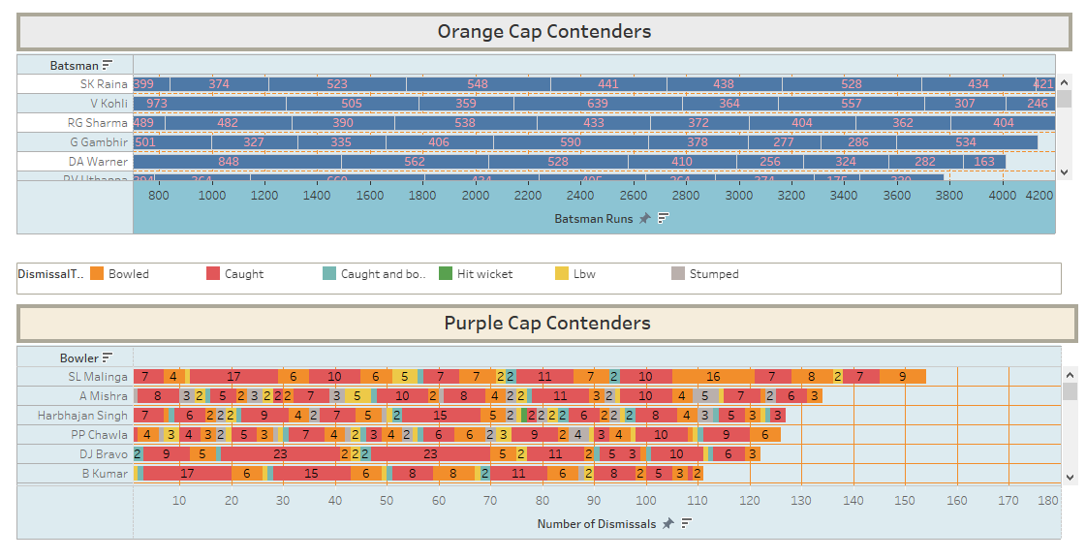
Dashboard - Players 1

Slide 5
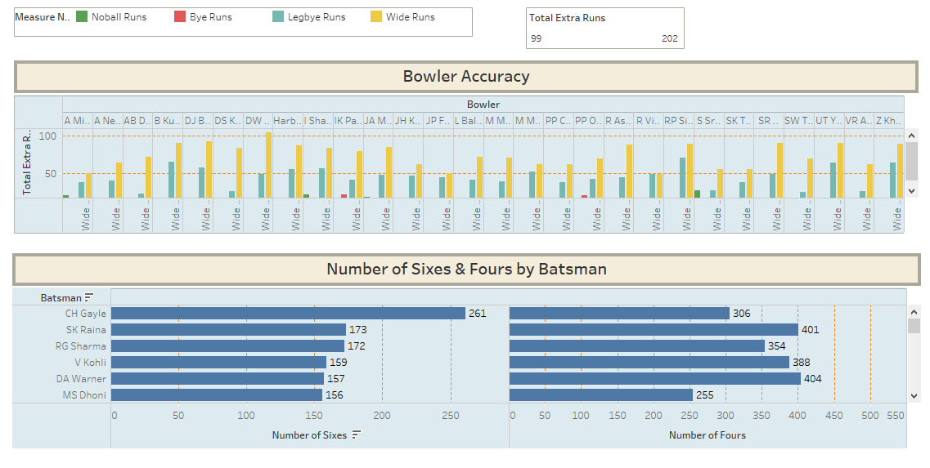
Dashboard - Players 2

Slide 6
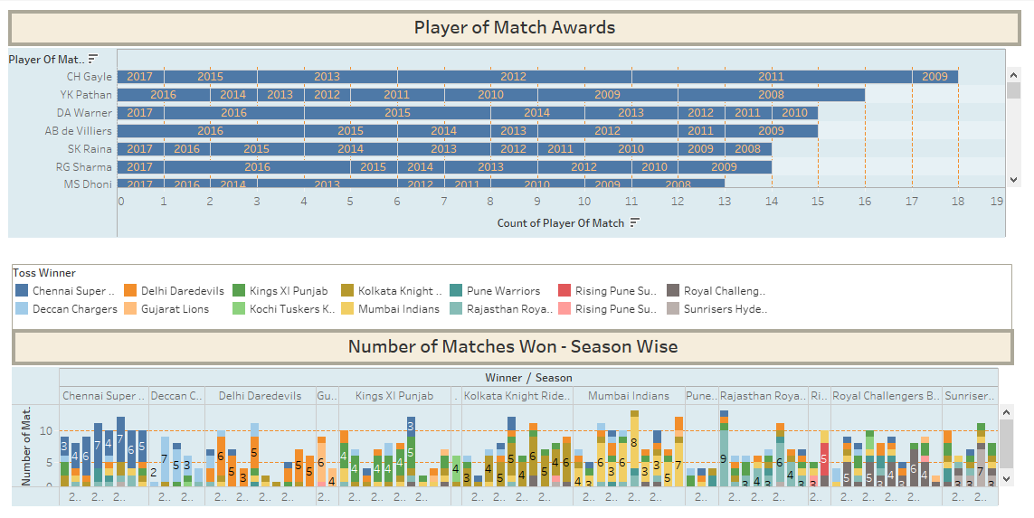
Dashboard - Match statistics

Slide 7
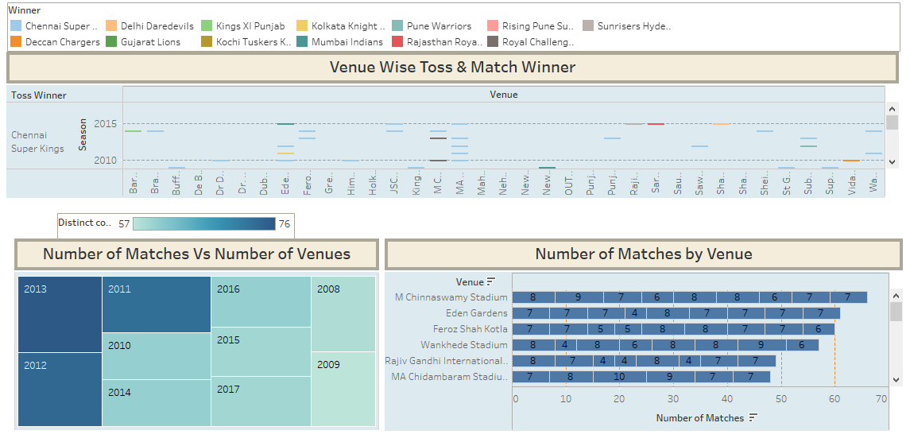
Dashboard -venue statistics

Slide 8
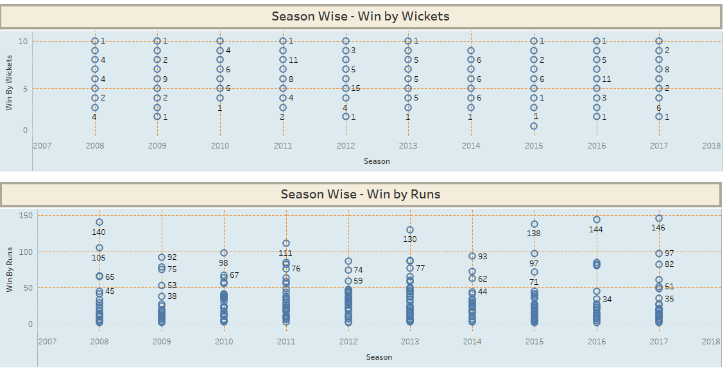
Dashboard - season statistics

Slide 9
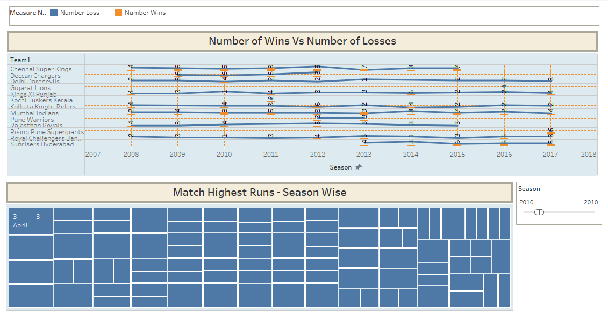
Dashboard - Win statistics

Slide 10
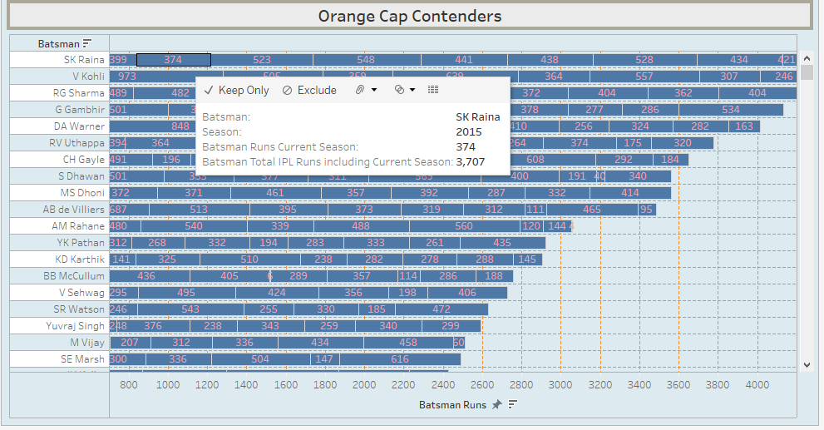
Worksheet - Orange cap contenders
 | Observations : This visualization shows batsmen who are contenders of “Orange Cap”, which is awarded to batsman who has scored highest runs in any particular IPL season.

Slide 11
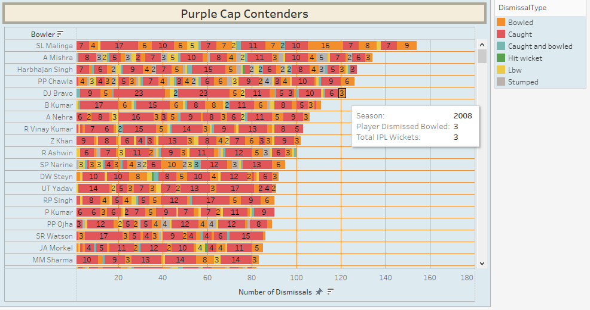
Worksheet - purple cap contenders
 | Observations : This visualization shows bowlers who are contenders of “Purple Cap”, which is awarded to bowler who has taken highest wickets in any particular IPL season. It is also showing type of dismissal for taken wicket, be it bowled, caught, caught and bowled, hit wicket, LBW or stumped.

Slide 12
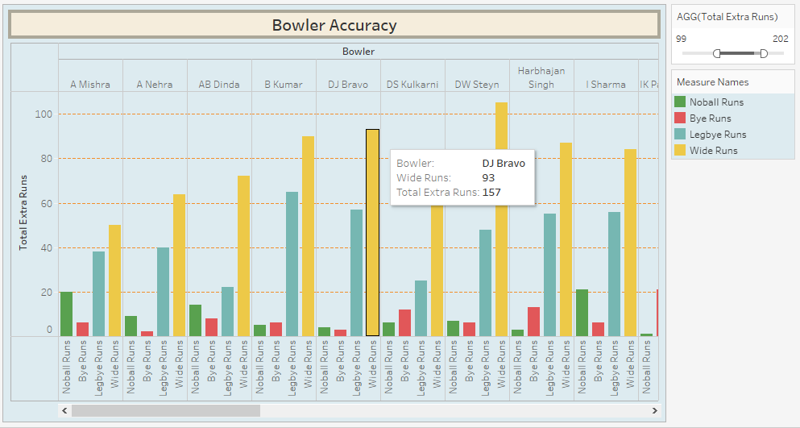
Worksheet - Bowler accuracy (extra runs given)
 | Observations : This visualization shows bowler accuracy in terms of how many extra runs in form of no ball, bye, leg bye and wide runs given by each bowler across all IPL seasons. It is also showing total extra runs given by that bowler across all IPL seasons.

Slide 13
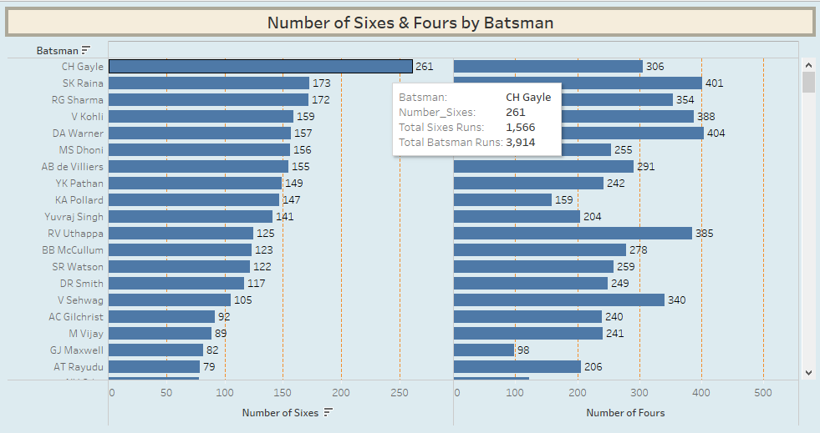
Worksheet - Number of sixes and fours by batsman
 | Observations : This visualization shows number of sixes and number of fours hit by each batsman, how much was total boundary runs scored by sixes and fours, and total batsman runs across whole IPL season.

Slide 14
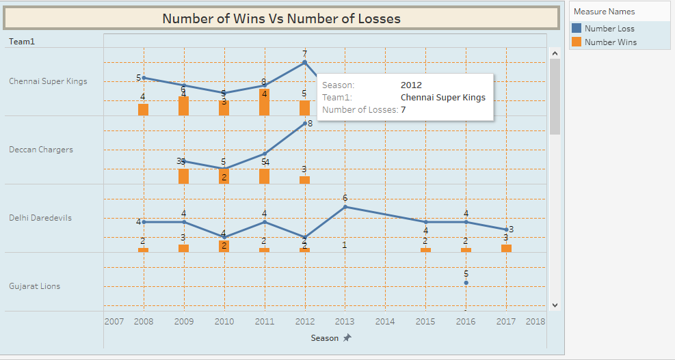
Worksheet - Number of wins vs number of losses
 | Observations : This visualization shows number of wins and number of losses by each IPL team across IPL seasons. This gives an idea about team’s consistency in performance and eventually becoming IPL champion.

Slide 15
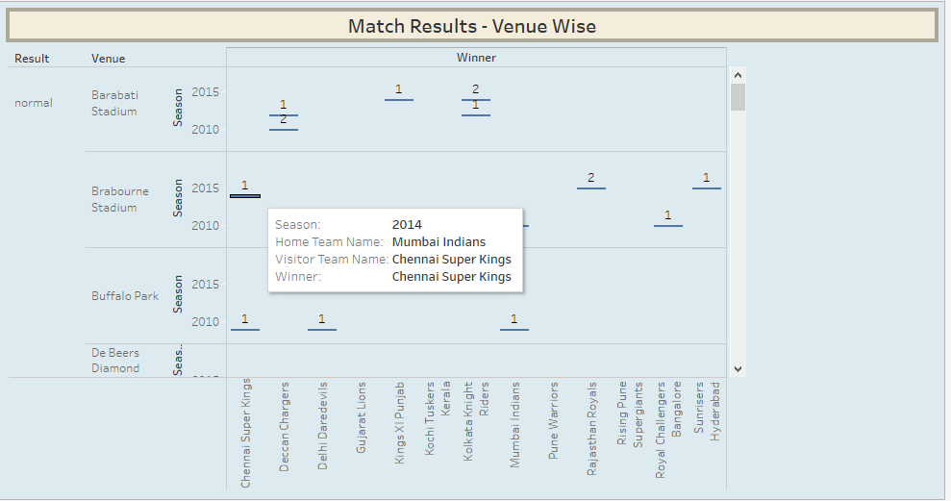
Worksheet - Match result (venue wise)
 | Observations : This visualization shows match results, be as no result, normal or tie venue wise showing additional details of which was home team, which was visitor team and who won that match for each season.

Slide 16
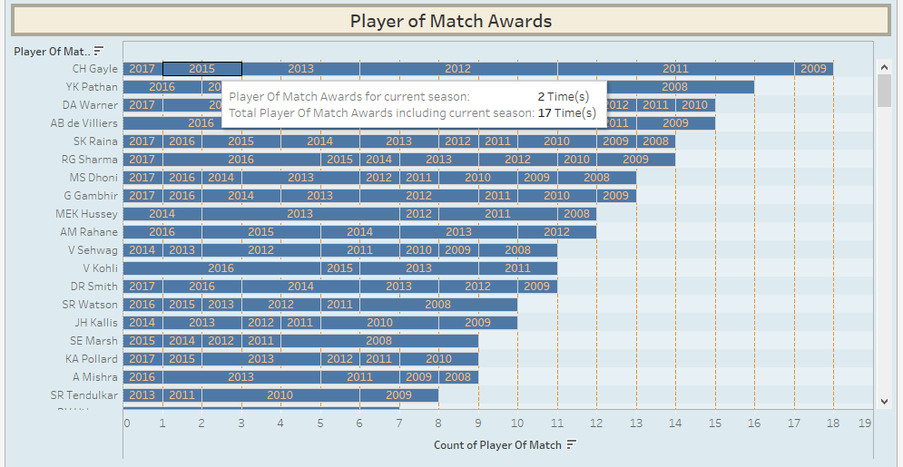
Worksheet - Player of Match awards
 | Observations : This visualization shows players who were awarded “Player of Match” for their performance in any particular IPL season as well as total number of “Player of Match” award won by that player.

Slide 17
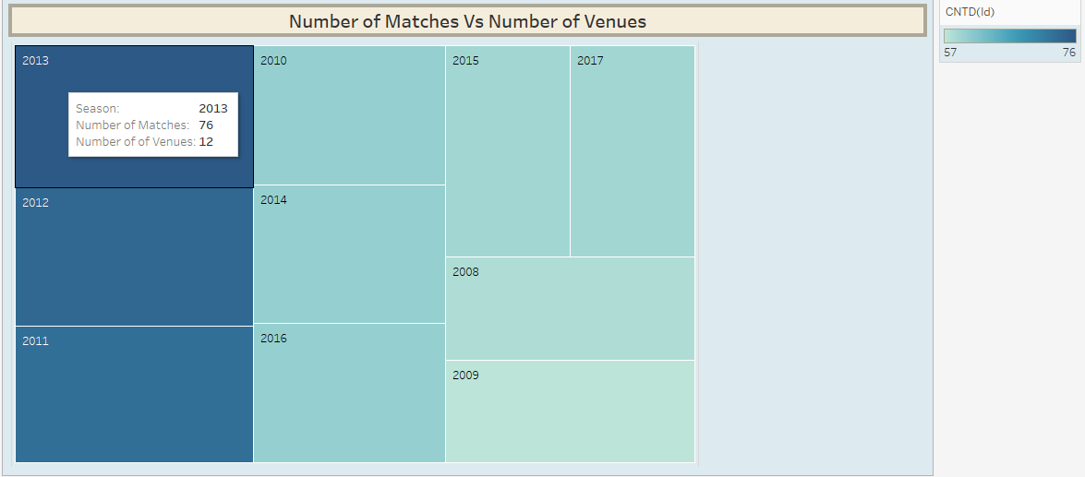
Worksheet - Number of matches vs number of venues
 | Observations : This visualization shows number of matches and number of venues for each IPL season.

Slide 18
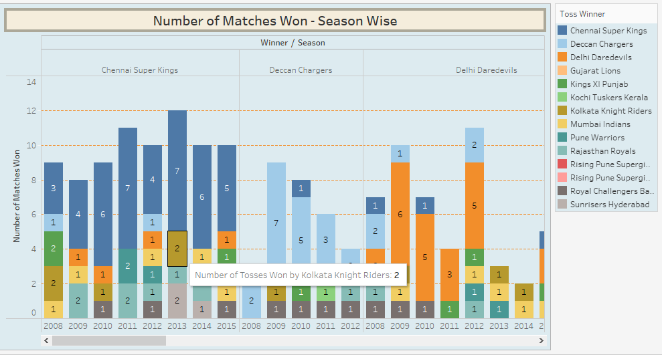
Worksheet - Number of matches won (season wise)
 | Observations : This visualization shows different IPL teams across season highlighting number of tosses won by that team as well as number of tosses by other teams, which was won by that particular team.

Slide 19
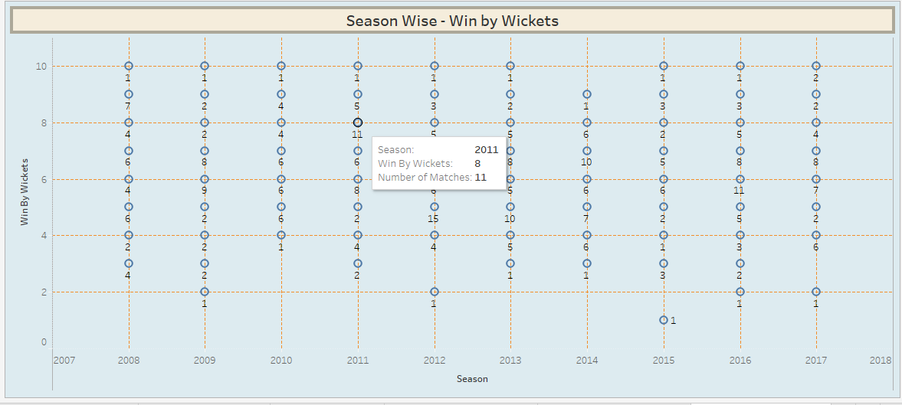
Worksheet - season wise (win by wickets)
 | Observations : This visualization shows number of matches across seasons won by wickets (team batting second). The winning team can win any match with margin of anywhere by 1 wicket to 10 wickets.

Slide 20
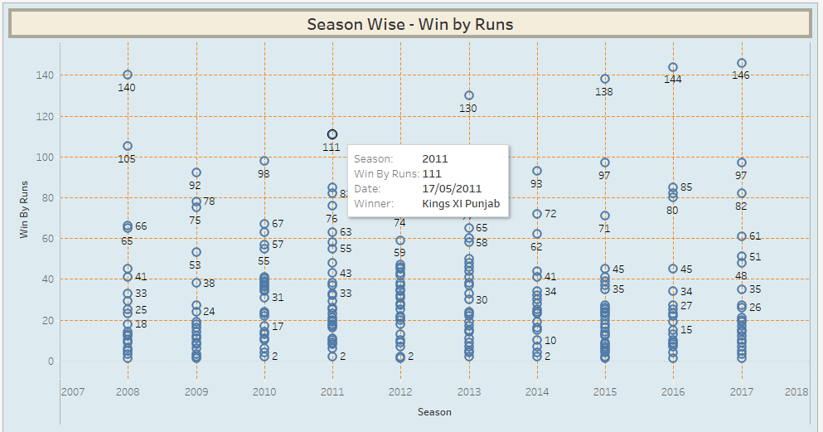
Worksheet - season wise (win by runs)
 | Observations : This visualization shows number of matches across seasons won by runs (team batting first). The winning team can win any match by any margin of runs (highest in current case study is 146 runs).

Slide 21
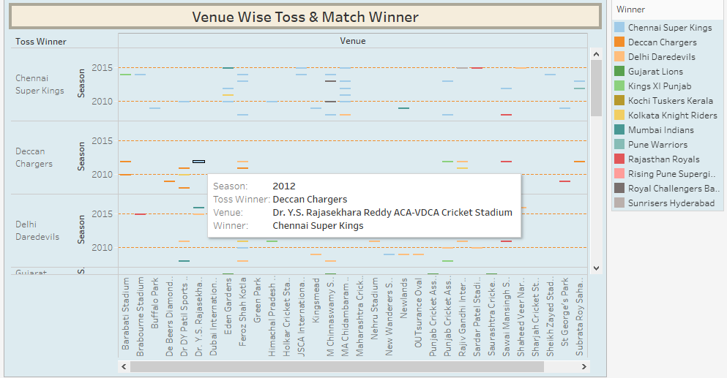
Worksheet - venue wise toss & match winner
 | Observations : This visualization shows venue wise toss winner and match winner for IPL season. This gives an idea about any particular venue being favourite for any team, where their winning percentage is comparatively higher than other venues.

Slide 22
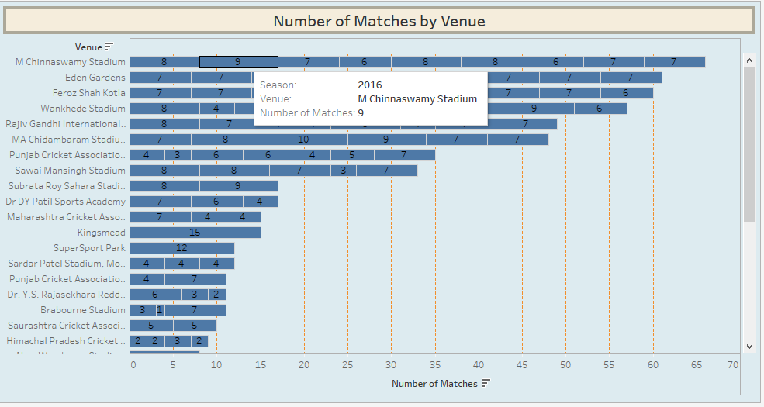
Worksheet - Number of matches by venue
 | Observations : This visualization shows number of matches hosted by each venue season wise.

Slide 23
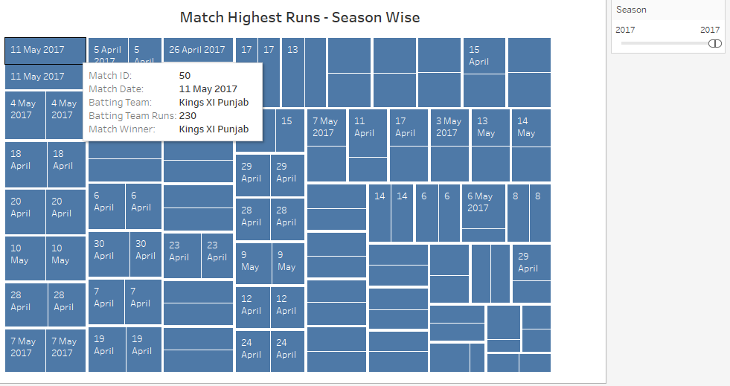
Worksheet - Match highest runs (season wise)
 | Observations : This visualization shows match details season wise with highest total runs with details such as match id, match date, batting team name, batting team runs and match winner.

Slide 24
conclusion
Tableau dashboard is a good option for data visualization of large quantity of data whether it is in format of files (Microsoft excel, Text files, csv files, JSON files, pdf files etc.) or databases (Microsoft sql server, oracle, mysql, amazon redshift, mongodb, mariadb etc.).
Tableau dashboard can be used for following business cases …
Analytical - to identify historical trends, establish targets, predict outcomes, and/or discover insights.
Operational - to monitor, measure, and manage processes in real-time.
Strategic - to track key performance indicators (KPIs) and progress towards established targets.

Slide 25


