Slide 1
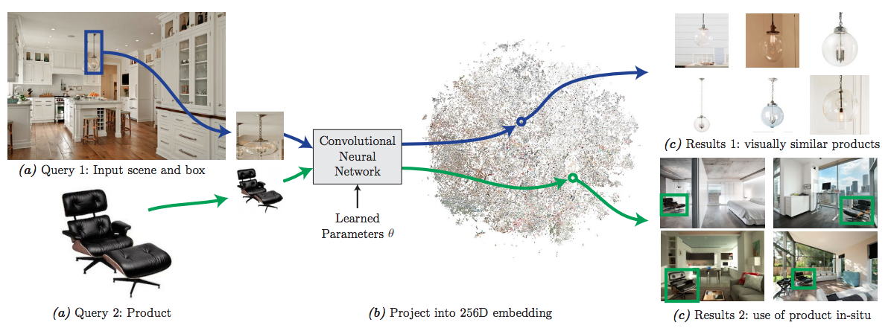
Learning visual similarity for product design with convolutional neural networks

Slide 2
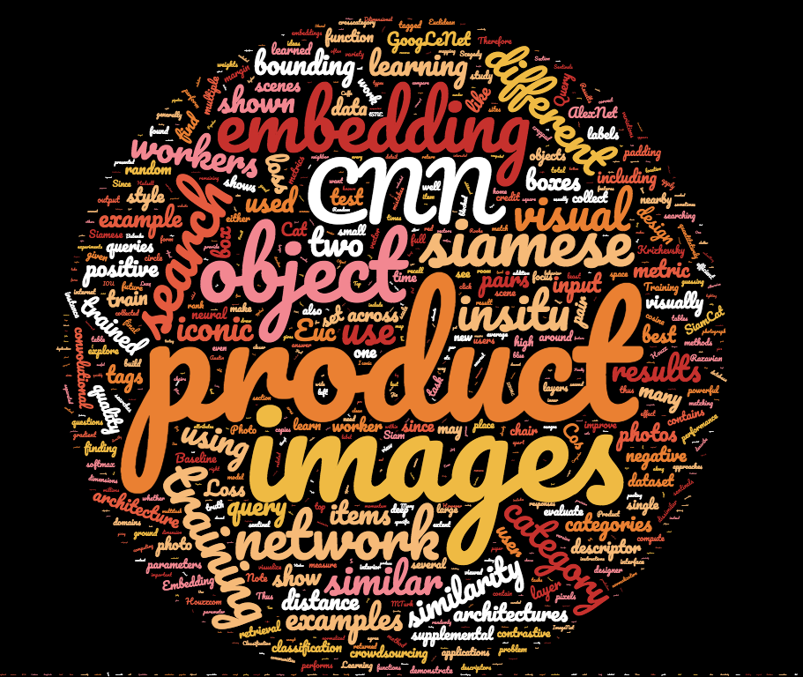
Word cloud for this paper

Slide 3
Problem Statement
Learning an embedding for visual search in interior design
Applications:
Identifying products in scenes
Finding stylistically similar products
How?
Train a convolutional neural network on pairs of images (Siamese)

Slide 4
Architecture

Slide 5
Technical aspects of the method

Slide 6
Input/Output

Slide 7
Results

