Slide 1
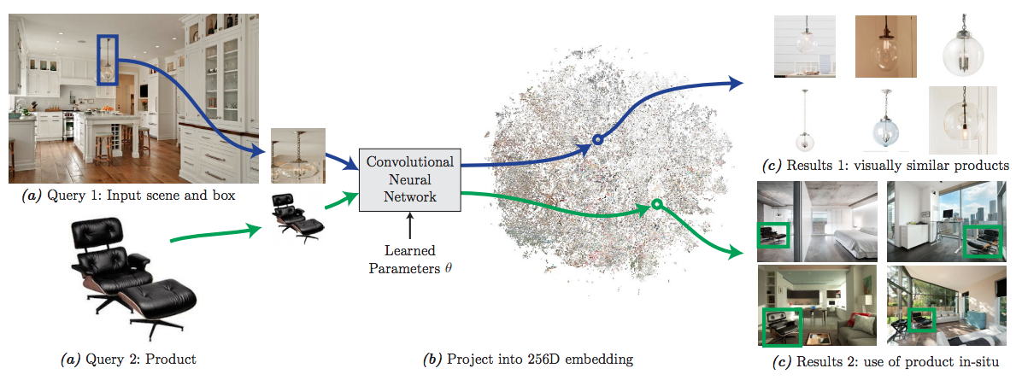
Learning visual similarity for product design with convolutional neural networks

Slide 2
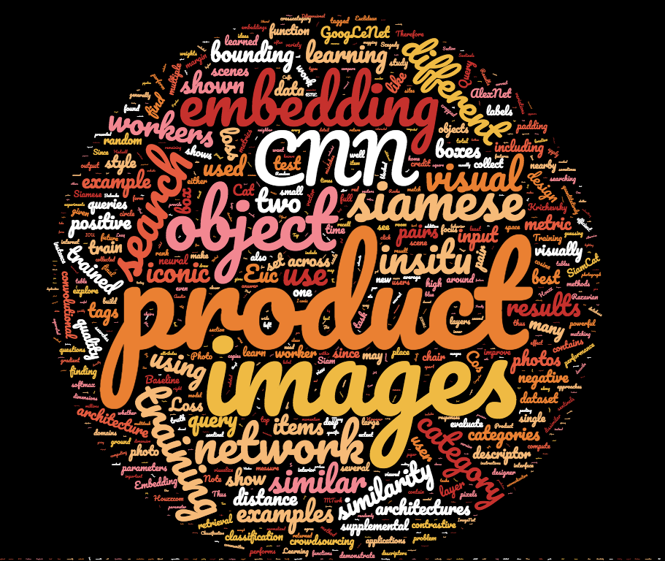
Word cloud for this paper

Slide 3
Problem Statement
Learning an embedding for visual search in interior design
Applications:
Identifying products in scenes
Finding stylistically similar products
How?
Train a convolutional neural network on pairs of images (Siamese)

Slide 5
Main contributions
Developed a crowdsourced pipeline to collect pairings between in-situ images and their corresponding product images.
Showed how this data can be combined with a siamese CNN to learn a high quality embedding.
Applied this embedding to image search applications like finding a product, finding designer scenes that use a product, and finding visually similar products across categories.

Slide 6
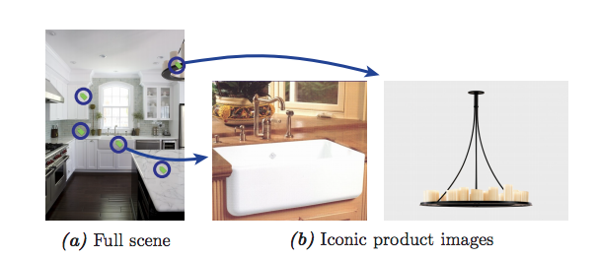
Training Data collection
Collected 7,249,913 product photos and 6,515,869 room photos from Houzz.com
Removed near- and exact-duplicate images using AlexNet (fc7 layer output)
Retained 3,387,555 product and 6,093,452 room photos
PROBLEM!!!!
Only 178,712 product photos have “product tags”
Also need to know the spatial extent of the product in the room

Slide 7
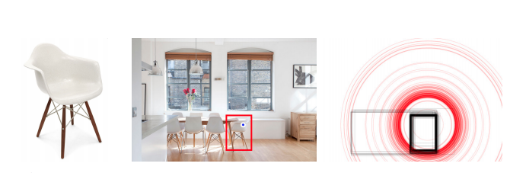
Crowdsourcing object extents
Used MTurk to obtain bounding boxes around the object
Quality control using SENTINELS!!
Sentinels are secret test images randomly mixed into each task
Sentinels ensure that bad workers are quickly blocked
Users must agree with the ground truth by having IOU score of at least 0.7
If users make mistakes frequently, prevent the user from submitting
11.9% of workers were blocked by sentinels

Slide 8
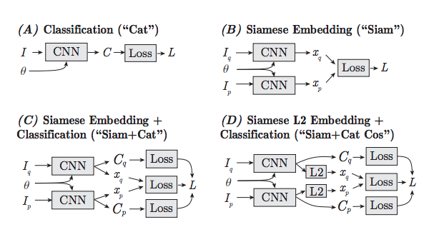
Architectures
a CNN that is used for classification and then re-purposed as an embedding
directly training an embedding
also predicting the object categories Cq, Cp
also normalizing the embedding vectors to have unit L2 length (since Euclidean distance on normalized vectors is cosine distance)
Loss for classification: softmax loss (softmax followed by crossentropy)
Loss for embedding: contrastive loss
TRAINING
63,820,250 training pairs with 1:20 positive to negative ratio
Stochastic gradient descent
Weights initialized from the learned weights hosted on BVLC Caffe website
Contrastive loss function margin m ∈ {1, √10, √100, √1000, }
Embedding size = Last layer with a D-dimentional output
D ∈ {256, 1024, 4096}

Slide 9
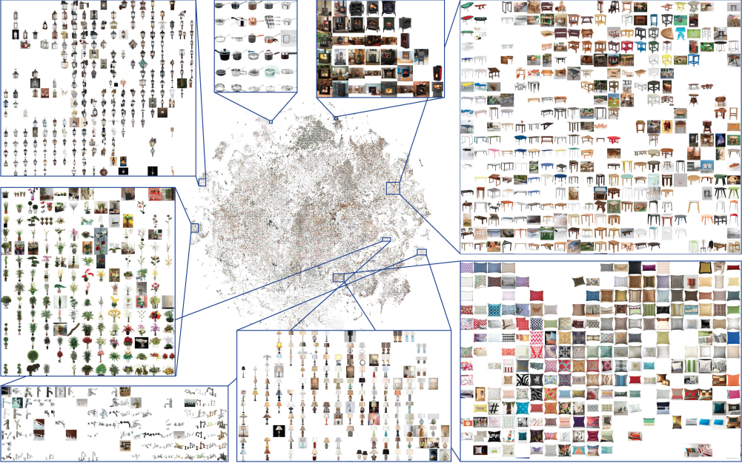
VISUALIZING THE EMBEDDING
Visualizing the result by projecting D-dimensional embedding down to two dimensions using the t-SNE algorithm

Slide 10
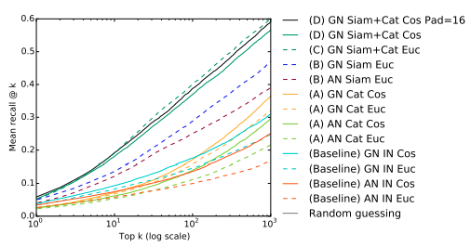
results

