Slide 1
Analysis and Benchmarking of Threaded Applications on MySQL and Neo4j
Abhay Goel, Pranay Methuku, Prerna Agarwal

Slide 2
Project Goal
If given a typical social media dataset where users have relationships with each other and interact with shared content, which DBMS implementation would be overall more efficient?
To feed various types of data into two database systems: Relational Databases and Graph Databases. Then, we would run some transactions on the two databases in a single-threaded and multithreaded fashion, to return a total of four observations:
Single-threaded RDBMS load Multi-threaded RDBMS load
Single-threaded Graph DB load Multi-threaded Graph DB load
Finally, these observations would be compared, and the results would be justified. The following is the progress division of our goals:
75% → single threaded loads on both DBs
100% → multi threaded code
125% → multithreaded loads with benchmarks and comparisons.

Slide 3
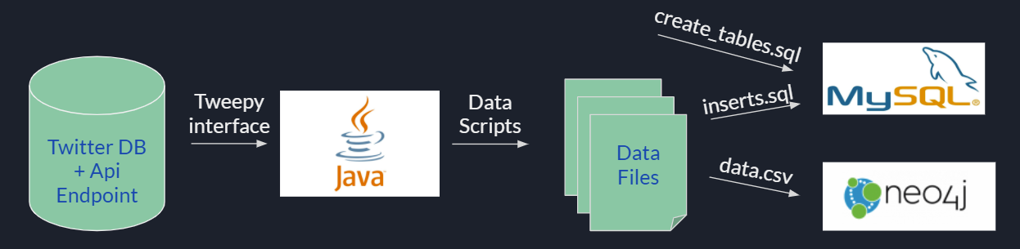
Infrastructure
We are building applications that would connect to the two database systems. The applications would execute single-threaded and multi-threaded loads on the databases and would be responsible for timing the responses.
MySQL for Relational Database
Neo4j for Graph Database
Twitter API endpoint for the data itself
Java for connecting to both the databases

Slide 4

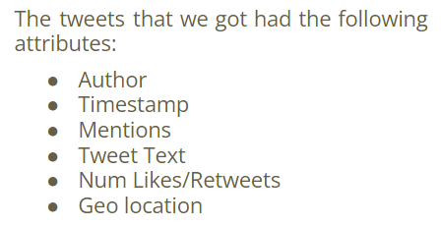

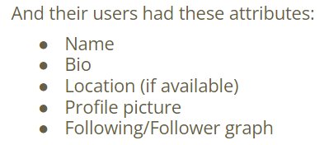
Dataset Used
Twitter data from 2013 fetched using open-source APIs
Same type of data used for both types of databases.
Fetched approximately 1GB of data.
Would use all of this to run benchmarks and test the performance.

Slide 5
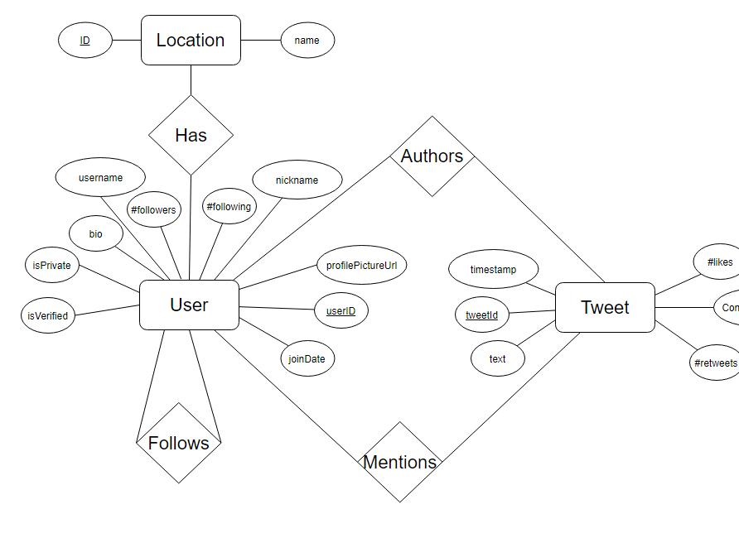
Entity-Relationship diagram

Slide 6
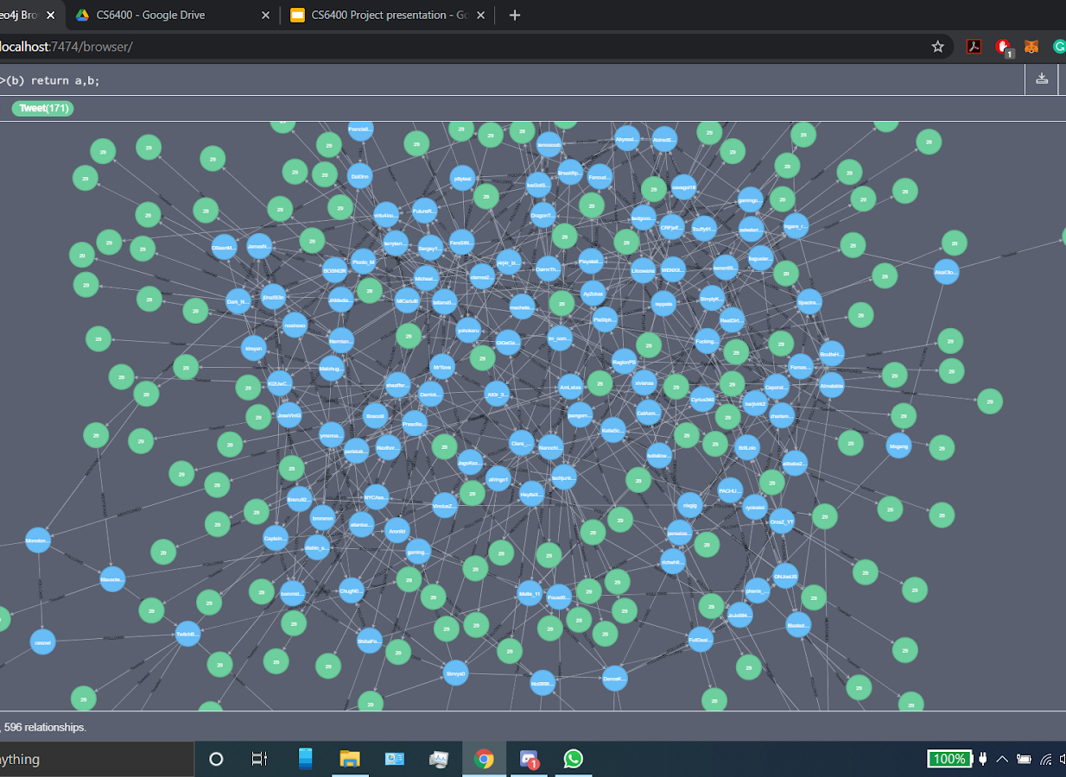
Neo4j Data representation
Each node represents a user or a tweet.
Users who follow each other are connected.
Their Geo-locations are also mentioned.

Slide 7
Queries
Perform a query that receives all links for tweets that have under 30 likes that come from users that have over 250 followers
Perform a query that receives all tweets that have more replies than likes
Perform a query that receives the username of all verified users with more than 10000 followers
Perform a query that returns all tweets made outside of the US with media attached to it.
Perform a query that receives all users within a US state that joined before 2012 with a bio that is not NULL and a profile picture
Perform a query that receives all tweets that contain links with more than 100 likes
Perform a query that receives all tweets made outside of California and Texas with media attached to them
Perform a query that returns each unverified user that is followed by a verified user.
Perform a query that returns each tweet that is geotagged to the user’s profile location
Perform a query that returns each user with a username that contains the letter “a”

Slide 8
Results
The following are the results for both Single and Multi-threaded loads ran on the database systems.
These were run on the same machines, and care was taken that no system receives any specific advantages over the other.
Time (ms)
Time (ms)
Queries (1-10)
Queries (1-10)

Slide 9
Challenges
Multiple disparities were observed while importing data from the Twitter API into both databases using Java as the connecting bridge between the two.
The data received was completely random and didn’t have enough graph-connections. We had to change it manually to demonstrate the purpose of the project.
Neo4j required CSV files to load data which was lossy, and many Database entries required hand-fixing.
The Twitter API enforces restrictions while gathering data, hence only 900 entries could be gathered in 15 minutes. This limited the size of our data.

Slide 10
Conclusions
Looking at the results, we can determine that MySQL was faster than Neo4j consistently for all queries, even with a social media dataset.
However, Neo4j was able to represent the data in a way that was easier to understand.
Neo4j implementations would excel in tasks like data analysis, assuming that a smaller dataset can be extrapolated from the original larger one.

Slide 11
Timeline of tasks
Weeks | Task | Task Owner (tentative) | Progress
1-2 | Set up the development environment, get the data, feed it to the systems. | Abhay, Pranay, Prerna | Done
3-4 | Write all the queries, make a test bench, connect the databases to Java applications. | Abhay, Pranay, Prerna | Done
5-6 | Run the single-threaded and multi-threaded loads on both the databases, obtain the results, and form justification. | Abhay, Pranay, Prerna | Done
7-8 | Prepare for presentations and demos, add new functionalities at the lower level, if time permits. | Abhay, Pranay, Prerna | Done
Here's the timeline that we followed, and we were able to accomplish everything that we wanted in-time.

Slide 12
Thank you

