Slide 1
Introduction to CPP

Slide 2
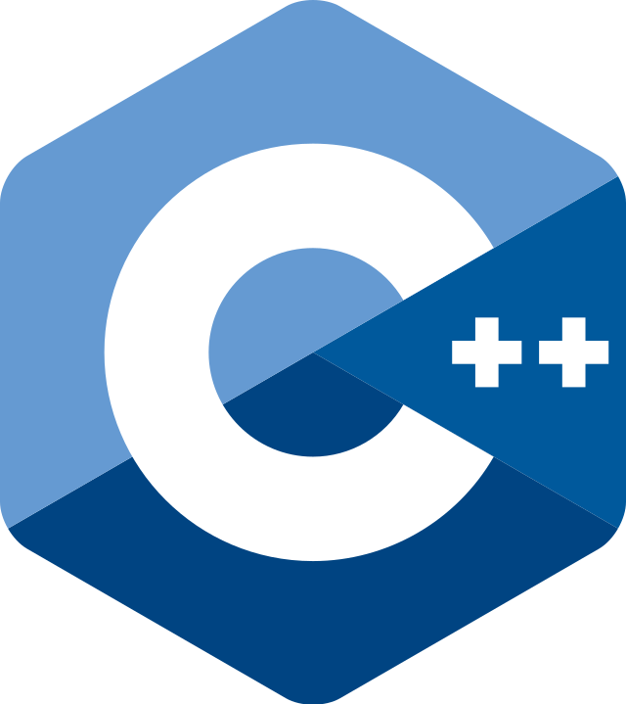

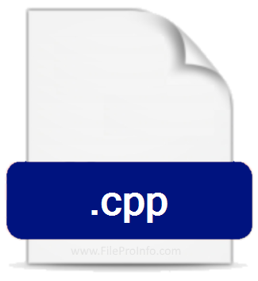
Invention of CPP
C++ was developed by Bjarne Stroustrup at Bell Laboratories over a period starting in 1979. Since C++ is an attempt to add object-oriented features (plus other improvements) to C, earlier it was called as “C with Objects”. As the language developed, Stroustrup named it as C++ in 1983.

Slide 3
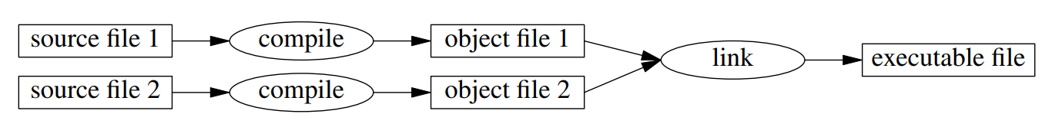
Compiled language
C++ is a compiled language. Source files are converted into object files and Linked together to produce a Executable file.
Executable file is not portable (built for specific target). Source files are portable and can be compiled on different targets.

Slide 4
GCC, the GNU Compiler collection
The GNU Compiler Collection includes front ends for C, C++, Objective-C, Fortran, Ada, Go, and D, as well as libraries for these languages (libstdc++,...). GCC was originally written as the compiler for the GNU operating system.
There are many other compilers for cpp.

Slide 5

ISO C++ standard
C++ is standardized by an ISO working group known as JTC1/SC22/WG21. So far, it has published six revisions of the C++ standard and is currently working on the next revision, C++23. In 1998, the ISO working group standardized C++ for the first time as ISO/IEC 14882:1998, which is informally known as C++98.
The ISO C++ standard defines two kinds of entities:
Core language features, such as built-in types (e.g., char and int) and loops (e.g., for-statements and while-statements)
Standard-library components, such as containers (e.g., vector and map) and I/O operations (e.g., << and getline())

Slide 6
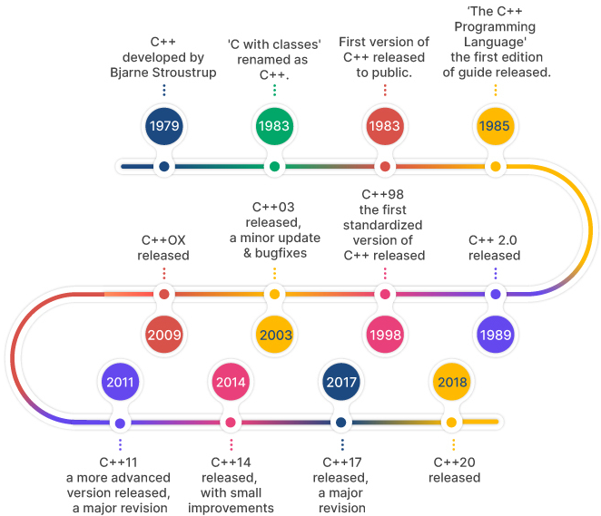
C++ Versions
C++98 (ISO/IEC 14882:1998)
C++03 (ISO/IEC 14882:2003)
C++11
C++14
C++17
C++20

Slide 7
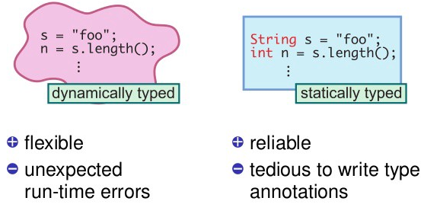
Statically typed language
C++ is a statically typed language.
Type of every entity must be known to the compiler at the point of use.
Type of the object determines the set of operations applicable to it.

Slide 8

OOP (Object Oriented Programming)
C++ is a object oriented programming language.
Objects are the things you think about first in designing a program and they are also the units of code that are eventually derived from the process.
Object-oriented programming is about creating objects that contain both data and functions.

Slide 9
Hello, World!
Refer hello_world.cpp for your first cpp program.
To compile and run:
g++ hello_world.cpp –o hello_world (compile)
./hello_world (run)

