Slide 1
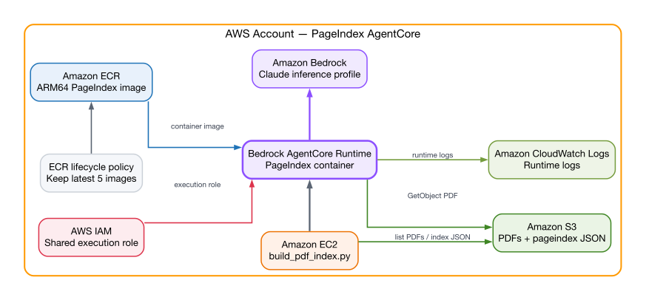
AWS resources power PageIndex through AgentCore
Architecture at a glance
Amazon EC2 discovers PDFs and invokes the runtime.
AgentCore pulls the ARM64 PageIndex image from Amazon ECR.
The runtime reads PDFs from S3 and invokes Claude through Bedrock.
CloudWatch receives runtime logs; IAM controls every connection.
Notes:
[Sources]
- /Users/abhay/Documents/csa-project/pageindex-agentcore/infra/main.tf
- https://developer.lucid.co/docs/overview-si
- https://developer.lucid.co/docs/aws-2024-library
[/Sources]

