Slide 1
Machine Learning Applications in Algorithmic Trading
Ryan Brosnahan
Ross Rothenstine

Slide 2
Goal
Create a learning stock trading algorithm that can produce consistent economic profit without excessive risk or hubris using techniques similar to those outlined by Berkeley Professor John Moody.

Slide 3

Real Goal

Slide 4
Introduction
Computational Mathematics is Hard!
Most Quants are Ph.D.
Requires multidisciplinary background
Expensive
Front-heavy Development Schedule

Slide 5
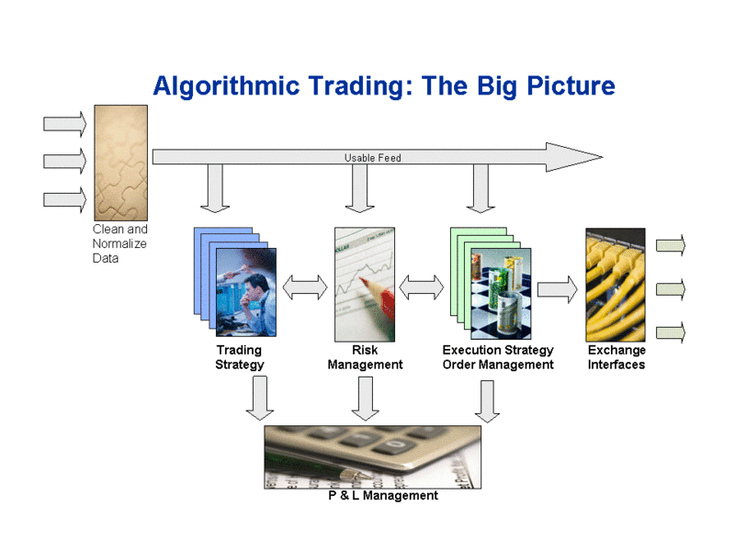
Typical Scenario
Notes:
P & L – profit loss

Slide 6
The Basic Steps
Acquire Data
Sanitize
Trading Strategy
Determine Risk
Determine Entry, Exit
Execute Trade
Interface Exchange
Interface Clearing house

Slide 7

Data
Time Scale
Latency
Sanitation
Multiple Sources
Data types
Economic
Sentiment
Price

Slide 8
Price Data Sources
Source | Cost | Frequency | Quality | Latency
Yahoo Finance | Time | >1s | Unreliable | >5s
IQ Feed | ~$100/month Basic | Tic | Reliable | <500ms
Bloomberg Data Feed | ~$1,800/month Basic | Tic | Very Reliable | <10ms
Google Finance | No longer available as of 22 October 2012

Slide 9
Other Data Sources
Compustat
Bureau of Economic Analysis
Bureau of Labor Statistics
World Bank
Twitter API

Slide 10
Time Scale
Short
Typically intraday to a few days at most
Based more on “dumb” forecasting techniques
Long
Typically daily or longer periods
Based on smarter forecasting techniques
Reversion to trend mean
Reversion to Fair Value
Some simpler techniques as well

Slide 11
Long Term: Piotroski - Timed Hedge
Rebalances every 4 weeks
Omits low EPS, low Operating Income, low cash flow, low liquidity
Positive d/dx on Return on Assets, Liquidity Ratio, Asset Turnover, Gross Margin
Negative or 0 d/dx on Outstanding Shares, Debt/Assets
Notes:
Joseph D. Piotroski is an American professor who specializes in accounting and financial reporting issues. As of October 2010 he serves as associate professor of accounting at the Stanford University Graduate School of Business. Prior to that, he taught at the University of Chicago Graduate School of Business from July 1999 to June 2007

Slide 12
Piotroski continued
Screen | SPDR S&P 500 ETF Trust
Return
Annualized | 27.99% | 6.22%
One Month | 3.55% | 5.58%
Three Month | 4.13% | 0.05%
One Year | 4.31% | 19.13%
Three Year | 60.59% | 37.21%
Five Year | 97.74% | 8.53%
Total | 1086.85% | 83.05%
Risk
Sharpe Ratio | 1.07 | 0.11
Sortino Ratio | 1.52 | 0.14
Max Drawdown | -23.64% | -55.42%
Standard Deviation | 22.69% | 23.87%
Correlation | 0.62 | -
R-Squared | 0.38 | -
Beta | 0.59 | -
Alpha (annualized) | 22.03% | -

Slide 13
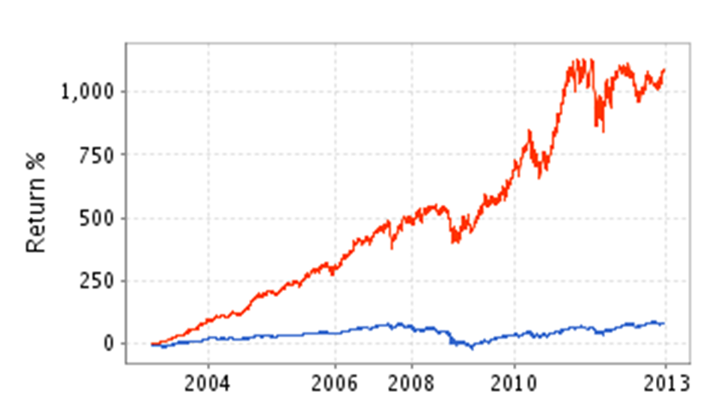
Piotroski continued

Slide 14
Considerations
Direct vs. Model Based Learning
SARSA, Q-Learning, RRL
Forecast Period
Estimating Differentials
Backward Euler Method, Finite Differences, Monte Carlo
Evaluating Performance
Sharpe Ratio vs. Sterling Ratio vs. Double Deviation Ratio
Notes:
Q-Learning is an Off-Policy algorithm for Temporal Difference learning. It can be proven that given sufficient training under any -soft policy, the algorithm converges with probability 1 to a close approximation of the action-value function for an arbitrary target policy. Q-Learning learns the optimal policy even when actions are selected according to a more exploratory or even random policy.
The Sarsa algorithm is an On-Policy algorithm for TD-Learning. The major difference between it and Q-Learning, is that the maximum reward for the next state is not necessarily used for updating the Q-values. Instead, a new action, and therefore reward, is selected using the same policy that determined the original action. The name Sarsa actually comes from the fact that the updates are done using the quintuple Q(s, a, r, s', a'). Where: s, a are the original state and action, r is the reward observed in the following state and s', a' are the new state-action pair.
Relational reinforcement learning, a learning technique that combines reinforcement learning with relational learning or inductive logic programming.
Moody found RRL had better average profits than Q-learning methods, but at the cost of much higher risk
The Sharpe ratio (also known as the Sharpe index, the Sharpe measure, and the reward-to-variability ratio) measures the excess return (or risk premium) per unit of deviation in an investment asset or a trading strategy, typically referred to as risk (and is a deviation risk measure), named after William Forsyth Sharpe.

Slide 15
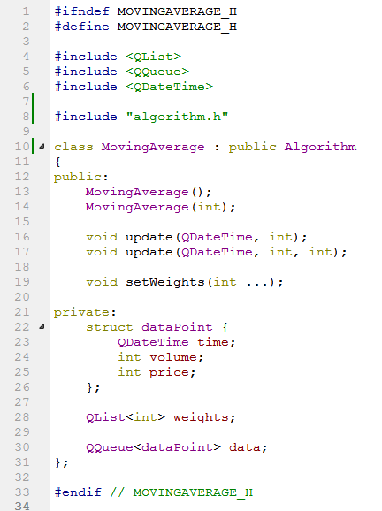
Models
Implemented
Simple Moving Average
Seasonal Index
Planned
ARCH
Regression
Holt-Winters
Notes:
Holt-Winters double exponential smoothing forecasting

Slide 16

Algorithm Management
Simple Moving Average
ARCH
Linear Prediction
Twitter Sentiment
Seasonal Index
Auto Regress.
SVD/PCA
Notes:
Models simplify the data, though at the cost of being super intense programmatically and in execution time
The brain uses traits of direct reinforced learning on models from the lower order. This hopefully reduces dimentionality
two kinds of reinforcement learning algorithms, direct (model-free) and indirect (model-based),

Slide 17
The Brain
Greedy Policy
Use Gradient ascent to maximize Sharpe Ratio on each level
Optimize at the algorithm level
i.e. number of moving average terms
Optimize at the portfolio level
i.e. which algo(s) to act on
Periodic Search of other maxima

Slide 18
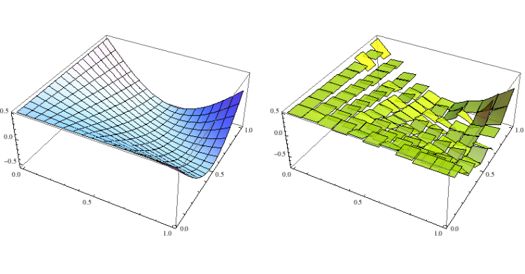
Maximizing Sharpe Ratio
Notes:
The strategy is very easy to describe: 1. Divide the domain of your function in k sub intervals. 2. Initialize k monomials; 3. Consider the monomials as centroids of your clustering algorithm. 4. Assign the points of the function to each monomial in compliance to the cluster algo. 5. Use the gradient descent to adjust the parameters of each monomial. 6. Go to 4. until the accuracy is good enough.

Slide 19
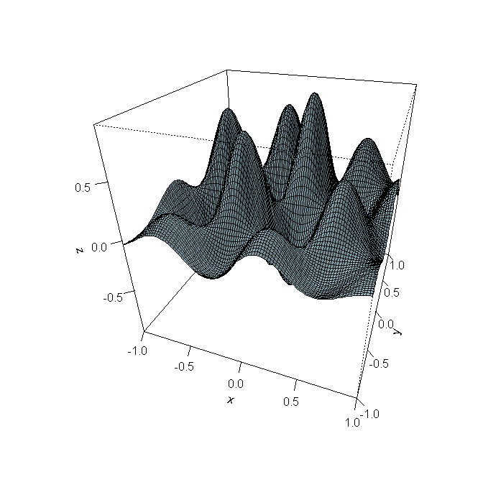
Problem with Greed
Notes:
Threshold Recurrent Reinforcement Learning Model outlined by
Dietmar Maringer and Tikesh Ramtohul
Universit¨at Basel, CH-4002 Basel, Switzerland

Slide 20
Future Work
Complete More Algorithms
Get Reliable Data
Learn more Math and Statistics

