Slide 1
Machine Learning Applications in Algorithmic Trading
Ryan Brosnahan
Ross Rothenstine

Slide 2
Goal
Create a learning stock trading algorithm that can produce consistent economic profit without excessive risk or hubris using techniques similar to those outlined by Berkeley Professor John Moody.

Slide 3

Real Goal

Slide 4
Introduction
Computational Mathematics is Hard!
Most Quants are Ph.D.
Requires multidisciplinary background
Expensive
Front-heavy Development Schedule

Slide 5
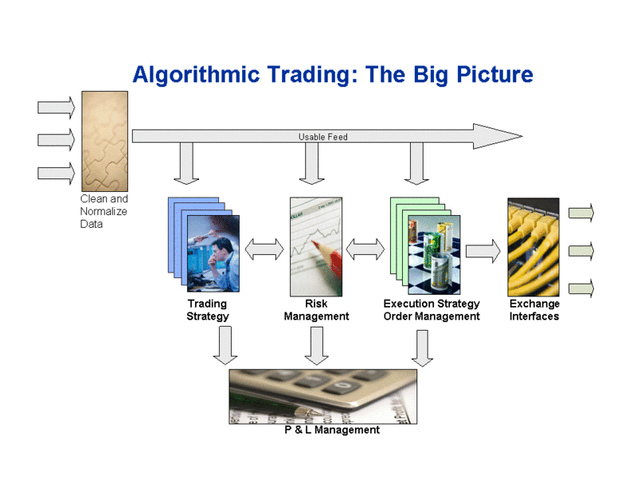
Typical Scenario
Notes:
P & L – profit loss

Slide 6
The Basic Steps
Acquire Data
Sanitize
Trading Strategy
Determine Risk
Determine Entry, Exit
Execute Trade
Interface Exchange
Interface Clearing house

Slide 7
Data
Time Scale
Latency
Sanitation
Multiple Sources
Data types
Economic
Sentiment
Price

Slide 8
Price Data Sources
Source | Cost | Frequency | Quality | Latency
Yahoo Finance | Time | >1s | Unreliable | >5s
IQ Feed | ~$100/month Basic | Tic | Reliable | <500ms
Bloomberg Data Feed | ~$1,800/month Basic | Tic | Very Reliable | <10ms
Google Finance | No longer available as of 22 October 2012

Slide 9
Other Data Sources
Compustat
Bureau of Economic Analysis
Bureau of Labor Statistics
World Bank
Twitter API

Slide 10
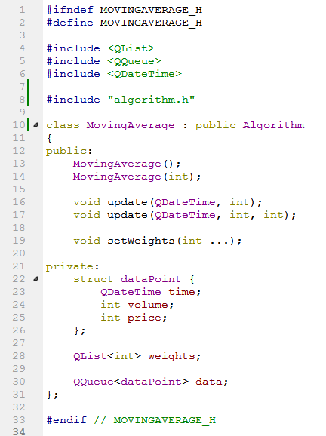
Algorithms
Implemented
Simple Moving Average
Seasonal Index
Planned
ARCH
Regression
Holt-Winters
Notes:
Holt-Winters double exponential smoothing forecasting

Slide 11
Considerations
Direct vs. Model Based Learning
SARSA, Q-Learning, RRL
Forecast Period
Estimating Differentials
Backward Euler Method, Finite Differences, Monte Carlo
Evaluating Performance
Sharpe Ratio vs. Sterling Ratio vs. Double Deviation Ratio
Notes:
We use model based
Q-Learning is an Off-Policy algorithm for Temporal Difference learning. It can be proven that given sufficient training under any -soft policy, the algorithm converges with probability 1 to a close approximation of the action-value function for an arbitrary target policy. Q-Learning learns the optimal policy even when actions are selected according to a more exploratory or even random policy.
The Sarsa algorithm is an On-Policy algorithm for TD-Learning. The major difference between it and Q-Learning, is that the maximum reward for the next state is not necessarily used for updating the Q-values. Instead, a new action, and therefore reward, is selected using the same policy that determined the original action. The name Sarsa actually comes from the fact that the updates are done using the quintuple Q(s, a, r, s', a'). Where: s, a are the original state and action, r is the reward observed in the following state and s', a' are the new state-action pair.
Relational reinforcement learning, a learning technique that combines reinforcement learning with relational learning or inductive logic programming.
Moody found RRL had better average profits than Q-learning methods, but at the cost of much higher risk

Slide 12

Algorithm Management
Simple Moving Average
ARCH
Linear Prediction
Twitter Sentiment
Seasonal Index
Auto Regress.
SVD/PCA

Slide 13
The Brain
Greedy Policy
Use Gradient ascent to maximize Sharpe Ratio on each level
Optimize at the algorithm level
i.e. number of moving average terms
Optimize at the portfolio level
i.e. which algo(s) to act on

Slide 14
Future Work
Complete More Algorithms
Get Reliable Data
Learn even more Math and Statistics

