Slide 1

Git
Git Introduction
ThePhoto by PhotoAuthor is licensed under CCYYSA.

Slide 2
What is git?
Git is a free and open-source distributed version control system designed to handle everything from small to substantial projects with speed and efficiency.

Slide 3
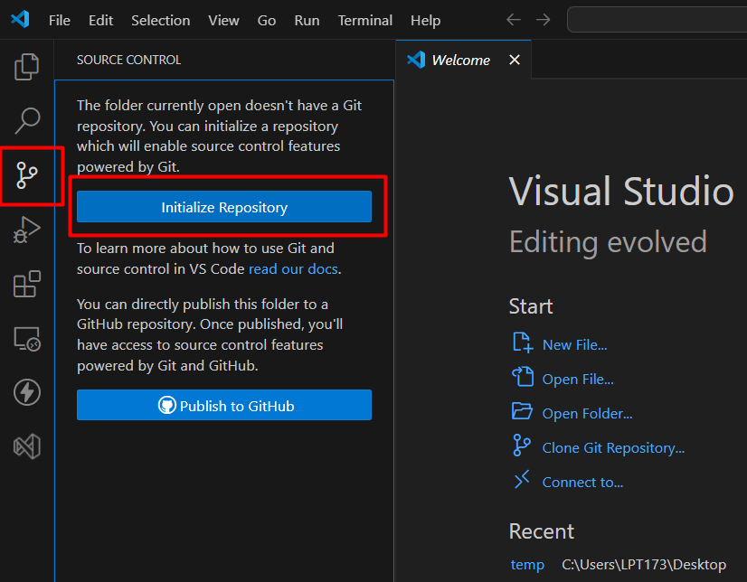
Create New Repository
Open any Project or folder in VS Code
Go-to Source Control
Click on Initialize Repository
Add commit message and Click Publish

Slide 4
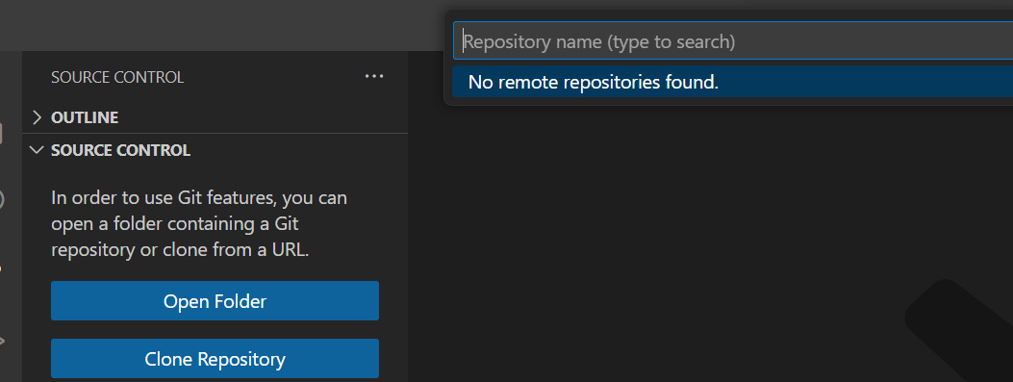
Cloning a repository
Open Visual Studio Code.
Click on source control.
Click on clone repository.
After that click on clone from github.
After that you need to add a repository name and click ok.

Slide 5
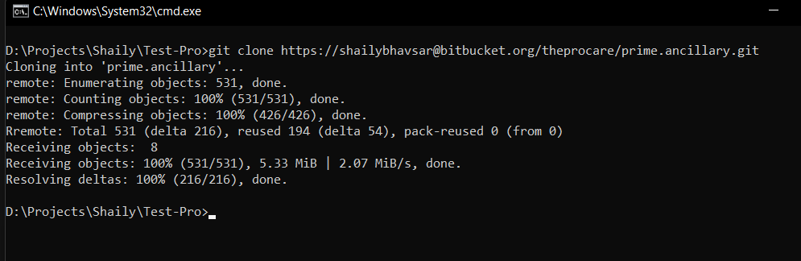
Cloning a repository by CLI
The git clone command copies an existing Git repository. This copy is working git repository
Command: git clone https://github.com/YOUR-USERNAME/YOUR-REPOSITORY

Slide 6
Rename remote repository
On GitHub, navigate to the main page of the repository.
Under your repository name, click Settings. If you cannot see the "Settings" tab, select the dropdown menu, then click Settings.
In the Repository Name field, type the new name of your repository.
Click Rename.

Slide 7
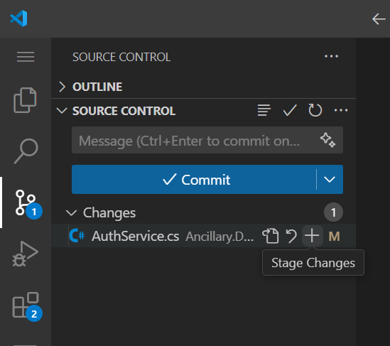
Stage a file
By selecting the '+' icon in the modifications area of the source control, you can stage a file.
Command: git add .
Go to Source Control, go to the changes and click on '+' icon.

Slide 8
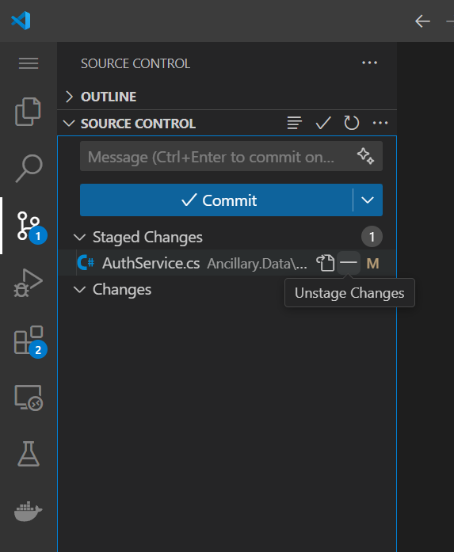
Unstage a file
By selecting the '-' icon in the staged changes area of the source control, you can unstage a file.

Slide 9
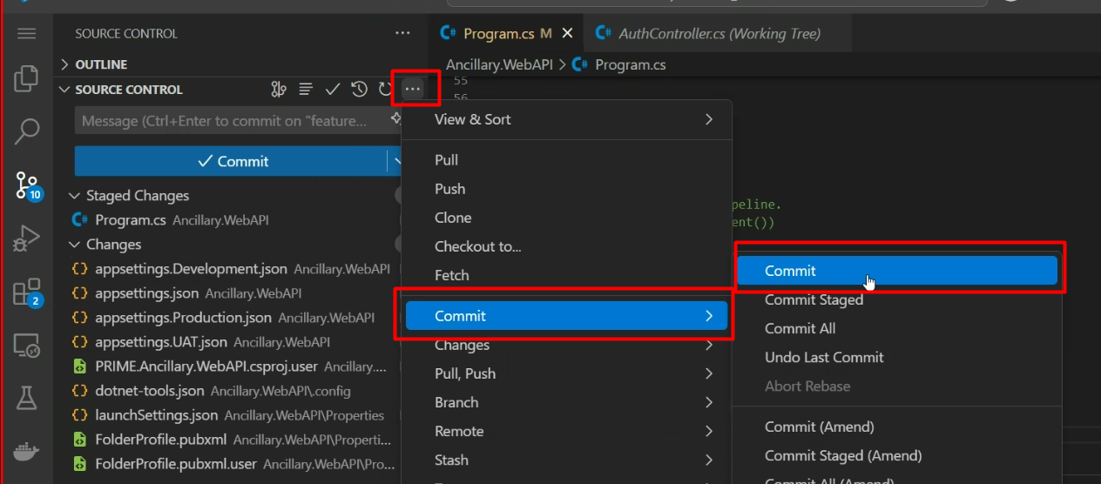
Commit code in the git
Since we have finished our work, we are ready move from stage to commit for our repo.
Adding commits keep track of our progress and changes as we work. Git considers each commit change point or "save point". It is a point in the project you can go back to if you find a bug, or want to make a change.
When we commit, we should always include a message.

Slide 10
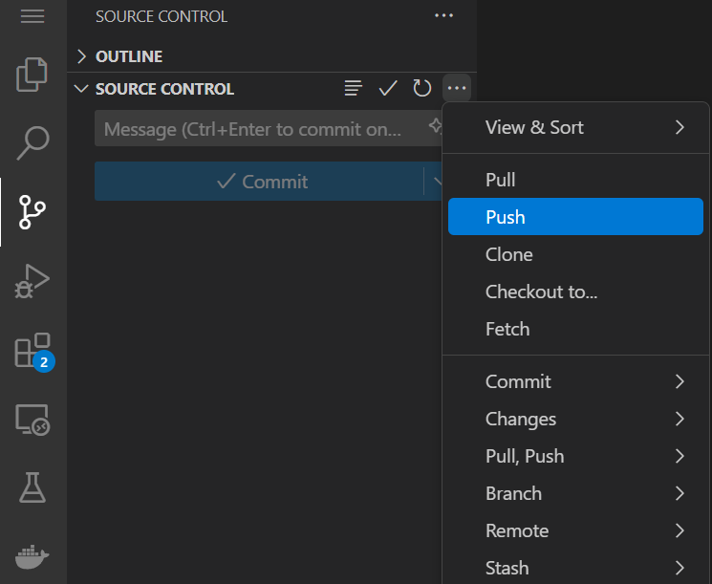
Push changes to remote repository
The git command allows you to send data to other repositories. By default it sends data from your current branch to the same branch of the repository.
Command: Git push.
Go to Source Control, click the three dots, and then click Push.

Slide 11
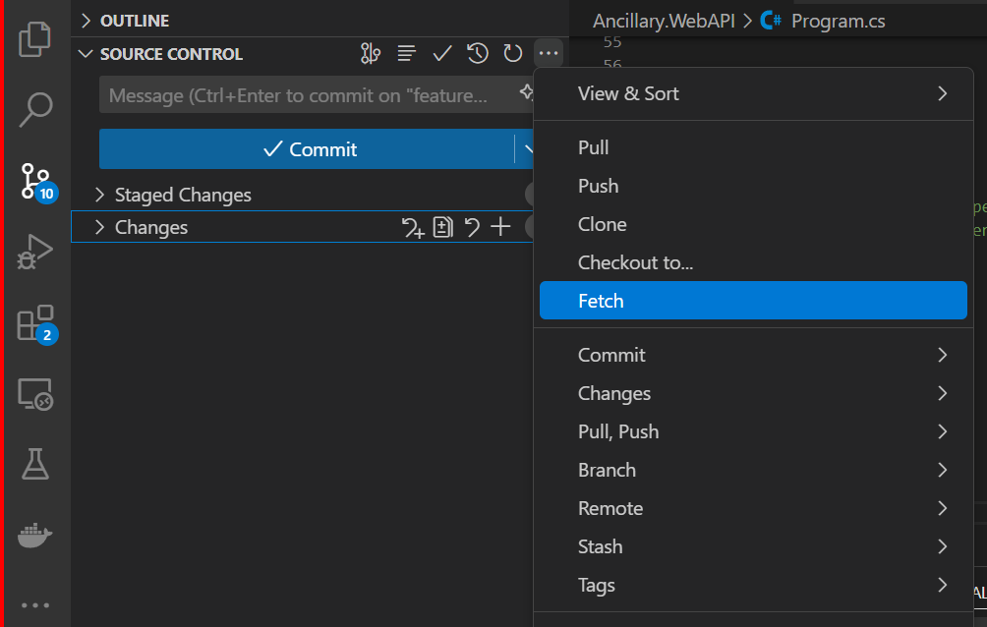
Fetch changes to remote repository
Git fetch is a command that retrieves updates from a remote repository but does not merge them with your local branch. It’s like downloading the latest changes without applying them directly to your working directory.
Command: Git fetch.
Go to Source Control, click the three dots, and then click Fetch.

Slide 12
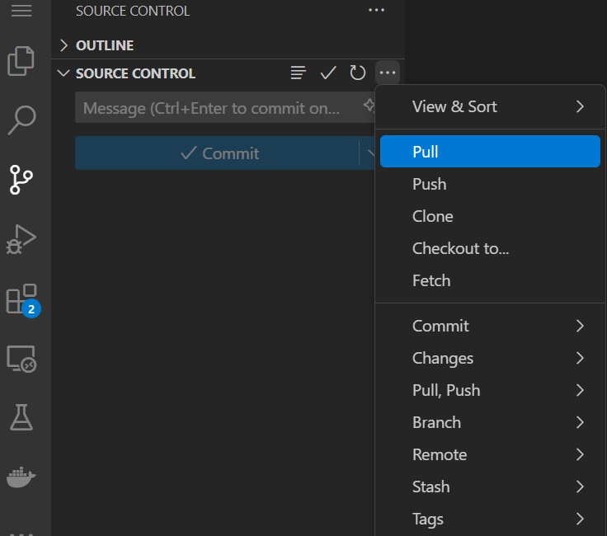
Pull changes to remote repository
The git pull command is used to fetch and download content from a remote repository and immediately update the local repository to match that content.
Command: Git pull.
Go to Source Control, click the three dots, and then click Pull.

Slide 13
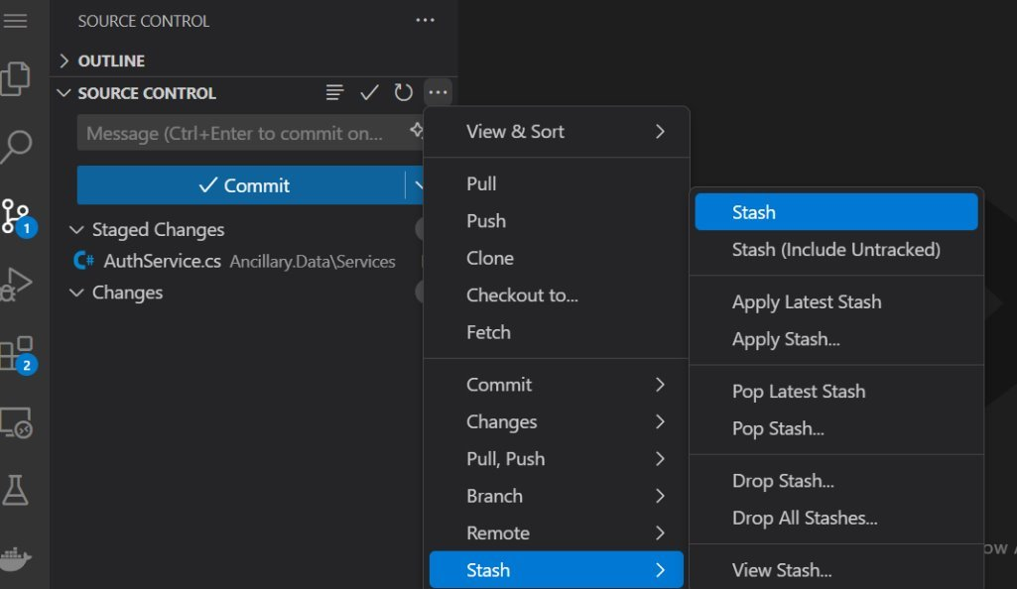
How to take a stash
The Git stash command can be used to accomplish this if a developer is working on a project and wants to preserve the changes without committing them.
Command: git stash
Navigate to Source Control, select the three dots, then select Stash. The name of the stash must then be provided in order to create a new stash.

Slide 14
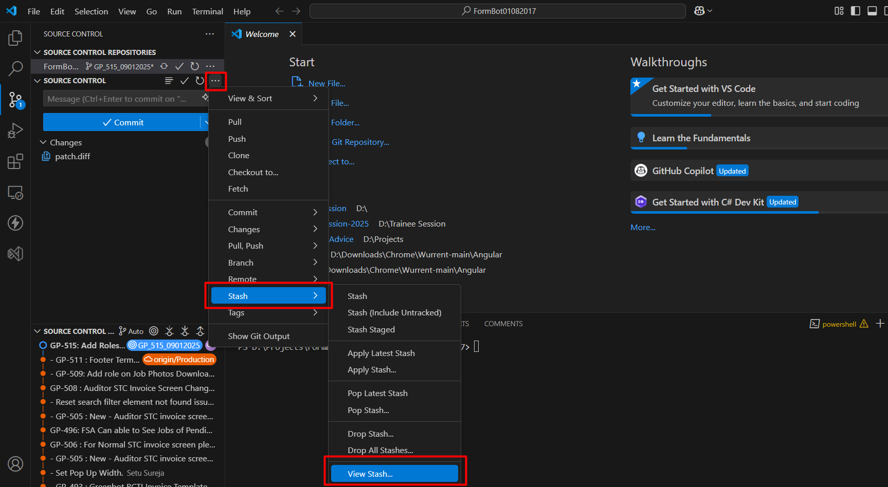
List all the stashes
You can list all stash by clicking on Stash > View Stash.
Navigate to Source Control, select the three dots, then select Stash. After that click on View Stash.

Slide 15
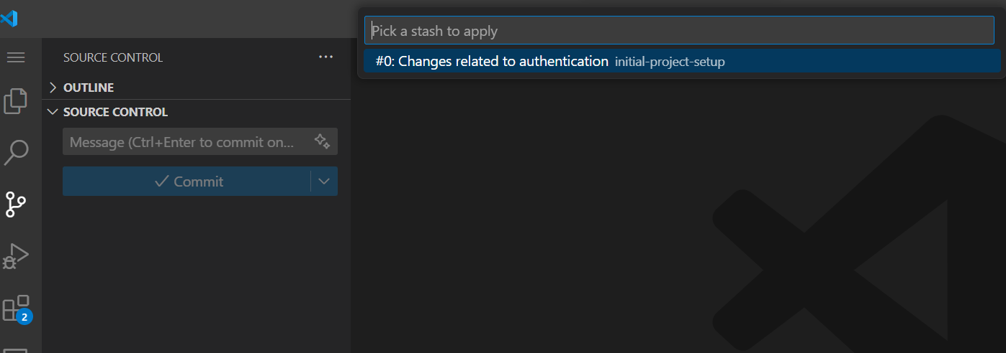
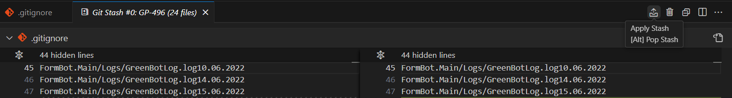
Apply a specific stash
You can apply specific stash by clicking on Apply Stash.
After that click on the stash name, that you want to apply to your branch

Slide 16
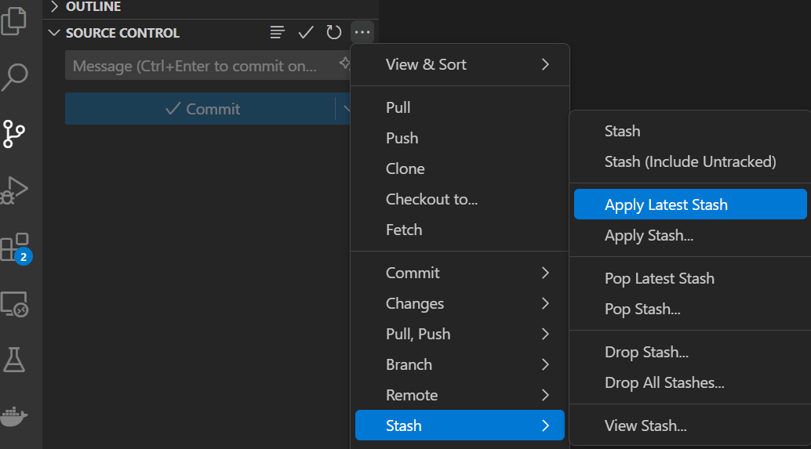
How to apply Latest stash
You can apply latest stash by clicking on Apply Latest Stash.
Navigate to Source Control, select the three dots, then select Stash. After that click on Apply Latest Stash. It will apply latest stash on the current branch.

Slide 17
List all the stashes by CLI
Below command is used to display a list of all stash entries.
Command: git stash list –all
If your git stash history is long, you can choose to view an arbitrary number of the most recent entries by providing a number option.
git stash list -3

Slide 18
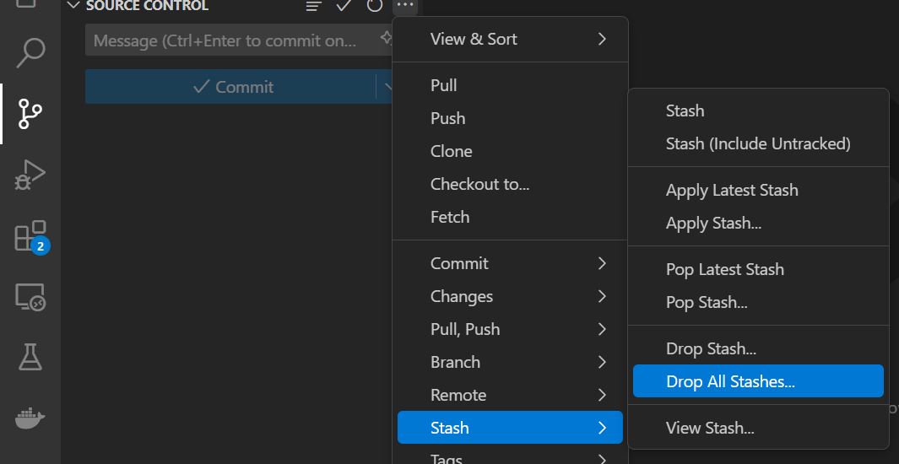
Drop/Clear a stash
Proceed to source control. To drop all the stashes, select Drop all stashes after navigating to the stash option.

Slide 19
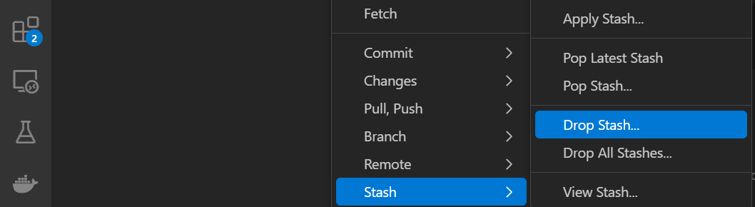
Drop/Clear a stash by CLI
To drop the most recent stash
git stash drop
To clear all the stashes
git stash clear

Slide 20
What is branch??
Git allows you to create branches. Branches are named pointers to commit. You can work on different branches independently from each other. The default branch is most often called master.

Slide 21
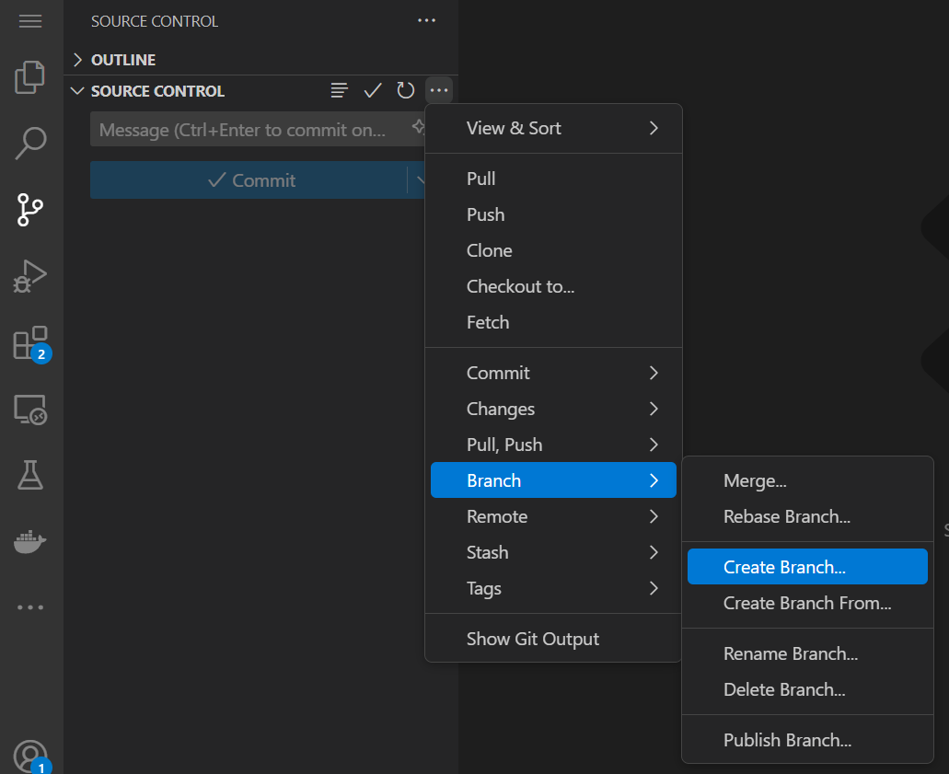
How to create a new branch
Go to Source Control, pick the three dots, and then choose Branch. Next, select the "Create branch" option to start a new branch. Next, you must provide the name of the branch."

Slide 22
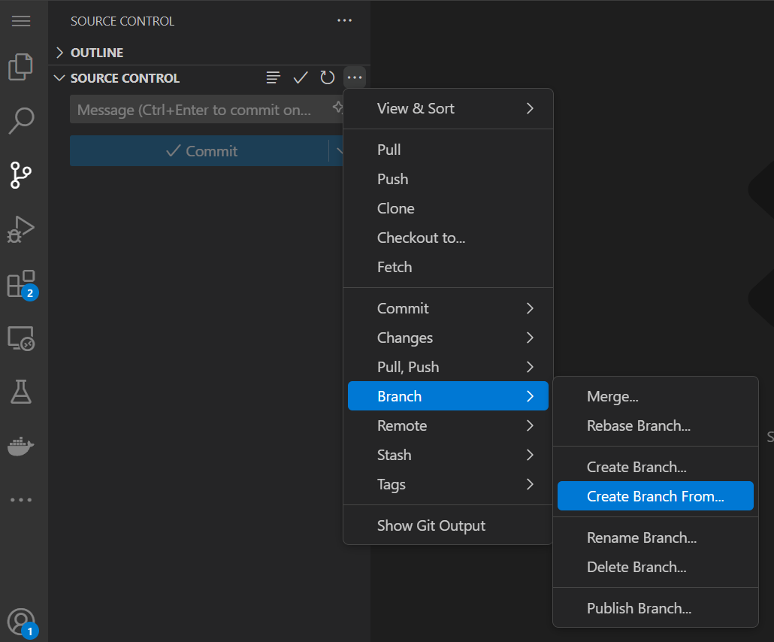
Create a new branch from specific branch
Select Branch after selecting the three dots in Source Control. Choose the "Create branch from" option after that. The branch list from which you wish to create a new branch will be opened. To establish a new branch, please choose the branch you wish to work from. Please give the branch a specific name once it has been chosen.

Slide 23
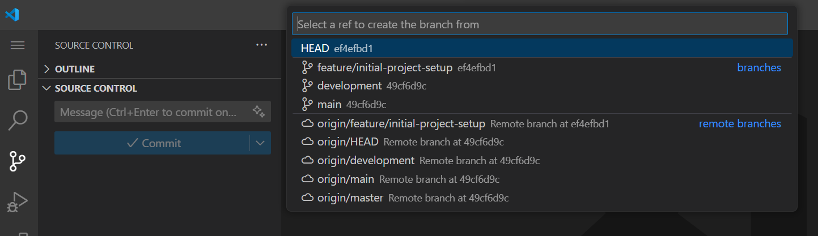
Select branch to create from
To create a new branch from the list of branches, refer to the screen grab above.

Slide 24
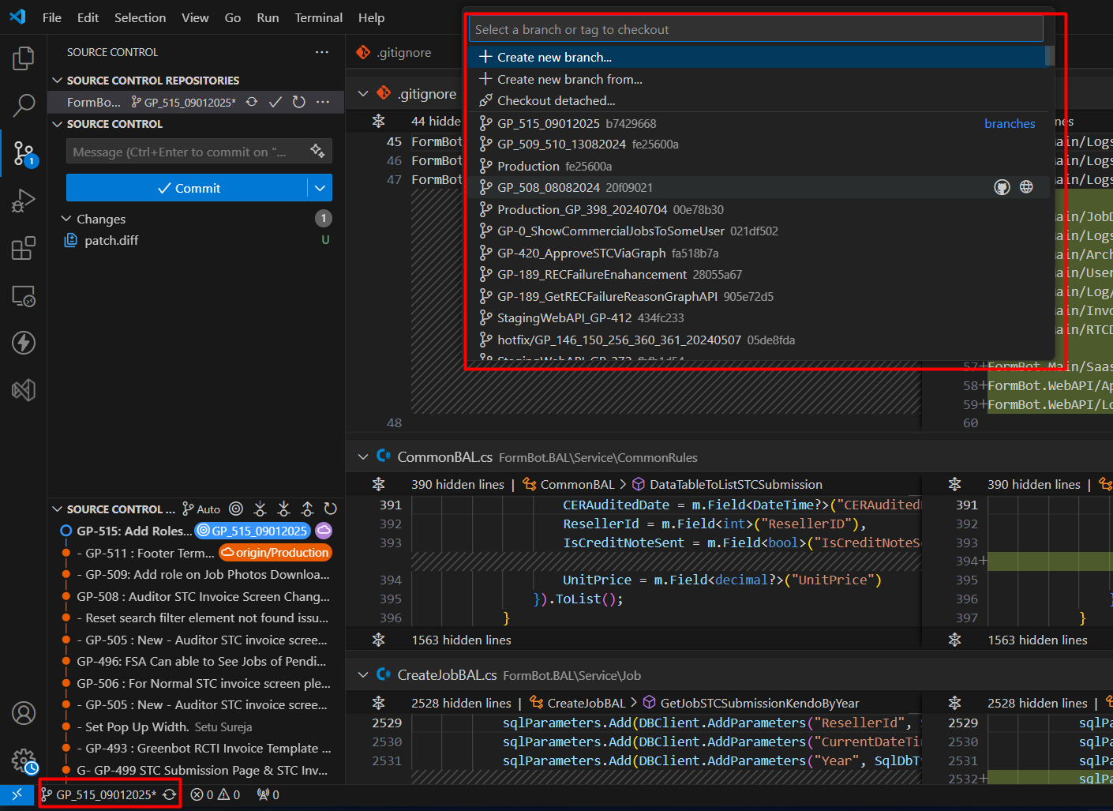
Switch between branches

Slide 25
Switch between branches by CLI
git fetch origin : This will fetch the branch
git checkout branch_name: Switching the branch

Slide 26
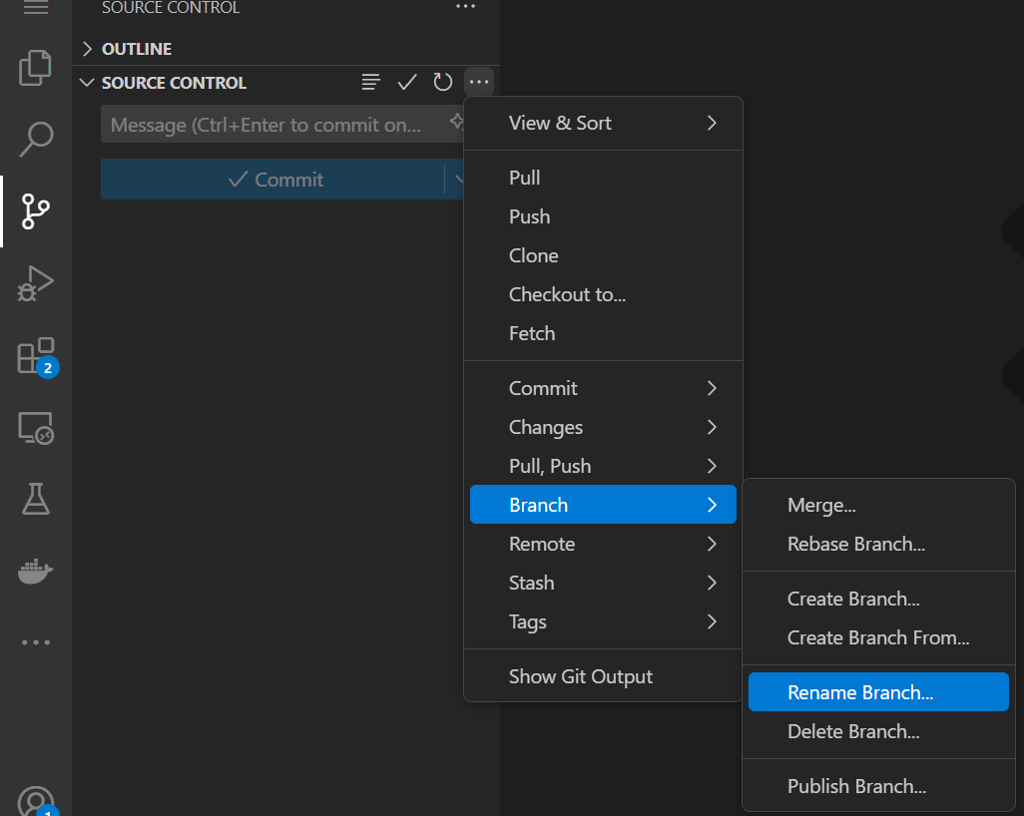
Rename a branch
Navigate to the source control. Click "Rename branch" after selecting "Branch." A text box will open as a result. As a result, we must change the branch name to the new one.

Slide 27
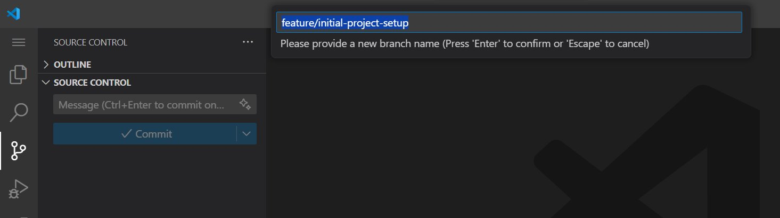

Slide 28
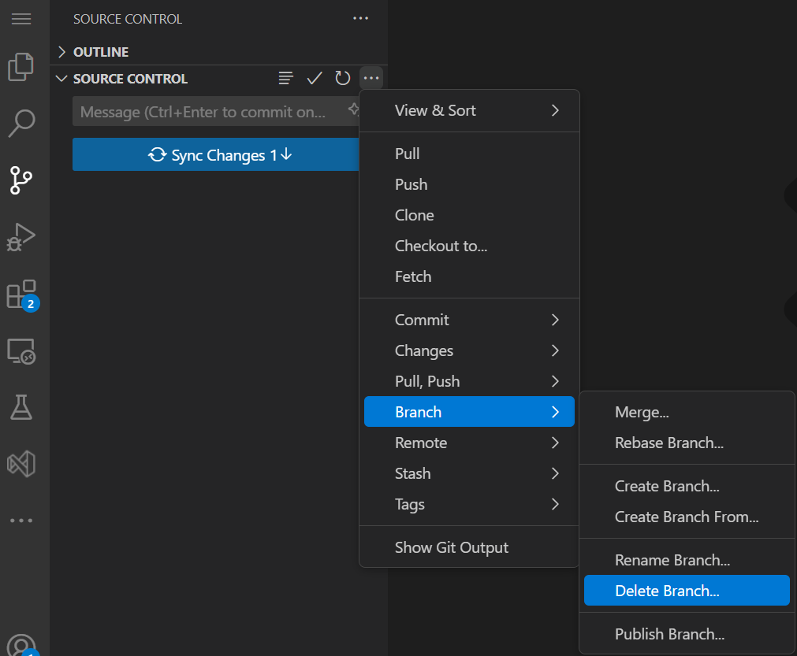
Delete a branch
Navigate to the source control. Click "Delete branch" after selecting "Delete Branch." Please select the branch from the list of all the branches that you want to delete

Slide 29
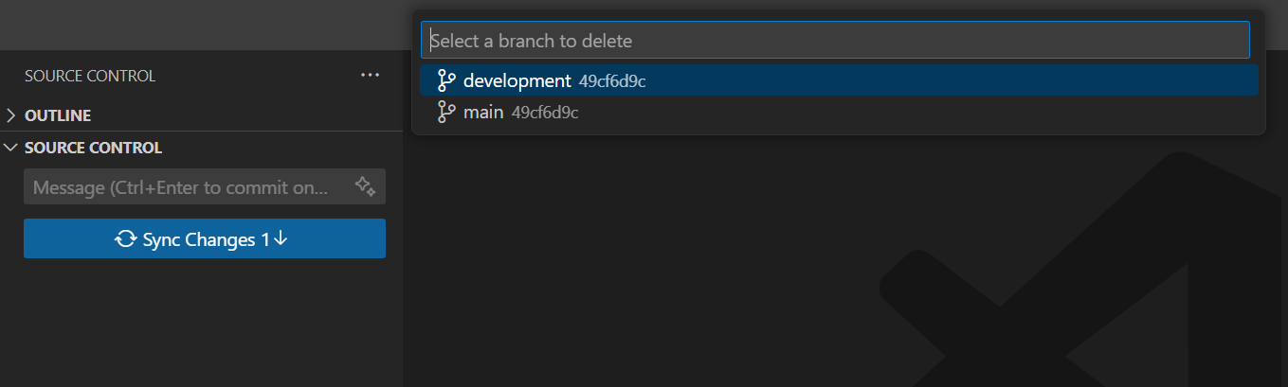

Slide 30
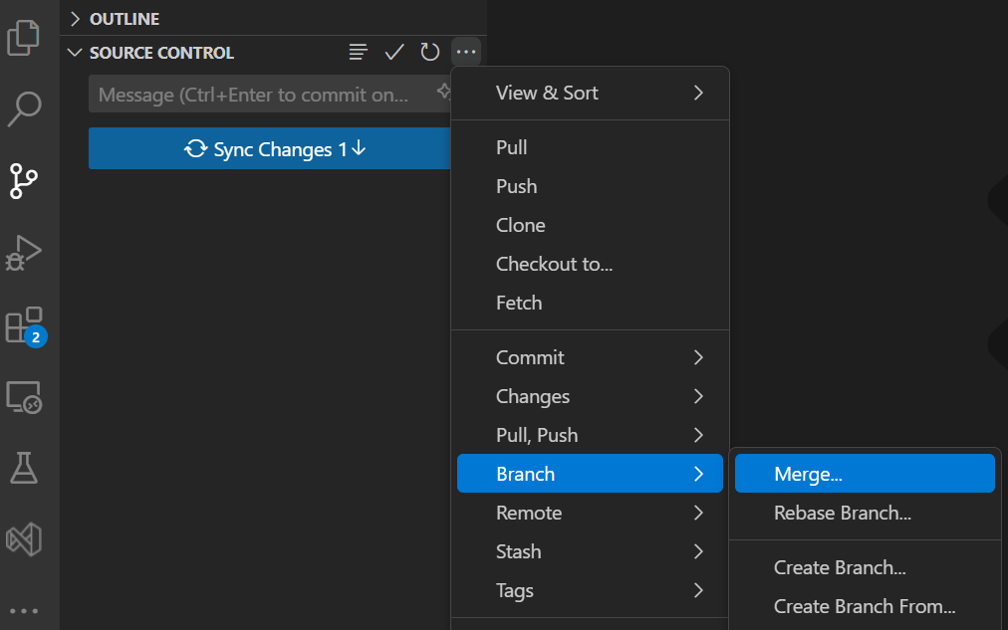
Merge branches
The git merge command performs a merge. You can merge changes from one branch to the current active one via the following command.

Slide 31
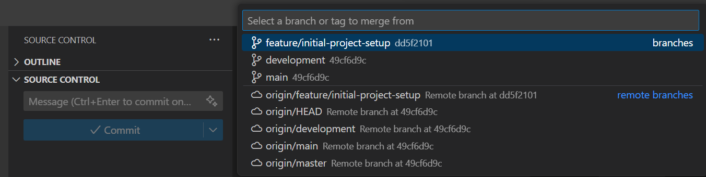

Slide 32
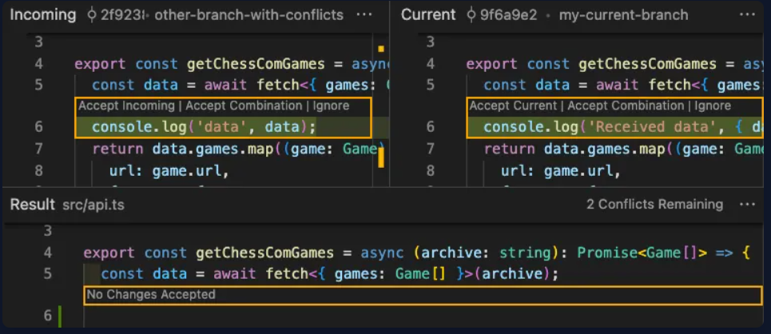
Resolve merge conflicts
A conflict during a merge operation occurs if commits from different branches have been modified the same content and git can not automatically determine how both changes should be combined when merging these branches.

Slide 33
Thank you..

