Slide 1
Design and Analysis of Algorithms
Algorithms-II : CS345A
Website: hello.iitk.ac.in
Lecture 10
Algorithms
for Directed Acyclic Graphs

Slide 2
Homework from last class
Optimal subpath property

Slide 3








Optimal subpath property
Can you realize an assumption in your proof ?
Consider any shortest path $P(s,v)$.
$δ(s,v)$= 51
Lemma 1: Every subpath of a shortest path is also a shortest path.
< 27
12
3
7
5
15
9
$$s$$
$$a$$
$$g$$
$$y$$
$$u$$
$$x$$
$v$
?
Proof:
Replacing $P\left(g,x\right)$ with the blue path will give a shorter $P\left(s,v\right)$. A contradiction!
Justify it.
Assumption:
The blue path intersects neither $P(s,g)$ nor $P(x,v)$.

Slide 4
Directed Acyclic Graphs

Slide 5






Directed Acyclic Graphs
Question: what is a cycle in $G$?
Answer: A sequence $v_{1}$, $v_{2}$,…, $v_{k}$ such that ($v_{i}$,$v_{i+1}$) $∈E$ for all $1≤i<k$
and ($v_{k}$,$v_{1}$) $∈E$ .
…
$$v_{1}$$
$$v_{2}$$
$$v_{3}$$
$$v_{k−1}$$
$$v_{k}$$

Slide 6
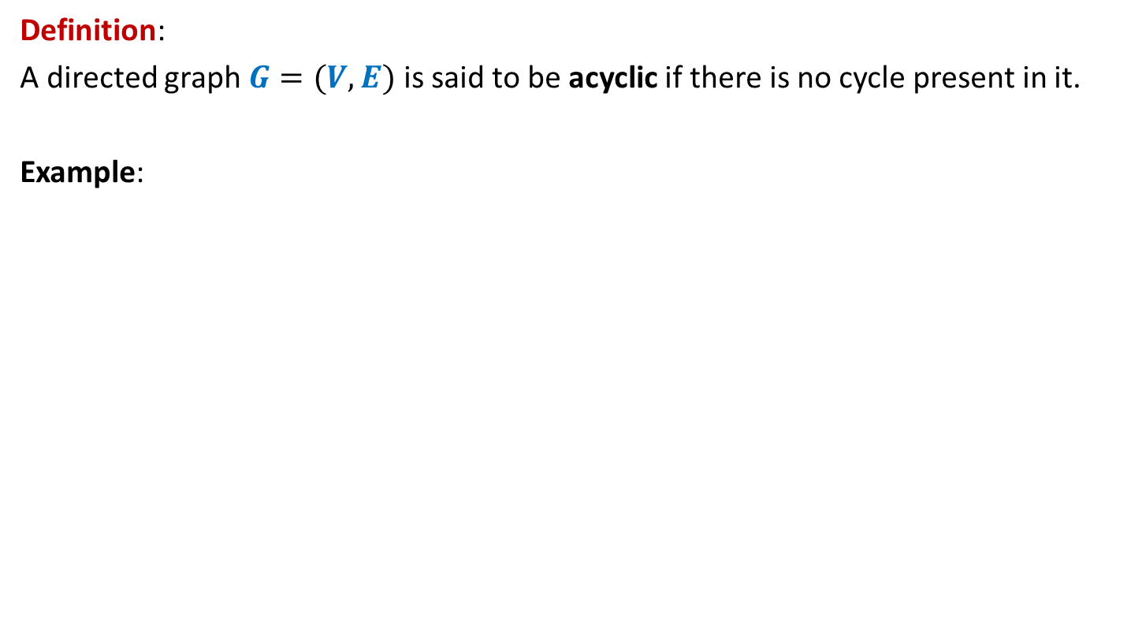
Directed Acyclic Graphs
Definition:
A directed graph $G=(V,E)$ is said to be acyclic if there is no cycle present in it.
Example:
u
DAG
z
b
v
y
x
w
a

Slide 7

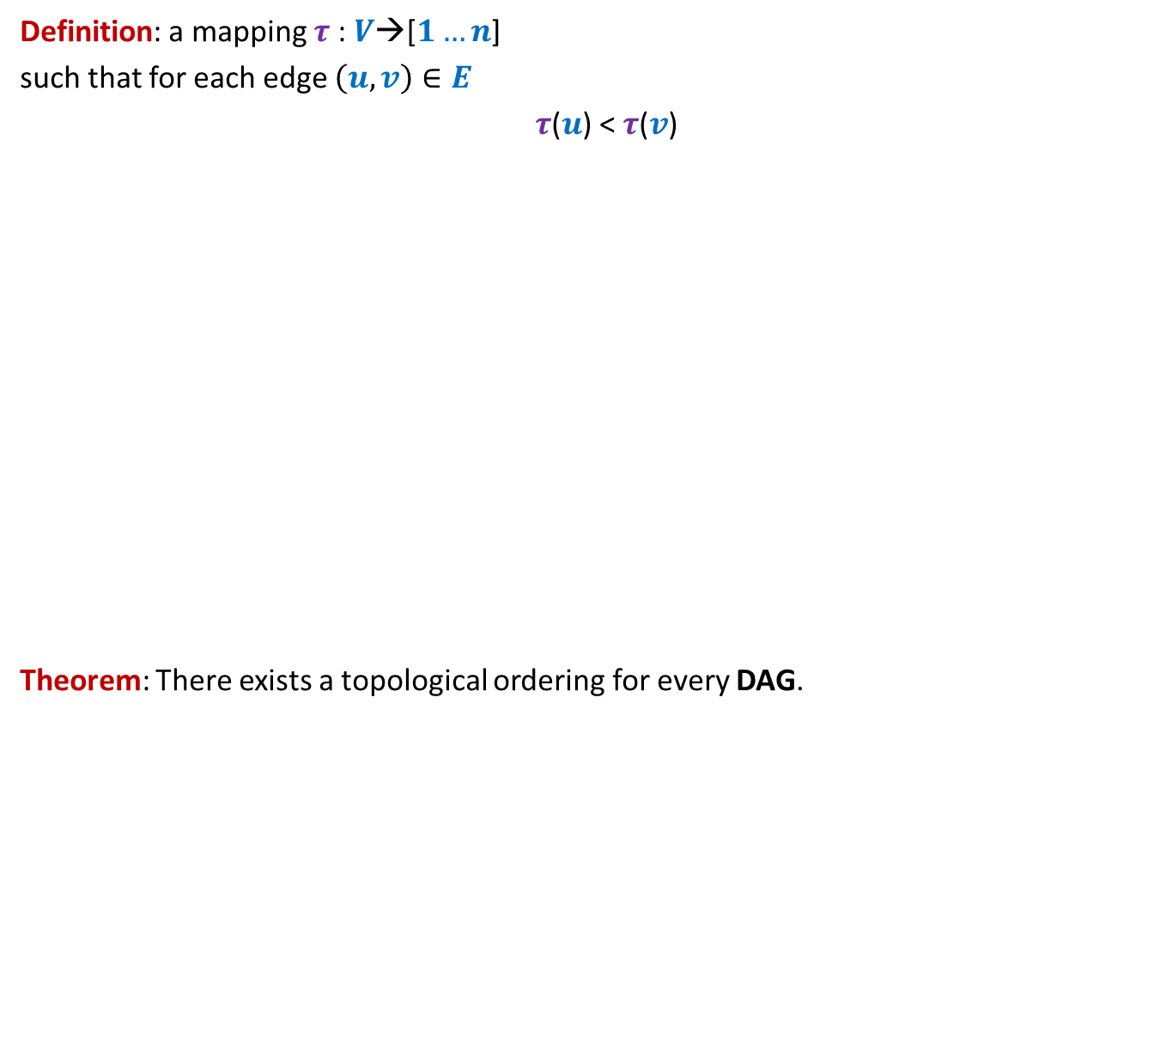
Topological ordering
Definition: a mapping $τ$ : $V$→[$1…n$]
such that for each edge $\left(u,v\right)∈E$
$τ$($u$) < $τ$($v$)
Theorem: There exists a topological ordering for every DAG.
1 2 3 4 5 6 7 8 9 10 11
Does there exist a topological ordering for every directed graph ?
>
<
<
<
<
<
<
Certainly No if there is any cycle

Slide 8

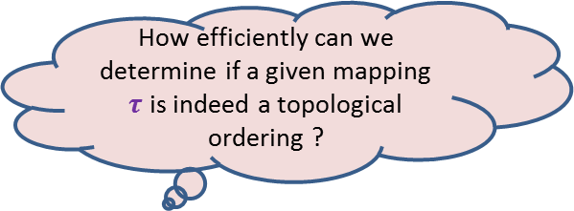
Topological ordering
Example:
This is indeed a valid topological ordering.
u
z
b
v
y
x
w
a
u
v
a
b
x
z
w
y
1 2 3 4 5 6 7 8
How efficiently can we determine if a given mapping $τ$ is indeed a topological ordering ?
O($m+n$) time

Slide 9
Topological ordering
Three questions
Question 1: Why does a topological ordering exist for every DAG ?
Question 2: How efficiently can we compute a topological ordering ?
Question 3: What is the use of topological ordering ?

Slide 10
applications of Topological ordering
Question 3

Slide 11
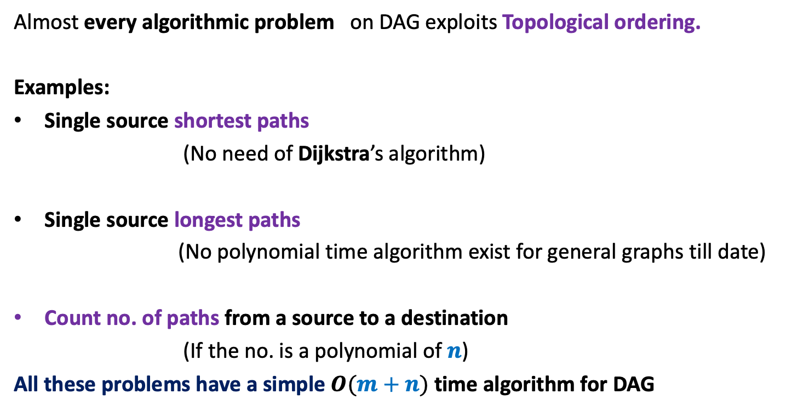
Applications of Topological ordering
Almost every algorithmic problem on DAG exploits Topological ordering.
Examples:
Single source shortest paths
(No need of Dijkstra’s algorithm)
Single source longest paths
(No polynomial time algorithm exist for general graphs till date)
Count no. of paths from a source to a destination
(If the no. is a polynomial of $n$)
All these problems have a simple $O(m+n)$ time algorithm for DAG

Slide 12
Why Does Topological ordering exist for every DAG?
Question 1

Slide 13
Why does Topological ordering exist ?
Example:
u
z
b
v
y
x
w
a
What is the guarantee that such a vertex always exists in a DAG ?
Any vertex of indegree=0 can be given number 1 in a topological ordering.
Is there any vertex for which you can be sure of its place in the ordering?

Slide 14

Why does Topological ordering exist ?
Lemma 1: Every DAG has at least one vertex with in-degree = 0.
Proof:
(an algorithmic proof)
Pick any vertex $v$.
While in-degree$(v)$ $≠$ 0 do
{ Let $(u,v)$ be an edge
$v$← $u$;
}
return $v$;
Observation: This algorithm, if terminates. will output a vertex of indegree =0.
But what is the guarantee that it will terminate.?
The algorithm does indeed terminate.
In fact, no vertex will be processed twice in while loop.
…
c
b
y
x
c
a
cycle

Slide 15
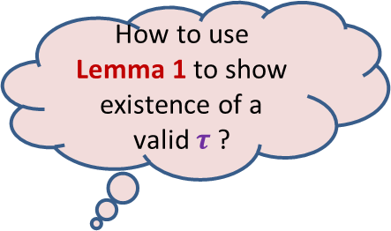
Why does Topological ordering exist ?
Lemma 1: Every DAG has at least one vertex with in-degree = 0.
u
z
b
v
y
x
w
a
How to use Lemma 1 to show existence of a valid $τ$ ?

Slide 16
Why does Topological ordering exist ?
u
z
b
v
y
x
w
a
u
v
a
b
x
z
w
y
1
2
3
4
5
6
7
8

Slide 17

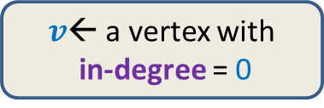
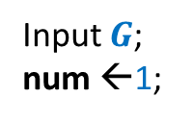
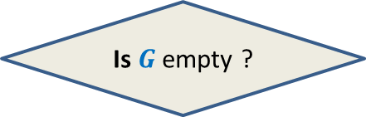

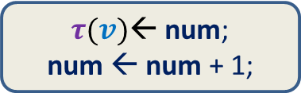

Why does Topological ordering exist ?
Time complexity of the algorithm: ?
$O(n^{2})$
Input $G$;
num ←1;
$v$← a vertex with
in-degree = 0
$τ(v)$← num;
num ← num + 1;
Remove $v$ and all its outgoing edges;
Yes
NO
Is $G$ empty ?
A valid $τ$

Slide 18

How efficiently can we compute Topological ordering ?
$O(m+n)$ time

Slide 19
Revisiting the example
..but slowly this time…
Main time consuming step:
To find next vertex with indegree=0
The new vertices with indegree=0 are created during ?
u
z
b
v
y
x
w
a
u
v
a
b
x
z
w
y
1
2
3
4
5
6
7
8
the processing of the current vertex of indegree=0

Slide 20
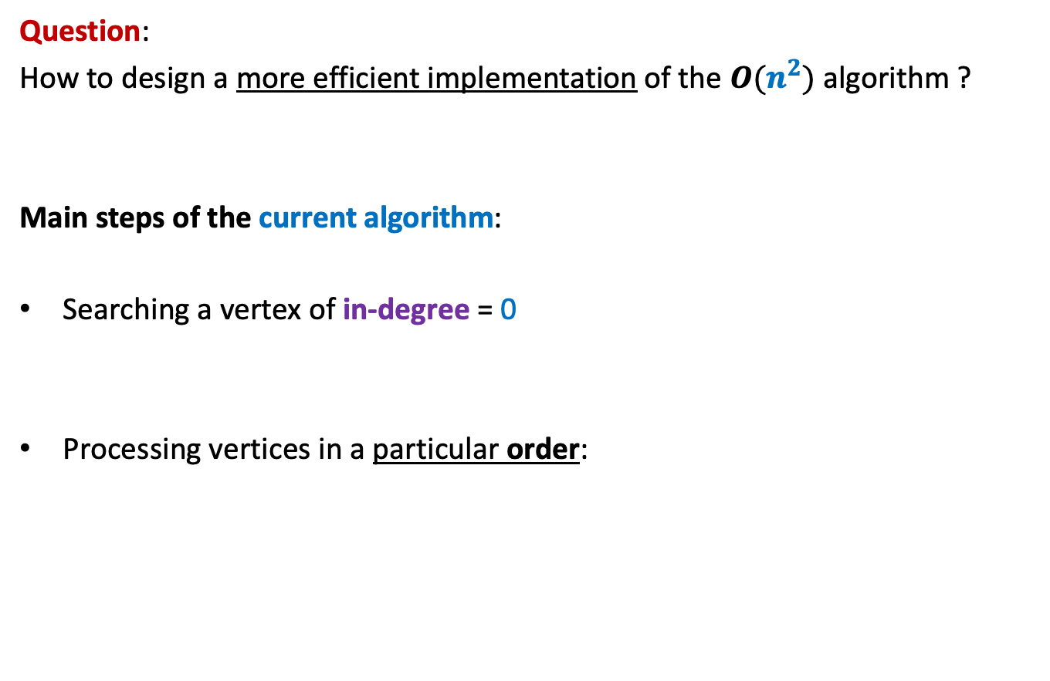
Algorithm for Topological ordering ?
Question:
How to design a more efficient implementation of the $O(n^{2})$ algorithm ?
Main steps of the current algorithm:
Searching a vertex of in-degree = 0
Processing vertices in a particular order:
Keep an array In-degree[]
?

Slide 21


The need of an order
How to ensure Constraint 1 ?
Events related to a vertex $u$ :
$A(u)$: Indegree($u$) becomes 0.
$B(u)$ : (i) Vertex $τ(v)$← num; num ← num + 1.
(ii) Deleting all outgoing edges of $u and$ updating
Indegree of the corresponding neighbors of $u$.
Easily.
Constraint 1:
$A(u)$must happen before $B(u)$.

Slide 22


The need of an order
How to ensure Constraint 2 ?
Events related to a vertex $u$ :
$A(u)$: Indegree($u$) becomes 0.
$B(u)$ : (i) Vertex $τ(v)$← num; num ← num + 1.
(ii) Deleting all outgoing edges of $u and$ updating
Indegree of the corresponding neighbors of $u$.
Using a Data Structure
Realize the importance of this constraint first.
Constraint 2:
If $A(u)$happens before $A(v)$,
then $B(u)$must happen before $B(v)$.

Slide 23




Keep a queue $Q$
Place a vertex into $Q$ as soon as its indegree = 0
Execute event $B(u)$ when we take the vertex out of the queue.
$$Q$$
First In, First Out feature of $Q$ ensures Constraint 2.
Constraint 2:
If $A(u)$happens before $A(v)$,
then $B(u)$must happen before $B(v)$.

Slide 24

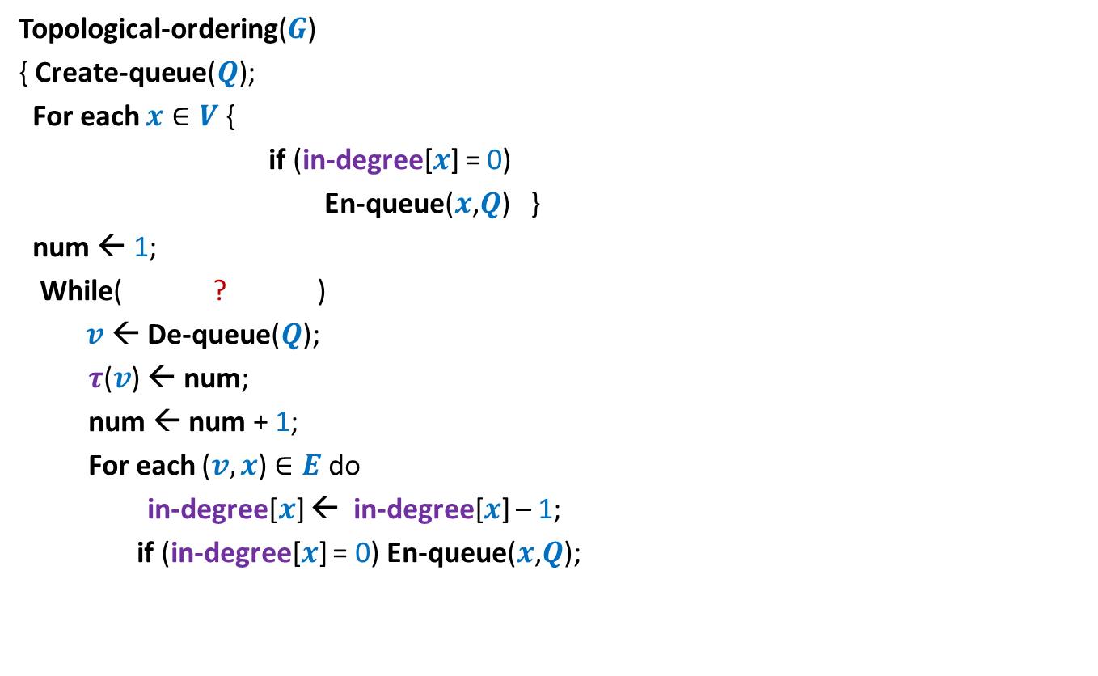
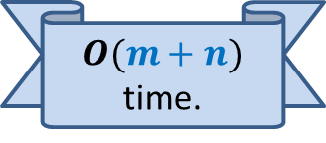


Algorithm for Topological ordering ?
Topological-ordering($G$)
{ Create-queue($Q$);
For each $x∈V$ {
if (in-degree[$x$] = 0)
En-queue($x$,$Q$) }
num ← 1;
While( ? )
$v$← De-queue($Q$);
$τ$($v$) ← num;
num ← num + 1;
For each ($v,x$) $∈E$ do
in-degree[$x$] ← in-degree[$x$] – 1;
if (in-degree[$x$] = 0) En-queue($x$,$Q$);
Proof of correctness ?
Attempt as a Homework.
We shall discuss in the next class.
not-empty($Q$)
{
O($deg(v)$) time
{
?
}
} return $τ$ ;
$O(m+n)$ time.

Slide 25
Applications of topological ordering ?

Slide 26
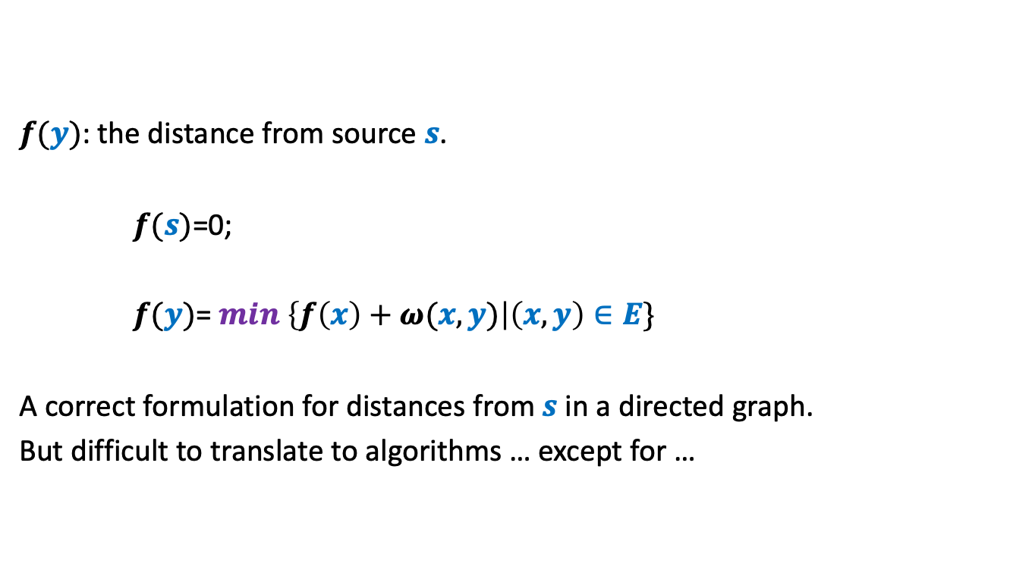
Example: Single source shortest paths
$f(y)$: the distance from source $s$.
$f(s)$=0;
$f(y)$= $min$ $\left\{f\left(x\right)+ω(x,y)\right|\left(x,y\right)∈E\}$
A correct formulation for distances from $s$ in a directed graph.
But difficult to translate to algorithms … except for …
DAGs

Slide 27

Topological ordering
A mapping $τ$ : $V$→[$1…n$] such that
For each edge $\left(u,v\right)∈E$ , $τ$($u$) < $τ$($v$)
1 2 3 4 5 6 7 8 9 10 11

Slide 28



Applications of Topological ordering I
A mapping $τ$ : $V$→[$1…n$] such that
For each edge $\left(u,v\right)∈E$ , $τ$($u$) < $τ$($v$)
Let $f$ be a function on $V$that we wish to compute
If $f(y)$ can be expressed in terms of ONLY $\left\{f\left(x\right) \right|\left(x,y\right)∈E\}$
➔We can compute $f$ by processing vertices in increasing order of $τ$.
It is useful to compute $f$ in this order
1 2 3 4 5 6 7 8 9 10 11
$$y$$

Slide 29
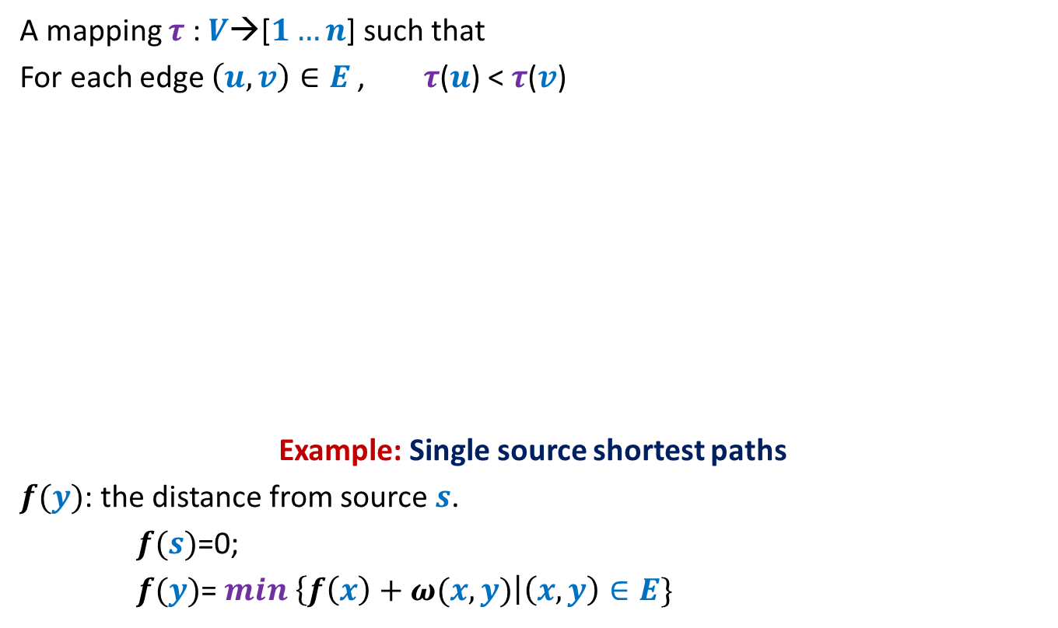

Applications of Topological ordering I
A mapping $τ$ : $V$→[$1…n$] such that
For each edge $\left(u,v\right)∈E$ , $τ$($u$) < $τ$($v$)
Example: Single source shortest paths
$f(y)$: the distance from source $s$.
$f(s)$=0;
$f(y)$= $min$ $\left\{f\left(x\right)+ω(x,y)\right|\left(x,y\right)∈E\}$
It is useful to compute $f$ in this order
1 2 3 4 5 6 7 8 9 10 11
$$y$$
$O(m+n)$ time algo

Slide 30


Applications of Topological ordering II
A mapping $τ$ : $V$→[$1…n$] such that
For each edge $\left(u,v\right)∈E$ , $τ$($u$) < $τ$($v$)
Let $f$ be a function on $V$that we wish to compute
If $f(y)$ can be expressed in terms of ONLY $\left\{f\left(z\right) \right|\left(y,z\right)∈E\}$
➔We can compute $f$ by processing vertices in decreasing order of $τ$.
It is useful to compute $f$ in this order
1 2 3 4 5 6 7 8 9 10 11
$$y$$

Slide 31
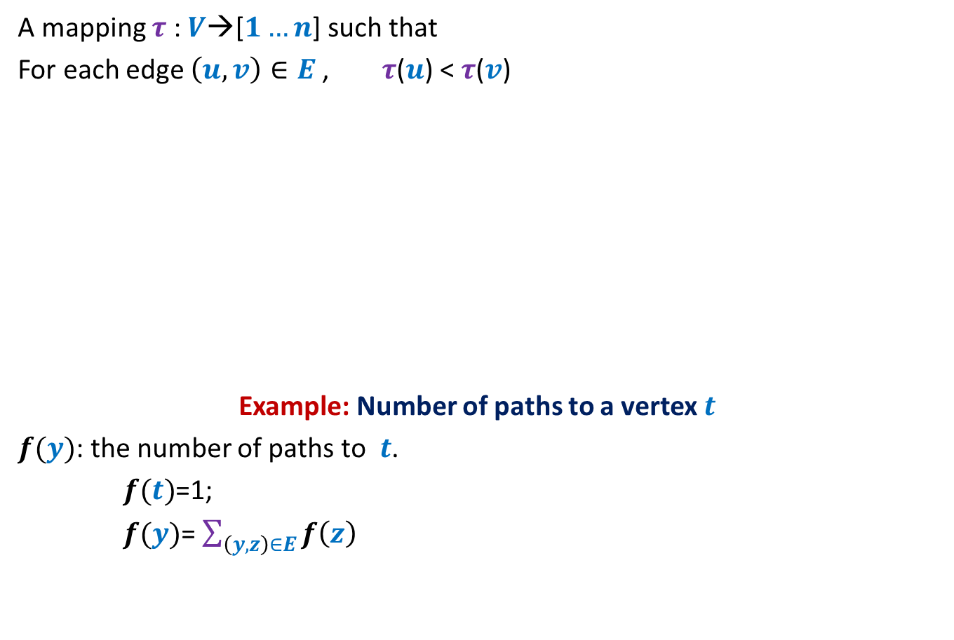
Applications of Topological ordering II
A mapping $τ$ : $V$→[$1…n$] such that
For each edge $\left(u,v\right)∈E$ , $τ$($u$) < $τ$($v$)
Example: Number of paths to a vertex $t$
$f(y)$: the number of paths to $t$.
$f(t)$=1;
$f(y)$= $\sum_{\left(y,z\right)∈E}{f\left(z\right)}$
It is useful to compute $f$ in this order
1 2 3 4 5 6 7 8 9 10 11
$$y$$
$O(m+n)$ time algo

Slide 32
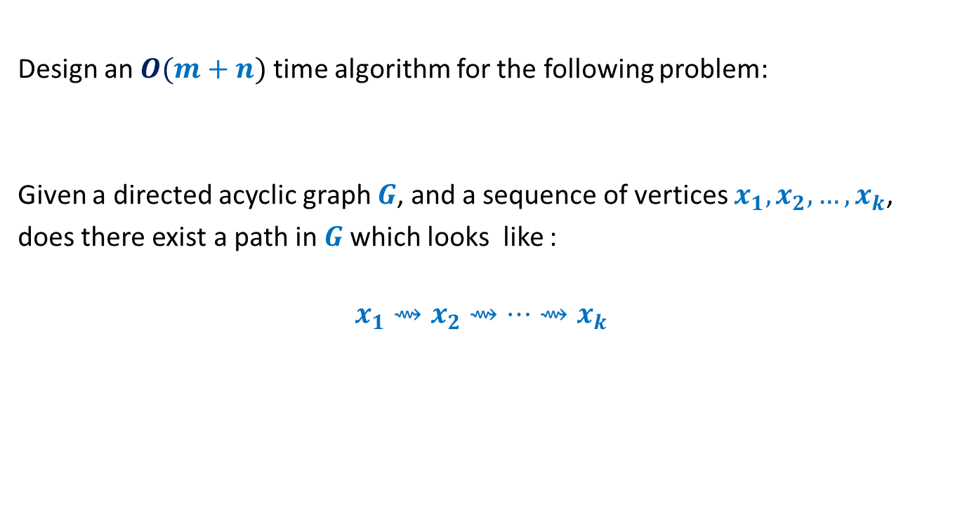
Homework
Design an $O(m+n)$ time algorithm for the following problem:
Given a directed acyclic graph $G$, and a sequence of vertices $x_{1},x_{2},…,x_{k}$,
does there exist a path in $G$which looks like :
$$x_{1}⇝x_{2}⇝…{⇝x}_{k}$$

