Slide 1
Design and Analysis of Algorithms
Algorithms-II : CS345A
Website: hello.iitk.ac.in
Lecture 11
Proof of Correctness (revisited)

Slide 2
Topological Numbering of a DAG

Slide 3



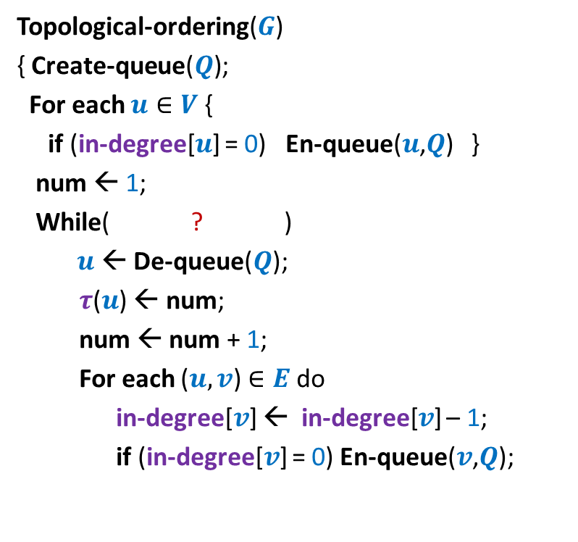




Algorithm for Topological ordering ?
Topological-ordering($G$)
{ Create-queue($Q$);
For each $u∈V$ {
if (in-degree[$u$] = 0) En-queue($u$,$Q$) }
num ← 1;
While( ? )
$u$← De-queue($Q$);
$τ$($u$) ← num;
num ← num + 1;
For each ($u,v$) $∈E$ do
in-degree[$v$] ← in-degree[$v$] – 1;
if (in-degree[$v$] = 0) En-queue($v$,$Q$);
Assertion 1:
For each ($x$,$y$) $∈E$, $τ$($x$) $<τ$($y$).
For each vertex $u$,
not-empty($Q$)
{
In-degree[$u$] ← 0
En-queue($u$, $Q$);
{
?
$u$← De-queue($Q$);
}
$τ$($u$) ← num;
} return $τ$ ;
}

Slide 4

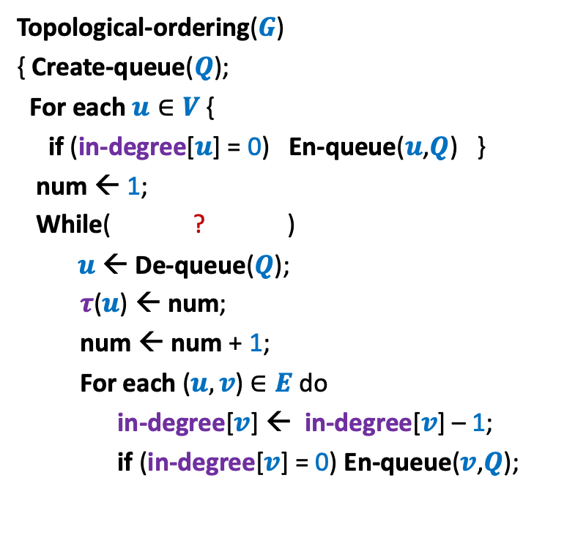
Algorithm for Topological ordering ?
Topological-ordering($G$)
{ Create-queue($Q$);
For each $u∈V$ {
if (in-degree[$u$] = 0) En-queue($u$,$Q$) }
num ← 1;
While( ? )
$u$← De-queue($Q$);
$τ$($u$) ← num;
num ← num + 1;
For each ($u,v$) $∈E$ do
in-degree[$v$] ← in-degree[$v$] – 1;
if (in-degree[$v$] = 0) En-queue($v$,$Q$);
Assertion 1:
For each ($x$,$y$) $∈E$, $τ$($x$) $<τ$($y$).
Fact 1:
If $x$ enters $Q$ before $y$ then $τ$($x$) $<τ$($y$).
not-empty($Q$)
{
{
}
} return $τ$ ;
}

Slide 5





Algorithm for Topological ordering ?
Topological-ordering($G$)
{ Create-queue($Q$);
For each $u∈V$ {
if (in-degree[$u$] = 0) En-queue($u$,$Q$) }
num ← 1;
While( ? )
$u$← De-queue($Q$);
$τ$($u$) ← num;
num ← num + 1;
For each ($u,v$) $∈E$ do
in-degree[$v$] ← in-degree[$v$] – 1;
if (in-degree[$v$] = 0) En-queue($v$,$Q$);
Assertion 1:
For each ($x$,$y$) $∈E$, $τ$($x$) $<τ$($y$).
En-queue($x$, $Q$);
not-empty($Q$)
{
$x$← De-queue($Q$);
{
In-degree[$y$] ← 0
En-queue($y$, $Q$);
}
} return $τ$ ;
}

Slide 6


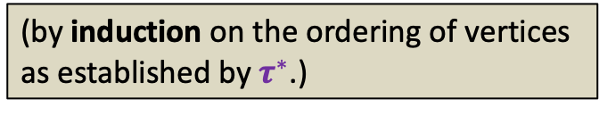
Algorithm for Topological ordering ?
Topological-ordering($G$)
{ Create-queue($Q$);
For each $u∈V$ {
if (in-degree[$u$] = 0) En-queue($u$,$Q$) }
num ← 1;
While( ? )
$u$← De-queue($Q$);
$τ$($u$) ← num;
num ← num + 1;
For each ($u,v$) $∈E$ do
in-degree[$v$] ← in-degree[$v$] – 1;
if (in-degree[$v$] = 0) En-queue($v$,$Q$);
Assertion 1:
For each ($x$,$y$) $∈E$, $τ$($x$) $<τ$($y$).
Assertion 2:
For each $x∈V$, $τ$($x$) is assigned a
number.
Proof:
Let $τ^{∗}$ be any topological numbering of
vertices of $G$.
Are we done ?
not-empty($Q$)
{
No.
What is the guarantee that $τ$($x$) is assigned a number during the algorithm.
{
(by induction on the ordering of vertices
as established by $τ^{∗}$.)
}
} return $τ$ ;
}

Slide 7


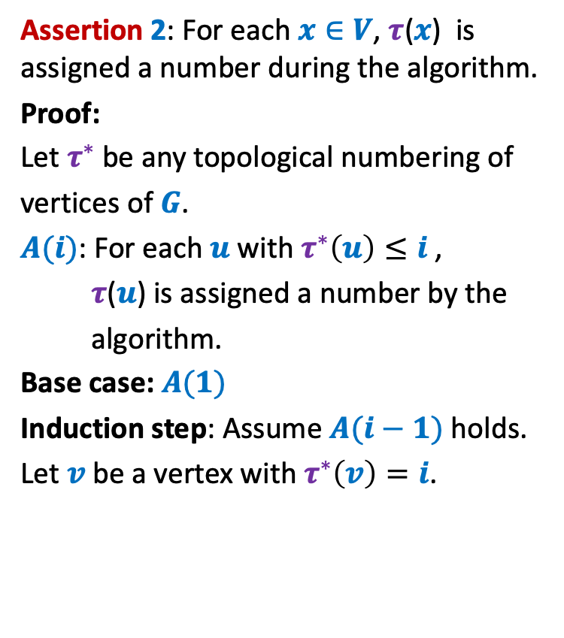



Algorithm for Topological ordering ?
Assertion 2: For each $x∈V$, $τ$($x$) is assigned a number during the algorithm.
Proof:
Let $τ^{∗}$ be any topological numbering of
vertices of $G$.
$A(i)$: For each $u$ with $τ^{∗}\left(u\right)≤i$ ,
$τ$($u$) is assigned a number by the
algorithm.
Base case: $A(1)$
Induction step: Assume $A(i−1)$ holds.
Let $v$ be a vertex with $τ^{∗}\left(v\right)=i$.
Topological-ordering($G$)
{ Create-queue($Q$);
For each $u∈V$ {
if (in-degree[$u$] = 0) En-queue($u$,$Q$) }
num ← 1;
While( ? )
$u$← De-queue($Q$);
$τ$($u$) ← num;
num ← num + 1;
For each ($u,v$) $∈E$ do
in-degree[$v$] ← in-degree[$v$] – 1;
if (in-degree[$v$] = 0) En-queue($v$,$Q$);
not-empty($Q$)
{
{
}
$$u$$
$$v$$
} return $τ$ ;
}
In-degree[$v$] ← 0
En-queue($v$, $Q$);

Slide 8

Algorithm for Topological ordering ?
Assertion 2: For each $x∈V$, $τ$($x$) is assigned a number during the algorithm.
Proof:
Let $τ^{∗}$ be any topological numbering of
vertices of $G$.
$A(i)$: For each $u$ with $τ^{∗}\left(u\right)≤i$ ,
$τ$($u$) is assigned a number by the
algorithm.
Base case: $A(1)$
Induction step: Assume $A(i−1)$ holds.
Let $v$ be a vertex with $τ^{∗}\left(v\right)=i$.
Topological-ordering($G$)
{ Create-queue($Q$);
For each $u∈V$ {
if (in-degree[$u$] = 0) En-queue($u$,$Q$) }
num ← 1;
While( ? )
$u$← De-queue($Q$);
$τ$($u$) ← num;
num ← num + 1;
For each ($u,v$) $∈E$ do
in-degree[$v$] ← in-degree[$v$] – 1;
if (in-degree[$v$] = 0) En-queue($v$,$Q$);
not-empty($Q$)
{
{
}
$$u$$
$$v$$
} return $τ$ ;
}
In-degree[$v$] ← 0
En-queue($u$, $Q$);

Slide 9

Algorithm for Topological ordering ?
Assertion 2: For each $x∈V$, $τ$($x$) is assigned a number during the algorithm.
Assertion 1:
For each ($x$,$y$) $∈E$, $τ$($x$) $<τ$($y$).
Theorem:
Topological-ordering($G$) assigns a valid
topological numbering to all vertices of
the DAG $G$.
Topological-ordering($G$)
{ Create-queue($Q$);
For each $u∈V$ {
if (in-degree[$u$] = 0) En-queue($u$,$Q$) }
num ← 1;
While( ? )
$u$← De-queue($Q$);
$τ$($u$) ← num;
num ← num + 1;
For each ($u,v$) $∈E$ do
in-degree[$v$] ← in-degree[$v$] – 1;
if (in-degree[$v$] = 0) En-queue($v$,$Q$);
not-empty($Q$)
{
{
}
} return $τ$ ;
}

Slide 10
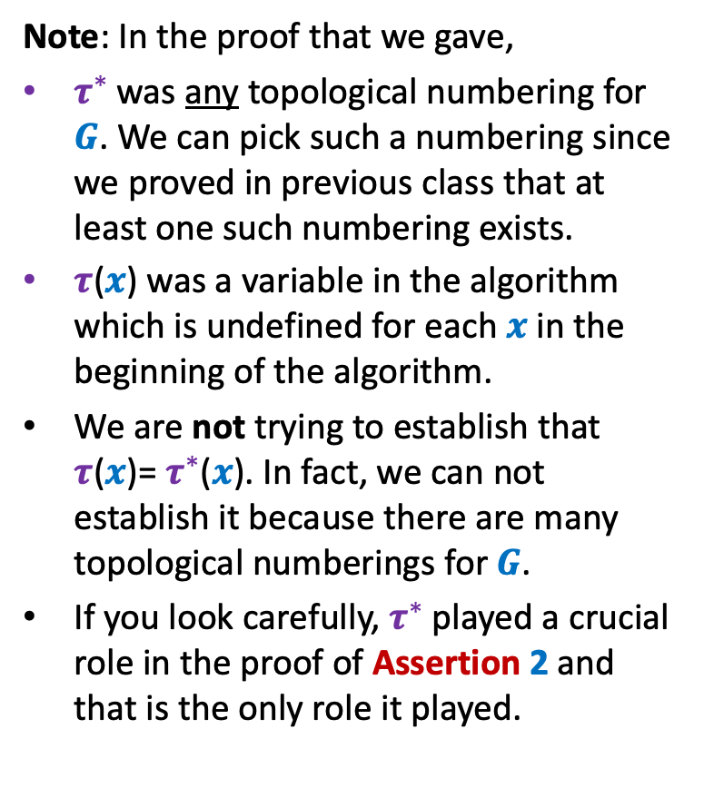
Algorithm for Topological ordering ?
Topological-ordering($G$)
{ Create-queue($Q$);
For each $u∈V$ {
if (in-degree[$u$] = 0) En-queue($u$,$Q$) }
num ← 1;
While( ? )
$u$← De-queue($Q$);
$τ$($u$) ← num;
num ← num + 1;
For each ($u,v$) $∈E$ do
in-degree[$v$] ← in-degree[$v$] – 1;
if (in-degree[$v$] = 0) En-queue($v$,$Q$);
Note: In the proof that we gave,
$τ^{∗}$ was any topological numbering for $G$. We can pick such a numbering since we proved in previous class that at least one such numbering exists.
$τ$($x$) was a variable in the algorithm which is undefined for each $x$ in the beginning of the algorithm.
We are not trying to establish that $τ$($x$)= $τ^{∗}$($x$). In fact, we can not establish it because there are many topological numberings for $G$.
If you look carefully, $τ^{∗}$ played a crucial role in the proof of Assertion 2 and that is the only role it played.
not-empty($Q$)
{
{
}
} return $τ$ ;
}

Slide 11
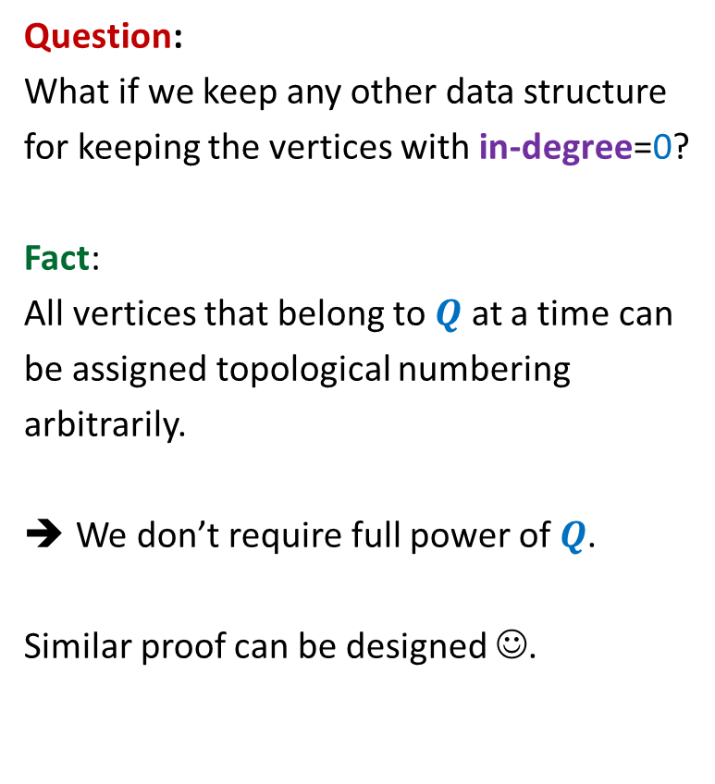
Algorithm for Topological ordering ?
Topological-ordering($G$)
{ Create-queue($Q$);
For each $u∈V$ {
if (in-degree[$u$] = 0) En-queue($u$,$Q$) }
num ← 1;
While( ? )
$u$← De-queue($Q$);
$τ$($u$) ← num;
num ← num + 1;
For each ($u,v$) $∈E$ do
in-degree[$v$] ← in-degree[$v$] – 1;
if (in-degree[$v$] = 0) En-queue($v$,$Q$);
Question:
What if we keep any other data structure
for keeping the vertices with in-degree=0?
Fact:
All vertices that belong to $Q$ at a time can
be assigned topological numbering
arbitrarily.
We don’t require full power of $Q$.
Similar proof can be designed ☺.
not-empty($Q$)
{
{
}
} return $τ$ ;
}

Slide 12
Proof of Correctness

Slide 13
Divide and Conquer Algorithm
Proof:
(By induction on the size of the problem)
Assume using I.H. that the algorithm for recursive calls
returns correct solution.
2. Just focus on the divide and combine step.

Slide 14
Greedy Algorithm
An adhoc proof.
Generic greedy technique.

Slide 15
Iterative Algorithm
Algorithm for Topological numbering
Binary Search
…

Slide 16
Binary Search

Slide 17
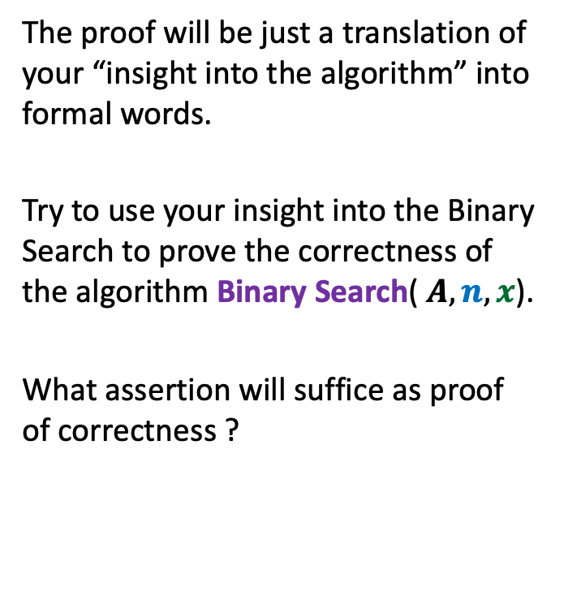
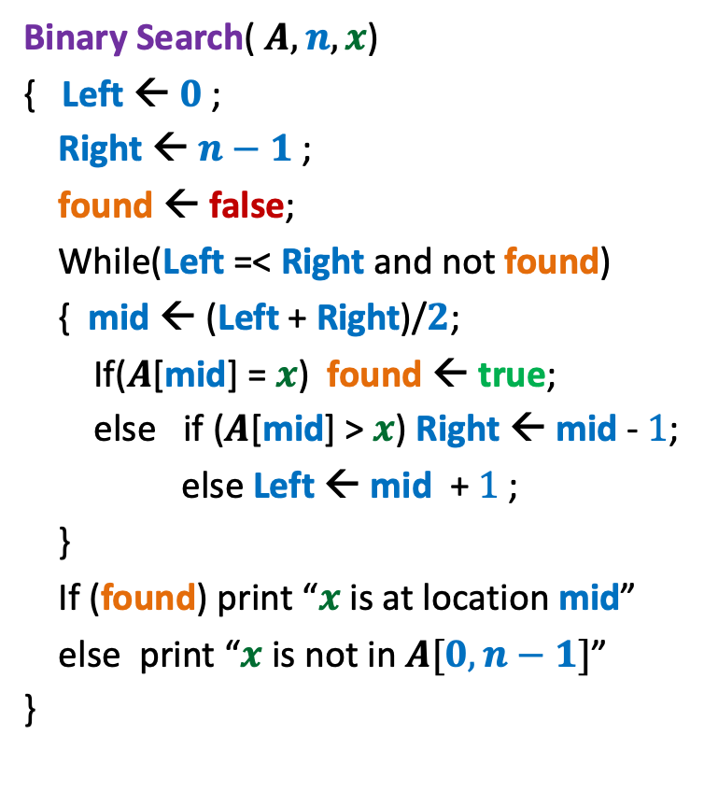
Binary Search
Binary Search( $A, n, x$)
{ Left ← $0$;
Right ← $n−1$ ;
found ← false;
While(Left =< Right and not found)
{ mid ← (Left + Right)/$2$;
If($A$[mid] = $x$) found ← true;
else if ($A$[mid] > $x$) Right ← mid - $1$;
else Left ← mid + $1$;
}
If (found) print “$x$ is at location mid”
else print “$x$ is not in $A[0,n−1]$”
}
The proof will be just a translation of your “insight into the algorithm” into formal words.
Try to use your insight into the Binary Search to prove the correctness of the algorithm Binary Search( $A, n, x$).
What assertion will suffice as proof of correctness ?

Slide 18

Binary Search
Binary Search( $A, n, x$)
{ Left ← $0$;
Right ← $n−1$ ;
found ← false;
While(Left =< Right and not found)
{ mid ← (Left + Right)/$2$;
If($A$[mid] = $x$) found ← true;
else if ($A$[mid] > $x$) Right ← mid - $1$;
else Left ← mid + $1$;
}
If (found) print “$x$ is at location mid”
else print “$x$ is not in $A[0,n−1]$”
}
Assertion 1:
If (not found) then $x∉$ $A[0,n−1]$.
Left
Right
Left
Right
Left
Right

Slide 19
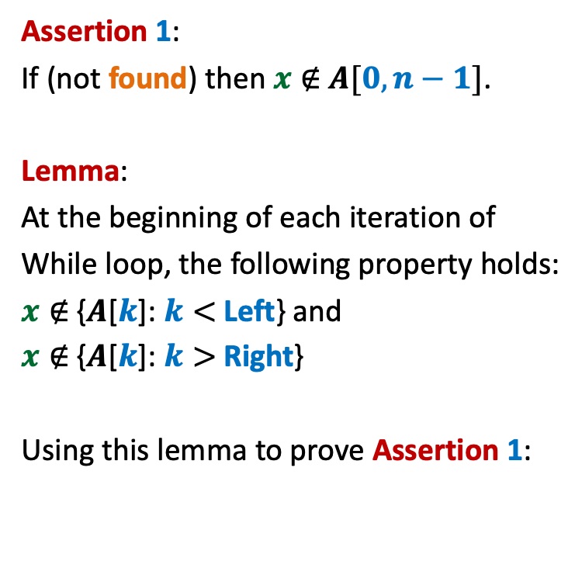

Binary Search
Binary Search( $A, n, x$)
{ Left ← $i$;
Right ← $j$ ;
found ← false;
While(Left =< Right and not found)
{ mid ← (Left + Right)/$2$;
If($A$[mid] = $x$) found ← true;
else if ($A$[mid] > $x$) Right ← mid - $1$;
else Left ← mid + $1$;
}
If (found) print “$x$ is at location mid”
else print “$x$ is not in $A[0,n−1]$”
}
Assertion 1:
If (not found) then $x∉$ $A[0,n−1]$.
Lemma:
At the beginning of each iteration of
While loop, the following property holds:
$x∉$ {$A$[$k$]: $k<$ Left} and
$x∉$ {$A$[$k$]: $k>$ Right}
Using this lemma to prove Assertion 1:
Left
Right
Right
Left

Slide 20
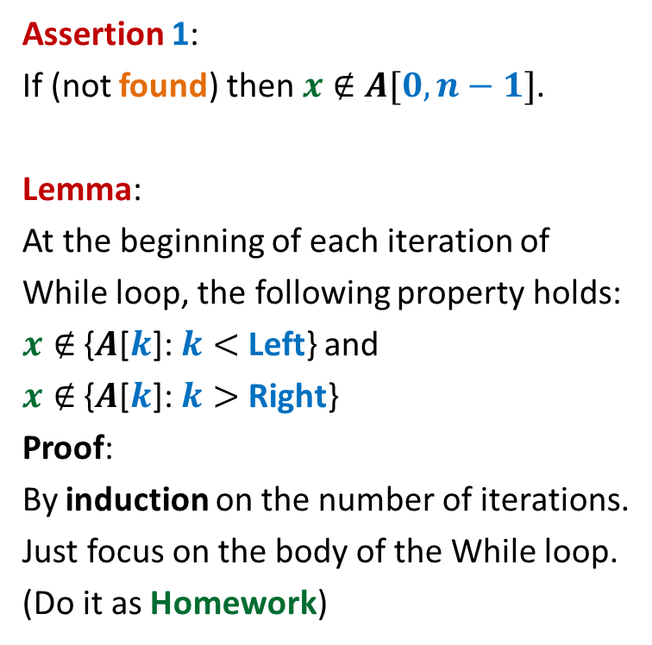
Binary Search
Binary Search( $A, n, x$)
{ Left ← $i$;
Right ← $j$ ;
found ← false;
While(Left =< Right and not found)
{ mid ← (Left + Right)/$2$;
If($A$[mid] = $x$) found ← true;
else if ($A$[mid] > $x$) Right ← mid - $1$;
else Left ← mid + $1$;
}
If (found) print “$x$ is at location mid”
else print “$x$ is not in $A[0,n−1]$”
}
Assertion 1:
If (not found) then $x∉$ $A[0,n−1]$.
Lemma:
At the beginning of each iteration of
While loop, the following property holds:
$x∉$ {$A$[$k$]: $k<$ Left} and
$x∉$ {$A$[$k$]: $k>$ Right}
Proof:
By induction on the number of iterations.
Just focus on the body of the While loop.
(Do it as Homework)
Loop Invariant

Slide 21
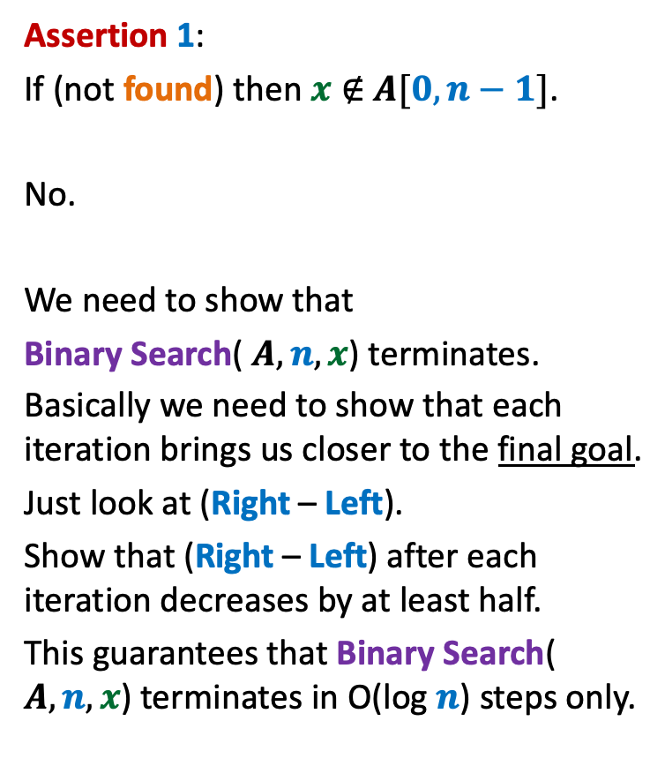
Binary Search
Binary Search( $A, n, x$)
{ Left ← $i$;
Right ← $j$ ;
found ← false;
While(Left =< Right and not found)
{ mid ← (Left + Right)/$2$;
If($A$[mid] = $x$) found ← true;
else if ($A$[mid] > $x$) Right ← mid - $1$;
else Left ← mid + $1$;
}
If (found) print “$x$ is at location mid”
else print “$x$ is not in $A[0,n−1]$”
}
Assertion 1:
If (not found) then $x∉$ $A[0,n−1]$.
No.
We need to show that
Binary Search( $A, n, x$) terminates.
Basically we need to show that each iteration brings us closer to the final goal.
Just look at (Right – Left).
Show that (Right – Left) after each iteration decreases by at least half.
This guarantees that Binary Search( $A, n, x$) terminates in O(log $n$) steps only.
Are we done ?

Slide 22
Algorithm for Topological ordering ?
Topological-ordering($G$)
{ Create-queue($Q$);
For each $u∈V$ {
if (in-degree[$u$] = 0) En-queue($u$,$Q$) }
num ← 1;
While( ? )
$u$← De-queue($Q$);
$τ$($u$) ← num;
num ← num + 1;
For each ($u,v$) $∈E$ do
in-degree[$v$] ← in-degree[$v$] – 1;
if (in-degree[$v$] = 0) En-queue($v$,$Q$);
Loop Invariant ?
not-empty($Q$)
{
{
}
} return $τ$ ;
}

