Slide 1
Design and Analysis of Algorithms
Algorithms-II : CS345A
Website: hello.iitk.ac.in
Lecture 12
A new algorithm paradigm
Dynamic Programming

Slide 2
Longest common subsequence

Slide 3


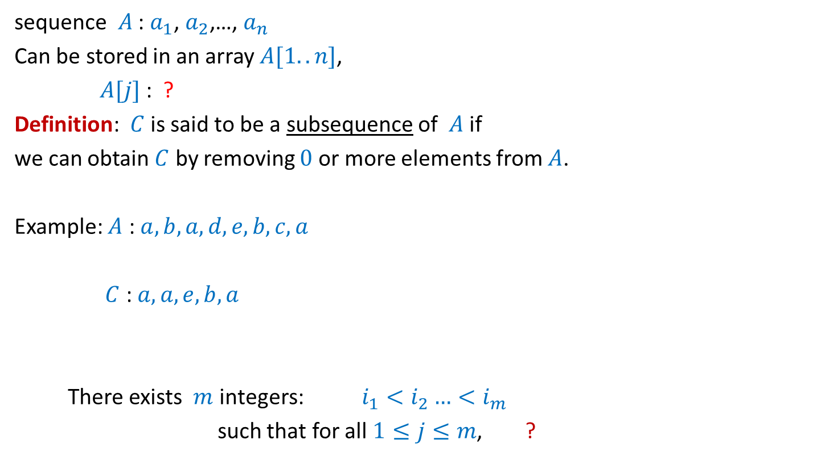





What is a subsequence ?
sequence $A$ : $a_{1}$, $a_{2}$,…, $a_{n}$
Can be stored in an array $A[1..n]$,
$A[j]$ : ?
Definition: $C$ is said to be a subsequence of $A$ if
we can obtain $C$ by removing $0$ or more elements from $A$.
Example: $A$ : $a,b,a,d,e,b,c,a$
$C$ : $a,a,e,b,a$
There exists $m$ integers: $i_{1}<i_{2}…<i_{m}$
such that for all $1≤j≤m$, ?
$$a_{j}$$
$A[1..k]$ : ?
$a_{1}$, $a_{2}$,…, $a_{k}$
A more formal definition ?
$$C[1..m]$$
$$1≤$$
$$≤n$$
$C\left[j\right]=A[i_{j}]$

Slide 4
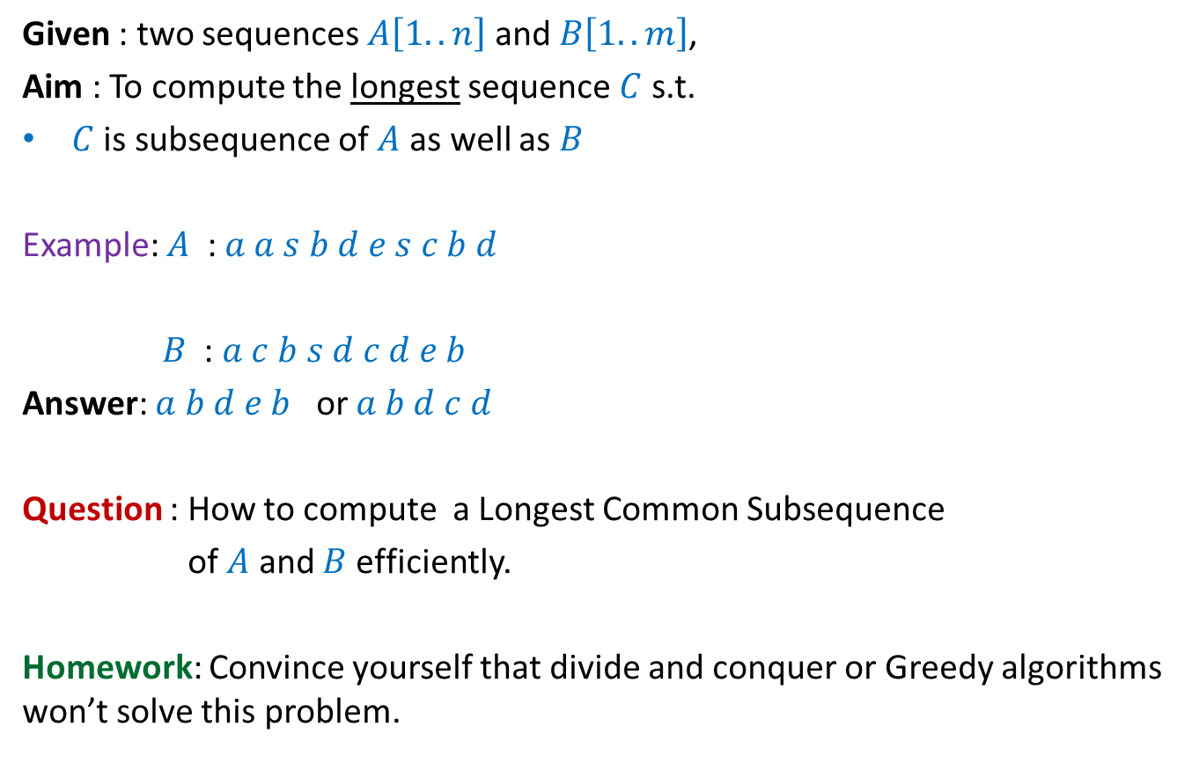
Problem Definition
Given : two sequences $A\left[1..n\right]$ and $B\left[1..m\right]$,
Aim : To compute the longest sequence $C$ s.t.
$C$ is subsequence of $A$ as well as $B$
Example: $A$ : $a a s b d e s c b d$
$B$ : $a c b s d c d e b$
Answer: $a b d e b$ or $a b d c d$
Question : How to compute a Longest Common Subsequence
of $A$ and $B$ efficiently.
Homework: Convince yourself that divide and conquer or Greedy algorithms won’t solve this problem.

Slide 5
Observations

Slide 6


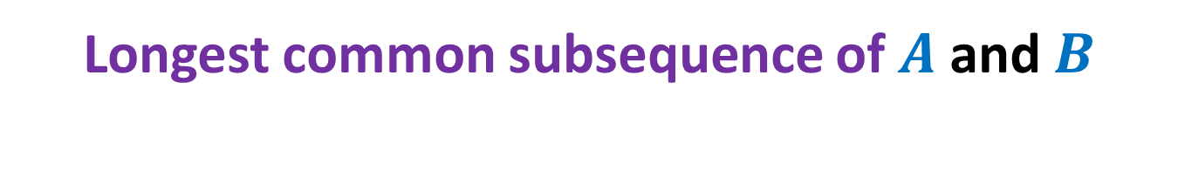



Longest common subsequence of $A$ and $B$
when $a_{n}=b_{m}$
$a_{1}$ $a_{2}$ $a_{3}$ … $a_{n−1}{ a}_{n}$
$$A$$
$$B$$
$b_{1}$ $b_{2}$ $b_{3}$ … $b_{m−1}{ b}_{m}$

Slide 7

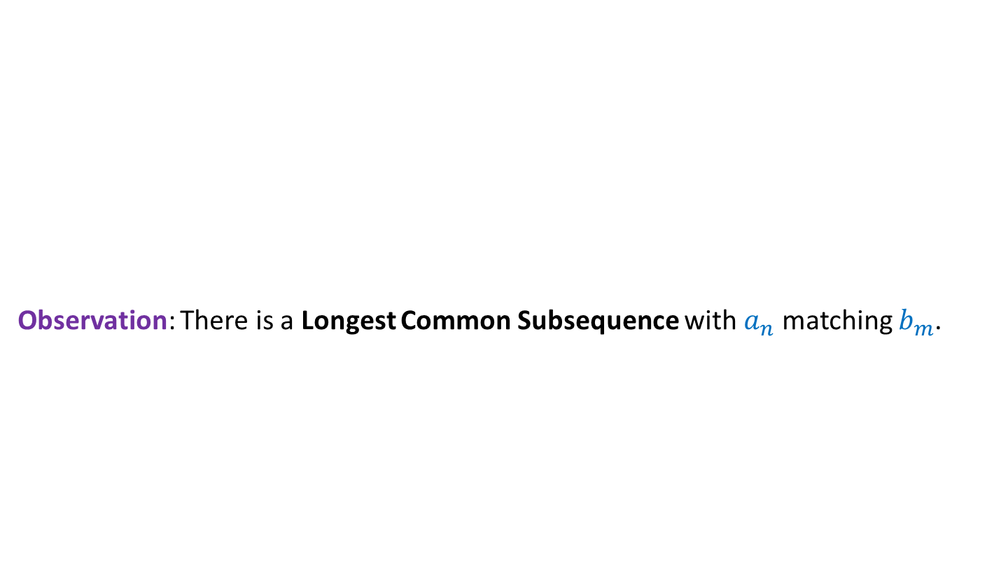


Longest common subsequence of $A$ and $B$
when $a_{n}=b_{m}$
Observation: There is a Longest Common Subsequence with $a_{n}$ matching $b_{m}$.
Otherwise, $b_{m}$ is matched with $a_{i}$ for some $i<n$. Since $b_{m}$ is the last symbol of $B$, we can as well match $b_{m}$ with $a_{n}$ to get the desired LCS.
Otherwise, we can append $a_{n}$ at the end of such LCS to get a longer LCS.
A contradiction !
$a_{1}$ $a_{2}$ $a_{3}$ … $a_{n−1}{ a}_{n}$
$$A$$
$$B$$
$b_{1}$ $b_{2}$ $b_{3}$ … $b_{m−1}{ b}_{m}$
Last symbol of Longest Common Subsequence must be $a_{n}$.
We can even make a stronger observation.
What kind of picture emerge for the LCS in this case ?

Slide 8


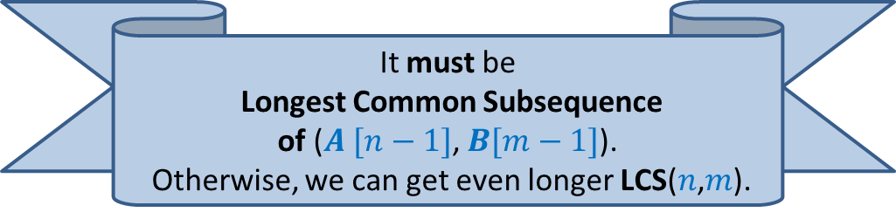

Longest common subsequence of $A$ and $B$
when $a_{n}=b_{m}$
Observation: There is a Longest Common Subsequence with $a_{n}$ matching $b_{m}$.
Lemma: If $a_{n}=b_{m}$then
Longest Common Subsequence =
?
$a_{1}$ $a_{2}$ $a_{3}$ … $a_{n−1}{ a}_{n}$
What can you say about the Longest Common Subsequence excluding the last (red) symbol ?
$b_{1}$ $b_{2}$ $b_{3}$ … $b_{m−1}{ b}_{m}$
LCS($n$,$m$)
LCS($n−1$,$m−1$) ::${ a}_{n}$
Longest Common Subsequence of $A [n−1]$, $B[m−1]$::${ a}_{n}$
It must be
Longest Common Subsequence
of ($A [n−1]$, $B[m−1]$).
Otherwise, we can get even longer LCS($n$,$m$).
LCS($i$, $j$): Longest common subsequence of $A\left[1..i\right]$ and $B\left[1..j\right]$

Slide 9
Longest common subsequence of $A$ and $B$
when $a_{n}=b_{m}$
Observation: There is a Longest Common Subsequence with $a_{n}$ matching $b_{m}$.
Lemma: If $a_{n}=b_{m}$then
Longest Common Subsequence =
?
$a_{1}$ $a_{2}$ $a_{3}$ … $a_{n−1}{ a}_{n}$
$$A$$
$$B$$
$b_{1}$ $b_{2}$ $b_{3}$ … $b_{m−1}{ b}_{m}$
LCS($n$,$m$)
LCS($n−1$,$m−1$) ::${ a}_{n}$
Longest Common Subsequence of $A [n−1]$, $B[m−1]$::${ a}_{n}$
LCS($i$, $j$): Longest common subsequence of $A\left[1..i\right]$ and $B\left[1..j\right]$

Slide 10

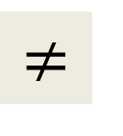
Longest common subsequence of $A$ and $B$
when $a_{n}=b_{m}$
$$≠$$
Observation: Either $a_{n}$or $b_{m}$is not the last symbol of LCS($n$,$m$).
Observation: If $a_{n}$is not the last symbol of LCS($n$,$m$)
$a_{1}$ $a_{2}$ $a_{3}$ … $a_{n−1}{ a}_{n}$
$$A$$
$$B$$
$b_{1}$ $b_{2}$ $b_{3}$ … $b_{m−1}{ b}_{m}$

Slide 11

Longest common subsequence of $A$ and $B$
when $a_{n}=b_{m}$
$$≠$$
Observation: Either $a_{n}$or $b_{m}$is not the last symbol of LCS($n$,$m$).
Observation: If $a_{n}$is not the last symbol of LCS($n$,$m$)
$a_{1}$ $a_{2}$ $a_{3}$ … $a_{n−1}{ a}_{n}$
$$A$$
$$B$$
$b_{1}$ $b_{2}$ $b_{3}$ … $b_{m−1}{ b}_{m}$

Slide 12


Longest common subsequence of $A$ and $B$
when $a_{n}=b_{m}$
$$≠$$
Observation: Either $a_{n}$or $b_{m}$is not the last symbol of LCS($n\text{,}m$).
Observation: If $a_{n}$is not the last symbol of LCS($n$,$m$)
➔ LCS($n$,$m$) is ?
$a_{1}$ $a_{2}$ $a_{3}$ … $a_{n−1}{ a}_{n}$
$$A$$
$$B$$
$b_{1}$ $b_{2}$ $b_{3}$ … $b_{m−1}{ b}_{m}$
LCS($n−1$,$m$)

Slide 13
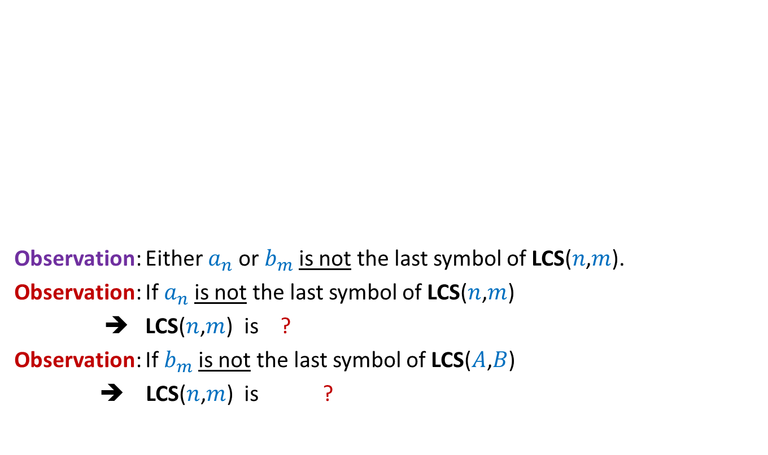

Longest common subsequence of $A$ and $B$
when $a_{n}=b_{m}$
$$≠$$
Observation: Either $a_{n}$or $b_{m}$is not the last symbol of LCS($n\text{,}m$).
Observation: If $a_{n}$is not the last symbol of LCS($n$,$m$)
➔ LCS($n$,$m$) is ?
Observation: If $b_{m}$is not the last symbol of LCS($A$,$B$)
➔ LCS($n$,$m$) is ?
$a_{1}$ $a_{2}$ $a_{3}$ … $a_{n−1}{ a}_{n}$
$$A$$
$$B$$
$b_{1}$ $b_{2}$ $b_{3}$ … $b_{m−1}{ b}_{m}$
LCS($n−1$,$m$)
LCS($n$,$m−1$)

Slide 14

Longest common subsequence of $A$ and $B$
when $a_{n}=b_{m}$
$$≠$$
Observation: Either $a_{n}$or $b_{m}$is not the last symbol of LCS($n$,$m$).
Lemma: If $a_{n}≠b_{m}$then
LCS($n\text{,}m$) is either LCS($n$,$m−1$) or LCS($n−1$,$m$)
$a_{1}$ $a_{2}$ $a_{3}$ … $a_{n−1}{ a}_{n}$
$$A$$
$$B$$
$b_{1}$ $b_{2}$ $b_{3}$ … $b_{m−1}{ b}_{m}$

Slide 15
Recursive formulation
LCS($i$, $j$): Longest common subsequence of $A\left[1..i\right]$ and $B\left[1..j\right]$

Slide 16
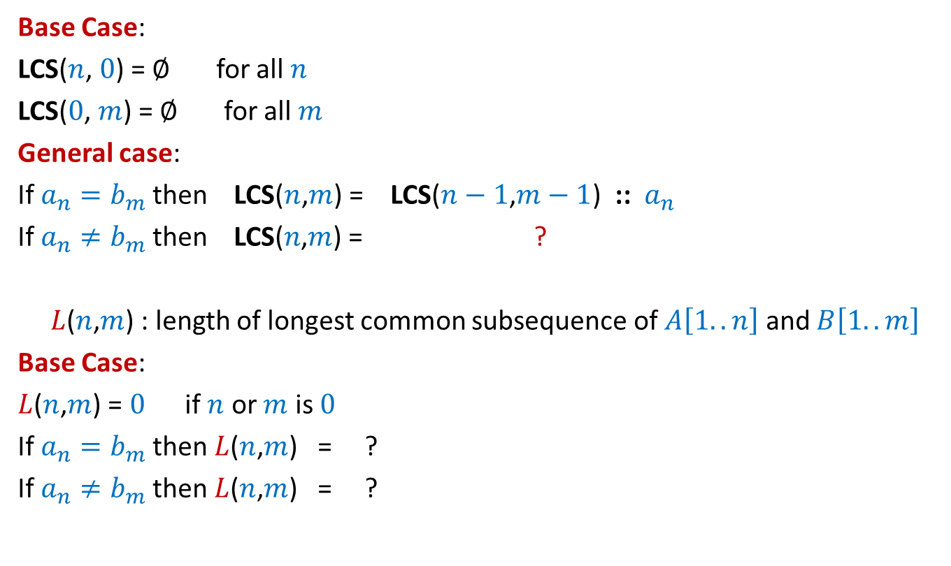




Recursive formulation for LCS($n$,$m$)
Base Case:
LCS($n$, $0$) = $∅$ for all $n$
LCS($0$, $m$) = $∅$ for all $m$
General case:
If $a_{n}=b_{m}$then LCS($n$,$m$) = LCS($n−1$,$m−1$) ::${ a}_{n}$
If $a_{n}≠b_{m}$then LCS($n\text{,}m$) = ?
$L$($n$,$m$) : length of longest common subsequence of $A\left[1..n\right]$ and $B\left[1..m\right]$
Base Case:
$L$($n$,$m$) = $0$ if $n$ or $m$ is $0$
If $a_{n}=b_{m}$then $L$($n$,$m$) = ?
If $a_{n}≠b_{m}$then $L$($n$,$m$) = ?
bigger of LCS($n$,$m−1$) or LCS($n−1$,$m$)
$L$($n−1$,$m−1$) + 1
Max( $L$($n−1$,$m$) , $L$($n$,$m−1$))

Slide 17
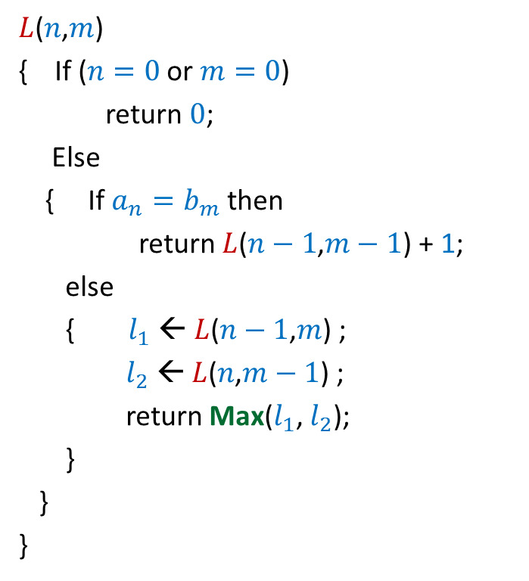

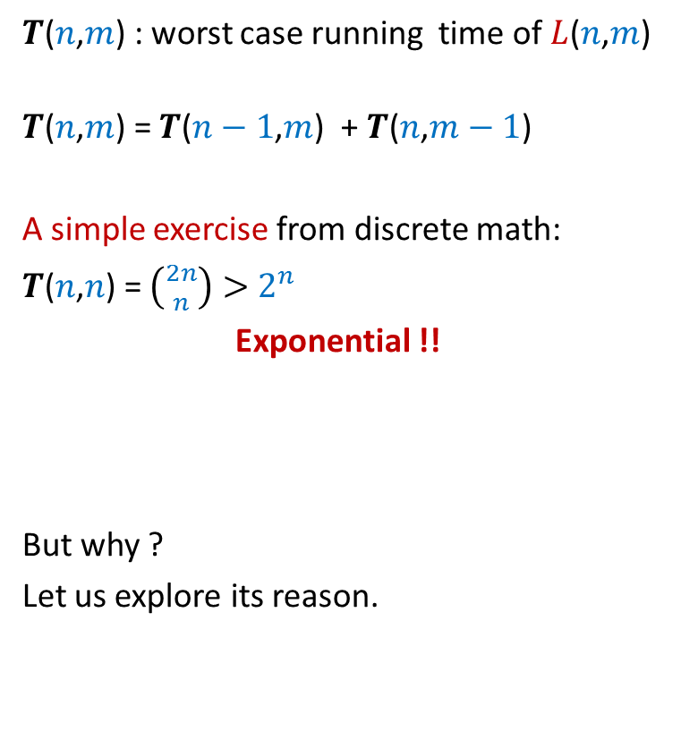
Recursive algorithm for $L$($n$,$m$)
$L$($n$,$m$)
{ If ($n=0$ or $m=0$)
return $0$;
Else
{ If $a_{n}=b_{m}$then
return $L$($n−1$,$m−1$) + 1;
else
{ $l_{1}$ ← $L$($n−1$,$m$) ;
$l_{2}$ ← $L$($n$,$m−1$) ;
return Max($l_{1}$, $l_{2}$);
}
}
}
$T$($n$,$m$) : worst case running time of $L$($n$,$m$)
$T$($n$,$m$) = $T$($n−1$,$m$) + $T$($n$,$m−1$)
A simple exercise from discrete math:
$T$($n$,$n$) = $\left({2n \atop n}\right)>$ $2^{n}$
Exponential !!
But why ?
Let us explore its reason.

Slide 18

Recursive algorithm for $L$($n$,$m$)
$L$($n$,$m$)
{ If ($n=0$ or $m=0$)
return $0$;
Else
{ If $a_{n}=b_{m}$then
return $L$($n−1$,$m−1$) + 1;
else
{ $l_{1}$ ← $L$($n−1$,$m$) ;
$l_{2}$ ← $L$($n$,$m−1$) ;
return Max($l_{1}$, $l_{2}$);
}
}
}
$T$($n$,$m$) : worst case running time of $L$($n$,$m$)
$T$($n$,$m$) = $T$($n−1$,$m$) + $T$($n$,$m−1$)
A simple exercise from discrete math:
$T$($n$,$n$) = $\left({2n \atop n}\right)>$ $2^{n}$
Exponential !!

Slide 19








Recursive algorithm for $L$($n$,$m$)
Recursion tree
$L$($n$,$m$)
$L$($n$,$m$)
{ If ($n=0$ or $m=0$)
return $0$;
Else
{ If $a_{n}=b_{m}$then
return $L$($n−1$,$m−1$) + 1;
else
{ $l_{1}$ ← $L$($n−1$,$m$) ;
$l_{2}$ ← $L$($n$,$m−1$) ;
return Max($l_{1}$, $l_{2}$);
}
}
}
Solving same sub-problem multiple times !!
But how many sub-problems are there ?
only ($n+1$)*($m+1$).
Can we compute them efficiently ?
$L$($n−1$,$m$)
$L$($n$,$m−1$)
$L$($n−1$,$m−1$)
$L$($n$,$m−2$)
$L$($n−2$,$m$)
$L$($n−1$,$m−1$)
The answer lies in a programming exercise you did long ago. ☺

Slide 20
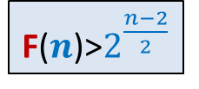
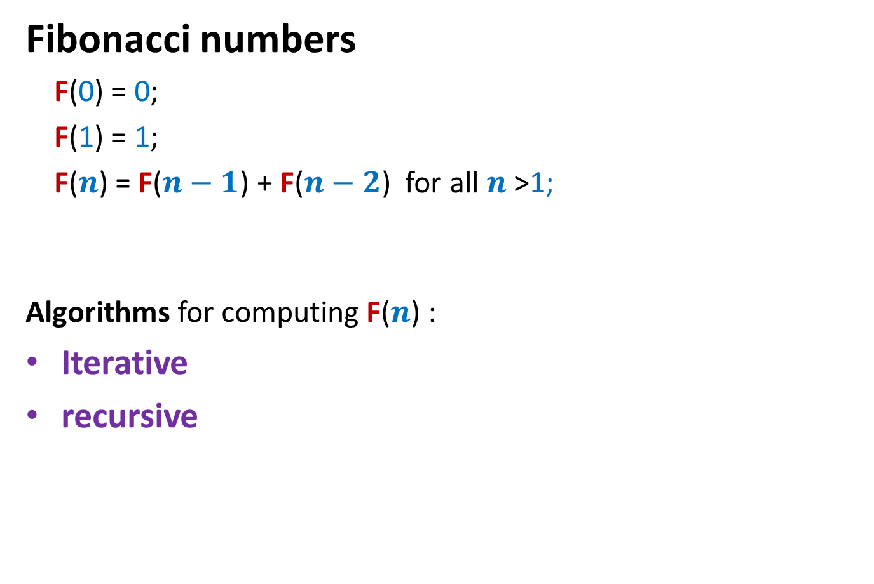
Fibonacci numbers
Fibonacci numbers
F(0) = 0;
F(1) = 1;
F($n$) = F($n−1$) + F($n−2$) for all $n$ >1;
Algorithms for computing F($n$) :
Iterative
recursive
F($n$)>$2^{\frac{n−2}{2}}$

Slide 21
Recursive algorithm for F(n)
Rfib(n)
{ if n=0 return 0;
else if n=1 return 1;
else return(Rfib(n-1) + Rfib(n-2))
}
Let G(n) : No. of instruction executed by RFib(n)
G(0) = 1; G(1) = 2;
For n>1 G(n) = G(n-1)+G(n-2) + 4
Observation 1: G(n)>F(n) for all n;
It follows from Observation 1 and Exercise 1 that G(n) is exponential in n !
Explore the recursion tree of Rfib(n) to find the reason behind this exponential time.

Slide 22




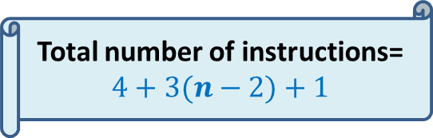

Iterative Algorithm for F($n$)
Total number of instructions= $4+3(n−2)+1$
IFib($n$)
if $n$=0 return 0;
else if $n$=1 return 1;
else { a ← 0; b← 1;
For($i$=2 to $n$) do
{ temp ← b;
b← a+b;
a← temp;
}
}
return b;
$$< 3n$$
4 instructions
$n−2$ iterations
3 instructions per iteration
the final instruction
F
0 1
0 | 1 | 2 | …
$$i$$

Slide 23







Recursive algorithm for $L$($n$,$m$)
$T$[$i$,$j$] = $L$($i$,$j$)
$L$($n$,$m$)
{ If ($n=0$ or $m=0$)
return $0$;
Else
{ If $a_{n}=b_{m}$then
return $L$($n−1$,$m−1$) + 1;
else
{ $l_{1}$ ← $L$($n−1$,$m$) ;
$l_{2}$ ← $L$($n$,$m−1$) ;
return Max($l_{1}$, $l_{2}$);
}
}
}
$$n$$
0
$$i$$
…
…
1
0
0
0 0 0 ... 0
0 1 ... $m$
$$j$$
$$T$$

Slide 24
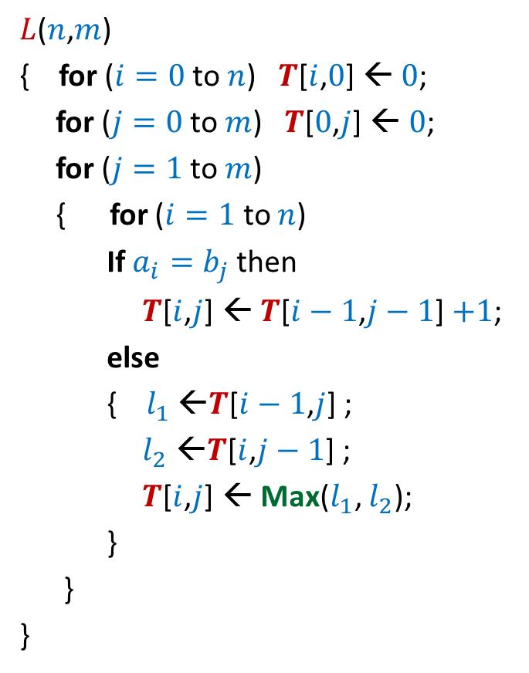


Iterative algorithm for $L$($n$,$m$)
$L$($n$,$m$)
{ for ($i=0$ to $n$) $T$[$i$,$0$] ← $0$;
for ($j=0$ to $m$) $T$[$0$,$j$] ← $0$;
for ($j=1$ to $m$)
{ for ($i=1$ to $n$)
If $a_{i}=b_{j}$then
$T$[$i$,$j$] ← $T$[$i−1$,$j−1$] $+1$;
else
{ $l_{1}$ ←$T$[$i−1$,$j$] ;
$l_{2}$ ←$T$[$i$,$j−1$] ;
$T$[$i$,$j$] ← Max($l_{1}$, $l_{2}$);
}
}
}
$$n$$
0
$$i$$
…
…
1
0
0
0 0 0 ... 0
0 1 ... $m$
$$j$$
Time complexity: O($nm$)
$$T$$

Slide 25
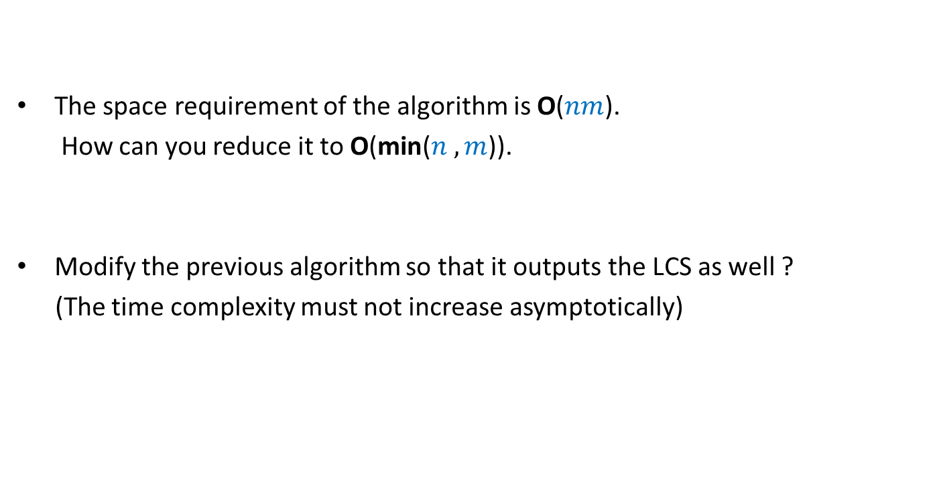
Homework
The space requirement of the algorithm is O($nm$).
How can you reduce it to O(min($n ,m$)).
Modify the previous algorithm so that it outputs the LCS as well ?
(The time complexity must not increase asymptotically)

Slide 26
Dynamic Programming algorithm paradigm
Expressing the solution recursively.
Overall there are only Polynomial number of subproblems.
But there is a huge overlap among the subproblems.
➔ So the recursive algorithm takes exponential time
(solving same subproblem multiple times).
So we compute the recursive solution iteratively in a bottom-up fashion
(like in case of Fibonacci numbers).
This avoids wastage of computation and leads to efficient implementation.

Slide 27
Steps of dynamic programming based algorithm
Recursive Formulation
Recursive Algorithm
Exponential time
Cause:
Overlap in subProblems
Polynomial no. of distinct subproblems
Bottom up approach to compute solution
A Polynomial time algorithm

Slide 28
OPTMAL Triangulation of a CONVEX POLYGON
Problem for the next lecture

Slide 29












Convex polygon
Representation: ?
How to store: ?
< $p_{i}$,…, $p_{j}$> : ?
< $p_{1}$,…, $p_{n}$>
Array
$$p_{i}$$
$$q$$
$$p_{n−2}$$
$$p_{3}$$
$$r$$
$$p_{2}$$
$$p_{n−1}$$
$$p_{n}$$
$$p_{1}$$
Polygon consisting of points $p_{i}$,…, $p_{j}$

Slide 30
Triangulation of a CONVEX POLYGON
Partitioning the polygon into triangles
$$p_{i}$$
$$p_{3}$$
$$p_{2}$$
$$p_{n−1}$$
$$p_{n}$$
$$p_{1}$$
, each defined by 3 points on the polygon

Slide 31
OPTMAL Triangulation of a CONVEX POLYGON

Slide 32


$ω$($i$,$j$,$k$) : weight of triangle formed by $p_{i}$, $p_{j}$, $p_{k}$.
Assumption: It takes O(1) time to compute $ω$($i$,$j$,$k$)
Cost of a triangulation : sum of the weight of $n−2$ triangles formed.
$$p_{i}$$
$$p_{3}$$
$$p_{2}$$
$$p_{n−1}$$
$$p_{n}$$
$$p_{1}$$

Slide 33

$ω$($i$,$j$,$k$) : weight of triangle formed by $p_{i}$, $p_{j}$, $p_{k}$.
Assumption: It takes O(1) time to compute $ω$($i$,$j$,$k$)
Problem:
Design an efficient algorithm for computing an optimal triangulation of a convex
polygon on $n$ vertices.
$$p_{i}$$
$$p_{3}$$
$$p_{2}$$
$$p_{n−1}$$
$$p_{n}$$
$$p_{1}$$

Slide 34
Homework
Make sincere attempt to solve the optimal triangulation problem using Dynamic Programming paradigm. It will be very helpful for you even if you fail to solve it.
We shall solve it interactively in the next class.

