Slide 1
Design and Analysis of Algorithms
Algorithms-II : CS345A
Website: hello.iitk.ac.in
Lecture 18
DFS traversal : Classification of non-tree edges
Network Flow

Slide 2
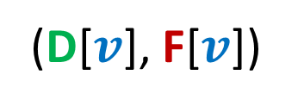
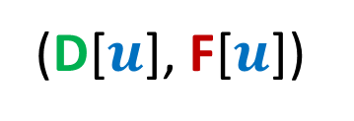
Classification of non-tree edges
using
(D[$u$], F[$u$])
and
(D[$v$], F[$v$])

Slide 3













Relation between
(D[$u$], F[$u$])
and
(D[$v$], F[$v$])
Disjoint
One enclosing another
What about
D[$u$]
F[$u$]
D[$v$]
F[$v$]
D[$u$]
F[$u$]
D[$v$]
F[$v$]
D[$u$]
F[$u$]
D[$u$] < D[$v$] <F[$u$] < F[$v$] ?
D[$v$]
F[$v$]

Slide 4

Classification of non-tree edges
There seems to be many different types of non-tree edges.
x
y
u
s
q
Can we classify the non-tree edges ?
w
j
r
p
v
t
b
d
h
c

Slide 5







($u$,$v$) is Forward edge
$$u$$
$$s$$
$$w$$
$$v$$
D[$u$]
F[$u$]
D[$v$]
F[$v$]

Slide 6





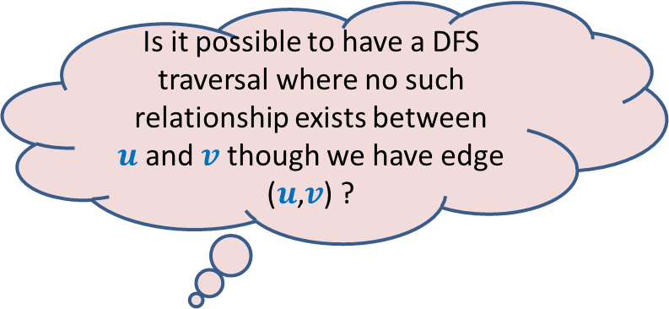





($u$,$v$) is Backward edge
Till now, we considered the situations in which either $u$ is ancestor of $v$ or vice versa.
$$v$$
$$s$$
Is it possible to have a DFS traversal where no such relationship exists between $u$and $v$ though we have edge ($u$,$v$) ?
$$w$$
$$u$$
Yes, indeed.
Think over it before moving to the next slide
D[$v$]
F[$v$]
D[$u$]
F[$u$]

Slide 7











($u$,$v$) is Cross edge
$$y$$
$$u$$
$$v$$
Is there any other type of non-tree edge ?
Think over it …
$$s$$
$$w$$
In the following slide, we shall show that these are the only possibilities of a non-tree edge.
$$x$$
D[$v$]
F[$v$]
D[$u$]
F[$u$]

Slide 8







Classification of non-tree edges
Consider an edge ($u$,$v$)
Case 1: ancestor to descendant
Case 2: descendant to ancestor
Case 3:
Tree edge or Forward edge
D[$u$]
F[$u$]
D[$v$]
F[$v$]
D[$v$]
F[$v$]
Backward edge
D[$u$]
F[$u$]
Cross edge
D[$v$]
F[$v$]
D[$u$]
F[$u$]
D[$u$]
F[$u$]
D[$v$]
F[$v$]

Slide 9
Algorithm Design Paradigms
Divide and Conquer
Greedy Strategy
Dynamic Programming

Slide 10

Designing an algorithm
Divide and Conquer
problem
Greedy Strategy
Dynamic Programming
Always take a fresh and unconditioned approach to solve a problem

Slide 11
Designing an algorithm
Fresh approach
Working on examples
Learning from mistakes
Theoretical formulation

Slide 12
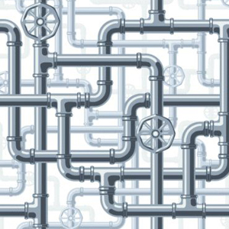
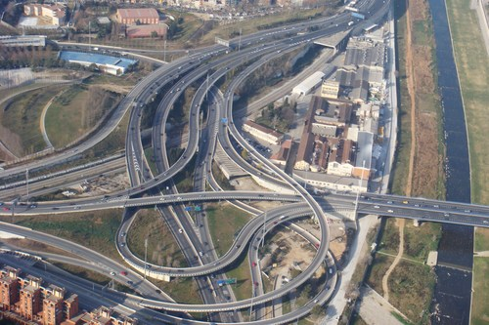
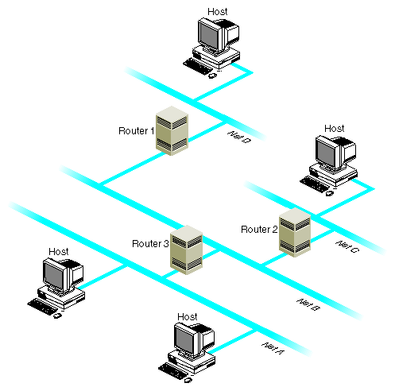
Network

Slide 13
Maximum Flow in a Network

Slide 14







Problem definition (Informal)
2
Given a network, where each edge has a certain capacity,
there is a designated source vertex $s$and sink vertex $t$.
Compute the maximum flow that we can achieve from $s$to $t$.
$$v$$
$$x$$
5
6
15
8
$$t$$
$$s$$
6
7
14
7
17
$$u$$
4
$$y$$

Slide 15
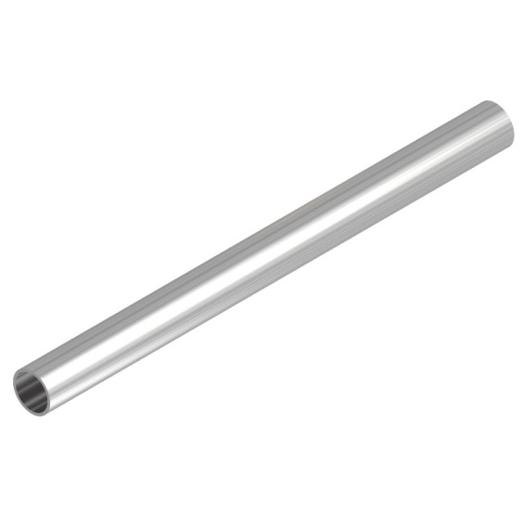
Question: What is flow along an edge ?
Answer: The rate at which the commodity is being transported along the edge.
Question: What is capacity of an edge ?
Answer: The maximum rate at which the commodity can be transported
along the edge.
Example: 25 litre/sec
1 GB /sec
An edge

Slide 16





Are there any constraints for a flow ?
$$x$$
$≤$25
Capacity constraint :
Flow along an edge cannot exceed its capacity
Conservation constraint :
Flow entering node $u$ = Flow leaving node $u$.
25
$$u$$
5
$$u$$
25
20

Slide 17
Formal Description of Flow

Slide 18
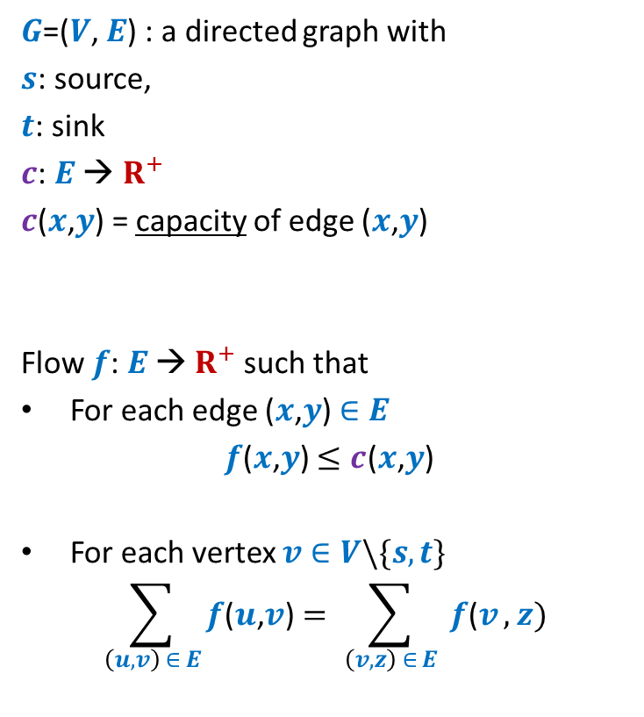
Formal Description of Flow
2
$G$=($V$, $E$) : a directed graph with
$s$: source,
$t$: sink
$c$: $E$ → $R^{+}$
$c$($x$,$y$) = capacity of edge ($x$,$y$)
Flow $f$: $E$ → $R^{+}$ such that
For each edge ($x$,$y$) $∈E$
$f$($x$,$y$) $≤c$($x$,$y$)
For each vertex $v∈V\backslash \{s,t\}$
$$\sum_{\left(u,v\right) ∈ E}{f\text{(}u\text{,}v\text{)}}=\sum_{ \left(v,z\right) ∈ E }{f\text{(}v},z)$$
$$v$$
$$x$$
5
6
15
8
$$t$$
$$s$$
6
7
14
7
17
$$u$$
4
$$y$$
Capacity constraint
Conservation constraint

Slide 19

Formal Description of Flow
2
$\text{value}\text{(}f\text{)=}$ flow leaving $s$
$$=\sum_{\left(s,v\right) ∈ E}{f\text{(}u\text{,}v\text{)}}$$
$G$=($V$, $E$) : a directed graph with
$s$: source,
$t$: sink
$c$: $E$ → $R^{+}$
$c$($x$,$y$) = capacity of edge ($x$,$y$)
Flow $f$: $E$ → $R^{+}$ such that
For each edge ($x$,$y$) $∈E$
$f$($x$,$y$) $≤c$($x$,$y$)
For each vertex $v∈V\backslash \{s,t\}$
$$\sum_{\left(u,v\right) ∈ E}{f\text{(}u\text{,}v\text{)}}=\sum_{ \left(v,z\right) ∈ E }{f\text{(}v},z)$$
$$v$$
$$x$$
4
5
5
11
6
1
15
8
$$t$$
$$s$$
6
7
1
7
7
14
7
17
$$u$$
4
$$y$$

Slide 20
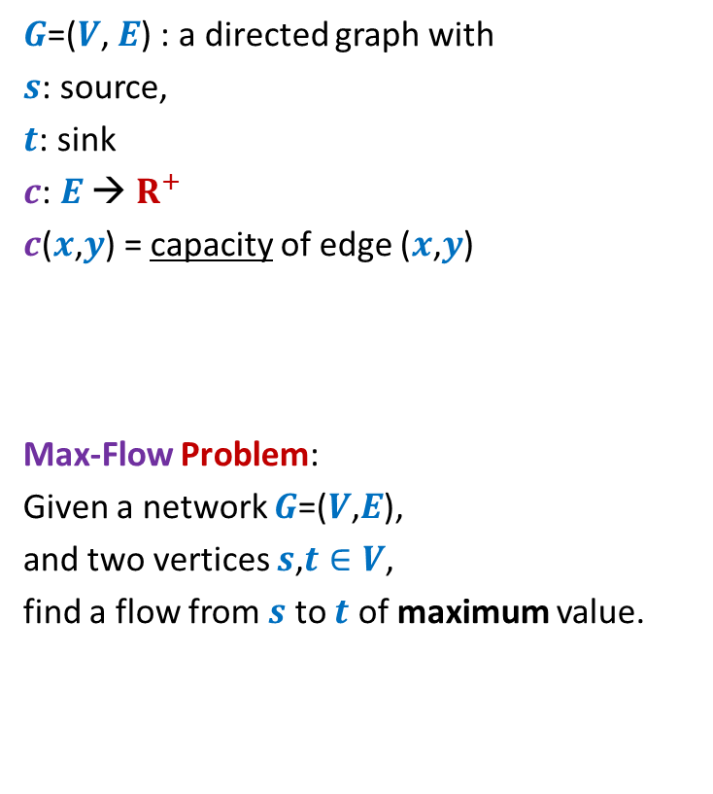
Formal Description of Flow
2
$\text{value}\text{(}f\text{)=}$ flow leaving $s$
$$=\sum_{\left(s,v\right) ∈ E}{f\text{(}u\text{,}v\text{)}}$$
$G$=($V$, $E$) : a directed graph with
$s$: source,
$t$: sink
$c$: $E$ → $R^{+}$
$c$($x$,$y$) = capacity of edge ($x$,$y$)
Max-Flow Problem:
Given a network $G$=($V$,$E$),
and two vertices $s$,$t∈V$,
find a flow from $s$ to $t$ of maximum value.
$$v$$
$$x$$
5
6
15
8
$$t$$
$$s$$
6
7
14
7
17
$$u$$
4
$$y$$

Slide 21

Towards designing max flow algorithm
2
Find some $s−t$ path,
Send flow along the path,
Update capacities,
Find some $s−t$ path,
…and so on ☺
$$v$$
$$x$$
5
6
5
5
+1
5
12
+7
6
15
What is the most natural approach to solve this problem ?
8
$$t$$
$$s$$
6
7
1
1
7
7
14
7
17
$$u$$
4
$$y$$

Slide 22
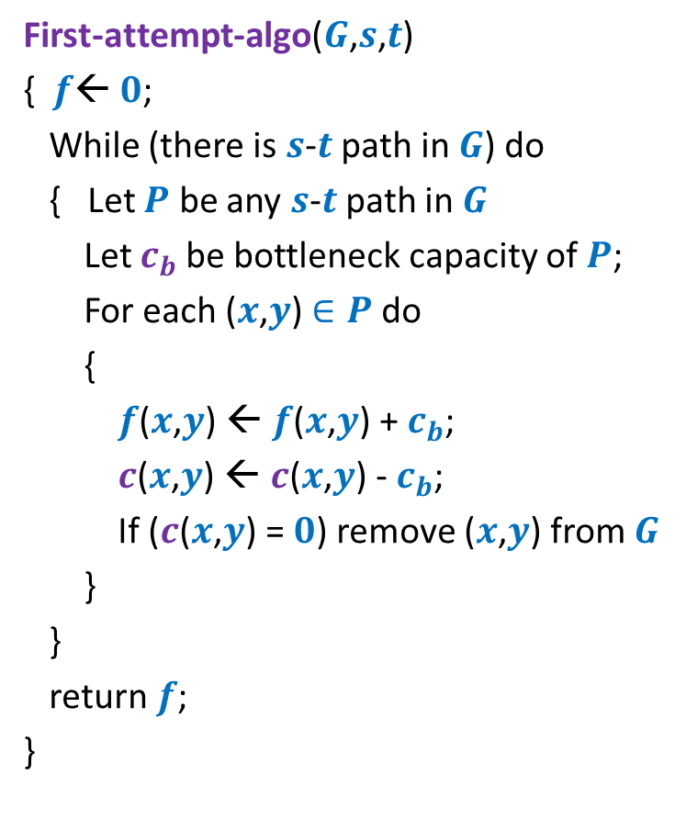
Towards designing max flow algorithm
First-attempt-algo($G$,$s$,$t$)
{ $f$← $0$;
While (there is $s$-$t$ path in $G$) do
{ Let $P$ be any $s$-$t$ path in $G$
Let $c_{b}$be bottleneck capacity of $P$;
For each ($x$,$y$) $∈P$ do
{
$f$($x$,$y$) ← $f$($x$,$y$) + $c_{b}$;
$c$($x$,$y$) ← $c$($x$,$y$) - $c_{b}$;
If ($c$($x$,$y$) = $0$) remove ($x$,$y$) from $G$
}
}
return $f$;
}
Correctness ?

Slide 23
A counterexample for First-attempt-algo

Slide 24

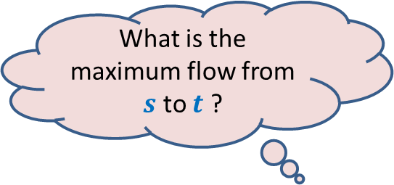



$$x$$
What is the maximum flow from $s$ to $t$ ?
20
10
$$s$$
50
$$t$$
30
10
20
$$y$$

Slide 25




Executing our first attempt algorithm
$$x$$
$$x$$
20
20
10
10
$$s$$
20
50
$$t$$
$$s$$
30
$$t$$
20
10
20
10
$$y$$
$$y$$
No $s−t$ path

Slide 26
Homework
Spend at least 30 minutes today on the following task
Work on this counterexample
and pursue a pure scientific approach
to modify the existing algorithm so that it may compute the maximum flow…

Slide 27
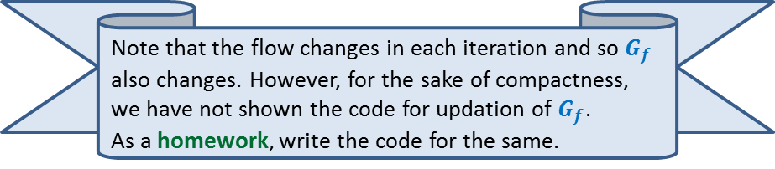
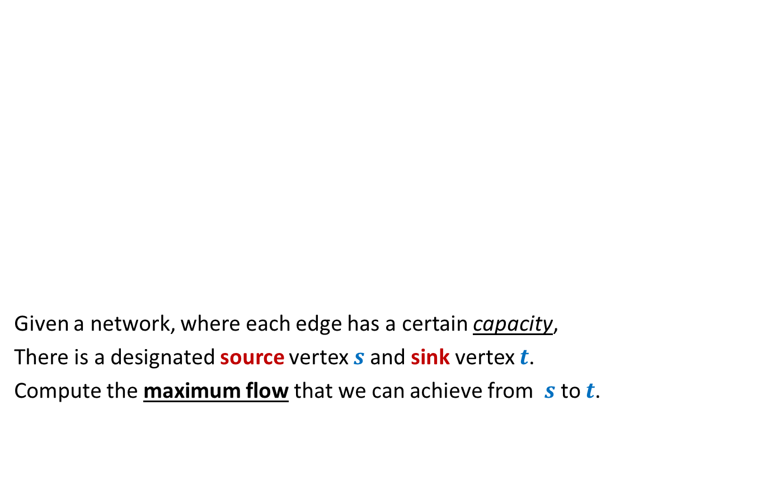

Rounding of a matrix
$$11$$
$$11.7$$
$$12$$
$$39$$ | $$19$$ | $$18$$ | $$30$$
$$37$$
$$15$$
$$20$$
$$34$$
$$11.7$$ | $$2.4$$ | $$4.3$$ | $$18.6$$
$$5.2$$ | $$6.1$$ | $$1.0$$ | $$2.7$$
$$6.7$$ | $$3.6$$ | $$9.1$$ | $$0.6$$
$$15.4$$ | $$6.9$$ | $$3.6$$ | $$8.1$$
$$12$$ | $$2$$ | $$4$$ | $$19$$
$$5$$ | $$6$$ | $$1$$ | $$3$$
$$7$$ | $$4$$ | $$9$$ | $$0$$
$$15$$ | $$7$$ | $$4$$ | $$8$$
An amazing application of max flows.
Design an algorithm to round a $n×n$ matrix, if possible ?
Rounding always exists !
Rounding can be computed efficiently.
Using Max Flow ☺

