Slide 1
Design and Analysis of Algorithms
Algorithms-II : CS345A
Website: hello.iitk.ac.in
Lecture 21
Network Flow – IV
Polynomial time algorithms for Maximum Flow

Slide 2
Rounding of a matrix
A motivating application of
Max Flow

Slide 3




Integrality of max-flow
Theorem: Given a network $G$=($V$,$E$), and two vertices $s$,$t∈V$,
if edge capacities are integers, then there exists a maximum $s$-$t$flow $f$
which is “integral”.
$f\left(e\right)∈Z$for each $e∈E$
0.67
1
0.67
1
1
1
1
$$s$$
1
0
$$t$$
0.33
0
0.33
1
1

Slide 4

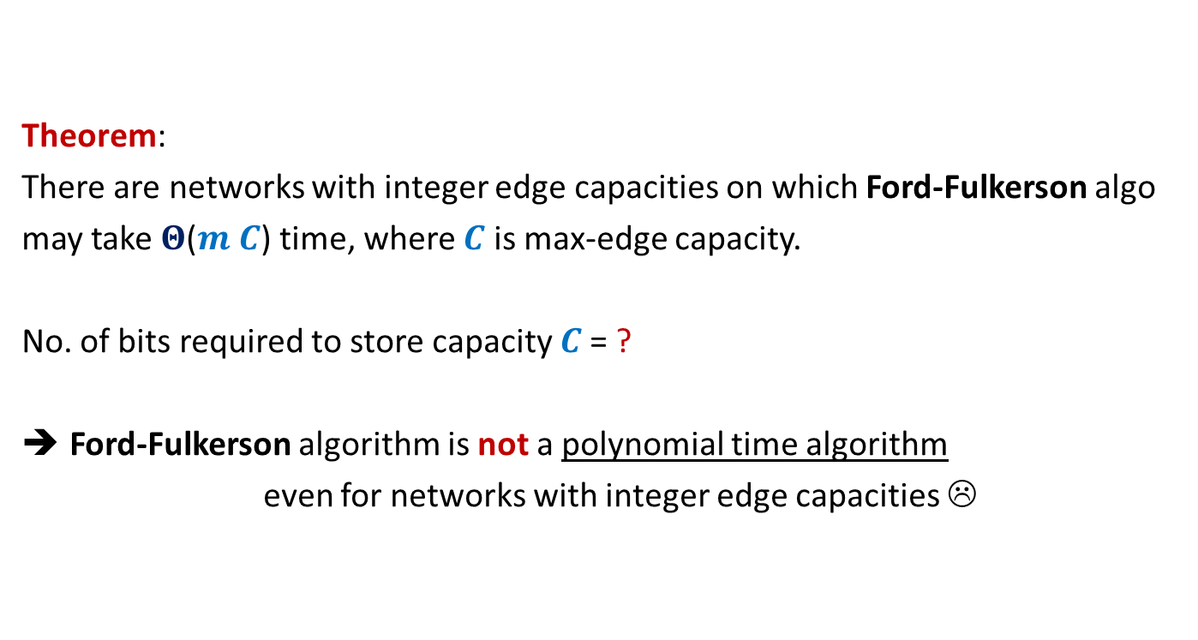

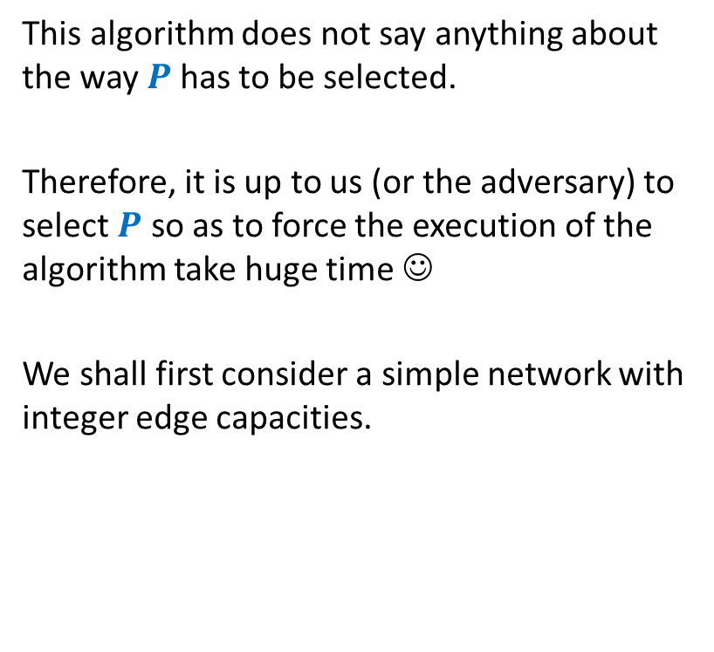


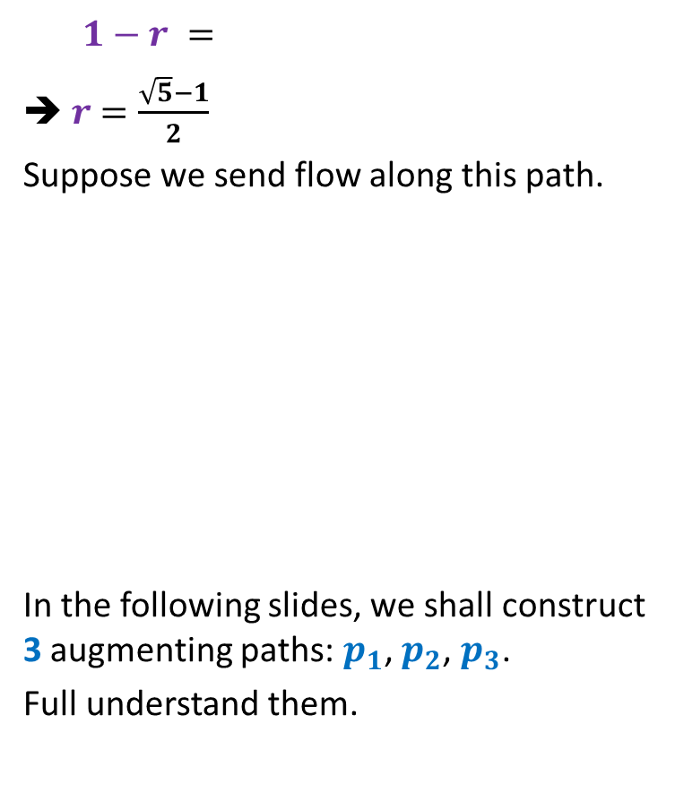

Rounding of a matrix
$$11$$
$$11.7$$
$$12$$
$$39$$ | $$19$$ | $$18$$ | $$30$$
$$37$$
$$15$$
$$20$$
$$34$$
$$11.7$$ | $$2.4$$ | $$4.3$$ | $$18.6$$
$$5.2$$ | $$6.1$$ | $$1.0$$ | $$2.7$$
$$6.7$$ | $$3.6$$ | $$9.1$$ | $$0.6$$
$$15.4$$ | $$6.9$$ | $$3.6$$ | $$8.1$$
$$12$$ | $$2$$ | $$4$$ | $$19$$
$$5$$ | $$6$$ | $$1$$ | $$3$$
$$7$$ | $$4$$ | $$9$$ | $$0$$
$$15$$ | $$7$$ | $$4$$ | $$8$$
Design an algorithm to round a $n×n$ matrix, if possible ?
Rounding always exists !
Rounding can be computed efficiently.
Using Max Flow ☺

Slide 5

Rounding of a matrix
Tool 1: Integrality of max-flow
Tool 2: An elementary observation
Max-Flow does not decrease if we increase the capacity of any set of edges.
Tool 3: A simple Homework exercise
If each matrix with entries $∈[0,1]$ can be rounded,
then each matrix can be rounded.

Slide 6

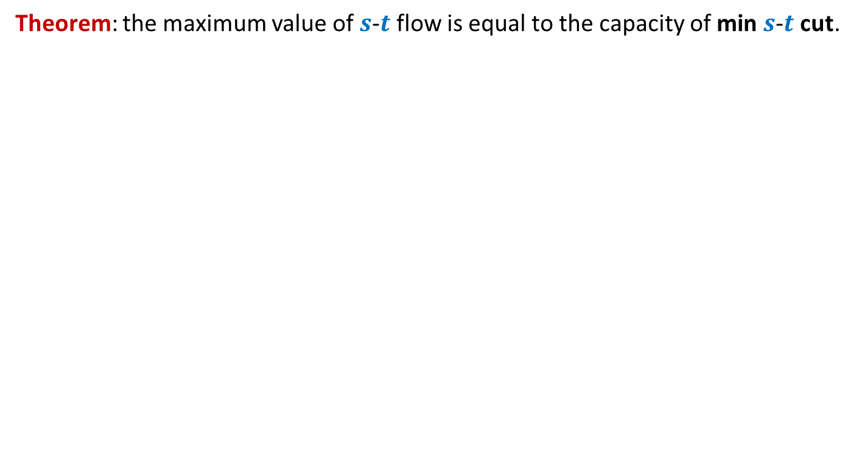
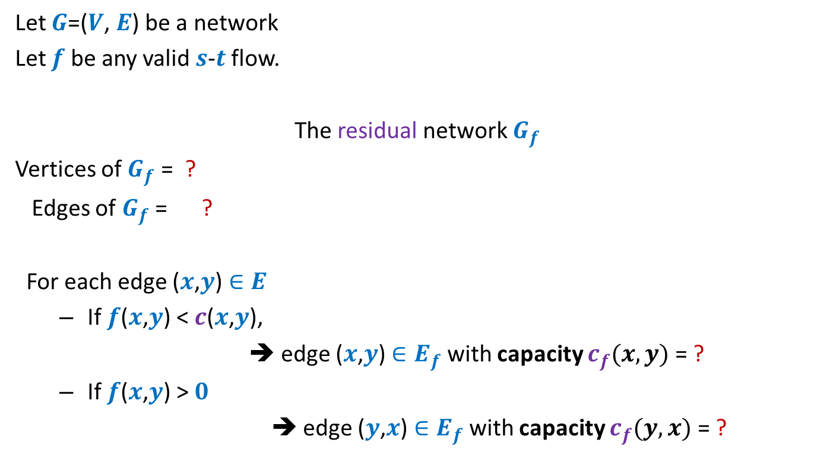
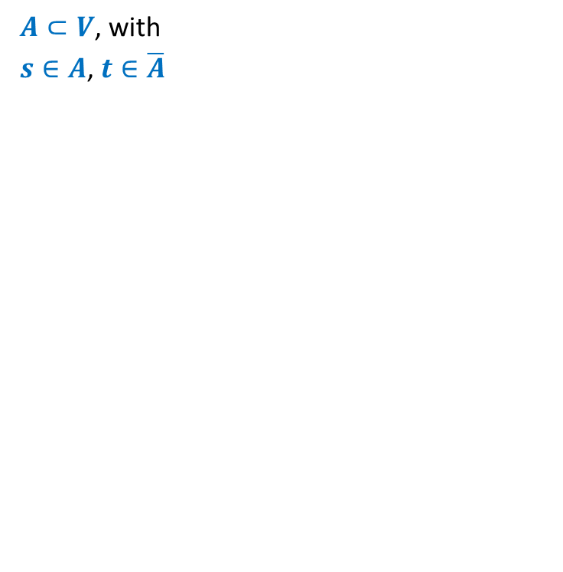






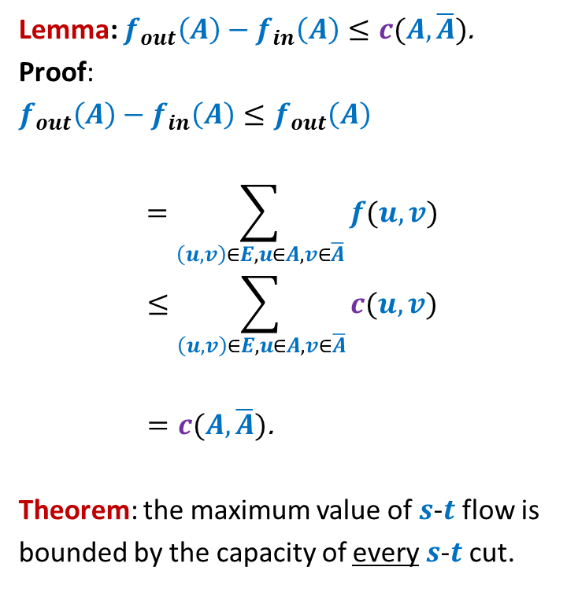







Rounding of a matrix
$$0$$
$$0.7$$
$$1$$
Tool 3
Tool 2
$$2$$ | $$2$$ | $$1$$ | $$2$$
Tool 1
rows
columns
$$2$$
$$1$$
$$2$$
$$2$$
$$0.7$$ | $$0.4$$ | $$0.3$$ | $$0.6$$
$$0.2$$ | $$0.1$$ | $$0.0$$ | $$0.7$$
$$0.7$$ | $$0.6$$ | $$0.1$$ | $$0.6$$
$$0.4$$ | $$0.9$$ | $$0.6$$ | $$0.1$$
$$1$$
$$0.2$$
$$2$$
$$2$$
$$1$$
$$0.1$$
$$2$$
$$1$$
$$0$$
$$2$$
$$0.0$$
$$1$$
$$0.7$$
$$1$$
$$2$$
$$2$$
Homework: Reproduce precise arguments on your own

Slide 7
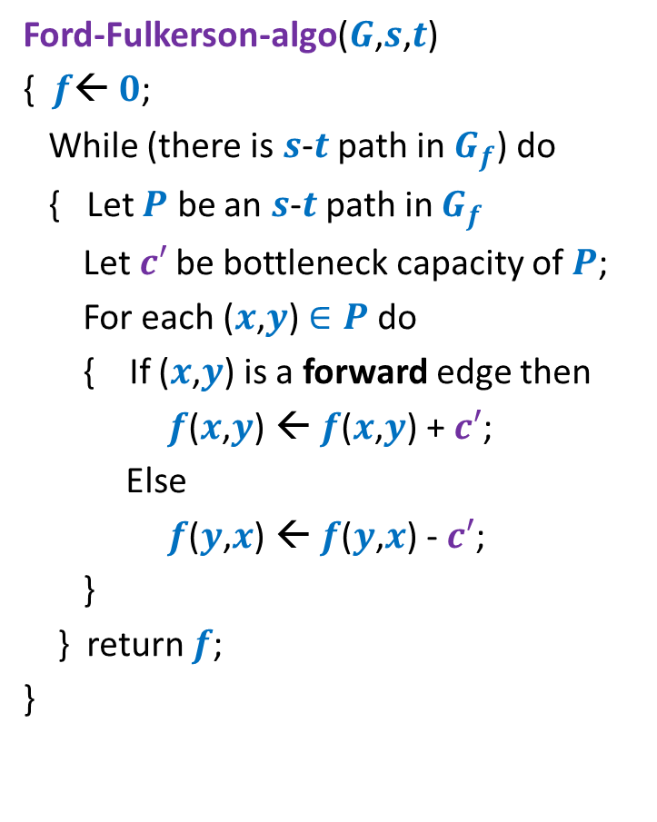
Ford Fulkerson algorithm
Ford-Fulkerson-algo($G$,$s$,$t$)
{ $f$← $0$;
While (there is $s$-$t$ path in $G_{f}$) do
{ Let $P$ be an $s$-$t$ path in $G_{f}$
Let$c′$ be bottleneck capacity of $P$;
For each ($x$,$y$) $∈P$ do
{ If ($x$,$y$) is a forward edge then
$f$($x$,$y$) ← $f$($x$,$y$) + $c′$;
Else
$f$($y$,$x$) ← $f$($y$,$x$) - $c′$;
}
} return $f$;
}
Polynomial time algorithm ?

Slide 8
Polynomial time algorithms for Max-Flow
A natural question: How to achieve polynomial running time ?
➔
A natural idea:
Select the path of maximum capacity.
select the paths in Ford-Fulkerson algorithm cleverly

Slide 9
Polynomial Time algorithms for max-flow
Algorithm 1 For Networks with integer capacities

Slide 10

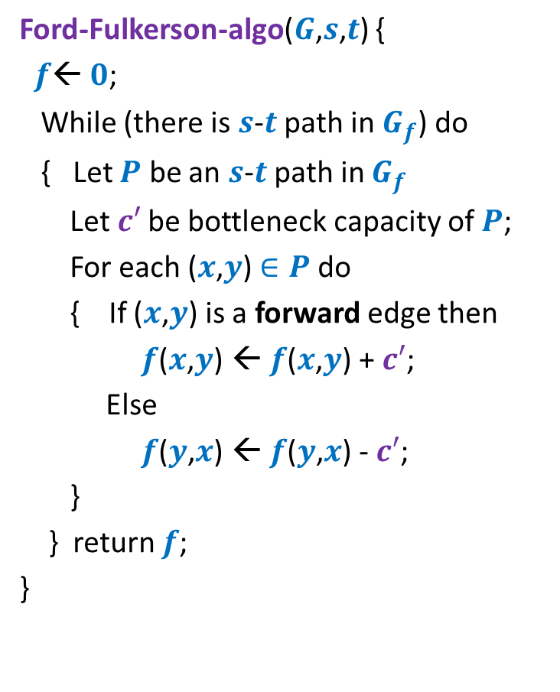

Algorithm 1
Algorithm-1($G$,$s$,$t$) {
Ford-Fulkerson-algo($G$,$s$,$t$) {
$f$← $0$;
While (there is $s$-$t$ path in $G_{f}$) do
{ Let $P$ be an $s$-$t$ path in $G_{f}$
Let$c′$ be bottleneck capacity of $P$;
For each ($x$,$y$) $∈P$ do
{ If ($x$,$y$) is a forward edge then
$f$($x$,$y$) ← $f$($x$,$y$) + $c′$;
Else
$f$($y$,$x$) ← $f$($y$,$x$) - $c′$;
}
} return $f$;
}
Let $P$ be the max-capacity $s$-$t$ path in $G_{f}$;

Slide 11
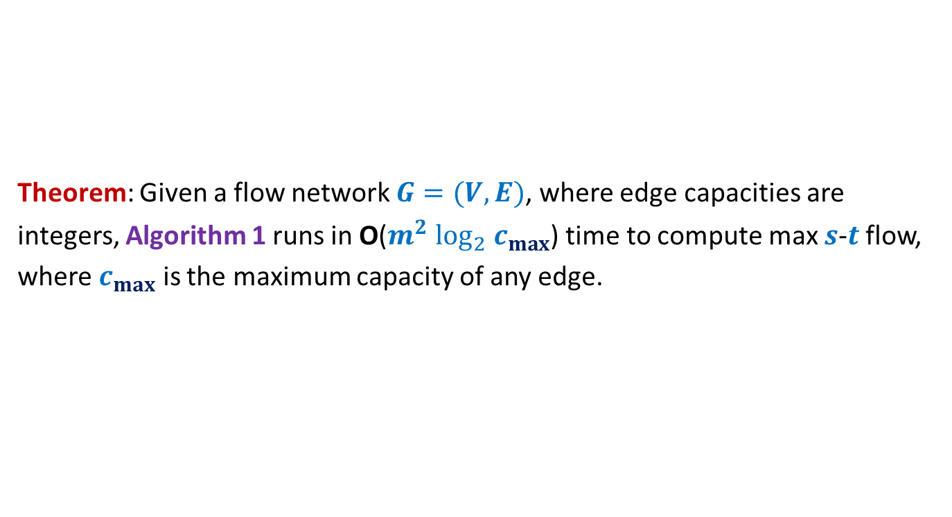
Algorithm 1
Theorem: Given a flow network $G=(V,E)$, where edge capacities are
integers, Algorithm 1 runs in O($m^{2} \log_{2} c_{max}$) time to compute max $s$-$t$ flow,
where $c_{max}$ is the maximum capacity of any edge.

Slide 12

Polynomial Time algorithm for max-flow
Algorithm 2
For Networks with edge capacities $∈R^{+}$

Slide 13
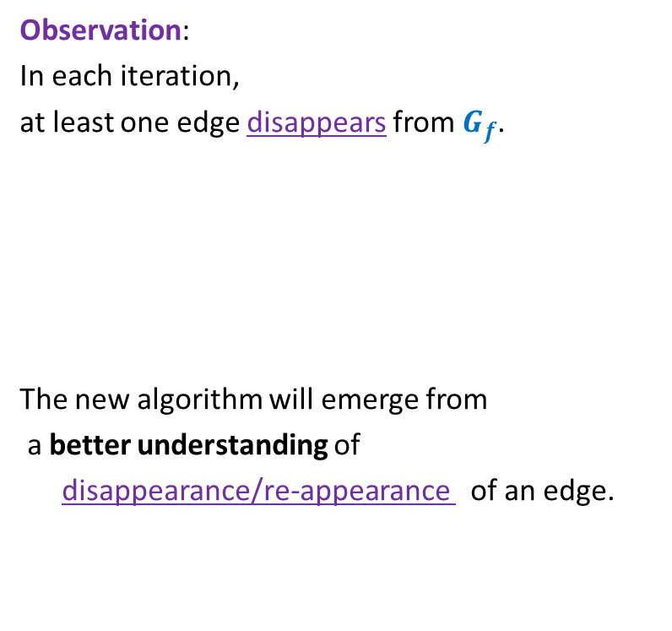

Ford Fulkerson Algorithm
Ford-Fulkerson-algo($G$,$s$,$t$) {
$f$← $0$;
While (there is $s$-$t$ path in $G_{f}$) do
{ Let $P$ be an $s$-$t$ path in $G_{f}$
Let$c′$ be bottleneck capacity of $P$;
For each ($x$,$y$) $∈P$ do
{ If ($x$,$y$) is a forward edge then
$f$($x$,$y$) ← $f$($x$,$y$) + $c′$;
Else
$f$($y$,$x$) ← $f$($y$,$x$) - $c′$;
}
} return $f$;
}
Observation:
In each iteration,
at least one edge disappears from $G_{f}$.
The new algorithm will emerge from
a better understanding of
disappearance/re-appearance of an edge.
But it may appear in $G_{f}$ again.

Slide 14
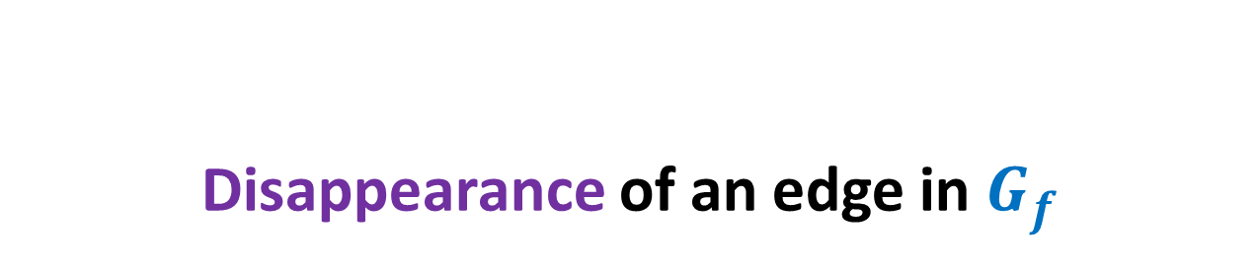
Disappearance of an edge in $G_{f}$

Slide 15












Disappearance of a forward edge
Flow must have increased along edge ($x$,$y$) up to $c$($x$,$y$).
➔ ($x$,$y$) must belong to the path $P$ selected during $i$th Iteration.
$$x$$
$$y$$
$$s$$
$$t$$
$$G_{f}$$
$$x$$
$$y$$
After $i$th Iteration
$$x$$
$$y$$
$$s$$
$$t$$
$$G_{f′}$$
$$x$$
$$y$$

Slide 16







Disappearance of a backward edge
Flow must have decreased along edge ($y$,$x$) to 0.
➔ ($x$,$y$) must belong to the path $P$ selected during $i$th Iteration.
$$y$$
$$x$$
$$s$$
$$t$$
$$G_{f}$$
$$x$$
$$y$$
After $i$th Iteration
$$y$$
$$x$$
$$s$$
$$t$$
$$G_{f′}$$
$$x$$
$$y$$

Slide 17
the (RE-)appearance of an edge

Slide 18










(Re)-Appearance of a forward edge
Flow must have reduced along edge ($x$,$y$) to less than $c$($x$,$y$).
➔ ($y$,$x$) must belong to the path $P$ selected during $i$th Iteration.
$$x$$
$$y$$
$$s$$
$$t$$
$$G_{f}$$
$$x$$
$$y$$
After $i$th Iteration
$$x$$
$$y$$
$$s$$
$$t$$
$$G_{f′}$$
$$x$$
$$y$$

Slide 19


(Re)-appearance of a backward edge
Flow must have increased along edge ($y$,$x$).
➔ ($y$,$x$) must belong to the path $P$ selected during $i$th Iteration.
$$y$$
$$x$$
$$s$$
$$t$$
$$G_{f}$$
$$x$$
$$y$$
After $i$th Iteration
$$y$$
$$x$$
$$s$$
$$t$$
$$G_{f′}$$
$$x$$
$$y$$

Slide 20
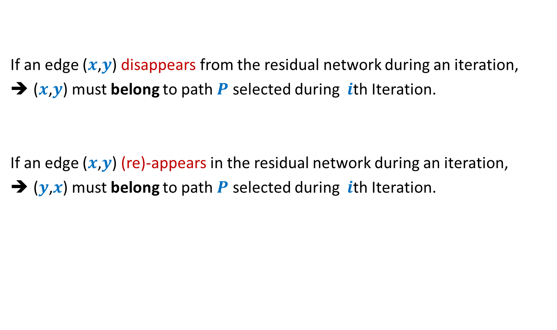
Disappearance/Reappearance of an edge in residual network
If an edge ($x$,$y$) disappears from the residual network during an iteration,
($x$,$y$) must belong to path $P$ selected during $i$th Iteration.
If an edge ($x$,$y$) (re)-appears in the residual network during an iteration,
($y$,$x$) must belong to path $P$ selected during $i$th Iteration.

Slide 21



Algorithm 2
Ford-Fulkerson-algo($G$,$s$,$t$) {
$f$← $0$;
While (there is $s$-$t$ path in $G_{f}$) do
{ Let $P$ be an $s$-$t$ path in $G_{f}$
Let$c′$ be bottleneck capacity of $P$;
For each ($x$,$y$) $∈P$ do
{ If ($x$,$y$) is a forward edge then
$f$($x$,$y$) ← $f$($x$,$y$) + $c′$;
Else
$f$($y$,$x$) ← $f$($y$,$x$) - $c′$;
}
} return $f$;
}
Algorithm-2($G$,$s$,$t$) {
In each iteration, at least one edge disappears from $G_{f}$.
This algorithm ensures that an edge can disappear and re-appear O($n$) times.
Let $P$ be the shortest $s$-$t$ path in $G_{f}$;
How to modify the FF algorithm so that the number of times an edge disappears has a polynomial bound ?

Slide 22

Algorithm 2
Ford-Fulkerson-algo($G$,$s$,$t$) {
$f$← $0$;
While (there is $s$-$t$ path in $G_{f}$) do
{ Let $P$ be an $s$-$t$ path in $G_{f}$
Let$c′$ be bottleneck capacity of $P$;
For each ($x$,$y$) $∈P$ do
{ If ($x$,$y$) is a forward edge then
$f$($x$,$y$) ← $f$($x$,$y$) + $c′$;
Else
$f$($y$,$x$) ← $f$($y$,$x$) - $c′$;
}
} return $f$;
}
Algorithm-2($G$,$s$,$t$) {
Let $P$ be the shortest $s$-$t$ path in $G_{f}$;
How to prove:
An edge can disappear and re-appear O($n$) times.

Slide 23







A crucial observation
Lemma : Distance from $s$ to each vertex increases monotonically in $G_{f}$.
$$δ_{f}\left(s,x\right)≤δ_{f′}\left(s,x\right)$$
$$δ_{f}(s,x)$$
$$s$$
$$t$$
$$x$$
$$G_{f}$$
After $i$th Iteration
$$δ_{f′}(s,x)$$
$$s$$
$$t$$
$$G_{f′}$$
$$x$$

Slide 24


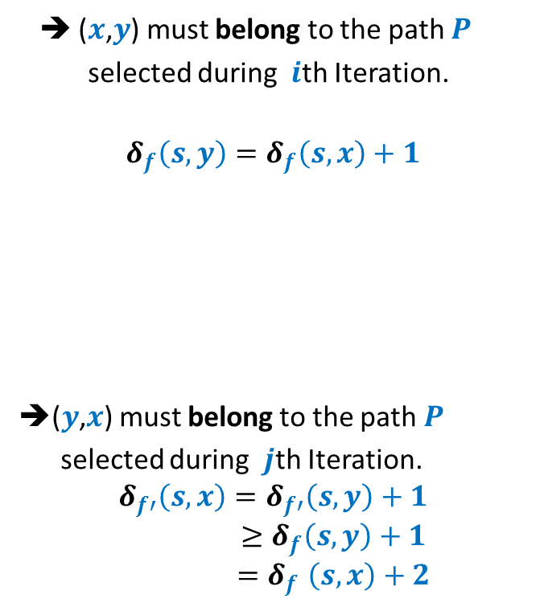



Bounding the disappearing/re-appearing of an edge
$$G_{f}$$
$$s$$
$$t$$
$$x$$
$$y$$
➔ ($x$,$y$) must belong to the path $P$
selected during $i$th Iteration.
$$δ_{f}\left(s,y\right)=δ_{f}\left(s,x\right)+1$$
➔($y$,$x$) must belong to the path $P$
selected during $j$th Iteration.
$$δ_{f′}\left(s,x\right)=δ_{f′}\left(s,y\right)+1$$
$$≥δ_{f}\left(s,y\right)+1$$
$${=δ}_{f}\left(s,x\right)+2$$
After $i$th Iteration
$$s$$
$$t$$
$$x$$
$$y$$
$$δ_{f′}\left(s,y\right)≥δ_{f}\left(s,y\right)$$
$$G_{f′}$$
After $j$th Iteration
$$s$$
$$t$$
$$x$$
$$y$$

Slide 25
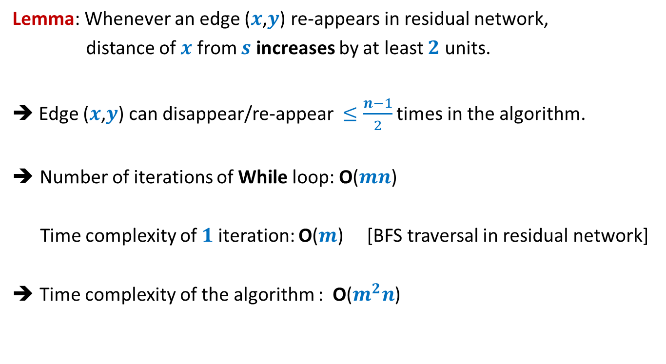
Analysis of Algorithm 2
Lemma: Whenever an edge ($x$,$y$) re-appears in residual network,
distance of $x$ from $s$ increases by at least $2$ units.
➔ Edge ($x$,$y$) can disappear/re-appear $≤\frac{n−1}{2}$ times in the algorithm.
Number of iterations of While loop: O($mn$)
Time complexity of $1$iteration: O($m$) [BFS traversal in residual network]
Time complexity of the algorithm : O($m^{2}n$)

Slide 26
Proof of the monotonic increase of distanceS in residual network
Homework 1: Ponder over the proof

Slide 27

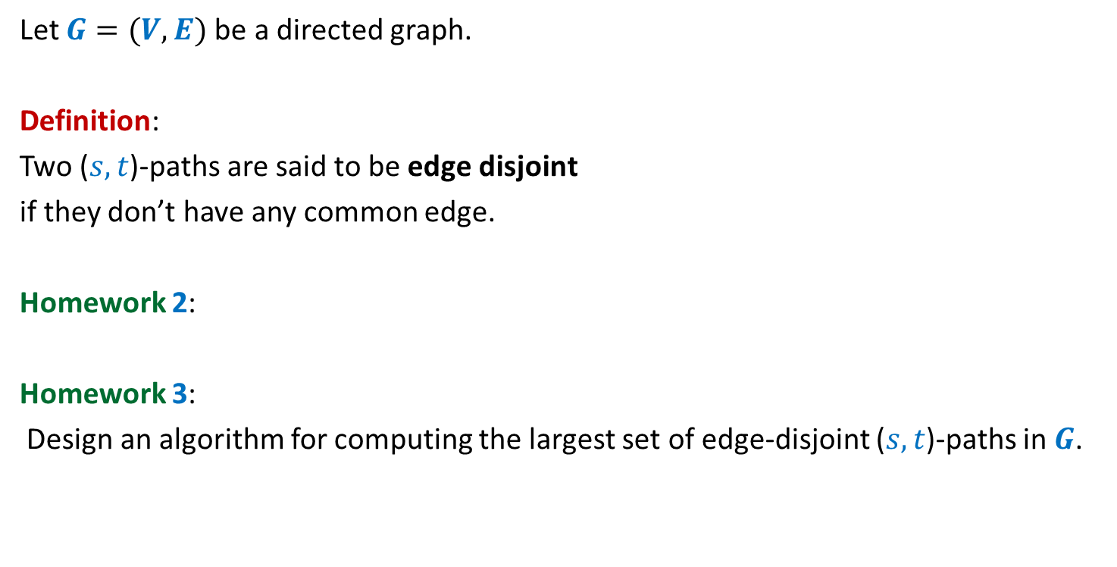

Maximum no. of edge disjoint paths
Let $G=(V,E)$be a directed graph.
Definition:
Two ($s,t$)-paths are said to be edge disjoint
if they don’t have any common edge.
Homework 2:
Homework 3:
Design an algorithm for computing the largest set of edge-disjoint ($s,t$)-paths in $G$.
Largest set of edge-disjoint ($s,t$)-paths
?
($s,t$)-mincut

Slide 28
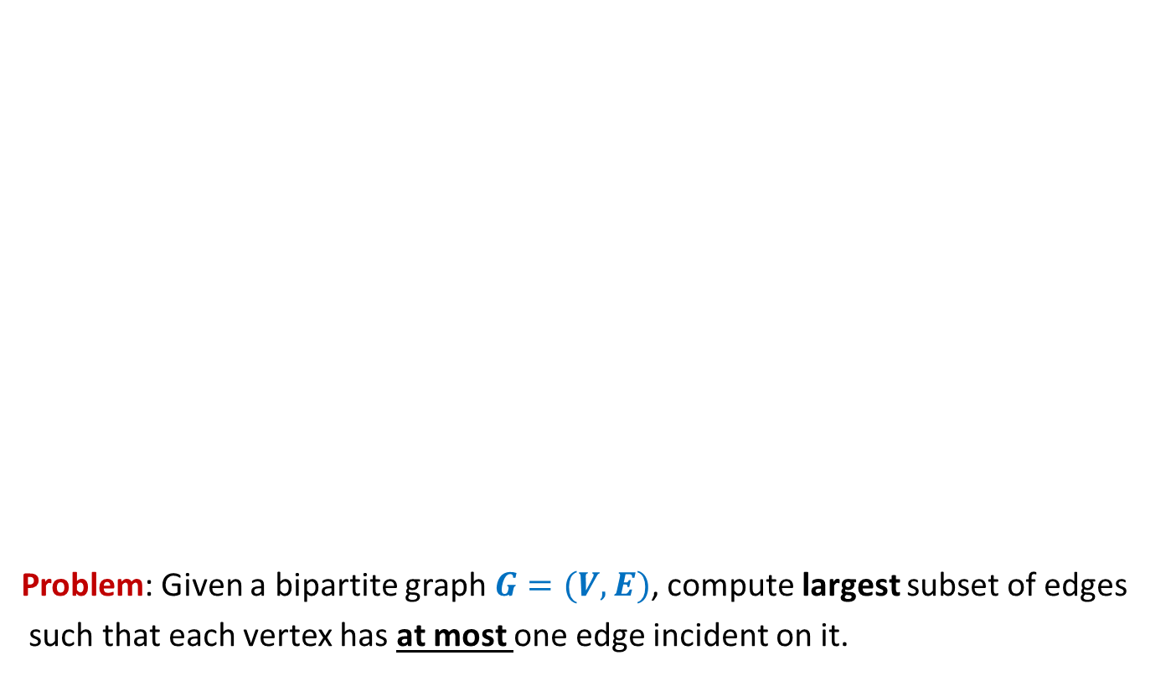
Bipartite matching
Problem: Given a bipartite graph $G=(V,E)$, compute largest subset of edges
such that each vertex has at most one edge incident on it.
applicants
jobs

