Slide 1
Design and Analysis of Algorithms
Algorithms-II : CS345A
Website: hello.iitk.ac.in
Lecture 22
Network Flow – V

Slide 2

Polynomial Time algorithm for max-flow
Algorithm 2
For Networks with edge capacities $∈R^{+}$

Slide 3
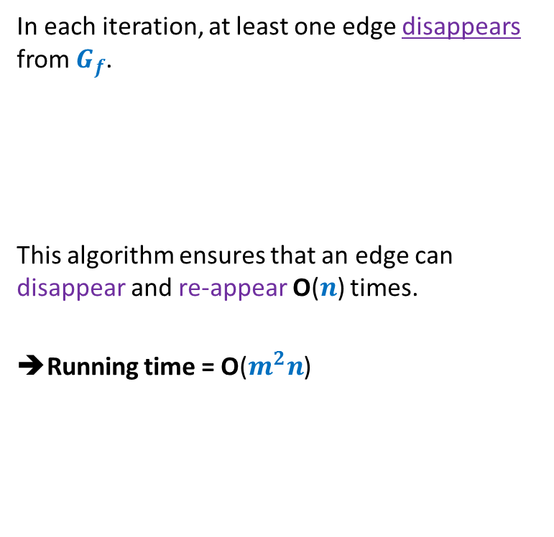
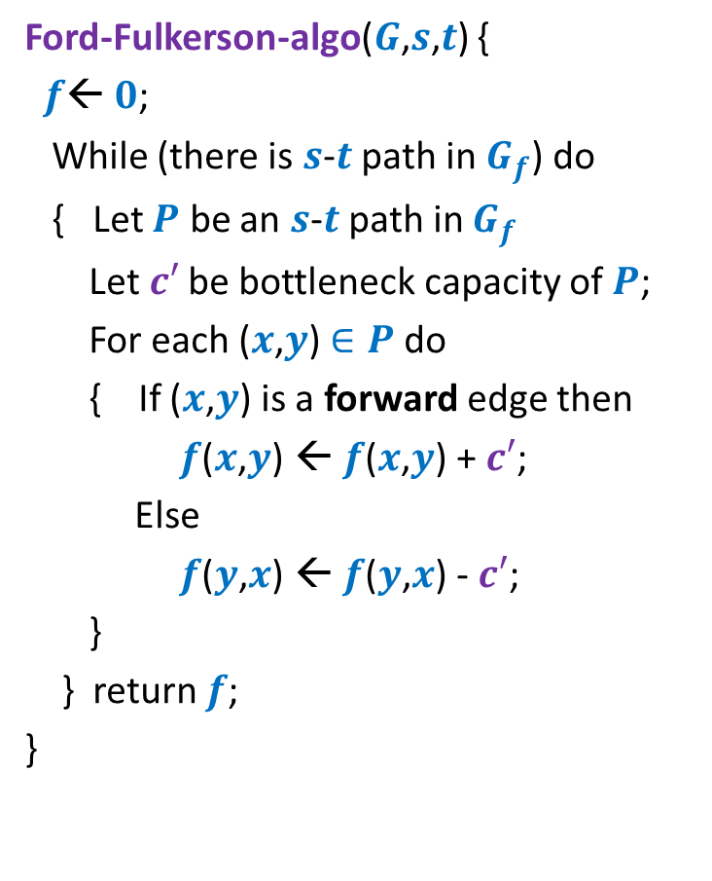



Algorithm 2
Ford-Fulkerson-algo($G$,$s$,$t$) {
$f$← $0$;
While (there is $s$-$t$ path in $G_{f}$) do
{ Let $P$ be an $s$-$t$ path in $G_{f}$
Let$c′$ be bottleneck capacity of $P$;
For each ($x$,$y$) $∈P$ do
{ If ($x$,$y$) is a forward edge then
$f$($x$,$y$) ← $f$($x$,$y$) + $c′$;
Else
$f$($y$,$x$) ← $f$($y$,$x$) - $c′$;
}
} return $f$;
}
Algorithm-2($G$,$s$,$t$) {
In each iteration, at least one edge disappears from $G_{f}$.
This algorithm ensures that an edge can disappear and re-appear O($n$) times.
➔Running time = O($m^{2}n$)
Let $P$ be the shortest $s$-$t$ path in $G_{f}$;
But it may appear in $G_{f}$ again.

Slide 4









A crucial observation
Lemma : Distance from $s$ to each vertex increases monotonically in $G_{f}$.
$$δ_{f}\left(s,x\right)≤δ_{f′}\left(s,x\right)$$
$$δ_{f}(s,x)$$
$$s$$
$$t$$
$$x$$
$$G_{f}$$
After $i$th Iteration
$$δ_{f′}(s,x)$$
$$s$$
$$t$$
$$G_{f′}$$
$$x$$

Slide 5





Proof by contradiction
$δ_{f′}\left(s,x\right)<δ_{f}\left(s,x\right)$
Let $x$be the nearest “defaulter”.
➔ For each vertex $v$in $G_{f′}$ with $δ_{f^{′}}\left(s,v\right)<δ_{f′}(s,x)$,
$δ_{f}\left(s,v\right)≤δ_{f′}\left(s,v\right)$
$$δ_{f}(s,x)$$
$$s$$
$$t$$
$$G_{f}$$
$$x$$
$i$th Iteration
$$δ_{f′}(s,x)$$
$$G_{f′}$$
$$s$$
$$t$$
$$x$$

Slide 6





Proof by contradiction
Definitely $δ_{f}\left(s,u\right)≤δ_{f′}\left(s,u\right)$
➔Edge $\left(u,x\right)$ must have appeared in residual network after $i$th iteration.
➔Edge $\left(x,u\right)∈P$ (the path selected during $i$th Iteration)
➔ $δ_{f}\left(s,u\right)=δ_{f}\left(s,x\right)+1$
$$δ_{f}(s,x)$$
$$s$$
$$t$$
$$G_{f}$$
$$x$$
$i$th Iteration
$$δ_{f′}(s,x)$$
$$G_{f′}$$
$$s$$
$$t$$
$$u$$
$$x$$
contradiction
$>δ_{f′}\left(s,x\right)+1$
$=(δ_{f^{′}}\left(s,u\right)+1)+1$
$δ_{f}\left(s,u\right)>δ_{f′}\left(s,u\right)$

Slide 7
Well Known Algorithms for Max-Flow

Slide 8





Well known algorithms for Max-Flow
Inventor(s) | Year | Time complexity
Ford & Fulkerson
1956
O($−−$)
Edmond and Karp
1972
O($m^{2}n$)
Yefim Dinitz
1970*
O($n^{2}m$)
V.M. Malhotra,
Pramodh Kumar,
S.N. Maheshwari
1978 @IITK
O($n^{3}$)
J. Orlin
2013
O($mn$)

Slide 9
Applications and Variants Of Max-Flow

Slide 10
















Multiple source and multiple sinks
Problem: Given multiple sources and multiple sinks, compute the maximum flow we can send from the sources to the sinks.
$$∞$$
$$s_{1}$$
$$t_{1}$$
$$∞$$
$$∞$$
$$∞$$
$$s_{2}$$
$$s$$
$$∞$$
$$t_{2}$$
$$∞$$
$$t$$
$$∞$$
$$s_{3}$$
$$t_{3}$$
$$s_{4}$$

Slide 11





Max flow when nodes also have capacity
Problem: Given a flow network $G=(V,E)$,
where each node $v∈V$also has a capacity
$c(v)$ : maximum flow that $v$ can allow to pass through it.
Compute the maximum $s$-$t$flow.
$$v$$
$c(v)$
$$v_{in}$$
$$v_{out}$$

Slide 12
Application # 2 of Max-Flow
Bipartite Matching

Slide 13
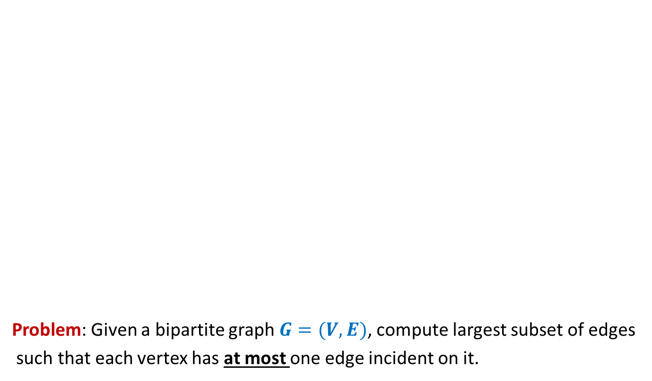
Bipartite matching
Problem: Given a bipartite graph $G=(V,E)$, compute largest subset of edges
such that each vertex has at most one edge incident on it.
applicants
jobs
Matching of size 5
Matching of size 3

Slide 14







Bipartite matching Maximum Flow
applicants
jobs
$$1$$
$$1$$
$$1$$
$$1$$
$$1$$
$$1$$
$$1$$
$$1$$
$$G′$$
$$s$$
$$1$$
$$t$$
$$1$$
$$1$$
$$1$$
$$1$$
$$1$$
$$1$$
$$1$$
$$1$$
$$1$$
$$1$$
$$1$$
$$1$$
$$1$$
$$1$$
$$1$$
How does the max-flow instance look like ?

Slide 15
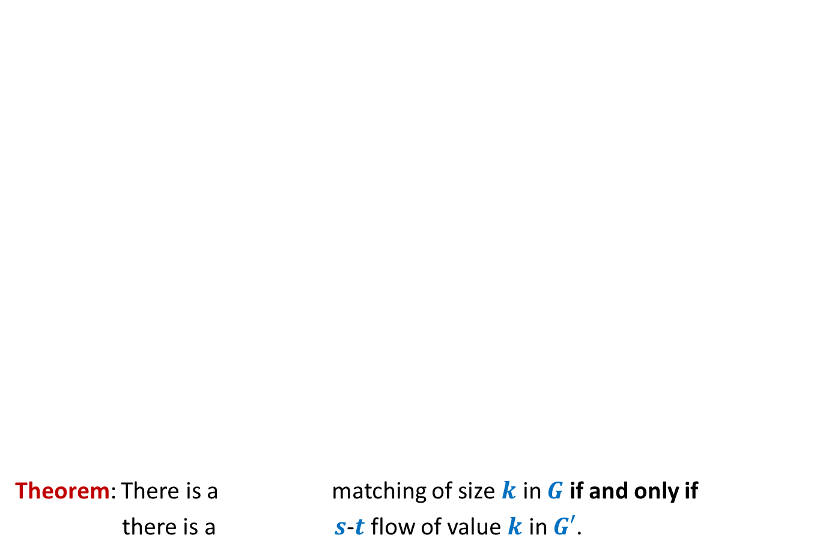

Bipartite matching Maximum Flow
Theorem: There is a matching of size $k$ in $G$ if and only if
there is a $s$-$t$ flow of value $k$ in $G′$.
Convince yourself that this theorem would directly imply that
maxflow in $G′$ = max matching in $G$
applicants
jobs
$$1$$
$$1$$
$$1$$
$$1$$
$$1$$
$$1$$
$$1$$
$$1$$
$$G′$$
$$s$$
$$1$$
$$t$$
$$1$$
$$1$$
$$1$$
$$1$$
$$1$$
$$1$$
$$1$$
What is the relation between the two instances ?
$$1$$
$$1$$
$$1$$
$$1$$
$$1$$
$$1$$
$$1$$
$$1$$
maximum
maximum

Slide 16
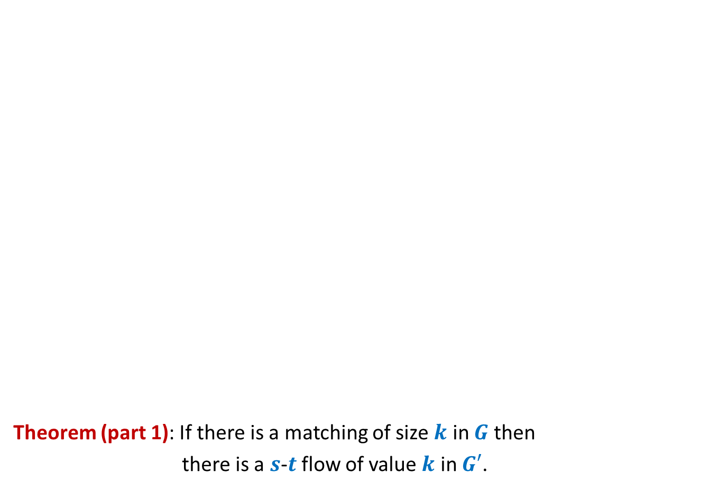

Bipartite matching Maximum Flow
Theorem (part 1): If there is a matching of size $k$ in $G$ then
there is a $s$-$t$ flow of value $k$ in $G′$.
Given an instance of matching of size $k$ in $G$, how will you construct a flow of value $k$ in $G′$ ?
applicants
jobs
$$1$$
$$1$$
$$1$$
$$1$$
$$1$$
$$1$$
$$1$$
$$1$$
$$G′$$
$$s$$
$$1$$
$$t$$
$$1$$
$$1$$
$$1$$
$$1$$
$$1$$
$$1$$
$$1$$
$$1$$
$$1$$
$$1$$
$$1$$
$$1$$
$$1$$
$$1$$
$$1$$

Slide 17
Bipartite matching Maximum Flow
Theorem (part 1): If there is a matching of size $k$ in $G$ then
there is a $s$-$t$ flow of value $k$ in $G′$.
applicants
jobs
$$1$$
$$1$$
$$1$$
$$1$$
$$1$$
$$1$$
$$1$$
$$1$$
$$G′$$
$$s$$
$$1$$
$$t$$
$$1$$
$$1$$
$$1$$
$$1$$
$$1$$
$$1$$
$$1$$
$$1$$
$$1$$
$$1$$
$$1$$
$$1$$
$$1$$
$$1$$
$$1$$

Slide 18
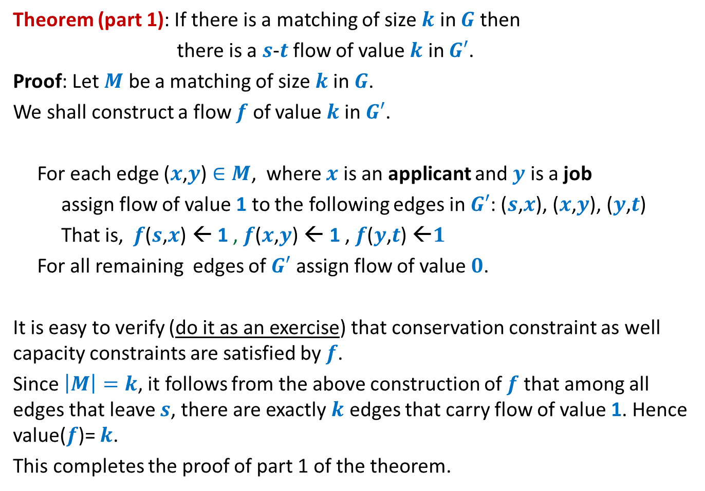
Theorem (part 1): If there is a matching of size $k$ in $G$ then
there is a $s$-$t$ flow of value $k$ in $G′$.
Proof: Let $M$ be a matching of size $k$in $G$.
We shall construct a flow $f$ of value $k$in $G′$.
For each edge ($x$,$y$) $∈M$, where $x$ is an applicant and $y$ is a job
assign flow of value 1 to the following edges in $G′$: ($s$,$x$), ($x$,$y$), ($y$,$t$)
That is, $f$($s$,$x$) ← 1 , $f$($x$,$y$) ← 1 , $f$($y$,$t$) ←$1$
For all remaining edges of $G′$ assign flow of value $0$.
It is easy to verify (do it as an exercise) that conservation constraint as well capacity constraints are satisfied by $f$.
Since $\left|M\right|=k$, it follows from the above construction of $f$that among all edges that leave $s$, there are exactly $k$ edges that carry flow of value 1. Hence value($f$)= $k$.
This completes the proof of part 1 of the theorem.

Slide 19


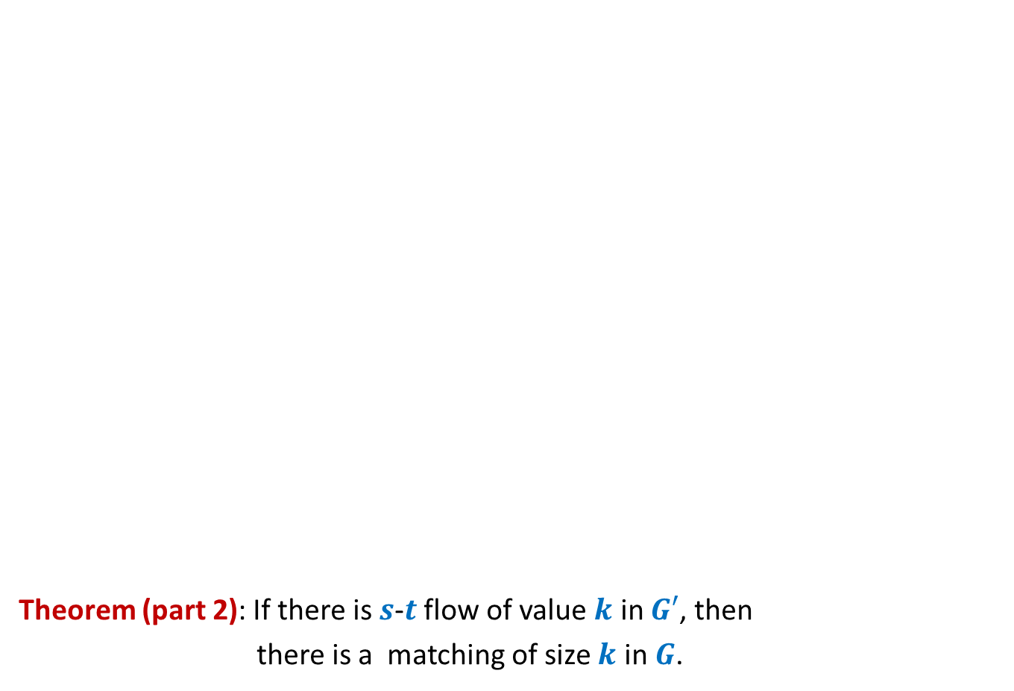
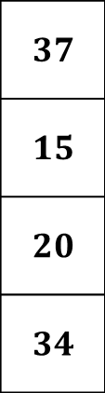

Bipartite matching Maximum Flow
Theorem (part 2): If there is $s$-$t$ flow of value $k$ in $G′$, then
there is a matching of size $k$ in $G$.
Integrality of flow
applicants
jobs
$$1$$
Unit edge capacity
$$1$$
$$1$$
$$1$$
$$1$$
$$1$$
$$1$$
$$A$$
$$1$$
$$G′$$
$$s$$
$$1$$
$$t$$
$$1$$
$$1$$
$$1$$
$$1$$
$A$= {$s$} $∪$ Applicants
$$1$$
$$1$$
$$1$$
$$1$$
$$1$$
$$1$$
$$1$$
$$1$$
Complete the proof with these pointer and verify with the proof given in the following slide.
$f_{out}\left(A\right)−f_{in}(A)$ = $k$
$$1$$
$$1$$
$$0$$
$$1$$

Slide 20
Theorem (part 2): If there is $s$-$t$ flow of value $k$ in $G′$, then
there is a matching of size $k$ in $G$.
Proof: Let $f$ be a $s$-$t$ flow of value $k$ in $G′$.
We shall now construct a matching of size $k$ in $G$.
Firstly, by integrality theorem, $f$ is integral.
Consider the set $A$= {$s$} $∪$ Applicants
So $f_{out}\left(A\right)−f_{in}(A)$ = $k$
Since there is no edge that enters $A$, so $f_{in}(A)$ = $0$,
Hence $f_{out}\left(A\right)$ = $k$.
Moreover, since capacity of each edge in $G′$ is $1$, each edge in $G′$ carries either no flow or a flow of value $1$.
Therefore, there are exactly $k$ edges between Applicants and jobs that carry flow of value $1$.
Let $M$ denote the set of these $k$ edges.
Since each edge leaving $s$ (and each edge entering $t$) has capacity $1$, there can be at most one edge from $M$incident on any applicant (or any job).
It thus follows that the set $M$is indeed a matching in $G$.
This completes the proof of part 2 of the theorem.

Slide 21

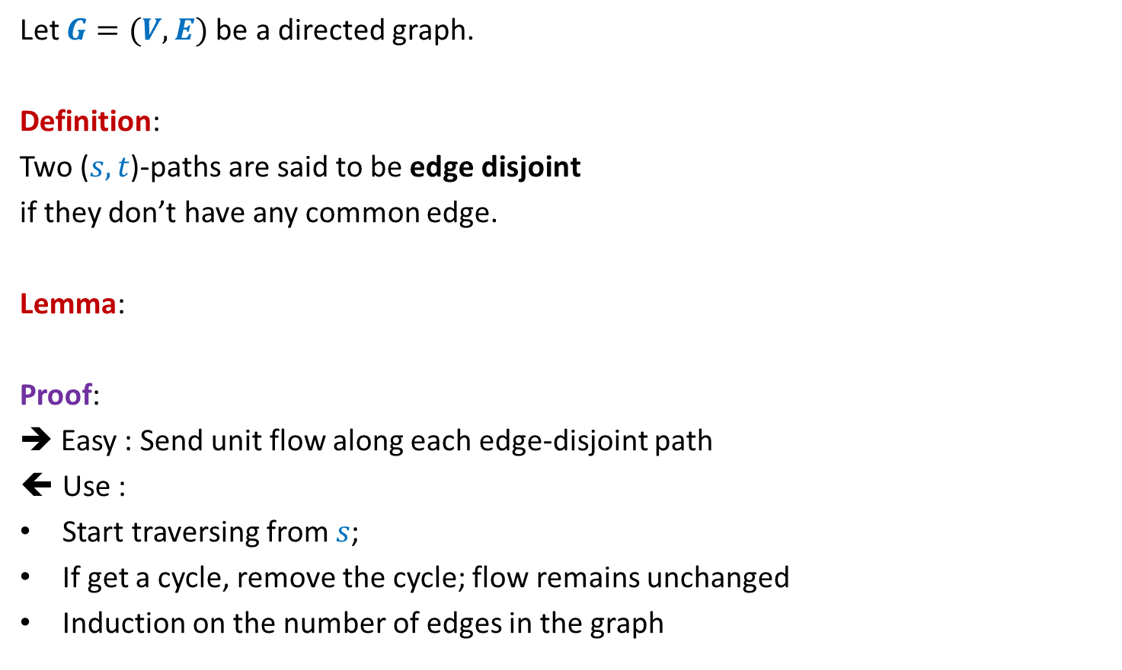


Maximum no. of edge disjoint paths
Let $G=(V,E)$be a directed graph.
Definition:
Two ($s,t$)-paths are said to be edge disjoint
if they don’t have any common edge.
Lemma:
Proof:
➔ Easy : Send unit flow along each edge-disjoint path
Use :
Start traversing from $s$;
If get a cycle, remove the cycle; flow remains unchanged
Induction on the number of edges in the graph
Largest set of edge-disjoint ($s,t$)-paths
=
($s,t$)-maxflow
($s,t$)-mincut

