Slide 1
Design and Analysis of Algorithms
Algorithms-II : CS345A
Website: hello.iitk.ac.in
Lecture 3
Divide and Conquer Paradigm - III
2. Power of Binary Search Trees - I
(partly)

Slide 2
An algorithm for multiplying two polynomials
1

Slide 3
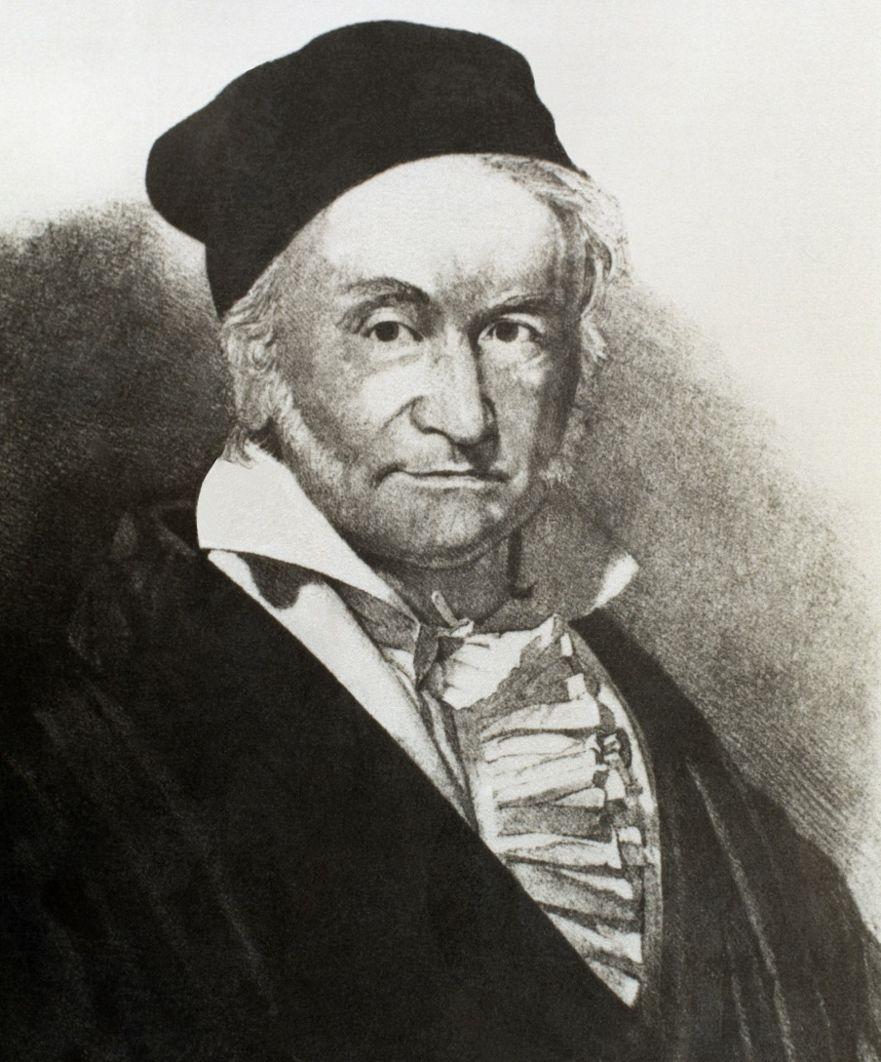
Carl Friedrich Gauss (1777-1855)

Slide 4

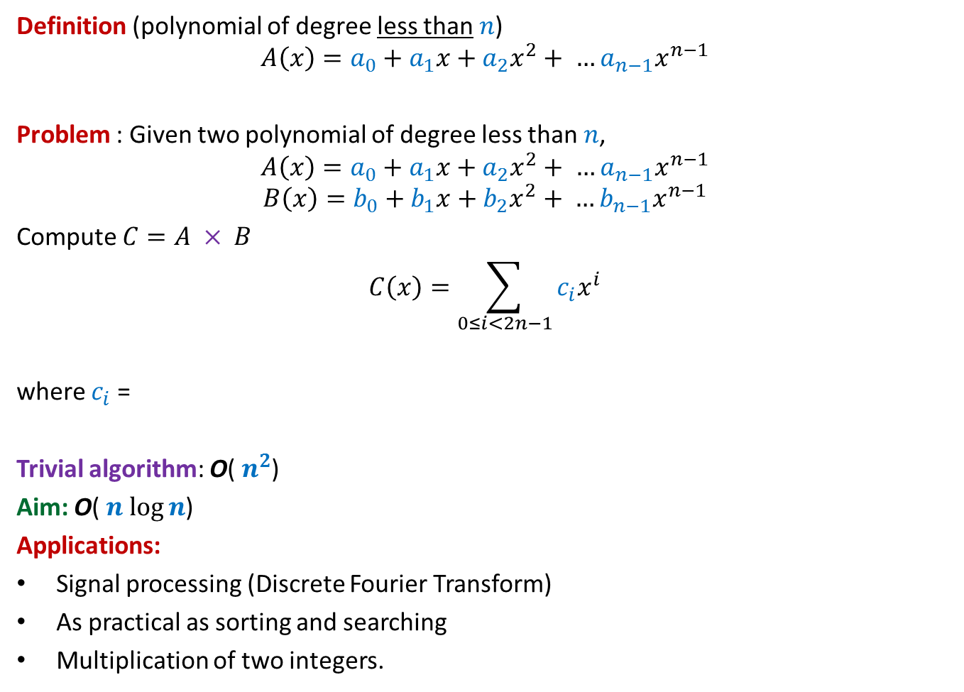

Multiplying two polynomials
Definition (polynomial of degree less than $n$)
$$A\left(x\right)=a_{0}+a_{1}x+a_{2}x^{2}+ …a_{n−1}x^{n−1}$$
Problem : Given two polynomial of degree less than $n$,
$$A\left(x\right)=a_{0}+a_{1}x+a_{2}x^{2}+ …a_{n−1}x^{n−1}$$
$$B\left(x\right)=b_{0}+b_{1}x+b_{2}x^{2}+ …b_{n−1}x^{n−1}$$
Compute $C=A × B$
$$C\left(x\right)=\sum_{0≤i<2n−1}{c_{i}x^{i}}$$
where $c_{i}$ =
Trivial algorithm: O( $n^{2}$)
Aim: O( $n$ $\log{n}$)
Applications:
Signal processing (Discrete Fourier Transform)
As practical as sorting and searching
Multiplication of two integers.
$$a_{0}b_{i}+a_{1}b_{i−1}+a_{2}b_{i−2}+ …+a_{i−1}b_{1}+a_{i}b_{0}$$
O($i$) time

Slide 5

Representation of a polynomial ?
Coefficient representation:
$$A\left(x\right)=a_{0}+a_{1}x+a_{2}x^{2}+ …a_{n−1}x^{n−1}$$
$<a_{0}, a_{1},a_{2},…,a_{n−1}>$

Slide 6







Representation of a polynomial ?
Alternate representation of polynomial
“$A\left(x\right)=a_{0}+a_{1}x$”
{$(r_{0}, A\left(r_{0}\right)),(r_{1}, A\left(r_{1}\right))$}
for any distinct $r_{0}$ and $r_{1}$uniquely define $A\left(x\right)$.
Alternate representation of polynomial “$A\left(x\right)=a_{0}+a_{1}x+a_{2}x^{2}$”
{$(r_{0}, A\left(r_{0}\right)),(r_{1}, A\left(r_{1}\right))$, $(r_{2}, A\left(r_{2}\right))$}
for any distinct $r_{0}$,$r_{1}$, and $r_{2}$ uniquely define $A\left(x\right)$.
$$(r_{1}, A\left(r_{1}\right))$$
$$(r_{2}, A\left(r_{2}\right))$$
$$(r_{0}, A\left(r_{0}\right))$$
$$(r_{1}, A\left(r_{1}\right))$$
$$(r_{0}, A\left(r_{0}\right))$$

Slide 7

Representation of a polynomial ?
Theorem:
Let {$(r_{0},t_{0}),(r_{1},t_{1})$, …, $(r_{m−1}, t_{m−1})$} be $m$ pairs of numbers with all $r_{i}$’s distinct.
There exists a unique polynomial $A$ of degree less than $m$ such that
$A\left(r_{i}\right)=t_{i}$ $∀ i$
Proof: Elementary matrix theory.
Do it as a Homework.
(point,value) representation of a polynomial

Slide 8



Questions
$A$ and $B$: two polynomial of degree less than $n$,
and
$C=A × B$
and
{$r_{0},r_{1}, r_{m−1}$}: any $m$ distinct numbers
If we are given {$A\left(r_{0}\right),A\left(r_{1}\right),…$ ,$A\left(r_{m−1}\right)$} and {$B\left(r_{0}\right),B\left(r_{1}\right),…$ ,$B\left(r_{m−1}\right)$}
Question 1 : How efficiently can we compute {$C\left(r_{0}\right),C\left(r_{1}\right),…$ ,$C\left(r_{m−1}\right)$} ?
Question 2 : What should be the smallest value of $m$ such that
{$\left(r_{0}, C\left(r_{0}\right)\right),…,(r_{m−1}, C\left(r_{m−1}\right)$} is a (point,value) representation of $C$ ?
O($m$) time
$$2n−1$$

Slide 9
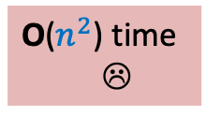

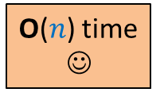

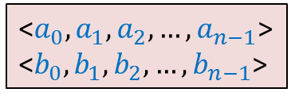
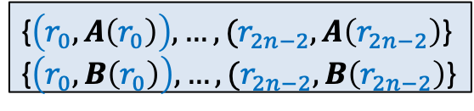
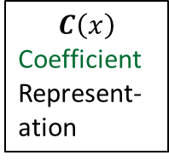


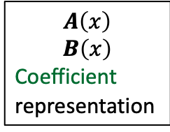

$C=A × B$
O($n^{2}$) time
☹
$$C\left(x\right)$$
Coefficient
Represent-ation
$$A\left(x\right)$$
$$B\left(x\right)$$
Coefficient
representation
<$a_{0}, a_{1},a_{2},…,a_{n−1}$>
<$b_{0}, b_{1},b_{2},…,b_{n−1}$>
<$c_{0}, c_{1},c_{2},…,c_{2n−2}$>
O($n$ log $n$) time
O($n$ log $n$) time
Polynomial Evaluation
Polynomial Interpolation
{$\left(r_{0}, A\left(r_{0}\right)\right),…,(r_{2n−2}, A\left(r_{2n−2}\right)$}
{$\left(r_{0}, B\left(r_{0}\right)\right),…,(r_{2n−2}, B\left(r_{2n−2}\right)$}
{$\left(r_{0}, C\left(r_{0}\right)\right),…,(r_{2n−2}, C\left(r_{2n−2}\right)$}
O($n$) time
☺

Slide 10

Polynomial Evaluation Problem
Given a polynomial $A$ of degree less than $n$in coefficient representation,
Choose any set $S$ of $n$ numbers
Compute $A\left(v\right)$ for all $v∈S$.
Assumption:
$n$ is a power of 2.

Slide 11
a Divide and Conquer algorithm for
Polynomial Evaluation Problem

Slide 12


Divide Step
Idea ?
$$A\left(x\right)=a_{0}+a_{1}x+a_{2}x^{2}+ …a_{n−1}x^{n−1}$$
$$S$$
Try to express $A\left(x\right)$ as 2 polynomials of degree less than $\frac{n}{2}$.

Slide 13




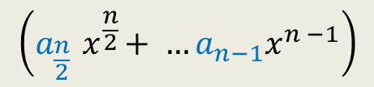





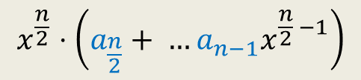


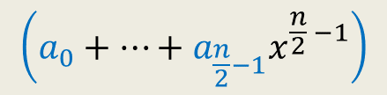
Divide Step
Attempt 1
$$A\left(x\right)=a_{0}+a_{1}x+a_{2}x^{2}+ …a_{n−1}x^{n−1}$$
$$S$$
$$A\left(x\right)= ? + ?$$
Evaluating $A$ at $S$ =
$$\left(a_{0}+…+a_{\frac{n}{2}−1}x^{\frac{n}{2} −1}\right)$$
$$x^{\frac{n}{2}}⋅\left(a_{\frac{n}{2}}+ …a_{n−1}x^{\frac{n}{2} −1}\right)$$
$$\left(a_{\frac{n}{2}}{ x}^{\frac{n}{2}}+ …a_{n−1}x^{n −1}\right)$$
First $\frac{n}{2}$ terms of $A\left(x\right)$
Last $\frac{n}{2}$ terms of $A\left(x\right)$
$$A_{first}\left(x\right)$$
$$A_{second}\left(x\right)$$
Evaluating $A_{first}$ at $S$
Evaluating $A_{second}$ at $S$
Evaluating $x^{\frac{n}{2}}$ at $S$
$+$ O($n log n$) time
O($n log n$) time
$+$ O($n$) time

Slide 14

















Divide Step
Attempt 2
$$A\left(x\right)= ? + ?$$
$A_{even}(x)$= $a_{0}+a_{2}x+ …+a_{n−2}x^{\frac{n}{2}−1}$
$A_{odd}(x)$ = $a_{1}+a_{3}x+ …+a_{n−1}x^{\frac{n}{2}−1}$,
Evaluating $A$ at $S$ =
$$A\left(x\right)=a_{0}+a_{1}x+a_{2}x^{2}+ …a_{n−1}x^{n−1}$$
$$S$$
$$\left(a_{0}+a_{2}x^{2}+…+a_{n−2}x^{n−2}\right)$$
$$(a_{1}x+a_{3}x^{3}+…+a_{n−1}x^{n−1}\text{)}$$
All odd terms of $A\left(x\right)$
All even terms of $A\left(x\right)$
$x⋅(a_{1}+a_{3}x^{2}+…+a_{n−1}x^{n−2}$)
$$a_{2i}{ x}^{2i}$$
$$a_{2i}{ (x^{2})}^{i}$$
$$a_{2i+1}{ (x^{2})}^{i}$$
$$a_{2i+1}{ x}^{2i}$$
$A\left(x\right)=$ $A_{even}$($x^{2}$) + $x A_{odd}$($x^{2}$)
Evaluating $A_{even}$ at ?
$$S^{2}=$$
$$\left\{c^{2} \right| c∈S\}$$
$$S^{2}$$
Evaluating $A_{odd}$ at $S^{2}$
$+$ O($n$) time

Slide 15
Homework
Pursue Attempt 1
Pursue Attempt 2
... with diligence
… with perseverance

Slide 16
The power of Binary Search Tree
2

Slide 17

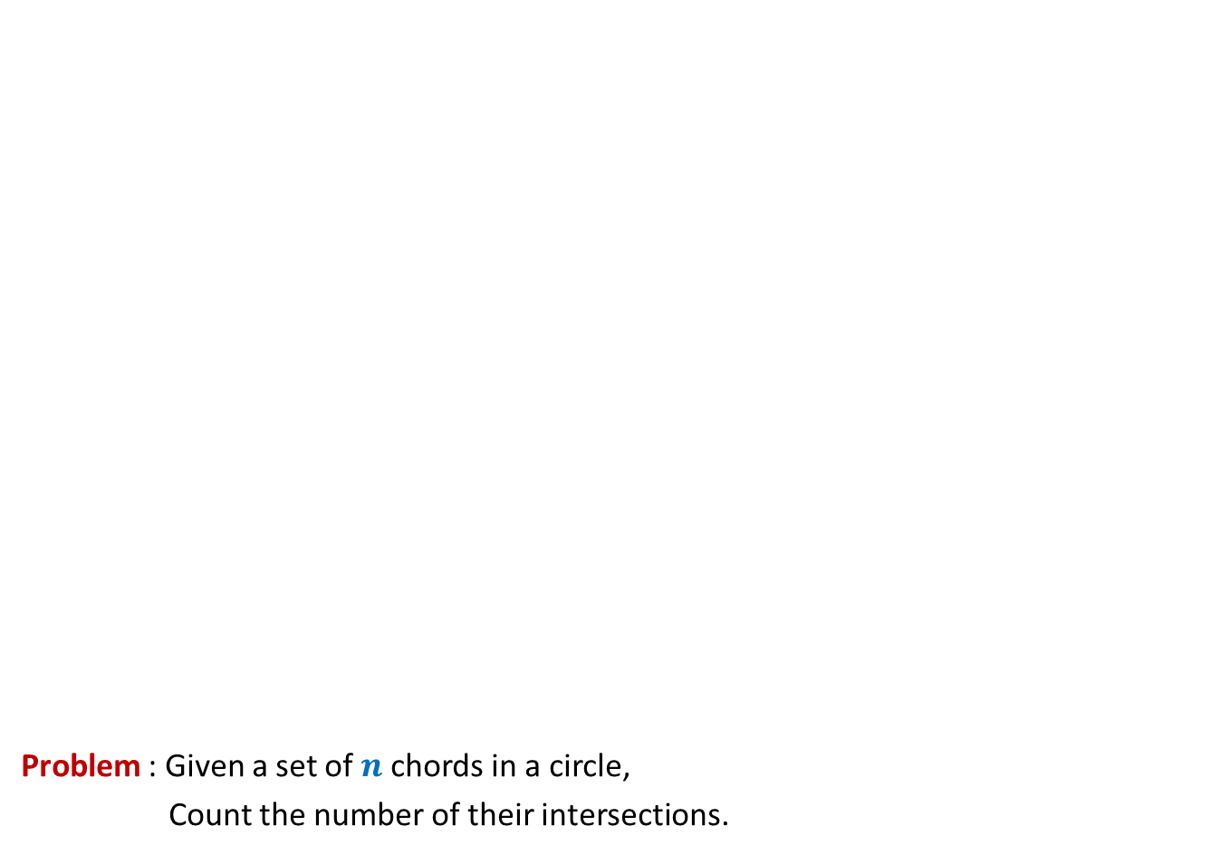
Problem : Given a set of $n$chords in a circle,
Count the number of their intersections.
O($n$ log $n$)

Slide 18
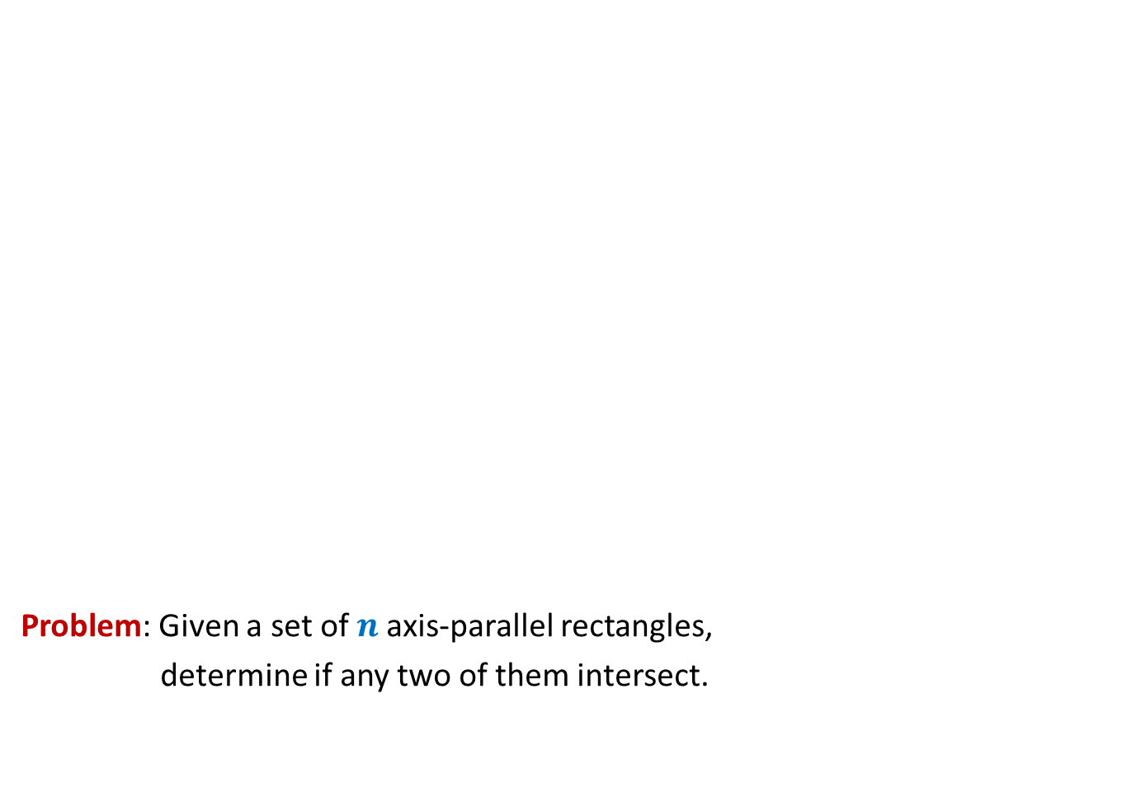
Surprising applications of data structures
Problem: Given a set of $n$axis-parallel rectangles,
determine if any two of them intersect.
O($n$ log $n$)

Slide 19
Revisiting Binary Search Tree

Slide 20
Red Black tree (Height Balanced BST)
Operations you already know
New operations
Search(T,x)
Insert(T,x)
Delete(T,x)
Min(T)
Max(T)
Predecessor(T,x)
Successor(T,x)
A NOTATION
T < T’ :
every element of T is smaller than every
element of T’.
8. SpecialUnion(T, T’):
Given T and T’ such that T < T’,
compute T*=TUT’.
NOTE: T and T’ don’t exist after the union.
9. Split(T, x):
Split T into T’ and T’’ such that T’ < x < T’’.
Every operation in O(log n) time.

Slide 21
Red-Black Tree

Slide 22
Insertion in a red-black tree
T
46
28
67
5
35
49
83
2
25
31
41
54
44
Color imbalance

Slide 23
SpecialUnion(T,T’)
Remember:
every element of T is smaller than every element of T’

Slide 24
SpecialUnion(T,T’)

Slide 25
A trivial algorithm that does not work
Time complexity: O(log n)
Height balance lost
<
T
T’

Slide 26
Towards an O(log n) time for SpecialUnion(T,T’) …
Simplifying the problem
Solving the simpler version efficiently
Extending the solution to generic version

Slide 27
Simplifying the problem
Simplified problem:
Given two trees T, T’ of same black height
and a key x, such that T<x<T’,
transform them into a tree T*=TU{x}UT’
x
<
<
T
T’

Slide 28
Solving the simplified problem
Simplified problem:
Given two trees T, T’ of same black height
and a key x, such that T<x<T’,
transform them into a tree T*=TU{x}UT’
x
O (1) time
<
<
T
T’

Slide 29
Extending the algorithm to the generic problem
T
T’

Slide 30
Extending the algorithm to the generic problem
x
<
<
T
T’

Slide 31
Extending the algorithm to the generic problem
x
T
T’

Slide 32
Extending the algorithm to the generic problem
x
T
T’

Slide 33
Extending the algorithm to the generic problem
v
x
T
T’’

Slide 34
Extending the algorithm to the generic problem
Homework: Write a neat pseudocode for the algorithm.
v
x
T
T’’

Slide 35

Extending the algorithm to the generic problem
Algorithm for SpecialUnion(T,T’):
Let x be the node storing smallest element of T’.
Delete the node x from T’.
Let black height of T ≤ black height of T’
Keep following left pointer of T’ until we reach a node v such that
left(v) is black
The subtree T” rooted at Left(v) has black height same as that of T
left(x)← T;
right(x) ← T”;
Color(x)← red;
left(v)← x;
parent(x)← v;
If color(v) is red, remove the color imbalance
(like in the usual procedure of insertion in a red-black tree)
Total time : O(log $n$)

Slide 36
Split(T,x)

Slide 37



Achieving O(log $n$) time for Split(T,x)
Take a scissor
cut T into trees starting from x
Make use of SpecialUnion algorithm.
Homework: Provide details for the O(log $n$) algorithm for Split(T,x)
x
T

Slide 38
Height Balanced BST (Red-black tree, AVL tree)
Operations you already know
New operation
Search(T,x)
Insert(T,x)
Delete(T,x)
Min(T)
Max(T)
Predecessor(T,x)
Successor(T,x)
SpecialMerge(T, T’)
Split(T,x)
10. FindRank(T, x):
return the no. of elements in T that are smaller
than x.
Every operation in O(log n) time.

Slide 39
Find-rank(T,x)

Slide 40

A trivial algorithm for Find-rank(T,x)
T
Repeatedly find predecessors of x and stop when you reach the min element.
Time complexity: O($k$ log $n$) (where $k$ is rank of x in T)
Homework: Show that all predecessors can be computed in O($k$+ log $n$) time.
46
28
67
5
35
49
2
25
31
41
48
53

Slide 41

Homework
Ponder over ways to perform Find-rank(T,x) in O(log $n$) time.
Hint: Store some extra field at each node.

