Slide 1
Design and Analysis of Algorithms
Algorithms-II : CS345A
Website: hello.iitk.ac.in
Lecture 30
NP Completeness – II

Slide 2
This lecture is going to be different from all other lectures.
Reasons:
The theory of NP class and NP complete class of problems took decades to get developed. So it is not justified that one can quickly understand the way this class is defined and the reason behind it.
Advice:
Go over the lecture slides with open mind.
On some slides, you will find formulation/definition to capture a class of problems.
If you don’t find a formulation/definition convincing,
discard it temporarily and
search on your own for an alternate formulation
Now revisit the formulation in the slide.
This should help you understand the formulation in a better way.
You are of course welcome to have a discussion with me.

Slide 3



Definition of Continuous function
Many of you would have found the definition of continuity of a function strange and an overkill ☹.
However, after spending enough time and thinking, you would have realized that this definition fully captures the intuition of a continuous function.
Same is going to be the case of NP problems ☺.
Definition:
A function is said to be continuous at point $x_{0}$,
if for each $δ>0$, there exists $ε>0$, such that
for every $x$ if $|x−x_{0}|$ $<ε$, then $|f(x)−f(x_{0})|$ $<δ$
f($x$)
$$x_{0}$$

Slide 4

Recap from last lecture
Optimization version ➔ Decision version
$$A≤_{P}B$$

Slide 5
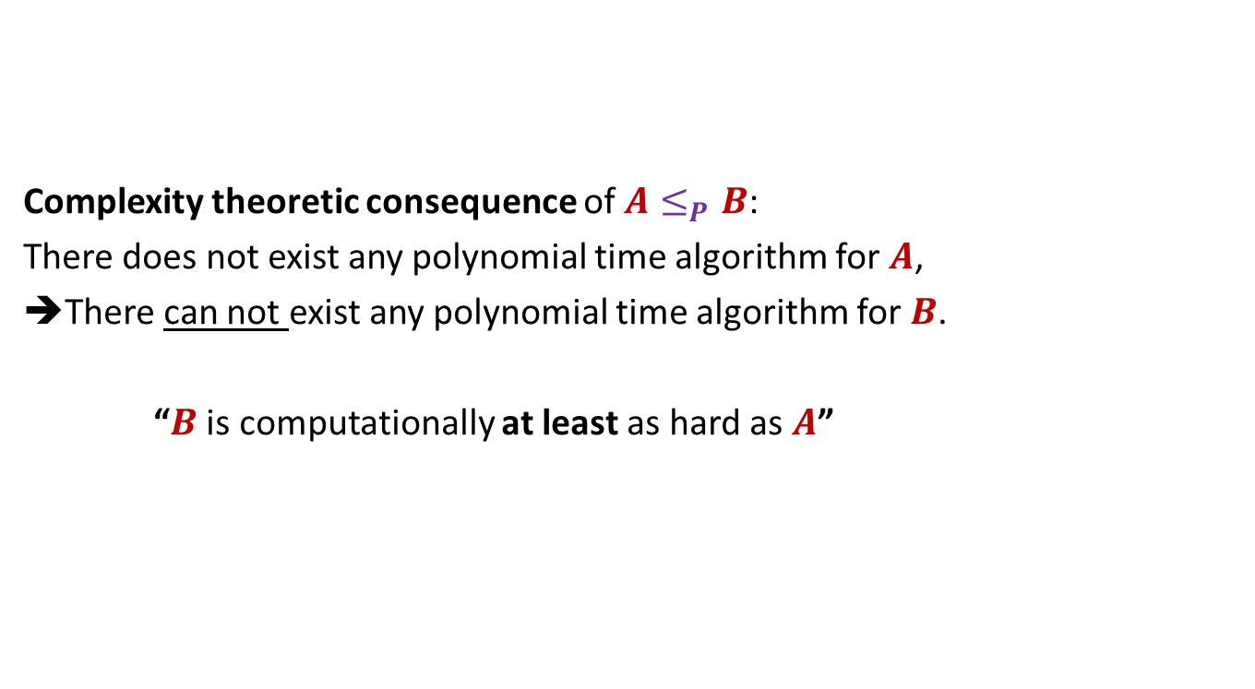

$$A≤_{P}B$$
Complexity theoretic consequence of $A≤_{P}B$:
There does not exist any polynomial time algorithm for $A$,
➔There can not exist any polynomial time algorithm for $B$.
“$B$ is computationally at least as hard as $A$”

Slide 6
NP A class of problems

Slide 7
Go back to 1960’s
Efficient algorithm
was found.
No Efficient algorithm
could be designed till date
This motivated researchers to search for any common traits among all these problems.
Shortest Path
Longest Path
Minimum spanning Tree
Travelling salesman Problem
Euler tour
Hamiltonian cycle
Min Cut
Balanced Cut
Independent Set on trees
Independent Set
Bipartite matching
3D matching
Linear Programming
Integer Linear Programming
…
…
It was quite surprising and even frustrating to be unable to find efficient algorithm for so many problems when their similar looking versions had very efficient algorithms.

Slide 8
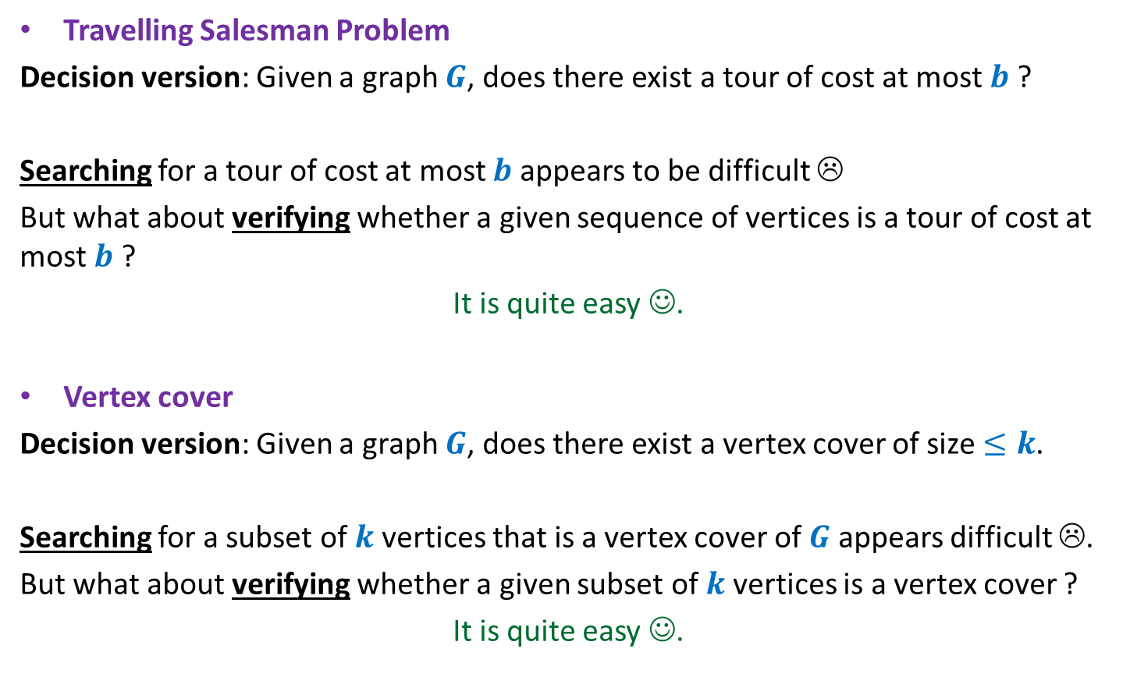
Travelling Salesman Problem
Decision version: Given a graph $G$, does there exist a tour of cost at most $b$ ?
Searching for a tour of cost at most $b$ appears to be difficult ☹
But what about verifying whether a given sequence of vertices is a tour of cost at most $b$ ?
It is quite easy ☺.
Vertex cover
Decision version: Given a graph $G$, does there exist a vertex cover of size $≤k$.
Searching for a subset of $k$vertices that is a vertex cover of $G$ appears difficult ☹.
But what about verifying whether a given subset of $k$vertices is a vertex cover ?
It is quite easy ☺.

Slide 9




What about verifying a proposed solution ?
Easy
No Efficient algorithm till date ☹
Longest Path
Is there a path of length $≥k$ in $G$ ?
Vertex cover
Does there exist a vertex cover of size $≤k$ in $G$?
Travelling salesman Problem
Does there exist a tour of cost $≤c$ in $G$?
Hamiltonian cycle
Does there exist a cycle of length $n$ in $G$?
Independent Set
Does there exist an independent set of size $≥k$ in $G$?
3D matching
…
…
Integer Linear Programming
…
What if the answer of an instance is Yes ?
There is a short certificate.

Slide 10
No Efficient algorithm till date ☹
Longest Path
short
certificate
Search: difficult
verification: easy
Vertex cover
Travelling salesman Problem
Hamiltonian cycle
Independent Set
3D matching
Integer Linear Programming
…

Slide 11
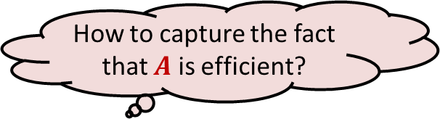
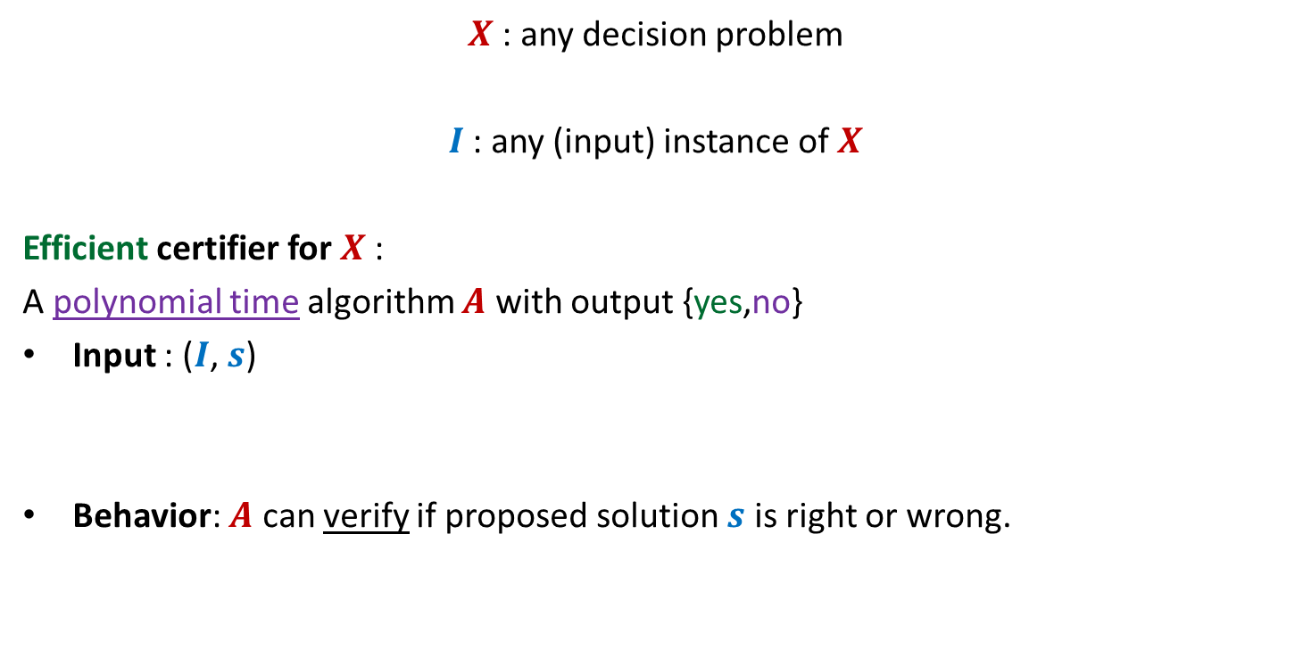

NP class
Efficient certifier
We shall redefine the behavior of $A$. Ponder over the new definition.
$X$: any decision problem
$I$ : any (input) instance of $X$
Efficient certifier for $X$:
A polynomial time algorithm $A$ with output {yes,no}
Input : ($I$, $s$)
Behavior: $A$ can verify if proposed solution $s$ is right or wrong.
Yes instance
No instance
How to capture the short certificate ?
How to capture the fact that $A$ is efficient?
Proposed solution

Slide 12

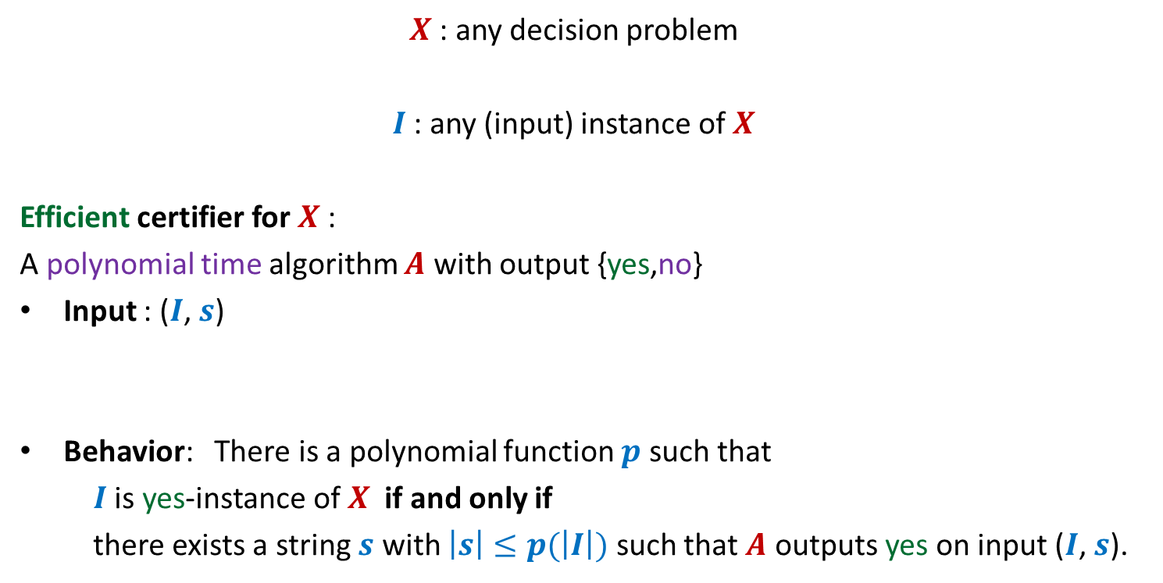
NP class
Efficient certifier
Ponder over the redefined behavior of $A$. Take your time …
$X$: any decision problem
$I$ : any (input) instance of $X$
Efficient certifier for $X$:
A polynomial time algorithm $A$ with output {yes,no}
Input : ($I$, $s$)
Behavior: There is a polynomial function $p$ such that
$I$ is yes-instance of $X$ if and only if
there exists a string $s$ with $\left|s\right|≤p(\left|I\right|)$ such that $A$ outputs yes on input ($I$, $s$).
Yes instance
No instance
Proposed solution

Slide 13
Efficient certifier
Examples
Convince yourself that these certifiers satisfy
the redefined behavior of efficient certifiers described in the previous slide.
 | Efficient certifiers:
Longest Path
Determines if the given string $s$ is a indeed path of length $≥k$ in $G$
Vertex cover
Determines if the given string $s$ is indeed a vertex cover of size $≤k$ for $G$
Travelling salesman Problem
Determines if the given string $s$ is indeed a tour of cost $≤c$ in $G$
Hamiltonian cycle
Determines if the given string $s$ is indeed a cycle in $G$
Independent Set
…
3D matching
Integer Linear Programming
…

Slide 14
NP class
Definition (NP):
The set of all decision problems which have efficient certifier.
NP : “Non-deterministic polynomial time”
Definition (P):
The set of all decision problems which have efficient algorithm.
Any Relation between P and NP : ?

Slide 15
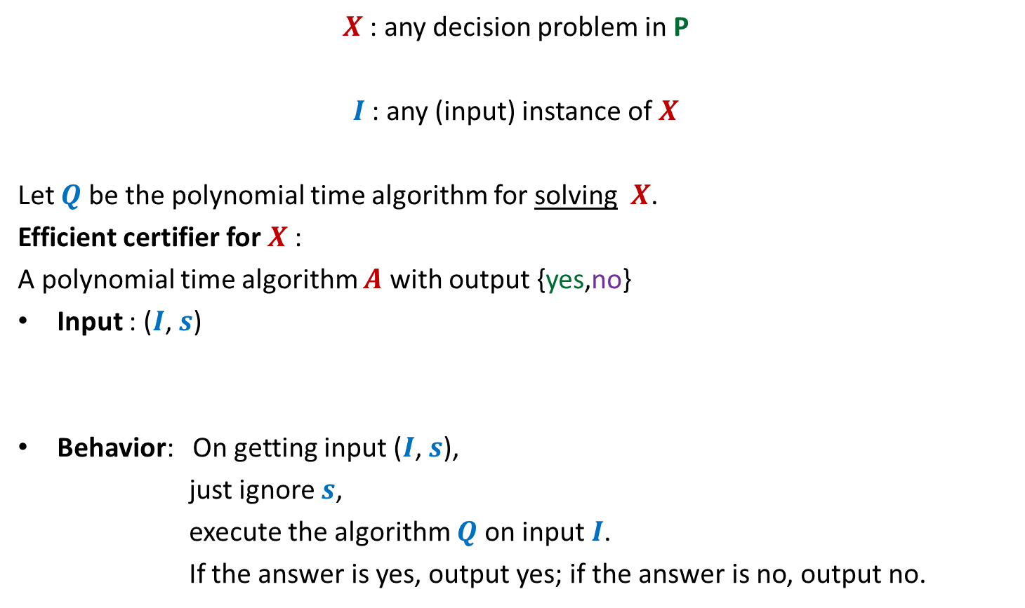
P is contained in NP
$X$: any decision problem in P
$I$ : any (input) instance of $X$
Let $Q$ be the polynomial time algorithm for solving $X$.
Efficient certifier for $X$:
A polynomial time algorithm $A$ with output {yes,no}
Input : ($I$, $s$)
Behavior: On getting input ($I$, $s$),
just ignore $s$,
execute the algorithm $Q$on input $I$.
If the answer is yes, output yes; if the answer is no, output no.
Yes instance
No instance
Convince yourself that this certifiers satisfy
the redefined behavior of efficient certifiers.
Proposed solution

Slide 16
NP versus P
Is P = NP ?
NP
P
Verifying a proposed solution versus finding a solution

Slide 17

NP Complete A class of problemS
$$\text{and} \text{how} \text{it} \text{came} \text{into} \text{existence}$$

Slide 18


NP-complete
A problem $X$ in NP class is NP-complete if for every $A∈$NP
$$A≤_{P}X$$
NP
$$X$$

Slide 19
Does any NP-complete problem exist ?
It really needs
courage to ask such a question and
great insight to pursue its answer ?
Because:
Every problem, known as well as unknown, from class NP has be reducible to this problem.
Such a problem would indeed be the hardest of all problems in NP.
But only such great questions in science lead to great inventions.

Slide 20




Does any NP-complete problem exist ?
Circuit satisfiability problem: [Cook and Levin , 1971]
A DAG with nodes corresponding to AND,NOT,OR gates and $n$ binary inputs,
does there exist any binary input which gives output 1 ?
$$⋀$$
V
$$⇁$$
$$⇁$$
V
$$⋀$$

Slide 21
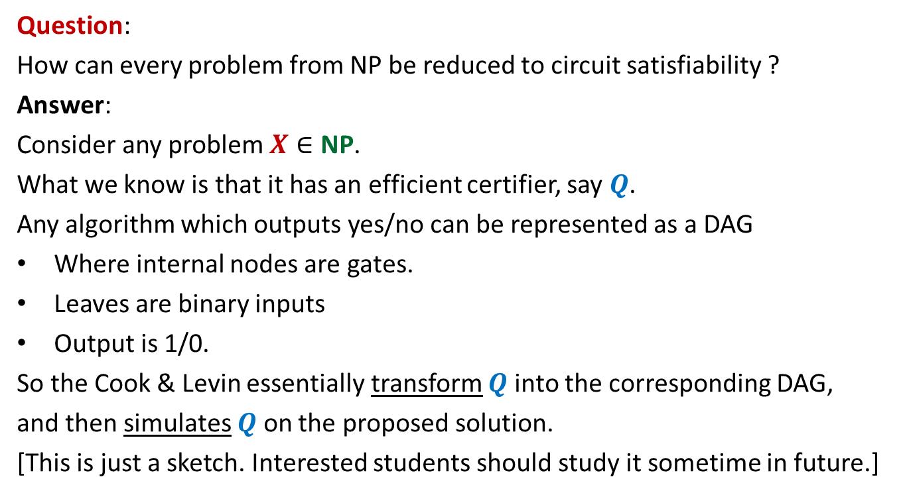
This slide is optional. (meant for the student whose aim is beyond just a good grade)
Question:
How can every problem from NP be reduced to circuit satisfiability ?
Answer:
Consider any problem $X∈$ NP.
What we know is that it has an efficient certifier, say $Q$.
Any algorithm which outputs yes/no can be represented as a DAG
Where internal nodes are gates.
Leaves are binary inputs
Output is 1/0.
So the Cook & Levin essentially transform $Q$ into the corresponding DAG,
and then simulates $Q$ on the proposed solution.
[This is just a sketch. Interested students should study it sometime in future.]

Slide 22

How many NP-complete problems exist ?
Polynomial reduction $A≤_{P}X$ [Richard Karp, 1972]
Circuit Satisfiability
Vertex Cover
Independent Set
3-SAT
Integer Linear Programming
Hamiltonian cycle
Travelling salesman Problem

Slide 23
NP versus P
If any NP-complete problem is solved in polynomial time
➔ P = NP
Is P = NP ?
NP
P
NP-complete

Slide 24



How to show a problem to be NP-complete ?
Let $X$be a problem which we wish to show to be NP-complete
Show that $X$ ϵ NP
Pick a problem $A$ which is already known to be NP-complete
Show that $A≤_{P}X$
NP
$$A$$
Y
$$X$$

Slide 25
Example
Showing Dominating Set to be NP-complete

Slide 26







Dominating Set
Definition: Given an undirected graph $G=(V,E)$,
$N(u)$= {$v$| $v=u$ or ($u,v$) $∈E$}
In other words, $N(u)$ is the set consisting of $u$and all neighbors of $u$in $G$.
a subset $X⊆V$ is said to be an dominating set if
For each $u∈V$, $N\left(u\right)∩X≠∅$
Optimization version: compute dominating set of smallest size.
Decision version: Does there exist a dominating set of size $k$ ?
Is it the smallest dominating set ?
Is it the smallest dominating set ?
$$b$$
NO.
YES
$$a$$
$$x$$
$$z$$
$$t$$
$$y$$

Slide 27
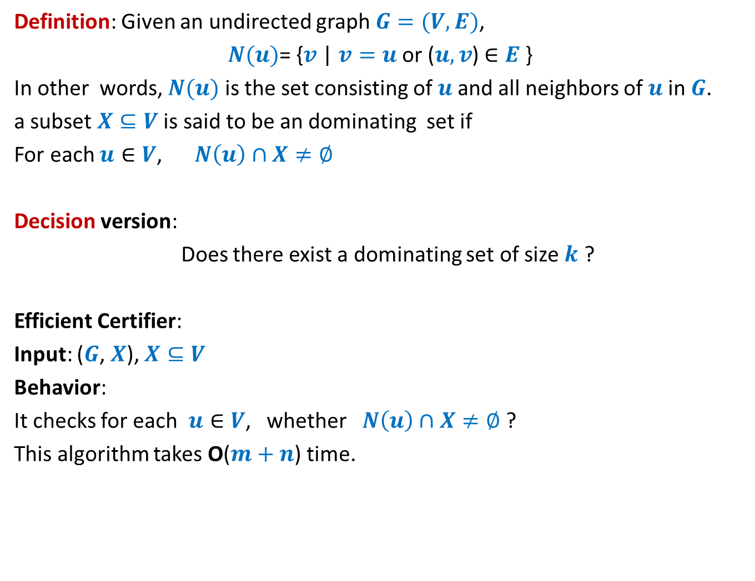
Dominating Set
Definition: Given an undirected graph $G=(V,E)$,
$N(u)$= {$v$| $v=u$ or ($u,v$) $∈E$}
In other words, $N(u)$ is the set consisting of $u$and all neighbors of $u$in $G$.
a subset $X⊆V$ is said to be an dominating set if
For each $u∈V$, $N\left(u\right)∩X≠∅$
Decision version:
Does there exist a dominating set of size $k$ ?
Efficient Certifier:
Input: ($G$, $X$), $X⊆V$
Behavior:
It checks for each $u∈V$, whether $N\left(u\right)∩X≠∅$ ?
This algorithm takes O($m+n$) time.

Slide 28

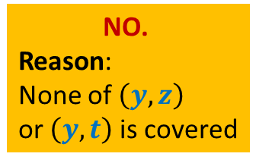
Vertex Cover
Definition: Given an undirected graph $G=(V,E)$,
a subset $X⊆V$ is said to be a vertex cover if
For each edge $\left(u,v\right)∈E$,
either $u∈X$ or $v∈X$
Optimization version: compute vertex cover of smallest size.
Decision version: Does there exist a vertex cover of size $k$ ?
Is it a vertex cover now ?
Is it a vertex cover ?
$$b$$
Yes.
NO.
Reason:
None of $\left(y,z\right)$
or $\left(y,t\right)$ is covered
$$a$$
$$x$$
$$z$$
$$t$$
$$y$$

Slide 29









VC $≤_{P}$ DS
VC: Vertex Cover
DS: Dominating Set
Input: an graph $G=(V,E)$ and $k∈Z^{+}$
Problem: Does there exist a vertex cover of size $k$?
Input: an graph $G=(V,E)$ and $t∈Z^{+}$
Problem: Does there exist an dominating set of size $t$ ?
$$b$$
Do you see any relation between the VC and DS?
$$b$$
$$a$$
$$x$$
$$a$$
$$x$$
$$z$$
$$t$$
$$z$$
$$t$$
$$y$$
$$y$$

Slide 30
VC $≤_{P}$ DS
VC: Vertex Cover
DS: Dominating Set
Input: an graph $G=(V,E)$ and $k∈Z^{+}$
Problem: Does there exist a vertex cover of size $k$?
Input: an graph $G=(V,E)$ and $t∈Z^{+}$
Problem: Does there exist an dominating set of size $t$ ?
$$b$$
$$b$$
$$a$$
$$x$$
$$a$$
$$x$$
$$z$$
$$t$$
$$z$$
$$t$$
$$y$$
$$y$$

Slide 31
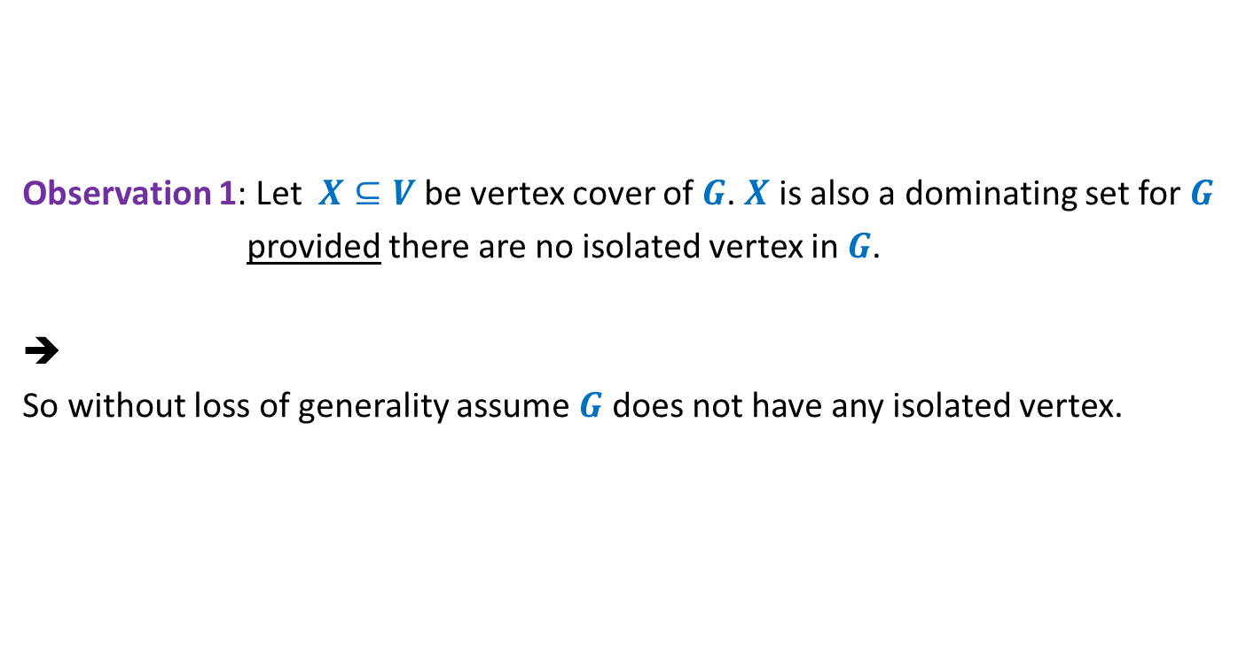
VC $≤_{P}$ DS
Observation 1: Let $X⊆V$ be vertex cover of $G$. $X$ is also a dominating set for $G$
provided there are no isolated vertex in $G$.
➔
So without loss of generality assume $G$ does not have any isolated vertex.

Slide 32

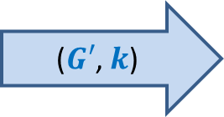
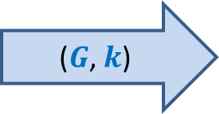

VC $≤_{P}$ DS
Aim: Given a graph $G=(V,E)$, how should $f$ transform it to graph $G′$ such that
$G$ has a vertex cover of size $≤k$if and only if $G′$has a dominating set of size $≤k$.
$$f$$
($G$, $k$)
($G′$, $k$)

Slide 33
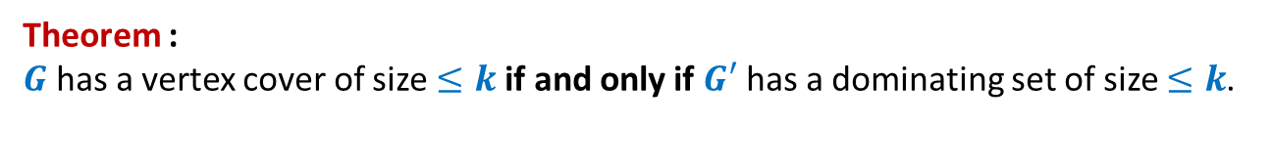






VC $≤_{P}$ DS
VC: Instance ($G$, $k$)
DS: Instance ($G′$, $k$)
$$b$$
$$b$$
$$a$$
$$x$$
$$a$$
$$x$$
$$z$$
$$t$$
$$z$$
$$t$$
$$y$$
$$y$$
Theorem :
$G$ has a vertex cover of size $≤k$if and only if $G′$ has a dominating set of size $≤k$.

Slide 34
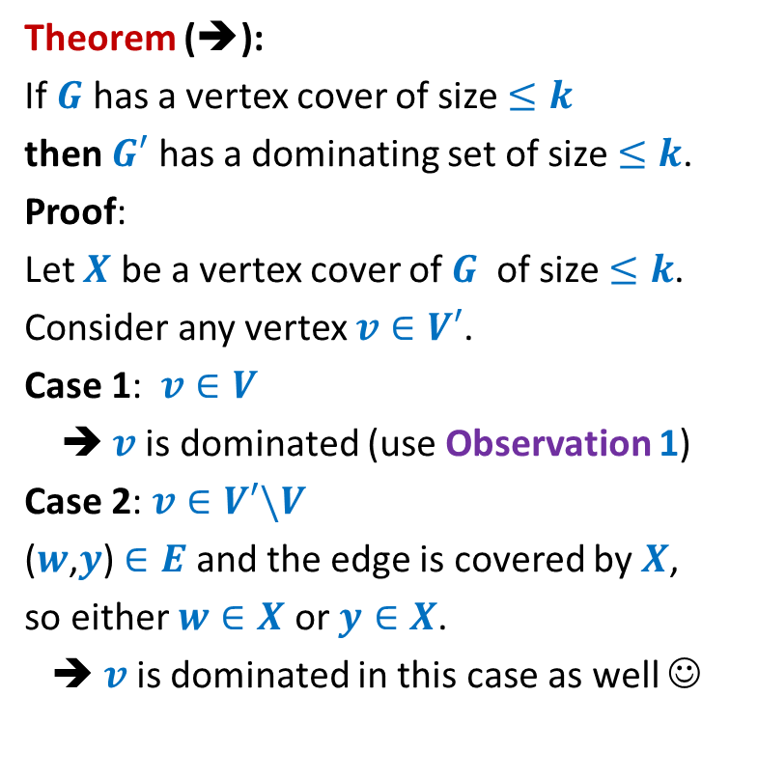




VC $≤_{P}$ DS
Theorem (➔):
If $G$ has a vertex cover of size $≤k$
then $G′$ has a dominating set of size $≤k$.
Proof:
Let $X$ be a vertex cover of $G$ of size $≤k$.
Consider any vertex $v∈V′$.
Case 1: $v∈V$
➔ $v$is dominated (use Observation 1)
Case 2: $v∈V′\backslash V$
($w$,$y$) $∈E$ and the edge is covered by $X$,
so either $w∈X$ or $y∈X$.
➔ $v$is dominated in this case as well ☺
$$v$$
$$y$$
$$v$$
$$w$$
$$y$$

Slide 35

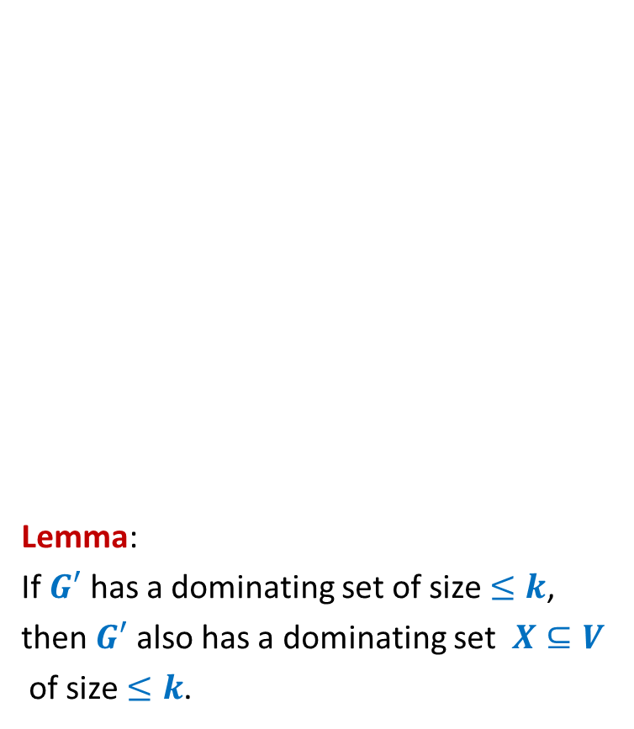
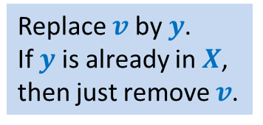
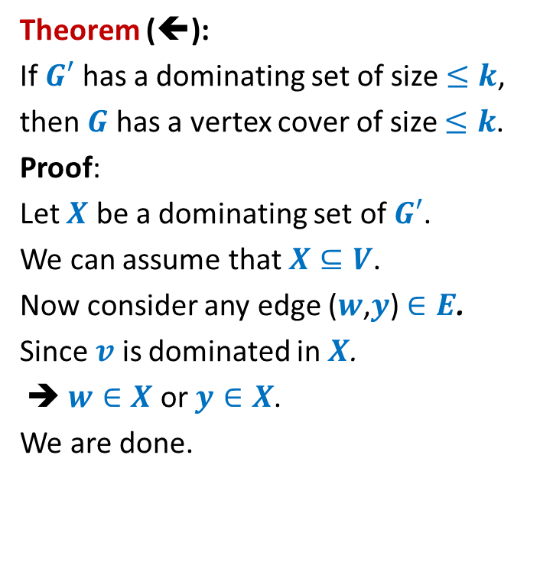

VC $≤_{P}$ DS
Replace $v$ by $y$.
If $y$ is already in $X$,
then just remove $v$.
Lemma:
If $G′$ has a dominating set of size $≤k$,
then $G′$ also has a dominating set $X⊆V$
of size $≤k$.
Theorem (⬅):
If $G′$ has a dominating set of size $≤k$,
then $G$ has a vertex cover of size $≤k$.
Proof:
Let $X$ be a dominating set of $G′$.
We can assume that $X⊆V$.
Now consider any edge ($w$,$y$) $∈E$.
Since $v$ is dominated in $X$.
➔ $w∈X$ or $y∈X$.
We are done.
$$v$$
$$w$$
$$y$$
$$v$$
$$w$$
$$y$$

Slide 36
More NP-complete Problems

Slide 37



















Subgraph Isomorphism
$a$→$1$
$$1$$
$$2$$
Definition: Graph $G=(V,E)$ is said to be isomorphic to $G′=(V′,E′)$
if there is a bijection $f$ : $V$→ $V′$ such that for any two vertices $u,v∈V$
$\left(u,v\right)∈E$ if and only if
Problem: Given two graphs $G$ and $G′$,
does there exist a subgraph of $G$ which is isomorphic to $G′$ ?
Homework: Show that subgraph isomorphism problem is NP-complete.
$$a$$
$$u$$
$b$→$3$
$c$→$5$
$$b$$
$$v$$
$u$→$2$
$$6$$
$$3$$
$v$→$4$
$$c$$
$$w$$
$w$→$6$
$$5$$
$$4$$
$$\left(f(u),f(v\right))∈E′$$

Slide 38
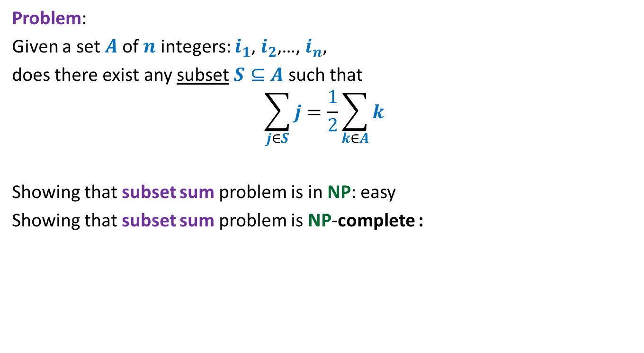
Subset sum problem
Problem:
Given a set $A$of $n$ integers: $i_{1}$, $i_{2}$,…, $i_{n}$,
does there exist any subset $S⊆A$ such that
$$\sum_{j∈S}{j}=\frac{1}{2}\sum_{k∈A}{k}$$
Showing that subset sum problem is in NP: easy
Showing that subset sum problem is NP-complete :
neither Homework
nor Exam problem

Slide 39
How to handle NP-complete Problems
Approximation Algorithms
(Next lecture)

