Slide 1
Design and Analysis of Algorithms
Algorithms-II : CS345A
Website: hello.iitk.ac.in
Lecture 31
How to handle NP-complete problems

Slide 2
How to handle NP-complete Problems
Approximation Algorithms

Slide 3
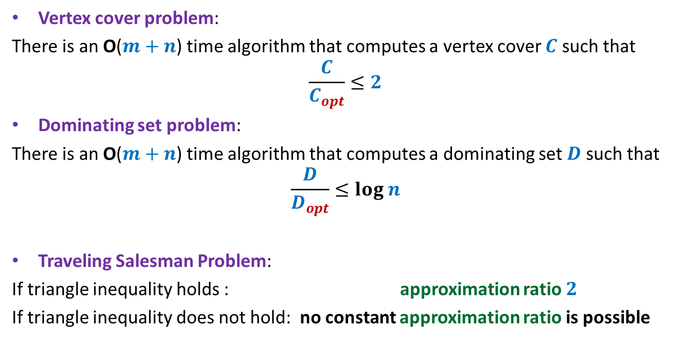
Approximation algorithms
Vertex cover problem:
There is an O($m+n$) time algorithm that computes a vertex cover $C$ such that
$$\frac{C}{C_{opt}}≤2$$
Dominating set problem:
There is an O($m+n$) time algorithm that computes a dominating set $D$ such that
$$\frac{D}{D_{opt}}≤log n$$
Traveling Salesman Problem:
If triangle inequality holds : approximation ratio $2$
If triangle inequality does not hold: no constant approximation ratio is possible

Slide 4
Set Cover Problem

Slide 5


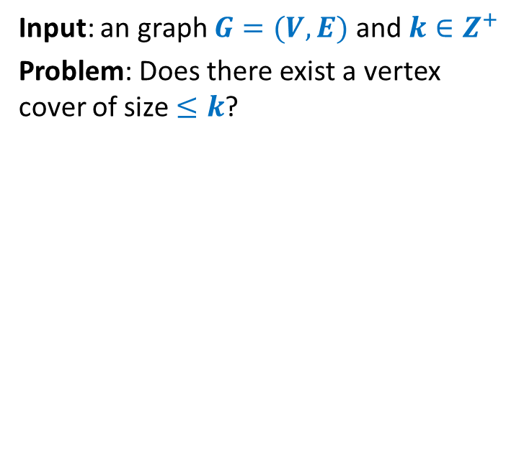







Set Cover Problem
a set $A$= {$e_{1}$, $e_{2}$,…,$e_{n}$}
$S_{1}$, $S_{2}$,…, $S_{k}$, with $S_{i}⊆A$
Optimization version: Compute least number of sets that can cover $A$.
Decision version: Does there exist $j$subsets that can cover all elements ?
$$e_{2}$$
$$e_{7}$$
$$e_{5}$$
$$e_{1}$$
$$e_{3}$$
$$e_{8}$$
$$e_{4}$$
$$e_{6}$$
$$e_{9}$$

Slide 6
Set Cover Problem
a set $A$= {$e_{1}$, $e_{2}$,…,$e_{n}$}
$S_{1}$, $S_{2}$,…, $S_{k}$, with $S_{i}⊆A$
Optimization version: Compute least number of sets that can cover $A$.
Decision version: Does there exist $j$subsets that can cover all elements ?
$$e_{2}$$
$$e_{7}$$
$$e_{5}$$
$$e_{1}$$
$$e_{3}$$
$$e_{8}$$
$$e_{4}$$
$$e_{6}$$
$$e_{9}$$

Slide 7
Set Cover Problem
a set $A$= {$e_{1}$, $e_{2}$,…,$e_{n}$}
$S_{1}$, $S_{2}$,…, $S_{k}$, with $S_{i}⊆A$
Optimization version: Compute least number of sets that can cover $A$.
Decision version: Does there exist $j$subsets that can cover all elements ?
$$e_{2}$$
$$e_{7}$$
$$e_{5}$$
$$e_{1}$$
$$e_{3}$$
$$e_{8}$$
$$e_{4}$$
$$e_{6}$$
$$e_{9}$$

Slide 8
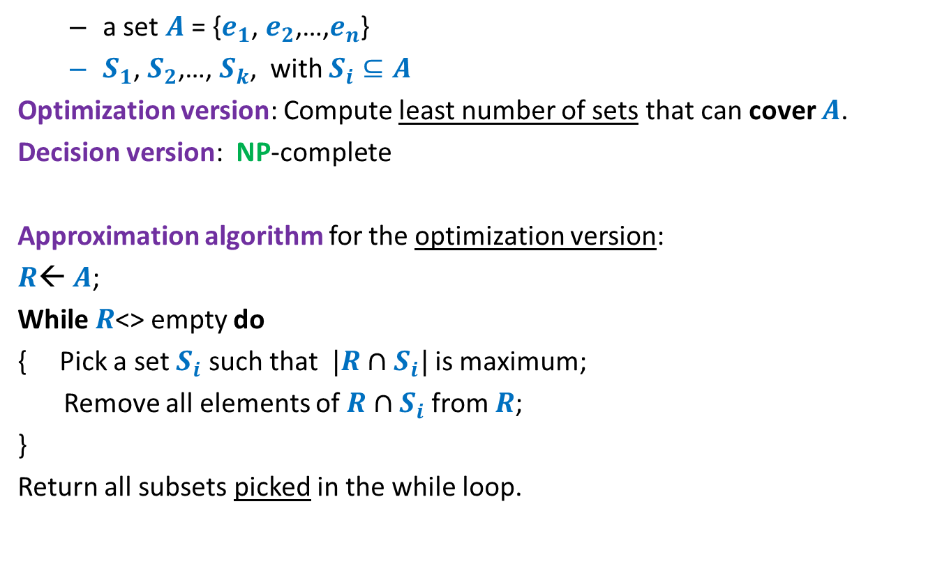
Set Cover Problem
a set $A$= {$e_{1}$, $e_{2}$,…,$e_{n}$}
$S_{1}$, $S_{2}$,…, $S_{k}$, with $S_{i}⊆A$
Optimization version: Compute least number of sets that can cover $A$.
Decision version: NP-complete
Approximation algorithm for the optimization version:
$R$← $A$;
While $R$<> empty do
{ Pick a set $S_{i}$ such that $|R∩S_{i}|$ is maximum;
Remove all elements of $R∩S_{i}$ from $R$;
}
Return all subsets picked in the while loop.
Homework
Think simple.
Follow your intuition

Slide 9





Optimality of the Greedy algorithm
a set $A$= {$e_{1}$, $e_{2}$,…,$e_{n}$}
$S_{1}$, $S_{2}$,…, $S_{k}$, with $S_{i}⊆A$
$$e_{8}$$
$$e_{2}$$
$$e_{7}$$
$$e_{5}$$
$$e_{9}$$
$$e_{1}$$
$$e_{3}$$
$$e_{6}$$
$$e_{4}$$

Slide 10
Optimality of the Greedy algorithm
a set $A$= {$e_{1}$, $e_{2}$,…,$e_{n}$}
$S_{1}$, $S_{2}$,…, $S_{k}$, with $S_{i}⊆A$
$$e_{8}$$
$$e_{2}$$
$$e_{7}$$
$$e_{5}$$
$$e_{9}$$
$$e_{1}$$
$$e_{3}$$
$$e_{6}$$
$$e_{4}$$

Slide 11
Optimality of the Greedy algorithm
a set $A$= {$e_{1}$, $e_{2}$,…,$e_{n}$}
$S_{1}$, $S_{2}$,…, $S_{k}$, with $S_{i}⊆A$
$$e_{8}$$
$$e_{2}$$
$$e_{7}$$
$$e_{5}$$
$$e_{9}$$
$$e_{1}$$
$$e_{3}$$
$$e_{6}$$
$$e_{4}$$

Slide 12

Optimality of the Greedy algorithm
a set $A$= {$e_{1}$, $e_{2}$,…,$e_{n}$}
$S_{1}$, $S_{2}$,…, $S_{k}$, with $S_{i}⊆A$
Greedy solution has $3$ sets
$$e_{8}$$
$$e_{2}$$
$$e_{7}$$
$$e_{5}$$
$$e_{9}$$
$$e_{1}$$
$$e_{3}$$
$$e_{6}$$
$$e_{4}$$

Slide 13




Optimality of the Greedy algorithm
a set $A$= {$e_{1}$, $e_{2}$,…,$e_{n}$}
$S_{1}$, $S_{2}$,…, $S_{k}$, with $S_{i}⊆A$
➔ Approx. ratio for this instance:
$$3/2$$
Greedy solution has $3$ sets
What is the worst case approx. ratio guaranteed for every possible instance ?
Optimal solution has $2$ sets
$$e_{8}$$
$$e_{2}$$
$$e_{7}$$
O($log n$)
$$e_{5}$$
$$e_{9}$$
$$e_{1}$$
$$e_{3}$$
$$e_{6}$$
$$e_{4}$$
We shall establish this approx. ratio for even the generic problem.

Slide 14
A discrete Math Gem

Slide 15


A discrete math gem
Let $j_{1}$, $j_{2}$,…, $j_{ℓ}$ be any arbitrary $ℓ$positive integers such that
$$\sum_{t=1}^{t=ℓ}{j_{t}}≤m$$
What is a bound on
$$\frac{j_{1}}{m}+ \frac{j_{2}}{m−j_{1}}+\frac{j_{3}}{m−j_{1}−j_{2}}+…+\frac{j_{ℓ}}{m−j_{1}−j_{2}−…−j_{ℓ−1}}$$
$$≤1$$

Slide 16





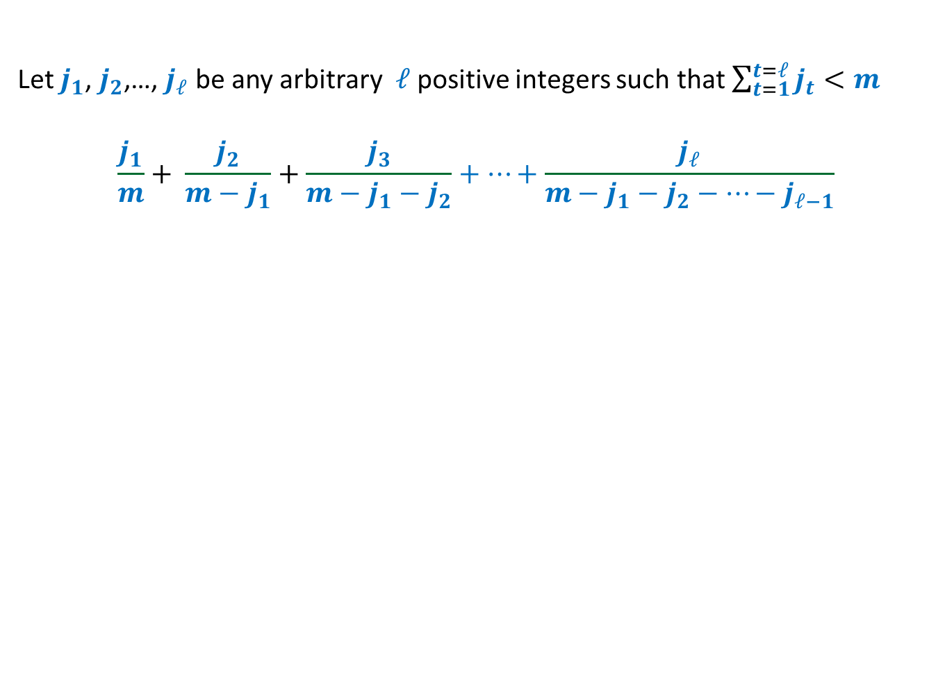








Let $j_{1}$, $j_{2}$,…, $j_{ℓ}$ be any arbitrary $ℓ$positive integers such that $\sum_{t=1}^{t=ℓ}{j_{t}}<m$
$$\frac{j_{1}}{m}+ \frac{j_{2}}{m−j_{1}}+\frac{j_{3}}{m−j_{1}−j_{2}}+…+\frac{j_{ℓ}}{m−j_{1}−j_{2}−…−j_{ℓ−1}}$$
$$≤log m$$
Relate the pink rectangles with the terms in the expression.
$$f\left(x\right)=1/x$$
$$\frac{1}{m−j_{1}−j_{2}−j_{3}}$$
$$\frac{1}{m−j_{1}−j_{2}}$$
$$\frac{1}{m−j_{1}}$$
$$\frac{1}{m}$$
$$j_{3}$$
$$j_{2}$$
$$j_{1}$$
$$m−j_{1}−j_{2}−j_{3}$$
$$m−j_{1}−j_{2}$$
$$m−j_{1}$$
$$m$$

Slide 17

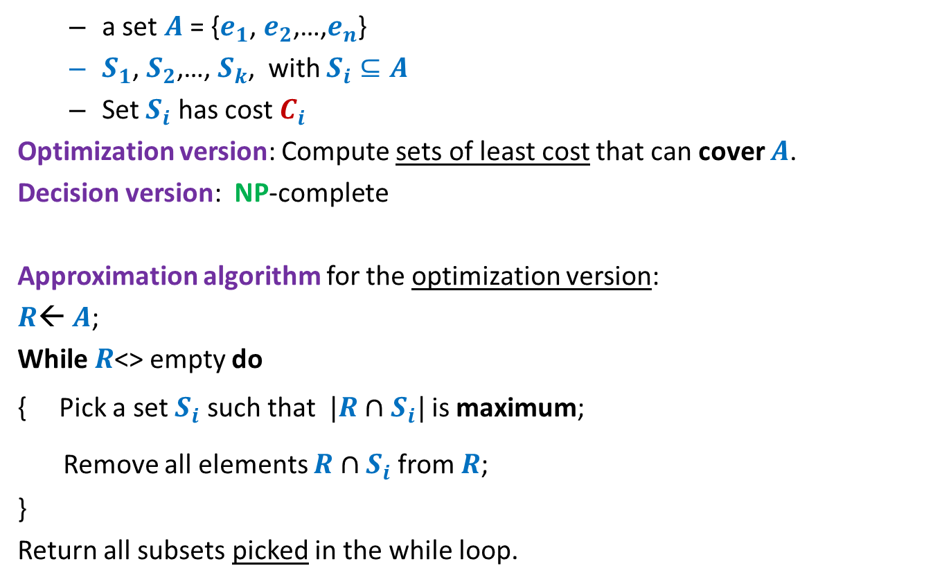

Set Cover Problem
Generic
a set $A$= {$e_{1}$, $e_{2}$,…,$e_{n}$}
$S_{1}$, $S_{2}$,…, $S_{k}$, with $S_{i}⊆A$
Set $S_{i}$ has cost $C_{i}$
Optimization version: Compute sets of least cost that can cover $A$.
Decision version: NP-complete
Approximation algorithm for the optimization version:
$R$← $A$;
While $R$<> empty do
{ Pick a set $S_{i}$ such that $|R∩S_{i}|$ is maximum;
Remove all elements $R∩S_{i}$ from $R$;
}
Return all subsets picked in the while loop.
$$\frac{|R∩S_{i}|}{C_{i}}$$
$$\frac{C_{i}}{|R∩S_{i}|}$$
is minimum;

Slide 18
How to analyze the greedy algorithm ?
The challenge:
No knowledge of the optimal solution.
Aim to get a worst case guarantee for all possible instances.
Conquering the challenge:
Pick any arbitrary instance
“Compare” greedy solution with its optimal solution.

Slide 19













How to analyze the greedy algorithm ?
Question: How to account for the sets $s_{2}$, $s_{6}$, $s_{11}$in the greedy algorithm ?
the sets belonging to “Optimal” solution
Optimal solution
$$s_{1}$$
$$s_{2}$$
$$s_{3}$$
$$s_{4}$$
$$s_{5}$$
$$s_{6}$$
$$s_{7}$$
$$s_{8}$$
$$s_{9}$$
$$s_{10}$$
$$s_{11}$$
$$s_{12}$$
Greedy solution
but absent in “Greedy” solution

Slide 20
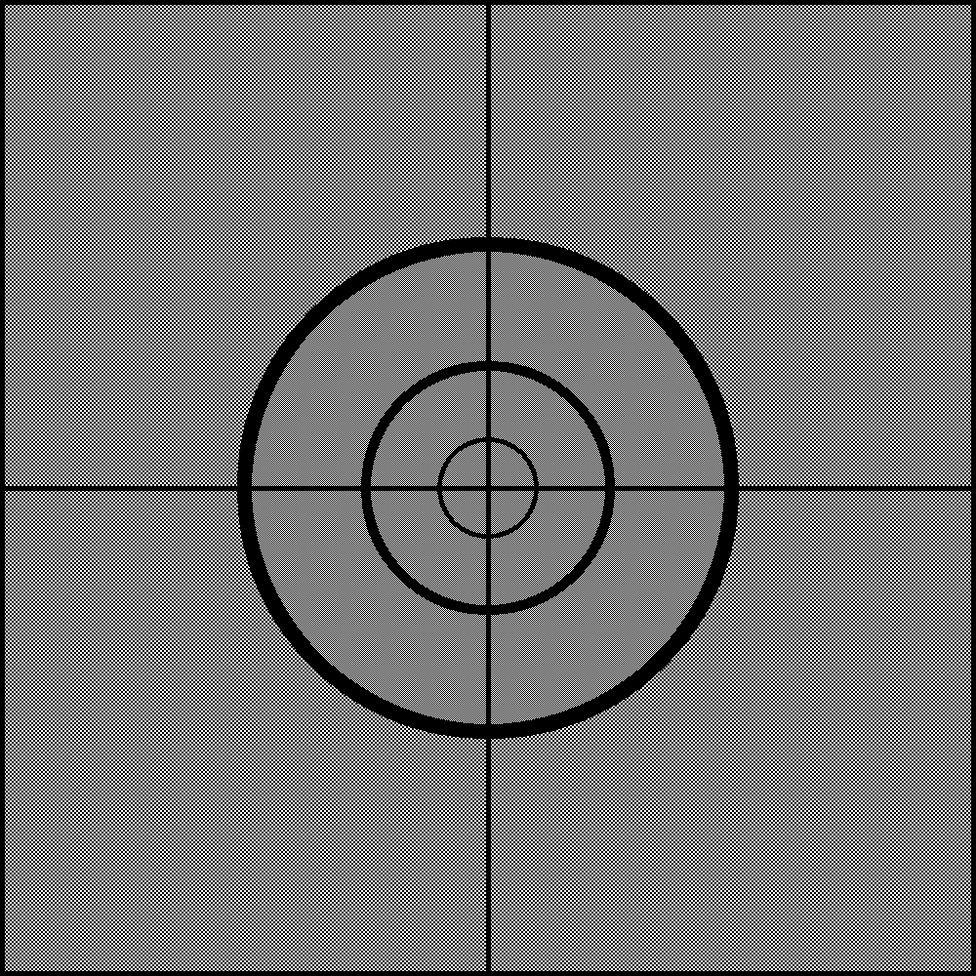
How to analyze the greedy algorithm ?
The key to analysis :
Cost of Sets
Cost of Elements

Slide 21

















Cost of each set ➔ cost of each element
Cost
Sets
Elements
$$e_{1}$$
$C_{1}$= $5$
$$s_{1}$$
$$e_{2}$$
$$e_{3}$$
$C_{2}$= $8$
$$s_{2}$$
$$e_{4}$$
$$e_{5}$$
$C_{3}$= $7$
$$s_{3}$$
$$e_{6}$$
$$e_{7}$$
$$e_{8}$$
$C_{4}$= $11$
$$s_{4}$$
$$e_{9}$$

Slide 22









Cost of each set ➔ cost of each element
Viewing any algorithm
Sum of cost of sets selected = sum of cost paid for each element.
Greedy algorithm: Select the set with ?
Cost
Sets
Elements
Cost/element
$$e_{1}$$
$$\frac{5}{4}$$
$C_{1}$= $5$
$$s_{1}$$
$$e_{2}$$
$$\frac{5}{4}$$
$$e_{3}$$
$$\frac{5}{4}$$
$C_{2}$= $8$
$$s_{2}$$
$$e_{4}$$
$$\frac{5}{4}$$
$$e_{5}$$
$$4$$
$C_{3}$= $7$
$$s_{3}$$
$$e_{6}$$
$$4$$
$$e_{7}$$
$$\frac{7}{3}$$
$$e_{8}$$
$$\frac{7}{3}$$
$C_{4}$= $11$
$$s_{4}$$
$$e_{9}$$
$$\frac{7}{3}$$
least cost per element

Slide 23



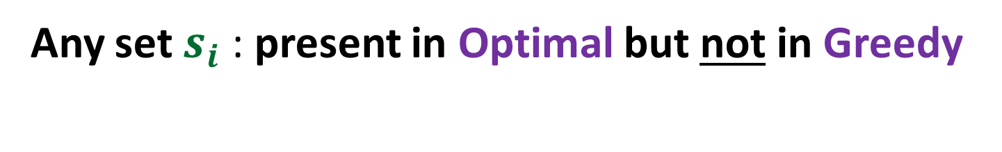
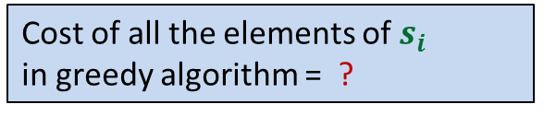


Any set $s_{i}$ : present in Optimal but not in Greedy
Cost =$C_{i}$
$$s_{i}$$
$|s_{i}|$ =$m_{i}$
Cost of these elements
in optimal algorithm = ?
Cost of all the elements of $s_{i}$
in greedy algorithm = ?
Cost of these elements
in greedy algorithm = ?
$$C_{i}$$
$${≤C}_{i} log m_{i}$$

Slide 24
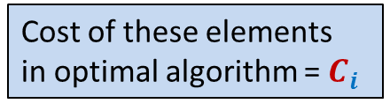

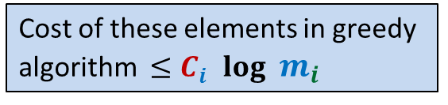
Any sequence of selecting the Optimal set cover
…
…
$$s_{i}$$
Cost of these elements
in optimal algorithm = $C_{i}$
Cost of these elements in greedy
algorithm ${≤C}_{i} log m_{i}$

Slide 25

The core of the analysis
Visualize the Greedy algorithm
from perspective of $s_{i}$

Slide 26




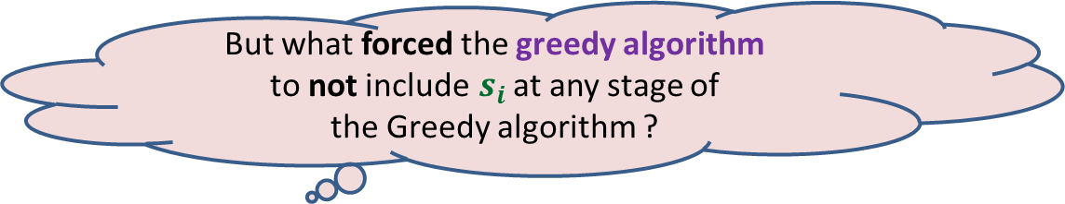




Visualize the Greedy algorithm from perspective of $s_{i}$
$$\sum_{k=1}^{k=ℓ}{j_{k}}=m_{i}$$
$$j_{1}$$
$$j_{2}$$
Cost =$C_{i}$
$$s_{i}$$
$$j_{3}$$
$|s_{i}|$ =$m_{i}$
…
…
$$j_{ℓ}$$
But what forced the greedy algorithm
to not include$s_{i}$ at any stage of
the Greedy algorithm ?
There was always another set that offered
“same or better cost per element” ☺

Slide 27





$$\sum_{k=1}^{k=ℓ}{j_{k}}=m_{i}$$
Cost of first $j_{1}$elements covered by greedy = ?
Cost of next $j_{2}$elements covered by greedy = ?
Cost of next $j_{3}$elements covered by greedy = ?
Cost of last $j_{ℓ}$elements covered by greedy = ?
$$j_{1}$$
$$j_{2}$$
Cost =$C_{i}$
$$s_{i}$$
$$j_{3}$$
$|s_{i}|$ =$m_{i}$
…
…
$$j_{ℓ}$$
$$≤\frac{C_{i}}{m_{i}}j_{1}$$
$$≤\frac{C_{i}}{m_{i}−j_{1}}j_{2}$$
$$≤\frac{C_{i}}{m_{i}−j_{1}−j_{2}}j_{3}$$
$$≤\frac{C_{i}}{m_{i}−j_{1}−j_{2}−…−j_{ℓ−1}}j_{ℓ}$$

Slide 28

$$\sum_{k=1}^{k=ℓ}{j_{k}}=m_{i}$$
Cost of covering all elements of $s_{i}$ by greedy =
$$≤\frac{C_{i}}{m_{i}}j_{1}+ \frac{C_{i}}{m_{i}−j_{1}}j_{2}+\frac{C_{i}}{m_{i}−j_{1}−j_{2}}j_{3}+…+\frac{C_{i}}{m_{i}−j_{1}−j_{2}−…−j_{ℓ−1}}j_{ℓ}$$
$$≤C_{i}\left(\frac{j_{1}}{m_{i}}+ \frac{j_{2}}{m_{i}−j_{1}}+\frac{j_{3}}{m_{i}−j_{1}−j_{2}}+…+\frac{j_{ℓ}}{m_{i}−j_{1}−j_{2}−…−j_{ℓ−1}}\right)$$
$≤C_{i} log m_{i}$
$$j_{1}$$
$$j_{2}$$
Cost =$C_{i}$
$$s_{i}$$
$$j_{3}$$
…
…
$$j_{ℓ}$$

Slide 29
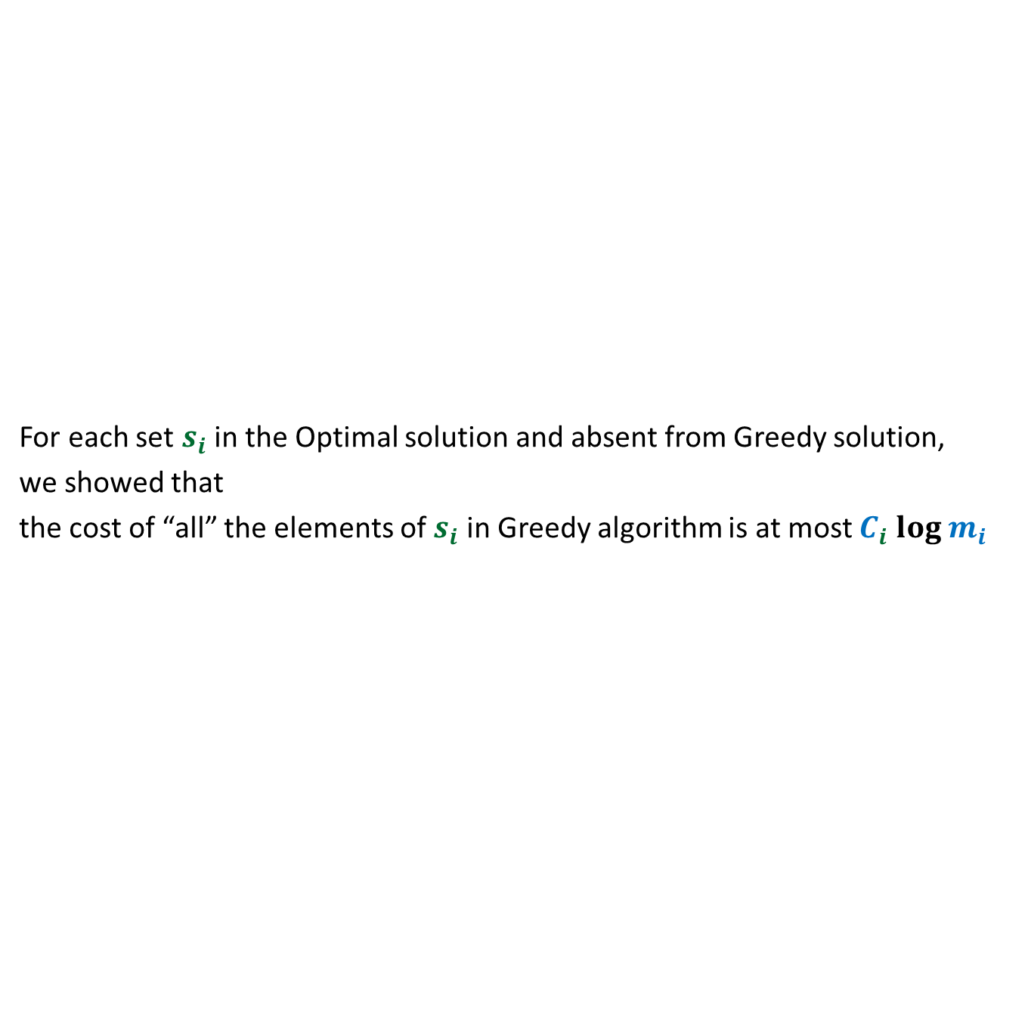
What have we established ?
For each set $s_{i}$in the Optimal solution and absent from Greedy solution,
we showed that
the cost of “all” the elements of $s_{i}$ in Greedy algorithm is at most $C_{i} log m_{i}$
Optimal solution
$$s_{1}$$
$$s_{2}$$
$$s_{3}$$
$$s_{4}$$
$$s_{5}$$
$$s_{6}$$
$$s_{7}$$
$$s_{8}$$
$$s_{9}$$
$$s_{10}$$
$$s_{11}$$
$$s_{12}$$
Greedy solution

Slide 30
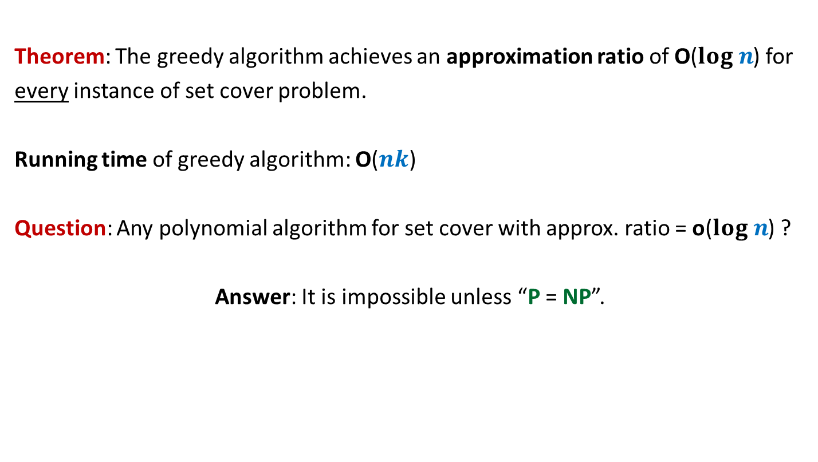
Conclusion
Theorem: The greedy algorithm achieves an approximation ratio of O($log n$) for
every instance of set cover problem.
Running time of greedy algorithm: O($nk$)
Question: Any polynomial algorithm for set cover with approx. ratio = o($log n$) ?
Answer: It is impossible unless “P = NP”.

Slide 31
That’s all !
If you started liking algorithms after this course, the credit goes only to the beautiful world of algorithms.
If you started disliking algorithms after this course, the blame goes to the instructor.
In that case, please fill up the student feedback/reaction survey sincerely so that I can improve as an instructor in future.

