Slide 1
Design and Analysis of Algorithms
Algorithms-II : CS345A
Website: hello.iitk.ac.in
Lecture 4
Divide and Conquer Paradigm - III
2. Power of Binary Search Trees - II
(finish)

Slide 2
Recap from Lecture 1
An algorithm for multiplying two polynomials

Slide 3
a Divide and Conquer algorithm for
Polynomial Evaluation Problem

Slide 4




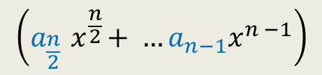




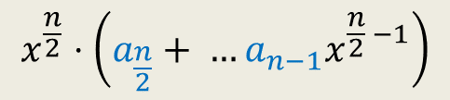

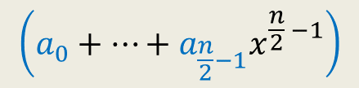
Divide Step
Attempt 1
$$A\left(x\right)=a_{0}+a_{1}x+a_{2}x^{2}+ …a_{n−1}x^{n−1}$$
$$S$$
$$A\left(x\right)= ? + ?$$
Evaluating $A$ at $S$ =
$$\left(a_{0}+…+a_{\frac{n}{2}−1}x^{\frac{n}{2} −1}\right)$$
$$x^{\frac{n}{2}}⋅\left(a_{\frac{n}{2}}+ …a_{n−1}x^{\frac{n}{2} −1}\right)$$
$$\left(a_{\frac{n}{2}}{ x}^{\frac{n}{2}}+ …a_{n−1}x^{n −1}\right)$$
First $\frac{n}{2}$ terms of $A\left(x\right)$
Last $\frac{n}{2}$ terms of $A\left(x\right)$
$$A_{first}\left(x\right)$$
$$A_{second}\left(x\right)$$
Evaluating $A_{first}$ at $S$
Evaluating $A_{second}$ at $S$
$+$ O($n log n$) time

Slide 5






Solving the sub-problem
points
for
evaluation
$A\left(x\right)=$ $A_{first}$($x$) + $x^{\frac{n}{2}} A_{second}$($x$)
degree
$$A$$
$$<n$$
$$S$$
$$n$$
$$A_{first}$$
$$A_{second}$$
$$<n/2$$
$$S$$
$$n$$
$$<n/4$$
$$S$$
$$n$$
$$<1$$
$$S$$
$$n$$
$n$ polynomials, each to be evaluated at $n$ distinct numbers
$Θ\left(n^{2}\right)time$☹

Slide 6













Divide Step
Attempt 2
$$A\left(x\right)= ? + ?$$
$A_{even}(x)$= $a_{0}+a_{2}x+ …+a_{n−2}x^{\frac{n}{2}−1}$
$A_{odd}(x)$ = $a_{1}+a_{3}x+ …+a_{n−1}x^{\frac{n}{2}−1}$,
Evaluating $A$ at $S$ =
$$A\left(x\right)=a_{0}+a_{1}x+a_{2}x^{2}+ …a_{n−1}x^{n−1}$$
$$S$$
$$\left(a_{0}+a_{2}x^{2}+…+a_{n−2}x^{n−2}\right)$$
$$(a_{1}x+a_{3}x^{3}+…+a_{n−1}x^{n−1}\text{)}$$
All odd terms of $A\left(x\right)$
All even terms of $A\left(x\right)$
$x⋅(a_{1}+a_{3}x^{2}+…+a_{n−1}x^{n−2}$)
$A\left(x\right)=$ $A_{even}$($x^{2}$) + $x A_{odd}$($x^{2}$)
Evaluating $A_{even}$ at ?
$$S^{2}=$$
$$\left\{c^{2} \right| c∈S\}$$
$$S^{2}$$
Evaluating $A_{odd}$ at $S^{2}$
$+$ O($n$) time

Slide 7
Solving the sub-problem
points
for
evaluation
$A\left(x\right)=$ $A_{even}$($x^{2}$) + $x A_{odd}$($x^{2}$)
degree
$$A$$
$$<n$$
$$S$$
$$n$$
Question: Is it possible to select $S$ such that
…
$$A_{even}$$
$$A_{odd}$$
$$<n/2$$
$$S^{2}$$
$$n$$
$$<n/4$$
$$S^{4}$$
$$n$$
$$<1$$
$$S^{n}$$
$$n$$
$n$ polynomials, each to be evaluated at $n$ distinct numbers
$Θ\left(n^{2}\right)time$☹
This hurdle is pointing to a very important question whose answer will solve this problem …
Now recall the set $S$
you selected. What is the size of $S^{2}$, $S^{4}$, …, $S^{n}$ ?
$${|S}^{2}|=\frac{n}{2}$$
$${|S}^{4}|=\frac{n}{4}$$
$${|S}^{n}|=1$$

Slide 8
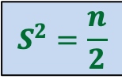




Question
Is it possible to select $S$ such that
…
$$S^{2}=\frac{n}{2}$$
$S$ = $\{2,3,9,−2,−3,−9\}$
$$S^{4}=\frac{n}{4}$$
$$S^{n}=1$$

Slide 9
Complex numbers
Recalling elementary facts
Some of you will start loving complex numbers after seeing their magical role in solving this problem. ☺

Slide 10
Complex numbers
$$\sqrt{a^{2}+b^{2}}$$
$$a+bi$$
$$=r(\cos{φ}+i\sin{φ})$$
$$x_{1} =r_{1}(\cos{φ_{1}}+i\sin{φ_{1}})$$
$$x_{2} =r_{2}(\cos{φ_{2}}+i\sin{φ_{2}})$$
Addition
$x_{1}+x_{2}$ = ?
Multiplication
$x_{1}⋅x_{2}$ = ?
Complex plane
$$b$$
$$r$$
$$φ$$
$$a$$
Vector addition
$$r_{1}r_{2}(\cos{(φ_{1}+φ_{2})}+i\sin{(φ_{1}+φ_{2})})$$
Magnitudes get multiplied &
Arguments get added… beautiful ☺

Slide 11
Complex roots of unity
Definition:
A number $z$ is said to be $n$th root of unity
if it satisfies equation.
$$z^{n}=1$$
$$z⋅z⋅z⋅ …⋅z=1$$
Magnitude($z$) = 1
Argument($z$) = ?
$$\{1, ω_{n} ,ω_{n}^{2},ω_{n}^{3},…,ω_{n}^{n−1}\}$$
Complex plane
$$\frac{2π}{n}$$
$$1$$
multiple of $\frac{2π}{n}$
So $x$ must lie on the unit circle. But where exactly …
$$R_{n}=$$
Unit circle

Slide 12

Complex roots of unity
$$R_{3}$$
What is $\left\{x^{2} \right|x∈R_{3}\}$ ?
$$R_{4}$$
What is $\left\{x^{2} \right|x∈R_{4}\}$ ?
$$ω_{4}^{1}$$
$$ω_{3}^{1}$$
$$ω_{3}^{3}$$
$$ω_{4}^{2}$$
$$ω_{4}^{4}$$
$$ω_{3}^{2}$$
$$ω_{4}^{3}$$
$$R_{3}$$
$$R_{2}$$

Slide 13
Complex roots of unity
Theorem:
If $n$ is odd $\left\{x^{2} \right|x∈R_{n}\}=R_{n}$
If $n$ is even $\left\{x^{2} \right|x∈R_{n}\}=$ $R_{\frac{n}{2}}$
Is it possible to select $S$ such that
…
?
$$S^{2}=\frac{n}{2}$$
$$S^{4}=\frac{n}{4}$$
$$S^{n}=1$$
$$S=R_{n}$$
Do you realize now why we assumed $n$ as power of $2$ ?

Slide 14
Solving the sub-problem
points
for
evaluation
$A\left(x\right)=$ $A_{even}$($x^{2}$) + $x A_{odd}$($x^{2}$)
degree
$$A$$
$$<n$$
$$R_{n}$$
T($n$) = Time complexity of Evaluating $A\left(x\right)$ on $R_{n}$
= a$n$ + $2$T($\frac{n}{2}$)
$$A_{even}$$
$$A_{odd}$$
$$<n/2$$
$$R_{\frac{n}{2}}$$
$$<n/4$$
$$R_{\frac{n}{4}}$$
$$<1$$
$$R_{1}$$

Slide 15
O($n^{2}$) time
☹
$$A\left(x\right)$$
$$B\left(x\right)$$
Coefficient
represntation
<$a_{0}, a_{1},a_{2},…,a_{n−1}$>
<$b_{0}, b_{1},b_{2},…,b_{n−1}$>
<$c_{0}, c_{1},c_{2},…,c_{2n−2}$>
O($n$ log $n$) time
Done
?
Practice sheet
with hints
O($n$ log $n$) time
{$\left(r_{0}, A\left(r_{0}\right)\right),…,(r_{2n−2}, A\left(r_{2n−2}\right)$}
{$\left(r_{0}, B\left(r_{0}\right)\right),…,(r_{2n−2}, B\left(r_{2n−2}\right)$}
{$\left(r_{0}, C\left(r_{0}\right)\right),…,(r_{2n−2}, C\left(r_{2n−2}\right)$}
O($n$) time
☺

Slide 16
The power of Binary Search Tree
II

Slide 17
Height Balanced BST (Red-black tree, AVL tree)
Operations you already know
New operation
Search(T,x)
Insert(T,x)
Delete(T,x)
Min(T)
Max(T)
Predecessor(T,x)
Successor(T,x)
SpecialMerge(T, T’)
Split(T,x)
10. FindRank(T, x):
return the no. of elements in T that are smaller
than x.
Every operation in O(log n) time.

Slide 18
Find-rank(T,x)

Slide 19
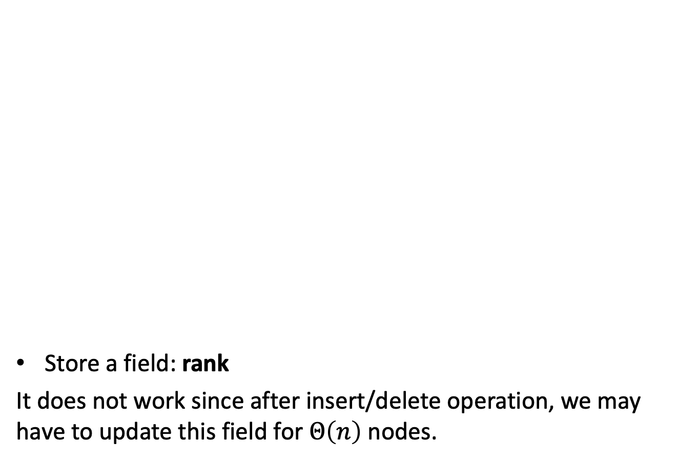
A trivial approach that does not work
Store a field: rank
It does not work since after insert/delete operation, we may have to update this field for $Θ\left(n\right)$ nodes.
T
46
28
67
5
35
49
2
25
31
41
48
53

Slide 20
Achieving O(log n) time for FindRank(T,x)
Assume without loss of generality that x belongs to T.
View the entire tree T from perspective of the path from x to the root.
How will T look like ?
x
T

Slide 21
Achieving O(log n) time for FindRank(T,x)
Can you identify the elements that contribute to Rank of x in this picture ?
Elements that are present in the subtrees lying to the left of this path.
And some elements on this path.
x
T

Slide 22
An elegant solution
Fields associated with a node v in T:
Value(v)
Left(v)
right (v)
parent(v)
Keep one more field
Size(v): The number of nodes stored in the subtree rooted at v.

Slide 23
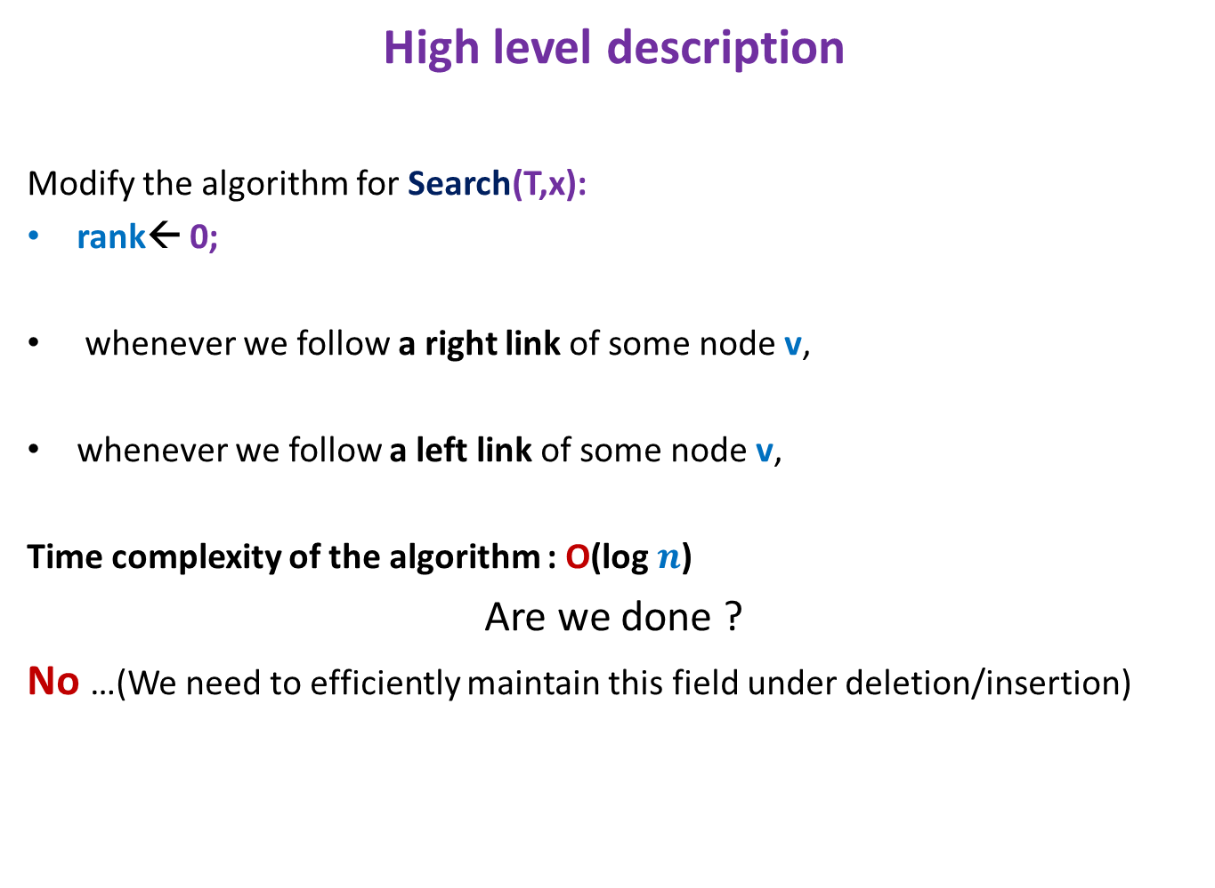
Algorithm for FindRank(T,x)
High level description
Modify the algorithm for Search(T,x):
rank← 0;
whenever we follow a right link of some node v,
whenever we follow a left link of some node v,
Time complexity of the algorithm : O(log $n$)
Are we done ?
No …(We need to efficiently maintain this field under deletion/insertion)
rank← rank + size(left(v)) + 1
Do nothing

Slide 24
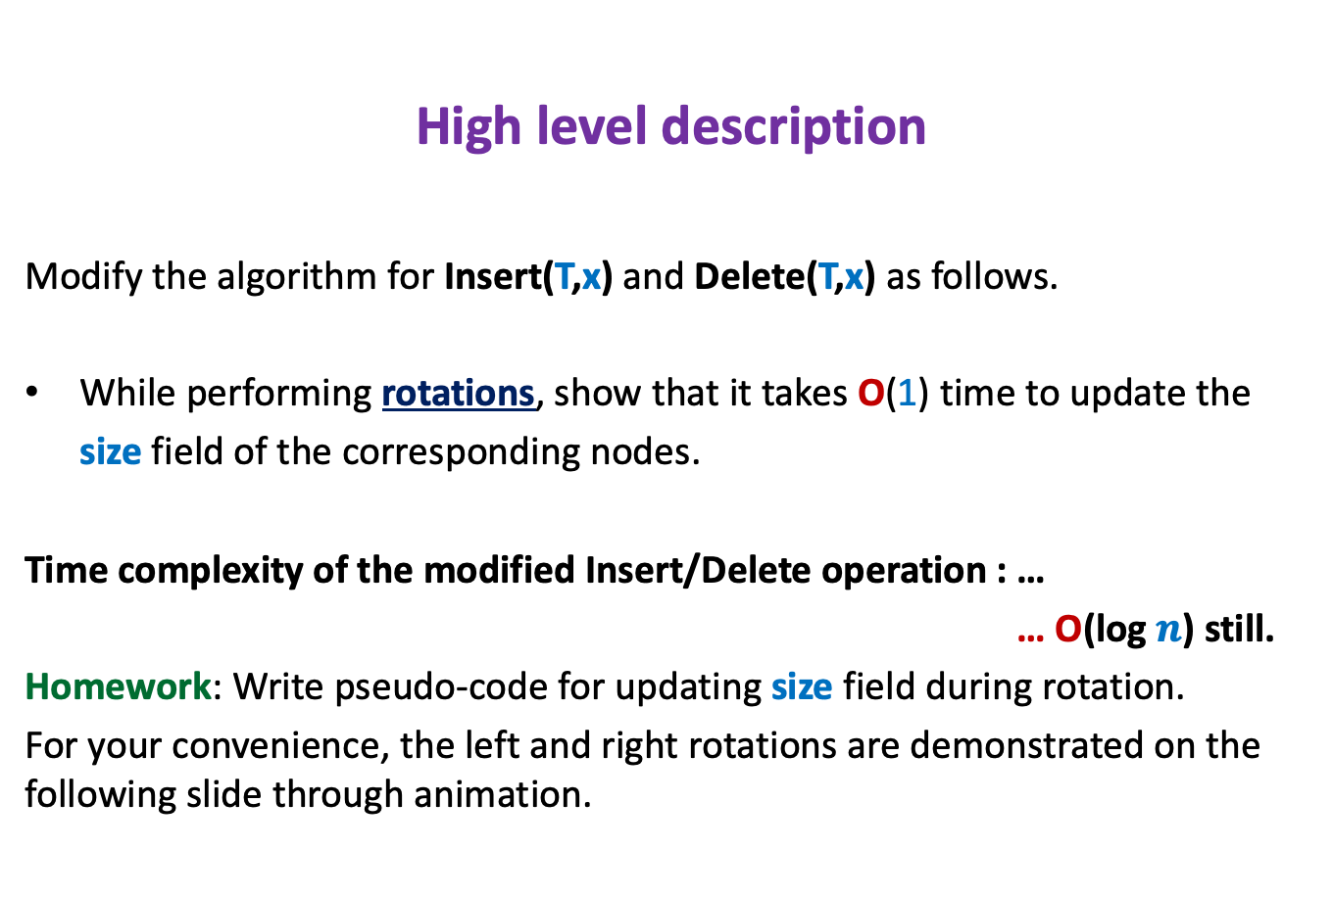
Maintaining size field T under insertion/deletion
High level description
Modify the algorithm for Insert(T,x) and Delete(T,x) as follows.
While performing rotations, show that it takes O(1) time to update the
size field of the corresponding nodes.
Time complexity of the modified Insert/Delete operation : …
… O(log $n$) still.
Homework: Write pseudo-code for updating size field during rotation.
For your convenience, the left and right rotations are demonstrated on the following slide through animation.

Slide 25
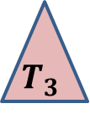





Rotation around a node
x
x
p
Right rotation
Left rotation
v
u
u
v
$$T_{3}$$
$$T_{1}$$
$$T_{2}$$
$$T_{3}$$
$$T_{1}$$
$$T_{2}$$
Note that the tree T continues to remain a BST even after rotation around any node.

Slide 26
What makes BST powerful and pervasive ?
: Additional information

Slide 27
Data Structure
For Dynamic Sequences

Slide 28



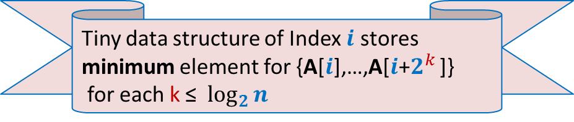

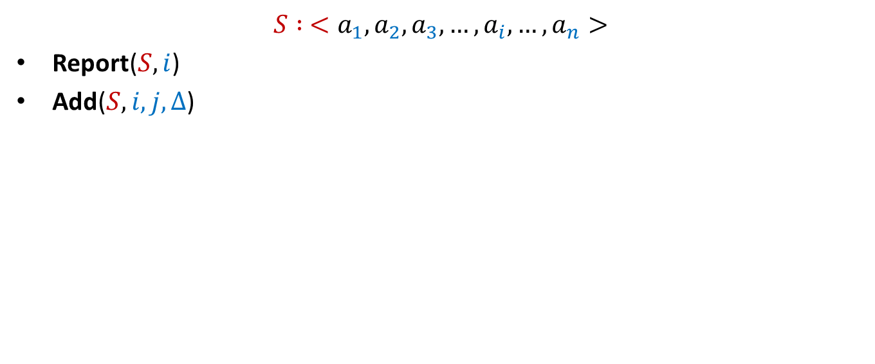





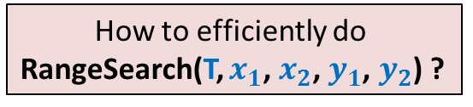

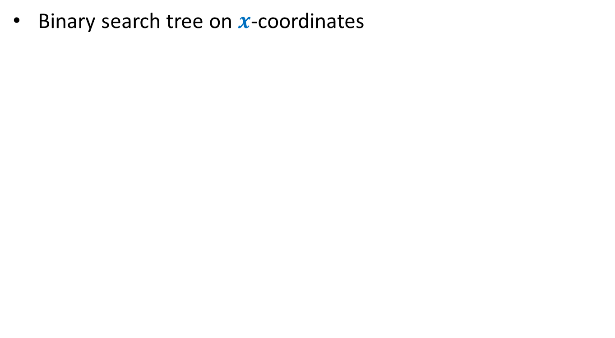
Dynamic Sequences
$$S : <a_{1}, a_{2},a_{3},…,a_{i}, …,a_{n}>$$
Report($S,i$)
Add($S,i,j,Δ$)
Add($S,3,8,6$)
Report($S,5$)
$$S$$
$$5$$
$$3$$
$$1$$
$$701$$
$$23$$
$$19$$
$$41$$
$$83$$
$$8$$
$$5$$

Slide 29





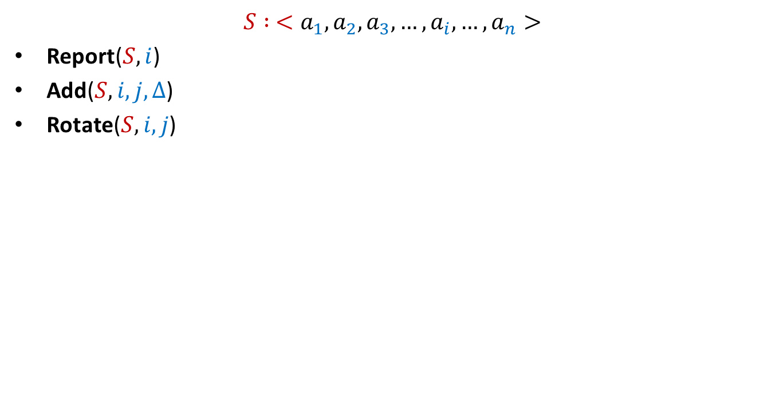


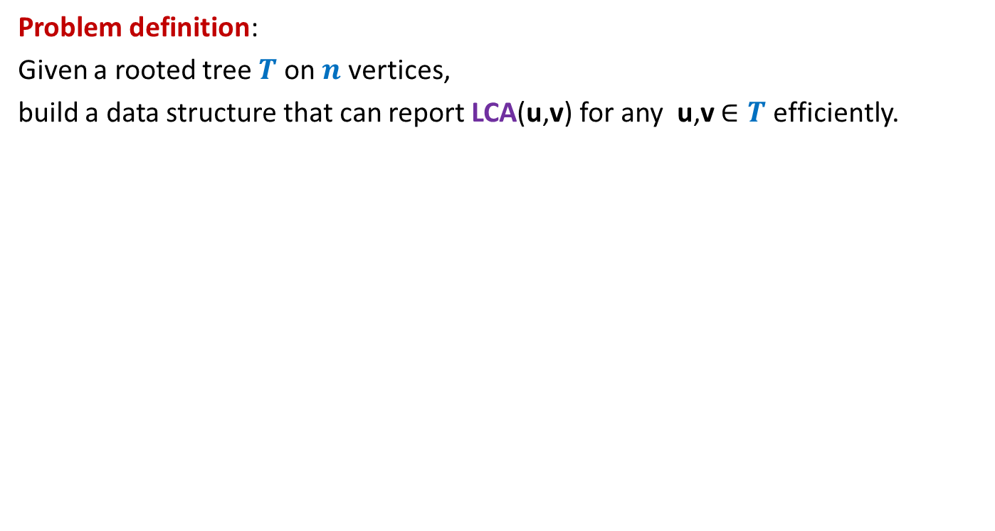







Dynamic Sequences
$$S : <a_{1}, a_{2},a_{3},…,a_{i}, …,a_{n}>$$
Report($S,i$)
Add($S,i,j,Δ$)
Rotate($S,i,j$)
$≈$ log $n$
Rotate($S,4,8$)
$$S$$
$$5$$
$$89$$
$$707$$
$$3$$
$$68$$
$$7$$
$$707$$
$$29$$
$$89$$
$$47$$
$$25$$
$$25$$
$$47$$
$$29$$
$$8$$
$$5$$
$$5$$
$$5$$
$$5$$

Slide 30
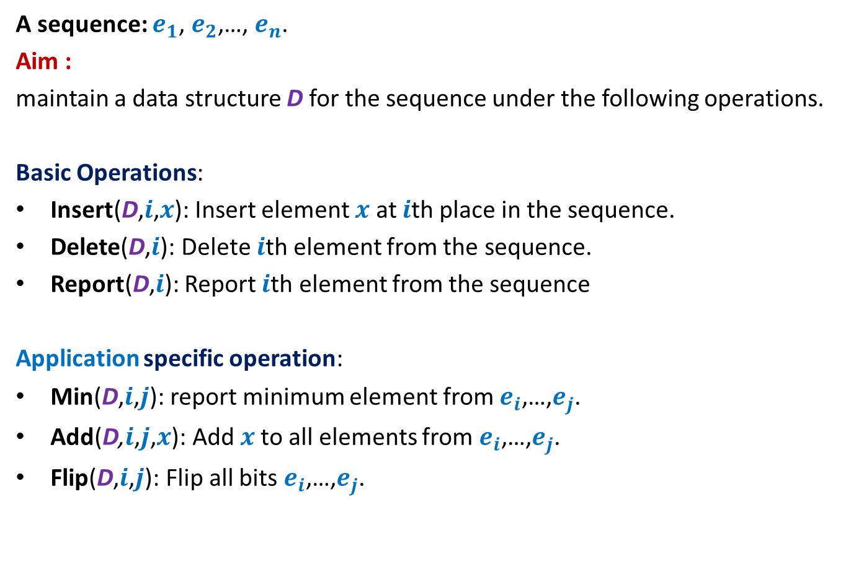
Dynamic Sequence
A sequence: $e_{1}$, $e_{2}$,…, $e_{n}$.
Aim :
maintain a data structure D for the sequence under the following operations.
Basic Operations:
Insert(D,$i$,$x$): Insert element $x$ at $i$th place in the sequence.
Delete(D,$i$): Delete $i$th element from the sequence.
Report(D,$i$): Report $i$th element from the sequence
Application specific operation:
Min(D,$i$,$j$): report minimum element from $e_{i}$,…,$e_{j}$.
Add(D,$i$,$j$,$x$): Add $x$to all elements from $e_{i}$,…,$e_{j}$.
Flip(D,$i$,$j$): Flip all bits $e_{i}$,…,$e_{j}$.
OR
OR

Slide 31



Representing sequence using a BST
A sequence: $e_{1}$, $e_{2}$,…, $e_{n}$.
Example: $6$, $0$, $5$, $13$, $2$, $14$, $1$, $32$.
“Inorder traversal produces the sequence.”
How can we represent a sequence using BST ?
$$2$$
$$0$$
$$1$$
$$6$$
$$5$$
$$14$$
$$32$$
$$13$$

Slide 32
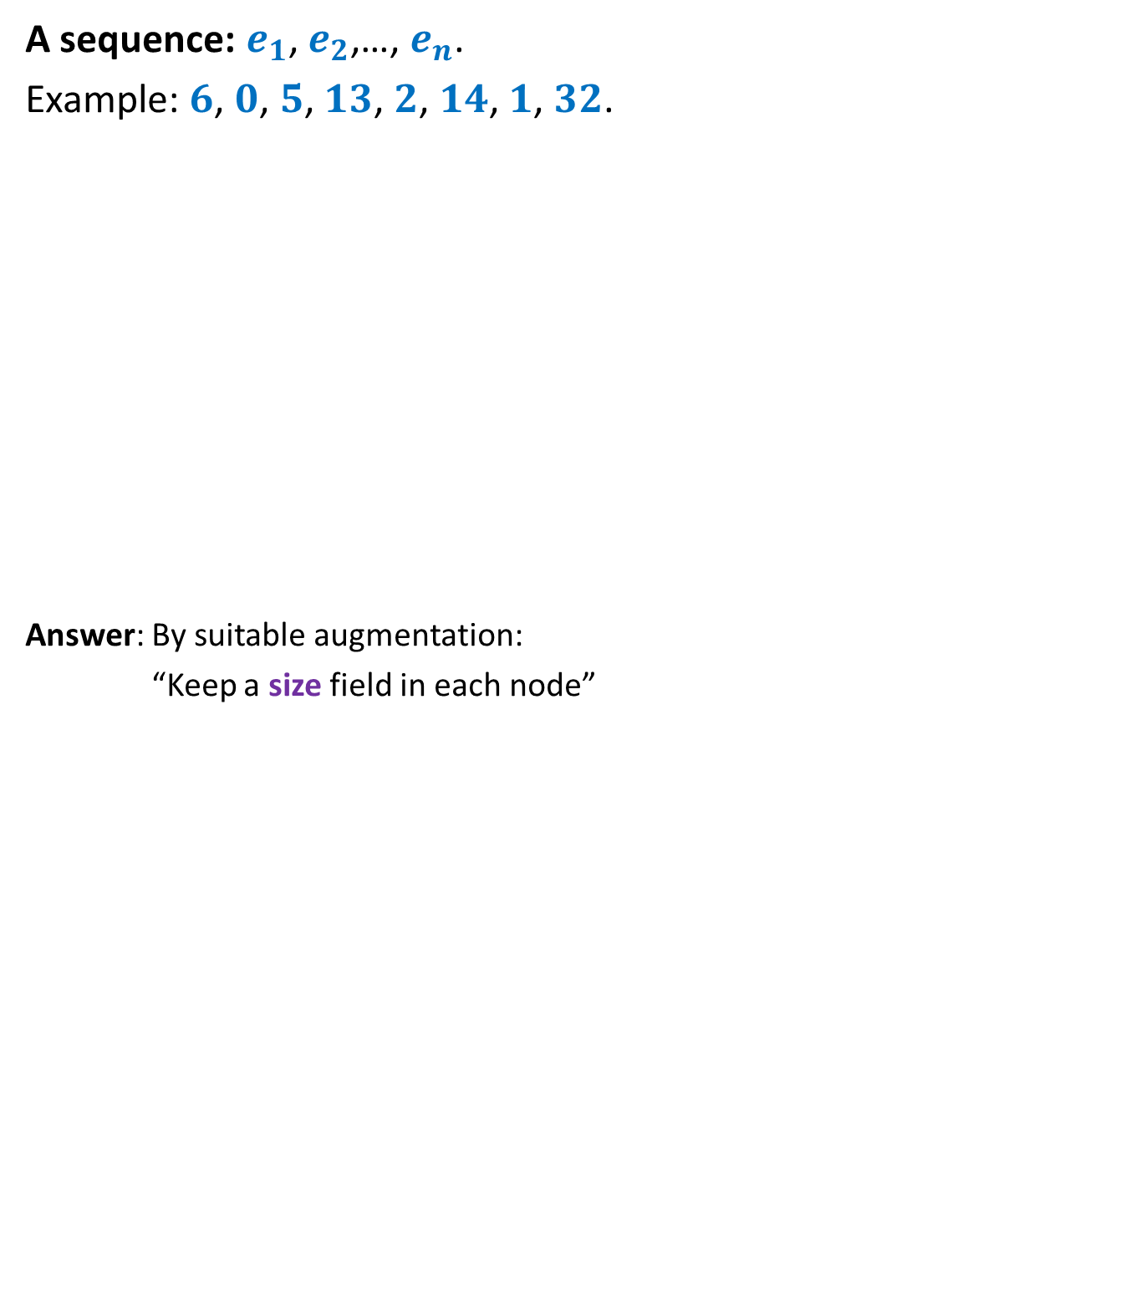

Representing sequence using a BST
A sequence: $e_{1}$, $e_{2}$,…, $e_{n}$.
Example: $6$, $0$, $5$, $13$, $2$, $14$, $1$, $32$.
Answer: By suitable augmentation:
“Keep a size field in each node”
How to access $i$th element of the sequence ?
: size field
$$2$$
8
$$0$$
4
$$1$$
3
$$6$$
1
$$5$$
2
$$14$$
1
$$32$$
1
$$13$$
1

Slide 33





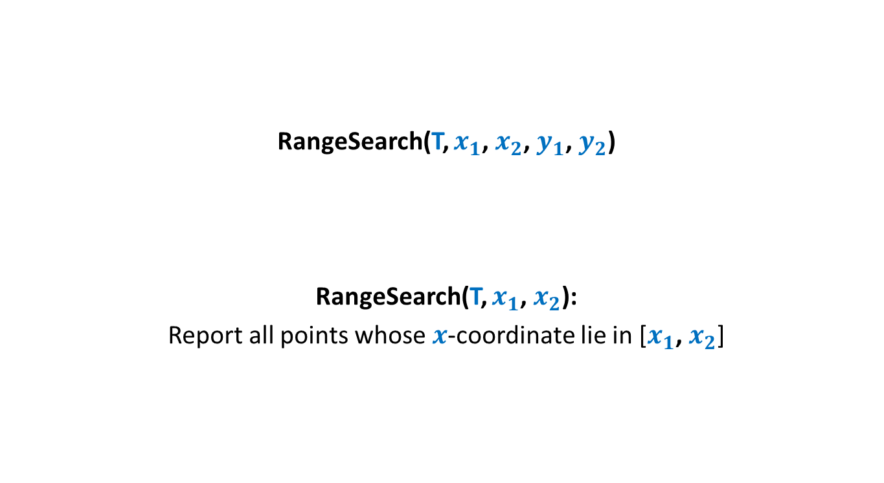
Report($T,$ $i$)
Report(T,$i$)
{ found=false; $\text{u} \text{← }$T ;
While( not found)
{
s ← size(left(u));
if(s = $i−1$) ?? ;
else if(s > $i−1$) ?? ;
else {
?? ;
?? ;
}
}
return val(u);
}
u
if(left(u)=NULL) s ← 0;
else
$\text{found}\text{← }\text{true}$;
$$\text{u} \text{← }\text{left}\text{(}\text{u}\text{)}$$
$i\text{←}i−$size(left(u)) $−$1
u← $\text{right}\text{(}\text{u}\text{)}$;

Slide 34
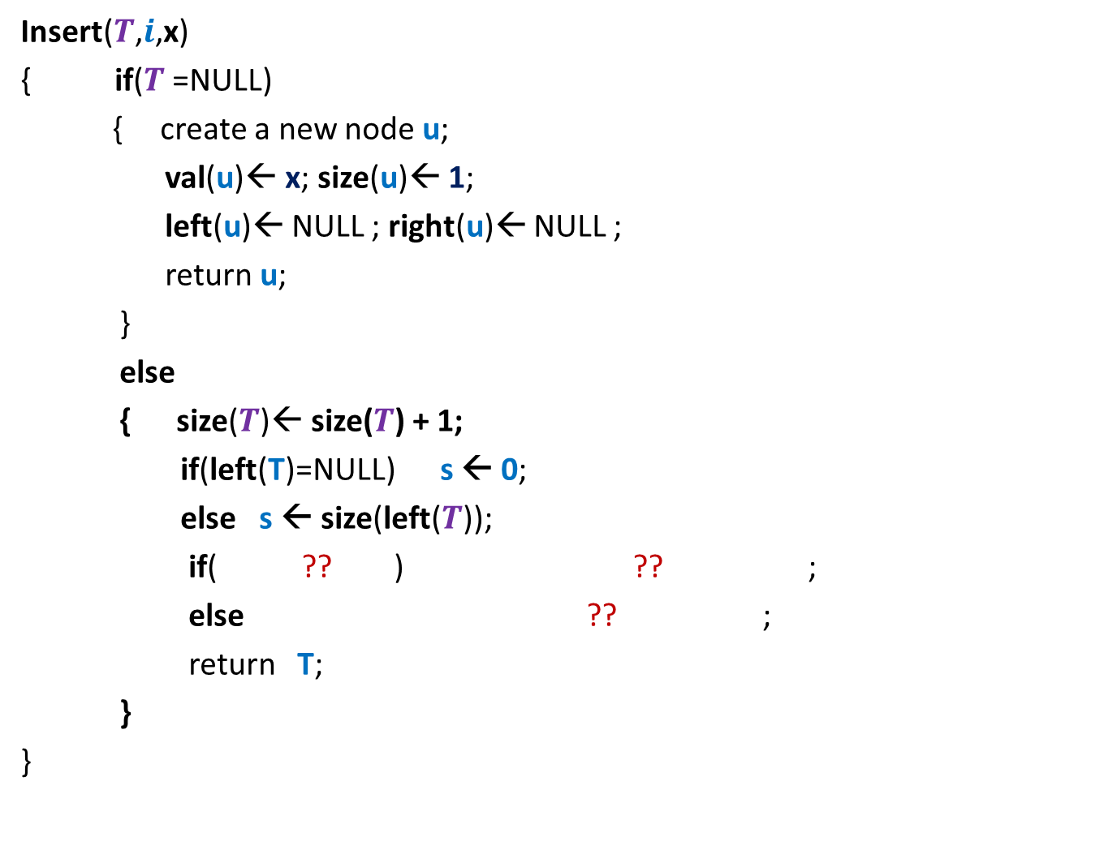




Insert($T,$ $i$, x)
Insert($T$,$i$,x)
{ if($T$=NULL)
{ create a new node $\text{u}$;
val($\text{u}$)← x; size($\text{u}$)← 1;
left($\text{u}$)← NULL ; right($\text{u}$)← NULL ;
return $\text{u}$;
}
else
{ size($T$)← size($T$) + 1;
if(left(T)=NULL) s ← 0;
else s ← size(left($T$));
if( ?? ) ?? ;
else ?? ;
return $\text{T}$;
}
}
T
Don’t forget to rebalance the tree height at the end !
$i$ $≤$s $+$1
$$\text{left}\text{(}T\text{)} \text{←}\text{Insert}\text{(}\text{(}\text{left}\text{(}T\text{))}\text{,}i\text{,}\text{x}\text{)}$$
$\text{righ}\text{t}\text{(}T\text{)} \text{←}\text{Insert}\text{(}\text{(}\text{right}\text{(}T\text{))}\text{,}i−1−\text{s}\text{,}\text{x}\text{)}$;

Slide 35
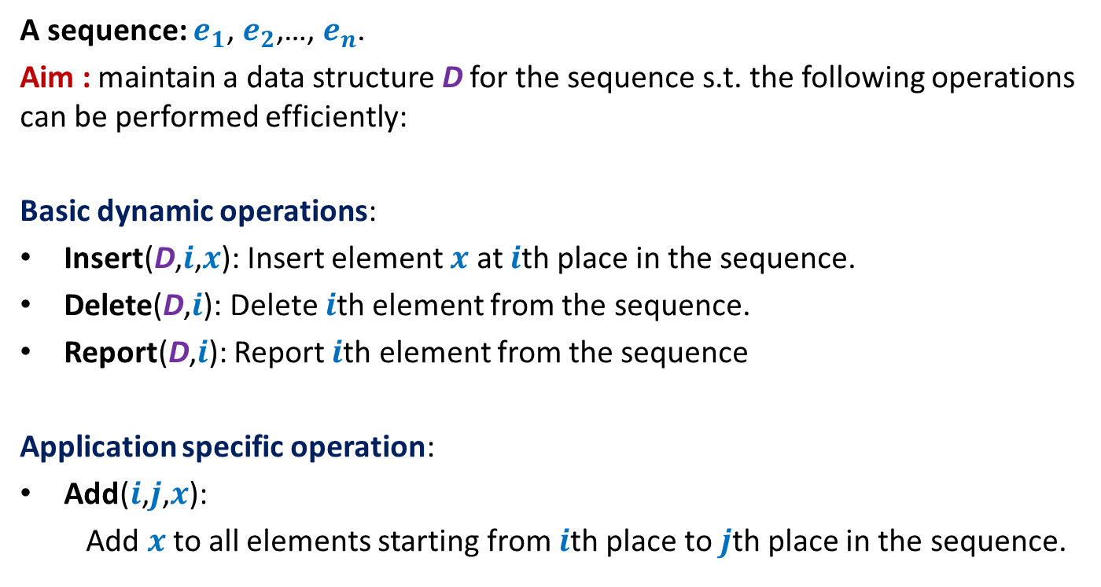
Example 2: sequence of numbers
A sequence: $e_{1}$, $e_{2}$,…, $e_{n}$.
Aim : maintain a data structure D for the sequence s.t. the following operations can be performed efficiently:
Basic dynamic operations:
Insert(D,$i$,$x$): Insert element $x$ at $i$th place in the sequence.
Delete(D,$i$): Delete $i$th element from the sequence.
Report(D,$i$): Report $i$th element from the sequence
Application specific operation:
Add($i$,$j$,$x$):
Add $x$to all elements starting from $i$th place to $j$th place in the sequence.

Slide 36
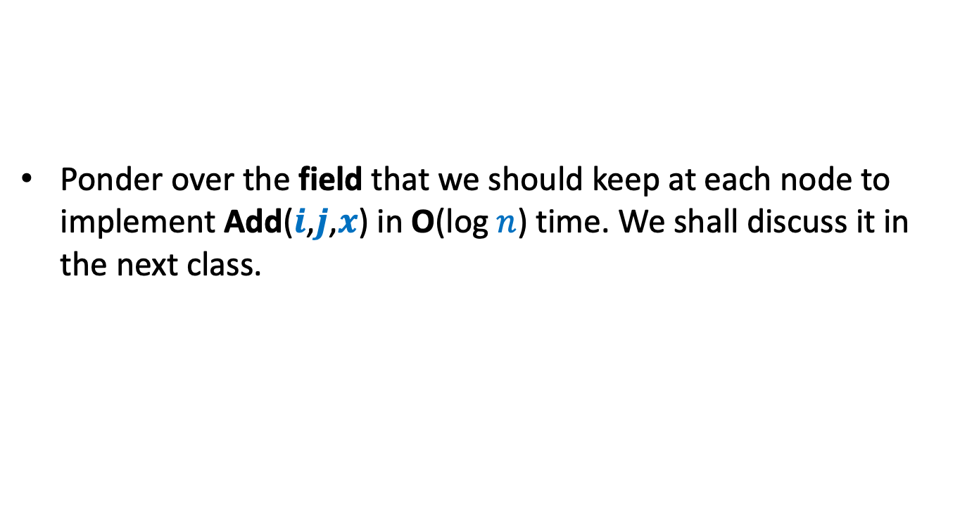
Homework
Ponder over the field that we should keep at each node to implement Add($i$,$j$,$x$) in O(log $n$) time. We shall discuss it in the next class.

