Slide 1
Design and Analysis of Algorithms
Algorithms-II : CS345A
Website: hello.iitk.ac.in
Lecture 5
Power of Binary Search Trees - III

Slide 2
Recap from Lecture 4
Augmented BST for dynamic sequences

Slide 3
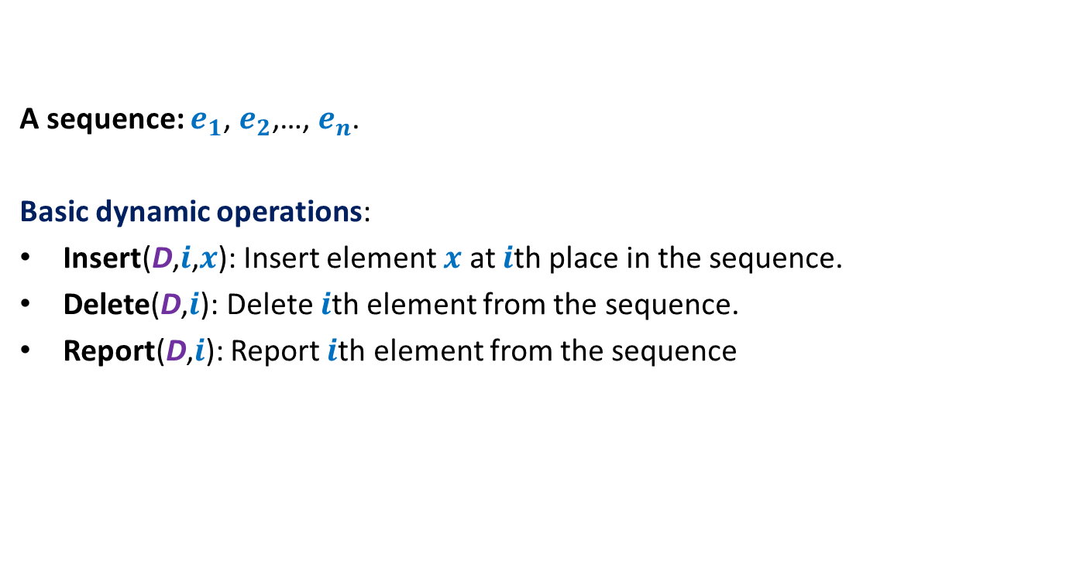
Dynamic sequence
A sequence: $e_{1}$, $e_{2}$,…, $e_{n}$.
Basic dynamic operations:
Insert(D,$i$,$x$): Insert element $x$ at $i$th place in the sequence.
Delete(D,$i$): Delete $i$th element from the sequence.
Report(D,$i$): Report $i$th element from the sequence

Slide 4









Representing sequence using a BST
A sequence: $e_{1}$, $e_{2}$,…, $e_{n}$.
Example: $6$, $0$, $5$, $13$, $2$, $14$, $1$, $32$.
: size field
$$2$$
8
$$0$$
4
$$1$$
3
$$6$$
1
$$5$$
2
$$14$$
1
$$32$$
1
$$13$$
1

Slide 5
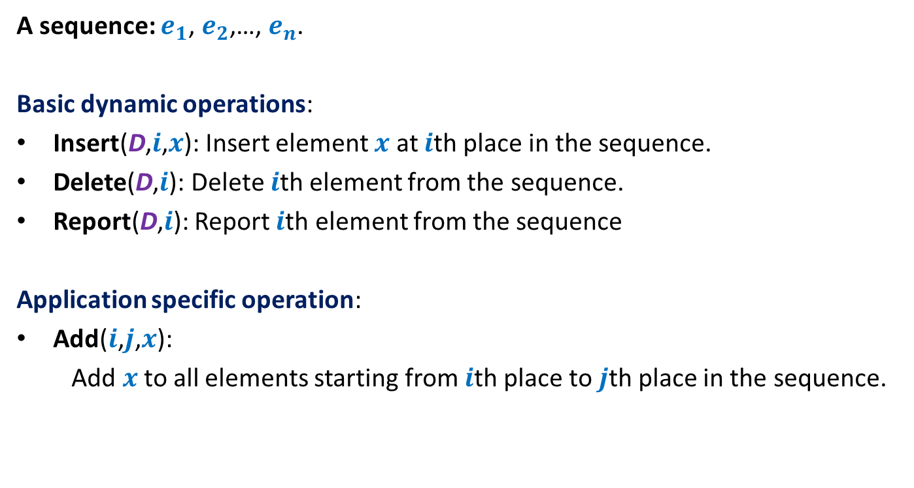
Example 1: sequence of numbers
A sequence: $e_{1}$, $e_{2}$,…, $e_{n}$.
Basic dynamic operations:
Insert(D,$i$,$x$): Insert element $x$ at $i$th place in the sequence.
Delete(D,$i$): Delete $i$th element from the sequence.
Report(D,$i$): Report $i$th element from the sequence
Application specific operation:
Add($i$,$j$,$x$):
Add $x$to all elements starting from $i$th place to $j$th place in the sequence.

Slide 6
Performing Add(T,i,j,x)
View the entire tree T from perspective of the paths from i and j to the root.
How will T look like ?
LCA(i,j)
j
i
T

Slide 7
Performing Add(T,i,j,x)
What are the nodes whose values has to be incremented by x ?
LCA(i,j)
j
i
T

Slide 8
Performing Add(T,i,j,x)
LCA(i,j)
j
i
T

Slide 9
Performing Add(T,i,j,x)
LCA(i,j)
j
i
T

Slide 10
Performing Add(T,i,j,x)
LCA(i,j)
j
i
T

Slide 11
Performing Add(T,i,j,x)
LCA(i,j)
j
i
T

Slide 12
Performing Add(T,i,j,x)
LCA(i,j)
j
i
T

Slide 13

Performing Add(T,i,j,x)
Easy
There are O(log $n$) nodes on the two paths whose value needs to incremented.
There are O(log $n$) subtrees also s.t. value of each of their elements needs to incremented☹
We can not afford to increment the value of each node in these subtrees explicitly. So what to do ?
: incr
LCA(i,j)
Keep an extra field incr
such that adding x to incr field of v means
….
j
adding x to each element in T(v)
i
T

Slide 14


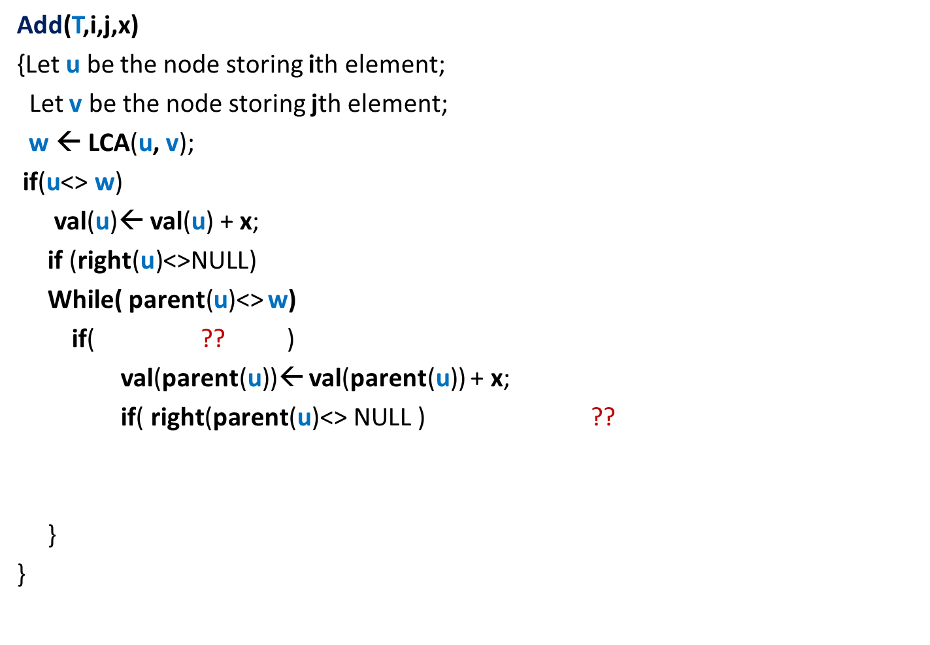



Performing Add(T,i,j,x)
Add(T,i,j,x)
{Let $\text{u}$ be the node storing ith element;
Let $\text{v}$ be the node storing jth element;
$\text{w} \text{← }$LCA($\text{u}$, $\text{v}$);
if($\text{u}$<> $\text{w}$)
val($\text{u}$)← val($\text{u}$) + x;
if (right(u)<>NULL)
While( parent($\text{u}$)<> $\text{w}$)
if( ?? )
val(parent($\text{u}$))← val(parent($\text{u}$)) + x;
if( $\text{right}\text{(}\text{parent}\text{(}\text{u}\text{)<> }\text{NULL}\text{ )}$ ??
}
}
val($\text{w}$)← val($\text{w}$) + x
{
incr(right($\text{u}$))← incr(right($\text{u}$)) + x ;
{
$\text{u}$=left(parent(u))
{
Incr(right($\text{parent}\text{(}\text{u}$)))← incr(right($\text{parent}\text{(}\text{u}$))) + x;
}
$\text{u}\text{←}\text{parent}\text{(}\text{u}$);
------- similarly process $\text{v}$---------(do it as homework);

Slide 15
Report(T,i)
i
T

Slide 16
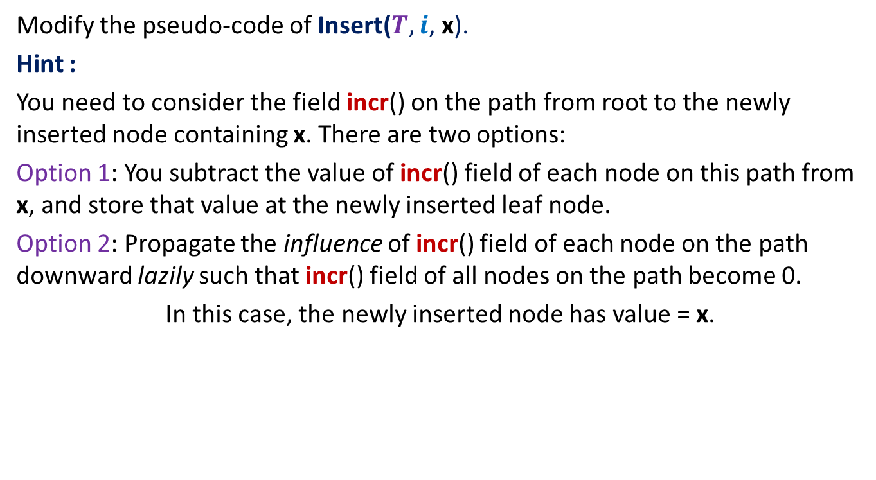
Homework
Modify the pseudo-code of Insert($T,$ $i$, x).
Hint :
You need to consider the field incr() on the path from root to the newly inserted node containing x. There are two options:
Option 1: You subtract the value of incr() field of each node on this path from x, and store that value at the newly inserted leaf node.
Option 2: Propagate the influence of incr() field of each node on the path downward lazily such that incr() field of all nodes on the path become 0.
In this case, the newly inserted node has value = x.

Slide 17

Homework
Modify the pseudo-code of Insert($T,$ $i$, x).

Slide 18
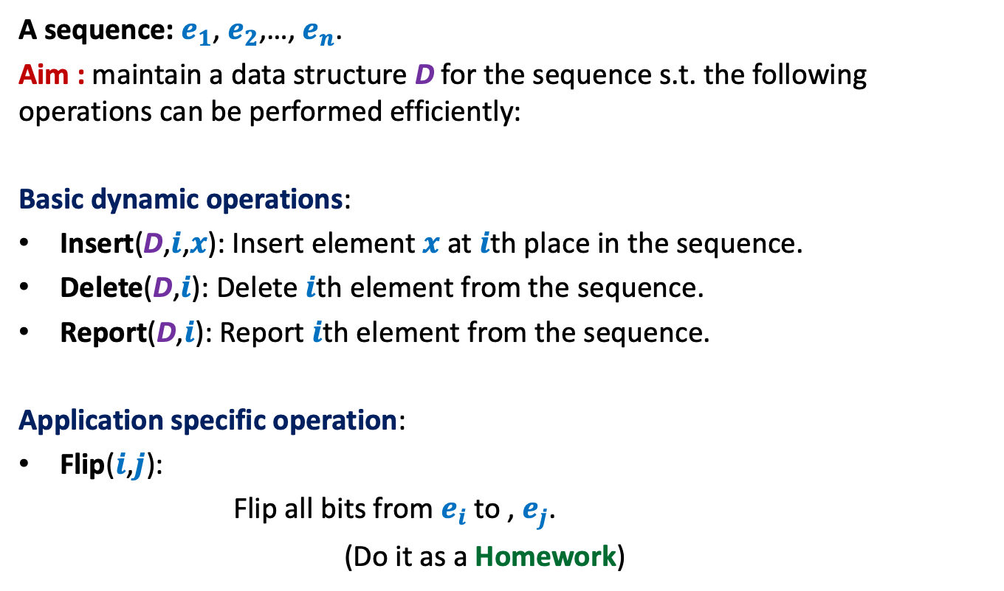
Example 2: sequence of bits
A sequence: $e_{1}$, $e_{2}$,…, $e_{n}$.
Aim : maintain a data structure D for the sequence s.t. the following operations can be performed efficiently:
Basic dynamic operations:
Insert(D,$i$,$x$): Insert element $x$ at $i$th place in the sequence.
Delete(D,$i$): Delete $i$th element from the sequence.
Report(D,$i$): Report $i$th element from the sequence.
Application specific operation:
Flip($i$,$j$):
Flip all bits from $e_{i}$ to , $e_{j}$.
(Do it as a Homework)

Slide 19
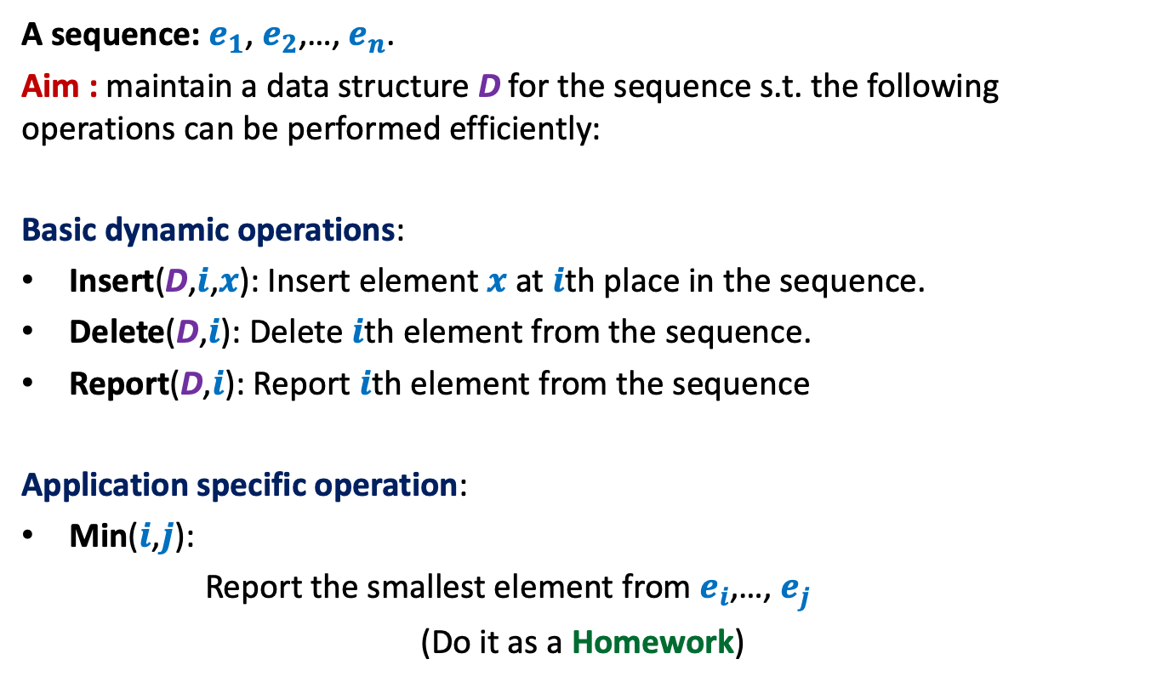
Example 3: sequence of numbers
A sequence: $e_{1}$, $e_{2}$,…, $e_{n}$.
Aim : maintain a data structure D for the sequence s.t. the following operations can be performed efficiently:
Basic dynamic operations:
Insert(D,$i$,$x$): Insert element $x$ at $i$th place in the sequence.
Delete(D,$i$): Delete $i$th element from the sequence.
Report(D,$i$): Report $i$th element from the sequence
Application specific operation:
Min($i$,$j$):
Report the smallest element from $e_{i}$,…, $e_{j}$
(Do it as a Homework)

Slide 20
interval tree
An augmented BST used for many
geometric problems

Slide 21





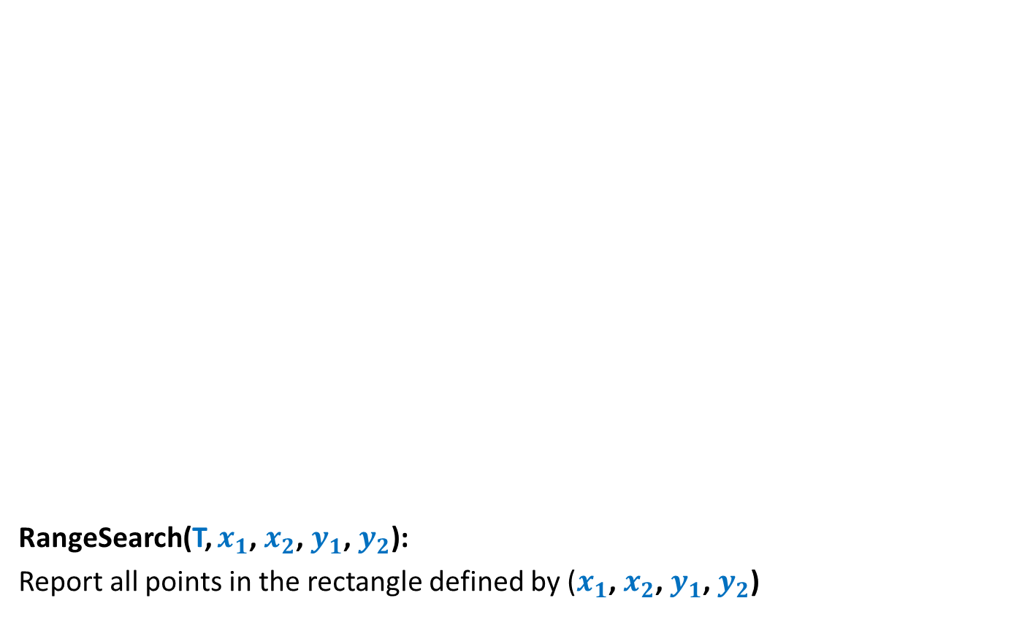
Interval
An interval [$a$, $b$] = {$x∈R$| $a≤x≤b$}.
For an interval $I$ = [$a$, $b$],
high[$I$] = $b$
low[$I$] = $a$
Given any two intervals [$a$, $b$] and [$c$, $d$],
they either overlap or don’t overlap.
➔ It takes O(1) time to check if two intervals overlap.
$$a$$
$$b$$
$$c$$
$$d$$
$$c$$
$$d$$
$$c$$
$$d$$
$$c$$
$$d$$

Slide 22



Problem Definition
Maintain a data structure for a set $S$ of intervals
so that the following operations can be performed efficiently.
Insert($S$,$I$): Insert interval $I$into $S$.
Delete($S$,$I$): Delete $I$from $S$.
Overlap($S$,$I$): determine if $I$overlaps any interval from $S$.
$$I$$
$$I$$
1
3
10
19
23
27
4
20
7
11
24
30

Slide 23
How to build a BST on intervals ?
1
3
10
19
23
27
4
20
7
11
24
30

Slide 24
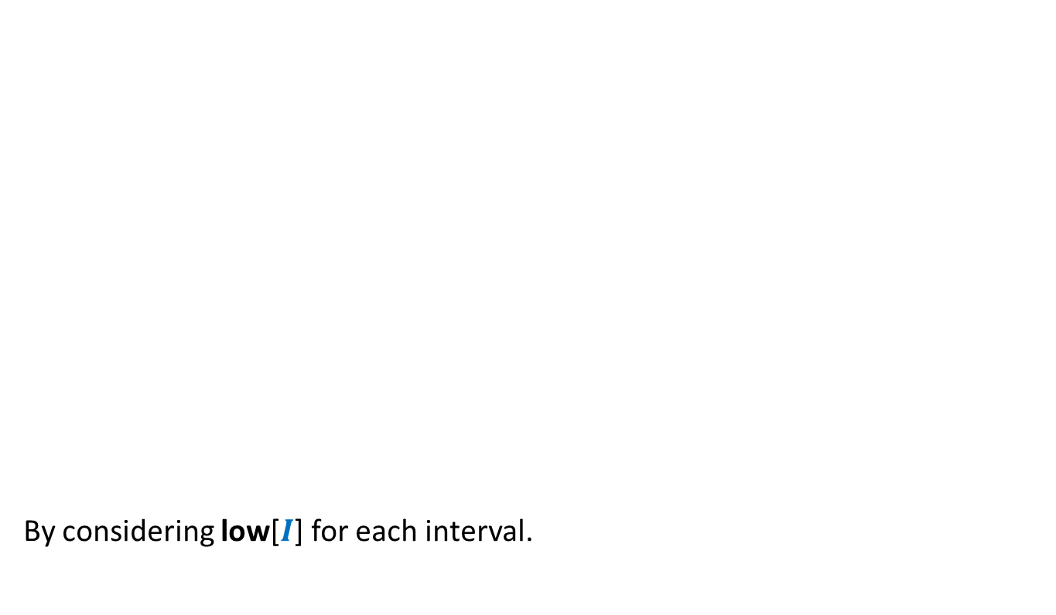
How to build a BST on intervals ?
How to define a total order on intervals ?
By considering low[$I$] for each interval.
1
3
10
19
23
27
4
20
7
11
24
30

Slide 25
How to build a BST on intervals ?
1
3
10
19
23
27
4
20
7
11
24
30

Slide 26

How to augment the BST ?
?
Main objective: How to perform Overlap($S$,$I$) efficiently ?
“determine if a query interval $I$overlaps any interval in tree storing intervals $S$.”
?
?
?
?
?

Slide 27




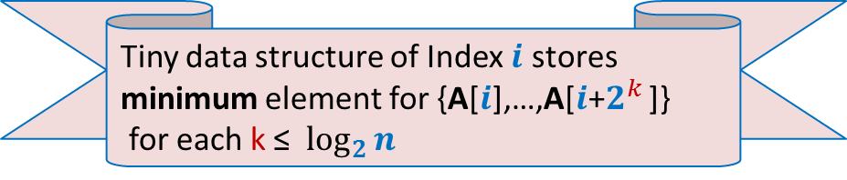


How to perform Overlap($S$,$I$) efficiently ?
$$c$$
$$d$$
$$c$$
$$d$$
$$c$$
$$d$$
$$a$$
$$b$$
$$L$$
$$R$$
Can we discard $R$ ?
Can we discard $L$ ?
Yes
No !
Here is a counter example

Slide 28

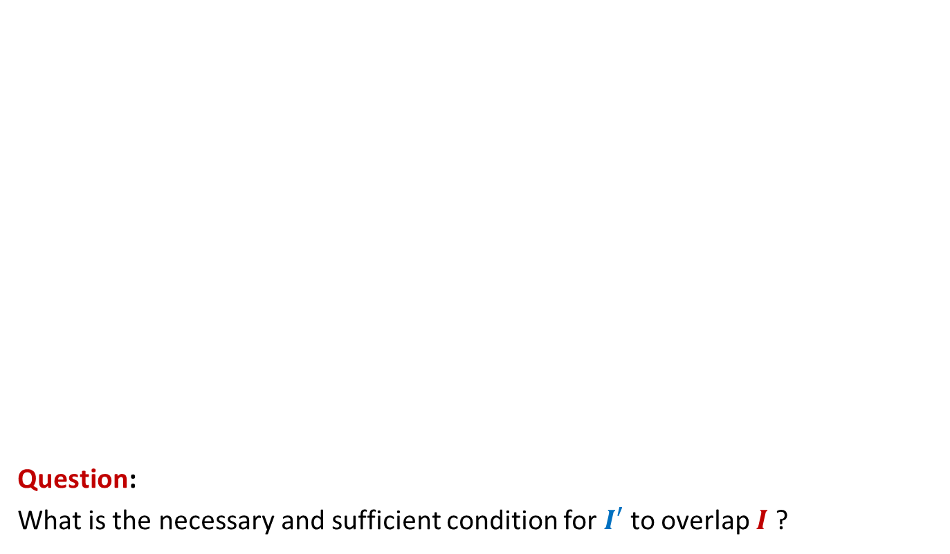


How to perform Overlap($S$,$I$) efficiently ?
$$c$$
$$d$$
$$c$$
$$d$$
$$a$$
$$b$$
Question:
What is the necessary and sufficient condition for $I′$ to overlap $I$ ?
$$I′$$
$$L$$
High($I′$) > Low($I$)
$$R$$

Slide 29
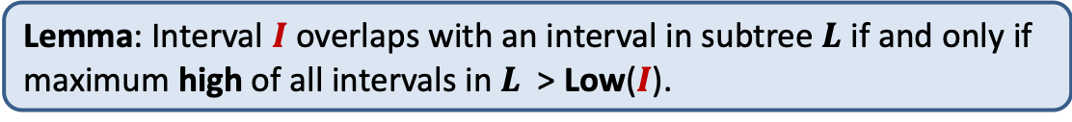

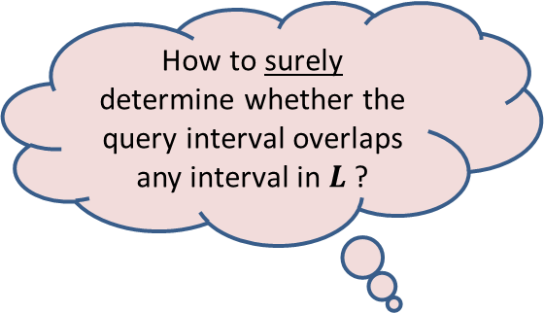

How to perform Overlap($S$,$I$) efficiently ?
$$c$$
$$d$$
$$c$$
$$d$$
$$a$$
$$b$$
How to surely determine whether the query interval overlaps any interval in $L$?
$$L$$
$$R$$
By knowing the maximum high of all intervals in $L$ ?
Lemma: Interval $I$ overlaps with an interval in subtree $L$ if and only if maximum high of all intervals in $L$ > Low($I$).

Slide 30



Augmentation of BST
10
30
19
For each node $\text{u}$, keep a field Max-high($\text{u}$):
Max-high($\text{u}$) = max{ high($I$) : $I∈$ T($\text{u}$)}
= max( ? , ? , ? )
4
20
23
27
20
30
1
3
7
11
24
30
3
11
30
This field is efficient to maintain during insertion/deletion
Max-high(left($\text{u}$))
high($\text{u}$)
Max-high(right($\text{u}$))

Slide 31
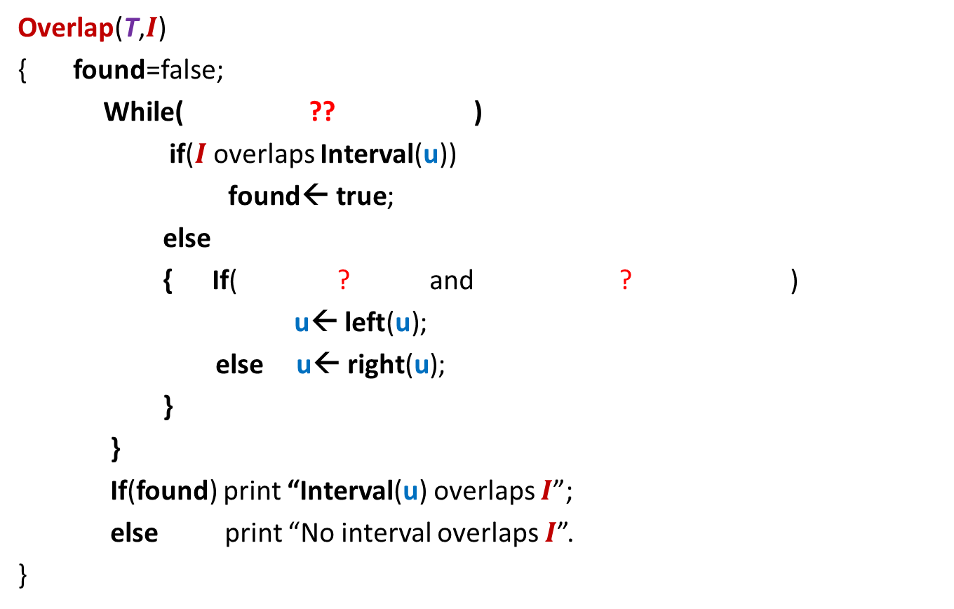




Overlap($T,$ $I$)
$$c$$
$$c$$
$$c$$
$$d$$
$$d$$
$$d$$
Overlap(T,$I$)
{ found=false;
While( ?? )
if($I$overlaps Interval(u))
$\text{found}\text{← }\text{true}$;
else
{ If( ? and ? )
u← $\text{lef}\text{t}\text{(}\text{u}\text{)}$;
else u← $\text{right}\text{(}\text{u}\text{)}$;
}
}
If(found) print “Interval(u) overlaps $I$”;
else print “No interval overlaps $I$”.
}
$\text{u} \text{← }$T ;
$\text{u}$<>NULL and not found
$$a$$
u
$$b$$
{
$\text{left}\text{(}\text{u}\text{)}$<> NULL
Max-high(left(u)) $>$Low($I$)
O(log $n$) time

Slide 32

Application 1
Given a set of $n$axis-parallel rectangles,
determine if any two of them intersect.

Slide 33
Application 1
Given a set of $n$axis-parallel rectangles,
determine if any two of them intersect.

Slide 34

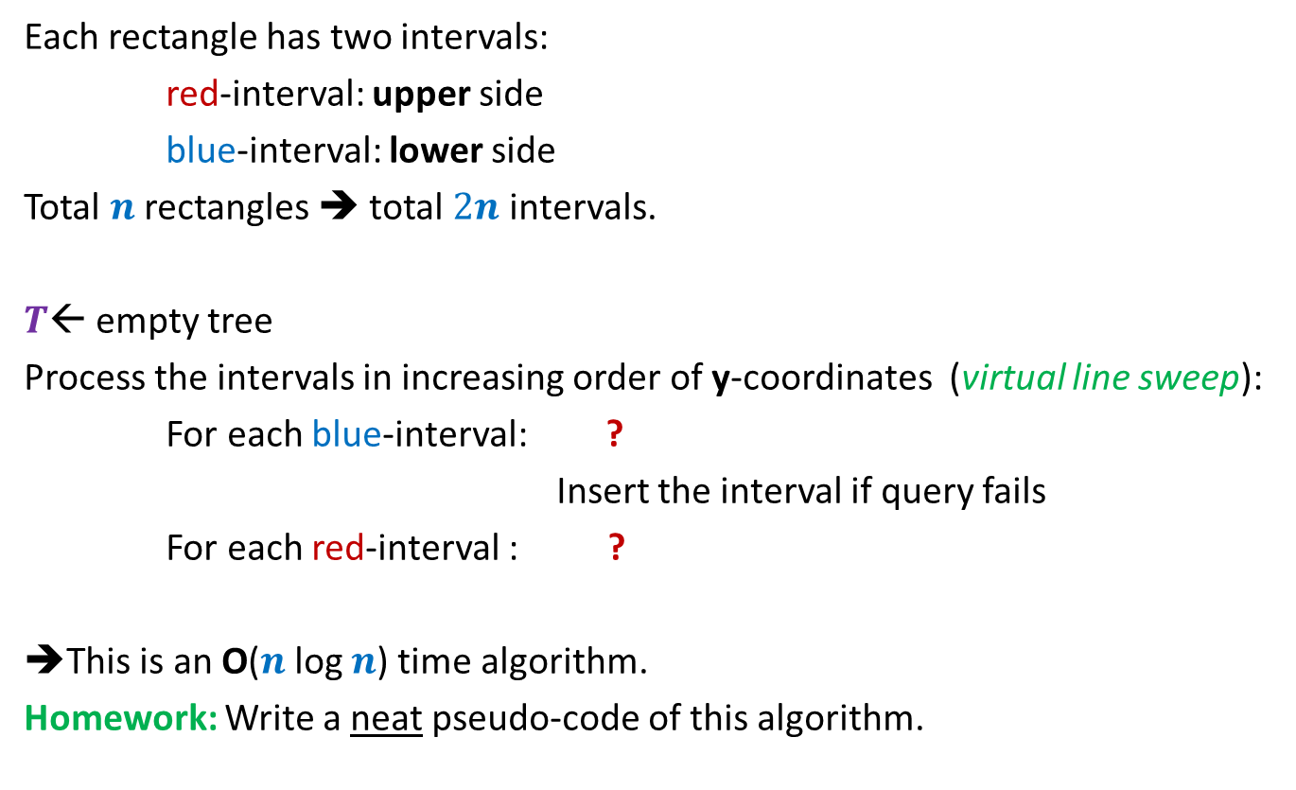
Algorithm
Each rectangle has two intervals:
red-interval: upper side
blue-interval: lower side
Total $n$ rectangles ➔ total $2n$ intervals.
$T$← empty tree
Process the intervals in increasing order of y-coordinates (virtual line sweep):
For each blue-interval: ?
Insert the interval if query fails
For each red-interval : ?
➔This is an O($n$log $n$) time algorithm.
Homework: Write a neat pseudo-code of this algorithm.
query if it intersects any interval in $T$
remove the corresponding blue interval

Slide 35

Application 2
Given a set of $n$axis-parallel rectangles,
compute their total area.
It requires some slight modifications to Interval tree.
just for a nice trial ☺. Not important from point of view of exams.

Slide 36
What makes BST powerful and pervasive ?
: Additional information

Slide 37

Orthogonal Range searching
Data structure: Size = O($n log n$),
Query = O($k+ \log^{2} n$),
Preprocessing time = O($n log n$)
Rectangle

Slide 38

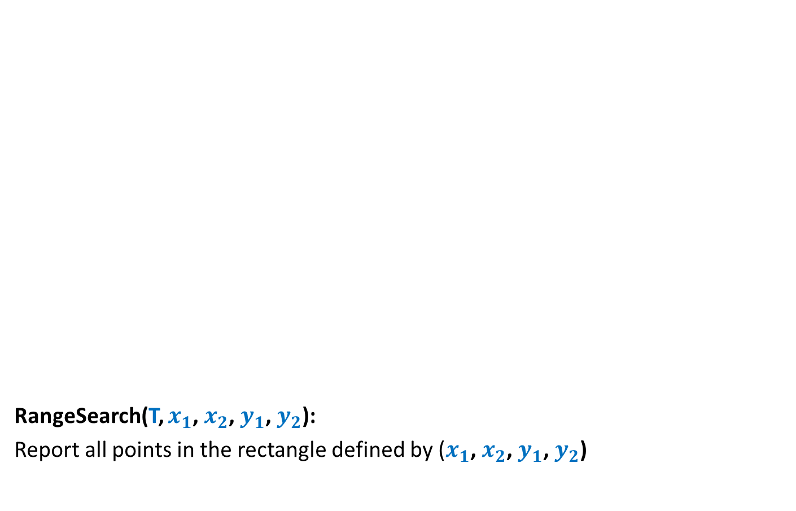

Orthogonal Range searching
RangeSearch(T, $x_{1}$, $x_{2}$, $y_{1}$, $y_{2}$):
Report all points in the rectangle defined by ($x_{1}$, $x_{2}$, $y_{1}$, $y_{2}$)
$$y_{2}$$
$$y_{1}$$
Rectangle
$$x_{1}$$
$$x_{2}$$

Slide 39

Orthogonal Range searching
RangeSearch(T, $x_{1}$, $x_{2}$, $y_{1}$, $y_{2}$)
RangeSearch(T, $x_{1}$, $x_{2}$):
Report all points whose $x$-coordinate lie in [$x_{1}$, $x_{2}$]
Simplify the problem.

Slide 40




RangeSearch(T, $x_{1}$, $x_{2}$):
Binary search tree on $x$-coordinates
$x_{2}$
$x_{1}$
T

Slide 41
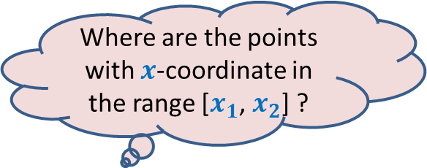
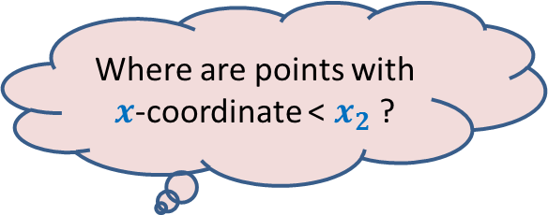
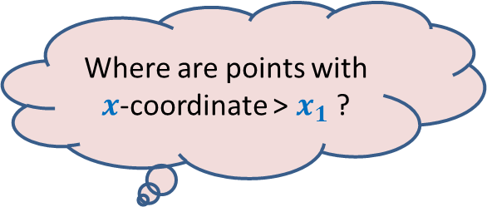

RangeSearch(T, $x_{1}$, $x_{2}$):
Binary search tree on x-coordinates
Where are points with $x$-coordinate > $x_{1}$ ?
Where are points with $x$-coordinate < $x_{2}$ ?
Where are the points with $x$-coordinate in the range [$x_{1}$, $x_{2}$] ?
LCA
$x_{2}$
$x_{1}$
T

Slide 42
RangeSearch(T, $x_{1}$, $x_{2}$):
Binary search tree on x-coordinates
LCA
$x_{2}$
$x_{1}$
T

Slide 43
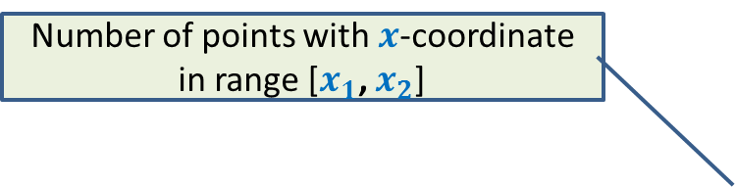

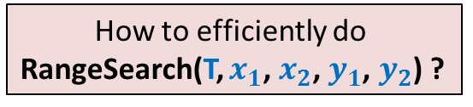
RangeSearch(T, $x_{1}$, $x_{2}$):
Number of points with $x$-coordinate in range [$x_{1}$, $x_{2}$]
Binary search tree on x-coordinates
How to efficiently do
RangeSearch(T, $x_{1}$, $x_{2}$, $y_{1}$, $y_{2}$) ?
Query time = O($k+log n$),
LCA
$x_{2}$
$x_{1}$
T

Slide 44

Homework
How should we augment each node so that we can answer RangeSearch(T, $x_{1}$, $x_{2}$, $y_{1}$, $y_{2}$) query efficiently?
We shall discuss it during the next 5 discussion sessions. Please do come if you are interested.

