Slide 1
Design and Analysis of Algorithms
Algorithms-II : CS345A
Website: hello.iitk.ac.in
Lecture 6
Synchronizing an electric circuit : A problem
Proof of correctness of an algorithm

Slide 2
Motivation
Study this lecture slowly, steadily, and try to answer each question posed in the slides.
Revisit this lecture whenever you want a better understanding of proof of correctness.
Algorithm designed for a problem is incomplete unless its correctness is established.
An algorithm without proof of correctness is just a heuristic.
As an important part of the course, one must have a fair amount of the understanding about proof of correctness of an algorithm.
Many times, one is not even clear about what claim one needs to prove to establish correctness of an algorithm. For every algorithm we study, there is
A formal and usually short proof of correctness.
There is no formula for proof of correctness of an algorithm.
The proof of correctness is based only on a better insight into the algorithm.
In this way, a proof just demands a better understanding of the algorithm.
It is hoped that from this lecture, you will be motivated to write short, and yet precise and formal proof of correctness for every algorithm you design.

Slide 3
Correctness of an algorithm
For every valid input,
the algorithm outputs a correct answer.

Slide 4
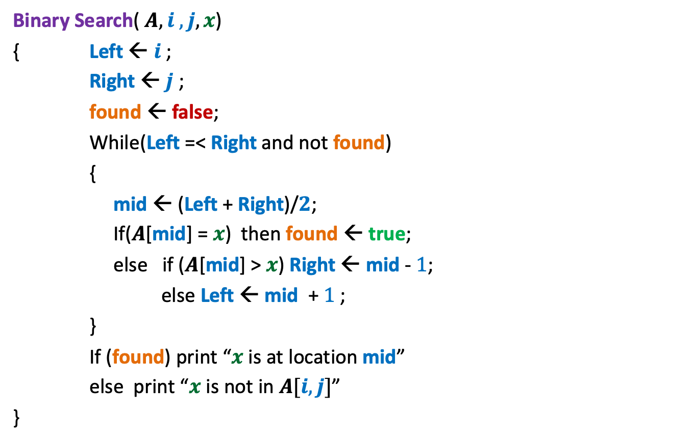
Binary Search
Binary Search( $A, i , j, x$)
{ Left ← $i$;
Right ← $j$ ;
found ← false;
While(Left =< Right and not found)
{
mid ← (Left + Right)/$2$;
If($A$[mid] = $x$) then found ← true;
else if ($A$[mid] > $x$) Right ← mid - $1$;
else Left ← mid + $1$;
}
If (found) print “$x$ is at location mid”
else print “$x$ is not in $A[i,j]$”
}
How did you establish the correctness of this algorithm : By successfully running it on some inputs ?
was that enough ?

Slide 5
Correctness of an algorithm
Almost every algorithm we study in this course, there is
A short and formal proof of correctness.
No formula for proof of correctness of an algorithm.
The proof of correctness is based only on insights into the algorithm.

Slide 6
Synchronizing a circuit
with minimum delay enhancement

Slide 7
An Electric Circuit
A complete binary tree
Electric signal originates at the root
Signal passing through each edge incurs a delay (a few nano seconds)
Finally signal reaches all the leaves.
Electric signal
6
5
3
2
4
2
2
1
6
2
1
2
3
2
Delay 11 10 14 10 10 11 10 9
14
10

Slide 8
Problem definition
Given:
There is a circuit in the form of a complete binary tree.
Electric signal propagates from root to all leaf nodes.
Each edge has certain delay
The delay in reaching signal to a leaf node =
“sum of delays on all edges on the path from root.”
Objective:
Enhance delay along certain edges so that
The delay on all paths from root to leaf nodes is the same.
Total delay enhancement is minimum.
What is the first step for designing an algorithm ?

Slide 9
Working on an Example

Slide 10
Working on an Example
How to achieve 1st Objective:
Synchronizing all paths from the root?
+4 is necessary and sufficient as well ☺
What algorithm comes to your mind based on this inference ?
Electric signal
Spend some time on this portion to see if you can reduce the total delay ?
Total delay enhancement: 27
6
5
How much enhancement is needed for this edge ?
3
2
4
2
2
1
6
2
1
2
3
2
+3 +4 +4 +3 +4 +5
+4
Delay 11 10 14 10 10 11 10 9
New Delay 14 14 14 14 14 14 14 14
Is this the minimum delay enhancement ?

Slide 11
Working on an Example
What algorithm comes to your mind based on this inference ?
Electric signal
Total delay enhancement: 27
6
5
3
2
4
2
+4
2
1
6
2
1
2
3
2
+3 +4 +4 +4 +3 +1
Delay 11 10 14 10 10 11 10 9
New Delay 14 14 14 14 14 14 14 14
➔ 23

Slide 12
Toward designing an algorithm
Electric signal
Total delay enhancement: 14
6
5
+3
3
+3
2
4
2
+1
2
6
+4
1
1
2
+1
3
2
+1
+1
2
14
11
14
14
14 14 14 14
11
11
Delay 11 10 14 10 10 11 10 9
11
10

Slide 13
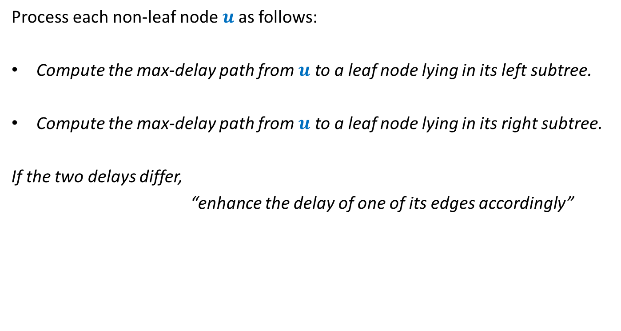
Overview of the proposed algorithm
Process each non-leaf node $u$as follows:
Compute the max-delay path from $u$ to a leaf node lying in its left subtree.
Compute the max-delay path from $u$ to a leaf node lying in its right subtree.
If the two delays differ,
“enhance the delay of one of its edges accordingly”
We need to describe this step more formally. ☺

Slide 14








For each non-leaf node $u$ do the following:
$D_{L}(u)$: max delay along any leftward path
$D_{R}(u)$: max delay along any rightward path
If ($D_{L}\left(u\right)≥D_{R}(u)$)
increase delay of right edge by $D_{L}\left(u\right)$ - $D_{R}\left(u\right)$
Else
increase delay of left edge by $D_{R}\left(u\right)$ - $D_{L}\left(u\right)$
$$γ$$
u
$$α$$
$$β$$
$$+D_{R}\left(u\right)\text{ − }D_{L}\left(u\right)$$
$$+D_{L}\left(u\right)\text{ − }D_{R}\left(u\right)$$
$$D_{L}(u)$$
$$D_{R}(u)$$

Slide 15
Proof of correctness of the algorithm
What assertion suffices as a proof ?

Slide 16
What assertion suffices as a proof ?
Usually it is difficult even to find out the claim whose establishment captures the correctness of the algorithm.☹
In the current algorithm, what might be this claim ?
Let us have a re-look at the algorithm from point of view of a single node .

Slide 17
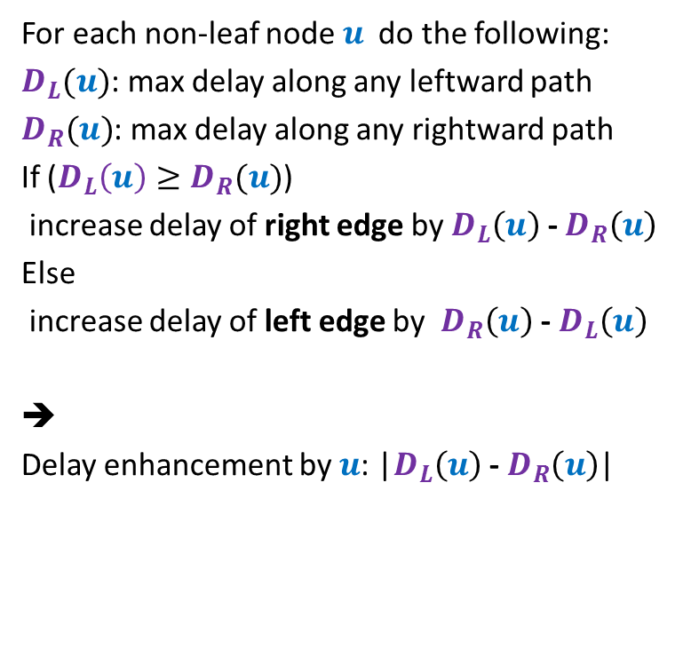



For each non-leaf node $u$ do the following:
$D_{L}(u)$: max delay along any leftward path
$D_{R}(u)$: max delay along any rightward path
If ($D_{L}\left(u\right)≥D_{R}(u)$)
increase delay of right edge by $D_{L}\left(u\right)$ - $D_{R}\left(u\right)$
Else
increase delay of left edge by $D_{R}\left(u\right)$ - $D_{L}\left(u\right)$
➔
Delay enhancement by $u$: |$D_{L}\left(u\right)$ - $D_{R}\left(u\right)$|
$$γ$$
u
$$α$$
$$β$$
$$+D_{L}\left(u\right)\text{ − }D_{R}\left(u\right)$$
$$D_{L}(u)$$
$$D_{R}(u)$$

Slide 18
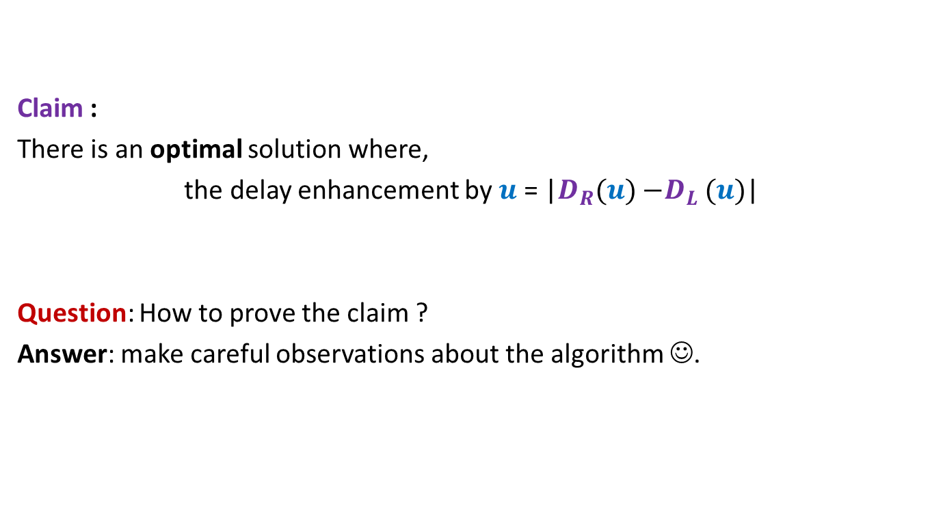
Claim :
There is an optimal solution where,
the delay enhancement by $u$ = |$D_{R}(u){−D}_{L}(u)$|
Question: How to prove the claim ?
Answer: make careful observations about the algorithm ☺.

Slide 19
Observations about the algorithm

Slide 20

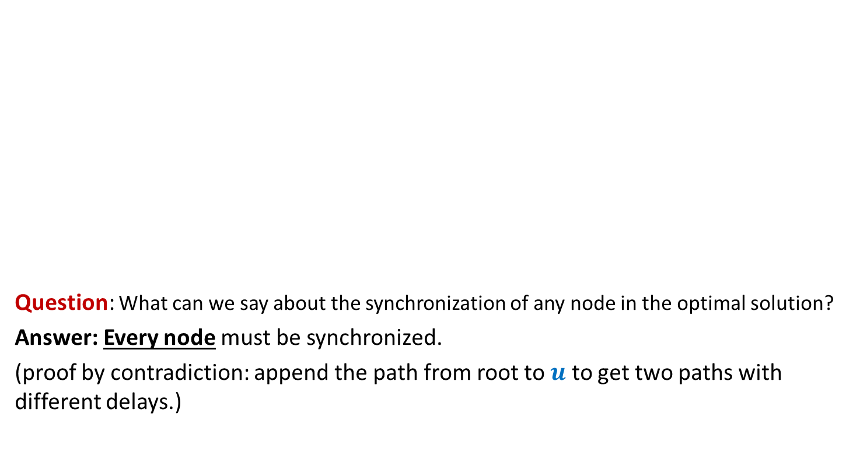


Observation 1
Electric signal
Question: What can we say about the synchronization of any node in the optimal solution?
Answer: Every node must be synchronized.
(proof by contradiction: append the path from root to $u$ to get two paths with different delays.)
$$u$$
$$δ_{1}$$
$$δ_{2}$$

Slide 21
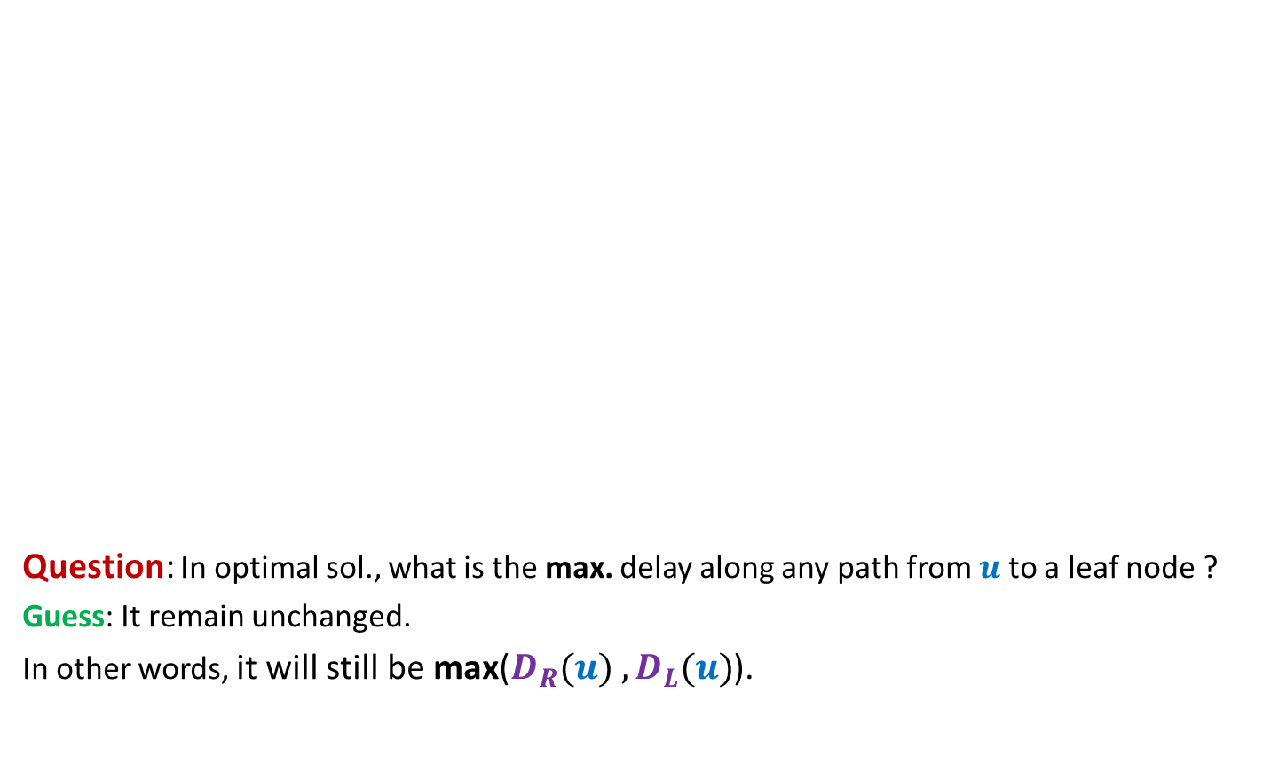
Observation 2
The maximum delay from the root to any leaf node remains unchanged in the optimal solution. What can we say about the maximum delay from any other node to any leaf node in its subtree?
Electric signal
Question: In optimal sol., what is the max. delay along any path from $u$ to a leaf node ?
Guess: It remain unchanged.
In other words, it will still be max($D_{R}(u){ ,D}_{L}(u)$).
$$u$$
6
5
+3
3
+3
2
4
2
+1
2
6
+4
1
1
2
+1
3
2
+1
+1
2
Delay 11 10 14 10 10 11 10 9
New Delay 14 14 14 14 14 14 14 14

Slide 22
Usefulness of the guess

Slide 23
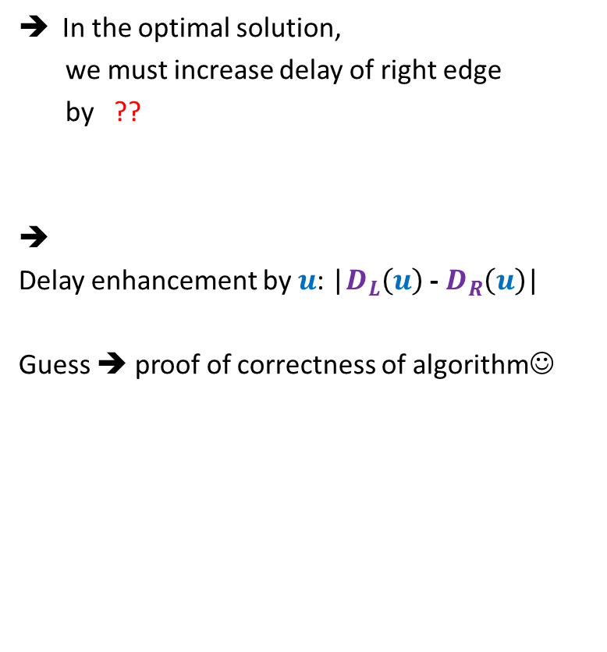



Usefulness of the guess
Suppose $D_{L}(u){≥D}_{R}(u)$
In the optimal solution,
we must increase delay of right edge
by ??
➔
Delay enhancement by $u$: |$D_{L}\left(u\right)$ - $D_{R}\left(u\right)$|
Guess ➔ proof of correctness of algorithm☺
How much enhancement ?
$$γ$$
How much enhancement ?
$D_{L}\left(u\right)$ - $D_{R}\left(u\right)$
u
$$α$$
$$β$$
0
$$+D_{L}\left(u\right)\text{ − }D_{R}\left(u\right)$$
$$D_{L}(u)$$
$$D_{R}(u)$$
unchanged
unchanged

Slide 24

Proving the guess
Guess : In the optimal solution, the delay along any path from $u$ to any leaf node is max($D_{R}(u){ ,D}_{L}(u)$).
Question: How to prove it ?
Answer: By contradiction.

Slide 25

What if the assertion fails at many nodes ?
Consider the lowest node in the tree where it fails.
In particular, any node with no red descendant will suffice.
(can you see why it is difficult to analyze any other “red” nodes ?)
$$u$$

Slide 26



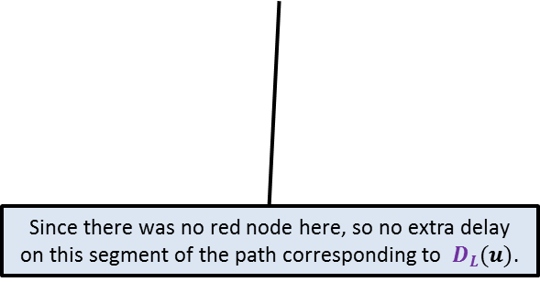


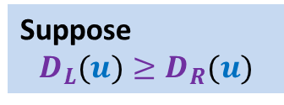



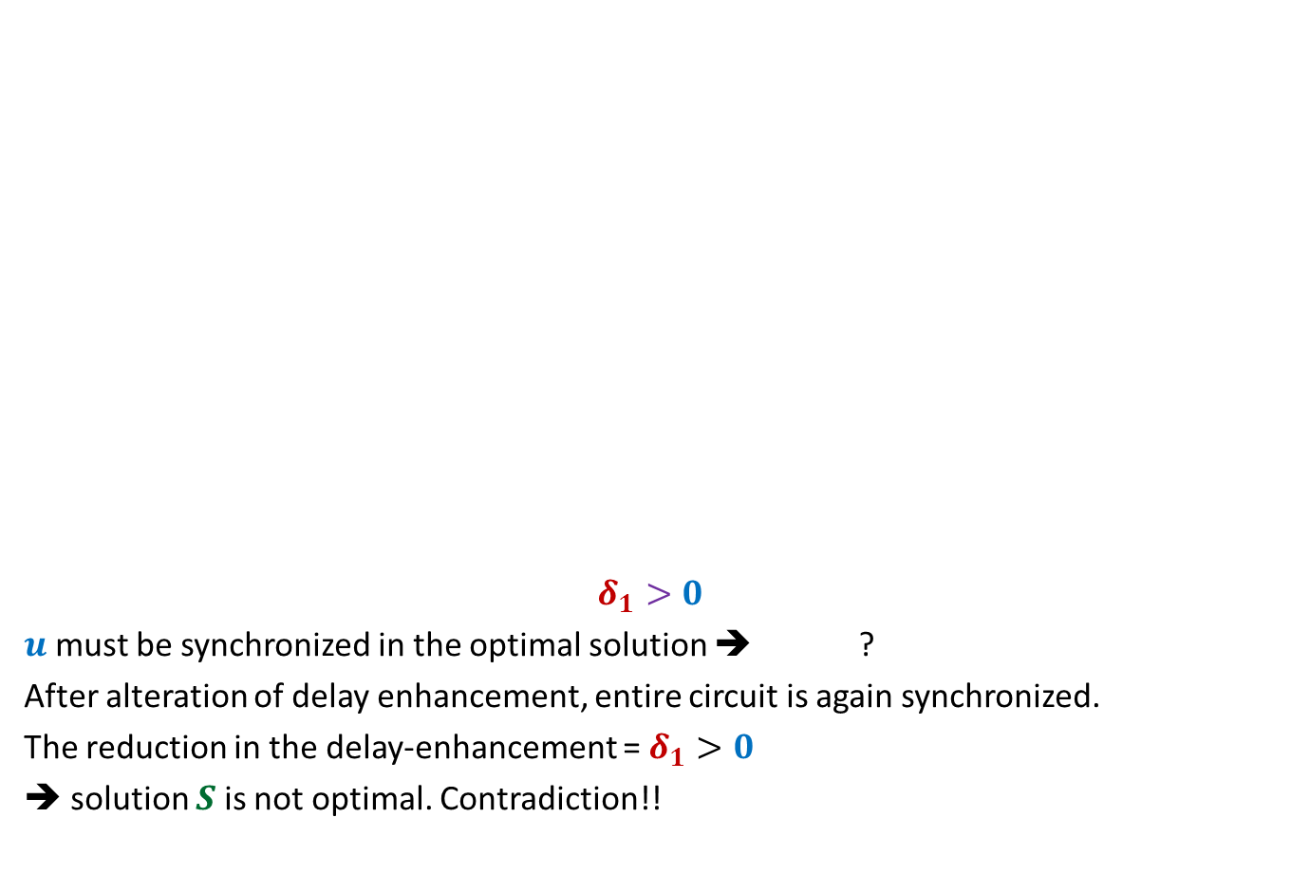













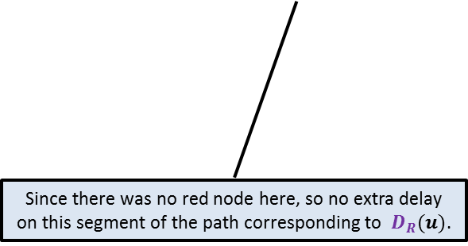
Proof:
the maximum delay on any path from $u$to any of its leaf node
is strictly greater than $D_{L}(u)$in an optimal solution $S$.
Suppose
$$D_{L}(u)≥D_{R}(u)$$
What does it imply ?
$$γ$$
$${+δ}_{3}$$
Can you do some manipulation to reduce the total delay enhancement ?
$$γ$$
What does it imply ?
$${+δ}_{3}$$
$${+δ}_{1}$$
$$u$$
$$u$$
$$δ_{1}>0$$
$u$ must be synchronized in the optimal solution ➔ ?
After alteration of delay enhancement, entire circuit is again synchronized.
The reduction in the delay-enhancement = $δ_{1}>0$
➔ solution $S$is not optimal. Contradiction!!
$$α$$
$${+δ}_{1}$$
$$β$$
$${+δ}_{2}$$
$$α$$
$$β$$
$${+D}_{L}\left(u\right)\text{ − }D_{R}\left(u\right)$$
$$+δ_{2}−δ_{1}$$
$$D_{L}(u)$$
$$D_{R}(u)$$
$$D_{L}(u)$$
$$D_{R}(u)$$
Since there was no red node here, so no extra delay on this segment of the path corresponding to $D_{R}(u)$.
Since there was no red node here, so no extra delay on this segment of the path corresponding to $D_{L}(u)$.
$$D_{L}(u)+δ_{1}=D_{R}(u)+δ_{2}$$

Slide 27
Efficient implementation of the algorithm

Slide 28
Efficient implementation of the algorithm
Electric signal
Delay enhancement: 14
6
5
+3
3
+3
2
4
2
+1
2
6
+4
1
1
2
+1
3
2
+1
+1
2
Delay 11 10 14 10 10 11 10 9
New Delay 14 14 14 14 14 14 14 14

Slide 29
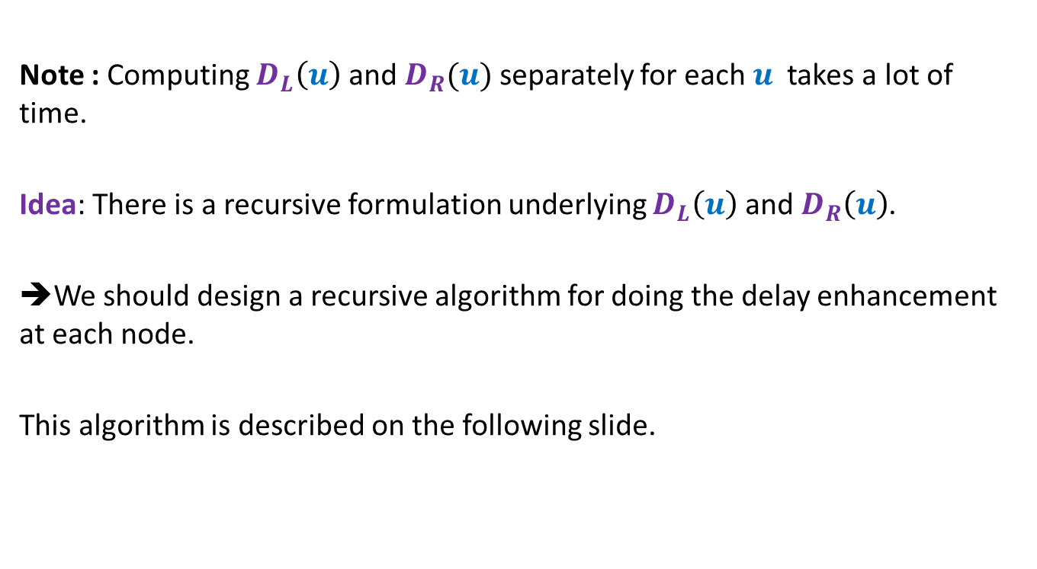
Efficient implementation of the algorithm
Note : Computing $D_{L}\left(u\right)$ and $D_{R}(u)$ separately for each $u$ takes a lot of time.
Idea: There is a recursive formulation underlying $D_{L}\left(u\right)$ and $D_{R}\left(u\right)$.
➔We should design a recursive algorithm for doing the delay enhancement at each node.
This algorithm is described on the following slide.

Slide 30
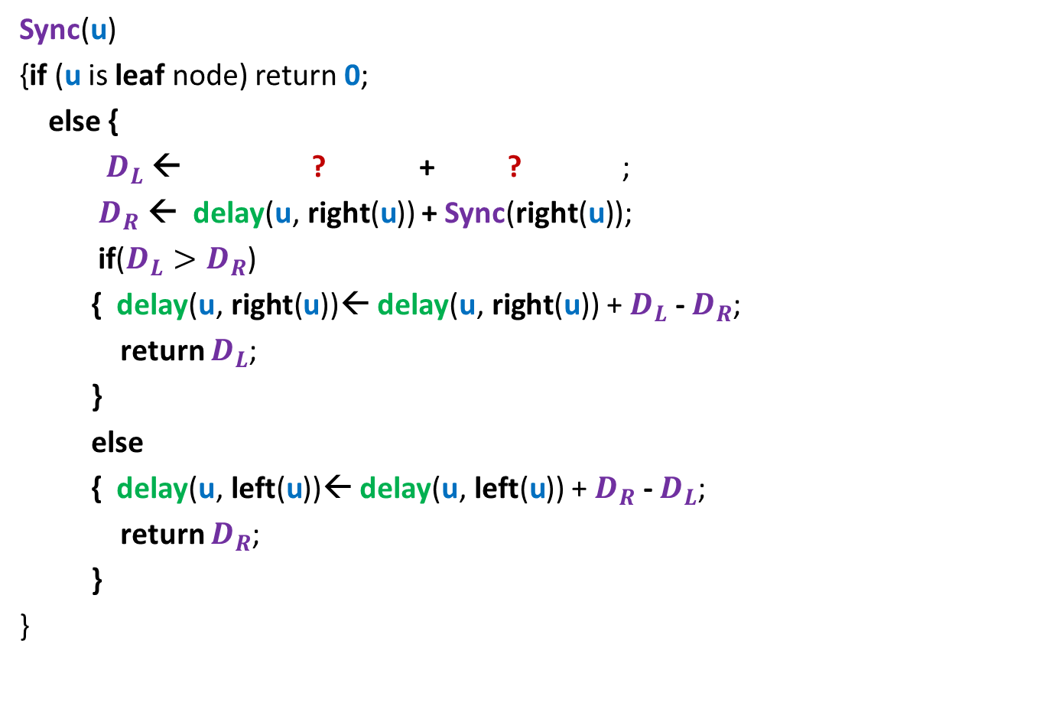



Sync($\text{u}$): A synchronization algorithm
Sync($\text{u}$)
{if ($\text{u}$ is leaf node) return $\text{0}$;
else {
$D_{L}$ ← ? + ? ;
$D_{R}$ ← delay($\text{u}\text{,} \text{right}\text{(}\text{u}$)) + Sync($\text{right}\text{(}\text{u}\text{)}$);
if($D_{L}>D_{R}$)
{ delay($\text{u}\text{,} \text{right}\text{(}\text{u}$))← delay($\text{u}\text{,} \text{right}\text{(}\text{u}$)) + $D_{L}$ - $D_{R}$;
return $D_{L}$;
}
else
{ delay($\text{u}\text{,} \text{lef}\text{t}\text{(}\text{u}$))← delay($\text{u}\text{,} \text{left}\text{(}\text{u}$)) + $D_{R}$ - $D_{L}$;
return $D_{R}$;
}
}
u
delay($\text{u}\text{,} \text{left}\text{(}\text{u}$))
Sync($\text{left}\text{(}\text{u}\text{)}$)

Slide 31

Theorem:
The algorithm Sync($\text{u}$) synchronizes the circuit with minimum enhancement in the delay.
Running time : linear in the size of the circuit.

Slide 32
Binary Search
Binary Search( $A, i , j, x$)
{ Left ← $i$;
Right ← $j$ ;
found ← false;
While(Left =< Right and not found)
{
mid ← (Left + Right)/$2$;
If($A$[mid] = $x$) then found ← true;
else if ($A$[mid] > $x$) Right ← mid - $1$;
else Left ← mid + $1$;
}
If (found) print “$x$ is at location mid”
else print “$x$ is not in $A[i,j]$”
}
How can you establish the correctness of this algorithm ?

Slide 33
A very important advice
The best way to internalize the proof of correctness of the algorithm is the following:
Close your eyes.
Think over the algorithm which is quite simple.
Ask yourself “what assertion is required to prove the correctness ?”
Once you are convinced about the assertion, try to think of ways to prove it.
Just rely on yourself and your insight.
If you fail, try to go through the proof given in these slides again.
Do it slowly, steadily,
With free and unconditioned mind
Outcome: Either you will understand the proof fully [most probable]
Or you will come up with an alternate proof. [less probable]
You are welcome to share your alternate proof with me ☺
In case none of these events happen, let us have a meeting to discuss the proof ☺

