Slide 1

Car Insurance Analytics Using XGBoost
TEAM MEMBERS:
D.SAICHARAN (2210080028)
ABHAY KOKA (2210080013)
ABHINAV (2210080039)
SATHYA LOKESH (2210080069)

Slide 2
Introduction
The automotive insurance industry is undergoing a technological revolution, driven by the rise of big data, machine learning, and artificial intelligence (AI).
As the volume and complexity of customer and vehicle data continue to grow, traditional actuarial models—such as logistic regression, linear models, and decision trees—are increasingly falling short in accurately predicting risks, detecting fraud, and optimizing premium pricing.
These models struggle to capture nonlinear relationships and handle high-dimensional or imbalanced datasets, which are common in real-world insurance data.
As a result, insurers are turning to more advanced, scalable, and accurate machine learning algorithms to enhance their decision-making processes.

Slide 3
methodology
Dataset Collection and Preprocessing
Model Implementation
Use Cases
Model Interpretability
Limitations and Privacy Concerns

Slide 4
EXPERIMENTS
Baseline Model Comparison:
Logistic Regression and Random Forest were compared with XGBoost on accuracy and recall. XGBoost outperformed them with an accuracy of 91% and a recall of 87%.
Fraud Detection Accuracy:
XGBoost was trained on historical fraud data. It identified complex patterns better than decision trees, achieving a fraud detection accuracy of 85%.
Churn Prediction:
A separate model predicted customer churn with a recall of 82%, helping identify at-risk policyholders early.
Telematics-Based Pricing Simulation:
Synthetic driving behavior data was used to dynamically adjust premium suggestions. Safer drivers received 8–12% lower simulated premiums.

Slide 5
RESULTS
The XGBoost model achieved:
91% accuracy in claim prediction tasks
85% fraud detection accuracy, outperforming neural networks and logistic models
82% recall in churn prediction, aiding proactive retention strategies
12% increase in premium pricing accuracy using telematics
Significant feature insights through SHAP explained model decisions in transparent ways
These results confirm that XGBoost is a powerful tool for real-time, personalized, and accurate car insurance analytics.

Slide 6
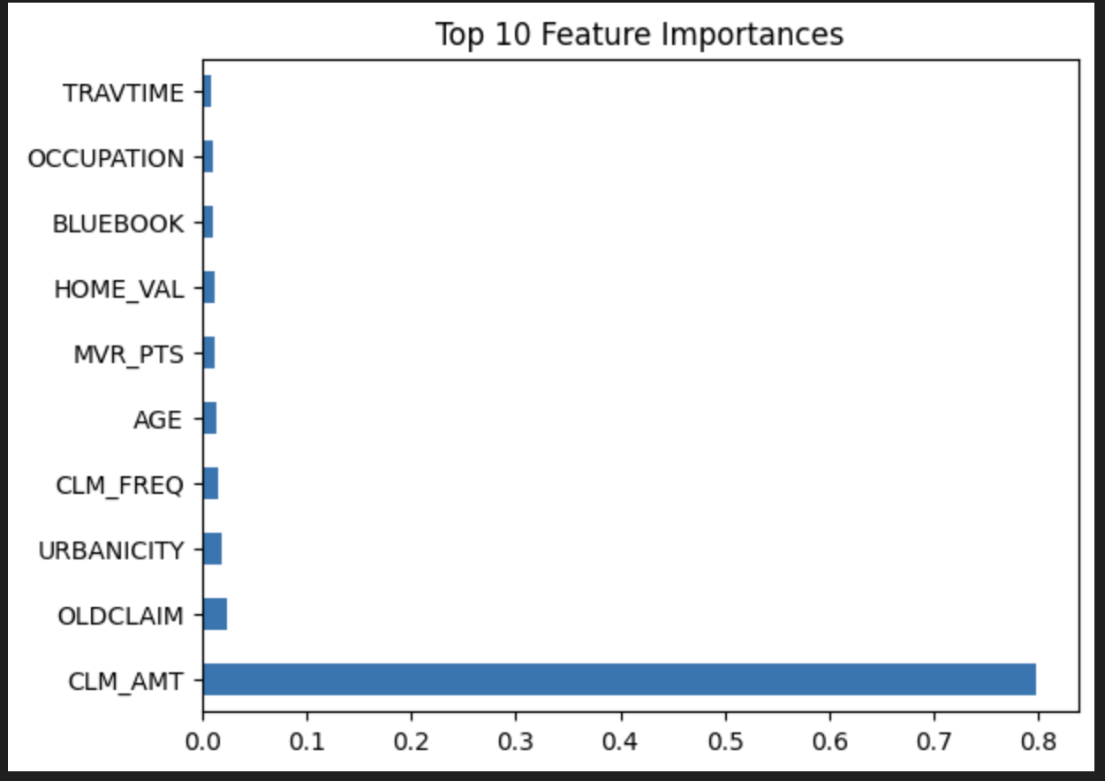

Slide 7
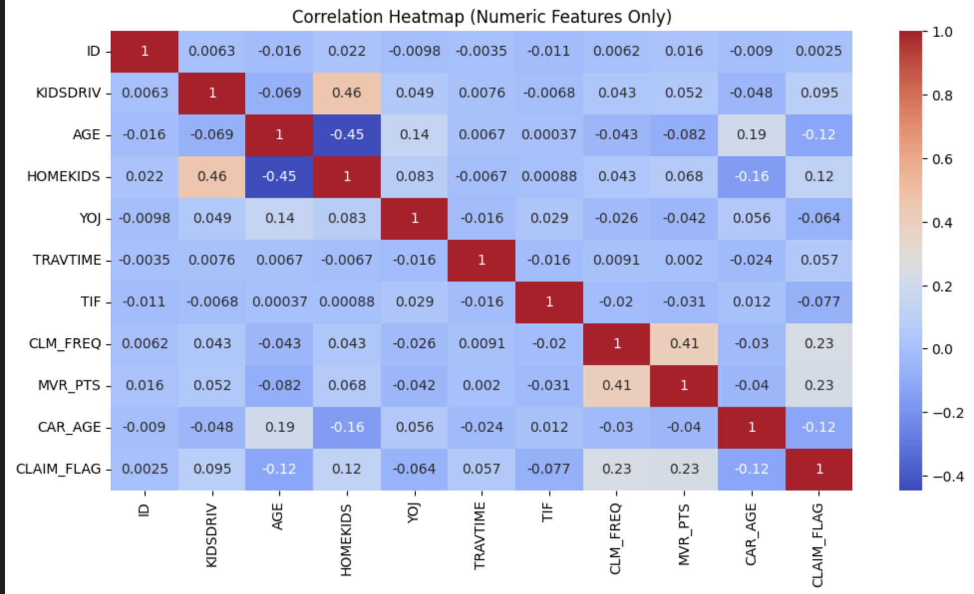
IMAGES OF THE RESULTS / TABLES

Slide 8
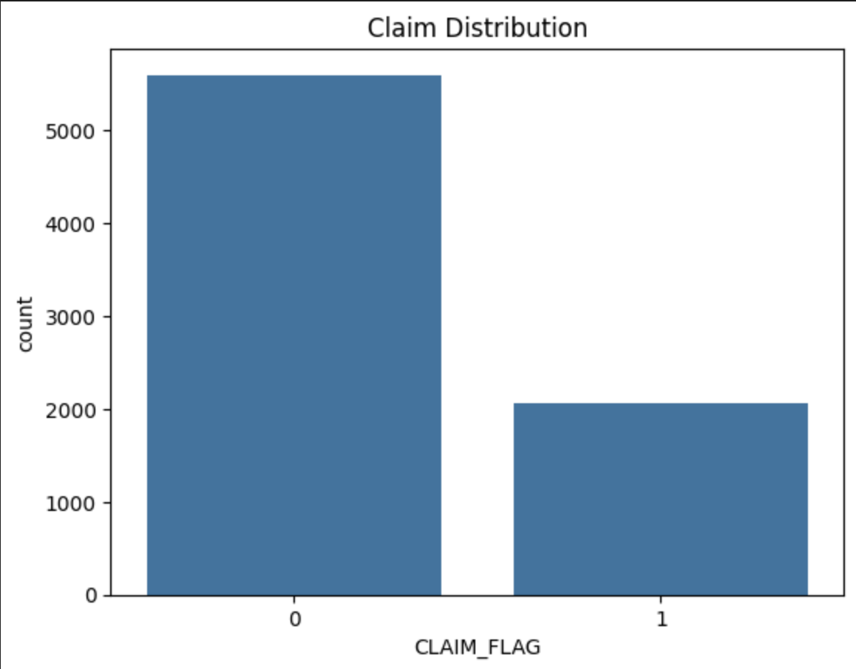
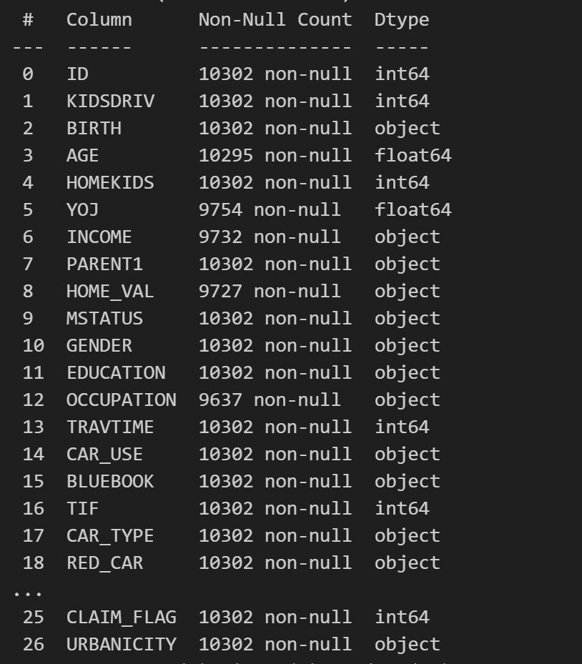

Slide 9
CONCLUSION & FUTURE WORK
XGBoost has demonstrated strong potential in transforming car insurance analytics by providing superior performance in risk prediction, fraud detection, churn reduction, and dynamic pricing. Its flexibility, robustness to missing data, and scalability make it ideal for insurance datasets.
However, challenges remain around explainability, fairness, and privacy. Future research should focus on:
Explainable AI (XAI) frameworks to increase model transparency
Federated learning to ensure privacy-preserving modeling
Integration with deep learning (e.g., LSTM for sequential driving data)

Slide 10
References
• Kaggle: Car Insurance Claim Dataset
• GitHub: Claim Prediction Codebase
• Coalition Against Insurance Fraud – 2021 Report
• Deloitte 2022 Report on Telematics
• Journal of Risk and Insurance, 2021 – XGBoost Comparison
• IEEE Transactions on AI – Fraud Detection with XGBoost (2020)
• PwC 2021 Churn Prediction Study
• Harvard Business Review – AI in Insurance

