Slide 1
JIRA for Scrum: A Comprehensive Demostration (15 minute walk-through)
By: Abhay Krishna
(Data Engineer)

Slide 2

What is JIRA?
Powerful Project Management tool developed by Atlassian.
It is widely used in Agile software development to plan, track, and manage projects.
JIRA facilitates collaboration among team members visibility across teams and projects and stakeholders.
Key features include issue tracking, customizable workflows, and extensive reporting capabilities.

Slide 3
Why use Jira, as a Project Managemetn Tool
Visibility of your team’s workload
Status of tasks and your deliverables.
With Jira Work Management
custom dashboards ( view of your work)
Reporting to stakeholders or informal interim review
Timeline feature : a complete roadmap view
Track work from multiple projects and teams to unlock cross-collaboration at the portfolio level

Slide 4
JIRA Features
Sprint Planning
Backlog Management
Task Tracking
Reporting and Metrics
Collaboration
Title: JIRA Features for Scrum Masters
Bullet Points:
Sprint Planning
Backlog Management
Task Tracking
Reporting and Metrics
Collaboration

Slide 5
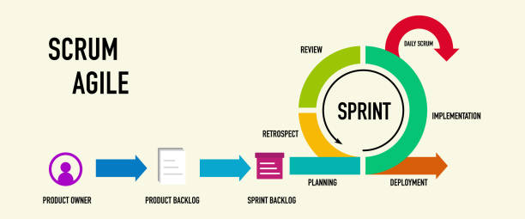
Scrum Overview Diagram

Slide 6
Sprint
During sprint planning, the Scrum Team collaborates to select user stories and tasks from the product backlog based on priority and feasibility.
The team breaks down selected items into smaller, manageable tasks and estimates the effort required to complete them.
Sprint planning results in a sprint backlog, which outlines the work to be accomplished during the sprint and serves as a guide.

Slide 7
Product Backlog vs Sprint Backlog
High-level list of all desired features and enhancements. | Subset of the product backlog.
Prioritized by the Product Owner. | Selected for a specific sprint.
Evolves over time as it represents the entire scope of the project. | Contains user stories and tasks. Guides the team's work during the sprint.

Slide 8
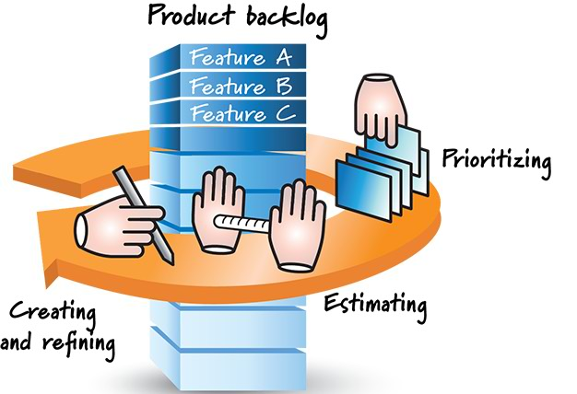
Backlog Management
Prioritizing user stories
Updating the backlog
Backlog Management
Bullet Points:
Prioritizing user stories
Grooming the backlog

Slide 9
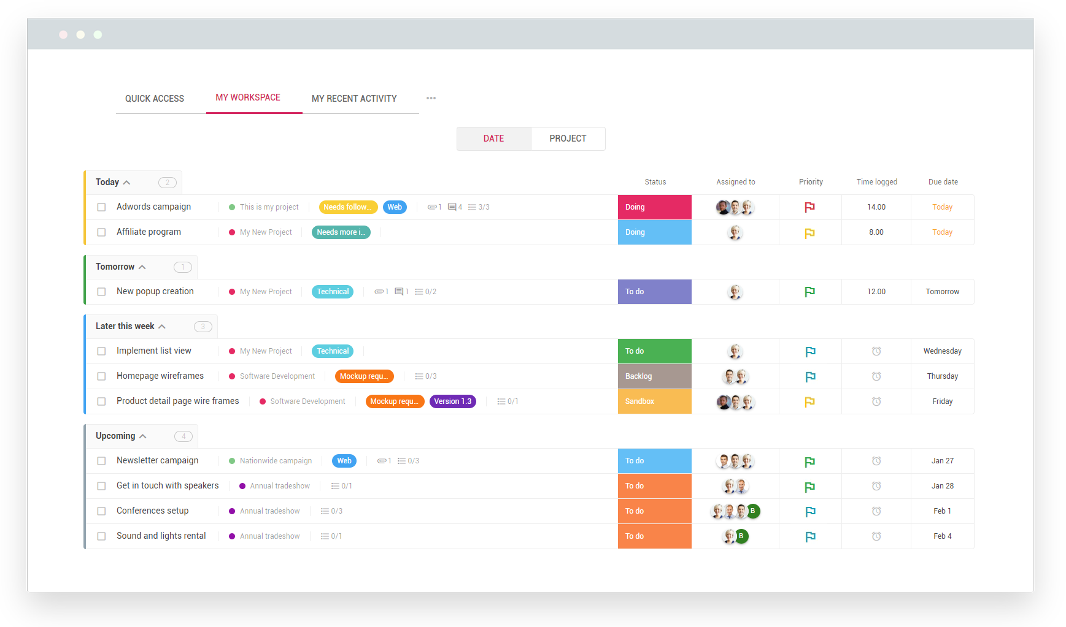
Task Tracking
Monitoring progress of tasks
Updating task statuses

Slide 10
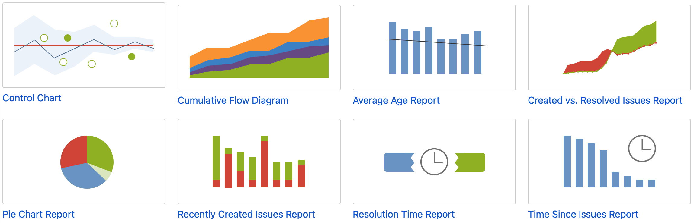
Reporting and Metrics
Generating burndown charts Tracking team velocity
Use Integrated Jira Reporting Apps: PowerBi, Google Sheets...

Slide 11
Notification
Can automate message notification on actions change on
every issue type to different person involved.

Slide 12
Members in JIRA: Roles and Responsibilities
Product Owner:
Represents the stakeholders and ensures that the product backlog is well-defined and prioritized.
Scrum Master:
Facilitates the Scrum process and ensures adherence to Agile principles and practices.
Development Team:
Completing user stories and delivering increments of working software.the user stories and delivering increments of working software.
Testing Team:
To identify and resolve defects. JIRA to log and track defects, assign them to appropriate team members, and verify fixes.

Slide 13
Best Practices & Collaboration
Communication through comments
Mentoring team members
Establishing Workflow
Regular Updates
Sprint Reviews
Continuous Improvement of Issues
Documentation

Slide 14
Basic Version for teams upto 10 person
Free version has
Only Team managed feature
Only access to each email-id account for 28 days
Next, Setting up a Project

Slide 15
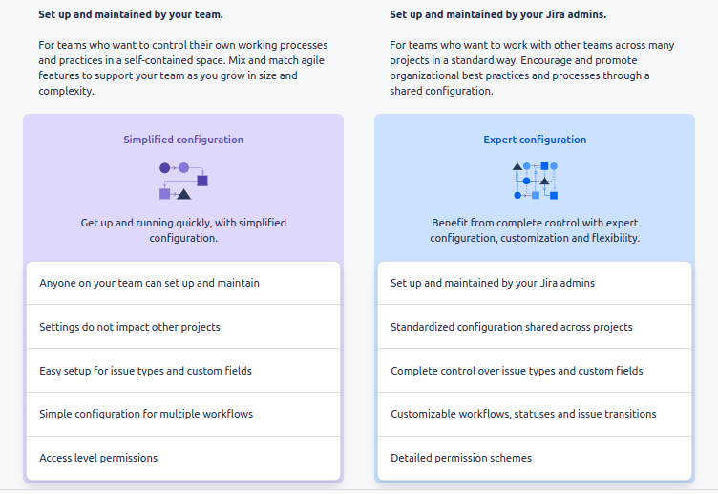

Slide 16
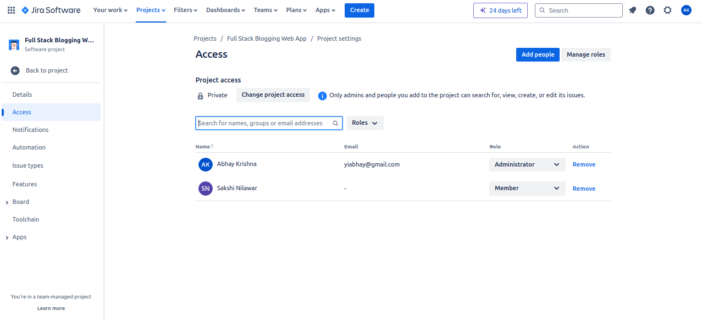
Access Projects/projName/Project settings

Slide 17
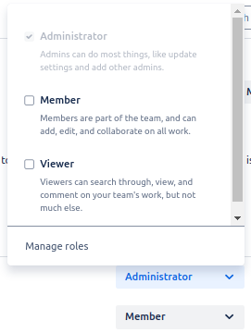
Role Assignment

Slide 18
Authorization: What can you do
Member :
can Add Edit collaborate
Viewer:
can only comment and only Search through Team’s work

Slide 19
Difference between Assignee vs Reporter
Assignee: The Assignee is the individual who is currently responsible for working on an issue. Assigning an issue to someone indicates that they are accountable for its resolution.
To assign an issue to a team member:
Do in "Assignee" field.
Reporter: The Reporter is the person who raised the issue or created it in Jira. They are typically the ones who initially identify a problem or request.

Slide 20
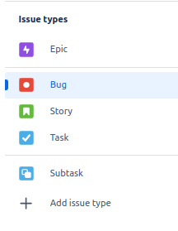
Issue: it’s not a problem

Slide 21
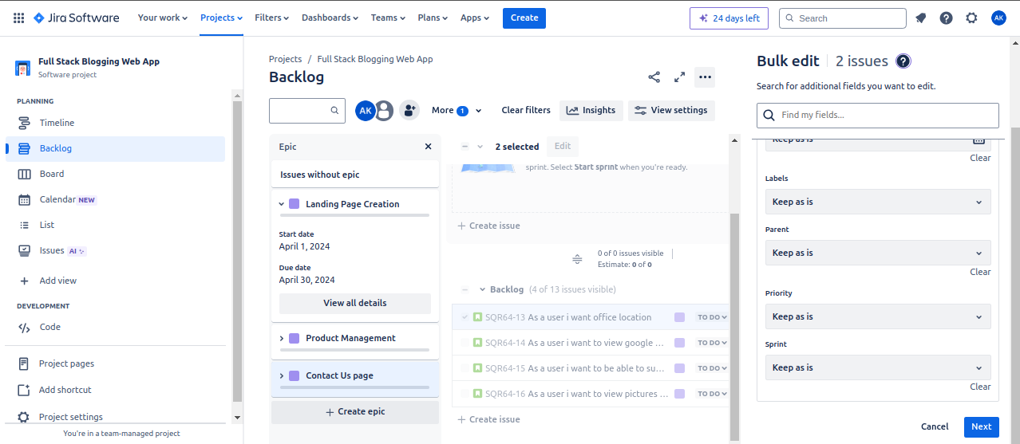
Bulk Edit issues

Slide 22
Automation feature
When an issue is transitioned → then automatically assign
When parent is completed → then close all the child issues present
When all child issues are completed → then close parent

Slide 23
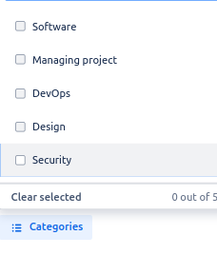
Automation

Slide 24
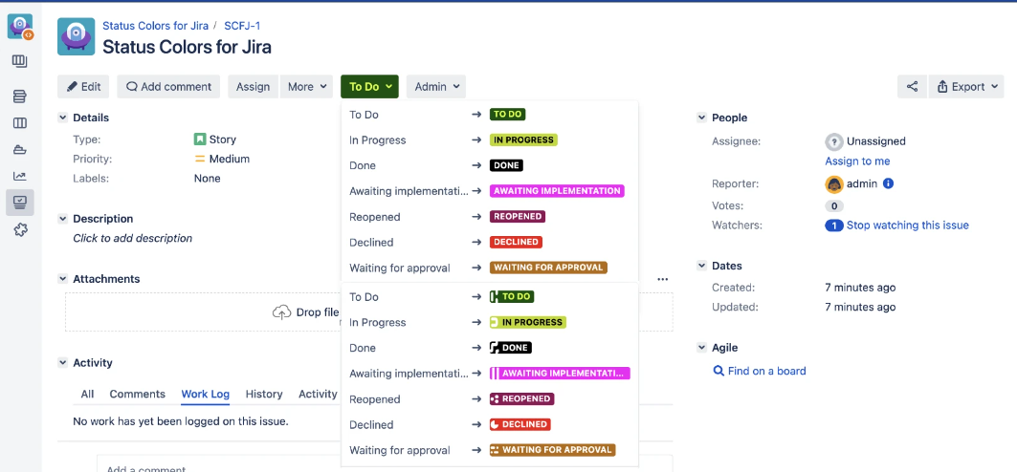
Colourful Jira
Blue : in Progress Task Green : Tasks Completed

Slide 25
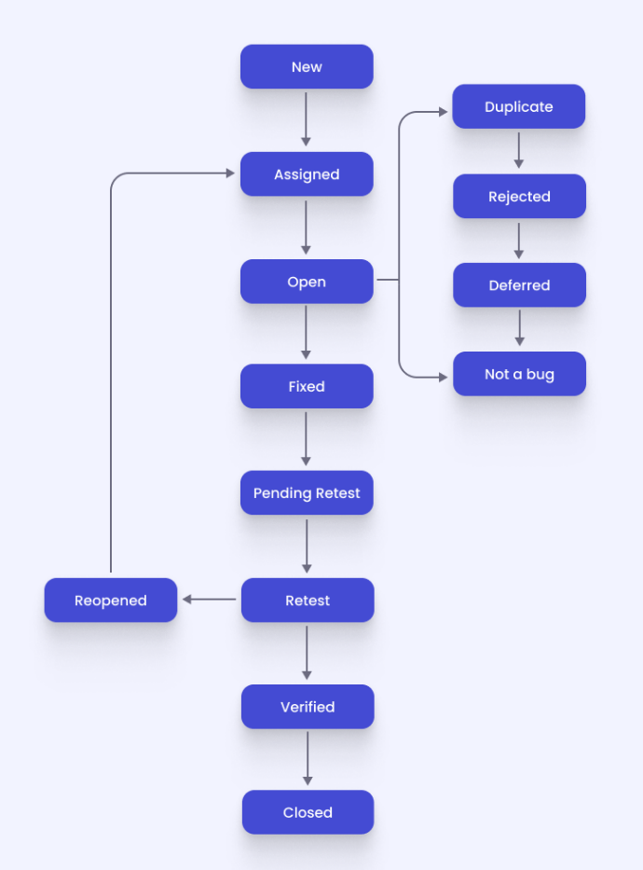
Bug Life Cycle
A bug has its life cycle from the point when the bug is logged in to the point the bug is closed.
Bug undergoes the following states:
New
Assigned
Open
Fixed
Retesting
Reopen
Verified
Closed

Slide 26
Pros | Cons
Efficient task tracking and management, scalable | Overwhelming for small teams or simple projects
Integration with other tools | Some features might feel complex
Reporting and analytics for project insights | Regular updates and maintenance for optimal performance
Jira for small businesses is quite affordable | Initial setup and configuration can be time-consuming

Slide 27
Live demonstration of key features

Slide 28
Q & A Thank you!!! Special Thanks - Ms. Jyoti ( Project Lead) Mr. Chirag Hathiari (CTO)

