Slide 1

Evaluate RLHF combined with RLAIF as an approach against RLHF & RLAIF alone
Professor:
Dr. Shridevi S
Team Members:
Ayush Goel 21BCE1115
Abhay Krishna 21BCE5378
Pratyush Mittal 21BCE1808

Slide 2
Work-let Name: Work-let Name: Evaluate RLHF combined with RLAIF as an approach against RLHF & RLAIF alone
Worklet Details
Worklet ID: 23GAI23
College Name: Vellore Institute Of Technology, Chennai
- Used additional open-source software for fine tuning
- Applied fine tuning on small LLMs
- Found methods to Apply RLHF while Fine-tuning.
- Requires Premium Subscriptions for some software platforms like replicate.
- Local Fine-tuning requires exorbitant amount of GPU and RAM.
- Too much time taken for computation.
- No readily available RLAIF Support form any platform.
KPIs achieved till now
Any Challenges/ Issues faced
Next Steps
- Fine tune larger LLMs
- implement RLHF while finetuning
- Was able to fine tune Tiny llama locally and on google colab.
- More research on fine tuning methods and approaches.
Key Achievements/ Outcome till now
Date: 31-01-2024

Slide 3
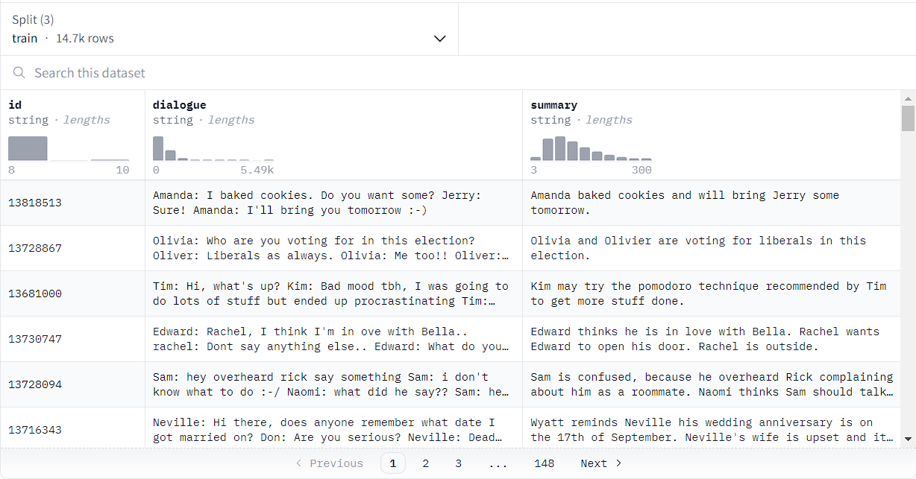
Dataset: samsum Dataset Size: 14k rows Dataset Description: Summarization for conversation between people.

Slide 4
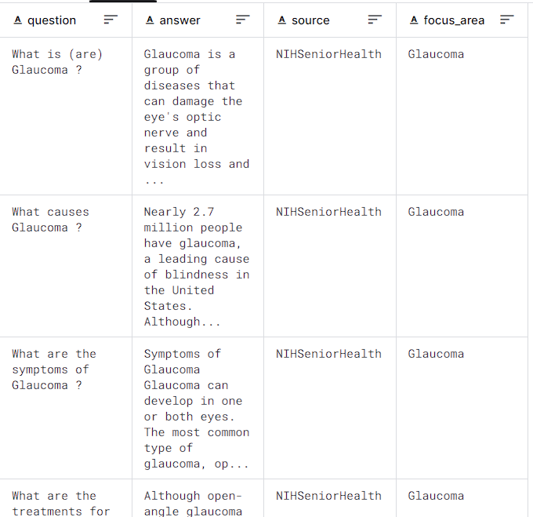
Dataset: medquad.csv Dataset Size: 47k rows Dataset Description: Question answer type dataset.

Slide 5
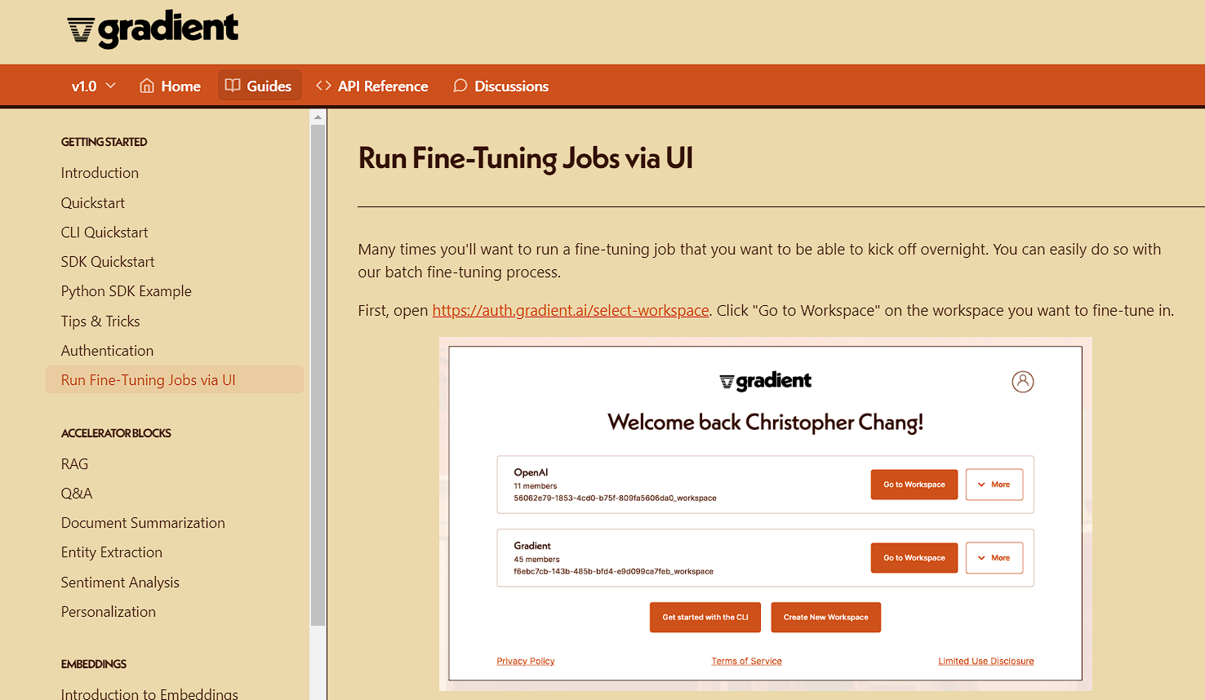
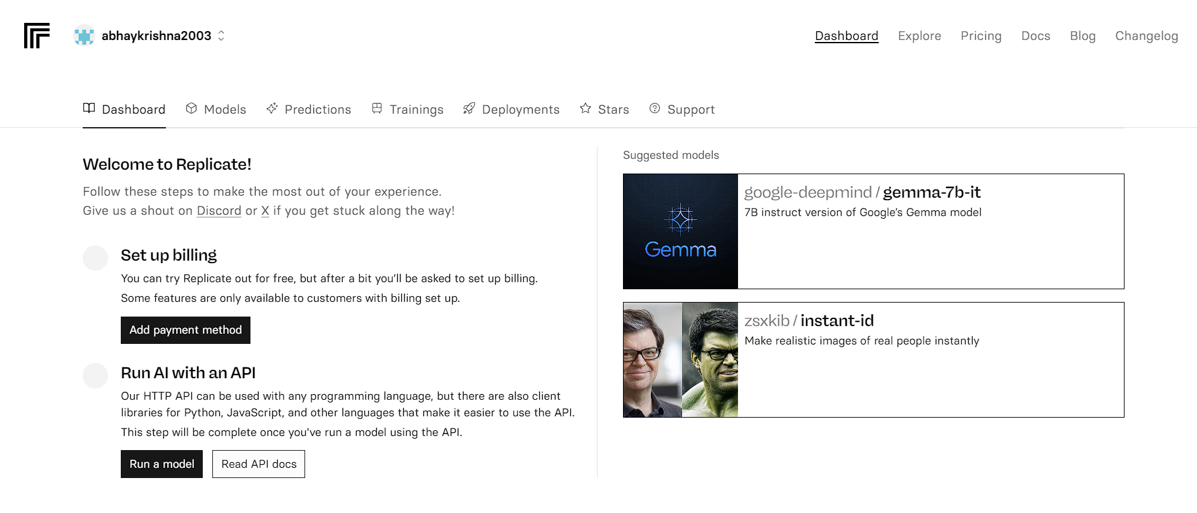
What we have tried
Gradient
Replicate

Slide 6
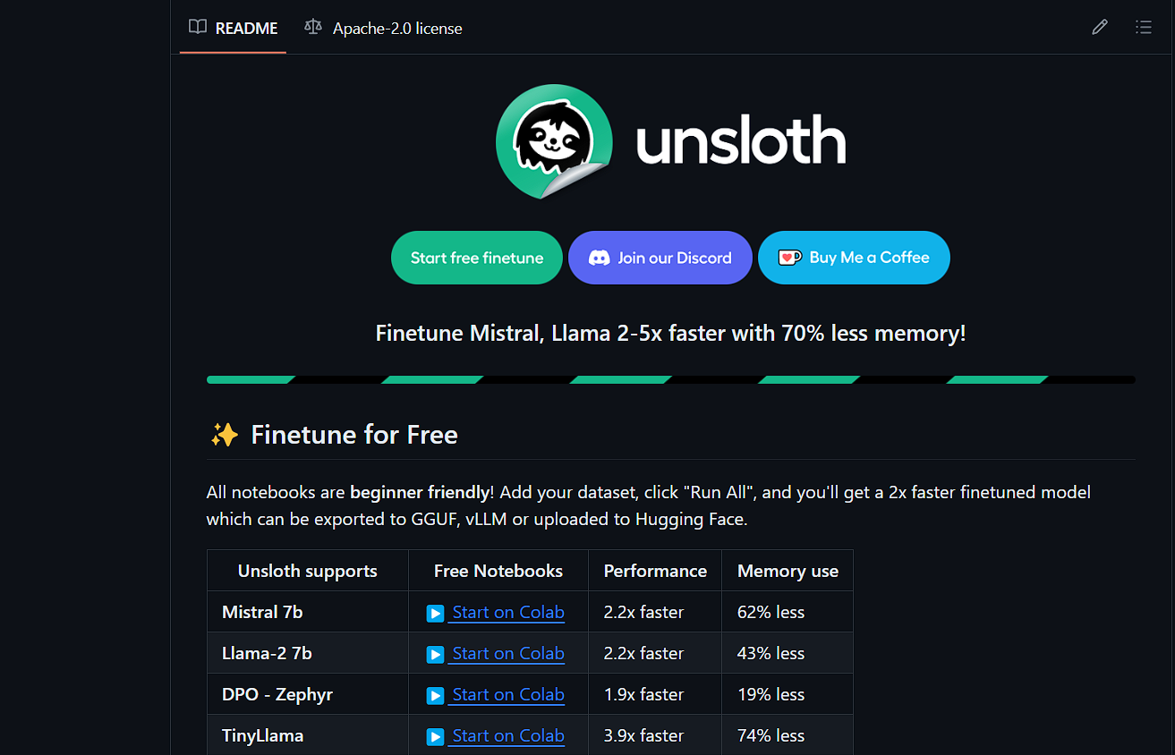
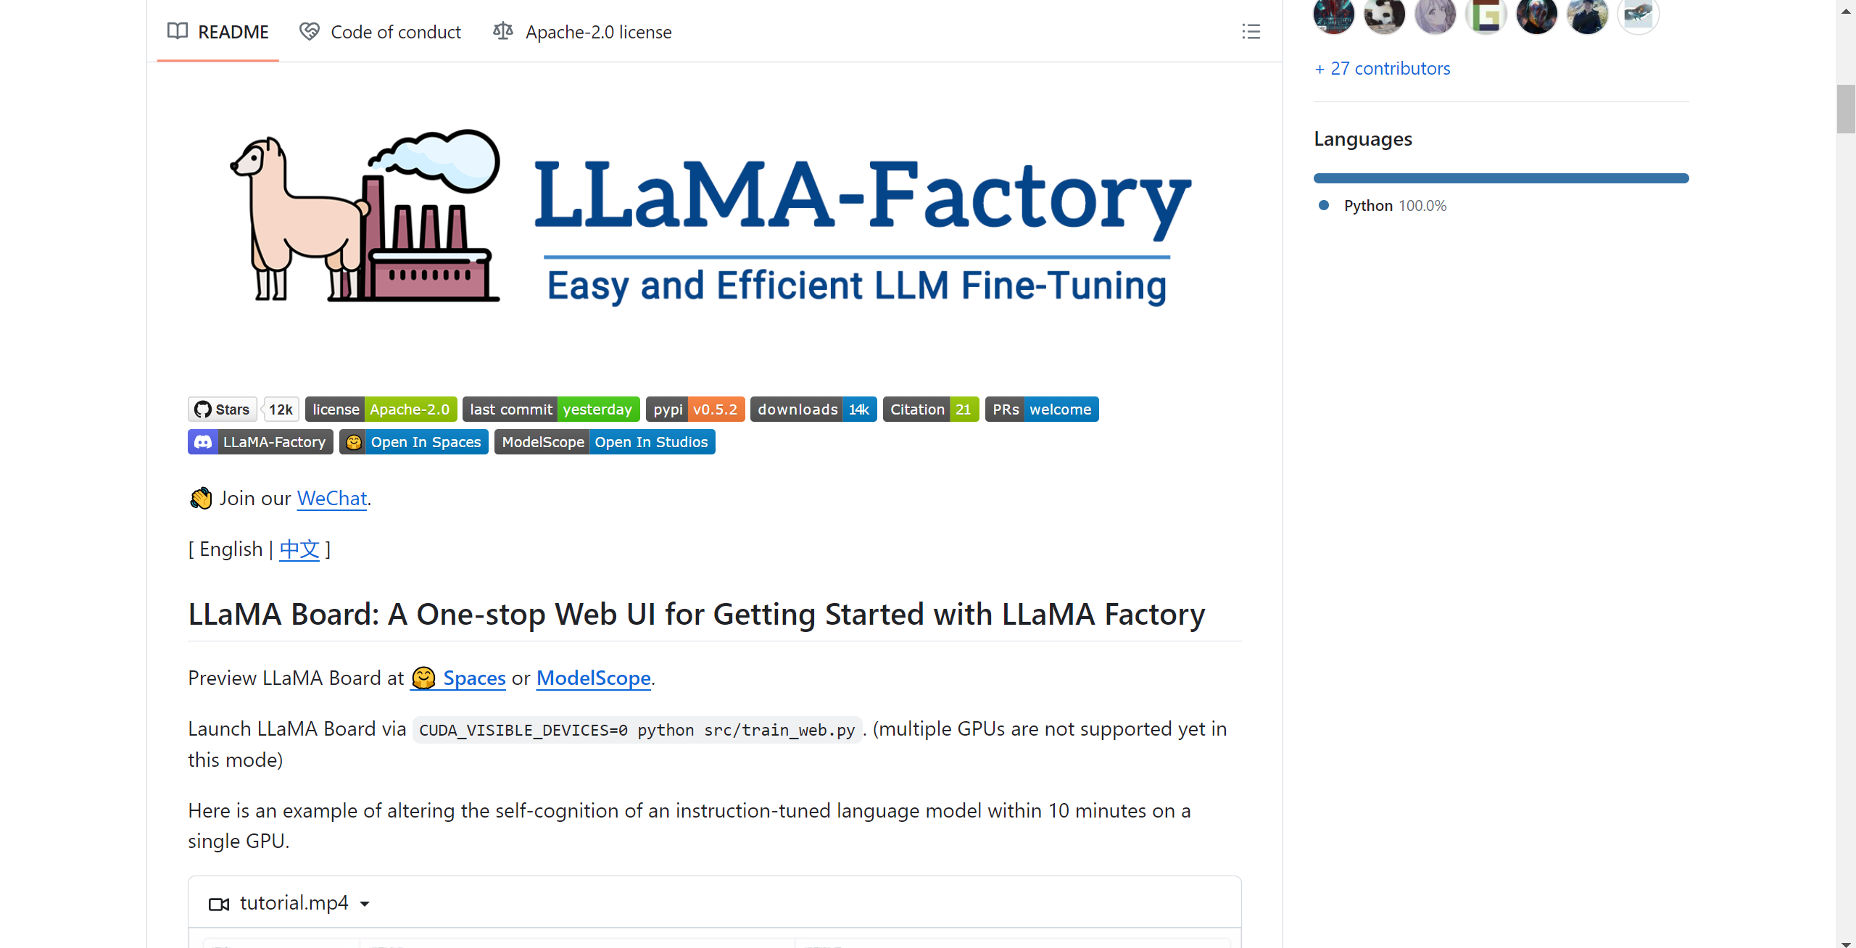
What we have tried
Llama factory:
Unsloth:

Slide 7
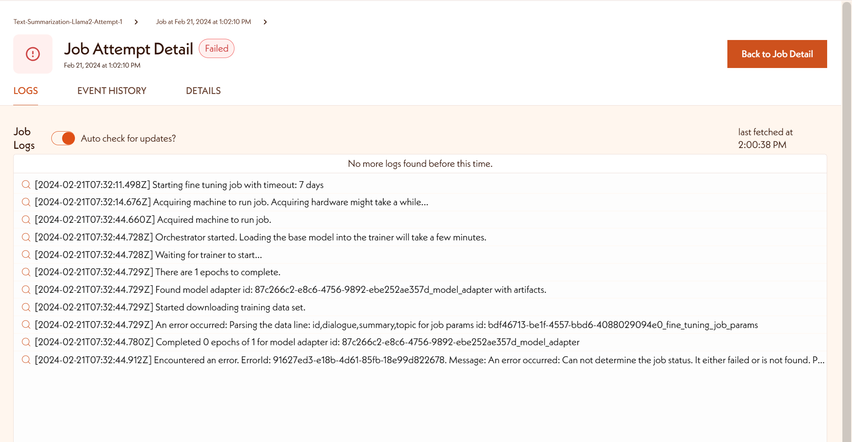
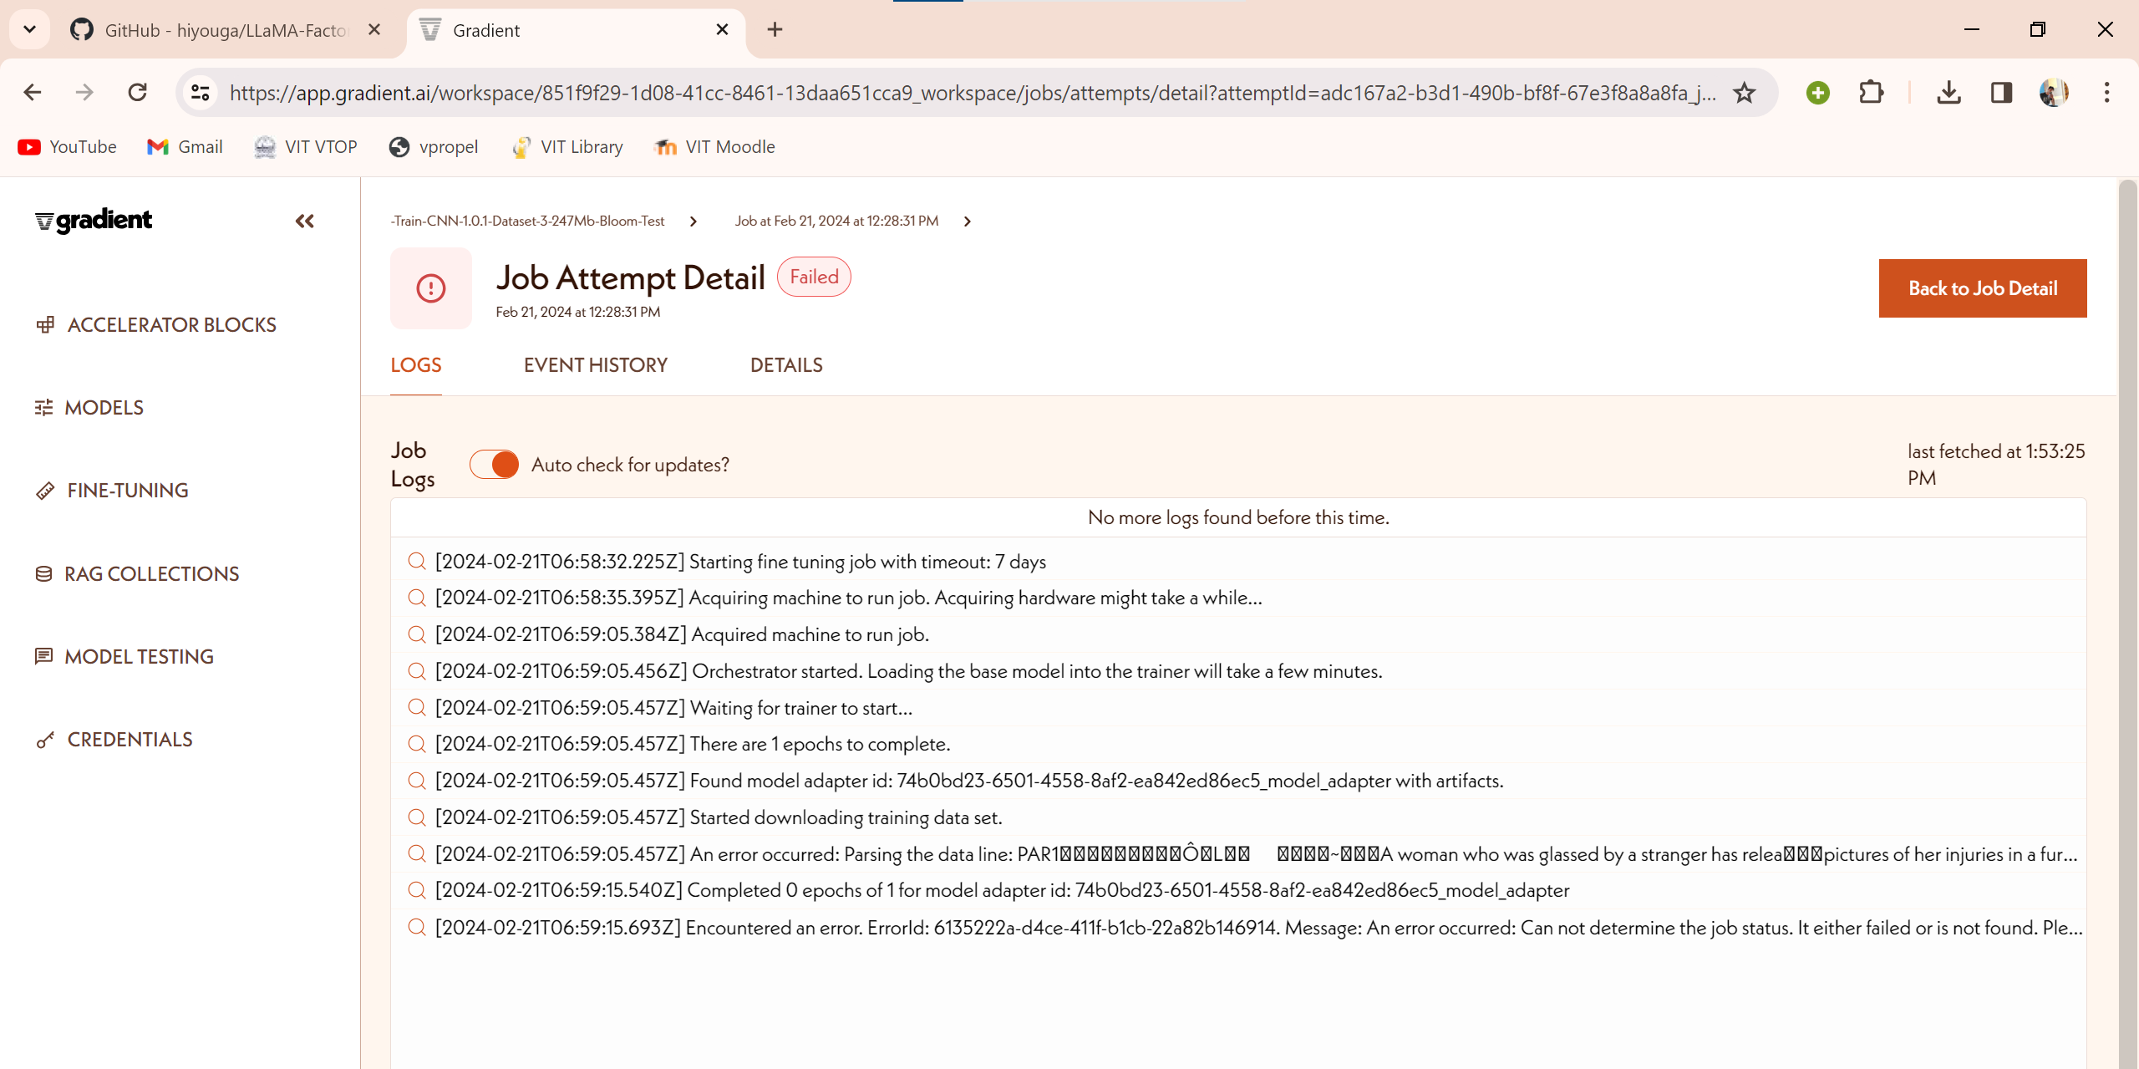
Issues with gradient:

Slide 8
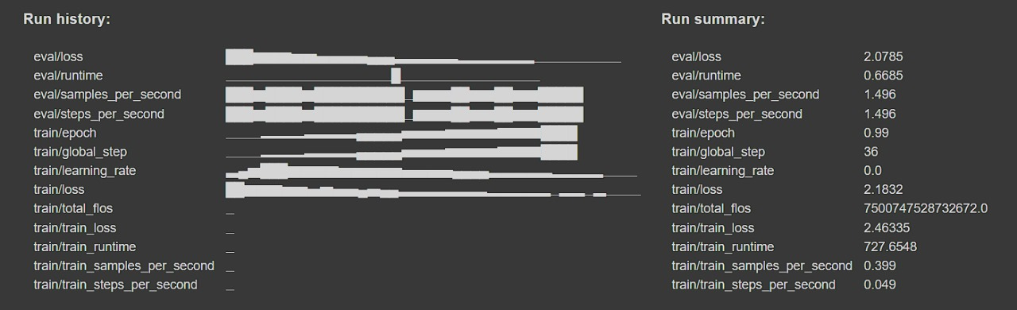


Issues with fine tuning:

Slide 9
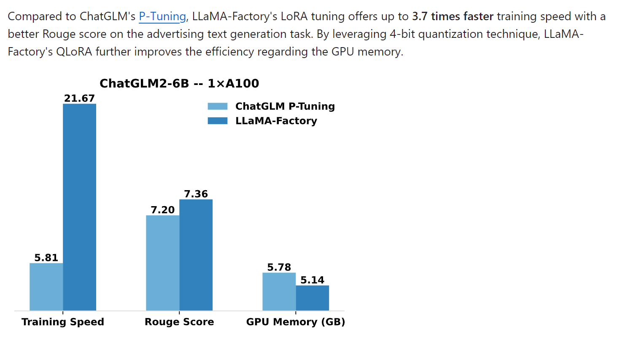
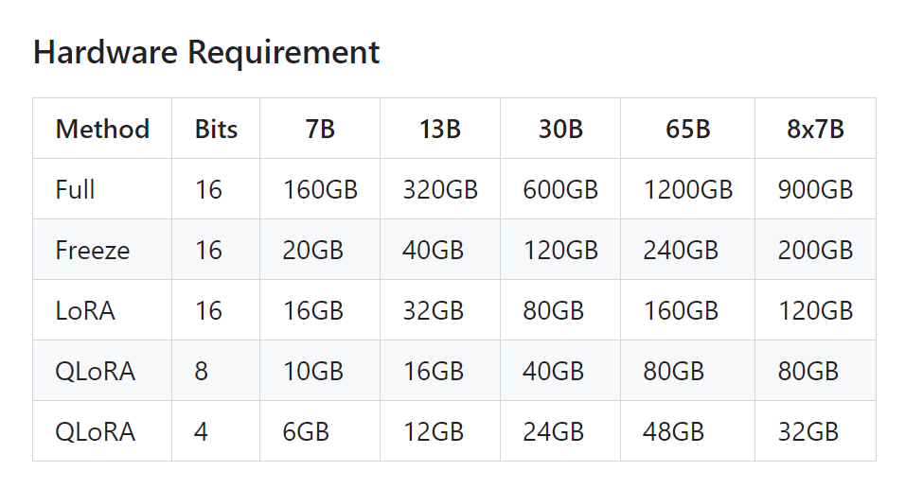
LLaMA – Factory Benchmarks and Hardware Requirement

Slide 10
Further Plans
Improve our accuracy using better models or larger dataset
Apply RLHF on Fine-Tuned LLM.
Find different metrics for human feedbacks
Find a method to use RLAIF.
Compare the accuracy of the model using RLAIF alone, RLHF alone, both RLAIF and RLHF.

Slide 11
Concerns – Issues with further Research
Compute resources required either hardware or cloud.
Not many viable options to implement RLAIF, Not offered by any of the popular cloud services.

