Slide 1
Virtual Private Network (VPN)
Presented By:- Abhay Kumar Angaria and Aayush Sharma
B.Tech 6th sem
23010603002, 23010603001
Presented To:- Ms. Kanika kapoor

Slide 2
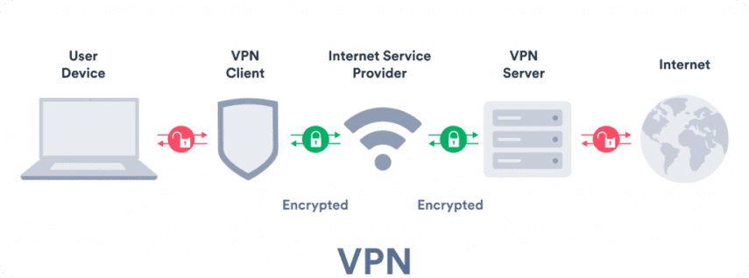
Introduction
VPN = Virtual Private Network
It is a security technology that :-
Creates encrypted tunnel
Hides real IP address
Ensures private communication

Slide 3
Types of VPN
A) Based on Usage (Deployment) :-
Remote Access VPN – Connects individual users to a private network (remote work)
Site-to-Site VPN – Connects multiple networks (office ↔ branch)
Mobile VPN – Maintains connection when switching networks (Wi-Fi ↔ mobile data)
MPLS VPN – Scalable enterprise network (less encryption by default)

Slide 4
Types of VPN
B) Based on Protocols (Tunneling Technology) :-
PPTP – Fast but low security (outdated)
L2TP/IPsec – Better security, slight performance overhead
OpenVPN – Strong security, flexible, widely used
IKEv2/IPsec – Fast, stable, ideal for mobile devices

Slide 5
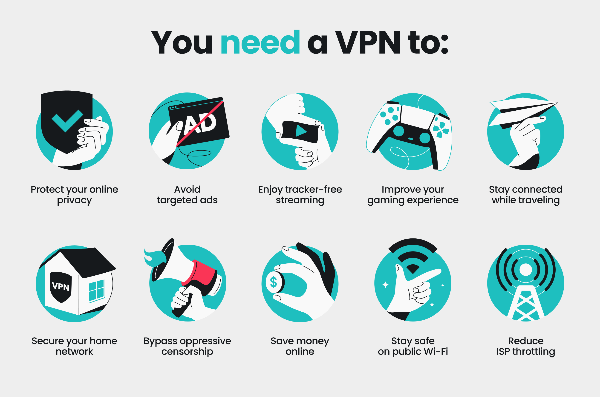
Need of VPN
Protect personal data
Secure public Wi-Fi
Prevent tracking
Access restricted content

Slide 6
Key Features of VPN
Privacy (IP masking)
Encryption of traffic
Bypass geo-restrictions
Reduce ISP throttling
Secure remote access

Slide 7
How a VPN Works
1. Connect to VPN server
2. Data gets encrypted
3. Travels via secure tunnel
4. Server forwards request
5. Response returns securely

Slide 8
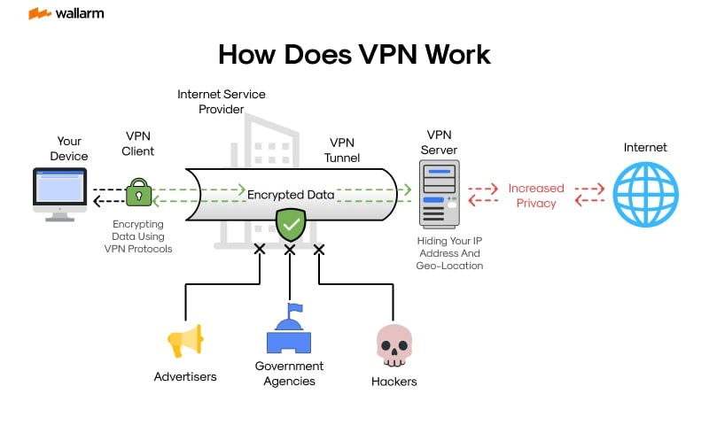

Slide 9
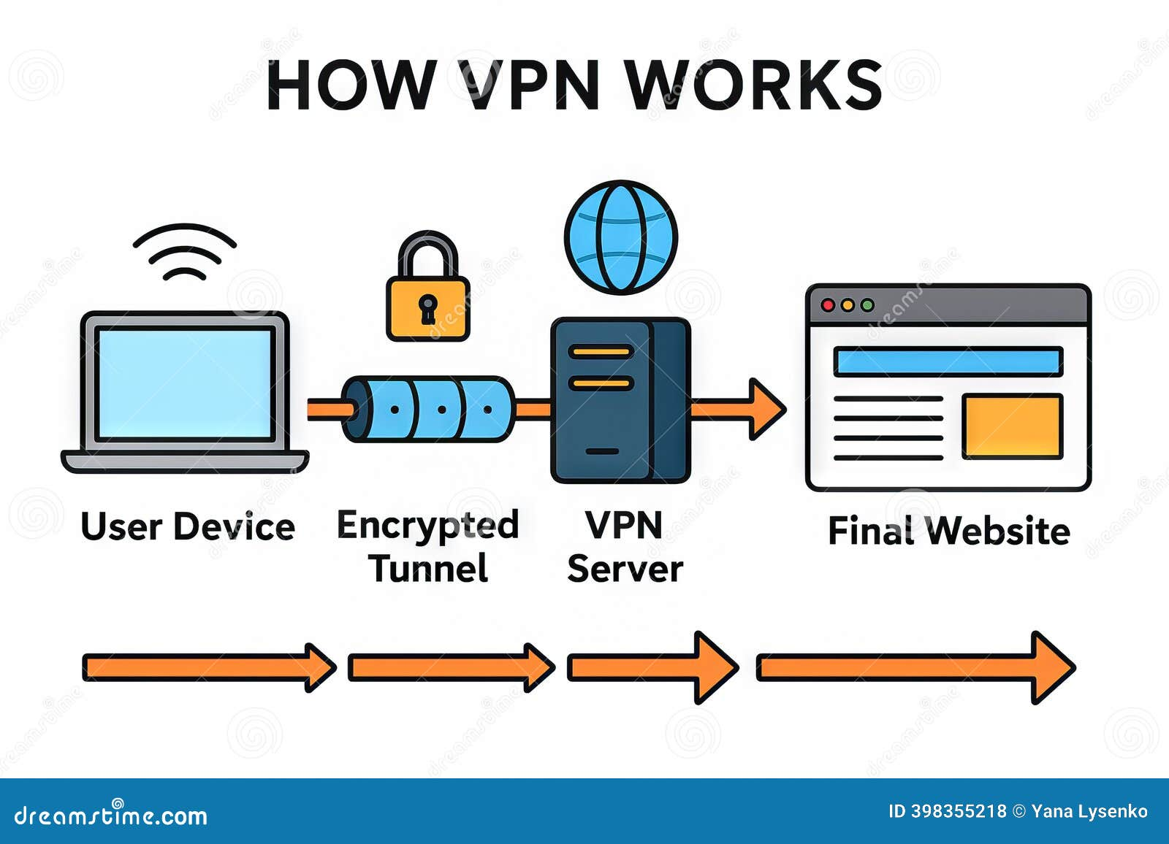
VPN Flow Diagram
User → Encrypted Tunnel → VPN Server → Internet
Internet → Encrypted Tunnel → User

Slide 10
Working Steps of VPN
• Authentication & connection
• Data encryption
• Secure tunneling
• Decryption at server
• End-to-end protection

Slide 11
VPN Protocol Highlights
PPTP – Fast but weak security (outdated)
L2TP/IPsec – More secure, slightly slower
OpenVPN – Highly secure, flexible, widely used
IKEv2/IPsec – Fast, stable, best for mobile devices

Slide 12
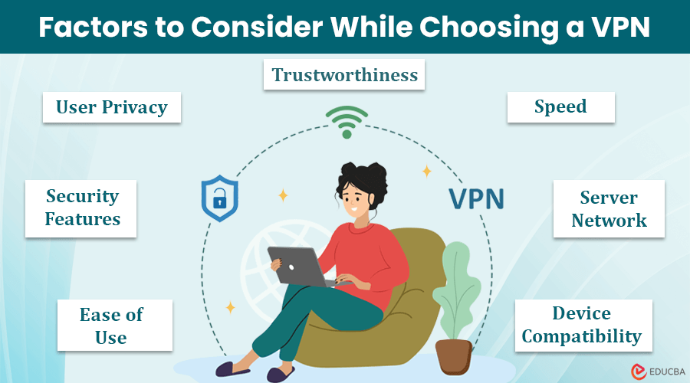
How to Choose VPN
• Strong encryption
• No-logs policy
• Fast performance
• Many servers
• Multi-device support

Slide 13
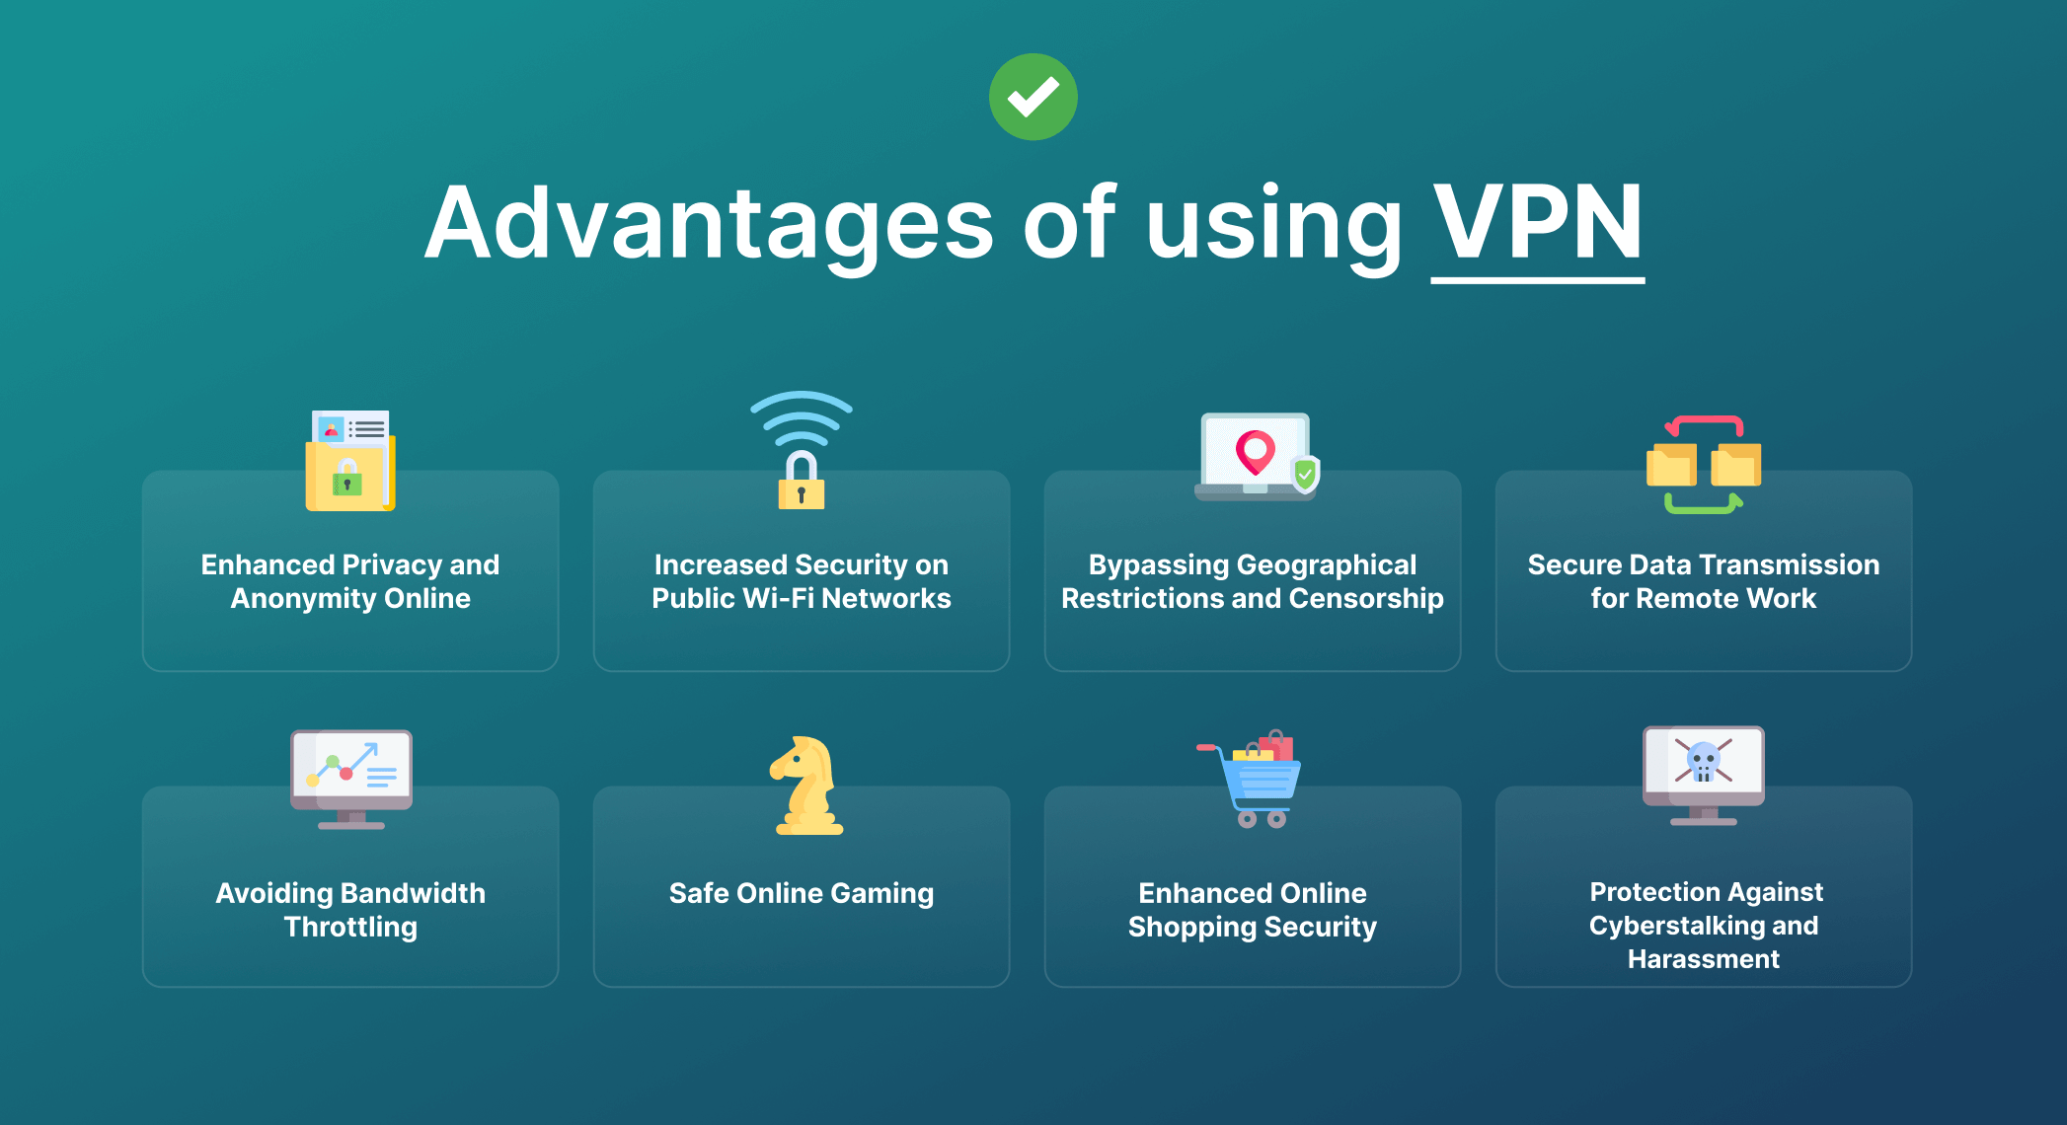
Advantages
• Privacy & anonymity
• Secure transmission
• Safe public Wi-Fi
• Access blocked content

Slide 14
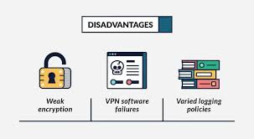
Drawbacks / Limitations
• Slower internet
• Some VPNs log data
• Blocked by websites
• Paid services cost money

Slide 15
THANK YOU

