Slide 1
Artificial Intelligence
Data
Science
Machine Learning
Deep Learning
Artificial Intelligence : Human Intelligence exhibited by machine.
Narrow AI : Computers can do a specific/one thing very well.
General AI : Computers can do multiple things like humans. We are very far away from this.
Machine Learning : Approach to try and achieve AI through systems that can find patterns in data. Stanford Univ - Science of getting computers to act without being explicitly programmed.
Deep Learning : One of the techniques to implement machine learning.
Data Science : Analysing Data

Slide 2
Play Ground
https://teachablemachine.withgoogle.com/
https://ml-playground.com/#

Slide 3
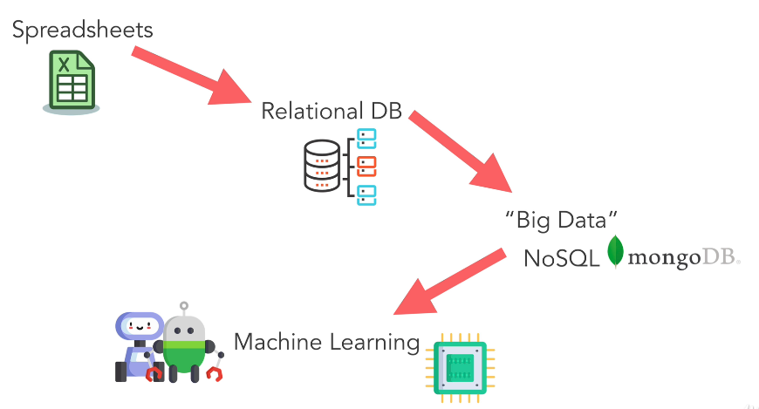
How did we get here ?

Slide 4
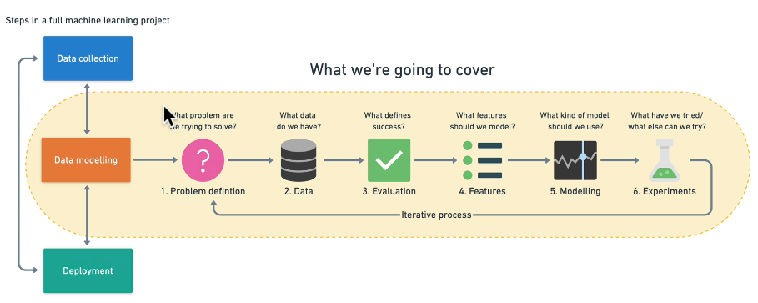

Slide 5
YouTube Recommendation Engine
https://ml-playground.com/#
X Axis - Duration of Video
Y Axis - Likes to the Video

Slide 6
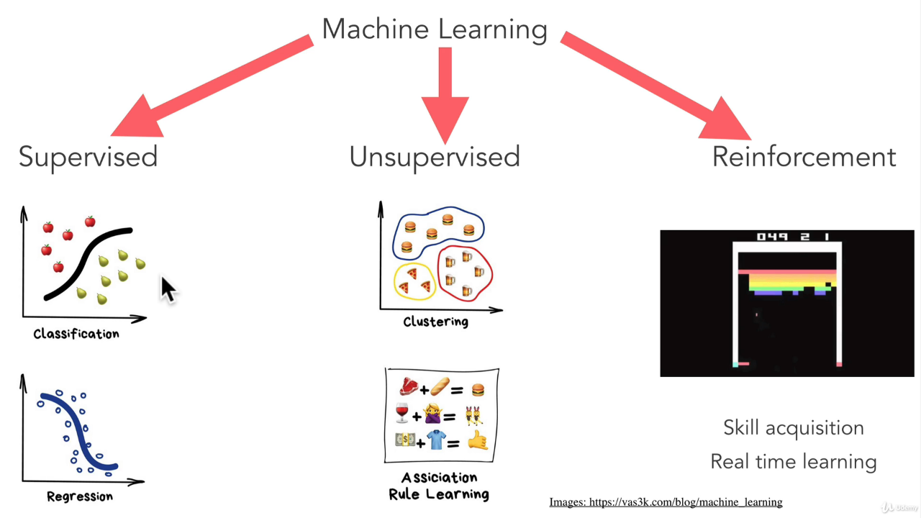
Types of machine learning
Is this a cat or dog ?
Machine
Categorizes
data
Predicting Stock prices
What customer
might buy ?

Slide 7
When not to use machine learning ?
Will simple hand coded instructions based system work ? If yes, then use it.

Slide 8
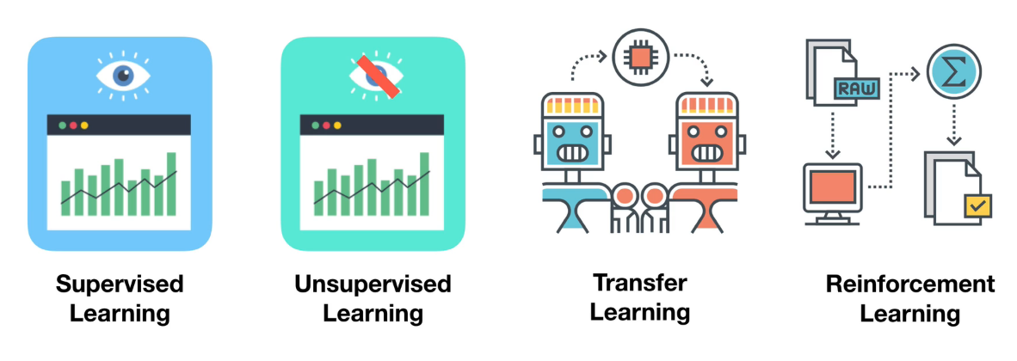
Main types of machine learning

Slide 9
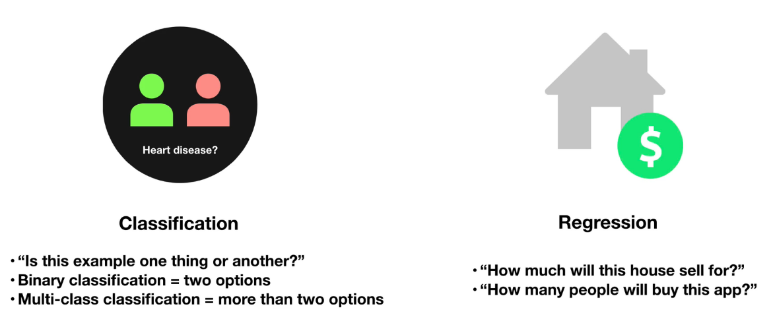
Supervised learning

