Slide 1
Trade Surveillance
An unified approach to leverage Big Data processing tools
to capture market abuses

Slide 2
Agenda
Trade Surveillance
Few Scenarios
Data Lake - The backbone of the system
Q & A

Slide 3
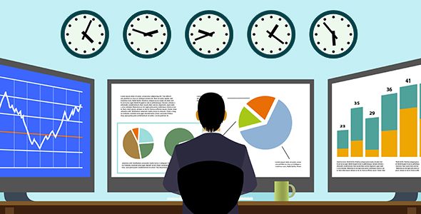
Trade Surveillance
Monitoring and Detecting
  Activities for market manipulation
  Fraud
  Behavioral patterning and more …
Happens Across
  all asset classes and products, thereby ensuring the prevention of illegal trading practices

Slide 4
Activities
Pre-Trade
  Trade Allocation, Trade Sequencing, Cross Trade
Post-Trade
  Price/Volume Verification, Erroneous Order Entry, Best Execution
Market Abuse
  Churning/Wash Trades, Spoofing, Window Dressing, Portfolio Pumping
Trade Violations
  Insider trading, Speculative trading, Dark Pools and HFT

Slide 5
Activities...
Market Surveillance
  Cross Market Surveillance, Equity Market Surveillance, OTC traded derivative surveillance
Reporting
  Transaction/Settlement Reporting, Suspicious Transactions Report, Audit Trail and documentation
Enhanced Trade Surveillance
  Trading/Volatility limits, Static/Dynamic Controls, Ping Order/Quote Stuffing
Others
  Data Management, Risk management, Control Review

Slide 6
Scenario - Spoofing
Fake visible sell orders
Fake sell orders canceled
X
X
X
X
Market Price
Genuine Buy Order
Genuine Buy Order Filled
Price►
Time►

Slide 7
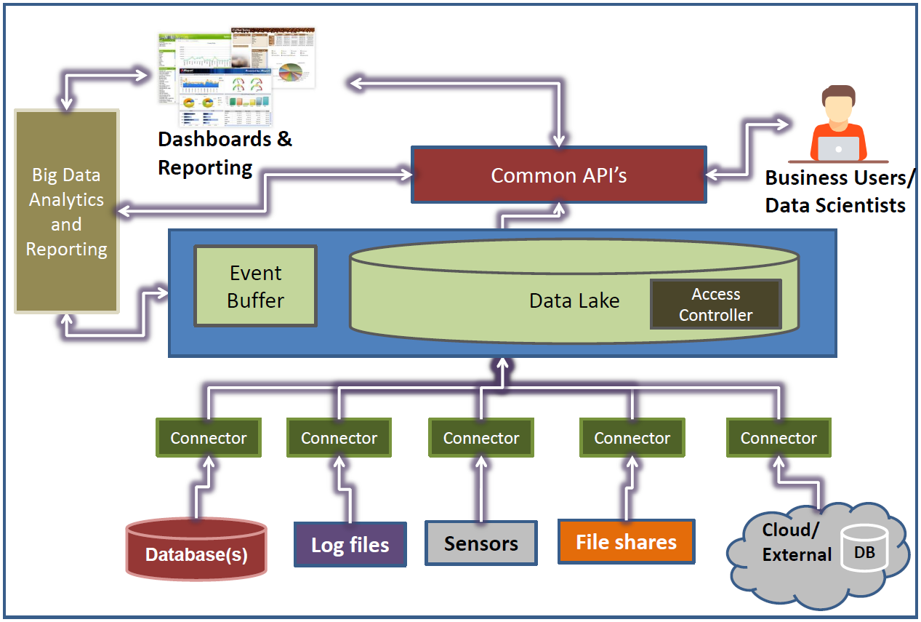
Data Lake Architecture
Applications

Slide 8
Q & A
?

Slide 9
Let's surveil together
Thank you

