Slide 1

The Scala Programming
Vol - 2
Bite-sized introductions to the most frequently used features of Scala.
https://github.com/abhaylodha/scala_basics

Slide 2
Agenda
String interpolation
Classes
Objects
Companion object
Case Classes
Traits
Pattern Matching
Case Objects
Implicit Parameters and Conversions

Slide 3
String interpolation
val i = 100.545866705
//Substitute Variable values
val str = s"Value Of i = $i"
println(str)
//Formatted Printing
println(f"Value Of i = $i%.4f")
//Prints An symbol within the String.
println(raw"Value Of i = $i%.4f")

Slide 4
Classes
class Animal{
var num_legs = 4
private val num_eyes = 2
}
val a1 = new Animal()
val a2 = new Animal()
val a3 = new Animal()
__________________________________________________________________
a1.num_legs = 2
a2.num_legs = 6
a2.num_legs = 8
a1
num_legs
a2
num_legs
4
a3
num_legs
a1
num_legs
2
a2
num_legs
6
a3
num_legs
8

Slide 5
Classes …Contd
class Animal(var name: String) {
val a = 100;
def getA = a;
//Validation
require(name.startsWith("A"))
//Constructor
/*private*/ def this() = this("As")
def this(a: String, b: String) = this(a)
var num_legs = 4
def make_noise: Unit = println("I don't know what does that mean.")
override def toString = s"a : $a getA : $getA num_legs : $num_legs make_noise : $make_noise"
}
class Dog(name: String) extends Animal(name) {
override def make_noise: Unit = { println("Dog : Bho bho") }
}
class Cat(name: String) extends Animal(name) {
override def make_noise: Unit = { println("Cat : Meau") }
}
val a1: Animal = new Dog("AA")
val a2: Cat = new Cat("AB")
val a3 = new Animal("AC")
val a4 = new Animal()
a1.make_noise
a2.make_noise
a3.make_noise
a4.make_noise
println(a1.a)
println(a4.a)
a1.name = "2"
println(a1)
println(a2)
println(a3)
println(a4)

Slide 6
Classes …Contd
class Rational(n: Int, d: Int) {
//Won't work
//def add(that: Rational) = new Rational(n * that.d + that.n * d, d * that.d)
require(d != 0)
val numer = n
val denom = d
def +(that: Rational) = new Rational(numer * that.denom + that.numer * denom, denom * that.denom)
override def toString : String = s"$n / $d"
}
val r1 = new Rational(10,3)
val r2 = new Rational(10,3)
println (s"$r1 + $r2 = ${r1 + r2}")

Slide 7
Objects
object Logger {
var line_num = 0
def log(s: String) = { println(s"$line_num : $s"); line_num += 1 }
}
Logger.log("This is a start of program")
Logger.log("Arguments are : a, b, c")
Logger.log("Calculating a")
Logger.log("Performing EOD procedures")
Logger.log("This is a end of program")

Slide 8
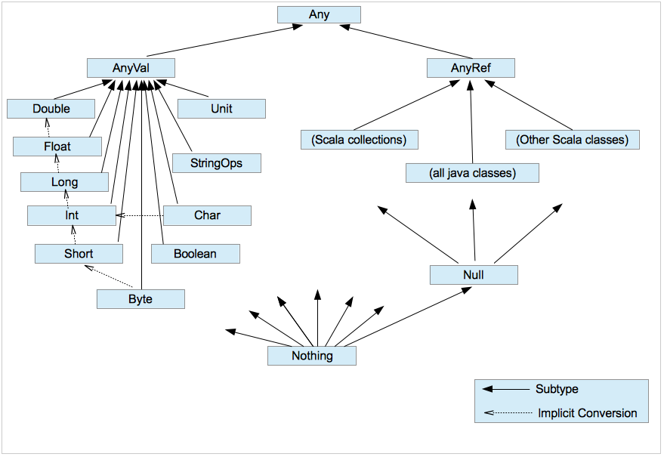
Data Types

Slide 9
Data Types …contd
class A1(val a: Int) extends AnyRef {
}
class A2(val a: Int) extends AnyVal {
}
val a1_1 = new A1(1)
val a1_2 = new A1(1)
val a2_1 = new A2(1)
val a2_2 = new A2(1)
if (a1_1 == a1_2) println("Equal") else println("Not Equal")
if (a2_1 == a2_2) println("Equal") else println("Not Equal")
//Reference comparison only for AnyRef tree
if (a1_1 eq a1_2) println("Equal") else println("Not Equal")
//object value comparison only for AnyVal tree. Below won't compile
//if (a2_1 eq a2_2) println("Equal") else println("Not Equal")

Slide 10
Companion objects
class C1(a: String, b: Int) {
def getA = this.a
def getB = b
override def toString : String = s"a : $a, b : $b"
}
object C1 {
def apply(): C1 = new C1("Str1", 5)
def apply(str: String): C1 = new C1(str, 5)
def apply(intVal: Int): C1 = new C1("Str1", intVal)
}
val a: C1 = C1()
val b: C1 = C1("XYZ")
val c: C1 = C1(100)
println(a)
println(b)
println(c)

Slide 11
Case Classes
A Packed Class with
Equality
Nice toString
Getters and Setters
case class CoOrdinates(val x: Int, val y: Int, var z: Int)
val p1 = CoOrdinates(10, 20, 30)
val neighbour_of_p1 = p1.copy(y = p1.y + 1)
println(p1)
println(neighbour_of_p1)
p1.z = 31
println(p1)
println(neighbour_of_p1)

Slide 12
Traits Used to share interfaces and attributes between classes.
trait Color {
val r: Int; val g: Int; val b: Int
def paint = println(s"Painting with Color : RGB($r,$g,$b)")
}
trait Style {
val size: Int; val bold: Boolean; val italic: Boolean = false
def applyStyle = println(s"Setting Style => (Size : $size, Bold : $bold, Italic : $italic)")
}
class FontColor(r_ : Int, g_ : Int, b_ : Int) extends Color {
val r = r_; val g = g_; val b = b_
override def paint = println(s"Setting Pen Color to : RGB($r,$g,$b)")
}
class BgColor(r_ : Int, g_ : Int, b_ : Int) extends Color {
val r = r_; val g = g_; val b = b_
}
class ColorAndStyle(r_ : Int, g_ : Int, b_ : Int, bold_ : Boolean, size_ : Int, italic_ : Boolean) extends Color with Style {
val r = r_; val g = g_; val b = b_; val bold = bold_; val size = size_; override val italic = italic_;
}
val backGround = new BgColor(10, 20, 30); backGround.paint
val cursorStyle = new FontColor(10, 20, 30) with Style() { val bold: Boolean = true; val size: Int = 20 }
cursorStyle.paint; cursorStyle.applyStyle
new ColorAndStyle(10, 20, 30, bold_ = true, 20, italic_ = true)

Slide 13
Pattern Matching A mechanism for checking a value against a pattern
import scala.util.Random
val x: Int = Random.nextInt(10)
x match {
case 0 => "zero"
case 1 => "one"
case 2 => "two"
case _ => "many"
}
abstract class Device
case class Phone(model: String) extends Device {
def screenOff = "Turning screen off"
}
case class Computer(model: String) extends Device {
def screenSaverOn = "Turning screen saver on..."
}
def goIdle(device: Device) = device match {
case p: Phone => p.screenOff
case c: Computer => c.screenSaverOn
case _ => "Unknown Device"
}
println(goIdle(new Phone("Avaya")))
println(goIdle(new Computer("HP")))
println(goIdle(new Device(){}))

Slide 14
Case Objects
A Packed Object with
Equality
Nice toString
Getters and Setters
Mostly used in Pattern matching
trait Dimension
case class Dimension_2(x: Int, y: Int) extends Dimension
case class Dimension_1(x: Int) extends Dimension // Case class
case object Dimension_0 extends Dimension // Case object
def callCase(f: Dimension) = f match {
case Dimension_2(f, g) => println("2 D CoOrdinates - x = " + f + " y =" + g)
case Dimension_1(f) => println("1 D CoOrdinates = " + f)
case Dimension_0 => println("Dimension 0")
}
callCase(Dimension_2(10, 10))
callCase(Dimension_1(10))
callCase(Dimension_0)

Slide 15
Implicit Parameters and Conversions A way to pass parameters without specifying explicitly
implicit val pi = 3.14
def area_of_circle(radius: Int)(implicit value_of_pi: Double) = value_of_pi * radius * radius
println(s"Area of Circle = ${area_of_circle(5)}")
case class CoOrdinates(x: Int, y: Int) {
def +(that: CoOrdinates): CoOrdinates = CoOrdinates(this.x + that.x, this.y + that.y)
}
implicit def stringToCoOrdinates(s: String) = {
val splitted_vals = s.split(",")
if (splitted_vals.length > 1) {
CoOrdinates(
Integer.parseInt(splitted_vals(0)),
Integer.parseInt(splitted_vals(1)))
} else {
CoOrdinates(0, 0)
}
}
val nextCoOrdinate = CoOrdinates(55, 2) + "2,2"
println(s"${nextCoOrdinate.x}, ${nextCoOrdinate.y}")

Slide 16
Exception Handling
scala> def half (n : Int) =
| {
| if (n % 2 == 0)
| n / 2
| else
| throw new RuntimeException("n must be even")
| }
half: (n: Int)Int
scala> half(6)
res1: Int = 3
scala> half(5)
java.lang.RuntimeException: n must be even
at .half(<console>:16)
... 28 elided
scala> def half (n : Int) = {
| if (n % 2 == 0) n / 2
| else throw new RuntimeException("n must be even")
| }
half: (n: Int)Int
scala>
scala> def get_half_or_default_val(m : Int) = {
| val h = try { half(m) }
| catch { case x : Exception => 1 }
| println(s"Value of half = $h")
| }
get_half_or_default_val: (m: Int)Unit
scala> get_half_or_default_val(6)
Value of half = 3
scala> get_half_or_default_val(5)
Value of half = 1

Slide 17
Closure The function value (the object) that's created at runtime from this function literal
scala> def makeIncreaser(more: Int) = (x: Int) => x + more
makeIncreaser: (more: Int)Int => Int
scala> def inc1=makeIncreaser(1) //This is a closure
inc1: Int => Int
scala> inc1(20)
res21: Int = 21
scala> def inc7=makeIncreaser(7) //This is a closure
inc7: Int => Int
scala> inc7(20)
res22: Int = 27
scala>

Slide 18
Default function arguments
def printSomething(msg: String = "Something"): Unit =
println(msg) //> printSomething: (msg: String)Unit
printSomething() //> Something
printSomething("ABCD") //> ABCD
printSomething(msg = "ABCD") //> ABCD

