Slide 1

The Scala Programming
Vol - 3
Bite-sized introductions to the most frequently used features of Scala.
https://github.com/abhaylodha/scala_basics

Slide 2
Agenda
Control Abstraction
Composition and Inheritance

Slide 3
Removing Code duplication using closure
def filesMatching(
fNames: List[String],
query: String,
matcher: (String, String) => Boolean) = {
for (file <- fNames; if matcher(file, query))
yield file
}
def filesEnding(fNames: List[String], query: String) =
filesMatching(fNames, query, _.endsWith(_))
def filesContaining(fNames: List[String], query: String) =
filesMatching(fNames, query, _.contains(_))
def filesRegex(fNames: List[String], query: String) =
filesMatching(fNames, query, _.matches(_))
val fileNames = List("ABCD", "AEFGH", "LMN", "OPQ", "RST", "UVW")
filesEnding(fileNames, "H")
filesContaining(fileNames, "B")

Slide 4
New Control Structures
def twice(op: Double => Double, x: Double) = op(op(x))
//> twice: (op: Double => Double, x: Double)Double
twice(_ + 1, 5) //> res0: Double = 7.0
//Is same as
twice(a => a + 1, 5) //> res1: Double = 7.0
//Resolves to
((5: Double).+(1)).+(1) //> res2: Double = 7.0

Slide 5
Substitute () with {} for one argument functions
println("Hello World") //> Hello World
//Can also be written as below. This makes code look like Control abstraction.
println { "Hello World" } //> Hello World
Can only be done for functions with one parameter. Below will not work.
def addTwoNumbers(a: Int, b: Int) = a + b
//addTwoNumbers{5,6}
// Work Around for this as below :
def addTwoNumbers_v2(a: Int)(b: Int) = a + b
addTwoNumbers_v2(5) { 6 }
addTwoNumbers _v2{ 5 } { 6 }
addTwoNumbers _v2{ 5 } ( 6 )

Slide 6
By-name parameters Allows us to replace ()=> with =>, when no parameters are passed.
val checkCondition = true
def testCondition(predicate: () => Boolean) = if (checkCondition && !predicate()) print("Assertion Error.")
testCondition(() => 5 > 6)
def testCondition_v2(predicate: => Boolean) = if (checkCondition && !predicate) print("Assertion Error.")
testCondition_v2(5 > 6)

Slide 7
By-name parameters …Contd
Then why not
def testCondition_v3(predicate: Boolean) = if (checkCondition && !predicate) print("Assertion Error.")
That is to avoid early evaluations. Check below code.
val checkCondition = false
def testCondition_v2(predicate: => Boolean) = if (checkCondition && !predicate) print("Assertion Error.")
def testCondition_v3(predicate: Boolean) = if (checkCondition && !predicate) print("Assertion Error.")
testCondition_v2(5/0 == 0)
testCondition_v3(5/0 == 0)
testCondition_v2 will not fail as expression is not evaluated, whereas testCondition_v3 will fail as it is evaluated earlier.

Slide 8
Composition A restricted aggregation. i.e. The contained object cannot exist without the other object.
Aggregation -
Parent class contains Child class. And
Child class can exist independently of the Parent class.
E.g. A Class contains Student. Student class can exist independent of Class. (A case where Student is studying, but not admitted to any Class.)
Composition -
Parent class contains Child class. And
Child class cannot exist independent of the Parent class.
E.g. A House contains Room. Room class cannot exist independent of House.

Slide 9
Abstract Class
abstract class Element {
//Will not compile. abstract cannot be used for members.
//abstract def contents: Array[String]
def contents: Array[String]
//Concrete Methods
def height: Int = contents.length
//empty-paren Method
//def height(): Int = contents.length
def width: Int = if (height == 0) 0 else contents(0).length
//Can also be defiend as below.
//It changes the time when it is evaluated. def will cause lazy evaluation and at each method call.
//val will be evaluated immediately on class initialization.
val width_v2: Int = if (height == 0) 0 else contents(0).length
}

Slide 10
Extending a Class
class ArrayElement
(conts: Array[String])
extends Element {
def contents: Array[String] = conts
}
class ArrayElement_v2(conts: Array[String]) extends Element {
//Uniform access principle makes it possible
//to convert def to val or vice versa
val contents: Array[String] = conts
}
scala
AnyRef
<java.lang.Object>
Element
<<abstract>>
ArrayElement
Array[String]
Uniform access principle is made possible by having only two name spaces in Scala viz. Values (fields, methods, ) and types
Java has four name spaces viz. fields, methods, types, packages.

Slide 11
Extending a Class …contd
In previous example, Class had a parameter - conts, used to initialize field. This is a "code smell“ which means unnecessary variable. This can be avoided as below.
class ArrayElement_v3(
val contents: Array[String]
) extends Element
Note the val in beginning of contents variable. var also can be used in place of val.
We cannot define methods this way.
Superclass constructor
class LineElement(s: String) extends ArrayElement(Array(s)) {
override val height = 1
override val width = s.length
}

Slide 12
Extending a Class …contd
override clause is
- Optional when overriding abstract methods and fields. (i.e. Uninitialized members)
- Compulsory when overriding concrete methods and fields. (i.e. Initialized members)
- Forbidden when no method/field names conflicts in inheritance hierarchy.

Slide 13
Extending a Class …contd
final keyword is
- Used to restrict the sub-classing
PROGRAM 1 :
abstract class Element {
final def demo1 = println("Final method")
}
class ArrayElement(conts: Array[String]) extends Element {
//Below will not compile as method in super class is final.
//override def demo1 = println("Final method")
}
PROGRAM 2 :
final class Element {
final def demo1 = println("Final method")
}
//Below will not compile as superclass is final.
// class ArrayElement(conts: Array[String]) //extends Element {
//}

Slide 14
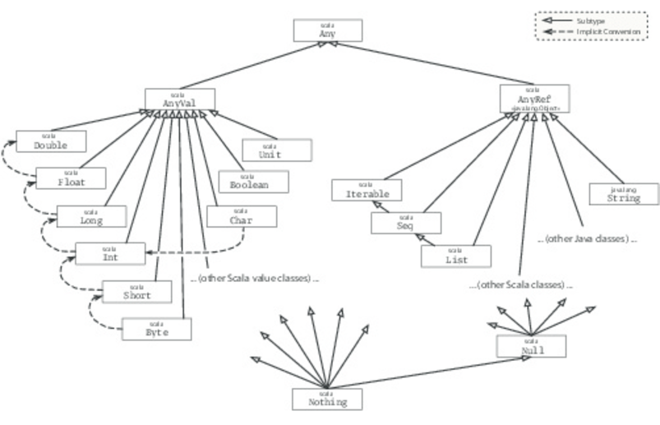
Class Hierarchy
Methods in Any Class :
final def ==(that: Any): Boolean final def !=(that: Any): Boolean def equals(that: Any): Boolean
def ##: Int def hashCode: Int def toString: String
8 first subclasses of AnyVal corresponds to Basic Java Primitive Types and Unit is roughly similar to void.
All subclasses of AnyVal are abstract and final. So “new Int(5)” or “Int(5)” is not valid.
AnyRef is an alias to java.lang.object class.

Slide 15
Class Hierarchy ….contd
val t = 5 until 14
5 is an instance of Int class. What happens when we call until on Int class ?
Where is the until method defined ?
until is the method defined in a Booster class : scala.runtime.RichInt.
implicit conversion happens from class Int to RichInt.
until method will be invoked.

Slide 16
Object Comparison in Scala
Scala transparently converts AnyVal to respective primitives seamlessly giving always uniform result.
Below Java Code will give different results :
System.out.println((5 == 5));
System.out.println((new Integer(5) == new Integer(5)));
Below scala code gives same results.
val i1 : Any = 5 //> i1 : Any = 5
val i2 : Any = 5 //> i2 : Any = 5
i1 == i2 //> res1: Boolean = true
val i3 : Int = 5 //> i3 : Int = 5
val i4 : Int = 5 //> i4 : Int = 5
i3 == i4 //> res2: Boolean = true
For AnyVal’s, == calls from primitives and for AnyRef’s, it calls equals transparently.

Slide 17
Object Comparison in Scala
Then How do we compare references in Scala ?
AnyRef defines two special methods called - eq and ne.
val x = new String("abc") //> x : String = abc
val y = new String("abc") //> y : String = abc
x == y //> res3: Boolean = true
x eq y //> res4: Boolean = false
x ne y //> res5: Boolean = true

Slide 18
Bottom Classes
Null is sub-class of all sub-classes of AnyRef.
Nothing is sub-class of every class (i.e. All sub-classes of AnyVal and AnyRef).
Nothing is useful to handle cases of abnormal behaviours like -
def error(msg: String): Nothing = throw new RuntimeException(msg)
def divide(x: Int, y: Int): Int = if (y != 0) x / y else error("Can't divide by 0")
Even if return type in else is Nothing, we can retain the return type of divide to Int.
₹

Slide 19
Defining own value classes
class Rupee(val r: Int) extends AnyVal {
override def toString = s"Rs.${r}"
}
object Rupee {
def apply(r: Int) = new Rupee(r)
}
val r = Rupee(50)
println(r)

Slide 20
Benefit of own value classes Same type argument order issues can be sorted out easily.
def calculateSimpleInterest1(p: Int, n: Int, r: Double): Double = {
p + ((p * n * r) / 100)
}
println(“Amt = " + calculateSimpleInterest1(10000, 5, 5.5))
println(“Amt = " + calculateSimpleInterest1(5, 10000, 5.5))
class Principle(val value: Int) extends AnyVal
class NoOfYears(val value: Int) extends AnyVal
class RateOfInterest(val value: Double) extends AnyVal
def calculateSimpleInterest(p: Principle, n: NoOfYears, r: RateOfInterest): Double = {
p.value + ((p.value * n.value * r.value) / 100)
}
println("Amt = " + calculateSimpleInterest(new Principle(10000), new NoOfYears(5), new RateOfInterest(5.5)))

Slide 21
A feature-rich example
class Principle(val value: Int) extends AnyVal
class NoOfYears(val value: Int) extends AnyVal
class RateOfInterest(val value: Double) extends AnyVal
object Principle {
def apply(value: Int) = new Principle(value)
}
object NoOfYears {
def apply(value: Int) = new NoOfYears(value)
}
object RateOfInterest {
def apply(value: Double) = new RateOfInterest(value)
}
implicit def PrincipleToInt(p: Principle): Int = p.value
implicit def NoOfYearsToInt(n: NoOfYears): Int = n.value
implicit def RateOfInterestToDouble(r: RateOfInterest): Double = r.value
def calculateSimpleInterest(p: Principle, n: NoOfYears, r: RateOfInterest): Double = {
p + ((p * n * r) / 100)
}
println("Amt = " + calculateSimpleInterest(Principle(10000), NoOfYears(5), RateOfInterest(5.5)))

