Slide 1

DIABETES PREDICTION USING MACHINE LEARNING TECHNIQUES Final year project Review-2 Batch – (2019-2023) Group Members : Abhay Kumar, Sungjemkaba Reg_no : 2019105194, 2019105219 07 Nov-2022
Department of Computer Science and Engineering
National Institute of Technology Nagaland

Slide 2
Contents
Glimpse of previous review
Proposed model
Flow diagram
Diabetes dataset
Data pre processing
Correlation
Balancing the dataset
Feature extraction
Accuracy analysis on under sampled data
Accuracy analysis on oversampled data
Confusion matrix
Conclusion
References

Slide 3
Glimpse of previous review
Diabetes is the fastest growing chronic disease in the world , according to world health organization data 537 million people suffering from diabetes and this data is increasing day by day.
Diabetes prediction model may be used in the medical field.
Going through the literature review on diabetes prediction using machine learning techniques , it has been found that using data pre-processing and balancing the accuracy may be increased.
Our objective is to develop a machine learning model for diabetes prediction.

Slide 4
Proposed model
Developing our own machine learning model with lesser running time.
Increasing the efficiency of the model.

Slide 5
Flow diagram
Normal data
PRE PROCESS DATA
PROCESSED
DATA
Classification algorithm such as SVM (support vector machine)
Performance evaluation
DATASET
Oversampled data
undersampled
data
Replacing missing values with mean
Min-max scaler
Result
Comparative analysis
Accuracy and f1 score
Diagram representing the flow of the model.

Slide 6
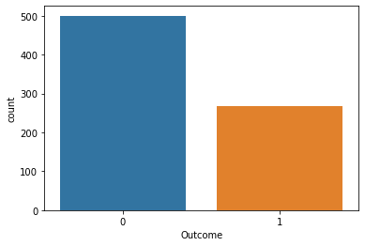
Diabetes dataset
Total no of hypothesis in PIMA diabetes dataset is 768 , out of which 268 is predicting it to be 1(yes) rest 0(no), so the dataset is imbalance.
Not diabetic
Diabetic
Graph representing the diabetes dataset.

Slide 7
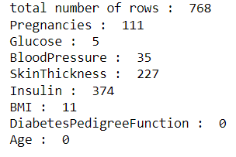
Data pre-processing
Out of 768 hypothesis column of some attribute contain 0 value.
we have replaced that 0 value with mean of particular column.
No of attribute having value as 0.

Slide 8
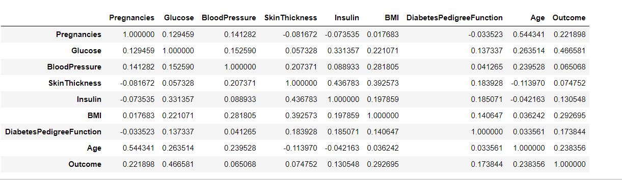
Correlation
The below fig shows the corelation between the different attribute present in the dataset.
On the basis of that we will decide which attribute has the higher effect on the output data.
Here we find out that Glucose concentration has the highest effect on the output where as blood pressure has the lowest effect.

Slide 9
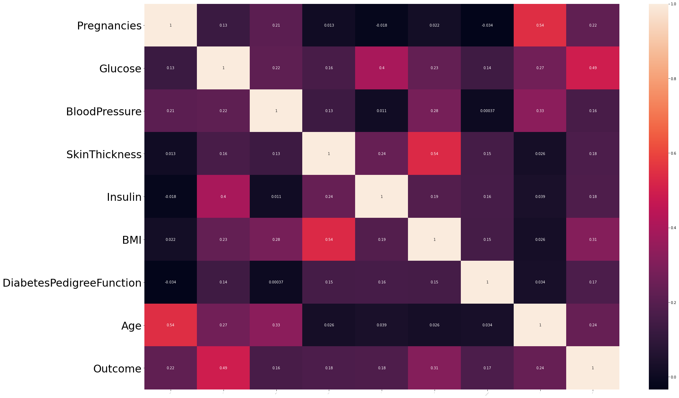
Correlation
Correlation between different attribute and class level value.

Slide 10
Balancing the dataset
Dataset will be balanced using oversampling, under sampling.
In oversampling we have only 268 samples of 1 class level value , so the dataset have been randomly selected and made it to 500. Now the dataset is balanced.
In under sampling we have only 268 samples of 1 class level value so only 268 samples have been selected of class level 0 value in order to balance the dataset.

Slide 11
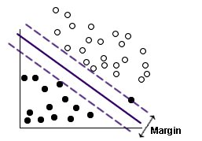
Feature extraction
Support Vector Machine (SVM) is a relatively simple Supervised Machine Learning Algorithm used for classification / regression.
SVM finds a hyper-plane that creates a boundary between the types of data. In 2-dimensional space, this hyper-plane is nothing but a line.
Transformation in N-dimensional space, where N is the number of features/attributes in the data.
https://www.ibm.com/docs/en/SS3RA7_sub/modeler_mainhelp_client_ddita/clementine/images/svm_improved.jpg
Diagram representing SVM classification

Slide 12
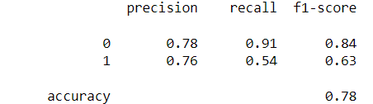
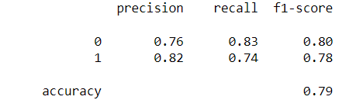
Accuracy analysis on under sampled data
Normal data
Under sampled data

Slide 13
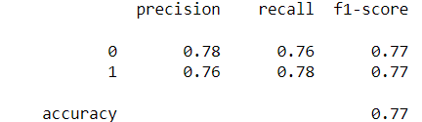
Accuracy analysis on oversampled data
Normal data
Oversampled data

Slide 14
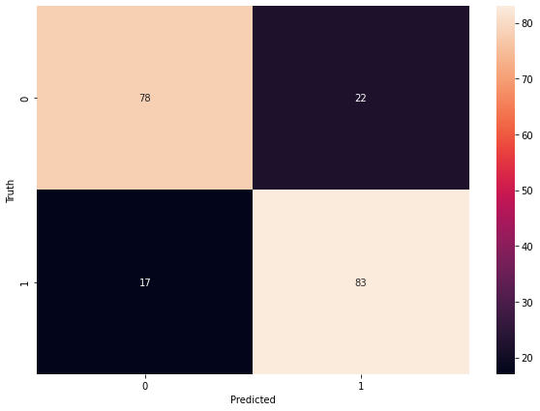
Confusion matrix
Matrix representing the predicted outcome

Slide 15
Conclusion
We have concluded that f1 score plays a very crucial role in the prediction if the dataset is imbalance.
Using SVM model as well as pre-processing the data, we get an accuracy of 79% with having higher value of f1 score for both the classes 0(not having diabetic) and 1(having diabetic).

Slide 16
References
[1] Shubham Joshi, Ali Rizwan , Basant Tiwari; A Novel Diabetes Healthcare Disease Prediction Framework Using Machine Learning Techniques; Journal of Healthcare engineering; vol. 2022, page (1-10), 2022.
[2] Neha prerna tigga , shruti garg; Prediction of Type 2 Diabetes using Machine Learning Classification Methods; Jounal of procedia computer science; vol. 167 ,page (706-716),2020.
[3] V. Jackins, S. Vimal, M. Kaliappan ,M.Y. Lee ;AI-based smart prediction of clinical disease using random forest classifier and Naive Bayes; Journal of Supercomputing; vol. 77,page (5198–5219), 2021.
[4] Ionnis kavakiotis, Olga Tsave,Athanasios Salifoglou; Machine Learning and Data Mining Methods in Diabetes Research; computational and structural biotechnology journal;vol. 15 , page (104-116),2020.
[5] Aishwarya Majumdar,Dr. V. vaidehi; Diabetes prediction using machine learning algorithm; International conference on recent trends in advanced computing; vol.165,page (192-199),2019.
Thank you

