Slide 1
ABHAY PRATAP SINGH
My Portfolio Comic Strip
B.Tech CSE (AI & ML) | Lovely Professional University

Slide 2
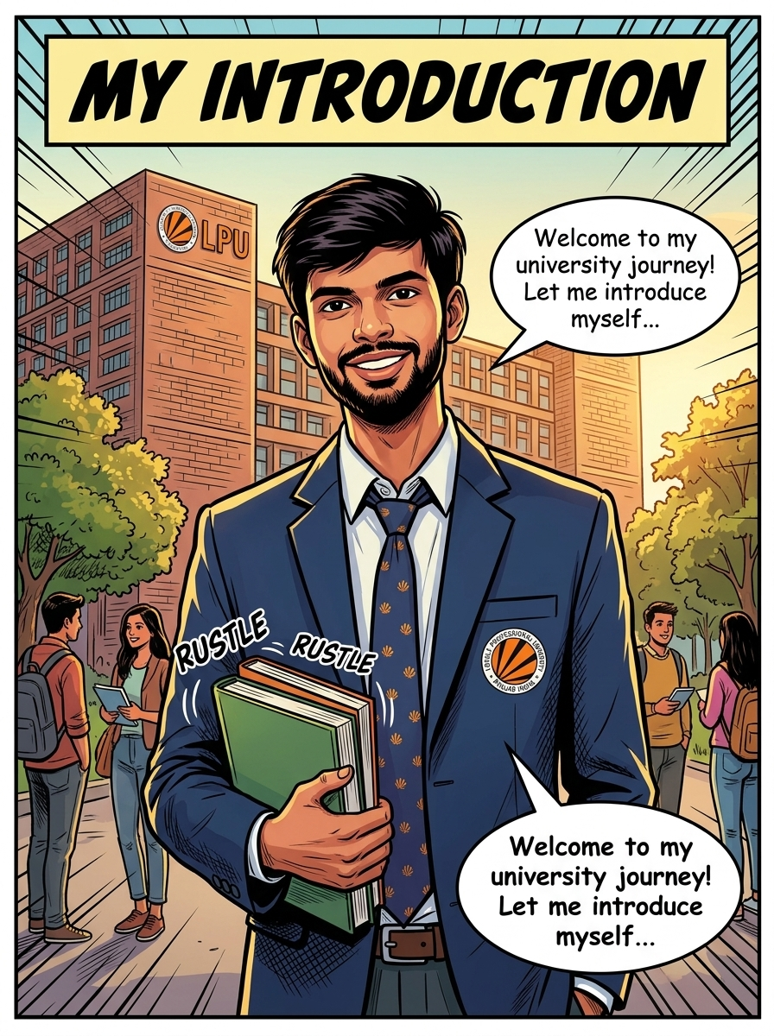
MY INTRODUCTION
Abhay Pratap Singh - B.Tech CSE (AI & ML) at LPU

Slide 3

MY EDUCATION
LPU B.Tech (CGPA: 9.4) | Class XII (79.8%) | Class X (84.2%)

Slide 4
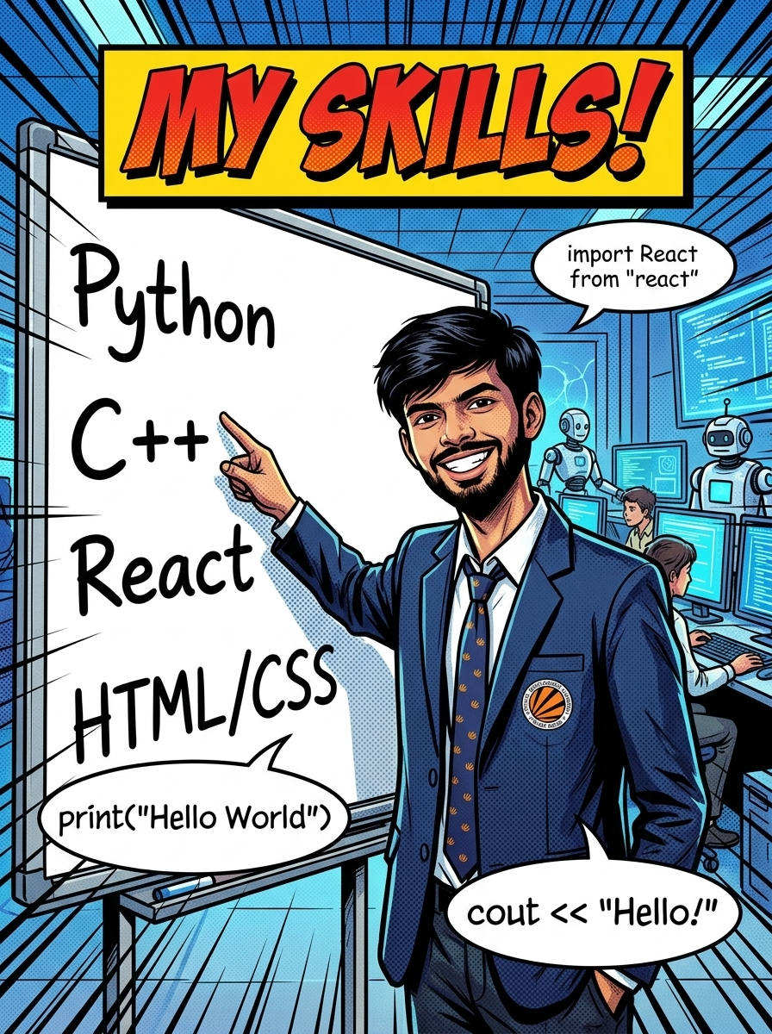
MY SKILLS
C, C++, Python, JavaScript, React.js, MySQL, Pandas

Slide 5
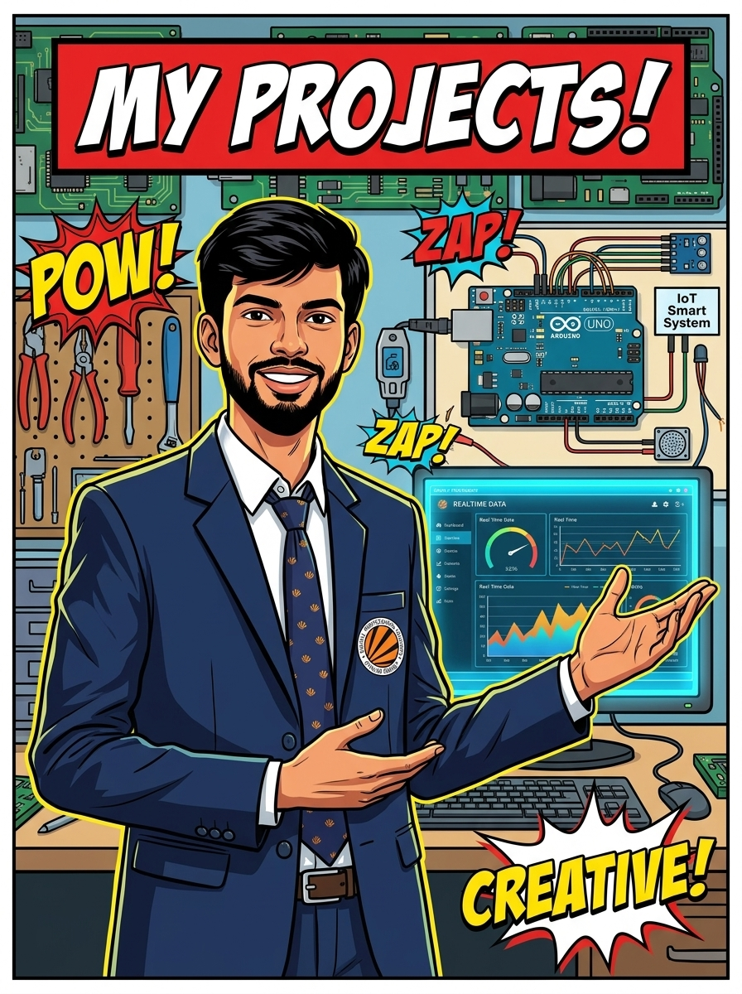
MY PROJECTS
Smart Drip Irrigation System (IoT) | Environmental Alert System

Slide 6
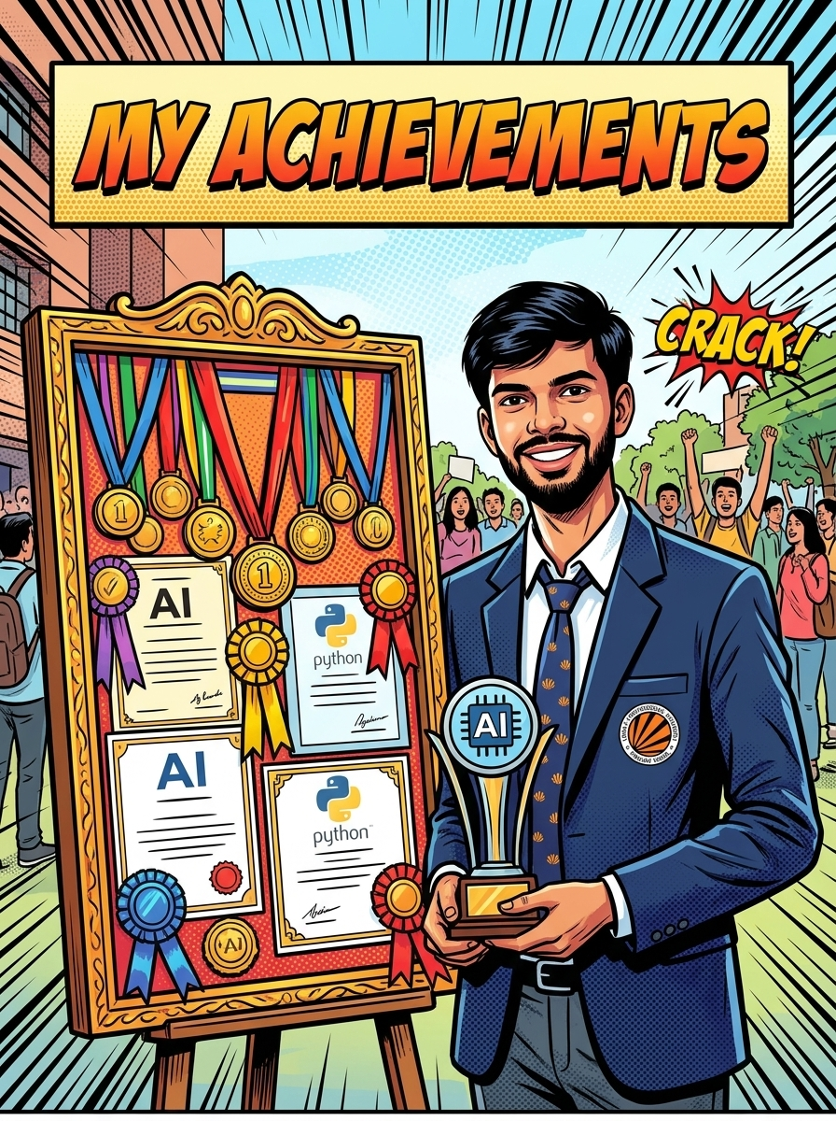
MY ACHIEVEMENTS
Certified in AI (Infosys), Python (Saylor), C Programming (Neo Colab)

Slide 7
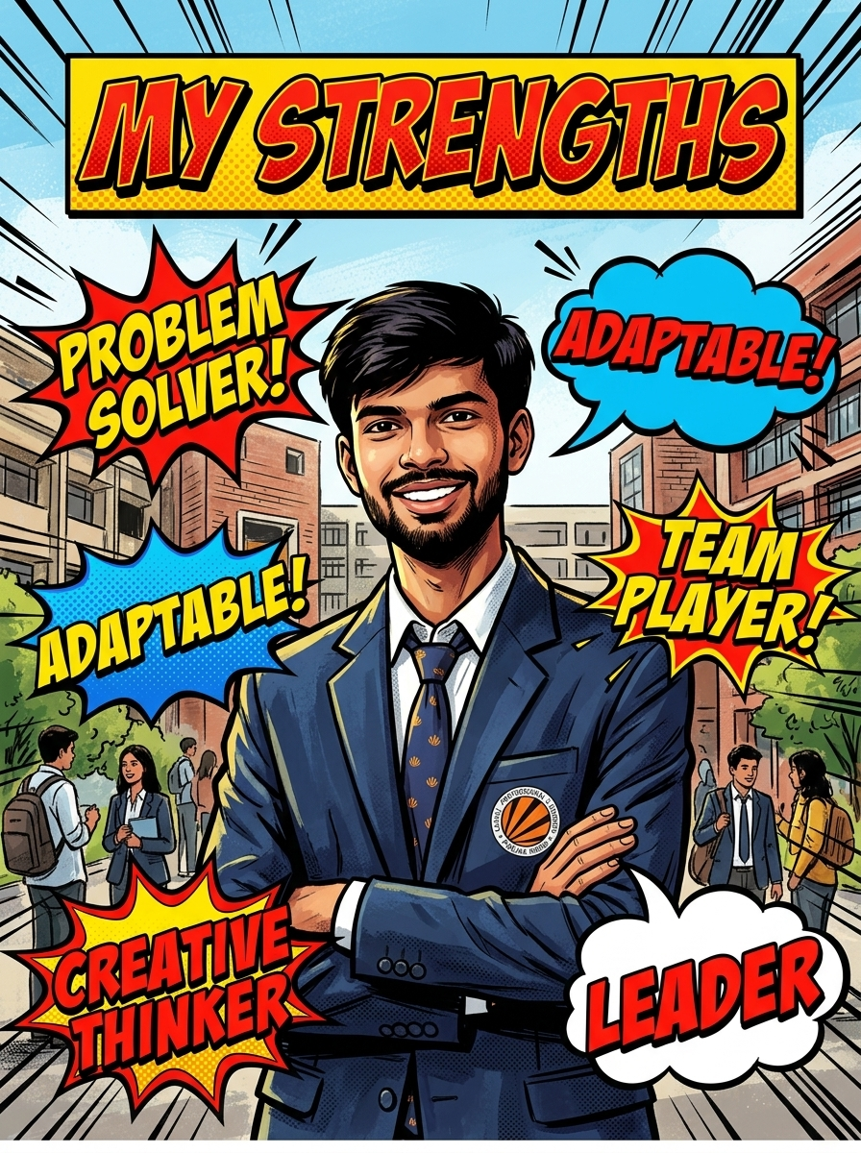
MY STRENGTHS
Problem Solver, Adaptable, Team Player, Time Manager

Slide 8

MY GOAL
Goal: AI & Machine Learning Engineer / Software Developer

