Slide 1
AWS Blockchain Services
Financial Services - Infosys
Dec 2018

Slide 2

Amazon wanted to solve
Ledger with a centralized trusted entity
Complete decentralized trust

Slide 3
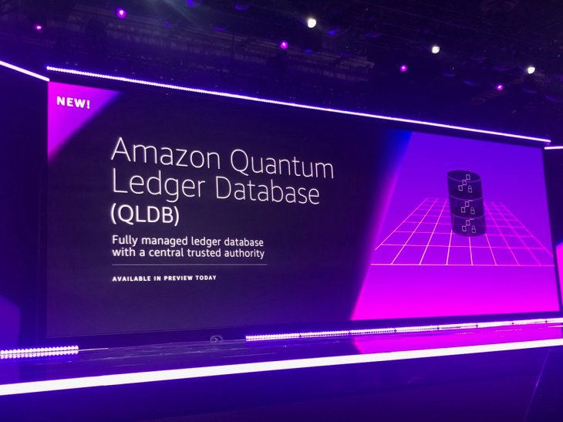

Slide 4
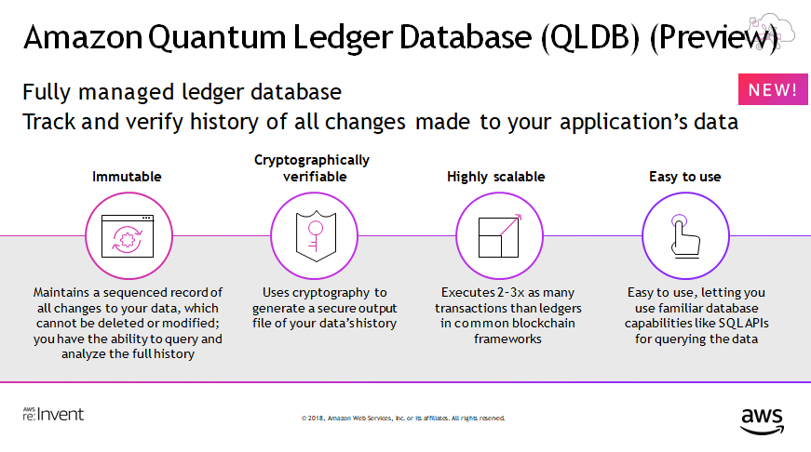

Slide 5
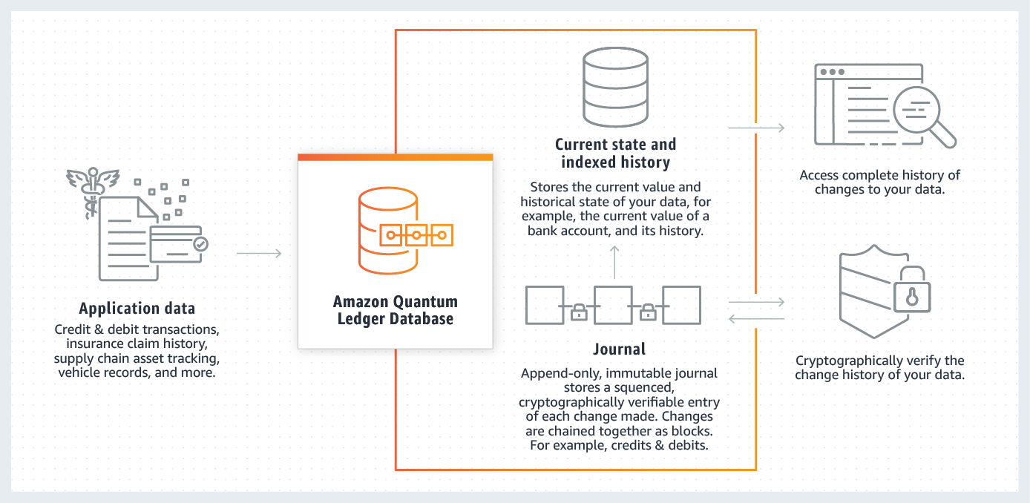
How it works

Slide 6
Amazon QLDB Use cases
Finance
Manufacturing
Insurance
HR & Payroll
Retail & Supply chain

Slide 7
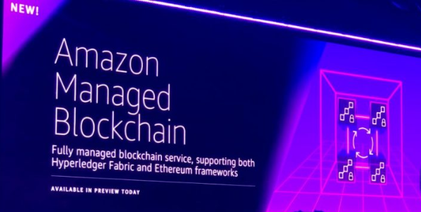

Slide 8
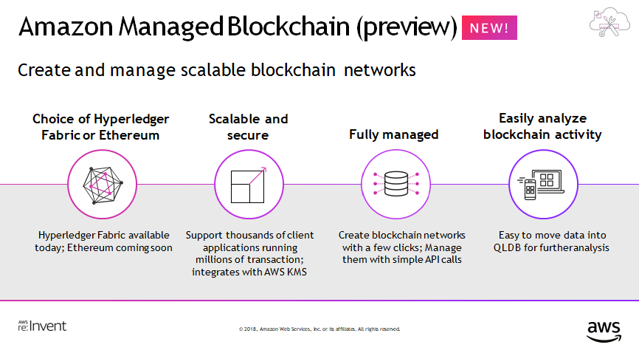

Slide 9
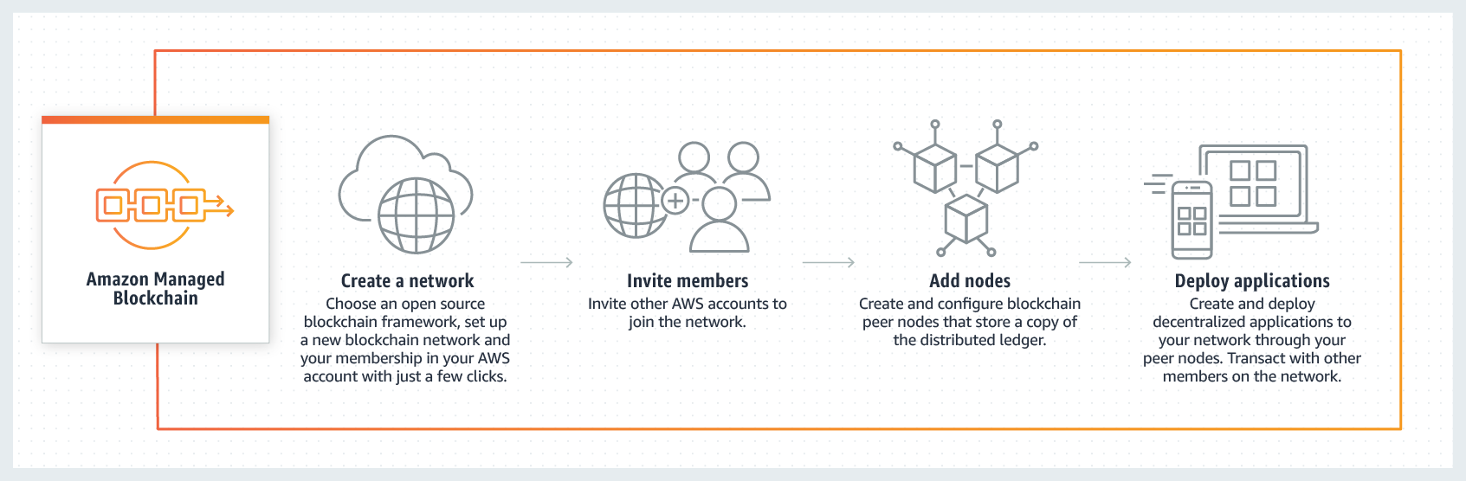
How it works

Slide 10
Amazon Managed Blockchain Use cases
Trading and Asset Transfer
Retail
Supply chain

Slide 11
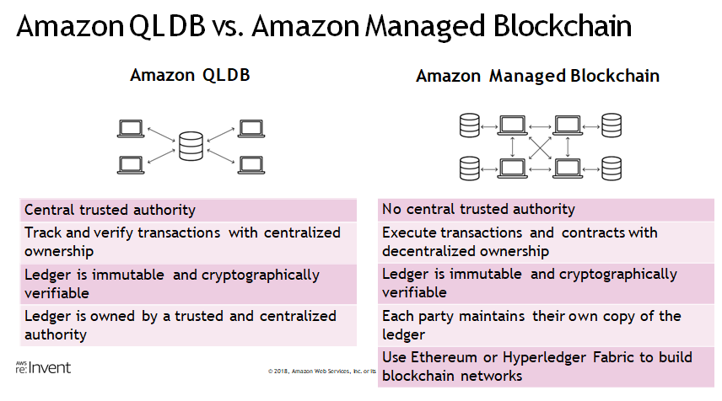

Slide 12
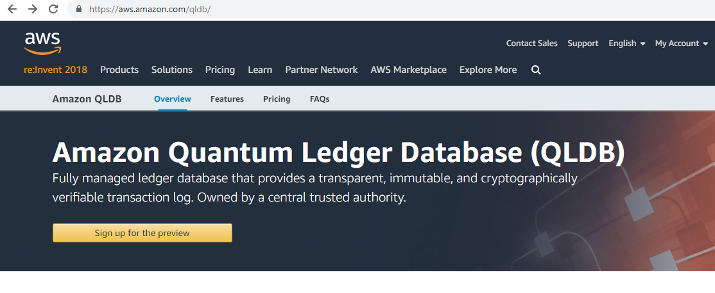
Where to Sign up

Slide 13
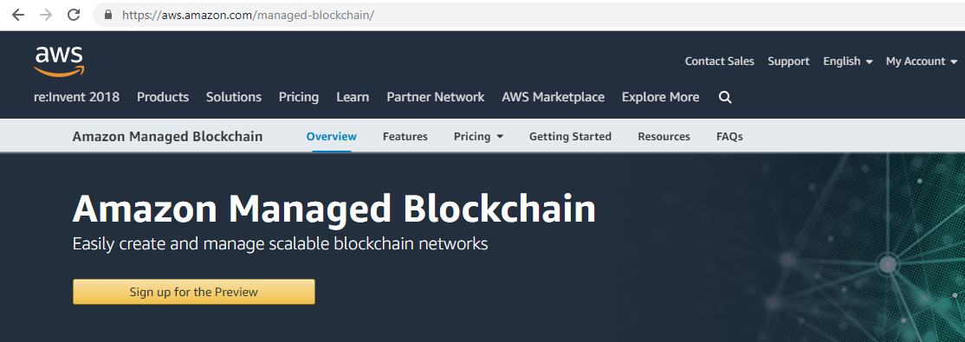
Where to Sign up

Slide 14
Thank you Blockchain@infosys.com

