Slide 1
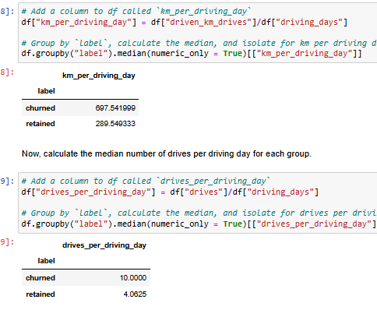
User Churn Project | Preliminary Data Summary
Prepared for: Waze Leadership Team
Project Overview
The Waze data team is currently developing a data analytics project aimed at increasing overall growth by preventing monthly user churn on the Waze app. For the purposes of this project, churn quantifies the number of users who have uninstalled the Waze app or stopped using the app.
COMPLETED STEP(EDA stage)
Explored the dataset, found missing values, found a specific pattern in churned users
There are around 700 rows of missing data(only in the column named ”labels”.
The ratio of device(iPhone and Andriod) had minimal difference in both null and full dataset
The dataset had 82% retained and 17% churned users.
IMP – Users who churned averaged ~3 more drives in the last month than retained users, even though retained users used the app over twice as many days as churned users in the same period
IMP - Median data shows that churned user drove ~200 km more and 2.5 hours more during last month than the median retained user.
IMP - The median user who churned, drove 698 km each day last month, which is almost 240% more than median retained users. Also the ratio of number of drives per day also were the same.
IMP - This data suggests that they are someone who drives a lot, could be long distance truck drivers.
Ratio of iPhone and Android users were also consistent between churned and retained group. These ratios are also consistent with ratios found in the overall datasetr
For the next step, I would request to gather more data related to the profile of the churned users, as they show a clear distinguishing pattern. Or maybe because the app is not meeting their specific needs.
Perform EDA and visualization to gather more information about the data.

