Slide 1
Amgen Pipeline – Select Overview
USA-CBU-81489

Slide 2
Amgen’s Pipeline Is Driven by State-of-the-Art Science (as of January 2023)
39 PRECLINICAL and CLINICAL TARGETS¹
Disease Area | Phase 1 | Phase 2 | Phase 3 | Biosimilars | Approved Products
Bone health¹⁻⁴ | 1 | – | 2 | – | 2
Cardiometabolic diseases^{1,4-6} | 3 | 1 | 1 | – | 2
Hematology/oncology^{1,4,7-20} | 16 | 4 | 5 | 1 | 14
Inflammation^{1,4,21-25} | 1 | 6 | 9 | 2 | 5
Nephrology^{1,4,8,10,26,27} | – | – | 1 | – | 4
Neuroscience^{1,4,28} | – | – | 1 | – | 1
INDUSTRY-LEADING toolkit with
12 drug modalities^{1,a}
INNOVATIVE MOLECULES, NEW INDICATIONS, and BIOSIMILARS
ªModalities in use across the pipeline and marketed products. Modality refers to the structural template of a therapeutic agent.
References: 1. Amgen pipeline. https://www.amgenpipeline.com/-/media/themes/amgen/amgenpipeline-com/amgenpipeline-com/pdf/amgen-pipeline-chart.pdf. Accessed January 16, 2023. 2. EVENITY ® (romosozumab-aqqg) prescribing information, Amgen. 3. Prolia® (denosumab) prescribing information, Amgen. 4. Amgen approved products. https://www.amgenmedinfo.com/s/us/explore-our-medical-products?language=en_US. Accessed January 16, 2023. 5. Corlanor® (ivabradine) prescribing information, Amgen. 6. Repatha® (evolocumab) prescribing information, Amgen. 7. LUMAKRAS™ (sotorasib) prescribing information, Amgen. 8. Aranesp® (darbepoetin alfa) prescribing information, Amgen. 9. BLINCYTO® (blinatumomab) prescribing information, Amgen. 10. EPOGEN® (epoetin alfa) prescribing information, Amgen. 11. IMLYGIC® (talimogene laherparepvec) prescribing information, BioVex, Inc., a subsidiary of Amgen Inc. 12. KANJINTI™ (trastuzumab-anns) prescribing information, Amgen. 13. KYPROLIS® (carfilzomib) prescribing information, Onyx Pharmaceuticals Inc., an Amgen Inc. subsidiary. 14. MVASI® (bevacizumab-awwb) prescribing information, Amgen. 15. Neulasta® (pegfilgrastim) prescribing information, Amgen. 16. NEUPOGEN® (filgrastim) prescribing information, Amgen. 17. Nplate® (romiplostim) prescribing information, Amgen. 18. Vectibix® (panitumumab) prescribing information, Amgen. 19. XGEVA® (denosumab) prescribing information, Amgen. 20. RIABNI™ (rituximab-arrx) prescribing information, Amgen. 21. Amjevita™ (adalimumab-atto) prescribing information, Amgen. 22. AVSOLA™ (infliximab-axxq) prescribing information, Amgen. 23. Enbrel® (etanercept) prescribing information, Amgen. 24. OTEZLA® (apremilast) prescribing information, Amgen. 25. TEZSPIRE® (tezepelumab-ekko) prescribing information, Amgen. 26. Parsabiv® (etelcalcetide) prescribing information, Amgen. 27. Sensipar® (cinacalcet) prescribing information, Amgen. 28. Aimovig® (erenumab-aooe) prescribing information, Amgen.
Notes:
Amgen pipeline. https://www.amgenpipeline.com/-/media/themes/amgen/amgenpipeline-com/amgenpipeline-com/pdf/amgen-pipeline-chart.pdf. Accessed January 16, 2023: 1-Table 1; 4-Table 1; 5-Table 1; 6-Table 1; 7-Table 1; 8-Table 1; 9-Table 1
Amgen pipeline. https://www.amgenpipeline.com/-/media/themes/amgen/amgenpipeline-com/amgenpipeline-com/pdf/amgen-pipeline-chart.pdf. Accessed January 16, 2023: 1-Table 1; 2-Table 1; 3-Table 1; 4-Table 1; 5-Table 1 ; 6-Table 1; 7-Table 1; 8-Table 1; 9-Table 1; 10-Table 1; 11-Table 1
Amgen pipeline. https://www.amgenpipeline.com/-/media/themes/amgen/amgenpipeline-com/amgenpipeline-com/pdf/amgen-pipeline-chart.pdf. Accessed January 16, 2023: 1-Table 1; 2-Table 1; 3-Table 1; 4-Table 1; 5-Table 1 ; 6-Table 1; 7-Table 1; 8-Table 1; 9-Table 1; 10-Table 1; 11-Table 1
Amgen pipeline. https://www.amgenpipeline.com/-/media/themes/amgen/amgenpipeline-com/amgenpipeline-com/pdf/amgen-pipeline-chart.pdf. Accessed January 16, 2023 : 2-Table 1; 5-Table 1
Amgen pipeline. https://www.amgenpipeline.com/-/media/themes/amgen/amgenpipeline-com/amgenpipeline-com/pdf/amgen-pipeline-chart.pdf. Accessed January 16, 2023: 5-Table 1 ; 7-Table 1; 9-Table 1; 11-Table 1
Amgen pipeline. https://www.amgenpipeline.com/-/media/themes/amgen/amgenpipeline-com/amgenpipeline-com/pdf/amgen-pipeline-chart.pdf. Accessed January 16, 2023: 1-Table 1; 2-Table 1; 3-Table 1; 4-Table 1; 5-Table 1 ; 6-Table 1; 7-Table 1; 8-Table 1; 9-Table 1; 10-Table 1; 11-Table 1
Aimovig (erenumab-aooe). PI. Amgen. 11/2021: 1-A-4
Amjevita (adalimumab-atto). PI. Amgen. 7/2022: 1-A-8
Avsola (infliximab-axxq). PI. Amgen. 9/2021: 1-A-9
Enbrel (etanercept). PI. Amgen. 6/2022: 1-A-9
Otezla (apremilast). PI. Amgen. 12/2021: 1-A-5
Amgen pipeline. https://www.amgenpipeline.com/-/media/themes/amgen/amgenpipeline-com/amgenpipeline-com/pdf/amgen-pipeline-chart.pdf. Accessed January 16, 2023: 4-Table 1
Aranesp (darbepoetin alfa). PI. Amgen. 1/2019: 1-A-5
Epogen (epoetin alfa). PI. Amgen. 7/2018: 1-A-10
Parsabiv (etelcalcetide). PI. Amgen. 2/2021: 1-A-3
Sensipar (cinacalcet). PI. Amgen. 12/2019: 1-A-3
Evenity (romosozumab-aqqg). PI. Amgen 4/2020: 1-A-6
Prolia (denosumab). PI. Amgen 1/2023: 1-A-5
Corlanor (ivabradine). PI. Amgen. 8/2021: 1-A-4
Repatha (evolocumab). PI. Amgen. 9/2021: 1-A-8
Amgen pipeline. https://www.amgenpipeline.com/-/media/themes/amgen/amgenpipeline-com/amgenpipeline-com/pdf/amgen-pipeline-chart.pdf. Accessed January 16, 2023: 1-Table 1; 2-Table 1; 3-Table 1; 7-Table 1; 8-Table 1; 9-Table 1; 10-Table 1; 11-Table 1
Aranesp (darbepoetin alfa). PI. Amgen. 1/2019: 1-A-6
Blincyto (blinatumomab) PI. Amgen. 2/2022: 1-A-5
Epogen (epoetin alfa). PI. Amgen. 7/2018: 1-A-10
Imlygic (talimogene laherparepvec) PI. BioVex. 6/2022: 1-A-5
Kanjinti (trastuzumab-anns). PI. Amgen. 10/2022: 1-A-7; 1-A-8
Kyprolis (carfilzomib). PI. Amgen. 6/2022: 1-A-7
Mvasi (bevacizumab-awwb). PI. Amgen. 11/2021: 1-A-8
Neulasta (pegfilgrastim). PI. Amgen. 2/2021: 1-A-5; 1-A-6; 1-A-7
Neupogen (filgrastim). PI. Amgen. 2/2021: 1-A-4; 1-A-5; 1-A-6; 1-A-7; 1-A-8; 1-A-9; 1-A-10
Nplate (romiplostim). PI. Amgen. 2/2022: 1-A-4; 1-A-5
Vectibix (panitumumab). PI. Amgen. 8/2021: 1-A-5
Riabni (rituximab-arrx). PI. Amgen. 6/2022: 1-A-12
Xgeva (denosumab). PI. Amgen. 6/2020: 1-A-4
Tezspire (tezepelumab-ekko). PI. Amgen. 12/2021: 1-A-3
Amgen Medinfo. Amgen Approved products. https://www.amgenmedinfo.com/s/us/explore-our-medical-products?language=en_US. Accessed January 16, 2023: 3-A-3; 3-A-4; 6-A-1; 6-A-2
Amgen Medinfo. Amgen Approved products. https://www.amgenmedinfo.com/s/us/explore-our-medical-products?language=en_US. Accessed January 16, 2023: 2-A-5; 2-A-6; 6-A-3; 6-A-4
Amgen Medinfo. Amgen Approved products. https://www.amgenmedinfo.com/s/us/explore-our-medical-products?language=en_US. Accessed January 16, 2023: 1-A-5; 1-A-7; 2-A-3; 2-A-4; 3-A-1; 3-A-2; 3-A-5; 3-A-6; 3-A-7; 4-A-1; 4-A-2; 4-A-3; 4-A-4; 4-A-5; 4-A-6; 4-A-7; 4-A-8; 4-A-9; 5-A-1; 5-A-2; 5-A-3; 5-A-4; 6-A-5; 6-A-6; 7-A-3; 7-A-4; 7-A-5; 7-A-6
Amgen Medinfo. Amgen Approved products. https://www.amgenmedinfo.com/s/us/explore-our-medical-products?language=en_US. Accessed January 16, 2023: 1-A-1; 1-A-2
Amgen Medinfo. Amgen Approved products. https://www.amgenmedinfo.com/s/us/explore-our-medical-products?language=en_US. Accessed January 16, 2023: 1-A-3; 1-A-4; 2-A-1; 2-A-2; 2-A-7; 2-A-8; 5-A-5; 5-A-6; 7-A-1; 7-A-2
Amgen Medinfo. Amgen Approved products. https://www.amgenmedinfo.com/s/us/explore-our-medical-products?language=en_US. Accessed January 16, 2023: 1-A-5; 1-A-6; 3-A-1; 3-A-2; 5-A-7; 5-A-8; 6-A-7; 6-A-8
LUMAKRAS. (sotorasib). PI. Amgen. 11/2022: 1-A-3
Amgen pipeline. https://www.amgenpipeline.com/-/media/themes/amgen/amgenpipeline-com/amgenpipeline-com/pdf/amgen-pipeline-chart.pdf. Accessed January 16, 2023: 1-Table 1

Slide 3
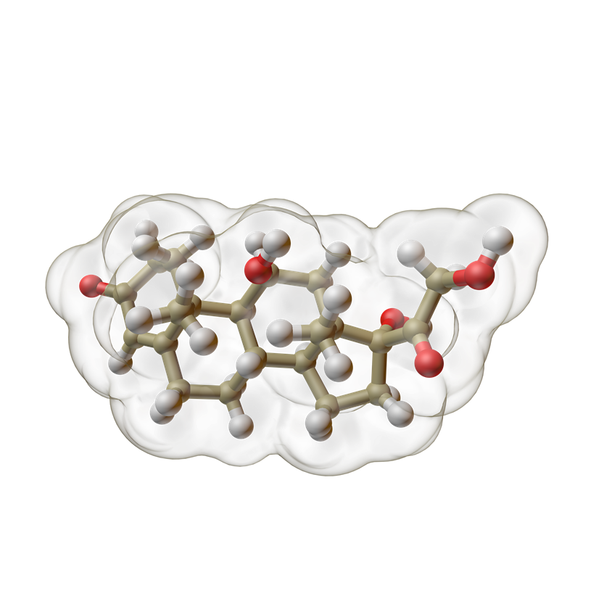
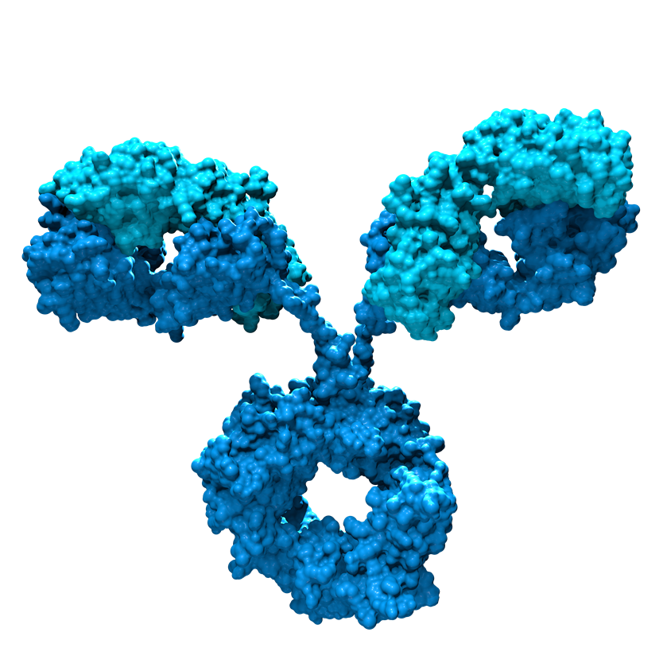
Select Data From the General Medicine Pipeline 2023–2026
Modality | Molecule | MOA | Phase | Investigational Indication | Estimated PCD or Information
 | Otezla¹ (apremilast) | PDE4 inhibitor | 3 | Pediatric plaque psoriasis (SPROUT)² Genital psoriasis (DISCREET)³ | Actual PCD: April 25, 2022² Actual PCD: September 23, 2021³
 | Tezspire^{1,a} (tezepelumab-ekko) | TSLP inhibitor | 3 | Severe chronic rhinosinusitis with nasal polyposis (WAYPOINT)⁴ | PCD: August 2, 2024⁴
 | Rocatinlimab¹ (Formerly AMG 451) | OX40 inhibitor | 3 | Moderate to severe atopic dermatitis (ROCKET-IGNITE)⁵ | PCD: January 6, 2025⁵
Small Molecule
Monoclonal Antibody
ªFDA approval received after priority review.⁶
FDA, Food and Drug Administration; MOA, mechanism of action; PCD, primary completion date; PDE4, phosphodiesterase 4; TSLP, thymic stromal lymphopoietin
References: 1. Amgen pipeline. https://www.amgenpipeline.com/-/media/themes/amgen/amgenpipeline-com/amgenpipeline-com/pdf/amgen-pipeline-chart.pdf. Accessed January 16, 2023.
2. ClinicalTrials.gov. https://clinicaltrials.gov/ct2/show/NCT03701763. Accessed January 16, 2023. 3. ClinicalTrials.gov. https://clinicaltrials.gov/ct2/show/NCT03777436. Accessed January 16, 2023.
4. ClinicalTrials.gov. https://clinicaltrials.gov/ct2/show/NCT04851964. Accessed January 16, 2023. 5. ClinicalTrials.gov. https://clinicaltrials.gov/ct2/show/NCT05398445. Accessed January 16, 2023.
6. Amgen News Release. https://www.amgen.com/newsroom/press-releases/2021/12/fda-approves-tezspire-tezepelumabekko-in-the-us-for-severe-asthma. Accessed January 16, 2023.
Pipeline information as of January 16, 2023.
Notes:
ClinicalTrials.gov. https://clinicaltrials.gov/ct2/show/NCT03701763. Accessed January 16, 2023. 2-A-10; 8-A-8
ClinicalTrials.gov. NCT03777436. https://clinicaltrials.gov/ct2/show/NCT03777436. Accessed January 16, 2023: 3-A-2
ClinicalTrials.gov. NCT04851964. https://clinicaltrials.gov/ct2/show/NCT04851964. Accessed January 16, 2023: 3-A-3
ClinicalTrials.gov. https://clinicaltrials.gov/ct2/show/NCT05398445. Accessed January 16, 2023:2-A-9
Amgen pipeline. https://www.amgenpipeline.com/-/media/themes/amgen/amgenpipeline-com/amgenpipeline-com/pdf/amgen-pipeline-chart.pdf. Accessed January 16, 2023: 4-Table 1
Amgen pipeline. https://www.amgenpipeline.com/-/media/themes/amgen/amgenpipeline-com/amgenpipeline-com/pdf/amgen-pipeline-chart.pdf. Accessed January 16, 2023: 5-Table 1
ClinicalTrials.gov. https://clinicaltrials.gov/ct2/show/NCT05398445. Accessed January 16, 2023: 1-Title; 2-A-7
ClinicalTrials.gov. https://clinicaltrials.gov/ct2/show/NCT03701763. Accessed January 16, 2023. 2-A-12
ClinicalTrials.gov. NCT03777436. https://clinicaltrials.gov/ct2/show/NCT03777436. Accessed January 16, 2023: 1-Title; 2-A-10
ClinicalTrials.gov. NCT04851964. https://clinicaltrials.gov/ct2/show/NCT04851964. Accessed January 16, 2023: 2-A-11; 3-A-1
Amgen Press Releases. FDA approves TEZSPIRE™ (Tezepelumab ekko) in the U.S. for severe asthma. https://www.amgen.com/newsroom/press-releases/2021/12/fda-approves-tezspire-tezepelumabekko-in-the-us-for-severe-asthma. Accessed January 16, 2023: 1-A-4
Amgen pipeline. https://www.amgenpipeline.com/-/media/themes/amgen/amgenpipeline-com/amgenpipeline-com/pdf/amgen-pipeline-chart.pdf. Accessed January 16, 2023: 5-Table 1

Slide 4
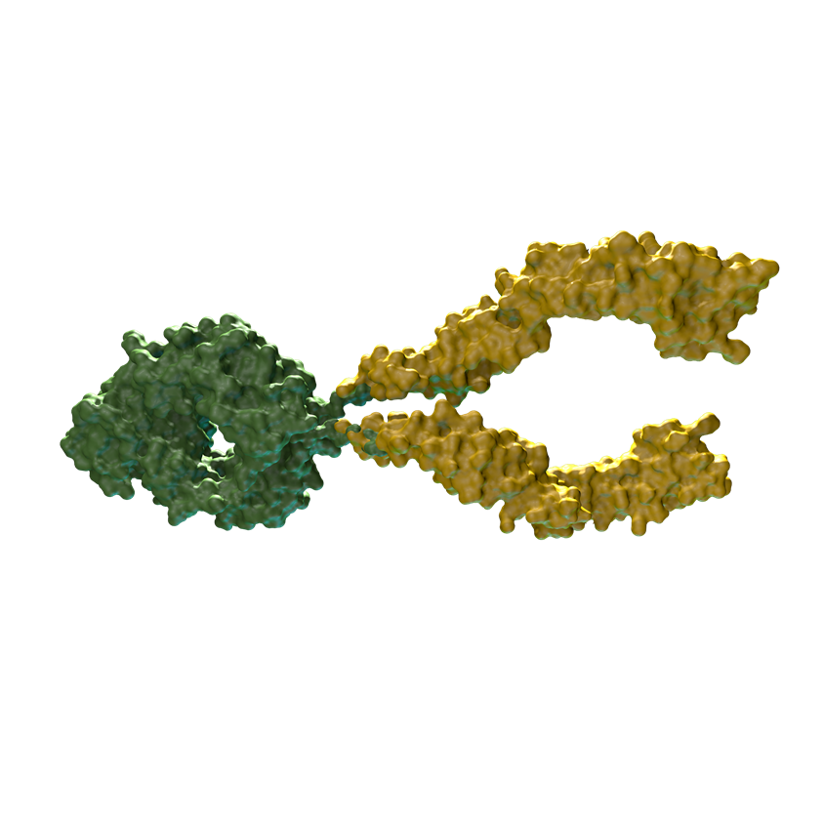
Select Data From the Biosimilar Pipeline 2023–2026
Modality | Molecule | MOA | Phase | Investigational Indication | Estimated PCD or Information
 | Amjevita¹⁻³ (HUMIRA® biosimilar)ª | TNF-alpha inhibitor | 3 | Moderate to severe plaque psoriasis (interchangeability trial)⁴ | Actual PCD: December 19, 2022⁴
 | ABP 654¹ (STELARA® biosimilar)^{b} | IL-12 and IL-23 inhibitor | 3 | STELARA® biosimilar, currently under study for moderate to severe plaque psoriasis (interchangeability trial)^{5,6} | Actual PCD: January 13, 2022; PCD: March 9, 2023^{5,6}
 | ABP 959 (SOLIRIS® biosimilar)^{1,b} | Anti-C5 mAb | 3 | SOLIRIS® biosimilar, currently under study for paroxysmal nocturnal hemoglobinuria (DAHLIA)⁷ | Actual PCD: July 12, 2022⁷
 | ABP 938¹ (EYLEA® biosimilar)^{b} | VEGF inhibitor | 3 | EYLEA® biosimilar, currently under study for neovascular (wet) AMD⁸ | Actual PCD: July 18, 2022⁸
Monoclonal Antibody
Fusion Protein
ªThis is for informational purposes only. This is not an offer for sale. AMJEVITA™ is currently not available commercially and will not be commercially available in the United States until or after January 31, 2023. AMGEVITA® has been launched in Europe.
^{b}This is for informational purposes only. This is not an offer for sale. ABP 654, ABP 959, and ABP 938 are currently not available commercially and will not be commercially available in the United States until a later date.
AMD, age-related macular degeneration; C5, complement protein 5; IL, interleukin; mAb, monoclonal antibody; MOA, mechanism of action; PCD, primary completion date; TNF, tumor necrosis factor; VEGF, vascular endothelial growth factor. STELARA® is a registered trademark of Johnson & Johnson. SOLIRIS® is a registered trademark of Alexion Pharmaceuticals, Inc. EYLEA® is a registered trademark of Regeneron Pharmaceuticals, Inc.
References: 1. Amgen pipeline. https://www.amgenpipeline.com/-/media/themes/amgen/amgenpipeline-com/amgenpipeline-com/pdf/amgen-pipeline-chart.pdf. Accessed January 16, 2023. 2. Amgen News Release. https://www.prnewswire.com/news-releases/amgen-and-abbvie-agree-to-settlement-allowing-commercialization-of-amgevita-300527303.html. Accessed January 16, 2023. 3. Amjevita™ (adalimumab-atto) prescribing information, Amgen. 4. ClinicalTrials.gov. https://clinicaltrials.gov/ct2/show/NCT05073315. Accessed January 16, 2023. 5. ClinicalTrials.gov. https://clinicaltrials.gov/ct2/show/NCT04607980. Accessed January 16, 2023. 6. ClinicalTrials.gov. https://clinicaltrials.gov/ct2/show/NCT04761627. Accessed January 16, 2023. 7. ClinicalTrials.gov. https://clinicaltrials.gov/ct2/show/NCT03818607. Accessed January 16, 2023. 8. ClinicalTrials.gov. https:// https://clinicaltrials.gov/ct2/show/NCT04270747. Accessed January 16, 2023.
Pipeline information as of January 16, 2023.
Notes:
Amgen News Release. https://www.prnewswire.com/news-releases/amgen-and-abbvie-agree-to-settlement-allowing-commercialization-of-amgevita-300527303.html. Accessed January 16, 2023: 1-A-1
ClinicalTrials.gov. NCT05073315. https://clinicaltrials.gov/ct2/show/NCT05073315. Accessed January 16, 2023: 2-A-8
ClinicalTrials.gov. https://clinicaltrials.gov/ct2/show/NCT04607980. Accessed January 16, 2023: 3-A-5
Amgen pipeline. https://www.amgenpipeline.com/-/media/themes/amgen/amgenpipeline-com/amgenpipeline-com/pdf/amgen-pipeline-chart.pdf. Accessed January 16, 2023: 6-Table 1
Amgen pipeline. https://www.amgenpipeline.com/-/media/themes/amgen/amgenpipeline-com/amgenpipeline-com/pdf/amgen-pipeline-chart.pdf. Accessed January 16, 2023: 6-Table 1
ClinicalTrials.gov. https://clinicaltrials.gov/ct2/show/NCT04761627. Accessed January 16, 2023: 3-A-3
ClinicalTrials.gov. NCT04270747. https://clinicaltrials.gov/ct2/show/NCT04270747. Accessed January 16, 2023: 3-A-3
ClinicalTrials.gov. NCT05073315. https://clinicaltrials.gov/ct2/show/NCT05073315. Accessed January 16, 2023: 2-A-10
Amgen pipeline. https://www.amgenpipeline.com/-/media/themes/amgen/amgenpipeline-com/amgenpipeline-com/pdf/amgen-pipeline-chart.pdf. Accessed January 16, 2023: 1-Table 1
ClinicalTrials.gov. https://clinicaltrials.gov/ct2/show/NCT04607980. Accessed January 16, 2023: 3-A-3
Amgen pipeline. https://www.amgenpipeline.com/-/media/themes/amgen/amgenpipeline-com/amgenpipeline-com/pdf/amgen-pipeline-chart.pdf. Accessed January 16, 2023: 6-Table 1
ClinicalTrials.gov. https://clinicaltrials.gov/ct2/show/NCT04761627. Accessed January 16, 2023: 3-A-1
ClinicalTrials.gov. NCT04270747. https://clinicaltrials.gov/ct2/show/NCT04270747. Accessed January 16, 2023: 3-A-5
Amgen pipeline. https://www.amgenpipeline.com/-/media/themes/amgen/amgenpipeline-com/amgenpipeline-com/pdf/amgen-pipeline-chart.pdf. Accessed January 16, 2023: 7-Table 1
ClinicalTrials.gov. NCT03818607. https://clinicaltrials.gov/ct2/show/ NCT03818607. Accessed January 16, 2023: 2-A-10
ClinicalTrials.gov. NCT03818607. https://clinicaltrials.gov/ct2/show/ NCT03818607. Accessed January 16, 2023: 1-Title; 2-A-8
Amjevita (adalimumab-atto). PI. Amgen. 7/2022: 1-A-8
Amgen pipeline. https://www.amgenpipeline.com/-/media/themes/amgen/amgenpipeline-com/amgenpipeline-com/pdf/amgen-pipeline-chart.pdf. Accessed January 16, 2023: 6-Table 1

Slide 5
Select Data From the Oncology Pipeline 2023–2026ª
Modality | Molecule | MOA | Phase | Investigational Indication | Estimated PCD or Information
 | LUMAKRASTM (sotorasib)^{1,b,c} | KRAS G12C inhibitor | 3 | Advanced metastatic non-small cell lung cancer with KRAS p.G12C mutation (CodeBreak 200)² | Actual PCD: August 2, 2022²
 |  |  | 1b | KRAS p.G12C mutation–harboring, advanced non-small cell lung cancer with brain metastases (CodeBreak 101)³ | PCD: December 9, 2024³
 | LUMAKRASTM (sotorasib)¹ + Vectibix® (panitumumab)⁴ vs Investigator’s choice^{5,d} | KRAS G12C inhibitor + EGFR inhibitor vs Other anti-cancer therapies | 3 | Advanced metastatic colorectal cancer with KRAS p.G12C mutation (CodeBreak 300)⁵ | PCD: April 18, 2023⁵
 | LUMAKRASTM (sotorasib)¹ in combinations³ | KRAS G12C inhibitor + Other anti-cancer therapies | 1b/2 | KRAS p.G12C mutation–harboring, advanced non-small cell lung cancer, colorectal cancer, and other solid tumors (CodeBreak 101)³ | PCD: December 9, 2024³
Small Molecule
Small Molecule + Other Treatment Modalities
ªSome oncology timelines can change.
^{b}FDA fast-track approval received after undergoing priority review under the breakthrough therapy and orphan drug designation.⁶
^{c}Sotorasib was given conditional approval by the FDA as the first KRAS G12C inhibitor in adults with KRAS G12C–mutated non-small cell lung cancer who had at least one prior systemic therapy; phase 3 is the confirmatory trial.⁷
^{d}Investigator’s choice (trifluiridine and tipiracil, or regorafenib).⁵
EGFR, epidermal growth factor receptor; FDA, Food and Drug Administration; KRAS, Kirsten rat sarcoma viral oncogene homolog; KRAS G12C, KRAS mutation with amino acid substitution at position 12 from glycine to cysteine; MOA, mechanism of action; PCD, primary completion date.
References: 1. Amgen pipeline. https://www.amgenpipeline.com/-/media/themes/amgen/amgenpipeline-com/amgenpipeline-com/pdf/amgen-pipeline-chart.pdf. Accessed January 16, 2023. 2. ClinicalTrials.gov. https://clinicaltrials.gov/ct2/show/NCT04303780. Accessed January 16, 2023. 3. ClinicalTrials.gov. https://www.clinicaltrials.gov/ct2/show/NCT04185883. Accessed January 16, 2023. 4. Amgen Press Release. https://www.amgen.com/newsroom/press-releases/2021/09/lumakras-sotorasib-combined-with-vectibix-panitumumab-showed-encouraging-efficacy-and-safety-in-patients-with-kras-g12cmutated-colorectal-cancer. Accessed January 16, 2023. 5. ClinicalTrials.gov. https://clinicaltrials.gov/ct2/show/NCT05198934. Accessed January 16, 2023. 6. US FDA. https://www.fda.gov/drugs/resources-information-approved-drugs/fda-grants-accelerated-approval-sotorasib-kras-g12c-mutated-nsclc. Accessed January 16, 2023. 7. Zhang SS, et al. Lung Cancer (Auckl). 2021;12:115-122.
Pipeline information as of January 16, 2023.
Notes:
Amgen pipeline. https://www.amgenpipeline.com/-/media/themes/amgen/amgenpipeline-com/amgenpipeline-com/pdf/amgen-pipeline-chart.pdf. Accessed January 16, 2023: 3-Table 1
ClinicalTrials.gov. NCT04303780. https://clinicaltrials.gov/ct2/show/NCT04303780. Accessed January 16, 2023: 2-A-10
Amgen Press Release. https://www.amgen.com/newsroom/press-releases/2021/09/lumakras-sotorasib-combined-with-vectibix-panitumumab-showed-encouraging-efficacy-and-safety-in-patients-with-kras-g12cmutated-colorectal-cancer. Accessed January 16, 2023: 1-A-3
ClinicalTrials.gov. NCT05198934. https://clinicaltrials.gov/ct2/show/NCT05198934. Accessed January 16, 2023: 1-Title; 2-A-8
ClinicalTrials.gov. NCT05198934. https://clinicaltrials.gov/ct2/show/NCT05198934. Accessed January 16, 2023:1-A-7; 2-A-1
ClinicalTrials.gov. NCT04185883 https://www.clinicaltrials.gov/ct2/show/NCT04185883. Accessed January 16, 2023: 3-A-4
ClinicalTrials.gov. NCT05198934. https://clinicaltrials.gov/ct2/show/NCT05198934. Accessed January 16, 2023: 2-A-10
Zhang SS, et al. Lung Cancer (Auckl). 2021: 119-B-3; 119-B-4
US FDA. FDA grants accelerated approval to sotorasib for KRAS G12C mutated NSCLC. https://www.fda.gov/drugs/resources-information-approved-drugs/fda-grants-accelerated-approval-sotorasib-kras-g12c-mutated-nsclc. Accessed January 16, 2023: 2-A-4
ClinicalTrials.gov. NCT04303780. https://clinicaltrials.gov/ct2/show/NCT04303780. Accessed January 16, 2023: 1-Title; 2-A-8
ClinicalTrials.gov. NCT04185883. https://www.clinicaltrials.gov/ct2/show/NCT04185883. Accessed January 16, 2023: 3-A-2; 3-Table 1; 4-Table 1; 5-Table 1; 6-Table 1; 7-Table 1
ClinicalTrials.gov. NCT04185883 https://www.clinicaltrials.gov/ct2/show/NCT04185883. Accessed January 16, 2023: 3-A-2; 5 Table 1
Amgen pipeline. https://www.amgenpipeline.com/-/media/themes/amgen/amgenpipeline-com/amgenpipeline-com/pdf/amgen-pipeline-chart.pdf. Accessed January 16, 2023: 3-Table 1
ClinicalTrials.gov. NCT04185883. https://www.clinicaltrials.gov/ct2/show/NCT04185883. Accessed January 16, 2023: 3-A-4
ClinicalTrials.gov. NCT04185883. https://www.clinicaltrials.gov/ct2/show/NCT04185883. Accessed January 16, 2023: 3-Table 1; 4-Table 1; 5-Table 1; 6-Table 1; 7-Table 1
Amgen pipeline. https://www.amgenpipeline.com/-/media/themes/amgen/amgenpipeline-com/amgenpipeline-com/pdf/amgen-pipeline-chart.pdf. Accessed January 16, 2023: 3-Table 1
ClinicalTrials.gov. NCT05198934. https://clinicaltrials.gov/ct2/show/NCT05198934. Accessed January 16, 2023:1-A-7; 2-A-1

Slide 6
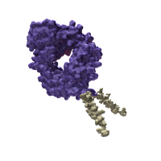
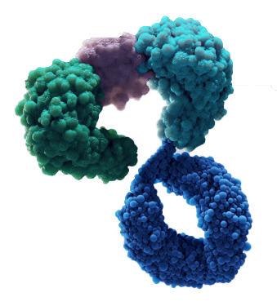

Select Data From the Oncology Pipeline 2023–2026ª (Continued)
Modality | Molecule | MOA | Phase | Investigational Indication | Estimated PCD or Information
 | Bemarituzumab^{1,b} | FGFR2b inhibitor | 3 | Advanced gastric cancer/gastroesophageal junction cancer (FORTITUDE-101)² | PCD: August 18, 2025²
 | Nplate® (romiplostim)¹ | TPO-RA agonist | 3 | Chemotherapy-induced thrombocytopenia (RECITE; PROCLAIM)^{3,4} | PCD: August 29, 2023; PCD: April 28, 2024^{3,4}
 | TARLATAMAB (formerly AMG 757)¹ | HLE anti-DLL3 x anti-CD3 | 2 | Relapsed/refractory small cell lung cancer (DeLLphi-301)⁵ | PCD: June 21, 2023⁵
 | Kyprolis® (carfilzomib)^{1,6} | Proteasome inhibitor | 3 | Relapsed/refractory multiple myeloma (ARROW-2)⁷ | PCD: February 28, 2023⁷
 |  |  | 2 | Pediatric relapsed/refractory acute lymphoblastic leukemia⁸ | PCD: February 22, 2024⁸
Monoclonal Antibody
Peptibody
BiTE® Antibody Construct
Small Molecule
ªSome oncology timelines can change.
^{b}FDA granted breakthrough therapy designation.⁹
BiTE®, bispecific T-cell engager; CD3, cluster of differentiation 3; DLL3, delta-like ligand 3; FDA, Food and Drug Administration; FGFR2b, fibroblast growth factor receptor 2; HLE, half-life extended; MOA, mechanism of action; PCD, primary completion date; TPO-RA, thrombopoietin receptor agonist.
References: 1. Amgen pipeline. https://www.amgenpipeline.com/-/media/themes/amgen/amgenpipeline-com/amgenpipeline-com/pdf/amgen-pipeline-chart.pdf. Accessed January 16, 2023. 2. ClinicalTrials.gov. https://clinicaltrials.gov/ct2/show/NCT05052801. Accessed January 16, 2023. 3. ClinicalTrials.gov. https://clinicaltrials.gov/ct2/show/NCT03362177. Accessed January 16, 2023. 4. ClinicalTrials.gov. https://clinicaltrials.gov/ct2/show/NCT03937154. Accessed January 16, 2023. 5. ClinicalTrials.gov. https://clinicaltrials.gov/ct2/show/NCT05060016. Accessed January 16, 2023. 6. KYPROLIS® (carfilzomib) prescribing information, Onyx Pharmaceuticals Inc., an Amgen Inc. subsidiary. 7. ClinicalTrials.gov. https://clinicaltrials.gov/ct2/show/NCT03859427. Accessed January 16, 2023. 8. ClinicalTrials.gov. https://clinicaltrials.gov/ct2/show/NCT02303821. Accessed January 16, 2023. 9. Amgen Press Releases. https://www.amgen.com/newsroom/press-releases/2021/04/amgens-investigational-targeted-treatment-bemarituzumab-granted-breakthrough-therapy-designation. Accessed January 17, 2023.
Pipeline information as of January 16, 2023.
Notes:
Amgen pipeline. https://www.amgenpipeline.com/-/media/themes/amgen/amgenpipeline-com/amgenpipeline-com/pdf/amgen-pipeline-chart.pdf. Accessed January 16, 2023: 8-Table 1
ClinicalTrials.gov. NCT05060016. https://clinicaltrials.gov/ct2/show/NCT05060016. Accessed January 16, 2022: 1-Title; 2-A-9
Amgen pipeline. https://www.amgenpipeline.com/-/media/themes/amgen/amgenpipeline-com/amgenpipeline-com/pdf/amgen-pipeline-chart.pdf. Accessed January 16, 2023: 1-Table 1
ClinicalTrials.gov. NCT05052801. https://clinicaltrials.gov/ct2/show/NCT05052801. Accessed January 16, 2023: 2-A-10
ClinicalTrials.gov. NCT03362177. https://clinicaltrials.gov/ct2/show/NCT03362177. Accessed January 16, 2023: 2-A-8
ClinicalTrials.gov. NCT03937154. https://clinicaltrials.gov/ct2/show/NCT03937154. Accessed January 16, 2023: 3-A-3
Amgen pipeline. https://www.amgenpipeline.com/-/media/themes/amgen/amgenpipeline-com/amgenpipeline-com/pdf/amgen-pipeline-chart.pdf. Accessed January 16, 2023: 3-Table 1
Amgen Press Releases. Amgen's Investigational Targeted Treatment Bemarituzumab Granted Breakthrough Therapy Designation. https://www.amgen.com/newsroom/press-releases/2021/04/amgens-investigational-targeted-treatment-bemarituzumab-granted-breakthrough-therapy-designation . Accessed January 17, 2023: 1-A-3
ClinicalTrials.gov. NCT05052801. https://clinicaltrials.gov/ct2/show/NCT05052801. Accessed January 16, 2023: 1-Title; 2-A-8
ClinicalTrials.gov. NCT03362177. https://clinicaltrials.gov/ct2/show/NCT03362177. Accessed January 16, 2023: 2-A-10.
ClinicalTrials.gov. NCT03937154. https://clinicaltrials.gov/ct2/show/NCT03937154. Accessed January 16, 2023: 2-A-10; 3-A-1
ClinicalTrials.gov. NCT05060016. https://clinicaltrials.gov/ct2/show/NCT05060016. Accessed January 16, 2023 : 2-A-11
Amgen pipeline. https://www.amgenpipeline.com/-/media/themes/amgen/amgenpipeline-com/amgenpipeline-com/pdf/amgen-pipeline-chart.pdf. Accessed January 16, 2023: 2-Table 1
ClinicalTrials.gov. NCT03859427. https://clinicaltrials.gov/ct2/show/NCT03859427. Accessed January 16, 2023: 2-A-9
ClinicalTrials.gov. NCT03859427. https://clinicaltrials.gov/ct2/show/NCT03859427. Accessed January 16, 2023: 1-Title; 2-A-7
ClinicalTrials.gov. NCT02303821. https://clinicaltrials.gov/ct2/show/NCT02303821. Accessed January 16, 2023: 3-A-3
ClinicalTrials.gov. NCT02303821. https://clinicaltrials.gov/ct2/show/NCT02303821. Accessed January 16, 2023: 3-A-5
Kyprolis (carfilzomib). PI. Amgen. 6/2022: 1-A-7

Slide 7
Thank you

