Slide 1
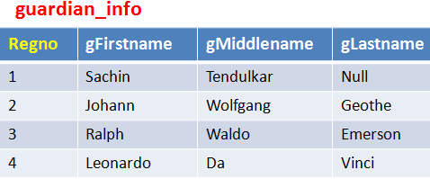
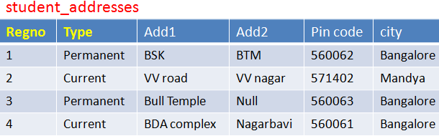
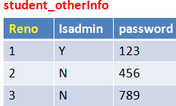
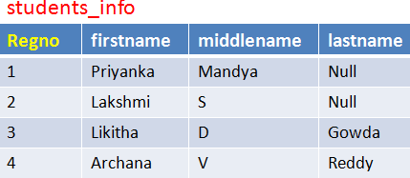
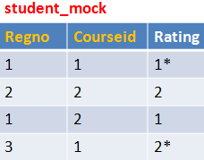
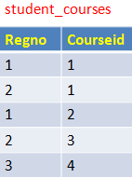
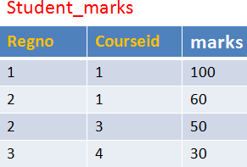
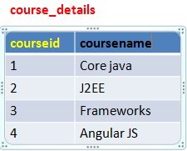
N
1
One to one
One to many
1
1
N
one to one
Many to one
Many to one
Many to many
N
N
N
1

Slide 2
1
1
One to one

Slide 3
1
N
One to many

Slide 4
1
One to many
N

Slide 5
1
Many to many
N
N
1

Slide 6
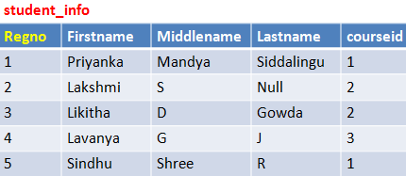
1
N
One to one
One to many
1
NN
N
many to one
Many to one
1
N

Slide 7
One to many

Slide 8
1
1
one to one

