Slide 1
Big Data Challenge
Prediction of Delhi 2015 Elections result using Twitter Data
Team Senti-mentals

Slide 2
Agenda
Objective
Prediction of Vote Share based on basic Text Mining
Approach
Results
Prediction of Vote Share based on Sentiment Analysis
Approach – Naïve Baye’s method
Results
Methodology for Conversion of Vote Share to Seat Share
Learnings

Slide 3
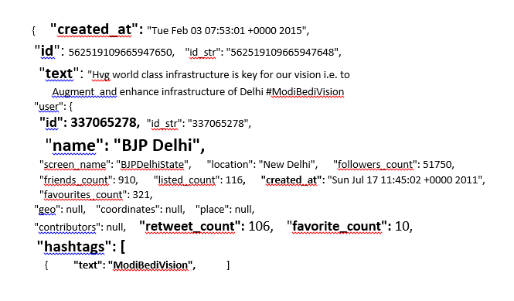
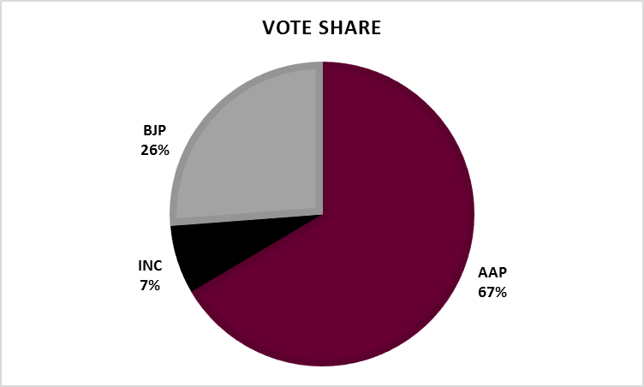
Objective
Predict results of Delhi Election using sentiment analysis with Twitter data
Input
Twitter Data in JSON format
Tweet text
Hashtags
- Twitter Handles
Retweets
Favourites
Candidate-Hashtag Mapping
Output
Party-wise (AAP, BJP, INC)
Vote Share
Seat Share
Solution Methodology
Text Mining
Naïve Bayes based Sentiment Analysis

Slide 4
Methodology: Predictions based on Basic Text Mining
% Vote Share Prediction
Text Mining
Mapped Hashtag to Party
Tagged Tweets to Party based on keywords
Tweet Frequency
Data Preparation
Converted JSON to CSV
Discarded tweets in Hindi
Removed URL & image tweets
Re-Tweet Frequency
Assumptions
Deleted untagged tweets
Inclusion and Exclusion of Tweets tagged to multiple parties
Favourite Frequency

Slide 5
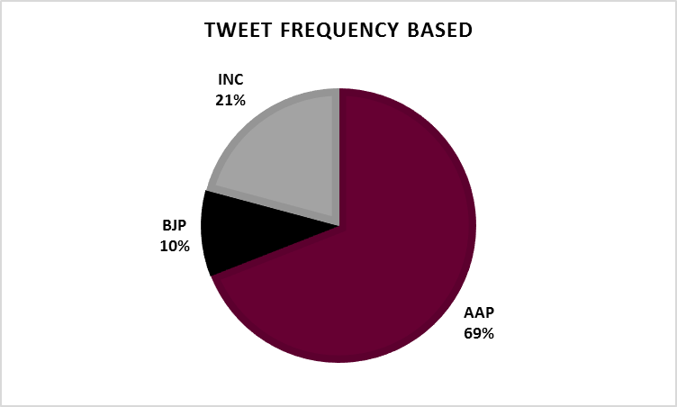
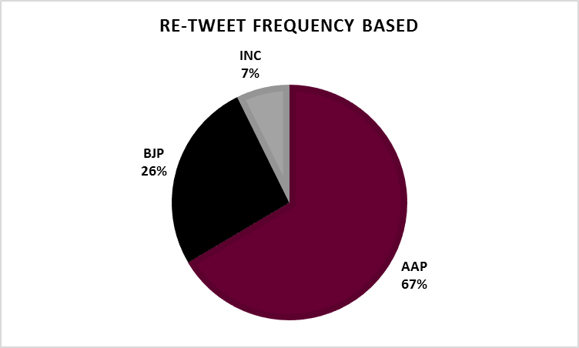
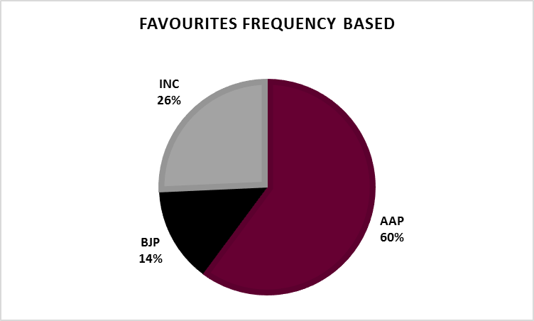
% Vote Share Predictions: Each Tweet – Single Party

Slide 6
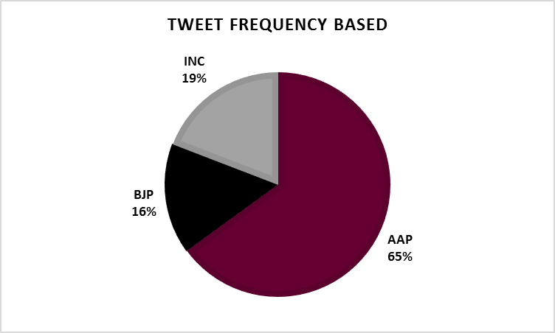
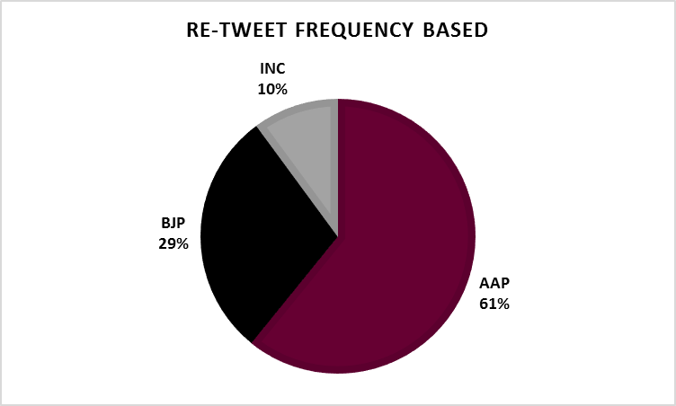
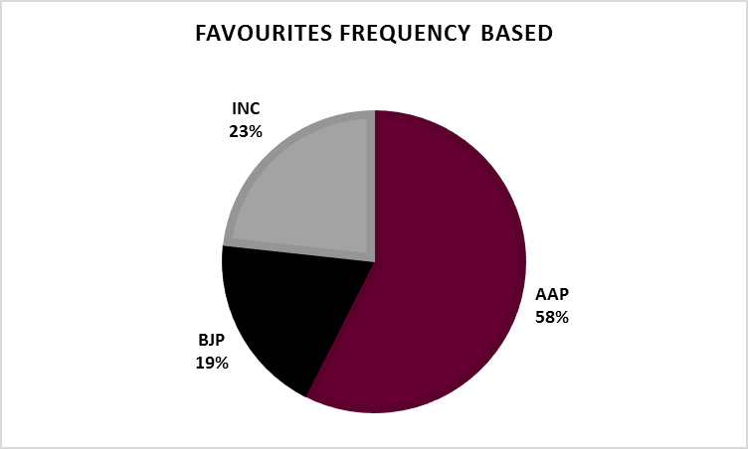
% Vote Share Predictions: Single or Multiple Parties---Predictions based on re-tweets-closest to the actual vote share numbers

Slide 7
Sentiment Analysis : Approach
Raw Data:
Tweet 1: “I love BJP” Sentiment: Positive(1) Tweet 2: “I don’t like BJP” Sentiment: Negative(0)
Data Structure:
Model:
Build a model using words as the features and sentiment as the target event
Methodology: Naïve Bayes
Easy to train and recalibrate
Can take in large number of variables
Data Used
Manually tagged the sentiment of 2000 tweets & external data of 7000 sentiment tagged sentences
Tweet id | I | love | BJP | Don’t | like | Sentiment(Target)
1 | 1 | 1 | 1 | 0 | 0 | 1
2 | 1 | 0 | 1 | 1 | 1 | 0

Slide 8
Sentiment Analysis : Pre-processing
1
Remove Punctuations and numbers
Remove URLs, Hashtags, user mentions
Remove stop words like ‘the’,’a’,’he’,’she’, etc.
Lower the case, Remove unnecessary spaces
2
Lemmatization
Lemma is the basic form of a word. Eg. Walk is the lemma of walked, walking
Lemmas are used in the model instead of the word
Reduces the number of features/words in the model by 14%
3
Negation Handling
Not correct to use ‘not’ as a feature
Eg.: “This is not good”. The feature in the model should be ‘not_good’ instead of ‘not’ and ‘good’ separately
Notes:
1. Remove punctuations/numbers 2. Remove URLs/hashtags/mentions 3. Remove stop words 4. Lemmatization 5. Negation handling

Slide 9
Sentiment Analysis : Accuracy and running the model on all tweets
Results:
Accuracy on the external sentiment data: 65.7%
Accuracy on the manually sentiment-tagged tweets: 55.7%
Running on all tweets:
Final sentiments are based on the model and the hashtags used
Distribution of sentiment on all tweets:
Sentiment Model
run on all tweets
If no matching words found, hashtags used
If no hashtag found, tweet tagged as neutral
Positive | Negative | Neutral
52% | 34% | 14%

Slide 10
Sentiment Analysis : Vote Share
“Tweets refers to” is available
Tweets which refer to multiple parties were removed
Vote Share Logic was used
Vote Share Logic:
Method 1: Vote share is proportional to Positive tweets – Negative tweets + Neutral tweets/2
Method 2: Vote share is proportional to Positive tweets – Negative tweets
Vote Share:
Method | AAP | BJP | INC
1 | 50% | 39% | 11%
2 | 48% | 42% | 10%

Slide 11
Converting vote share to number of seats: Regression
Multivariate Linear Regression model based on vote share and seat share data of past Delhi Assembly Elections (‘93,’98,’03,’08,’13)
y1 = B1x1 + B2x2 + C1
y2 = B3x1 + B4x2 + C2
y3 = B5x1 + B6x2 + C3
Validation
Actual Seats |  |  |  |  | Model Predicted Seats
Year | 1st | 2nd | 3rd |  | Year | 1st | 2nd | 3rd
2013 | 31 | 28 | 8 |  | 2013 | 33 | 26 | 8
2008 | 43 | 23 | 2 |  | 2008 | 41 | 25 | 2
2003 | 47 | 20 | 0 |  | 2003 | 50 | 17 | 1
1998 | 52 | 15 | 0 |  | 1998 | 52 | 15 | 0
1993 | 49 | 14 | 4 |  | 1993 | 45 | 18 | 4
Result
 | 1st | 2nd | 3rd
Vote Share | 50% | 39% | 11%
Seats | 46 | 20 | 2

Slide 12
Converting vote share to number of seats: Swing Analysis
Extent of change in voter support, typically from one election to another, expressed as a positive or negative percentage
One Party Swing = Percentage of vote (current election) − percentage of vote (previous election)
 | 2013 vote share | 2013 vote share (normalized) | Predicted vote share | State level swing
AAP | 29% | 34% | 50% | 16%
BJP | 33% | 38% | 39% | 1%
INC | 25% | 28% | 11% | -17%
Uniform Swing Assumption: State level swing assumed at constituency
 | 2013 |  |  |  |  |  |  | 2015
Name | AAP | BJP | INC | SAD | IND | JDU | BSP | AAP | BJP | INC | SAD | IND | JDU | BSP
Adarsh Nagar | 28% | 38% | 26% | 0% | 0% | 0% | 6% | 44% | 39% | 9% | 0% | 0% | 0% | 6%
Ambedkar Nagar | 42% | 29% | 23% | 0% | 1% | 0% | 4% | 59% | 30% | 6% | 0% | 1% | 0% | 4%

Slide 13
Converting vote share to number of seats: Swing Analysis
Vote Share Margin: Difference in the vote share of winner and runner up
Safe Constituency: State with a vote share margin of >2.5%
Swing Constituency: State with a vote share margin of <2.5%
Constituency | AAP | BJP | INC | SAD | IND | JDU | BSP | Swing Flag
Kasturba Nagar | 54.2% | 33.8% | 10.2% | 0.0% | 0.3% | 0.0% | 0.5% | 0
Bawana | 41.8% | 42.1% | 8.1% | 0.0% | 0.6% | 0.0% | 5.4% | 1
Since swing constituencies can go either way, a range of possible seats is given for each of the 3 parties
Max Seats: Safe Seats + Swing Seats
Min Seats: Safe Seats
Result
final seats | max seats | min seats | final seats
AAP | 56 | 52 | 52-56
BJP | 15 | 12 | 12-15
INC | 1 | 0 | 0-1

Slide 14
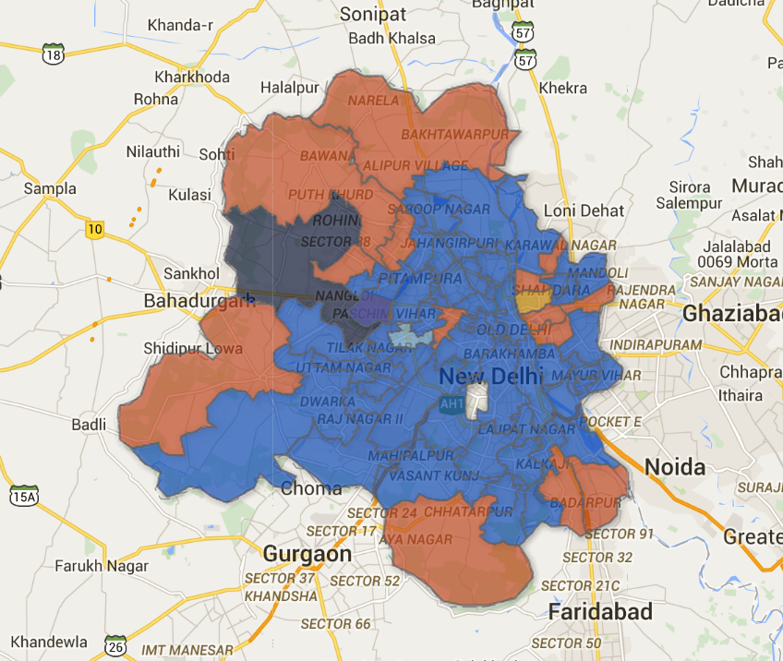
Converting vote share to number of seats: Swing Analysis - Visualization
Assumption: No Swing Seats
https://www.google.com/fusiontables/DataSource?docid=1qjgi13PJcrY2Eimz-4ikRHcviYquMUVLRPoUuXr3

Slide 15
Learnings and actionables
Sentiment Analysis:
Using spell-check and auto-correction to improve the features
Using bigrams like ‘very_good’
Better negation handling. Eg.: “This is not that bad”. ‘not_that_bad’ should be a feature
Feature Selection. Optimum number of features to be used
Customer risk categorization through sentiment analysis on Facebook and Twitter

Slide 16
Thank You

