Slide 1
CIA - Creating Information Assets through crowd sourcing and projects...
Completed/ In-progress project/ event/ contest:
CIA#1 - Capability to work with social media data (Delhi election)
CIA#2 – Beyond regression – Naïve Bayes (predicting hidden affluence)
CIA#3 – Super bureau datamart
CIA#4 – MMS.IND data use cases
Upcoming event/ contest:
CIA#5 – Innovative risk splitting variable for CA base for retail unsecured product
CIA#6 – Business project based on learning of working with social media data
CIA#7 - Drop your ideas in CIA Box

Slide 2
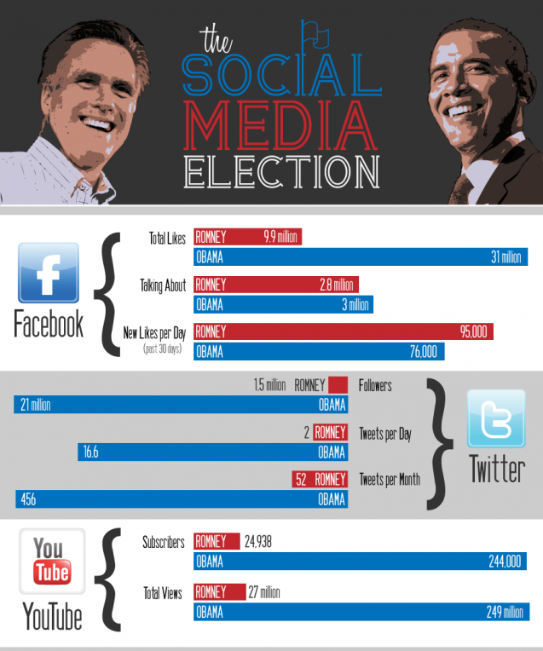
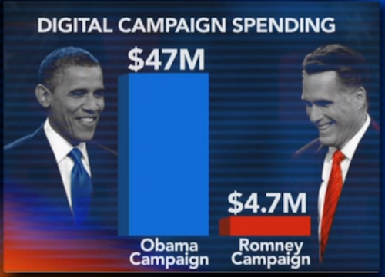
Barack Obama's 2008 campaign was one of the first to master social media and the investments and the sentiments captured by various social media forums truly reflected the results

Slide 3
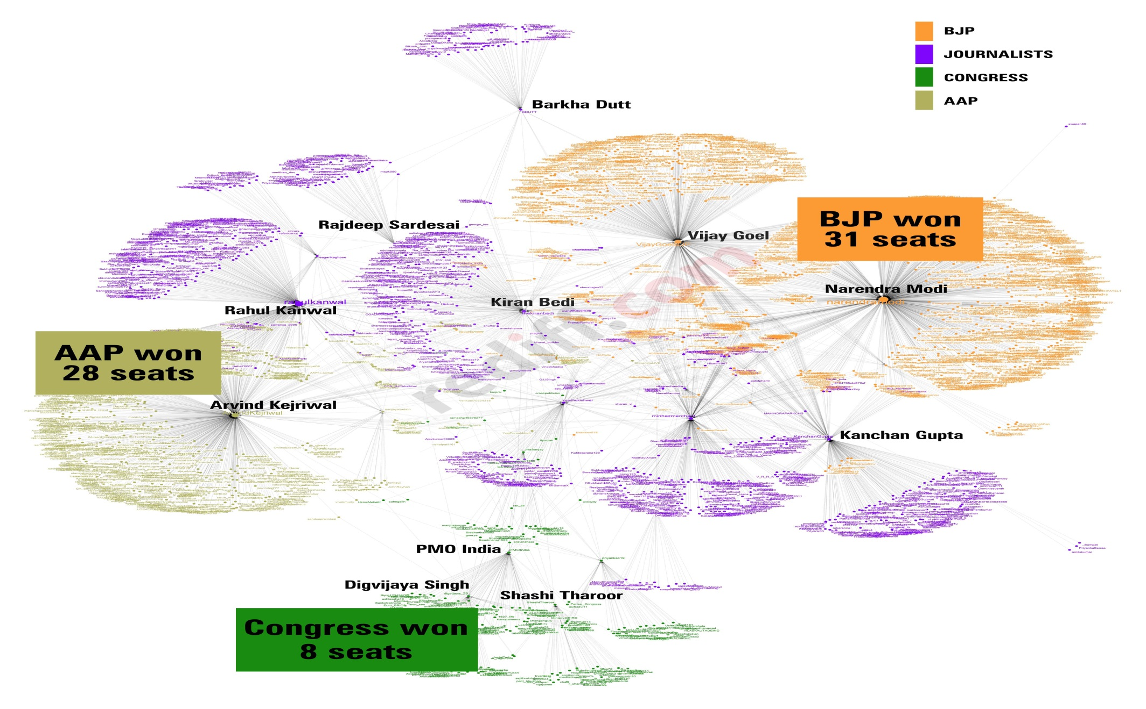
Re tweets, a proxy for endorsement for an opinion proved to be the right barometer to gauge the sentiments of the public last time in Delhi Assembly elections 2013 as the election outcome mimicked the social media activities

Slide 4
CIA #1 – Capability to work with social media data
Use a real life event (Delhi Assembly Elections in this context) to establish usability and credibility of the following
Text Analytics using Natural Language Processing (NLP)
Sentiment as a measure of possible outcome
Social media as a data source
Twitter Data
Data was provided from Jan 14 to Feb 7
Tweets will be provided for – Contestants, Stakeholders, Hashtags (trending in Delhi and India)
Participation
10 teams with 57 participants having team of 4-6
6 teams made final submissions
Evaluation & Prizes
Category 1: Best prediction
Category 2: Best usages of "natural language processing" and prediction methods category
Closest Prediction
Predicted 66 vs actual 67 for AAP

Slide 5
Approach Taken by the Team “ElecTrolls”

Slide 6
Team: ElecTrolls
Verdict: Delhi ElecTrolled by AAP !
# of seats | Actual | Predicted- Volume based | Naïve Bayesian Approach
AAP | 67 | 66 | 63
BJP | 3 | 4 | 7
INC | 0 | 0 | 0

Slide 7
Based on our understanding, the vote share may be estimated by broadly two ways: only parameter count i.e. volume based and the other using sentiment analysis coupled with parameter
Vote Percentage Calculation
Volume Based
# tweets mentioning candidate keywords
# of unique users mentioning the party
Sentiment + Volume
based
Lexicon based sentiment detection
# of followers of party/candidate
Machine learning sentiment detection

Slide 8
Volume Based: Volume based prediction which is more related with the social media activity of parties have been empirically found to estimate the vote share with very low error
1. # of tweets mentioning candidate keywords
Assumption: Candidates’ vote proportions in an election considered to be in proportion to the number of tweets mentioning party
2. # of unique users mentioning the party
Assumption: Number of users is better than tweet counting because each user has only one vote
Election | German Federal Elections-2009 |  | Dutch Senate Elections-2011
Prediction | MAE: 1.65% |  | MAE: 2-3%
Party | Vote Share | Seats |  | Vote Share | Seats
AAP | 59% | 69 |  | 57% | 66
BJP | 21% | 1 |  | 27% | 4
INC | 15% | 0 |  | 10% | 0
Others | 5% | 0 |  | 6% | 0

Slide 9
Estimating the number of seats from Votes
Uni-variate Regression:
Regression Model is used to estimate seats from votes at overall level as constituency level estimated vote share was not there
The Regression Model is: N=a₀+a₁V where N is the number of seats & V is the vote share. Let the vote share for the largest parties be V₁, V₂, V₃ and correspondingly the number of seats be N₁, N₂, N₃
The seats for the 2nd & 3rd largest parties were estimated with the constraint N_{i} ≥0 & N_{i} ≤70-N₁ ∀ i≠1
Model Parameters Significance :
Parameters | Coefficients | Standard Error | t Stat | P-value
Intercept | -36.493 | 14.882 | -2.452 | 0.037
X Variable 1 | 1.793 | 0.394 | 4.545 | 0.001
Model | F | Significance F | R square
Regression | 24.07 | 0.040 | 0.7

Slide 10
Sentiment + Volume Based: Another approach is to apply sentiment detection in each twitter text to positive, negative & neutral and estimate vote share based on the sentiment
Lexicon Based
Each word in the tweet is compared with a lexicon database to know the sentiment value of each word. If the total value is positive, then that tweet will be categorized as positive tweet
Machine Learning-Naïve Bayes
Naïve Bayes is a supervised classifier that applies Bayes’ theorem with a (naïve) assumptions that the features are independent with one another
Using a training data, supervised machine learning uses a classifier to divide between positive and negative tweet
Naive Bayes algorithm is one of the most widely used algorithm for document classification and based on the literature review of the research has been found out to be more accurate than Lexicon approach

Slide 11
Method 3- Naïve Bayesian
Rationale:
As already discussed, the supervised learning approach has been found to be more accurate in terms of its classifying power for text classification/ document classification
We have identified the sentiment of the tweet as Positive & Negative sentiment based on the classifier. A publicly available database for sentiment words was selected and was further appended with words relevant to Delhi’s election
Kazem Jahanbakhsh used this approach for predicting US elections of 2012 & correctly predicted winners of ~80% states in US
Predictions:
The Vote share was predicted and further seats were estimated using Regression Model using the historical data for Delhi Elections-Votes and Seats
Party Name | Vote Share | No of Seats
AAP | 52% | 57
BJP | 29% | 13
INC | 16% | 0
Others | 3% | 0

Slide 12
Method 4- Naïve Bayesian + Unique Users
Rationale:
The previous method estimated the vote share basis the sentiment analysis done on all the tweets ignoring the unique users which might lead to a biased result towards party with more activity by less number of users affiliated to it
A better approach would be to take only unique users affiliated to a party and gauge their sentiment at the user level thereby keeping both the important drivers intact i.e. overall sentiment along with the one vote per user concept
The method can be far more strengthened if there are large number of unique users in the dataset
Predictions:
The Vote share was predicted and further seats were estimated using Regression Model using the historical data for Delhi Elections-Votes and Seats
Party Name | Vote Share | No of Seats
AAP | 55% | 63
BJP | 32% | 7
INC | 10% | 0
Others | 2% | 0

Slide 13
Approach Taken by the Team “Senti-mentals”

Slide 14
Prediction Framework
Text Mining
Mapped Hashtag to Party
Tagged Tweets to Party based on keywords
% Vote Share Prediction
Frequency Based
Tweet Frequency
Re-Tweet Frequency
Favorite Frequency
Data Preparation
Converted JSON to CSV
Discarded tweets in Hindi
Removed URL & image tweets
Removing stop words, punctuations, http link etc
Naïve Based
Sentiment Analysis
Polarity tagging
Assumptions
Deleted untagged tweets
Inclusion and Exclusion of Tweets tagged to multiple parties
# Seat Prediction
Multivariate Linear Regression
Swing Analysis

Slide 15
Sentiment Analysis : Naïve Bayes Model: Pre-processing
Remove Punctuations and numbers
Remove URLs, Hashtags, user mentions
Remove stop words like ‘the’,’a’,’he’,’she’, etc.
Lower the case, Remove unnecessary spaces
1
2
Lemmatization
Lemma is the basic form of a word. Eg. Walk is the lemma of walked, walking
Lemmas are used in the model instead of the word
Reduces the number of features/words in the model by 14%
3
Negation Handling
Not correct to use ‘not’ as a feature
Eg.: “This is not good”. The feature in the model should be ‘not_good’ instead of ‘not’ and ‘good’ separately
Manually tagged 2000 tweets to build the model
Results:
Sentiment prediction accuracy on the external sentiment data: 65.7%
Notes:
1. Remove punctuations/numbers 2. Remove URLs/hashtags/mentions 3. Remove stop words 4. Lemmatization 5. Negation handling

Slide 16
Sentiment Analysis : Vote Share
“Tweets refers to” is available
Tweets which refer to multiple parties were removed
Vote Share Logic was used
Vote Share Logic:
Method 1: Vote share is proportional to Positive tweets – Negative tweets + Neutral tweets/2
Method 2: Vote share is proportional to Positive tweets – Negative tweets
Vote Share:
Method | AAP | BJP | INC
1 | 50% | 39% | 11%
2 | 48% | 42% | 10%

Slide 17
Converting vote share to number of seats: Regression
Multivariate Linear Regression model based on vote share and seat share data of past Delhi Assembly Elections (‘93,’98,’03,’08,’13)
y1 = B1x1 + B2x2 + C1
y2 = B3x1 + B4x2 + C2
y3 = B5x1 + B6x2 + C3
Validation
Actual Seats |  |  |  |  | Model Predicted Seats
Year | 1st | 2nd | 3rd |  | Year | 1st | 2nd | 3rd
2013 | 31 | 28 | 8 |  | 2013 | 33 | 26 | 8
2008 | 43 | 23 | 2 |  | 2008 | 41 | 25 | 2
2003 | 47 | 20 | 0 |  | 2003 | 50 | 17 | 1
1998 | 52 | 15 | 0 |  | 1998 | 52 | 15 | 0
1993 | 49 | 14 | 4 |  | 1993 | 45 | 18 | 4
Result
 | 1st | 2nd | 3rd
Vote Share | 50% | 39% | 11%
Seats | 46 | 20 | 2

Slide 18
Converting vote share to number of seats: Swing Analysis
Extent of change in voter support, typically from one election to another, expressed as a positive or negative percentage
One Party Swing = Percentage of vote (current election) − percentage of vote (previous election)
 | 2013 vote share | 2013 vote share (normalized) | Predicted vote share | State level swing
AAP | 29% | 34% | 50% | 16%
BJP | 33% | 38% | 39% | 1%
INC | 25% | 28% | 11% | -17%
Uniform Swing Assumption: State level swing assumed at constituency
 | 2013 |  |  |  |  |  |  | 2015
Name | AAP | BJP | INC | SAD | IND | JDU | BSP | AAP | BJP | INC | SAD | IND | JDU | BSP
Adarsh Nagar | 28% | 38% | 26% | 0% | 0% | 0% | 6% | 44% | 39% | 9% | 0% | 0% | 0% | 6%
Ambedkar Nagar | 42% | 29% | 23% | 0% | 1% | 0% | 4% | 59% | 30% | 6% | 0% | 1% | 0% | 4%

Slide 19
Converting vote share to number of seats: Swing Analysis
Vote Share Margin: Difference in the vote share of winner and runner up
Safe Constituency: State with a vote share margin of >2.5%
Swing Constituency: State with a vote share margin of <2.5%
Constituency | AAP | BJP | INC | SAD | IND | JDU | BSP | Swing Flag
Kasturba Nagar | 54.2% | 33.8% | 10.2% | 0.0% | 0.3% | 0.0% | 0.5% | 0
Bawana | 41.8% | 42.1% | 8.1% | 0.0% | 0.6% | 0.0% | 5.4% | 1
Since swing constituencies can go either way, a range of possible seats is given for each of the 3 parties
Max Seats: Safe Seats + Swing Seats
Min Seats: Safe Seats
Result
final seats | max seats | min seats | final seats
AAP | 56 | 52 | 52-56
BJP | 15 | 12 | 12-15
INC | 1 | 0 | 0-1

Slide 20
Some interesting outputs

Slide 21
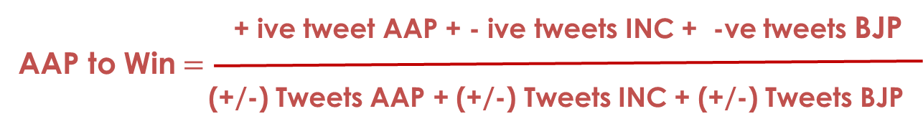
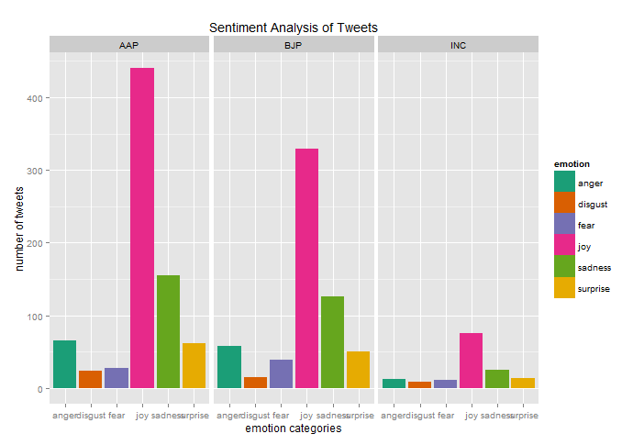
Team “ThinkTanks” applied Naïve Bayes based method to derive emotions from Tweets followed by a formula to arrive at vote share
Party | Vote Share (Actual) | Vote Share (Pred)
AAP | 54.3% | 59%
BJP | 32.1% | 28%
INC | 9.8% | 13%
Prediction Technique:
Tag Parties per Tweet based on custom dictionary
Used “Naïve Bayes” for Tweet Emotions and Polarity
Emotions: Anger, Disgust, Fear, Joy, Sadness, Surprise, Unknown.
Polarity: Positive, Negative, Neutral.

Slide 22
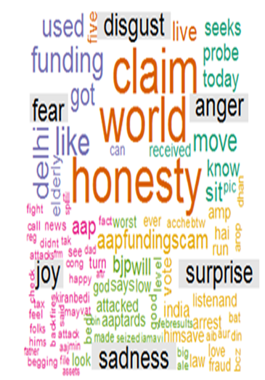
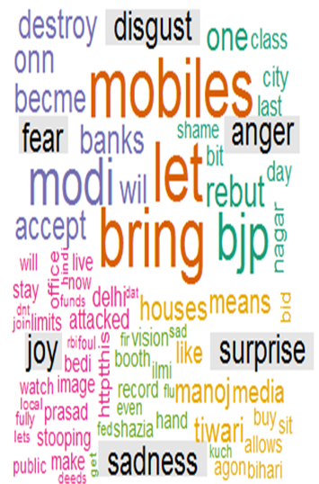
Team “Crawlers” created word cloud of the sentiments for AAP and BJP
For AAP
For BJP

Slide 23
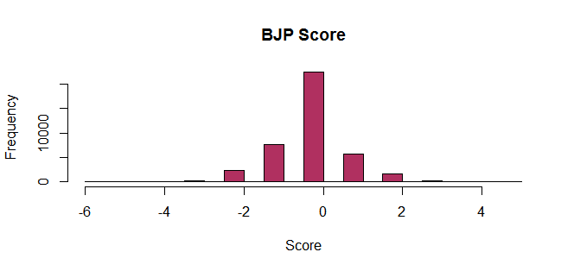
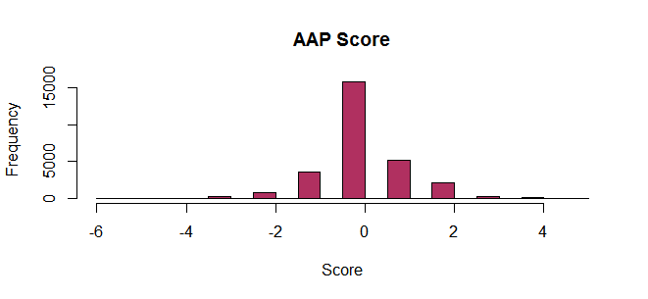
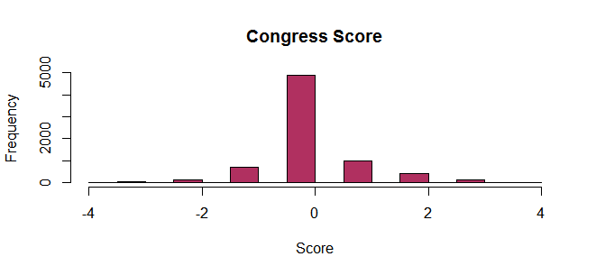
Team “Twitlyzer” computed an elementary sentiment score for each tweet..
Sentiment Score = ( # of positive word matches) - ( # of negative word matches)
BJP
AAP
INC

