Slide 1
PRODUCTS
(5 Divisions/dropdown,Hyperlinked)
Security
Surveillance
Peripherals
Paints
Hardware
Cables
Enquire Now?
(Link to enquiry form)

Slide 2
Security
Surveillance
(6 Divisions/dropdown,Hyperlinked)
DVR
(Digital Video Recorders)
NVR
(Network Video Recorders)
CCTV
VIDEO DOOR PHONE
CABLES
(No Link)
Electronic Safes
(No Link)
Enquire Now?
(Link to enquiry form)

Slide 3


CCTV
Enquire Now?
(Link to enquiry form)

Slide 4
HD Camera
IP Camera
PTZ
Enquire Now?
(Link to enquiry form)

Slide 5
HD Camera
(Please import the product list from the link
provided,only enter picture and model number , description not required)
1 MP
(http://www.cpplusworld.com/products/analog-hd-camera/1-mp)
2 MP
(http://www.cpplusworld.com/products/analog-hd-camera/2-mp)
1.3 MP
(http://www.cpplusworld.com/products/analog-hd-camera/1-3-mp)
1.4 MP
(http://www.cpplusworld.com/products/analog-hd-camera/1-4-mp)
2.4 MP
(http://www.cpplusworld.com/products/analog-hd-camera/2-4-mp)
4 MP
(http://www.cpplusworld.com/products/analog-hd-camera/4-mp)
4 K
(http://www.cpplusworld.com/products/analog-hd-camera/4k)
4 IOT
(http://www.cpplusworld.com/products/analog-hd-camera/iot)
Enquire Now?
(Link to enquiry form)

Slide 6
IP Camera/Network Camera
(Please import the product list from the link
provided,only enter picture and model number , description not required)
1 MP
(http://www.cpplusworld.com/products/network-camera/1-mp)
1.3 MP
(http://www.cpplusworld.com/products/network-camera/1-3-mp)
2 MP
(http://www.cpplusworld.com/products/network-camera/2-mp)
3 MP
(http://www.cpplusworld.com/products/network-camera/3-mp)
4 MP
(http://www.cpplusworld.com/products/network-camera/4-mp)
5 MP
(http://www.cpplusworld.com/products/network-camera/5-mp)
6 MP
(http://www.cpplusworld.com/products/network-camera/6-mp)
12 MP
(http://www.cpplusworld.com/products/network-camera/12-mp)
ePOE
(http://www.cpplusworld.com/products/network-camera/epoe)
4 K
(http://www.cpplusworld.com/products/network-camera/4k)
Ezycam
(http://www.cpplusworld.com/products/network-camera/ezykam)
Project Models
(http://www.cpplusworld.com/products/network-camera/project-models)
Enquire Now?
(Link to enquiry form)

Slide 7
PTZ/SPEED DOME
(http://www.cpplusworld.com/products/speed-dome/analog-hd ,
http://www.cpplusworld.com/products/speed-dome/network)
Enquire Now?
(Link to enquiry form)

Slide 8
(https://www.dahuasecurity.com/products/allProducts/4562)
Enquire Now?
(Link to enquiry form)

Slide 9
DVR
(Digital Video Recorders)
(http://www.cpplusworld.com/products/dvr)
(https://www.dahuasecurity.com/products/allProducts/417)
Enquire Now?
(Link to enquiry form)

Slide 10
NVR
(Network Video Recorders)
4 Channel
(http://www.cpplusworld.com/products/nvr/4-ch)
8 Channel
(http://www.cpplusworld.com/products/nvr/8-ch)
16 Channel
(http://www.cpplusworld.com/products/nvr/16-ch)
32 Channel
(http://www.cpplusworld.com/products/nvr/32-ch)
Entire CP Plus product portfolio available on request:
Enquire Now?
(Link to enquiry form)

Slide 11
VIDEO DOOR PHONE
(http://www.cpplusworld.com/products/video-door-phones/multi-villa,
http://www.cpplusworld.com/products/video-door-phones/villa,
http://www.cpplusworld.com/products/video-door-phones/multi-apartment,
)
Enquire Now?
(Link to enquiry form)

Slide 12

CABLES
(http://paramountcables.com/wp-content/uploads/2017/09/brochure-01_paramount-brochure.pdf)
Enquire Now?
(Link to enquiry form)

Slide 13






Peripherals
{https://www.tp-link.com/no/products/list-9.html}
(http://www.dlink.co.in/products/category/?cid=3)
(https://www.seagate.com/in/en/internal-hard-drives/surveillance/)
(http://tendacn.com/en/service/download.html)
(https://www.iball.co.in/Category/Technology-Accessories/282)
(https://storage.toshiba.com/consumer-hdd/internal)
Enquire Now?
(Link to enquiry form)

Slide 14

Paints
(https://www.jotun.com/in/en/b2c/products/)
Enquire Now?
(Link to enquiry form)

Slide 15



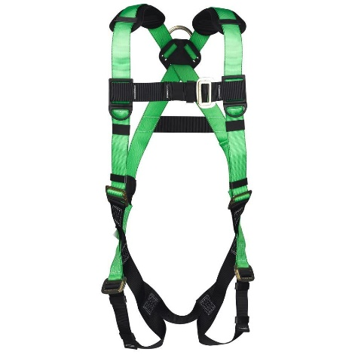
Hardware
(http://www.fluke.com/fluke/inen/Products/)
Enquire Now?
(Link to enquiry form)

Slide 16
Enquiry Form(Layout)
Name
Contact Number
Email Id
City
Company Name
Requirement/Description
(All responses should be mailed/notified to suyashagrawal17@gmail.com)

