Slide 1
pprof
Visualization and analysis tool for profiling data
(NOT an official google product)
https://github.com/google/pprof

Slide 2
How to build and install
Install supported version of Go development kit
To build and install run command go install github.com/google/pprof@latest This will install the binary in $GOPATH/bin
If you want to generate graphic visualization of profiles then also install Graphviz

Slide 3
How it works?
Reads a collection of profiling samples in profile.proto format.
Generates reports to visualize and help analyze the profiling data. It can generate both text and graphical reports. For graphical reports it uses the dot visualization package such as graphviz.
It can read a profile from a file or from a server via http.
The objective of pprof is to generate a report for a profile.

Slide 4
What is profile in pprof?
A profile is a collection of samples, where each sample is associated to a point in a location hierarchy, one or more numeric values and a set of labels.
Profiles represents data collected through statistical sampling of a program where each sample describes a call stack and a number or value of samples collected at a location.
Notes:
We will be talking more about location hierarchy in slide 7. Pprof is agnostic to to the profile semantics, so other uses are possible. The interpretation of the reports generated by pprof depends on the semantics defined by the source of the profile.

Slide 5
What is profile.proto?
It is a protocol buffer that describes a set of callstacks and symbolization information.
Format is described in link . It is currently using version 3 of protocol buffers language.
Protocol buffers are Google’s language-neutral, platform-neutral, extensible mechanism for serializing structured data.
Notes:
For point 3 you can think about it as XML, but smaller, faster, and simpler. You define how you want your data to be structured once, then you can use special generated source code to easily write and read your structured data to and from a variety of data streams and using a variety of languages.

Slide 6
Ways of using pprof
To generate a report in specified format and exit we can use syntax pprof <format> [options] source
To start an interactive shell we can use following syntax pprof [options] source
To use pprof via a web interface use following syntax pprof -http=[host]:[port] [options] source. In this case pprof will start serving HTTP requests on specified port.

Slide 7
HOW PPROF generates A report
Report is generated from a location hierarchy which is reconstructed from the profile samples. Each location contains 2 values:
flat: the value of location itself
cum: the value of location plus all its descendants.
NOTE: Samples that include a location multiple times (e.g. recursive function) are counted only once per location.
Each sample in a profile may include multiple values, representing different entities associated to the sample. pprof reports include a single sample value, which by convention is the last one specified in the report.
Sample values are numeric values associated to a unit. If pprof can recognize these units, it will attempt to scale the values to a suitable unit for visualization. The unit= option will force the use of a specific unit. For example, unit=sec will force any time values to be reported in seconds. pprof recognizes most common time and memory size units.
Notes:
The location hierarchy in the context of a pprof profile refers to the structured representation of program counters (PCs) or function call sites within the profile data. When profiling a Go program using pprof, the tool collects samples of stack traces at regular intervals (for CPU profiling) or on certain events (like memory alloc Here's a breakdown of what the location hierarchy means in a pprof profile:ation for memory profiling). Each sample consists of a series of program counters or function call sites that represent the call stack at the moment the sample was taken.
Root: The root of the hierarchy is the entry point of the profile, which might not correspond to a specific function but rather to the start of the profiling session.
Nodes: Each node in the hierarchy represents a specific function call site or program counter. The hierarchy reflects the call stack of the program, with parent nodes calling child nodes.
Edges: The edges between nodes represent the call relationships between functions. An edge from function A to function B indicates that A called B.
Leaves: The leaves of the hierarchy are the functions that were on top of the call stack when the sample was taken. These functions are currently executing or are the most recent in the call chain.
The location hierarchy allows developers to understand the call relationships and execution paths within their program. By analyzing the hierarchy, developers can identify hot spots, performance bottlenecks, and areas of the code that contribute most to resource usage (CPU time, memory allocations, etc.). This information is crucial for optimizing and debugging applications.
After last point mention that samples in a profile may have tags. These tags have a name and a value. The value can be either numeric or a string; the numeric values can be associated with a unit. Tags are used as additional dimensions that the sample values can be broken by. The most common use of tags is selecting samples from a profile based on the tag values. pprof also supports tags at the visualization time. The -tagfocus option is the most used option for selecting data in a profile based on tag values.

Slide 8
How to configure a report?
options configure the contents of a report.
Some common pprof options are:
-flat [default], -cum: Sort entries based on their flat or cumulative value on text reports.
-functions [default], -filefunctions, -files, -lines, -addresses: Generate the report using the specified granularity.
-nodecount=int: Maximum number of entries in the report. pprof will only print this many entries and will use heuristics to select which entries to trim.
-focus= regex: Only include samples that include a report entry matching regex.
-ignore= regex: Do not include samples that include a report entry matching regex.
-show_from= regex: Do not show entries above the first one that matches regex.
-show= regex: Only show entries that match regex.
-hide= regex: Do not show entries that match regex.

Slide 9
Types of reports
Text reports – In such reports pprof show the location hierarchy in text format.
Graphical reports – In such reports pprof will basically generate reports in DOT format and convert them to multiple formats using the graphviz package. These reports represent the location hierarchy as a graph, with a report entry represented as a node. Nodes are removed using heuristics to limit the size of the graph, controlled by the nodecount option. From dot you can generate reports in svg, png, jpeg, gif and pdf formats.

Slide 10
FETCHING PROFILES
pprof can read profiles from a file or directly from a URL over HTTP or HTTPS. The native format it supports is a gzipped profile.proto file.
When fetching from a URL handler, pprof accepts options to indicate how much to wait for the profile.
-seconds= int: Makes pprof request for a profile with the specified duration in seconds. Only makes sense for profiles based on elapsed time, such as CPU profiles.
-timeout= int: Makes pprof wait for the specified timeout when retrieving a profile over http. If not specified, pprof will use heuristics to determine a reasonable timeout.
NOTE : pprof also supports skipping verification of the server's certificate chain and host name when collecting or symbolizing a profile. To skip this verification, use "https+insecure" in place of "https" in the URL.
If multiple profiles are specified, pprof will fetch them all and merge them. This is useful to combine profiles from multiple processes of a distributed job. The profiles may be from different programs but must be compatible (for example, CPU profiles cannot be combined with heap profiles).

Slide 11
symbolization
It is the process of converting raw memory addresses or program counters (PCs) into human-readable function names and line numbers. When pprof collects profiling data, it captures stack traces that include memory addresses indicating where functions are located in the executable's address space. For a developer, these raw addresses are not very informative without the context of what code they correspond to. The symbolization process involves mapping these addresses back to the function names and locations in the source code that they represent.
pprof can extract the symbol information locally by examining the binaries using the binutils tools, or it can ask running jobs that provide a symbolization interface.
Symbolization makes profiling data much more accessible and actionable, as it directly ties resource usage to specific parts of the source code. This is crucial for optimizing performance and diagnosing issues in complex applications.
pprof will attempt symbolizing profiles by default, and its -symbolize option provides some control over symbolization:
-symbolize=none: Disables any symbolization from pprof.
-symbolize=local: Only attempts symbolizing the profile from local binaries using the binutils tools.
-symbolize=remote: Only attempts to symbolize running jobs by contacting their symbolization handler.

Slide 12
Pprof web interface
When the user requests a web interface (by supplying an -http=[host]:[port] argument on the command-line), pprof starts a web server and opens a browser window pointing at that server. The web interface provided by the server allows the user to interactively view profile data in multiple formats.

Slide 13
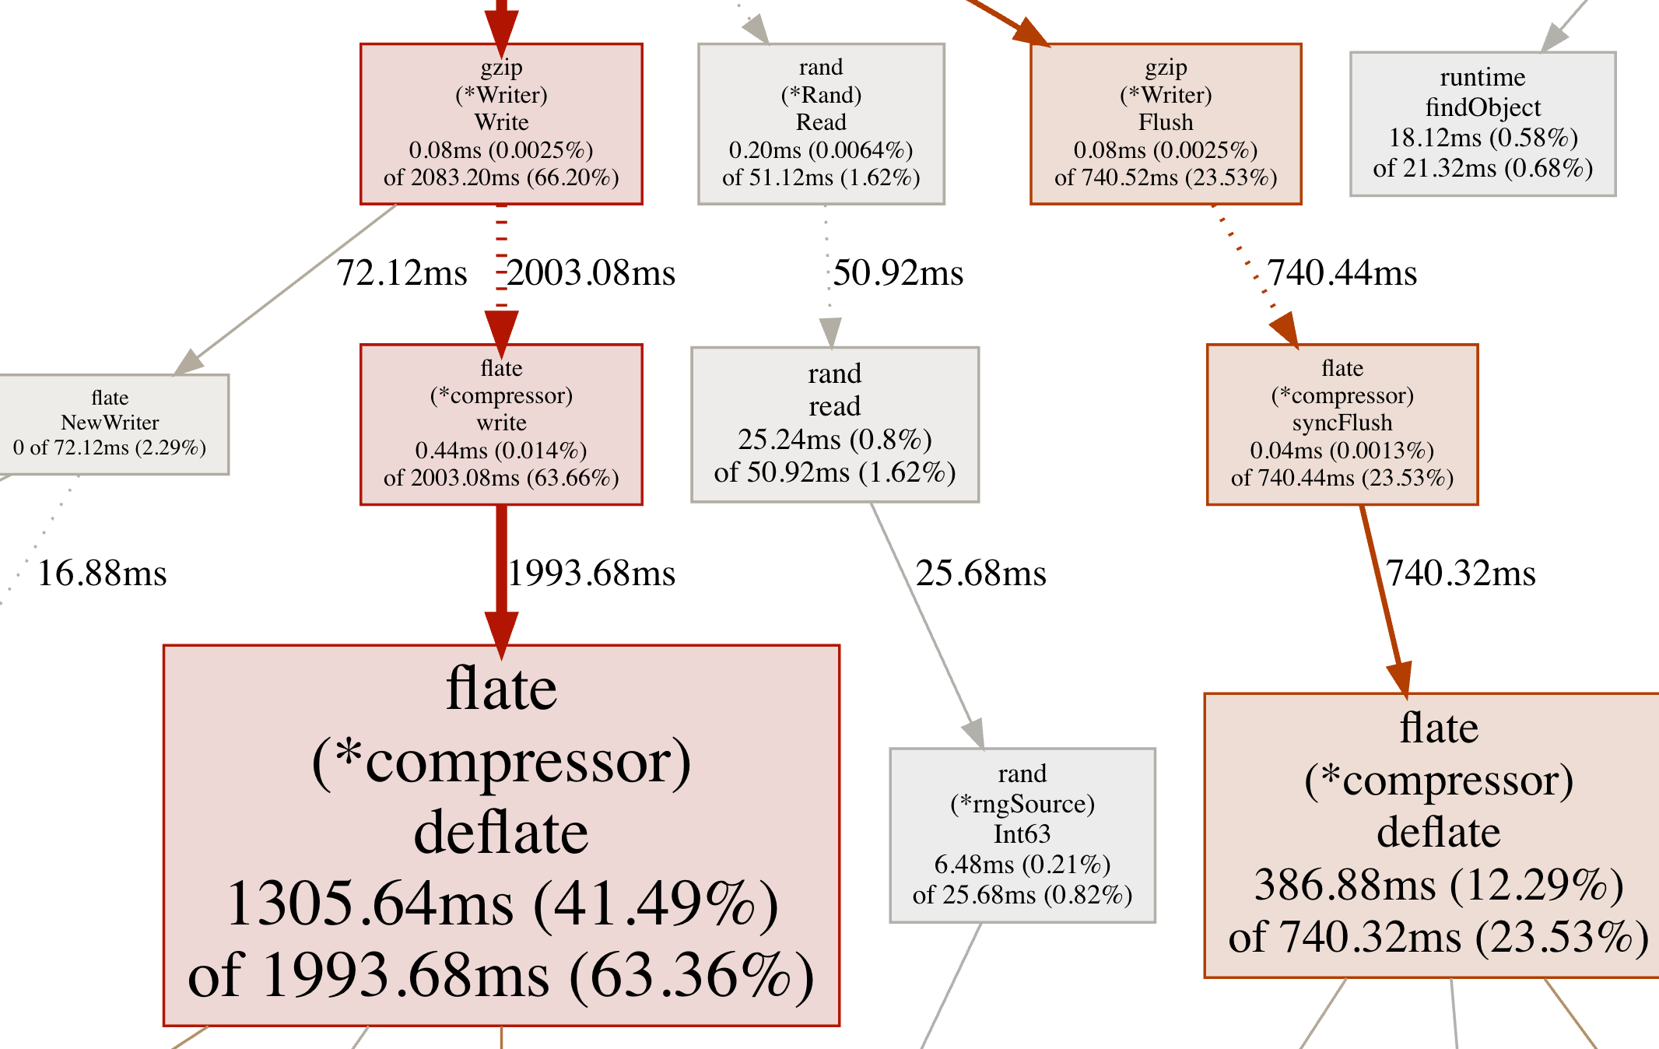
Callgraph sample
Notes:
For nodes:
(*Rand).Read has a small flat value and a small cum value because the the font is small and the node is grey.
(*compressor).deflate has a large flat value and a large cum value because the font is large and the node is red.
(*Writer).Flush has a small flat value and a large cum value because the font is small and the node is red.
For edges:
the edge between (*Writer).Write and (*compressor).write:
Since it is a dashed edge, some nodes were removed between those two.
Since it is thick and red, more resources were used in call stacks between those two nodes.
the edge between (*Rand).Read and read:
Since it is a dashed edge, some nodes were removed between those two.
Since it is thin and grey, fewer resources were used in call stacks between those two nodes.
the edge between read and (*rngSource).Int63:
Since it is a solid edge, there are no nodes between those two (i.e. it was a direct call).
Since it is thin and grey, fewer resources were used in call stacks between those two nodes.

Slide 14
Interpreting the callgraph
Node color
Large positive cumulative values are red.
Large negative cumulative values are green; negative values are most likely to appear during profile comparison.
Cumulative values close to zero are grey.
Node font size
Large font size means larger absolute flat values.
Smaller font size means smaller absolute flat values.

Slide 15
Interpreting the callgraph (continues…)
Edge weight
Thicker edges indicate that more resources were used long that path.
Thinner edges indicate that fewer resources were used along the path.
Edge color
Large positive values are red.
Large negative values are green.
Values close to zero are grey.

Slide 16
Interpreting the callgraph
Dashed edges
Some locations between the two connected locations were removed
Solid edge
One location directly calls the other

Slide 17
Additional pprof features
Annotated Code
Comparing profiles

Slide 18
Annotated code
pprof can also generate reports of annotated source with samples associated to them. For these, the source or binaries must be locally available, and the profile must contain data with the appropriate level of detail.
pprof uses the binutils tools to examine and disassemble the binaries. By default it will search for those tools in the current path, but it can also search for them in a directory pointed to by the environment variable $PPROF_TOOLS.
Notes:
pprof will look for source files on its current working directory and all its ancestors. pprof will look for binaries on the directories specified in the $PPROF_BINARY_PATH environment variable, by default $HOME/pprof/binaries (%USERPROFILE%\pprof\binaries on Windows). It will look binaries up by name, and if the profile includes linker build ids, it will also search for them in a directory named as the build id.
pprof will look for source files on its current working directory and all its ancestors. pprof will look for binaries on the directories specified in the $PPROF_BINARY_PATH environment variable, by default $HOME/pprof/binaries (%USERPROFILE%\pprof\binaries on Windows). It will look binaries up by name, and if the profile includes linker build ids, it will also search for them in a directory named as the build id.
-list= regex: Generates an annotated source listing for functions matching regex, with flat/cum values for each source line.
-disasm= regex: Generates an annotated disassembly listing for functions matching regex.
-weblist= regex: Generates a source/assembly combined annotated listing for functions matching regex, and starts a web browser to display it.

Slide 19
Comparing profiles
pprof can subtract one profile from another, provided the profiles are of compatible types (i.e. two heap profiles)
pprof has two options which can be used to specify the filename or URL for a profile to be subtracted from the source profile:
-diff_base= profile: useful for comparing two profiles. Percentages in the output are relative to the total of samples in the diff base profile.
-base= profile: useful for subtracting a cumulative profile, like a golang block profile, from another cumulative profile collected from the same program at a later time. When comparing cumulative profiles collected on the same program, percentages in the output are relative to the difference between the total for the source profile and the total for the base profile.
Notes:
The -normalize flag can be used when a base profile is specified with either the -diff_base or the -base option. This flag scales the source profile so that the total of samples in the source profile is equal to the total of samples in the base profile prior to subtracting the base profile from the source profile. Useful for determining the relative differences between profiles, for example, which profile has a larger percentage of CPU time used in a particular function.
When using the -diff_base option, some report entries may have negative values. If the merged profile is output as a protocol buffer, all samples in the diff base profile will have a label with the key "pprof::base" and a value of "true". If pprof is then used to look at the merged profile, it will behave as if separate source and base profiles were passed in.
When using the -base option to subtract one cumulative profile from another collected on the same program at a later time, percentages will be relative to the difference between the total for the source profile and the total for the base profile, and all values will be positive. In the general case, some report entries may have negative values and percentages will be relative to the total of the absolute value of all samples when aggregated at the address level.

Slide 20
Pprof web interface views
Graph (Default)
Top
Flame Graph
Peek
Source
Disassemble
Notes:
The default view in the local web interface displays a graph where the nodes are functions, and edges indicate caller/callee relations.

