Slide 1
ONLINE BANKING
RLL GROUP PROJECT
GROUP-5

Slide 2
GROUP MEMBERS
Abhay Tiwari -2528627
Vigneshwaran Ravichandran- 2530037
V Siva Kamalesh- 2529633
Ujjwal Kumar Tiwari- 2530616
Sanjeev Sagar- 2530476
Rajnish X- 2529911
Venkatesan Ganesha- 2530610
Vishwa Pravin K- 2529607
Divyansh Kumar- 2528304
Maddipati Naveen-2530802

Slide 3
INTRODUCTION
Online banking is an electronic payment system that enables customers of a bank or other financial institution to conduct a range of financial transactions through the financial institution's website.
Banking online means accessing your bank account and carrying out financial transactions through the internet on your smartphone, tablet or computer. It's quick, usually free and allows you to do tasks, such as deposits, transfers, and online bill payments etc.
Every bank has some form of online banking, available both on desktop and mobile versions.

Slide 4
RLL –Requirement Specifications
Domain: Banking
Project Objective: Create a dynamic and responsive Java online banking web application to deposit, withdraw, and transfer money between accounts.
Technology Stack:
Front-End: Angular
Server-side: Spring Boot
Back-end: MYSQL, Hibernate
Server: Tomcat

Slide 5
RLL –Requirement Specifications
Background of the project:
ICIN is one of the top banking firms that accepts deposits from the public for the purpose of lending loans to the public. It also invests an amount in securities. Recently, the business analysts notice drop in the number of customers of the bank. They found out that online banking systems of banks like AXIS and American Express are gaining more profits by eliminating middlemen from the equation. As a result, the team decided to hire a Full Stack developer who can develop an online banking web application with a rich and user-friendly interface. You are hired as one of the Full Stack Java developers and have been asked to develop the web application. The management team has provided you with the requirements and their business model so that you can easily arrange different components of the application.

Slide 6
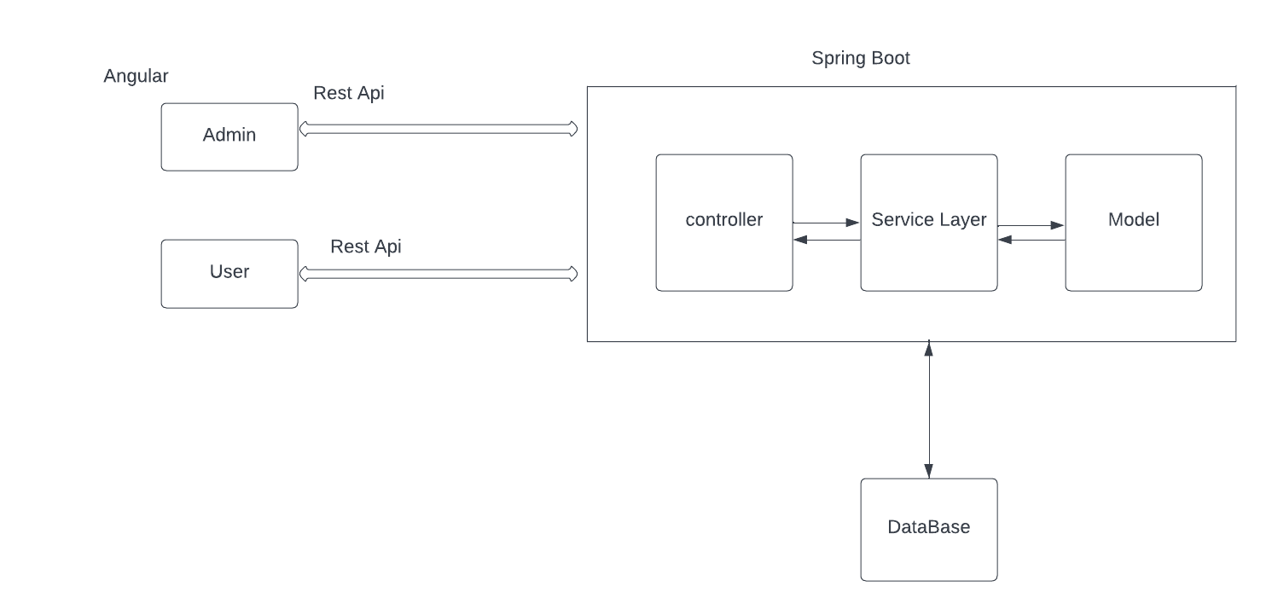
System Architecture

Slide 7
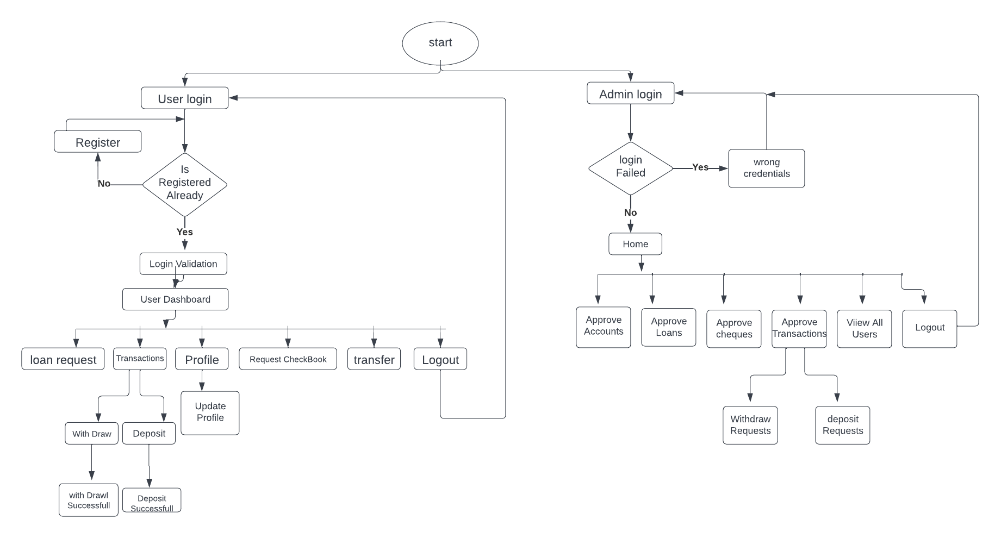
OVERALL FLOW CHART

Slide 8
MODULES AND TECHNOLOGIES
User Registration
Login
User Dashboard
Admin Dashboard

Slide 9
ADMIN USER REQUIREMENTS
Login to the portal
Authorize the roles and guidelines for the user
Grant access to the user regarding money transfer, deposits, and withdrawal
Block a user account in case of any threat and authorize cheque book requests
Open an account
Handle new loan requests for approvals
View daily transaction reports
View list of all approved and rejected loan
Download transaction report
View the Funds transferred
Verify transaction Id and transaction password
Check the balance of an account
View transactions on monthly basis/yearly basis/search by date

Slide 10
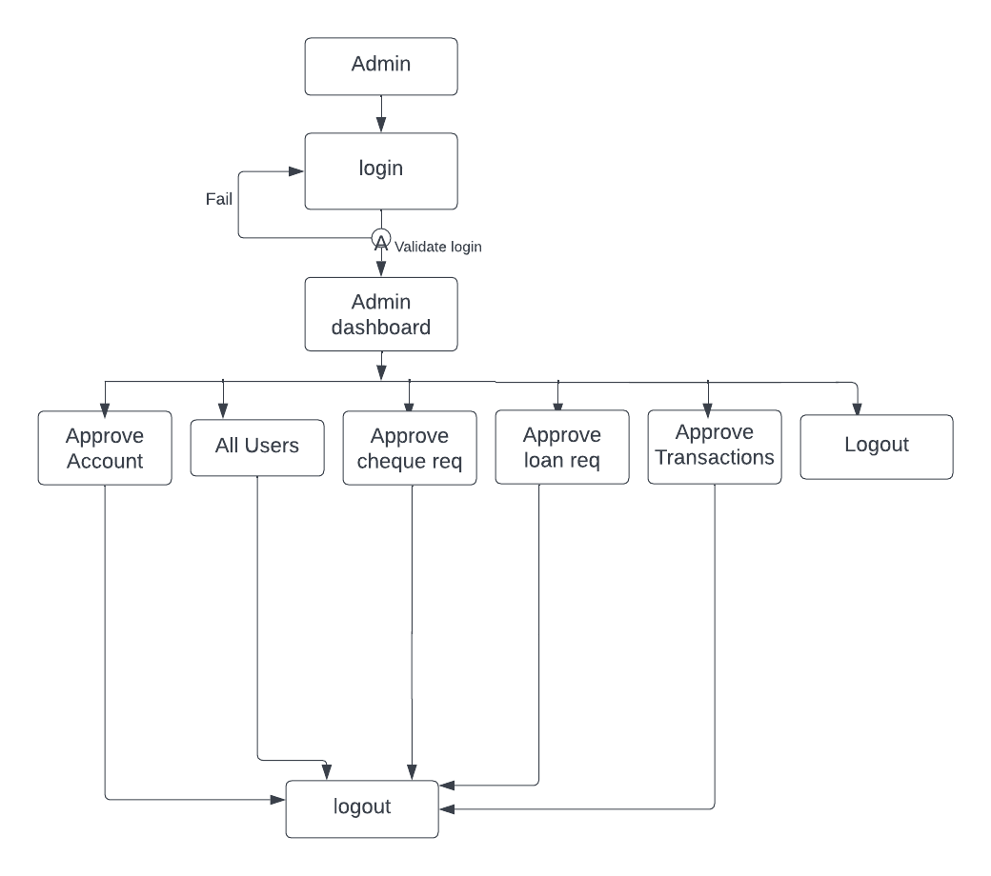
Admin Activity Diagram

Slide 11
END USER REQUIREMENTS
Register or log in to the application to maintain a record of activities.
Change the password.
Change address, email, mobile.
Deposit and withdraw money from the account.
View account statement on monthly basis/yearly basis/search by date.
View the balance in their primary and savings account.
Cheque book requests for different accounts.
Transfer funds between different accounts and add recipients.
Apply for loan

Slide 12
PHASES OF THE PROJECT
Phase 1: Database Schema Design
1.Identify domain objects and their attributes as per the requirement.
2.Create a Database tables with necessary relationship as per the requirement.
Phase 2: Front End Development
Develop a static web pages per requirements for online banking web application using Angular. PFB screenshots for references

Slide 13
PHASES OF THE PROJECT
Phase 3: Back End Development
Develop a RESTful Web API to perform CRUD operations on Domain objects as per requirement using Spring Boot and MySQL/Oracle database.
Phase 4: Unit Testing
1.Perform Unit Testing using Junit frameworks for all the functional requirements.
2.Perform Functional Testing using POSTMAN for all REST end points

Slide 14
USER REGESTRATION

Slide 15
USER REGESTRATION
In this task user able to signup & can create an account on the website for user & admin Also and admin able to login.
The user will register themself with their personal details.
And After that user will be able to login with username and password.
The admin will get credential to login.
Both should work properly and able to navigate to their corresponding home page

Slide 16
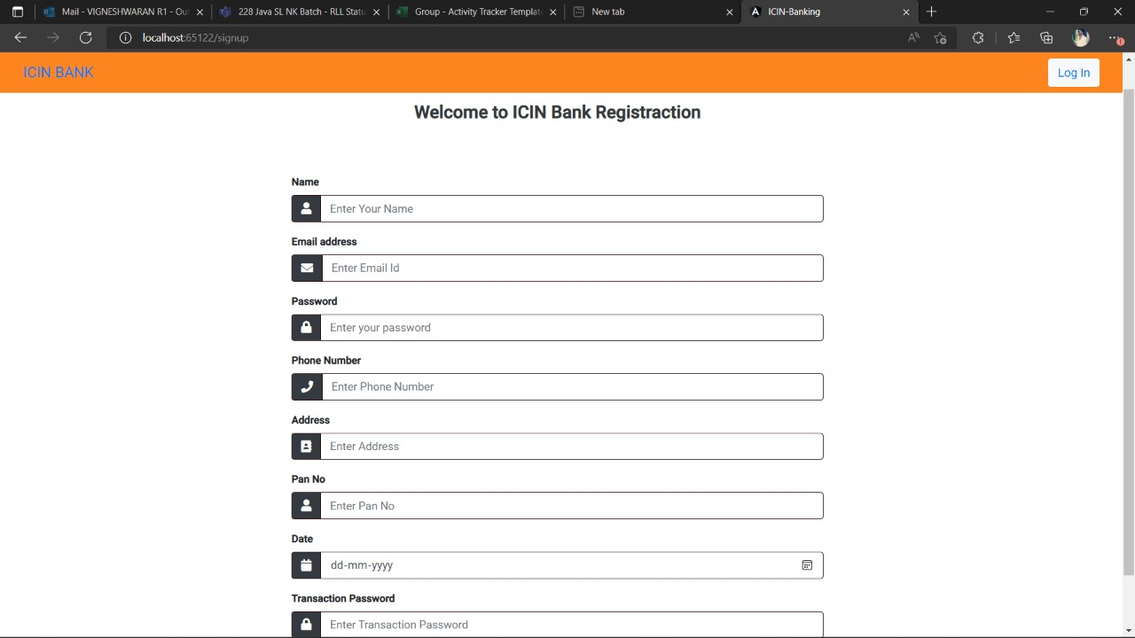
USER REGESTRATION

Slide 17
LOGIN

Slide 18
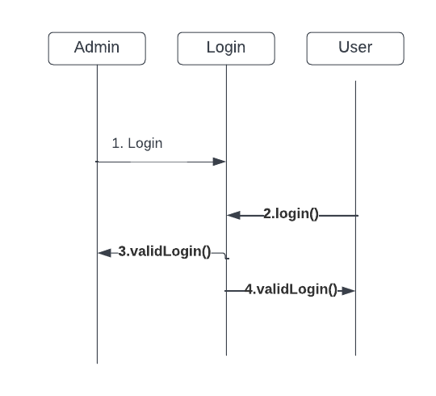
Login Sequence Diagram

Slide 19
LOGIN
In this task we have created a login page
It will allow user to login with the credential got from the signup page
It will allow admin to login with the credential got from the signup page
If the credentials don't match with the database, then it will pop a message
Every entry should be filled

Slide 20
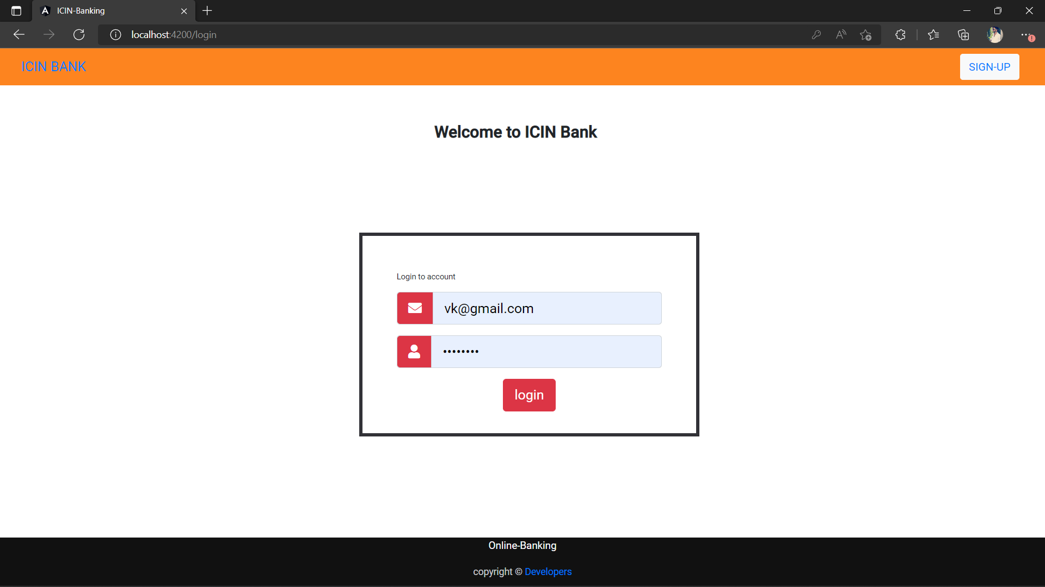
LOGIN

Slide 21
User Dashboard
After the user logs in the user dashboard shows the services that are provided by the bank.
First the account balance of both the primary and savings account is displayed.
A deposit option is shown to user which is used to handle deposits for both primary and savings account.
A withdrawal option is also shown to the user using which withdrawal for the accounts is handled.

Slide 22
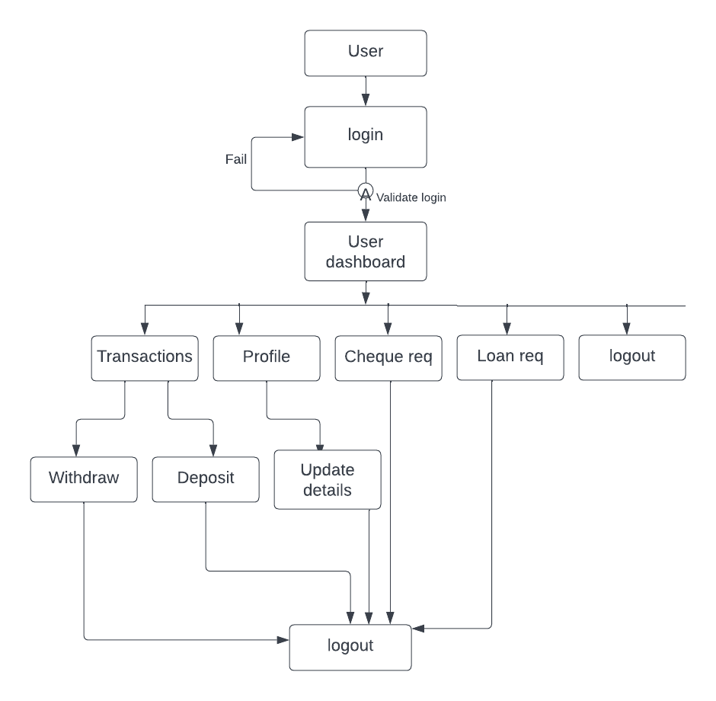
User Activity Diagram

Slide 23
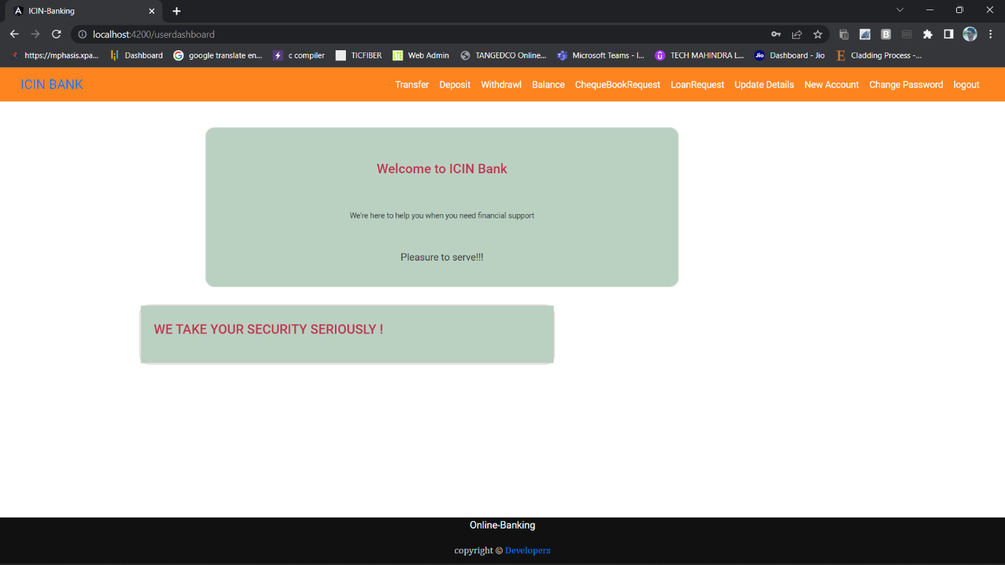
USER DASHBOARD

Slide 24
SAVING ACCOUNT
The Bank Transaction - In this module the user can see their Bank Balance details.
The Bank Transaction System which keeps the day by day Talley record of complete banking system.
There are different type of Bank accounts. One of these is Savings account.
In this method the user can create can new savings account. It will automatically generates new account number.
After deposit , the old data is updated to the Database. This process is working Simultaneously.

Slide 25
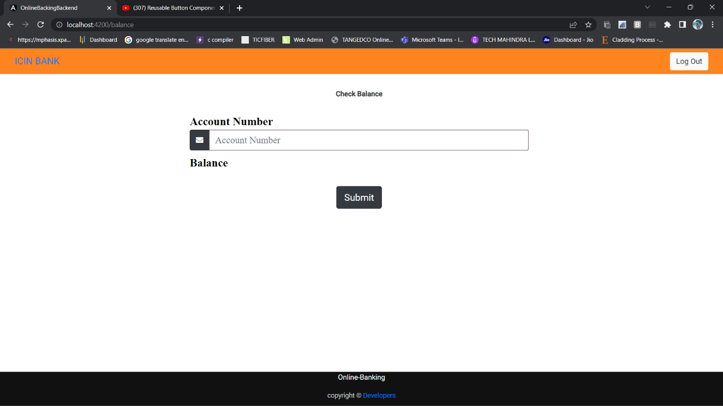
SAVINGS ACCOUNT

Slide 26
DEPOSIT MONEY

Slide 27
DEPOSIT MONEY
User will be able to deposit money in their bank account.
User is able to select their respective account type - Primary / Saving.
Also the balance of the corresponding account type will be displayed in the balance field.
Then user can add money in the Amount to be deposited filed.
The amount will be added to his respective account balance

Slide 28
DEPOSIT MONEY
The input field of the deposit money should not be negative and Zero.
Get Balance() Function - Used to get the balance of the specific account number.
Get Balance As Per Account Type() - Navigates to The GetBalance() with specific account type and returns the balance.
If the primary account condition fails in Get Balance AsPerAccountType(), the condition will be applied for Savings Account type.
Handle Transfer Fund() - By getting the account type, the value of the deposit money input field will be send to Deposit Money in the service class which invokes the backend.
Alert message will be popped for Successful Transaction, Invalid Fields and Transaction failed.

Slide 29
DEPOSIT MONEY
In Backend
Annotations like @GetMapping, @Autowired, @CrossOrigin, @PathVariable are used.
Account Controller - Getting Account Type, No, Amount and invoking the Service class with the condition Primary/ Saving
Primary/Saving Account Service - The Deposited Money is added with the Original Balance and date of the transaction is updated.
Finally Database is updated.

Slide 30
DEPOSIT MONEY
Using Selenium - Chrome web driver login with the credentials.
Using By id attribute , driver moves to the deposit page and selects the account type and enters the money.
Then Checks the alert message and end it.

Slide 31
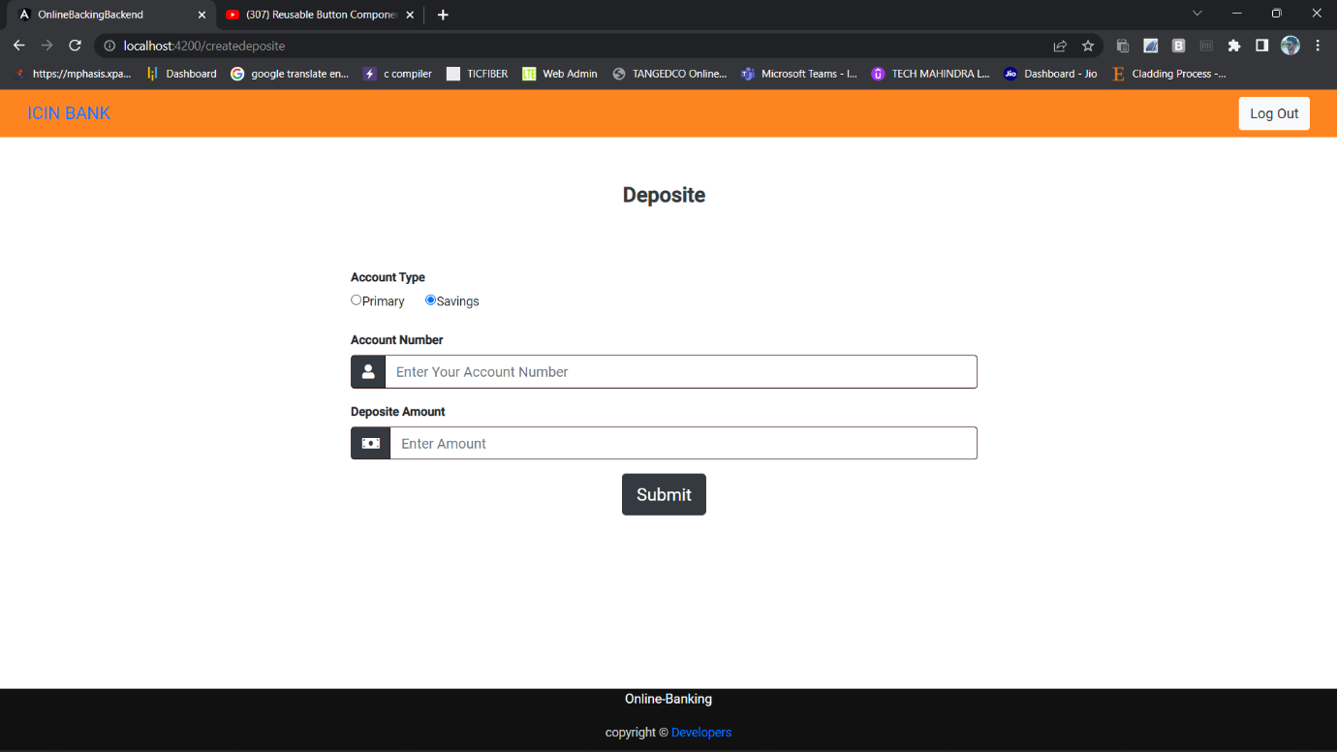
DEPOSIT MONEY

Slide 32
LOAN REQUEST

Slide 33
LOAN REQUEST
Backend
Model - New table is created (loan) , with id, status check and user details.
The JPA repository is implemented to create loan request and also for approval.
Implementation - User
Create Loan
Implementation - Admin
Display All Loan, Find Loan By ID, Approval for Loan requests functions are implemented
Controller - the above implementations are controlled by Loan Controller.

Slide 34
LOAN REQUEST
In this module user able to send the loan request to admin. And admin have to confirm the request or cancel it.
The user send the loan request to admin.
The request has been created and display in admin dashboard.
Admin will confirm the status of the request.
Then the status will updated from pending to confirmed

Slide 35
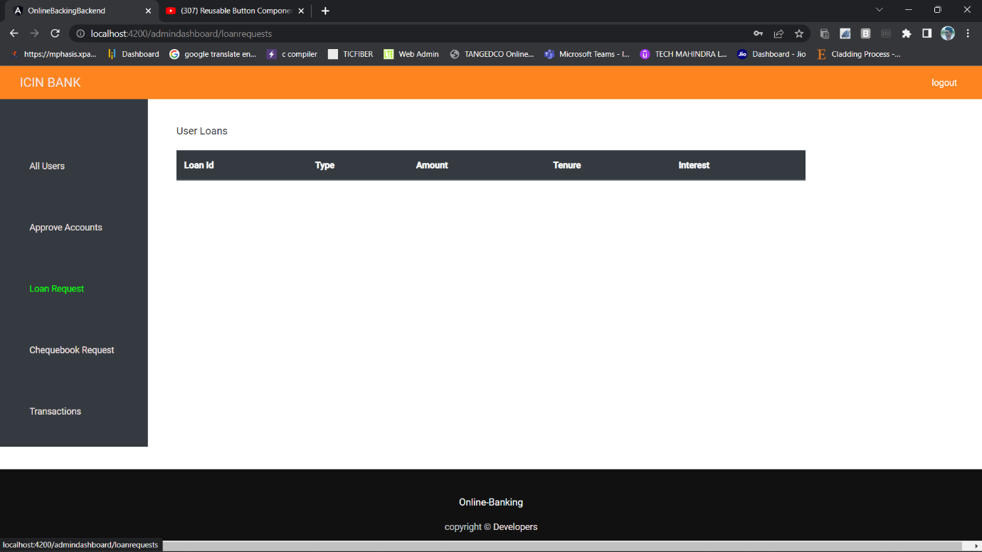
LOAN REQUEST

Slide 36
LOAN REQUEST USER
Select the required Account type.
Give description for the current request.
Submit request.
Select the loan requests.
The list of requests will be displayed.
Approve the request by clicking on the action
Then status will be updated from pending to confirmed

Slide 37
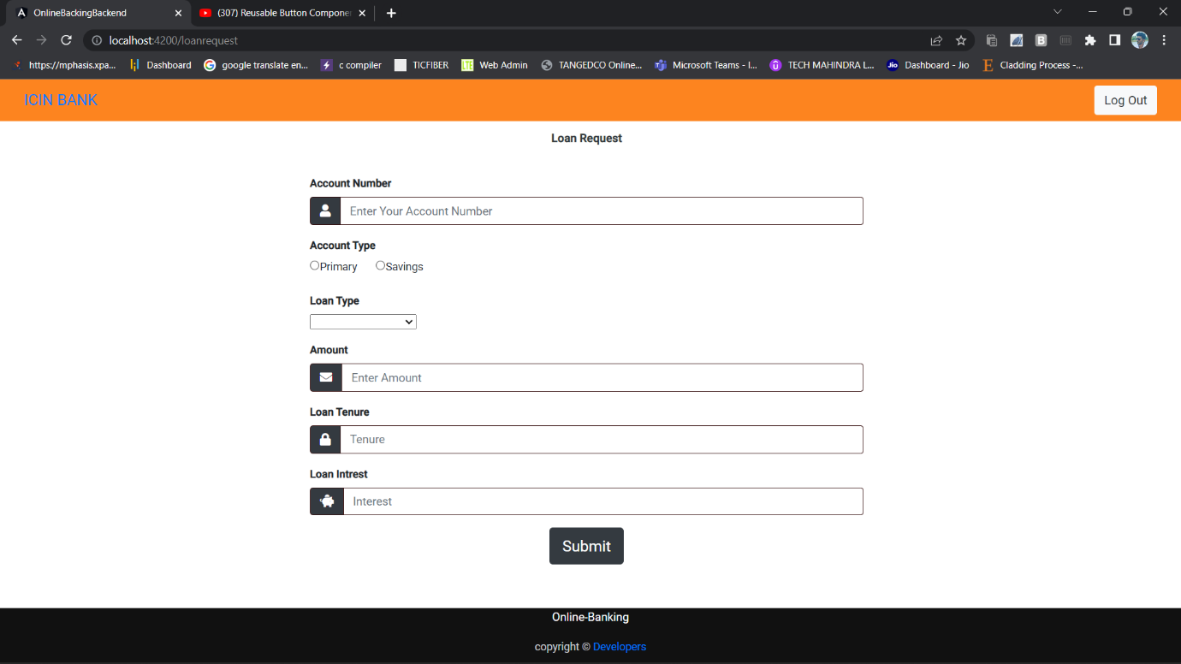
LOAN REQUEST USER

Slide 38
WITHDRAW MONEY

Slide 39
WITHDRAW MONEY
User able to withdrawn their money from their account.
User able to select their account type from the list of accounts.
Also the balance of the corresponding account type will be displayed in the balance label.
The amount to be withdrawn should not be greater than the actual balance.

Slide 40
WITHDRAW MONEY
Login to your User Account and Click on Withdraw.
The form will be displayed.
After the enter the amount the amount will be withdrawn successfully.
The alert message will displayed in case of insufficient funds.

Slide 41
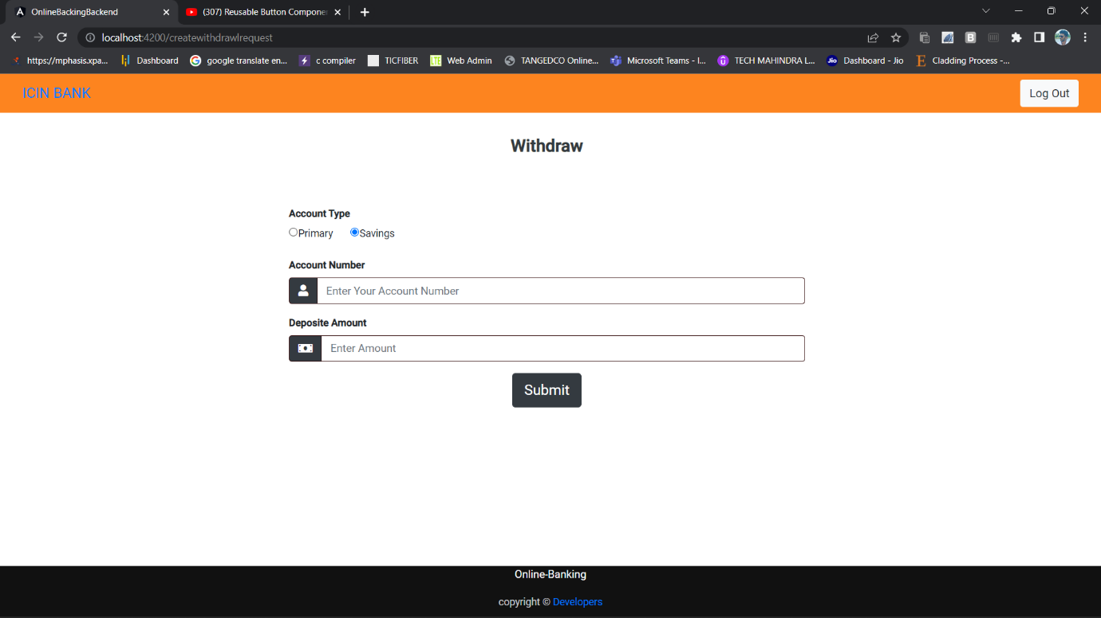
WITHDRAW MONEY

Slide 42
CHEQUE BOOK REQUEST
In Cheque Book Request form Select Account Type
Primary/Savings Cheque type
Individual / Corporate
Click on Send Request

Slide 43
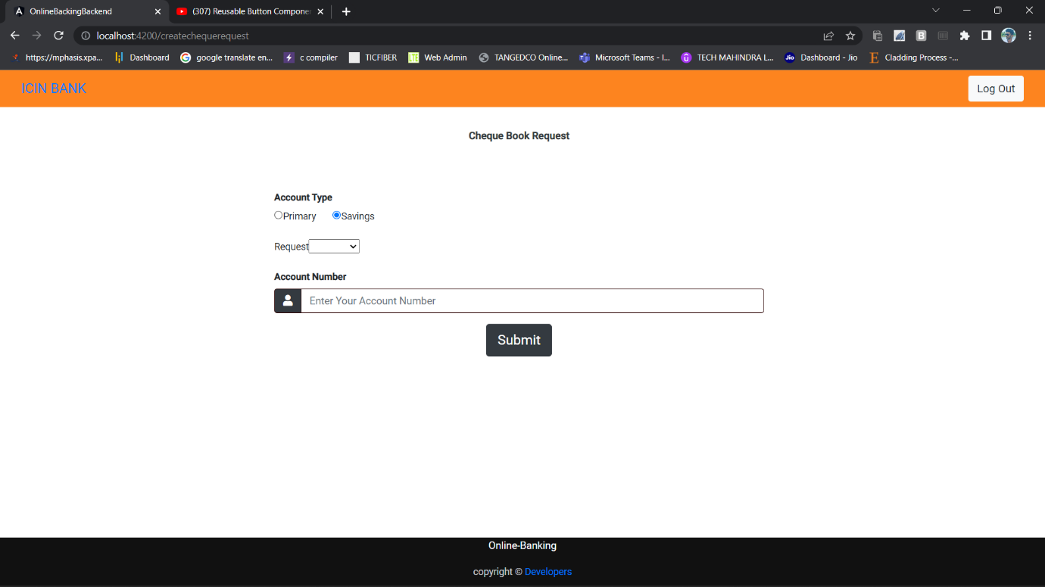
CHEQUE BOOK REQUEST

Slide 44
TRANSACTION
In the transaction money from the sender’s account has been transferred to the receiver’s account.
The sender and receiver both should have a bank account and the amount of money that sender has to transfer should be lesser than or equal to the sender’s account balance. If not the transaction will be failed

Slide 45
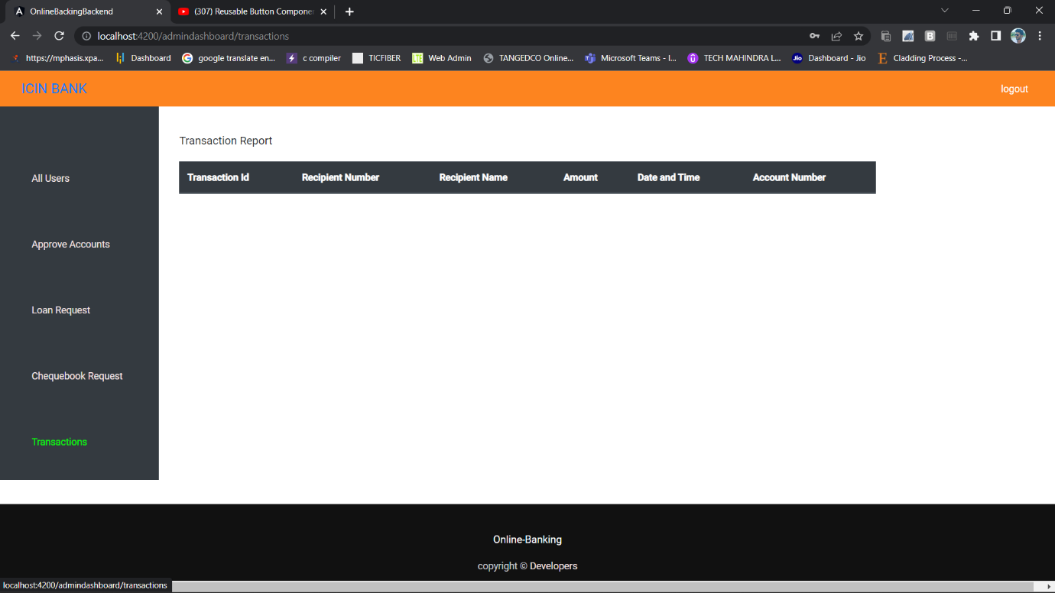
TRANSACTION

Slide 46
USER PROFILE
The user profile contains information about the user details.
Information regarding the user’s mobile number, Address, Pan card, etc
It also contains information about the user’s account details and balance.

Slide 47
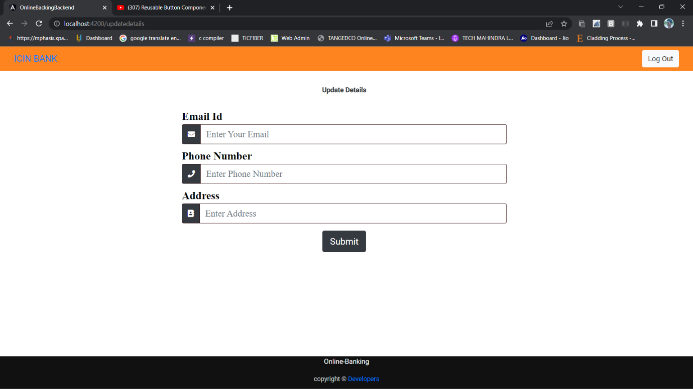
USER PROFILE

Slide 48
DASHBOARD AND NAV BAR

Slide 49
ADMIN NAVBAR
After the admin logs in, the navbar shows 4 options
They are user Account, Checkbook request, Loan Request and Logout option
These 4 options are Routed to their corresponding components using router Link

Slide 50
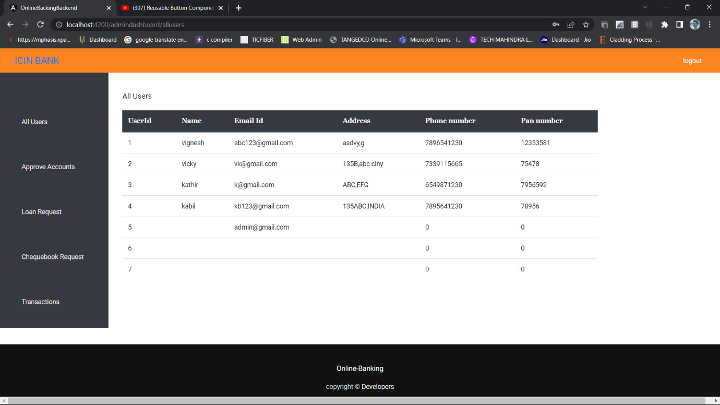
ADMIN NAVBAR

Slide 51
USER NAVBAR
Before the user logs into the webpage the navbar should show login link and register link which when clicked will redirect to corresponding components with the help of router Link.
If the user is logged in the navbar should display 5 dropdown menus.
By clicking on the dropdown options it redirects to corresponding components.

Slide 52
USER NAVBAR

Slide 53
LOGIN TESTING
Steps for Testing User Login Component.
Selenium Chrome Driver Declaration.
Link to test the webpage.
Selecting the elements via CSS selector.
Passing values to the elements.
Checking expected and actual redirect Link.

Slide 54
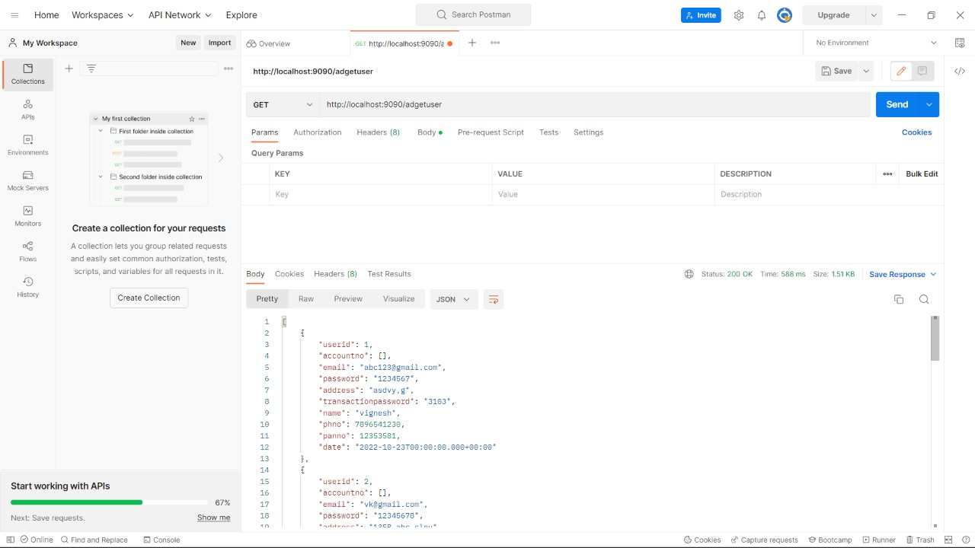
TESTING

Slide 55
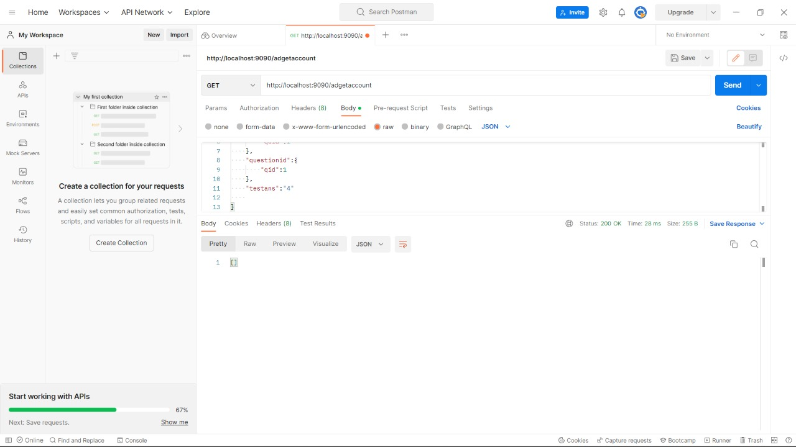
TESTING

Slide 56
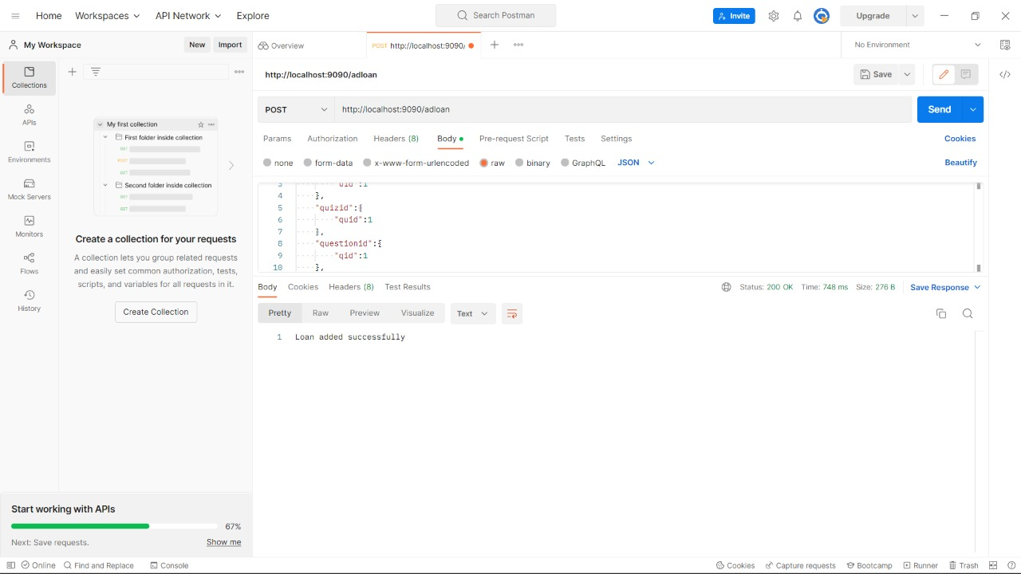
TESTING

Slide 57
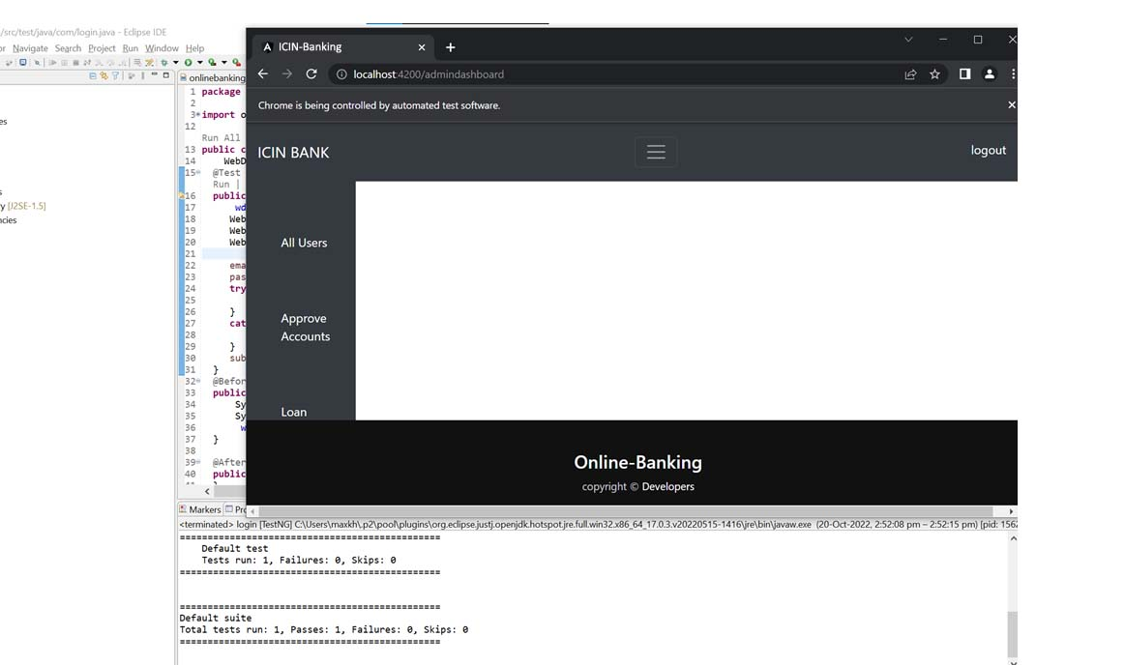
TESTING

Slide 58
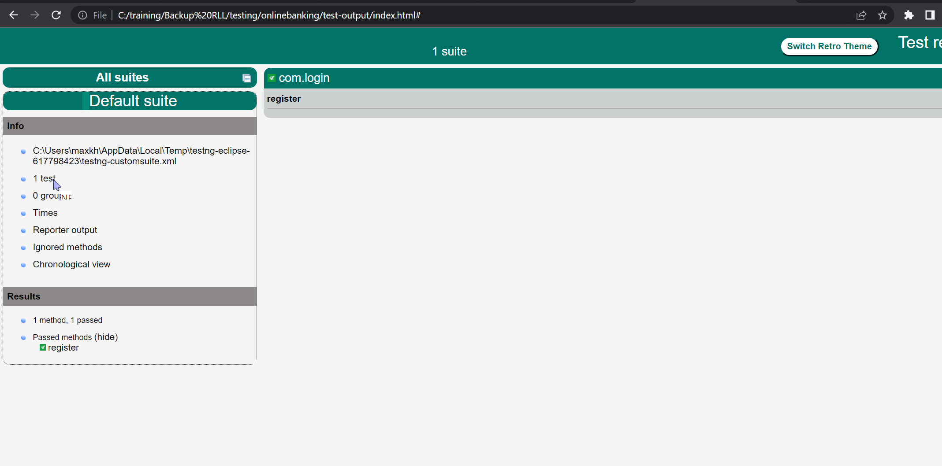
TESTING

Slide 59
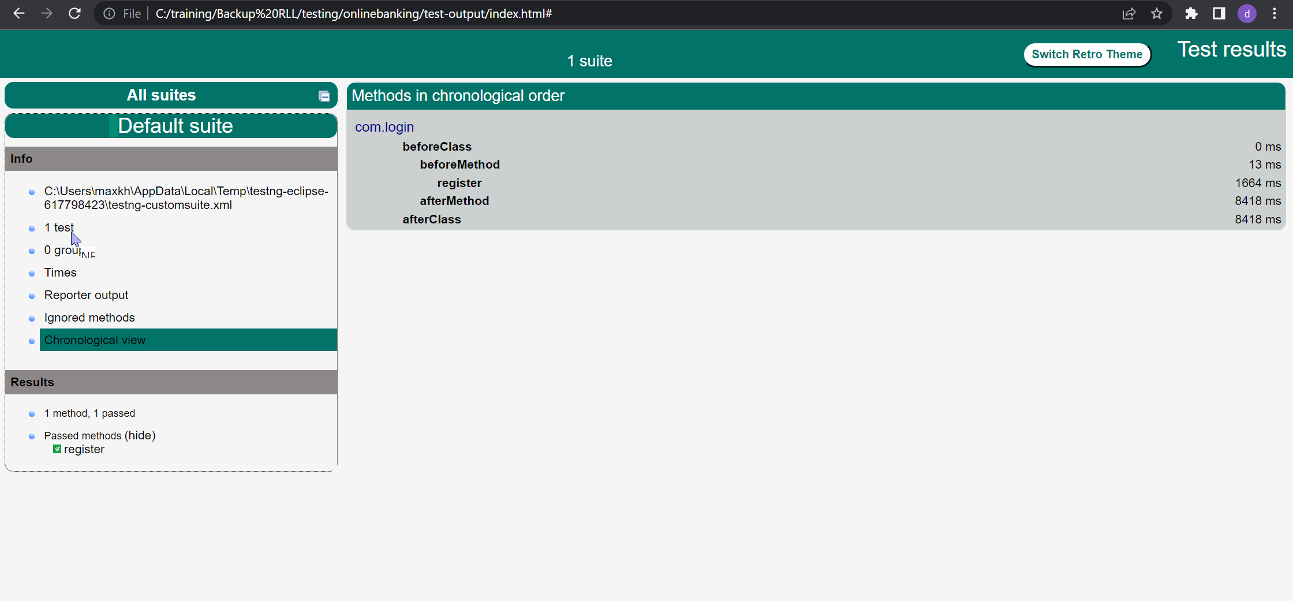
TESTING

Slide 60
Conclusion
The creation of online banking is done successfully and is tested for the accurate results.
During the completion of this project all the requirements for the project are accomplished and it meets the organisation needs.

