Slide 1
PipeTalk
Inter-Process Chat Application
Using IPC
OSSP Hackathon | Team 8
Team members
Abhay Tripathi 2520030353
K. Pranav 2520030477
Jashwanth 2520030236
Guided by:
Ms. Soumya
17 October 2026
PipeTalk / OSSP Hackathon Team 8
01
Notes:
Introduce the project as the Team 8 Inter-Process Chat Application Using IPC. The backend consists of two independent Linux C processes using named pipes. Team members: Abhay Tripathi, K. Pranav and Jashwanth. Guided by Ms. Soumya.

Slide 2
Problem and Proposed Solution
The problem
Our implementation
Independent processes need a way to exchange data.
A terminal-only example makes the message journey difficult to observe.
Two C processes communicate through two Linux named pipes.
The website shows messages, receiving confirmations and live process details.
Required outcome: a working two-way IPC prototype
PipeTalk / OSSP Hackathon Team 8
02
Notes:
The assigned problem asks for two independent processes exchanging messages in both directions using IPC. Explain that isolated Linux processes need an operating-system communication mechanism. PipeTalk adds a web interface so the communication and process evidence can be demonstrated together.

Slide 3
System Architecture
Layer | Implementation | Connection
Interface | HTML, CSS and JavaScript | HTTP JSON requests
Bridge | Python standard library | Peer stdin and stdout
Chat endpoints | Independent C processes A and B | Two named FIFOs
Operating system | Linux kernel | Descriptor and pipe I/O
A sends through a_to_b.fifo. B replies through b_to_a.fifo.
PipeTalk / OSSP Hackathon Team 8
03
Notes:
The browser uses HTTP to reach the Python bridge. The bridge sends commands through anonymous stdin pipes. The C peers exchange the actual payload through named FIFOs. Receiving confirmations return through stdout. Explain the separation between the control streams and peer-to-peer message transport. Source: backend/server.py and backend/peer.c.

Slide 4
Linux IPC Implementation
Operation | Purpose
os.mkfifo() | Create two named FIFO special files
open() | Open incoming and outgoing channels
poll() | Wait for commands or incoming data
write() and read() | Transfer JSON frames between peers
close() and SIGTERM | Release descriptors and stop peers
Each peer has its own PID and address space.
PipeTalk / OSSP Hackathon Team 8
04
Notes:
The bridge creates each FIFO using os.mkfifo with mode 0600. Each peer opens the FIFO descriptors, waits using poll, and exchanges frames using write and read. The descriptors are closed during shutdown. The Linux-specific O_RDWR and O_NONBLOCK combination avoids startup ordering deadlocks. References: https://www.man7.org/linux/man-pages/man7/fifo.7.html and https://www.man7.org/linux/man-pages/man7/pipe.7.html . Source: backend/peer.c.

Slide 5
Message Delivery Lifecycle
01
Submit
The browser sends text and a selected sender to the bridge.
02
Write
Process A writes the JSON frame into a_to_b.fifo.
03
Read
Process B reads the FIFO and emits a receiving event.
04
Confirm
The bridge matches the message ID and text before delivery.
PipeTalk / OSSP Hackathon Team 8
05
Notes:
Describe an A-to-B message. The bridge validates input and creates a unique message ID. It sends the JSON frame to A stdin. A writes that frame into a_to_b.fifo. B reads it and reports the payload through stdout. The bridge checks the destination and message content before marking delivery. The direction is reversed for a reply. Source: Engine.send and Engine._reader in backend/server.py.

Slide 6
Web Bridge and HTTP Operations
Operation | Purpose
GET /api/state | Read messages, events and process details
POST /api/send | Queue text for the selected C peer
POST /api/restart | Recreate both peers and FIFO channels
GET /api/export | Download retained session records
Local server: 127.0.0.1
Browser refresh: HTTP polling every 500 ms
PipeTalk / OSSP Hackathon Team 8
06
Notes:
The web bridge uses ThreadingHTTPServer and subprocess.Popen. It exposes only the listed local application routes. State refreshes every 500 milliseconds. Commands require a session token and valid local Host and Origin values. There is no framework, database or external runtime dependency. References: https://docs.python.org/3.11/library/subprocess.html and https://docs.python.org/3.12/library/http.server.html .

Slide 7
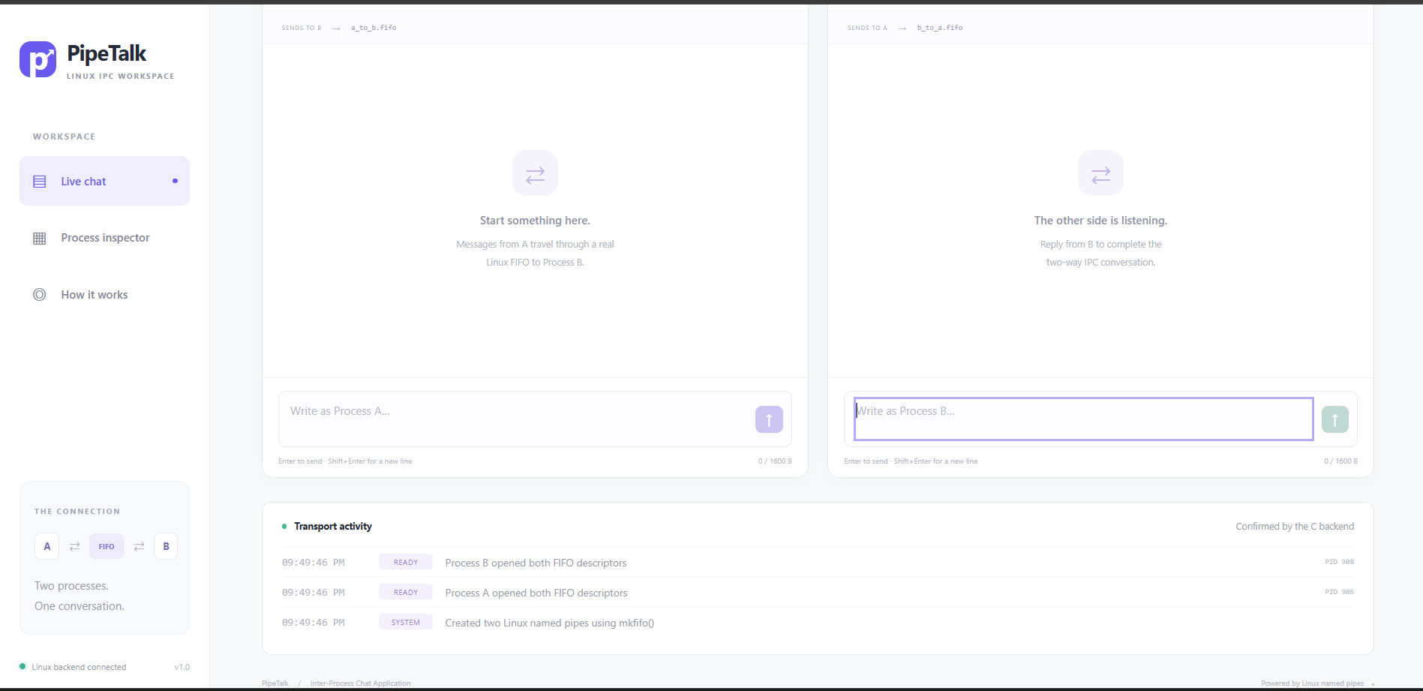
PipeTalk Web Interface
Two endpoint panels with a transport activity stream
PipeTalk / OSSP Hackathon Team 8
07
Notes:
This is an actual user-supplied screenshot of the implemented application in its initial connected state. Point to the two endpoint input areas and the ready events in Transport activity. The initial empty conversation is not evidence of message delivery. During the live demonstration send a message in both directions and show destination confirmation. Source image: image(2).png supplied during project execution.

Slide 8
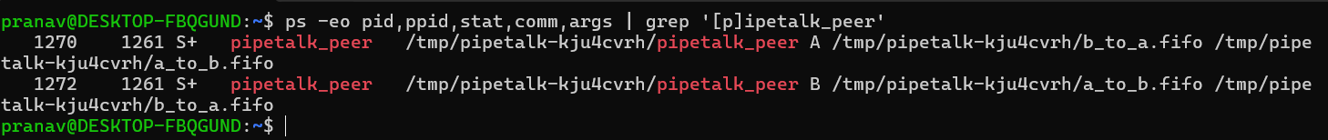
Linux Process Evidence
PID 1270
PID 1272
Process A
Process B
Parent PID 1261 launches both peers.
Their arguments identify the real FIFO paths.
PipeTalk / OSSP Hackathon Team 8
08
Notes:
The process listing is an actual user-supplied Ubuntu screenshot. It shows A as PID 1270 and B as PID 1272, with shared parent PID 1261 for that session. Their arguments show opposite incoming and outgoing FIFO paths. The PIDs are examples from that run, not fixed configuration. The S state indicates interruptible sleep, consistent with waiting for input. Source image: image(4).png.

Slide 9
Testing and Verification
Test area | Coverage | Result
IPC transport | Distinct PIDs, FIFOs and two-way delivery | Pass
Text and input | Unicode, multiline text and validation | Pass
Concurrent messages | 20 alternating submissions, six threads | Pass
Lifecycle and export | Peer restart, session export and cleanup | Pass
Launcher checks | Spaces, busy ports and WSL argument contract | Pass
10 automated checks passed in Linux
Windows execution and browser interaction were not automated.
PipeTalk / OSSP Hackathon Team 8
09
Notes:
All ten packaged unittest checks passed against the current implementation in the Linux build environment. They launch real C processes. The concurrency test uses 20 alternating submissions through six client threads. GCC strict compilation and Python, shell and JavaScript syntax checks also passed. The Windows-specific tests inspect the WSL command argument contract on Linux. They do not execute Windows or PowerShell. Sources: tests/test_integration.py, tests/test_launcher.py and tests/test_windows_launcher.py.

Slide 10
Live Demonstration Procedure
01
Exchange messages
Send A to B, reply B to A and show delivered status.
02
Inspect the backend
Compare dashboard PIDs with the Ubuntu ps command.
03
Verify the FIFO files
Use ls -l and point to the leading p file-type marker.
04
Show recovery
Stop Process B, restart both peers and exchange messages again.
PipeTalk / OSSP Hackathon Team 8
10
Notes:
Keep the launcher running in terminal 1. Use terminal 2 for ps and the generated ls command. Do not press Ctrl+C until the end. Send A-to-B and B-to-A messages in the browser and show receiving events. For recovery, terminate only the displayed current B PID with kill -TERM, then use Restart processes. Never use cat to read an active FIFO because it can consume a peer message.

Slide 11
Results and Current Scope
Implemented
Current limits
Two-way FIFO communication
Receiving-process confirmation
Live PID and resource inspection
Restart and JSON session export
Two endpoints on one Linux host
Local browser access only
500 retained messages in memory
200 retained transport events
Observed delivery time includes bridge overhead.
PipeTalk / OSSP Hackathon Team 8
11
Notes:
The implemented prototype supports the assigned two-endpoint FIFO chat with receiving confirmation, live process metadata and manual restart. State is in memory and export is available. Retention limits are 500 messages and 200 events. There is no persistent database or remote user authentication. Observed delivery time includes bridge scheduling and read-confirmation overhead and is not a kernel-only benchmark. Source: backend/server.py and README.md.

Slide 12
Conclusion and Future Work
The prototype makes Linux IPC observable.
Independent C processes exchange real message frames through named pipes. The browser and Ubuntu terminal show complementary evidence of that communication.
Future work
Persistent message storage
Multiple isolated chat sessions
Automated browser verification
PipeTalk / OSSP Hackathon Team 8
12
Notes:
Conclude that the project meets the assigned two-way communication objective by using actual independent Linux C processes and kernel-managed FIFOs. The website exposes the communication while the terminal independently verifies resources. Possible future work includes persistent storage, multiple isolated sessions and automated browser tests. These are proposals, not implemented features. Thank the evaluators and invite questions about the Linux IPC mechanism.

