Slide 1
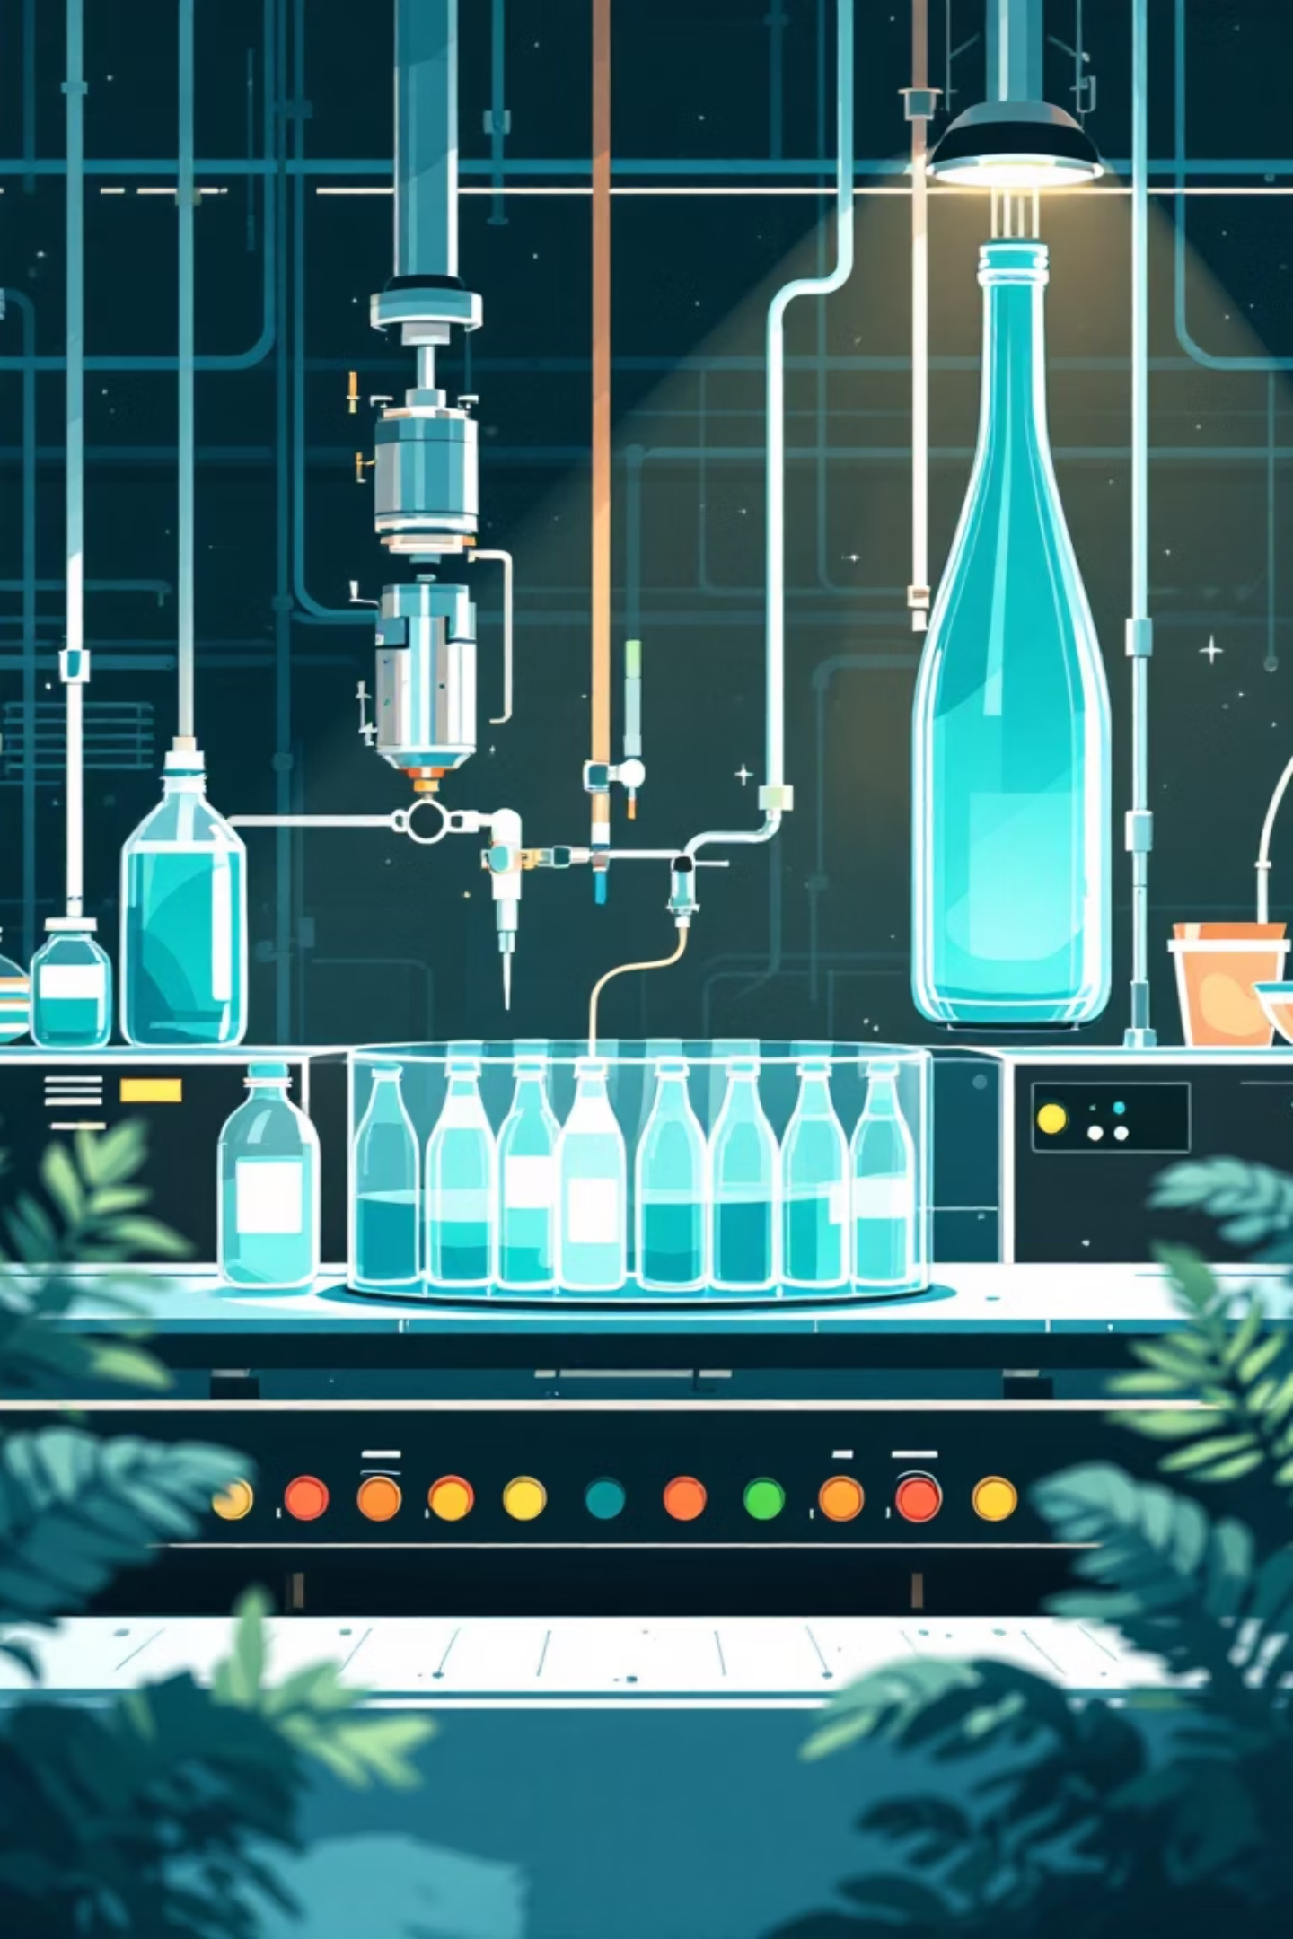
Transition to Electrostatic Spray Technology in Beverage Bottle Production
Mid-Term Project
Abhay Tyagi

Slide 2
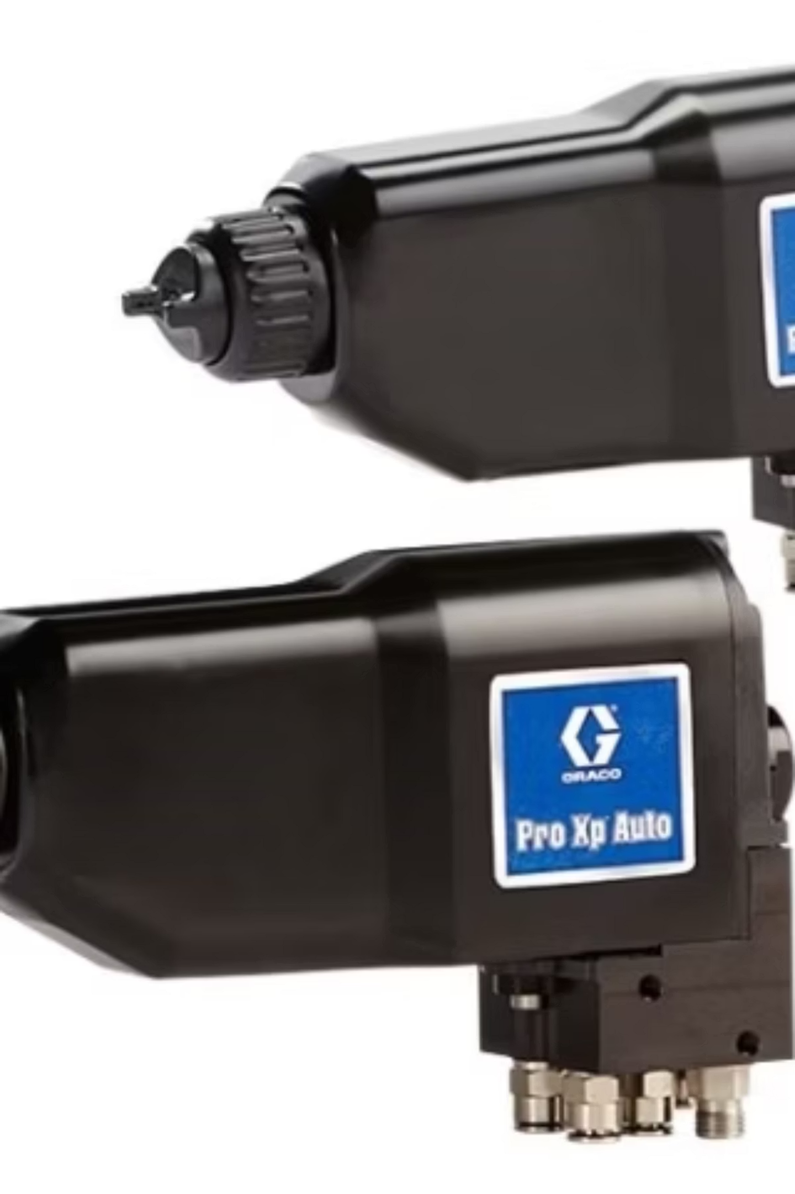
Product Description and Sector Application
Technology Overview
Electrostatic spray technology represents a significant advancement in beverage bottle coating processes. By applying an electrical charge to paint particles, the system ensures superior coating adhesion and uniformity while dramatically reducing material waste.
Pro Xp Auto Electrostatic Spray Guns deliver industry-leading performance with precision atomization and intelligent charge control.
Industry Applications
This technology serves the beverage manufacturing sector across multiple production environments:
High-volume automated bottling lines
Semi-automated production facilities
Manual coating stations requiring precision
Quality-critical premium beverage packaging

Slide 3




Customer Requirements
Superior Coating Quality
Enhanced Throughput
Achieve flawless finish with minimal defects, ensuring consistent brand presentation and customer satisfaction across all product lines.
Increase production capacity to meet growing market demand while maintaining operational efficiency and quality standards.
Reduced Downtime
Environmental Sustainability
Minimize maintenance interruptions and operational costs through improved equipment reliability and preventive strategies.
Lower paint waste and volatile organic compound emissions, aligning with corporate sustainability goals and regulatory compliance.

Slide 4
Implementation Timeline and Financial Targets
Weeks 1–2: Baseline Analysis
1
₹21L
Data collection and comprehensive system evaluation of current coating operations
Total Investment
2
Weeks 3–4: Process Modeling
Complete system implementation cost
JaamSim simulation development for optimization analysis
Weeks 5–6: Reliability Assessment
3
₹12L
Predictive maintenance analysis and performance metrics establishment
Monthly Savings
4
Weeks 7–8: Financial Analysis
Operational cost reduction
ROI calculation and comprehensive cost-benefit evaluation
Week 9+: Implementation
5
1.6
Documentation, stakeholder approval, and full-scale deployment
Payback Period
Months to ROI achievement

Slide 5
Risk Management Strategy
Risk: Inconsistent Baseline Data
Risk: Unreliable Failure Predictions
Risk: Post-Implementation Issues
Challenge: Incomplete or inconsistent data on paint usage, downtime, or throughput may compromise analysis reliability and decision-making accuracy.
Challenge: Limited historical failure data could lead to overestimation or underestimation of Mean Time Between Failures (MTBF) and Mean Time To Repair (MTTR).
Challenge: Unforeseen maintenance challenges or equipment performance issues after technology deployment.
Mitigation: Establish robust preventive maintenance schedules, implement continuous monitoring systems with IoT sensors, and maintain close vendor support relationships.
Mitigation: Implement standardized data recording templates, conduct Gemba-based observations at production floor level, and validate all input data through cross-functional team reviews.
Mitigation: Leverage industry benchmarks, update reliability metrics monthly based on actual performance, and calibrate predictive maintenance algorithms using real-time downtime logs.

Slide 6
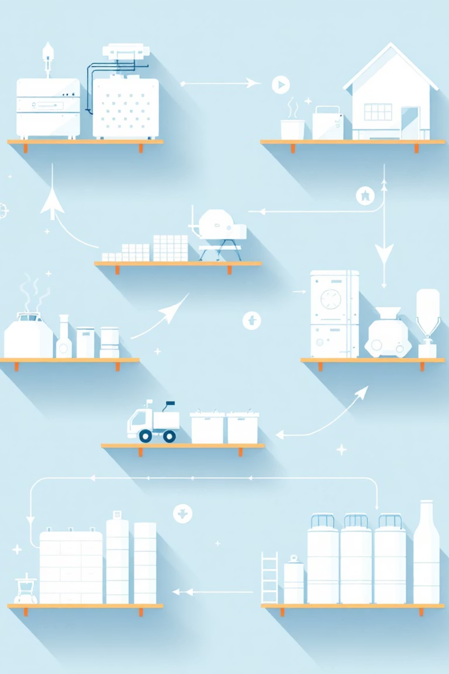


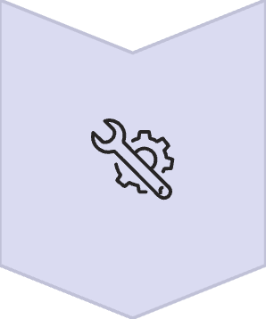
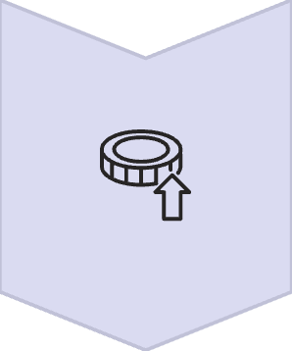
Methodology
Data Collection
Comprehensive baseline measurement of current operations
Simulation Modeling
JaamSim discrete event analysis for optimization
Predictive Maintenance
Reliability analysis and downtime reduction strategies
Financial Analysis
ROI calculation and cost-benefit assessment

Slide 7
Data Collection
A detailed Gemba-based data collection was performed to establish the current operational baseline for the beverage bottle coating process. This table compares key performance indicators under the existing baseline against projected metrics with the implementation of the new automated electrostatic spray technology.
Bottles/day
90,000
108,000
bottles
Inter-arrival time
0.96
0.80
s
Service time per bottle
0.9
0.72
s
MTBF
4000
6000
hrs
MTTR
20
12
hrs
Refill delay
30 s every 1000 bottles
None
—
Paint transfer efficiency
70%
88%
—
Paint used/day
600 L
480 L
—
Defect rate
3%
1%
—

Slide 8
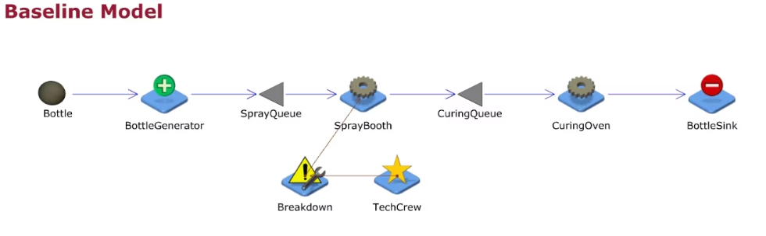
Baseline Simulation Metrics
This table outlines the key performance indicators and operational parameters that define our current beverage bottle coating process before any optimizations.
Bottles per Day
90,000 bottles
Inter-arrival Time
0.96 seconds
Service Time per Bottle
0.9 seconds
MTBF
4000 hours
MTTR
20 hours
Refill Delay
30 seconds every 1000 bottles
Paint Transfer Efficiency
70%
Paint Used per Day
600 liters
Defect Rate
3%

Slide 9
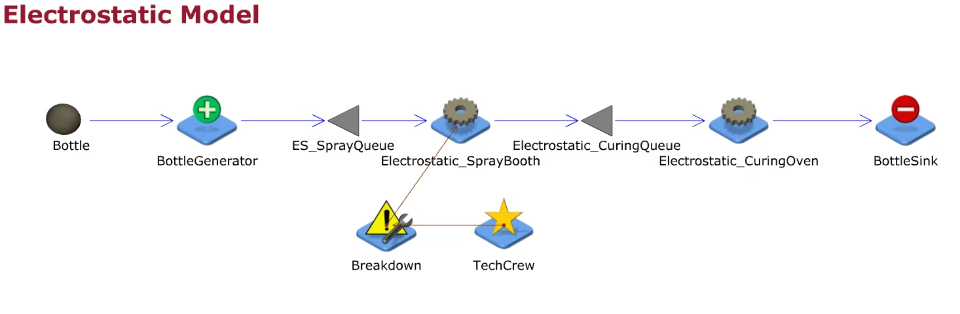
Automated System Performance
Enhanced operational metrics with electrostatic spray technology
108,000 bottles/day (+20% production increase)
88% transfer efficiency (+18% improvement)
1% defect rate (-66% reduction)
Inter-arrival time: 0.80 seconds (17% faster)
Service time: 0.72 seconds (20% faster)
MTBF: 6000 hours (+50%) | MTTR: 12 hours (-40%)
No refill delays (continuous operation)
Paint consumption: 480 liters daily (-20%)

Slide 10
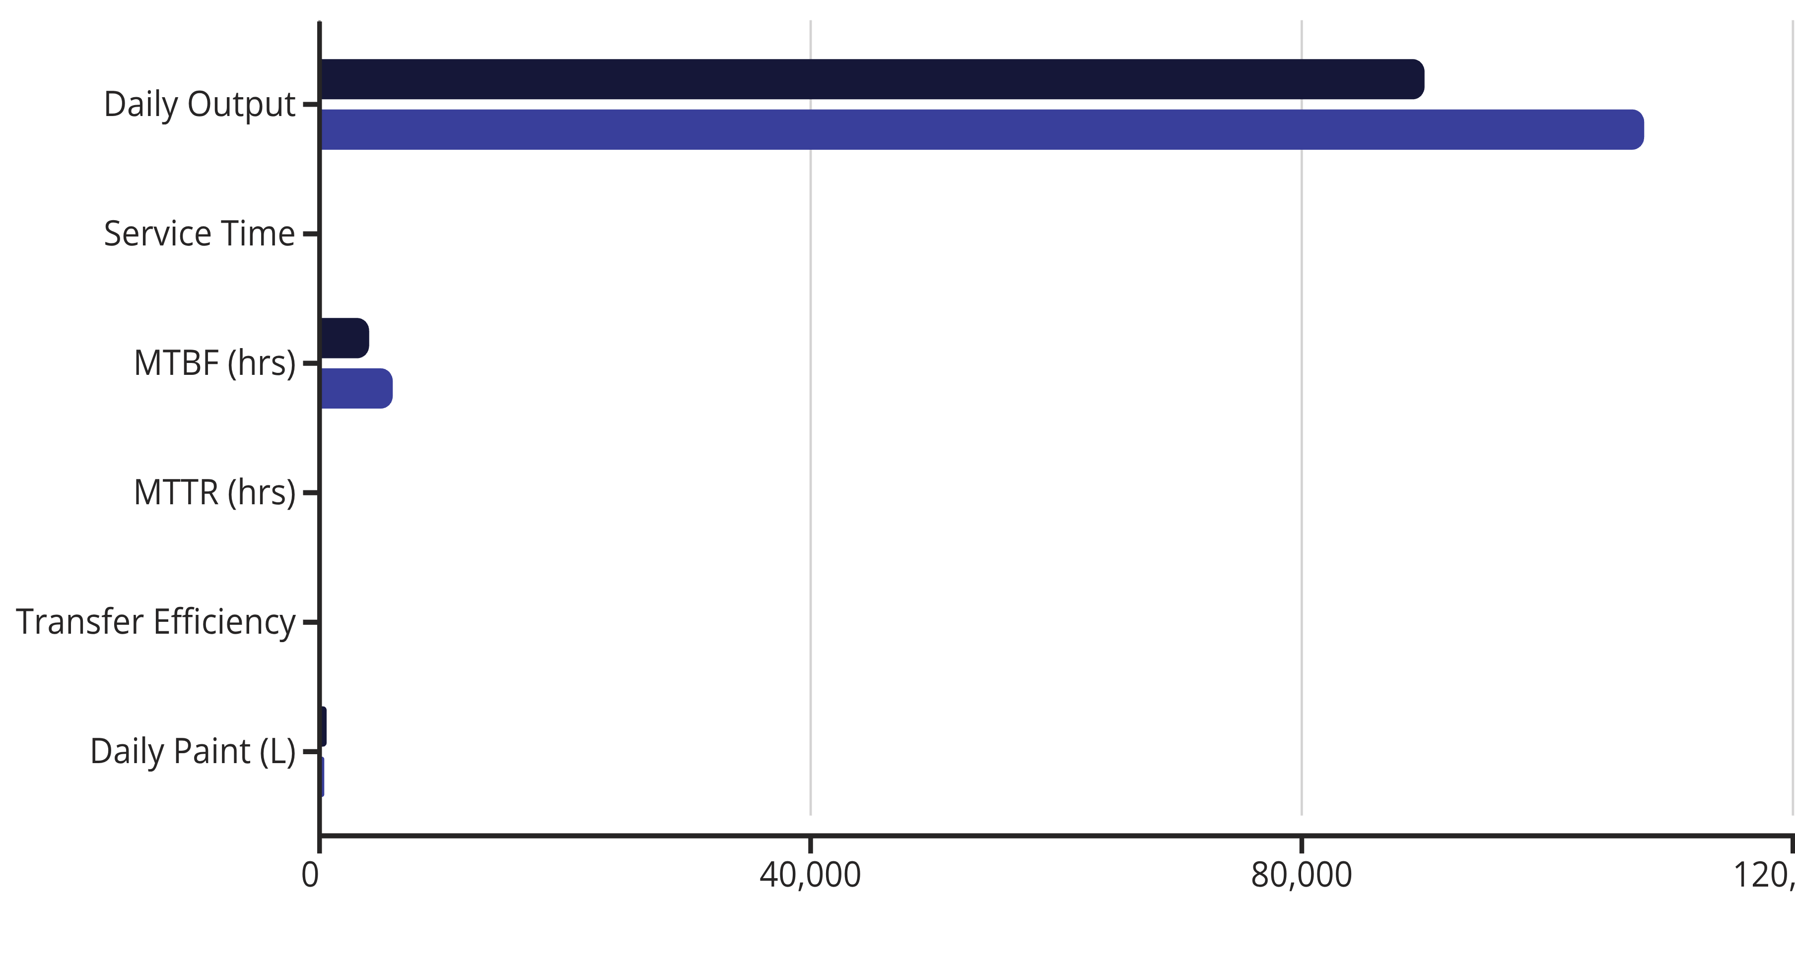
Baseline vs. Automated System Performance
Comprehensive data collection reveals significant performance improvements across all critical operational metrics:
Efficiency Gains
18% higher paint transfer efficiency
20% reduction in material consumption
67% decrease in defect rates (3% to 1%)
Key Improvements
50% increase in MTBF reliability
40% reduction in repair time
20% boost in daily production capacity
Baseline System
Automated System

Slide 11
Simulation Results and Performance Metrics
JaamSim discrete event simulation modeling demonstrates substantial operational improvements across the production line. The automated electrostatic system delivers measurable gains in throughput, efficiency, and quality consistency.
+20%
-17%
+8%
-40%
Throughput Increase
Cycle Time Reduction
Utilization Gain
Downtime Reduction
From 90,000 to 108,000 bottles per day
Average processing time decreased to 0.80 seconds
Equipment utilization improved from 82% to 90%
Annual downtime cut from 500 to 300 hours
+18%
+11%
Transfer Efficiency
OEE Improvement
Paint application efficiency increased significantly
Overall Equipment Effectiveness rose to 91%

Slide 12
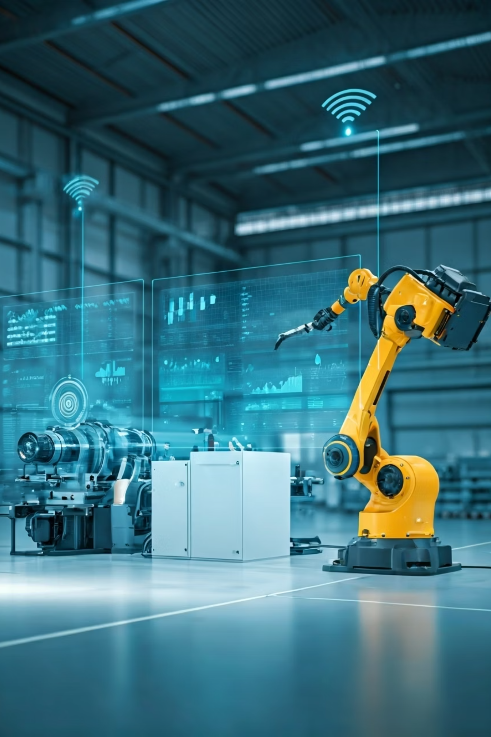
Predictive Maintenance Analysis
Implementing a predictive maintenance strategy significantly enhances equipment availability and operational output.
Metric
Baseline
New Line
Improvement
Unplanned Downtime
500 hrs/yr
300 hrs/yr
–40%
Bottles Lost to Downtime
1.875 million
1.125 million
+7.5 lakh bottles recovered
Extra Revenue
—
₹15 lakh/year
From additional production
Availability
94%
97%
+3% uptime
Predictive maintenance reduces annual downtime by 200 hours, adding ~7.5 lakh bottles of output and ~₹15 lakh in additional annual revenue — a clear gain in equipment availability and system reliability.

Slide 13
Financial Analysis and Strategic Outcomes
Annual Material Savings
Additional Production Revenue
Total Annual Benefit
₹1.44 crore
₹1.59 crore
20% reduction in paint consumption delivers substantial cost savings through improved transfer efficiency
₹15 lakh per year
Combined savings and revenue generation demonstrate compelling business case
Recovered production capacity from reduced downtime creates new revenue opportunities
Return on Investment
Strategic Achievements
Annual ROI: 750%
20% throughput increase
Payback Period: 1.6 months
19% material cost reduction
Rapid capital recovery with sustained benefits
40% downtime improvement
Enhanced sustainability profile

Slide 14









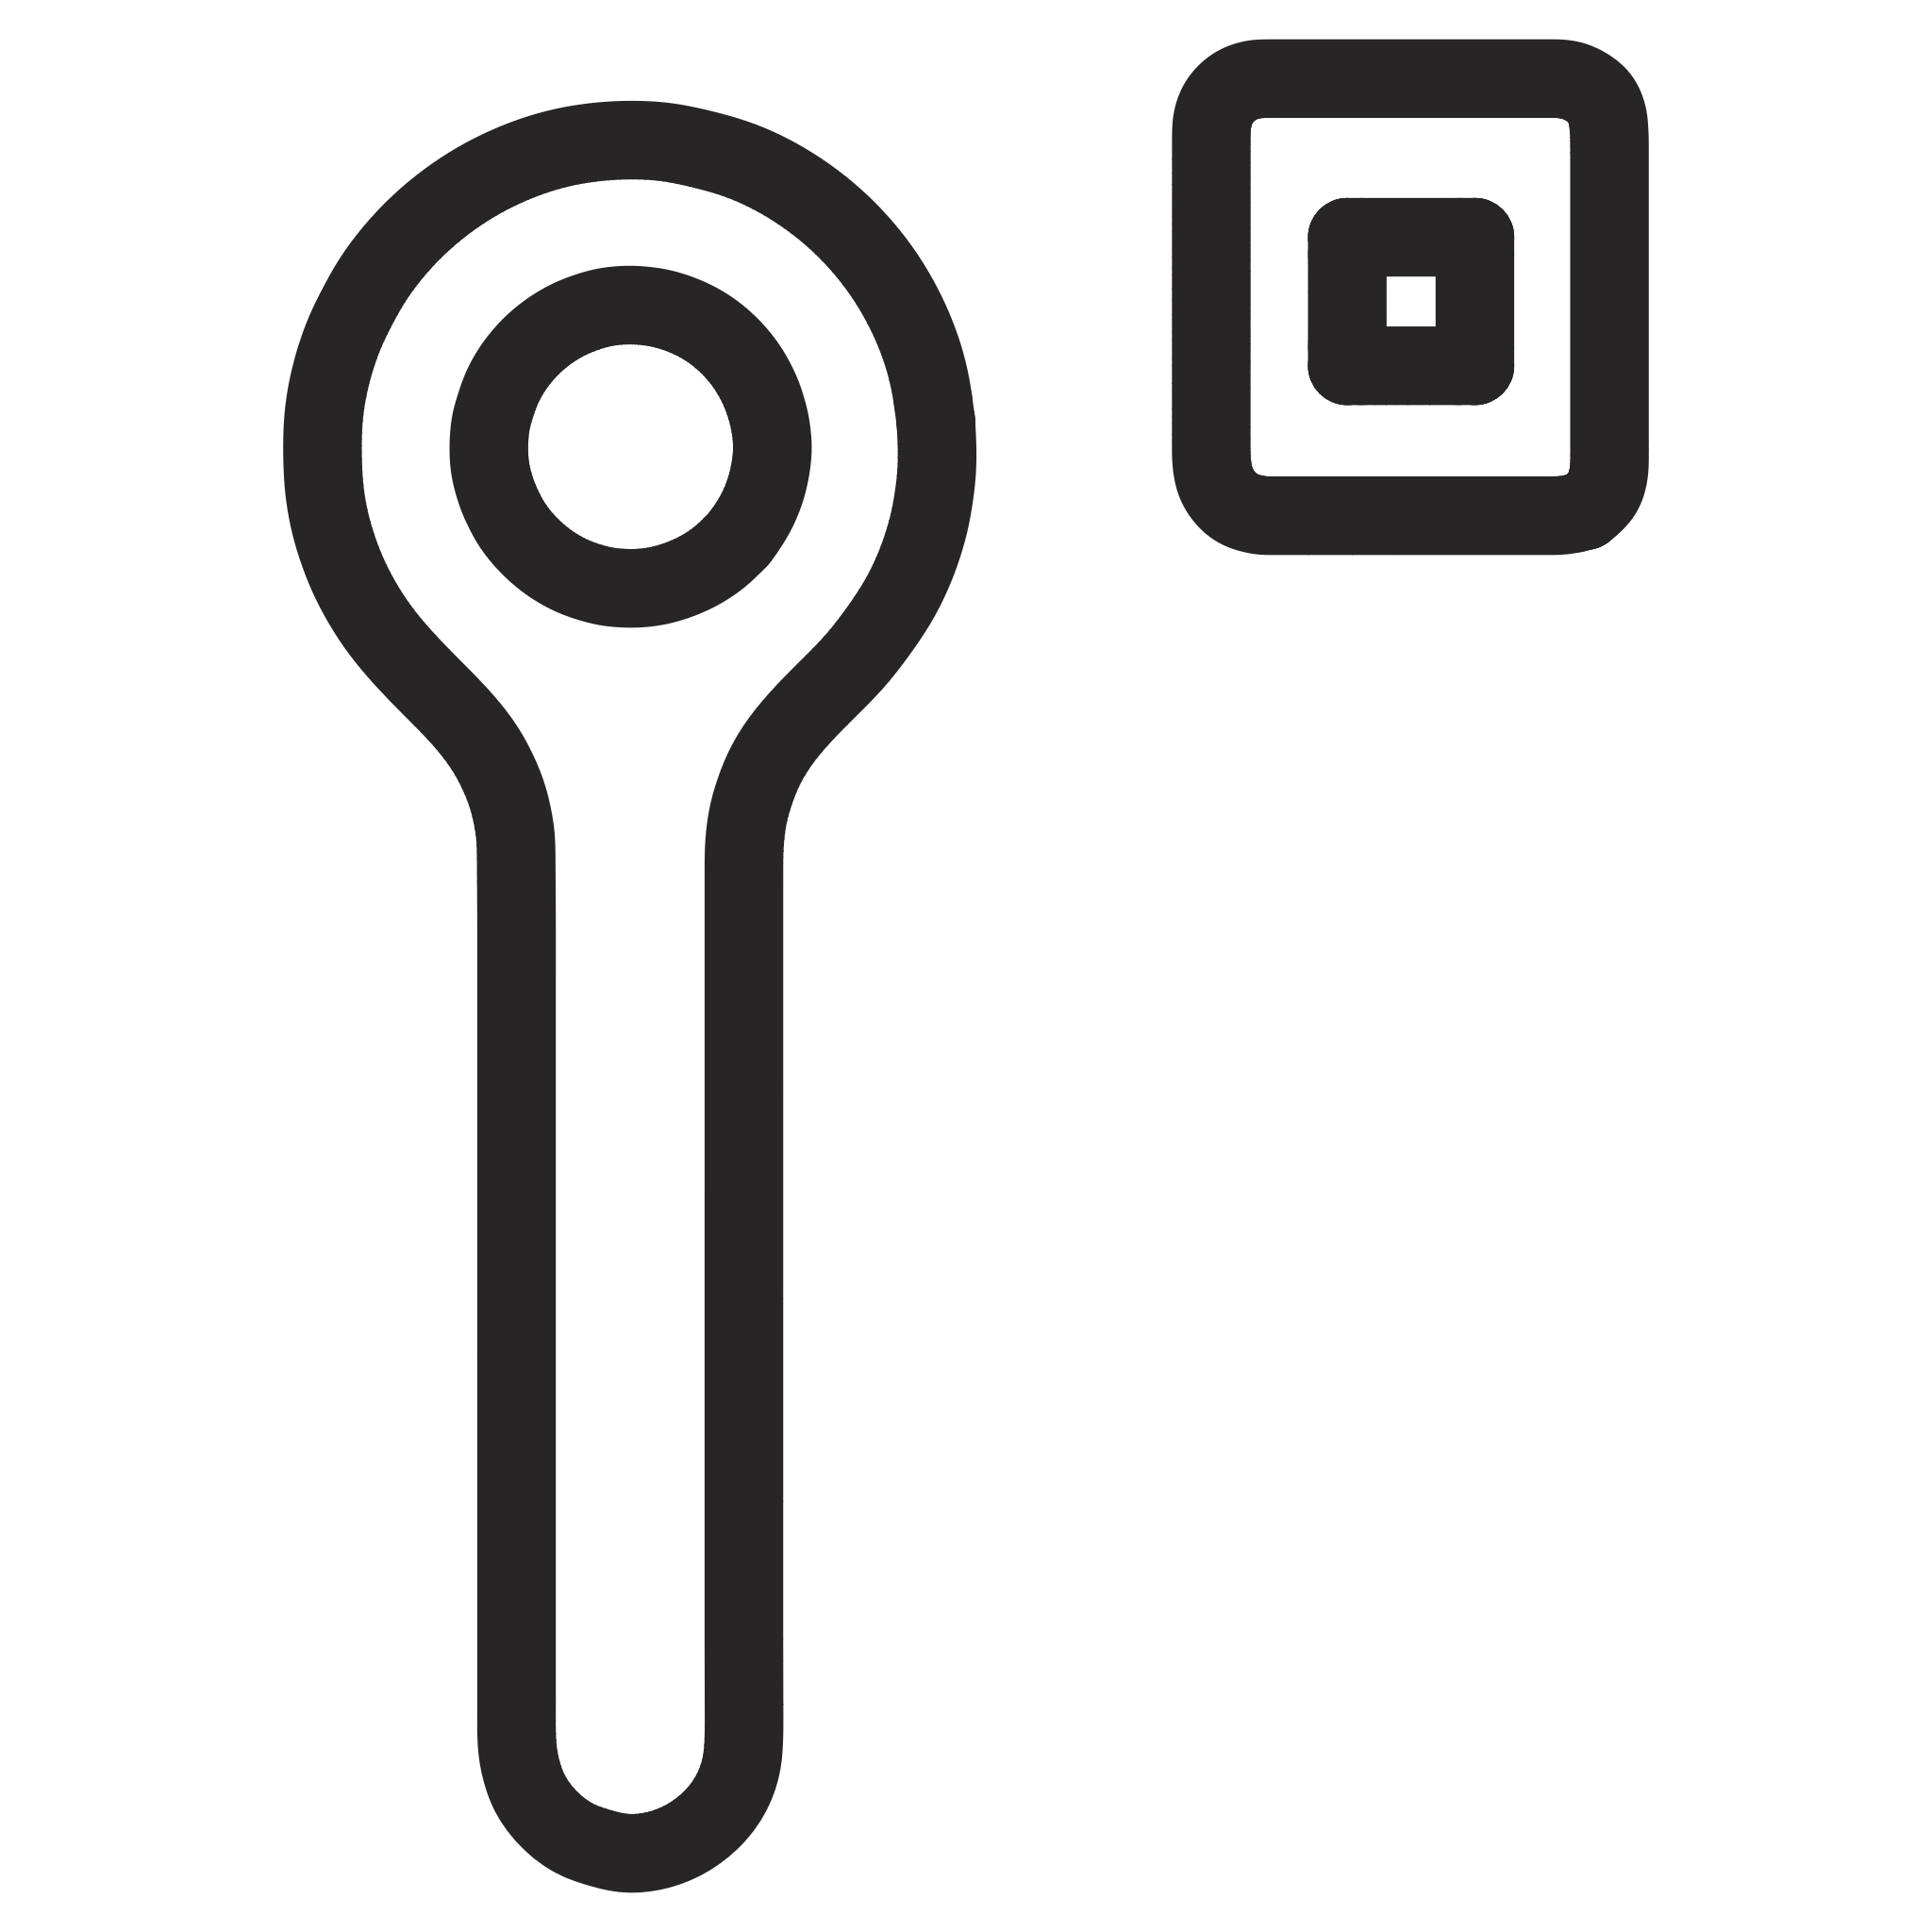


Project Highlights: Key Outcomes
Technology Transition
Operational Gains
Successfully migrated from traditional air-spray to advanced electrostatic spray technology for beverage bottle production, enhancing efficiency and quality.
Achieved a 20% increase in throughput and 19% paint material savings, optimizing resource utilization.
Strategic Advantages
Enhanced Reliability
Significantly enhanced sustainability, ensured consistent quality, and improved cost efficiency across all production phases.
Reduced unplanned downtime by 40% through strategic predictive maintenance integration.
Exceptional ROI
Simulation & Optimization
Confirmed rapid payback within 1.6 months and delivered an annual return on investment exceeding
700%.
Utilized JaamSim simulation for rigorous process optimization and performance benchmarking, driving continuous improvement.

