Slide 1
COLLEGE PROJECT PRESENTATION
BankEase:
BANKEASE
NextGen Net Banking
Account Management • Fund Transfer • Bill Pay • Loans & Investments
•••• •••• •••• 2400
Presented by
✓
Abhay Uttam
Roll No: 2400320100027 • CSE • ABES Engineering College
Academic Year 2026–2027
JWT
RBAC
MySQL
Source: Uploaded BankEase SRS, cover page
Notes:
Say: Good morning. I am Abhay Uttam. Today I am presenting BankEase: NextGen Net Banking, a web-based banking platform for account management, fund transfer, bill payment, loans and investments. The project is designed as an academic prototype using Angular, Spring Boot and MySQL.

Slide 2
Why BankEase?
The project brings common banking operations into one secure web platform.
PROBLEM
OBJECTIVES
Traditional banking can fragment everyday tasks.
01
Secure access
Registration, login, JWT and roles
Account, transfer, bills, loans and investments are often handled separately.
02
Money movement
Accounts, beneficiaries and transfers
03
Service hub
Bills, loans and investments
04
Admin control
KYC, user status and loan decisions
Users need a single, clear dashboard for routine banking actions.
Source: Uploaded SRS, functional requirements §§3.1–3.6
Financial actions require strong authentication, authorization and validation.
Notes:
Say: The main problem is fragmentation of common banking tasks and the need for secure financial processing. Our objectives are secure authentication, account and money-transfer support, service access for bills, loans and investments, and administrative control.

Slide 3
Key Features
All major features documented in the SRS are grouped into seven modules.
01
Authentication
02
Accounts
03
Beneficiaries
04
Fund Transfer
Register • Login • JWT • USER/ADMIN
View balances, IFSC, limits & ownership
Add • List • Deactivate securely
Validate owner, beneficiary, balance & status
Core
Core
Core
Financial flow
05
Bill Payments
06
Loans & Investments
07
Administration
Pay bills and view payment history
Apply for loans • Invest • View • Redeem
Users • KYC • Enable/Disable • Loan decisions
Core
Core
Admin
One platform • one authenticated session • multiple banking services
Source: Uploaded SRS, §§3.1–3.6
Notes:
Say: These are the seven functional areas defined in the SRS. The most important user flow is fund transfer, while administration provides controlled KYC and loan-decision functions.

Slide 4
Technology Stack & System Architecture
Three-tier design: Angular presentation, Spring Boot application services, MySQL data layer.
Frontend
Backend
Database
Security
Angular 20.3
Spring Boot + Java
MySQL + JPA/Hibernate
Spring Security + JWT
Routes • Guards • Forms • Reusable UI • API service
Controllers • Services • DTOs • Validation • Security
Repositories • Entities • Transactions • Persistence
BCrypt • Bearer tokens • USER/ADMIN • CORS
ARCHITECTURE FLOW
User
Angular
REST API
MySQL
Browser / Client
Presentation Layer
Application Layer
Data Layer
JSON + Bearer JWT
Source: Uploaded SRS, §6.3 + §5.3
Notes:
Say: The project uses a three-tier architecture. Angular is the presentation layer. Spring Boot handles business logic, DTO validation, REST APIs and security. MySQL stores persistent data using JPA and Hibernate. Protected requests use JSON and a Bearer JWT.

Slide 5
Security & Transaction Integrity
Security controls are central because the application handles financial state changes.
AUTHENTICATION PIPELINE
CRITICAL CHECKS
1
Login
Email + password
✓
Ownership
Prevents cross-user account/data access
2
BCrypt
Password hashing
✓
Balance
Reject transfer when funds are insufficient
3
JWT
Token issued after auth
✓
Validation
Jakarta Bean Validation on DTOs
4
Filter
Bearer token validated
✓
Atomicity
Financial state changes processed atomically
5
RBAC
USER / ADMIN permission
✓
CORS
Local Angular origin is explicitly configured
6
API
Protected operation executes
✓
Errors
Meaningful HTTP status + structured errors
Source: Uploaded SRS, §4.1–4.3
Notes:
Say: Security is a core requirement. Passwords are processed with BCrypt, protected requests use JWT, and role-based access separates USER and ADMIN operations. Ownership checks, balance validation, DTO validation and atomic financial updates protect transactions.

Slide 6
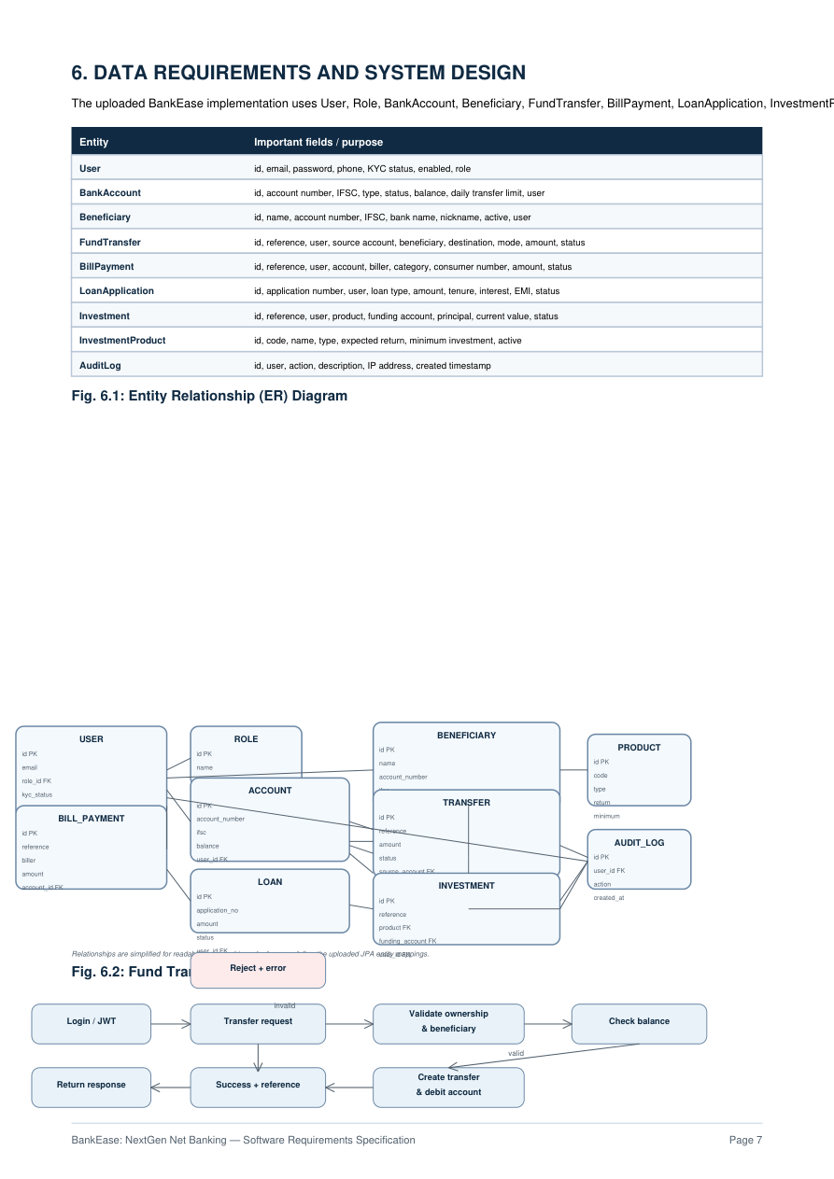
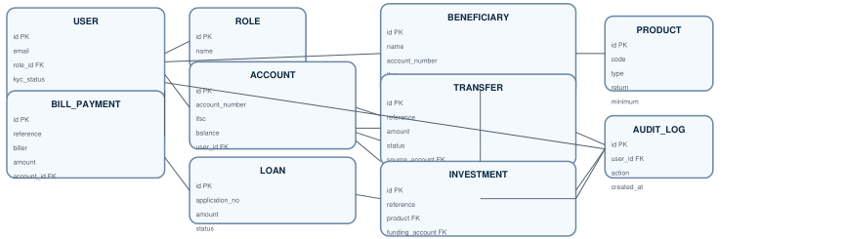
Database Design & ER Model
Core entities and relationships are based on the supplied JPA implementation.
CORE ENTITIES
Identity
User • Role
Banking
BankAccount • Beneficiary • FundTransfer
Services
BillPayment • LoanApplication
Wealth
Investment • InvestmentProduct
Audit
AuditLog
Relationships simplified for readability; ownership and references follow the JPA mappings.
Source: Uploaded SRS, page 7
Notes:
Say: The data model contains identity, banking, service, wealth and audit entities. One user can own multiple accounts and beneficiaries. Transfers reference a source account and, where applicable, a beneficiary. Investments reference a product and funding account. Roles control administrative access.

Slide 7
Fund Transfer Flow
This is the most important business flow because it changes financial state.
HAPPY PATH + REJECTION PATH
Login / JWT
Transfer request
Validate ownership
Check balance
valid
Create transfer
Authenticate
Source + beneficiary
Account + beneficiary
Enough funds?
Debit + reference
invalid
success
Reject
Success
Meaningful error
Reference returned
Key validations
Ownership
Beneficiary
Account status
Balance
Reference + status
Atomic update
Source: Uploaded SRS, §§3.4 and 6.4; flow visual based on page 7
Notes:
Say: A transfer starts after login and JWT authentication. The service validates account ownership, beneficiary ownership, account status and transfer amount, then checks available balance. If valid, the transfer is created and the account is debited. Otherwise, the request is rejected with an error. The design also keeps a unique reference and status for traceability.

Slide 8
Testing, Future Scope & Takeaway
The SRS defines 10 core test cases and identifies clear production-grade enhancements.
TESTING
FUTURE SCOPE
Representative test coverage
Two-factor authentication & stronger device/session security
TC-01
Valid registration
User created
TC-02
Valid login
JWT returned
TC-04
Unauthorized account access
Access denied
TC-06
Transfer within balance
Balance updated
TC-07
Transfer above balance
Transfer rejected
TC-10
Admin loan decision
ADMIN only
Takeaway
BankEase centralizes everyday banking services in one secure, structured web application.
Fraud/anomaly detection & transaction risk scoring
Source: Uploaded SRS, page 8
Authorized payment/biller integrations and notifications
Loan repayment schedules & investment analytics
Containerized deployment, logging, backups & disaster recovery
Notes:
Say: The SRS covers registration, login, authorization, beneficiary, transfer, bill, loan and admin tests. The key negative test is insufficient balance. Future enhancements include two-factor authentication, fraud detection, integrations, notifications, analytics and production operations. The main takeaway is that BankEase centralizes everyday banking services with a security-first architecture.

